Slide 1
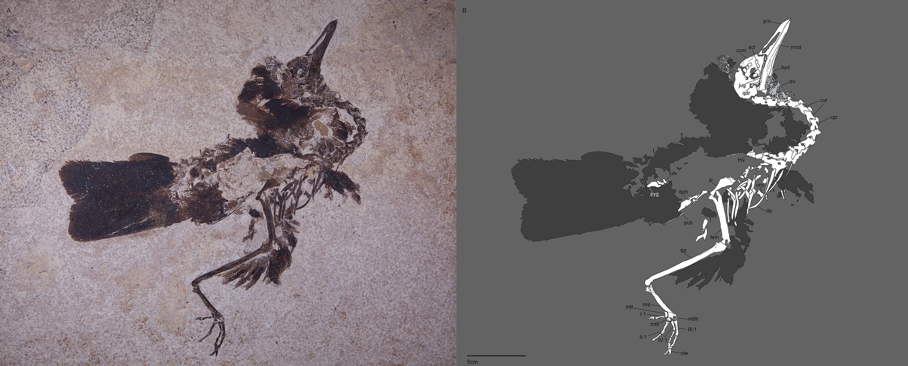
Quantifying trends in morphological evolution
Andrew Brinkworth
ab2054@bath.ac.uk
AndyBrinkworth
Nahmavis grandei FMNH PP778
Modified from Figure 1 in Musser & Clarke (2020. Front.Ecol.Evol.)

Slide 2
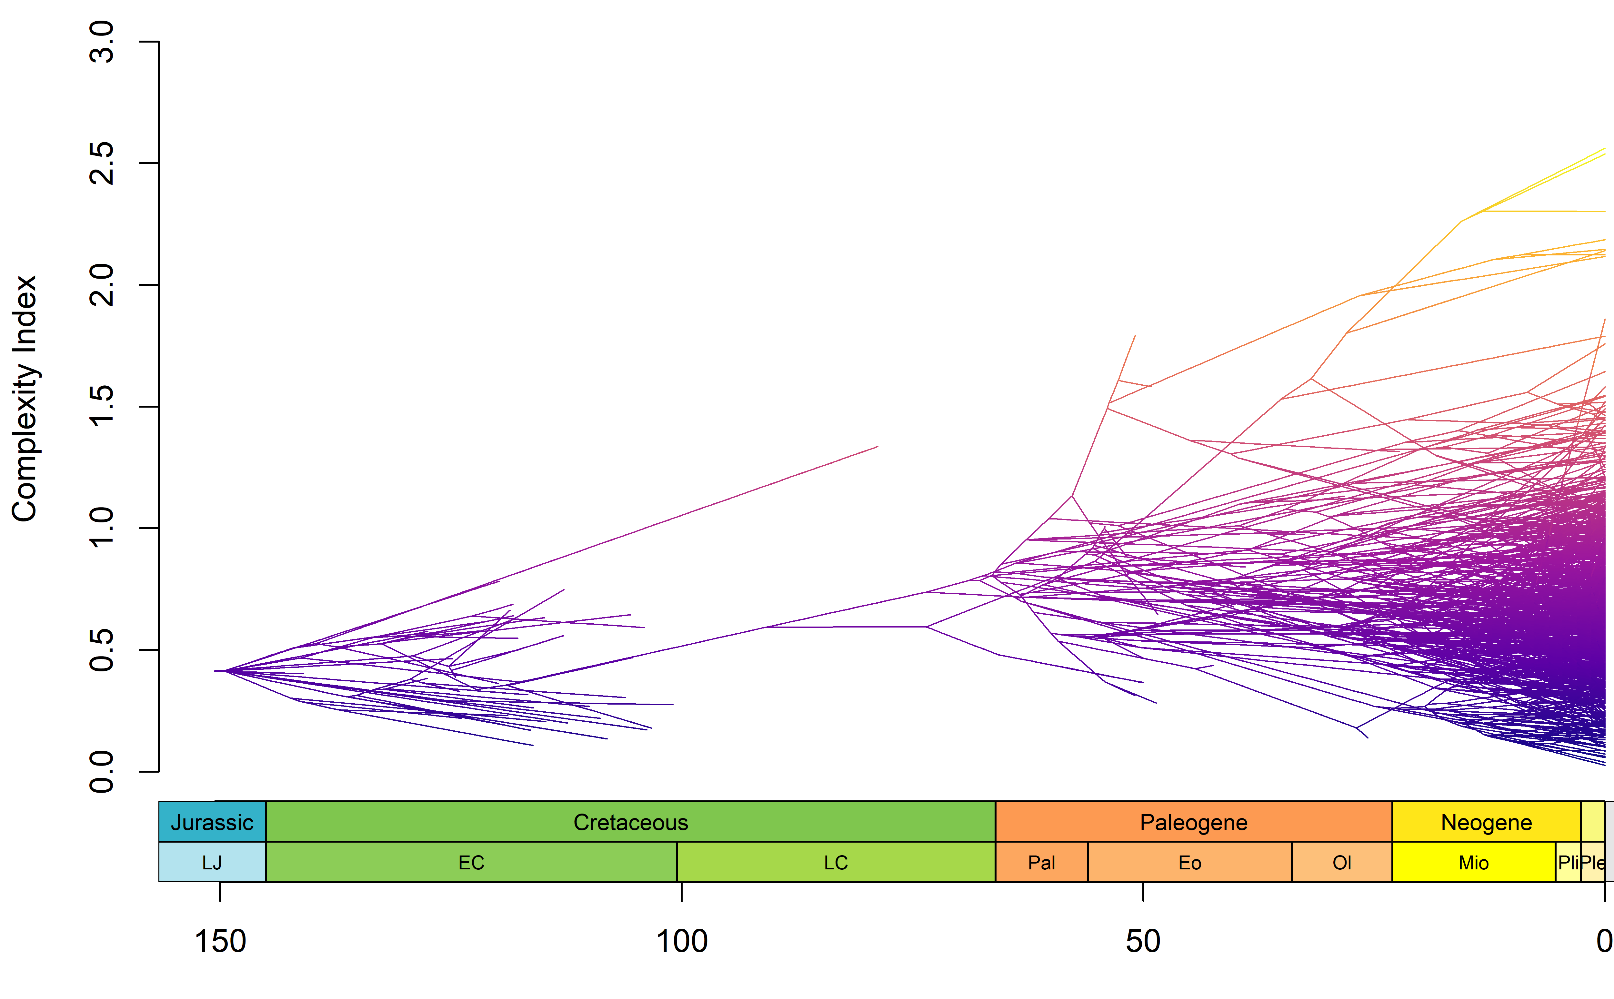
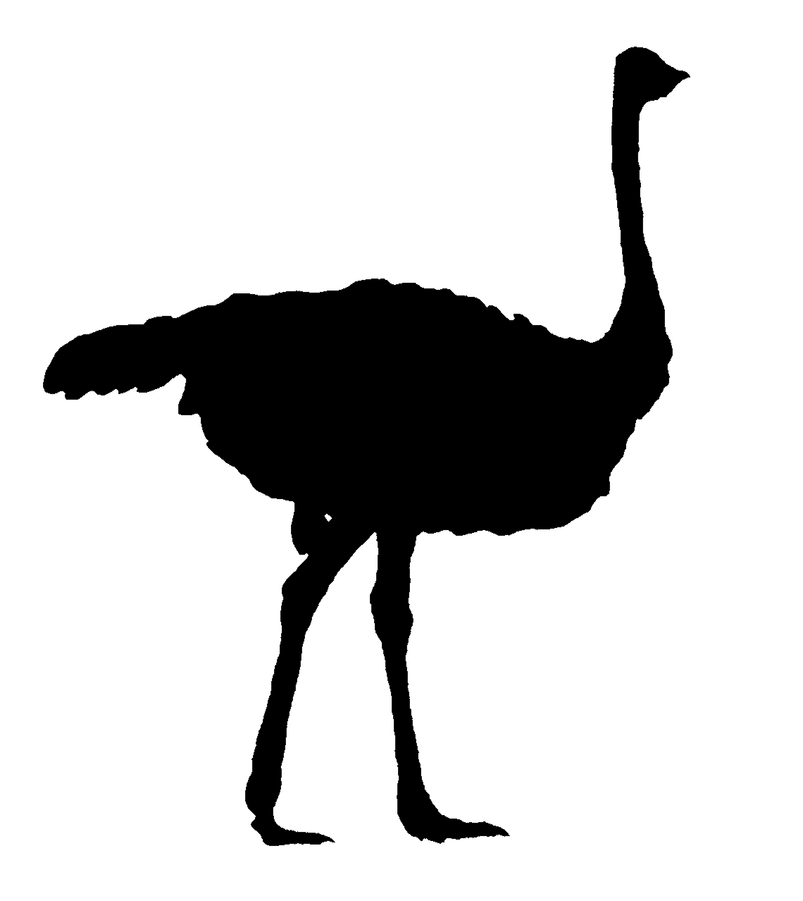
Phylogenetic trees
Nodes represent inferred common ancestors
Lengths of branches represent lifespans of lineages
Tips of the tree represent sampled species
Complexity Index
Geological time / Mya

Slide 3
What is a trend?
Long-term net changes in a trait of interest
Univariate traits can either increase or decrease through time
For example, species’ body sizes and organismal complexity have both increased since the origin of life
Or, the maximum has…
We want to understand these patterns in more detail.
Mean and maximum size increase through time in this lineage
The minimum decreases at first, then remains stationary
Figure 3 in Stanley (1973. Nature)

Slide 4
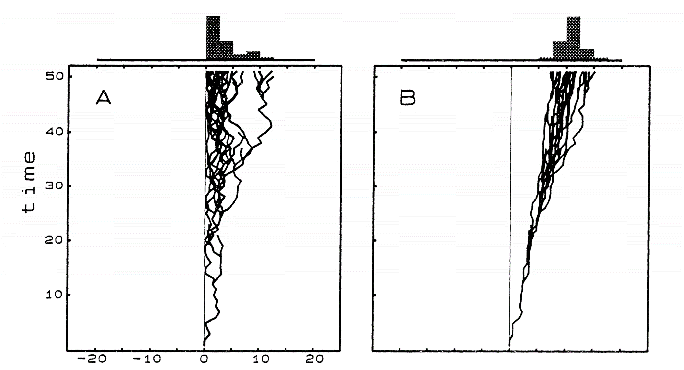
Types of trend
Passive trends
Equal probability of change in either direction
Variance increases through time
Impermeable lower boundary creates directional change
Active trends
Unequal probability of change in either direction
Will create unidirectional movement in mean, maximum, and minimum of the trait
Forces
Forces
Modified from Figure 2 in McShea, 1994. Evolution
These likely represent extremes of a spectrum, with real trends being a combination of both processes at different times and in different lineages of species.

Slide 5
Problem 1: Assumptions of a passive trend
We assume that increases and decreases are equally probable for a passive process.
Complexity Index
Is this actually true when there is a lower boundary?
Nowhere to go but up for species at the lower boundary, thus bias towards increases?
Impermeable lower boundary
Geological time / Mya

Slide 6
Problem 2: Measuring mass extinction impact
Some lineages survive mass extinction events, and others do not.
Surviving groups sometimes radiate after the event.
Does type of trend change across boundary?
Complexity Index
Geological time / Mya

Slide 7
Problem 2: Measuring mass extinction impact
Stochastic models of continuous evolution on trees exist.
Some implementations allow shifts in model at specified time points.
Can we modify this to look directly at trend models?
Can we optimise the time of the shift?
Complexity Index
Geological time / Mya

Slide 8
Thank you for your time
We want to understand long-term trends in evolution (specifically of complexity)
Problem 1: Are our assumptions flawed?
Problem 2: What are the impacts of mass extinction?
All thoughts welcome!
We plan on building this further from my PhD into a new grant

