Slide 1
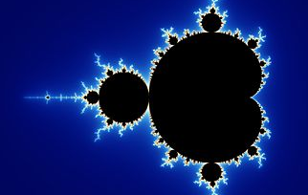
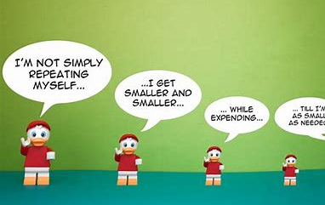
Recursion: On cauliflowers, snails and dragons
Dr Karol Bacik and Dr Christian Rohrbeck

Slide 2
What is this About?
Today we introduce the concept of recursion
It’s important in mathematics and programming
We will first introduce the concept before considering how we can use it to create intriguing images with it
In the workshops you will create your own images

Slide 3
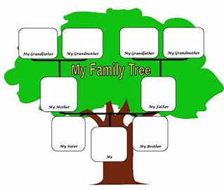
A simple recursion example – Creating a family tree
Suppose we want to create a list of all our ancestors:
We start with our parents
We add the parents of our parents (i.e. our grandparents)
We add the parents of our grandparents and so on
In each step we only looked for the parents of a person. By applying this operation repeatedly we created a list of our ancestors.

Slide 4
A more Formal definition of Recursion
Recursion consists of two aspects:
A starting point
An operation (or set of rules) that is repeatedly applied to the value/output we obtained after the previous step.
For creating the family tree, the starting point is us and the operation is to add the parents of all family members to the list. This is very much related to the session on Algorithms.
Suppose I want to calculate the number $2^{16}$, but I have no calculator. How could I use recursion in this situation?
How could I create a list of the natural numbers up to 1000 using recursion?

Slide 5
Creating Images with Recursion
Recursion can be used to create beautiful images.
Can you identify the starting point and operation that produces the following sequence of images (from left to right)?

Slide 6
What about the CauliFlower?

Slide 7
The Fibonacci Numbers
Suppose our starting point are the numbers $a_{0}=0$ and $a_{1}=1$.
We define the next terms in the sequence as${ a}_{2}=a_{0}+a_{1}$, ${ a}_{3}=a_{1}+a_{2}$ and so on.
What are the numbers we get?
We get the sequence
0, 1, 1, 2, 3, 5, 8, 13, 21, 34, …
These are called the Fibonacci numbers (named after the Italian mathematician Leonardo of Pisa)

Slide 8
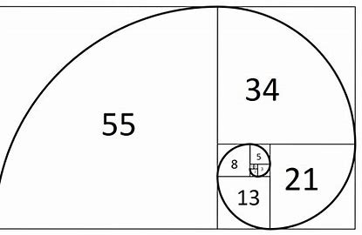
Creating Snails – the Fibonacci spiral
The Fibonacci numbers allow us to create an image using recursion.
This is known as the Fibonacci spiral, which looks like a snail and occurs quite often in nature.

Slide 9
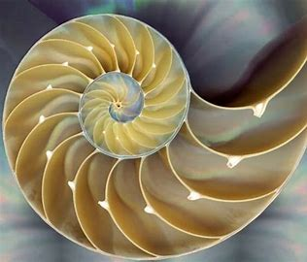
Where do we find such Spirals?
Spiral Galaxy
Nautilus shells

Slide 10
The mandelbrot

Slide 11
HEIGHWAY DRAGON CURVES

