Slide 1
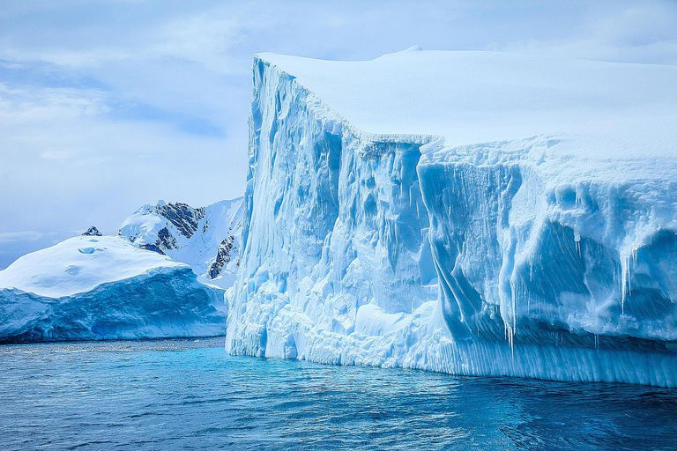



Is the Mid Pleistocene Transition a
Grazing Bifurcation
Chris Budd and Susan Morupisi
UCC, September 2020

Slide 2
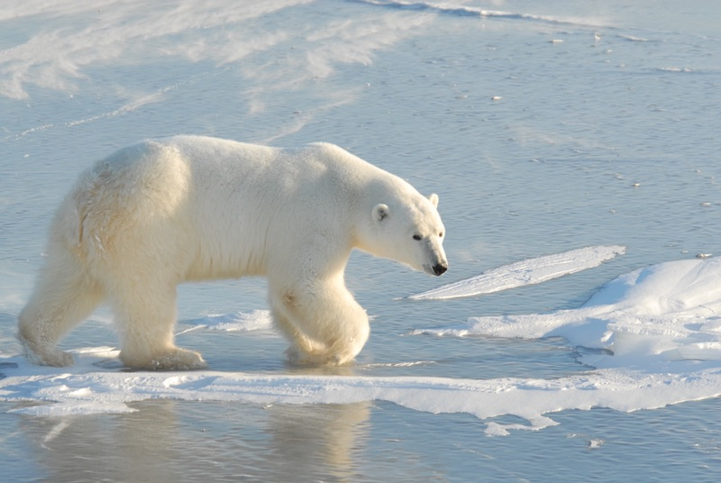
Can we predict the climate?
Method 1: (The IPCC way)
Construct a very sophisticated model
Solve on a super computer
Only works for short (100 year) prediction periods
Method 2: (The mathematicians way)
Construct reduced climate models for long term qualitative and quantitative predictions

Slide 3
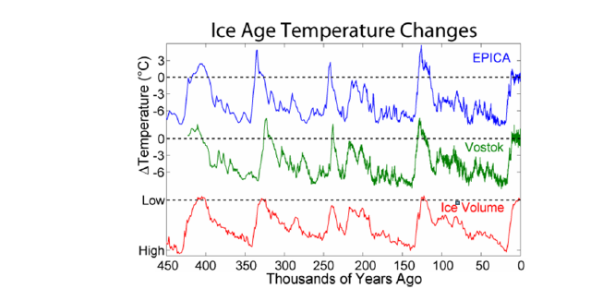
What causes the 100 kyr periodicity in the ice ages?

Slide 4
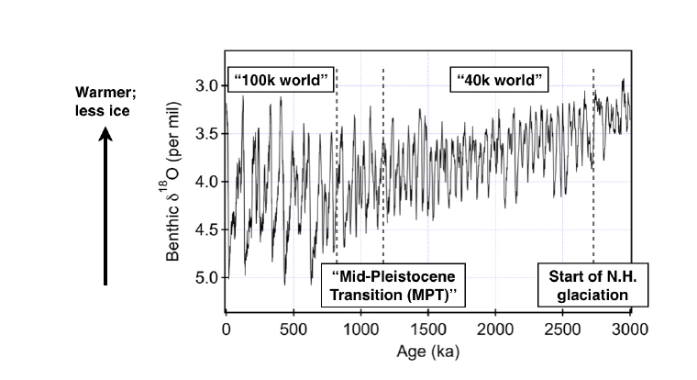
Mid Pleistocene Transition (MPT):
Change in frequency one million years ago

Slide 5
Variety of low-dimensional dynamical systems
models are used to model this
Classical dynamical systems:
Smooth evolution. Hopf bifurcations for the transitions
Non-smooth dynamical systems and relaxation oscillators
Switches and very different time-scales for the evolution. Grazing bifurcations for the transitions.

Slide 6
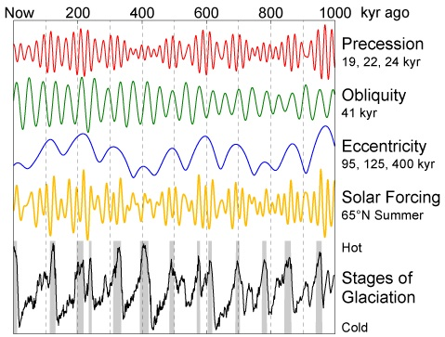
Key factor:
Solar forcing S(t) varies due to Milankovich cycles
S(t) = I_65

Slide 7
Issues:
19kyr, 23kr, 41kyr cycles all significant
implying linear forcing before the MPT
2. 100kr eccentricity variation: very small forcing!!
Q. Is the recent 100kyr cycle
Forced by the eccentricity changes: Unlikely!
Weakly synchronised by the eccentricity changes
Independent of these changes and instead caused by an internal climate variation which also has a 100kyr period
eg. Ice sheet growth

Slide 8
[Saltzman + Maasch 1990,1991] Carbon Cycle model
V: Ice mass
T: Deep ocean temperature
C: CO2
Parameters CHOSEN to give 100kyr cycle
CO2 Tectonic plate forcing

Slide 9
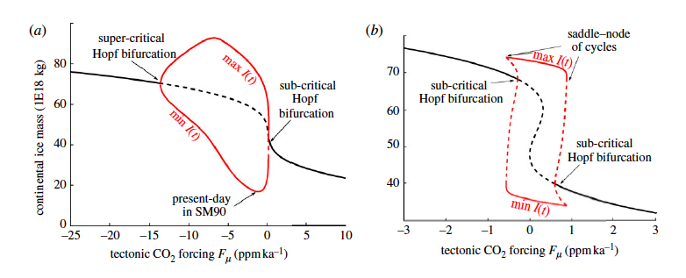
Predicts: Hopf bifurcation as an explanation for the MPT
Bifurcation occurs due to a slow variation in CO2 forcing
Linear regime before MPT (forced)
Nonlinear regime after MPT (synchronised)
But …. Crucial CO2 equation very contrived! No real justification!

Slide 10
Relaxation Oscillator Models
[Paillard], [Ashwin], [review in Crucifix] [B and Morupisi]
These model the climate as a multi-equilibrium system which relaxes to a set of different states.
Transitions between the states are generated using non-smooth maps which can be modelled using hybrid dynamical systems or by using a slow manifold
Can give some explanation for the MPT transition

Slide 11
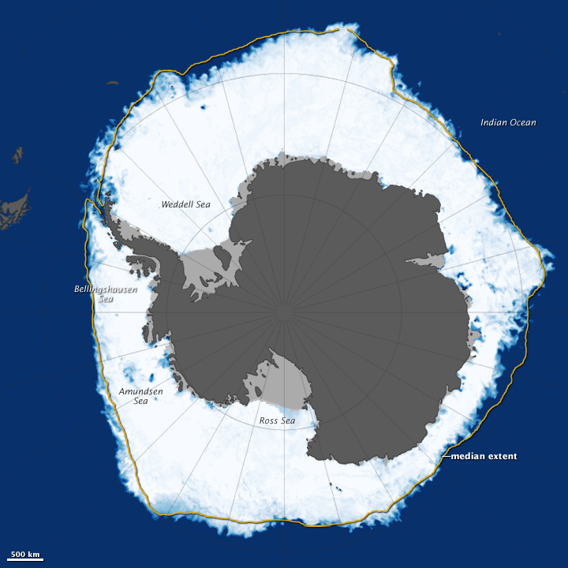
Paillard and Parrenin (2004) PP04 Transition Model
V: Ice volume A: Antarctic Ice C: Carbon Dioxide
Model: atmospheric Carbon Dioxide rapidly increases when Southern Ocean suddenly ventilates
Ventilation occurs when deep ocean stratification ceases
Release of Carbon Dioxide leads to warming of the Earth which drives a rapid deglaciation process

Slide 12
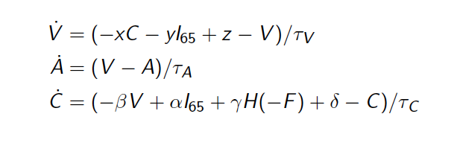
Heavyside function
V: Ice volume A: Antarctic Ice C: Carbon Dioxide
Stratification parameter or Salt water formation efficiency

Slide 13
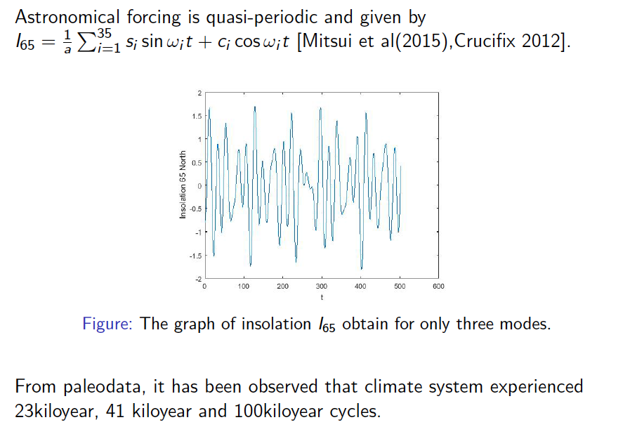

Slide 14
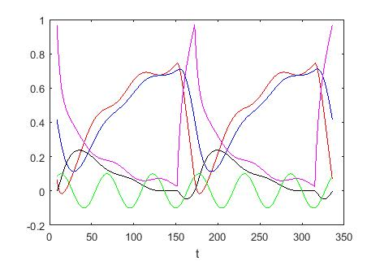
Typical Periodic Solution of PP04
C
A
V
F
I_65

Slide 15
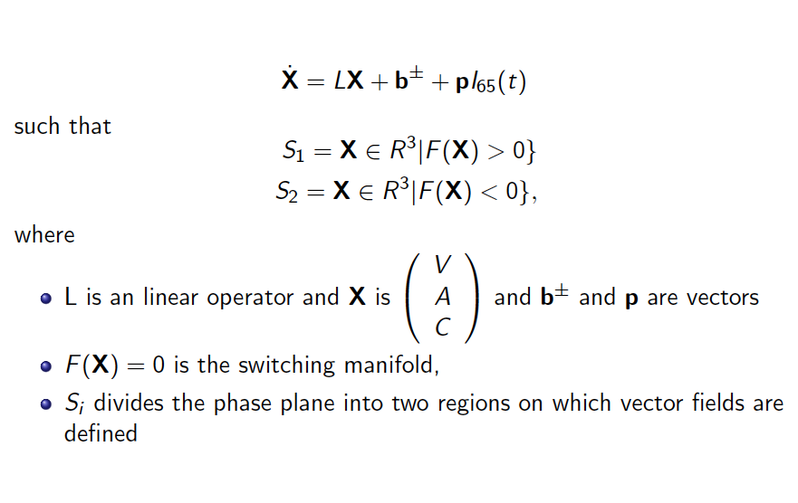
PP04 has structure of a forced
non-smooth discontinuous Filipov system
Glacial
Inter Glacial
Switching manifold

Slide 17
Analysis of the unforced system
Fixed points
Physical
Virtual

Slide 18
Theorem
There exist critical values of the parameter d
If interglacial state is physical and globally attracting
If glacial state is physical and globally attracting
If see a periodic solution
Transitions occur at Border Collision Bifurcations when

Slide 19
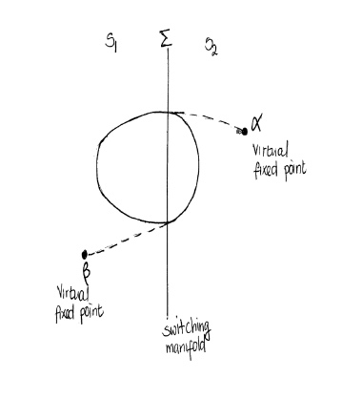
Literally a sketch proof of (c)
Formal proof using the Brouwer Fixed Point Theorem

Slide 20
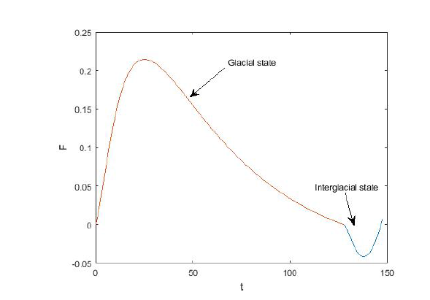
Unique periodic solution. Period 147 kYr

Slide 21
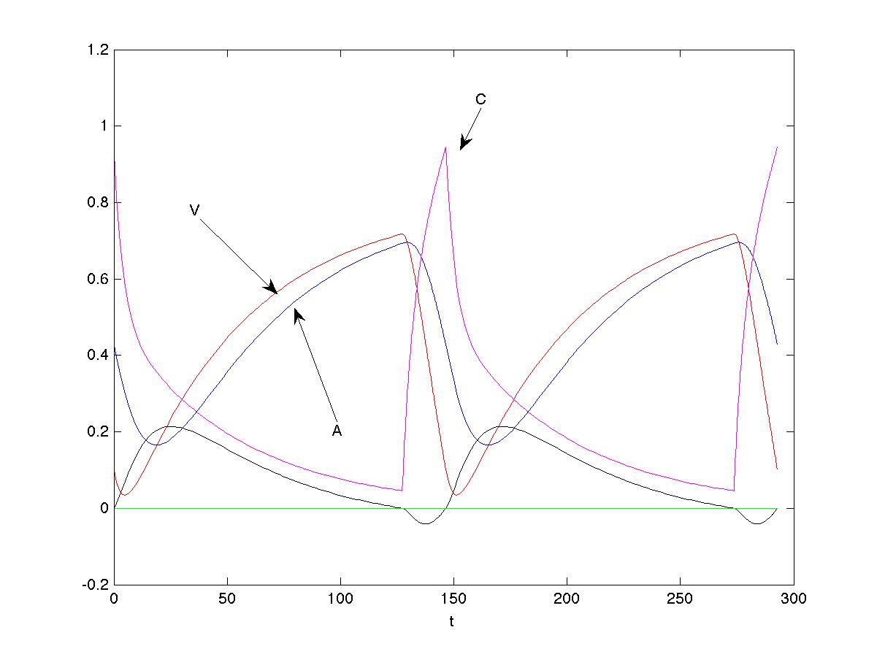
Periodic Solution: Period = 147 years

Slide 22
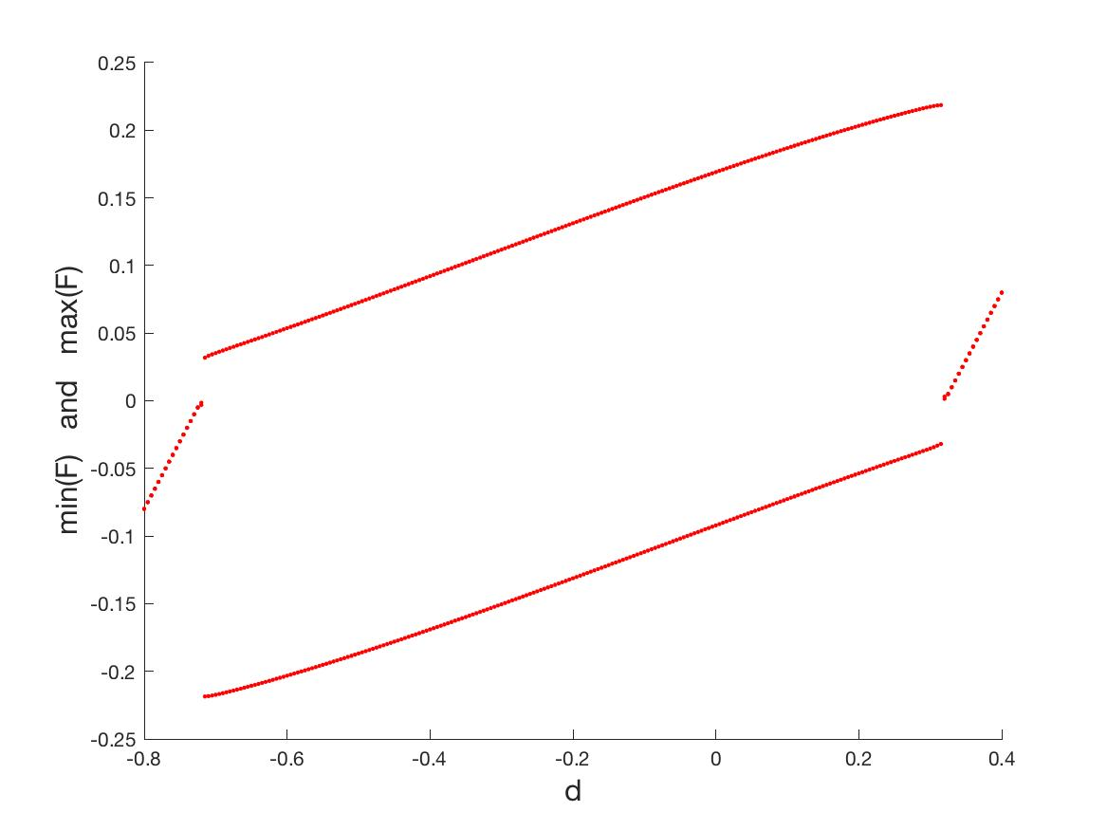
Border collision bifurcation

Slide 23
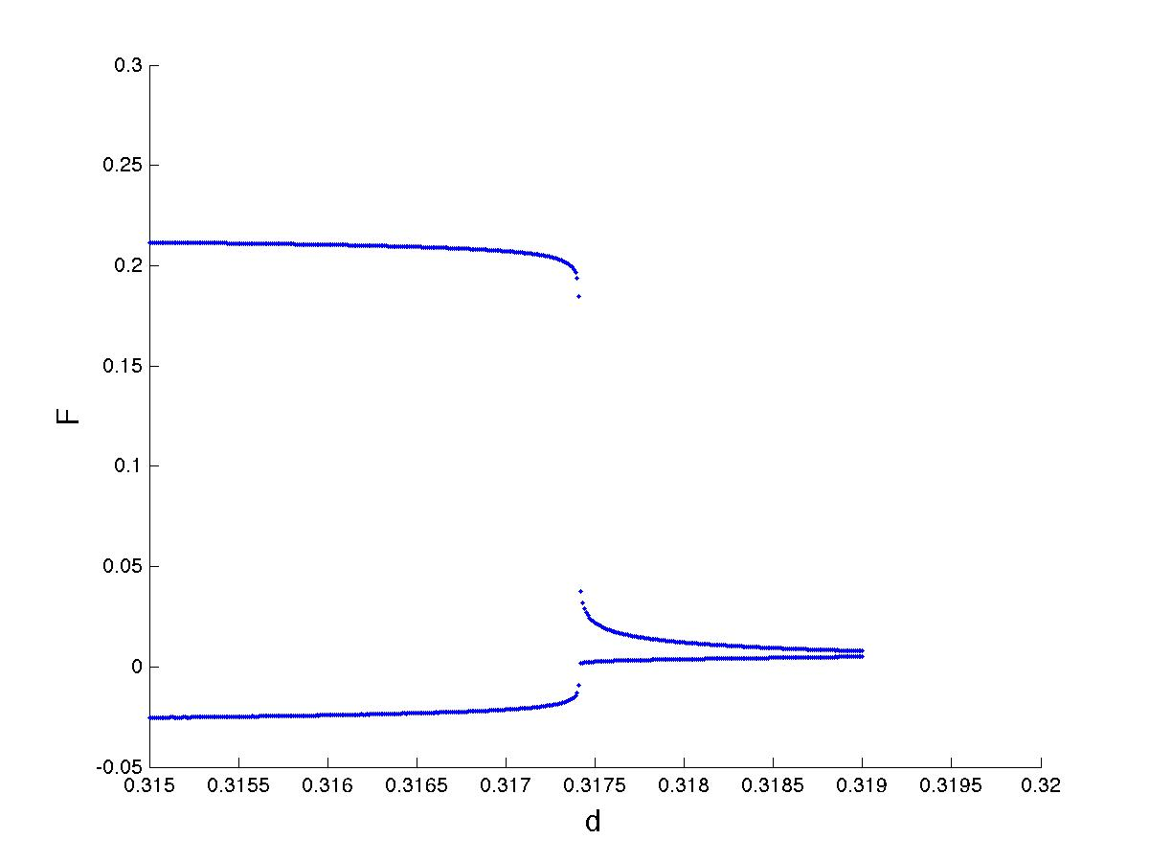
If we replace the Heavyside function by a smoother function we get a Hopf bifurcation followed by a cyclic fold

Slide 24

Periodically Forced System
Study for small mu by looking at perturbations of the unforced periodic solution which lead to
(m,n) synchronised periodic solutions
m: glacial cycles
n: forcing cycles (period = )

Slide 25
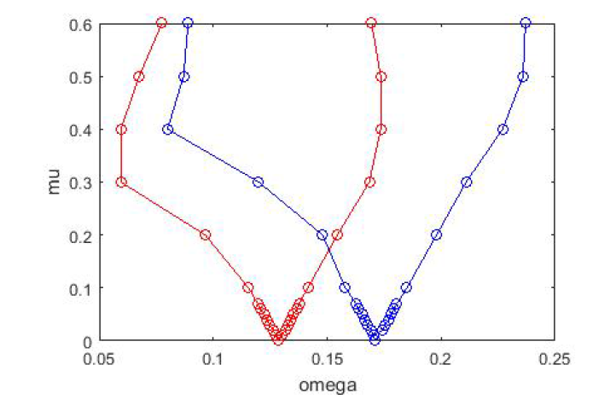
Calculated Arnold tongues of periodic existence
(1,3)
(1,4)
QP
QP
QP

Slide 26
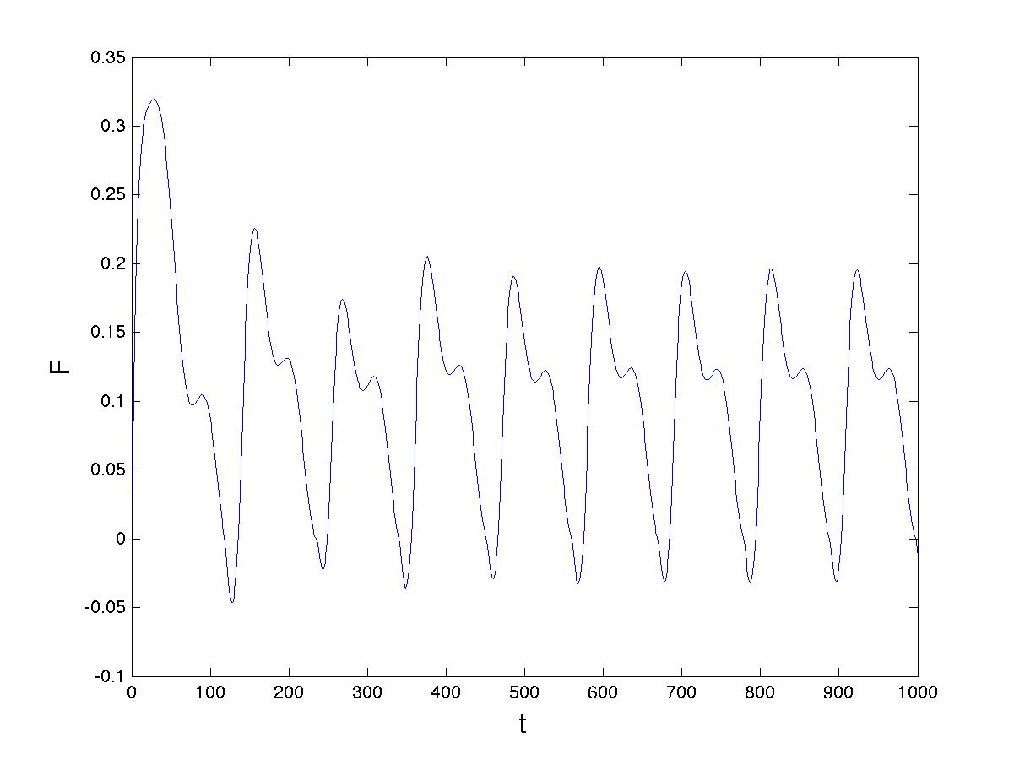
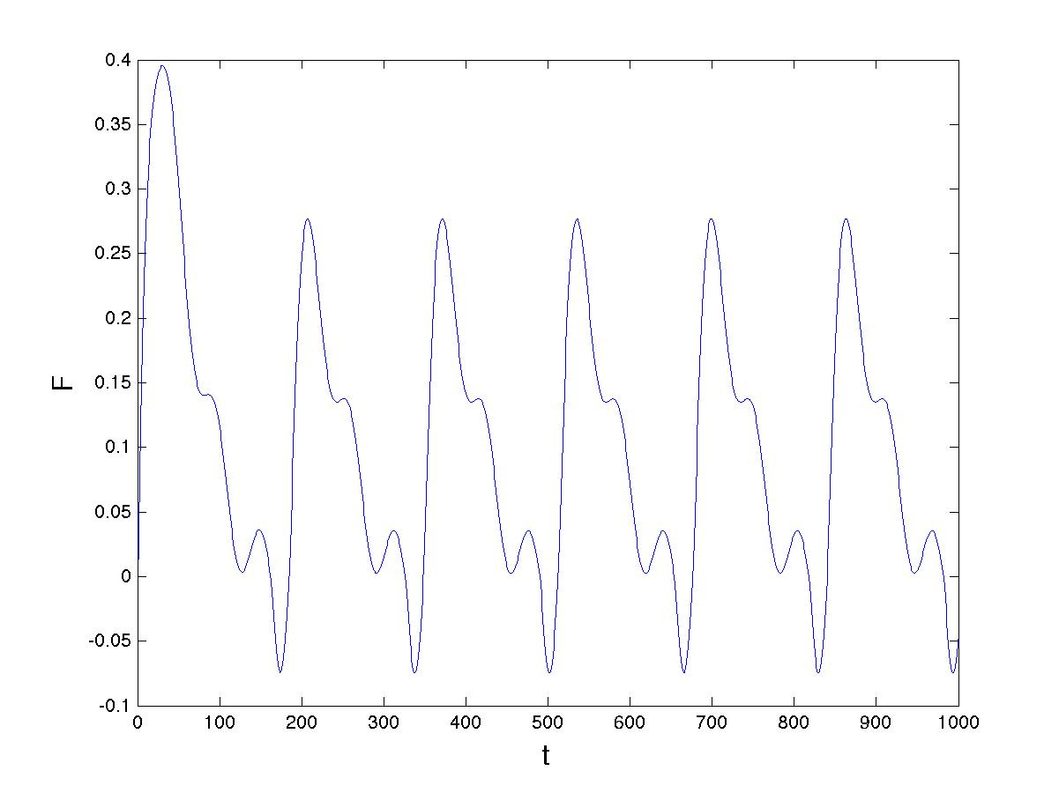
(1,2) periodic orbit
(1,3) periodic orbit

Slide 27
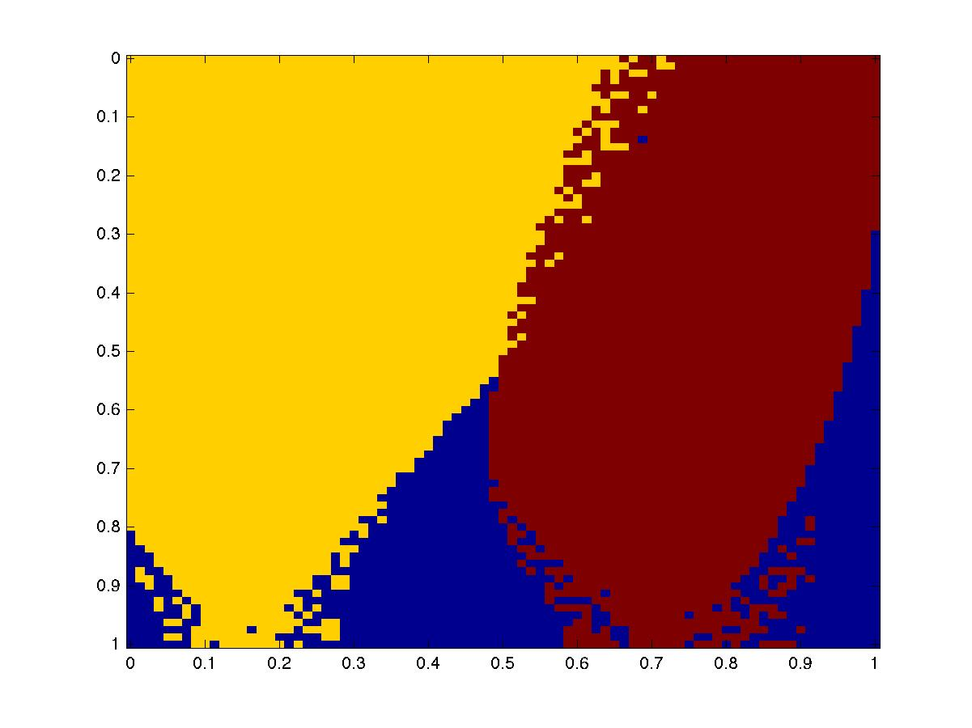
(1,2)
(1,3)
QP
0.075
0.10
0.11
0.12
0.13
0.14
0.15
0.13

Slide 28
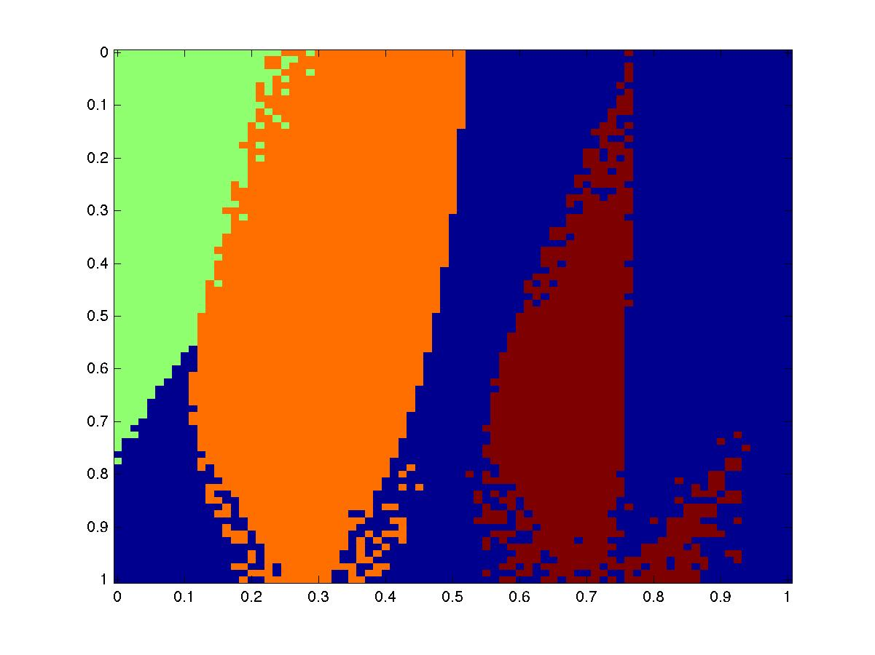
(1,2)
(1,3)
(1,4)
QP
QP

Slide 29
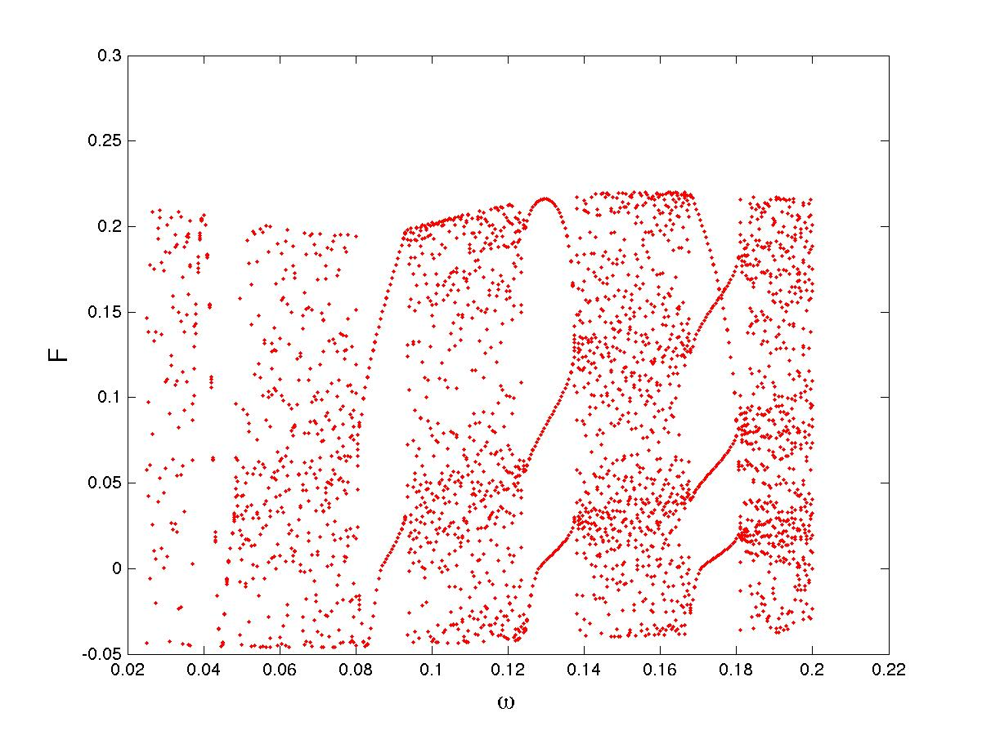
Very small mu

Slide 30
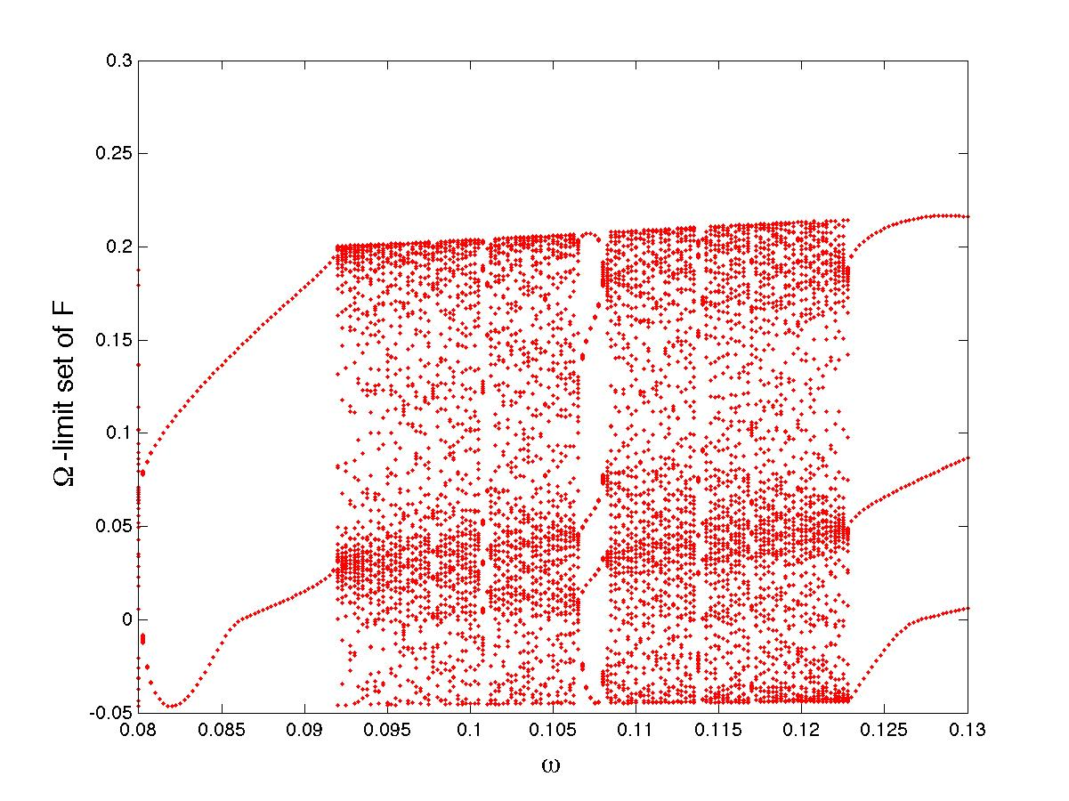
Larger mu behaviour
(1,3)
(2,5)
(1,2)

Slide 31
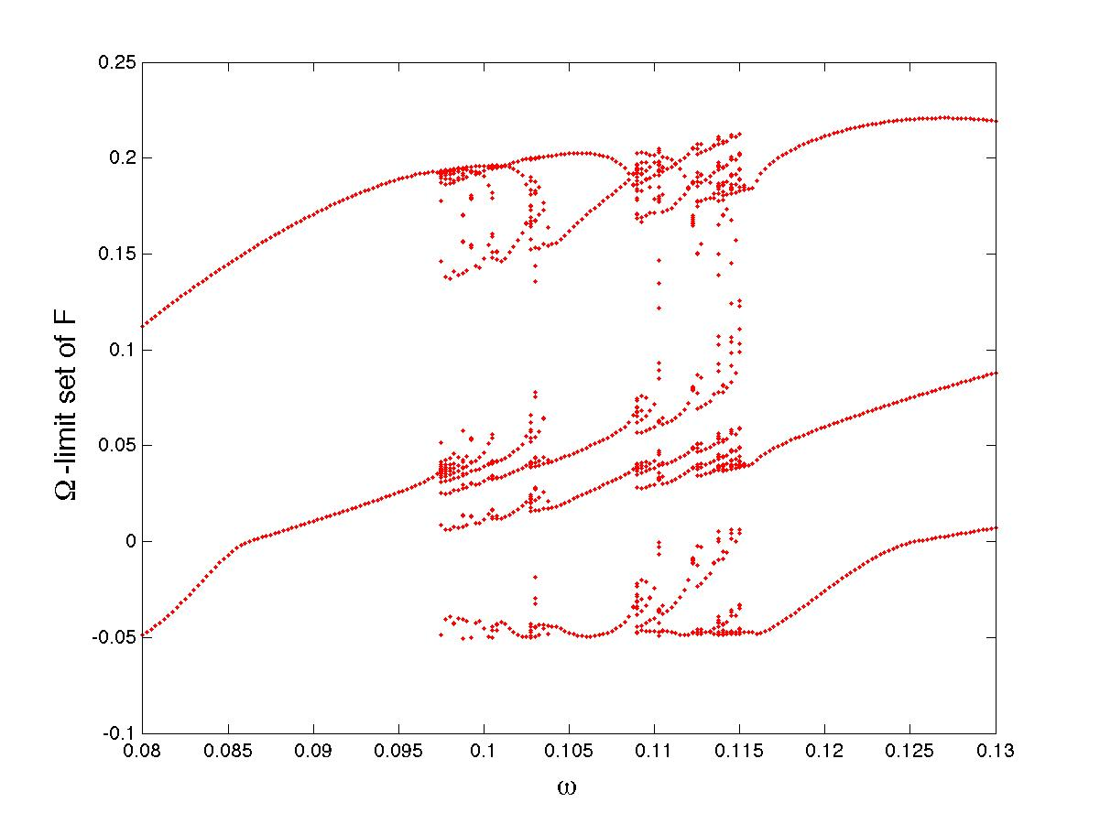
Even larger mu behaviour

Slide 32
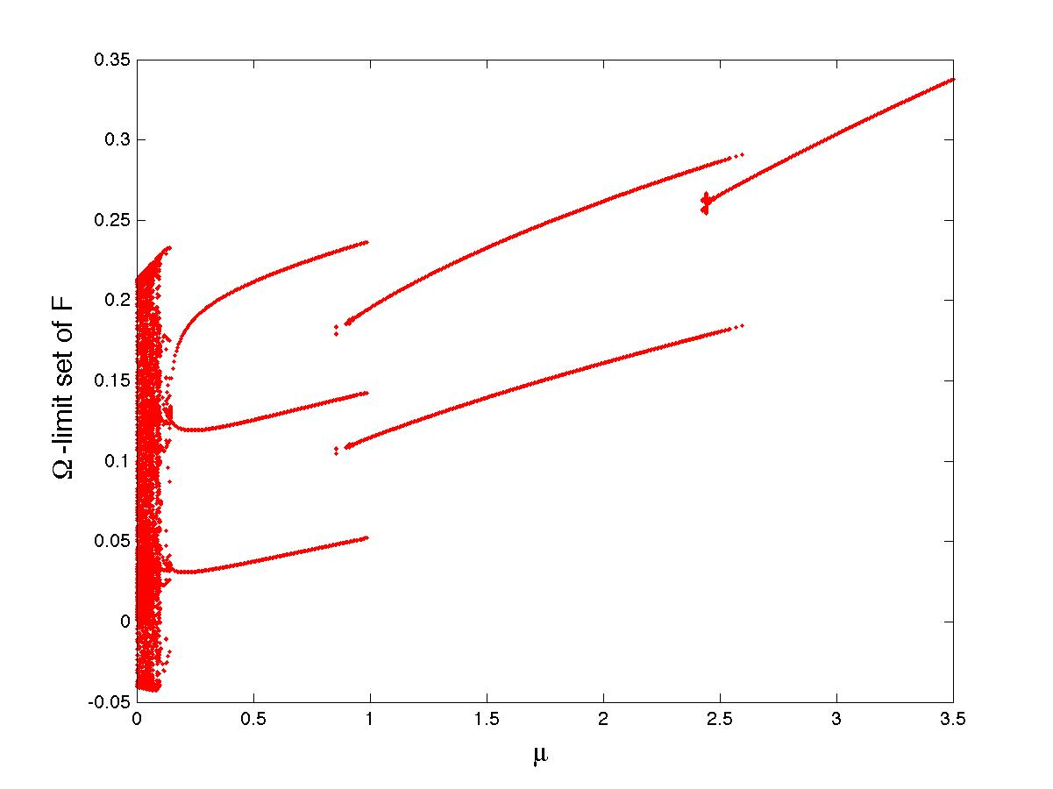
(1,3)
(1,2)
(1,1)

Slide 33
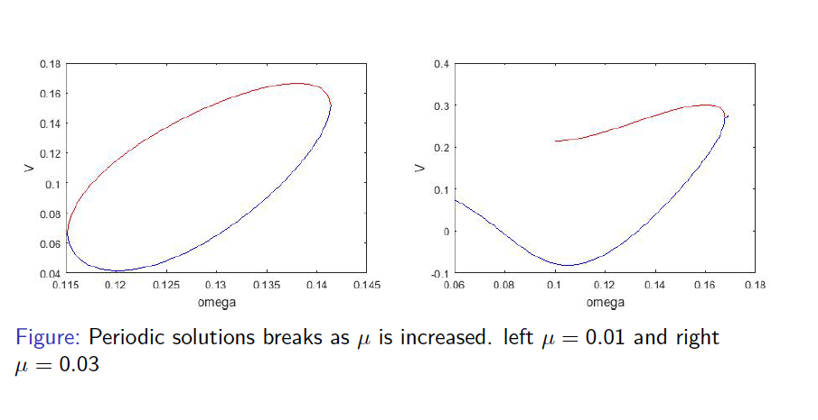
Bifurcation Diagram (1,3) solution
Saddle node bifurcation
Ellipse of size (small) mu is parametrised by the phase of the start of the glacial cycle

Slide 34
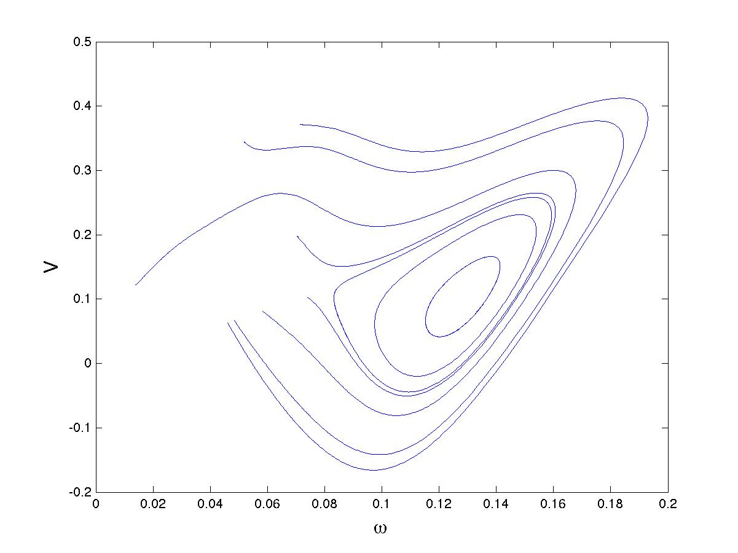

Slide 35
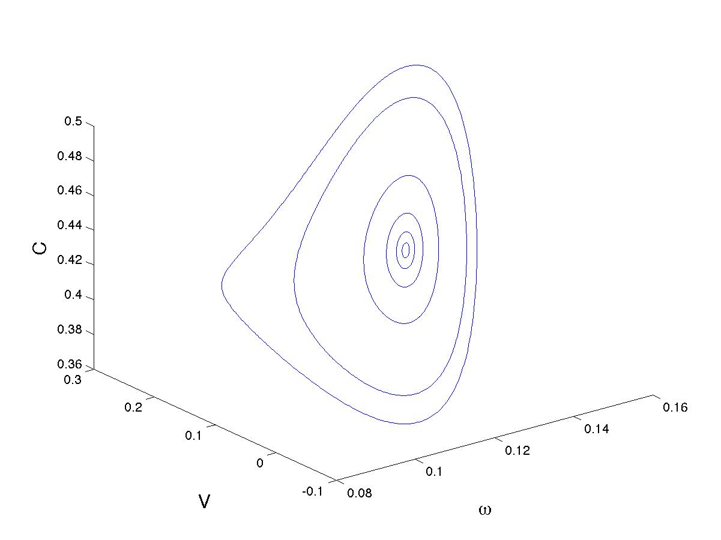

Slide 36
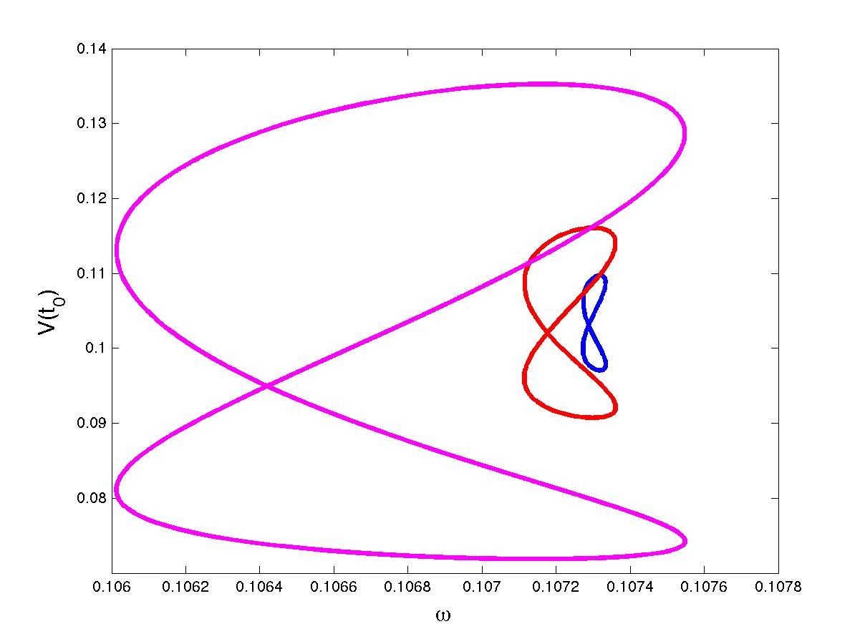
Bifurcation diagram (2,5) solution

Slide 37
Transitions

Slide 38
SN
G
PD
(1,1)
(1,2)
(1,3)
0.0427
0.0854
0.128

Slide 39
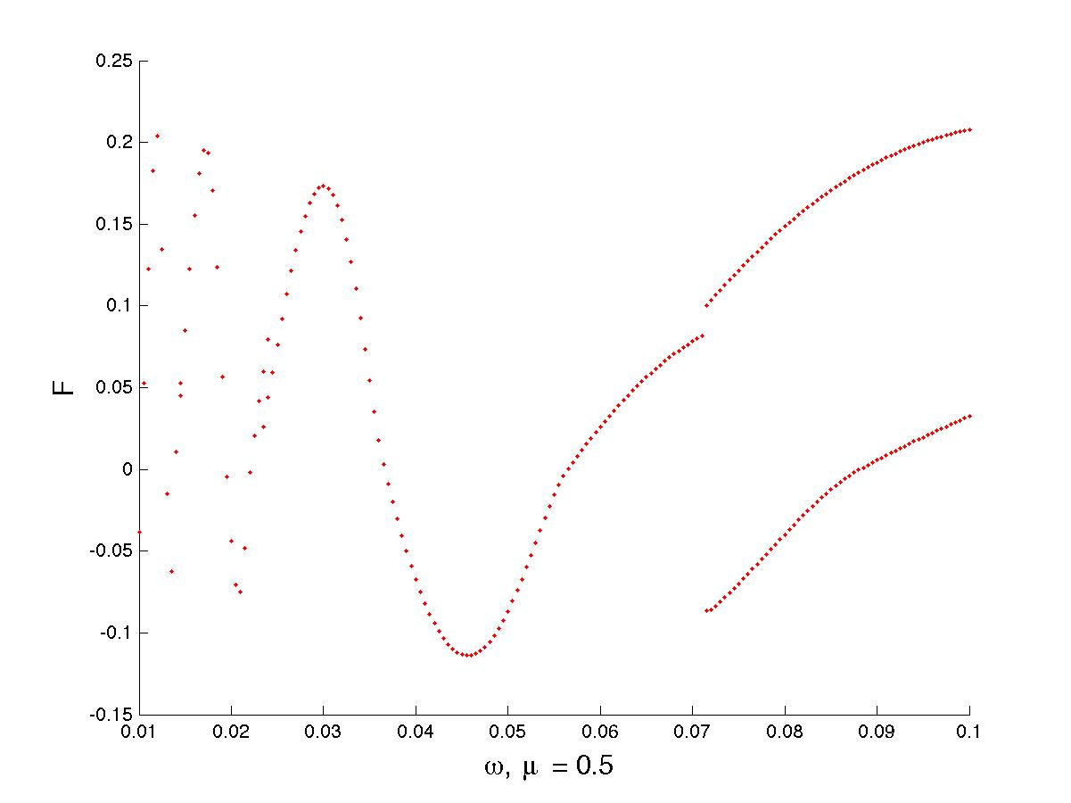
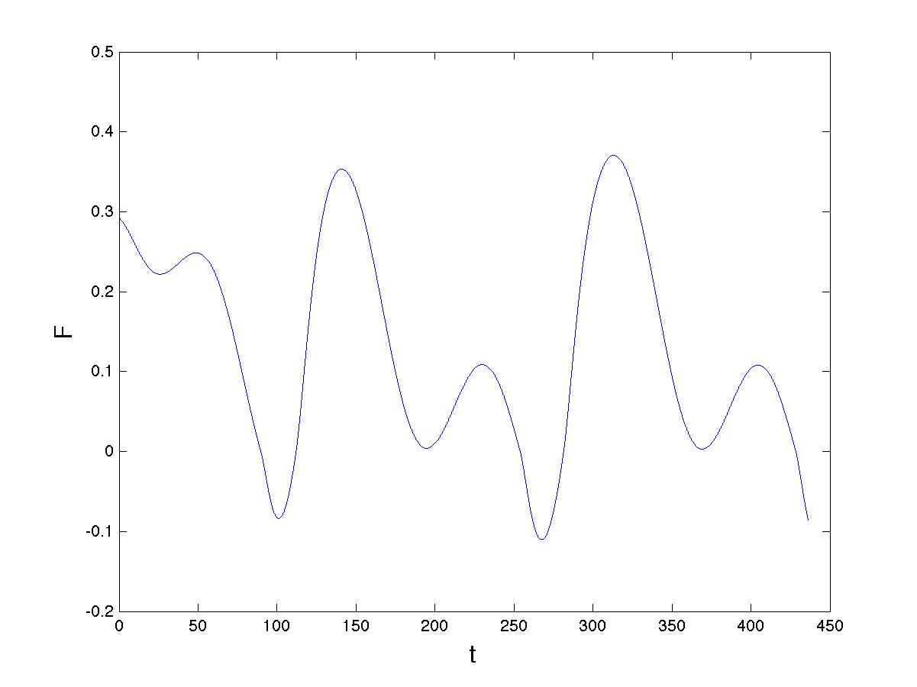
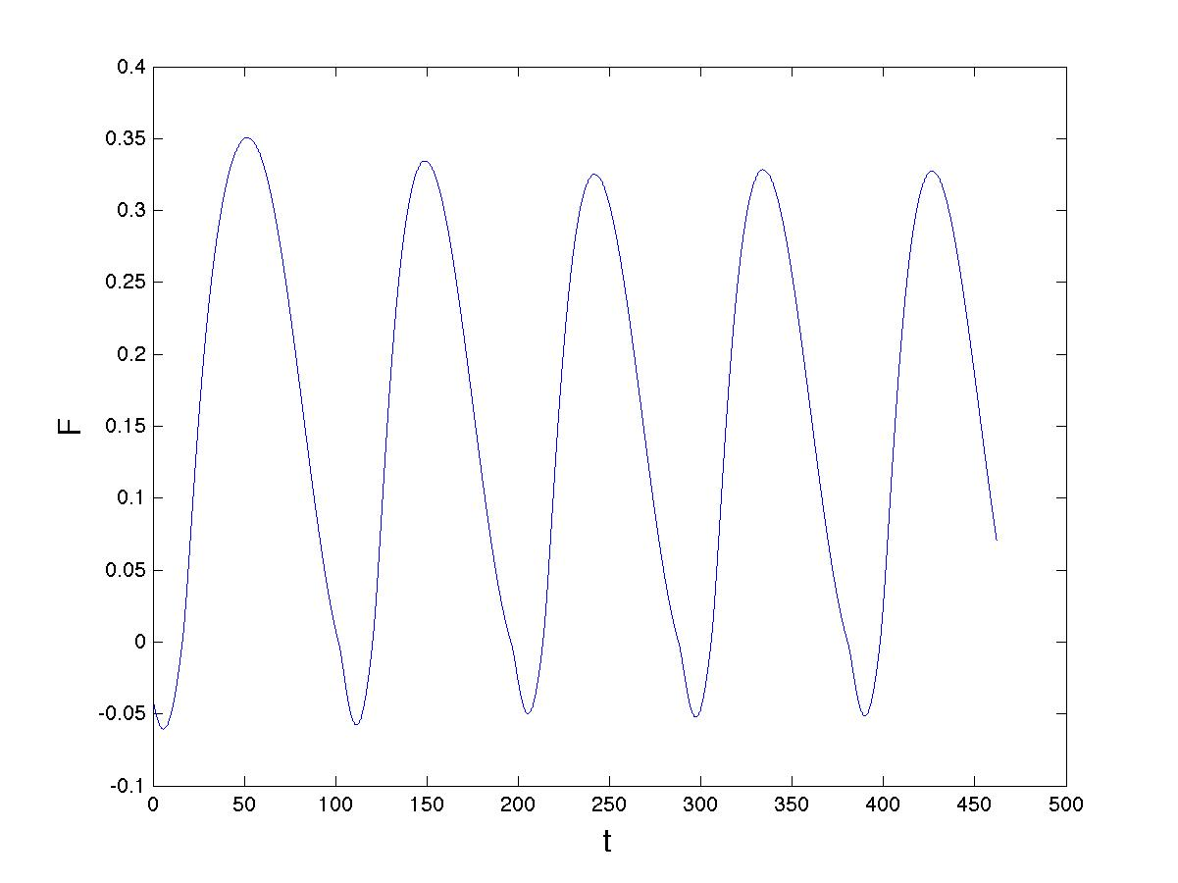

Slide 40
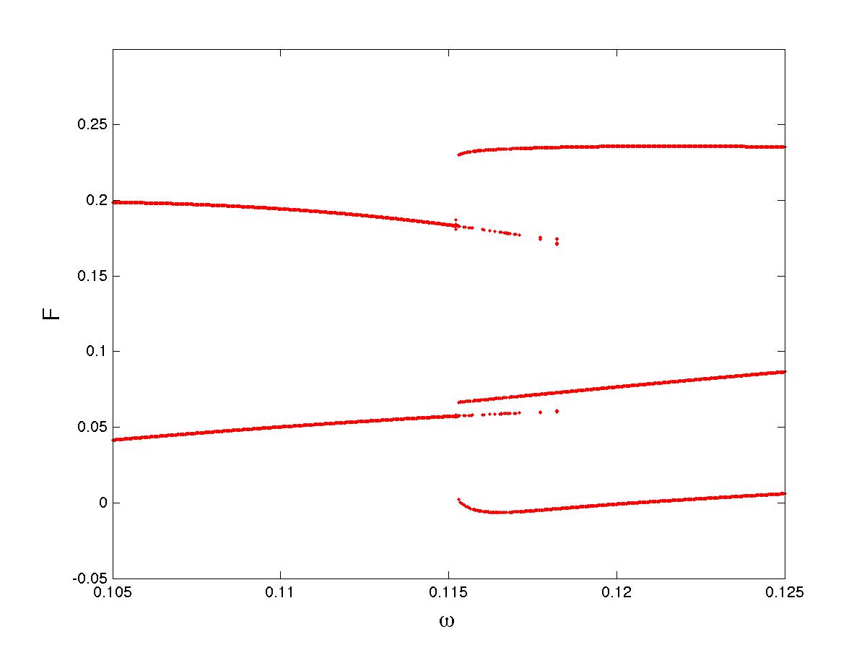
Coexistence of period 2 and period 3
(1,2) periodic orbit
(1,3) periodic orbit

Slide 41
(1,2) periodic orbit
(1,3) periodic orbit

Slide 42
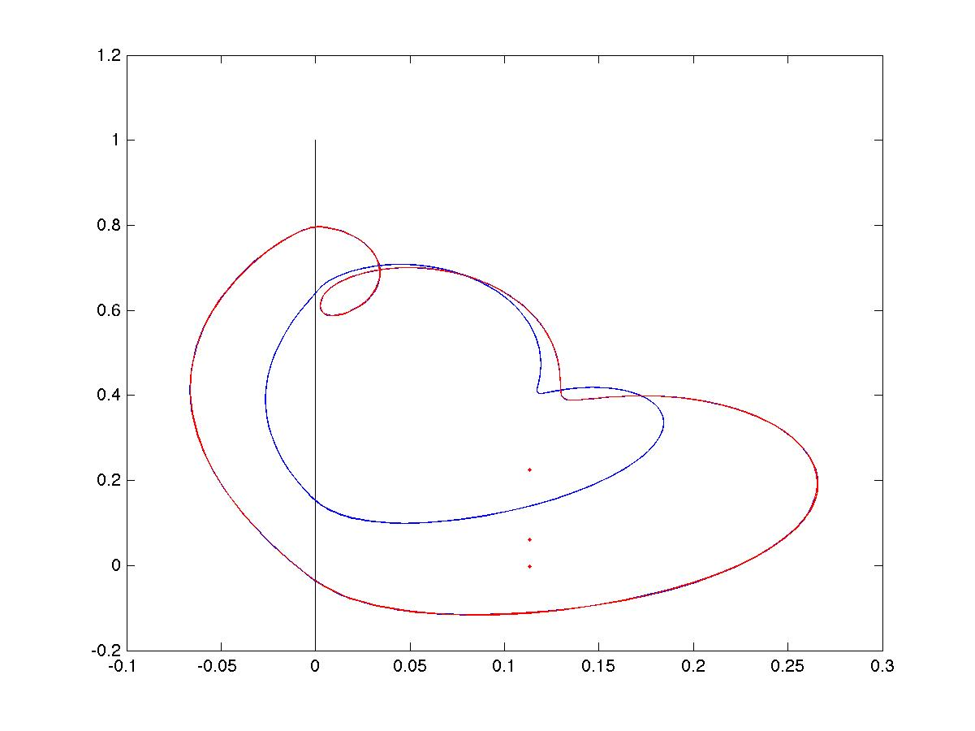

Slide 43
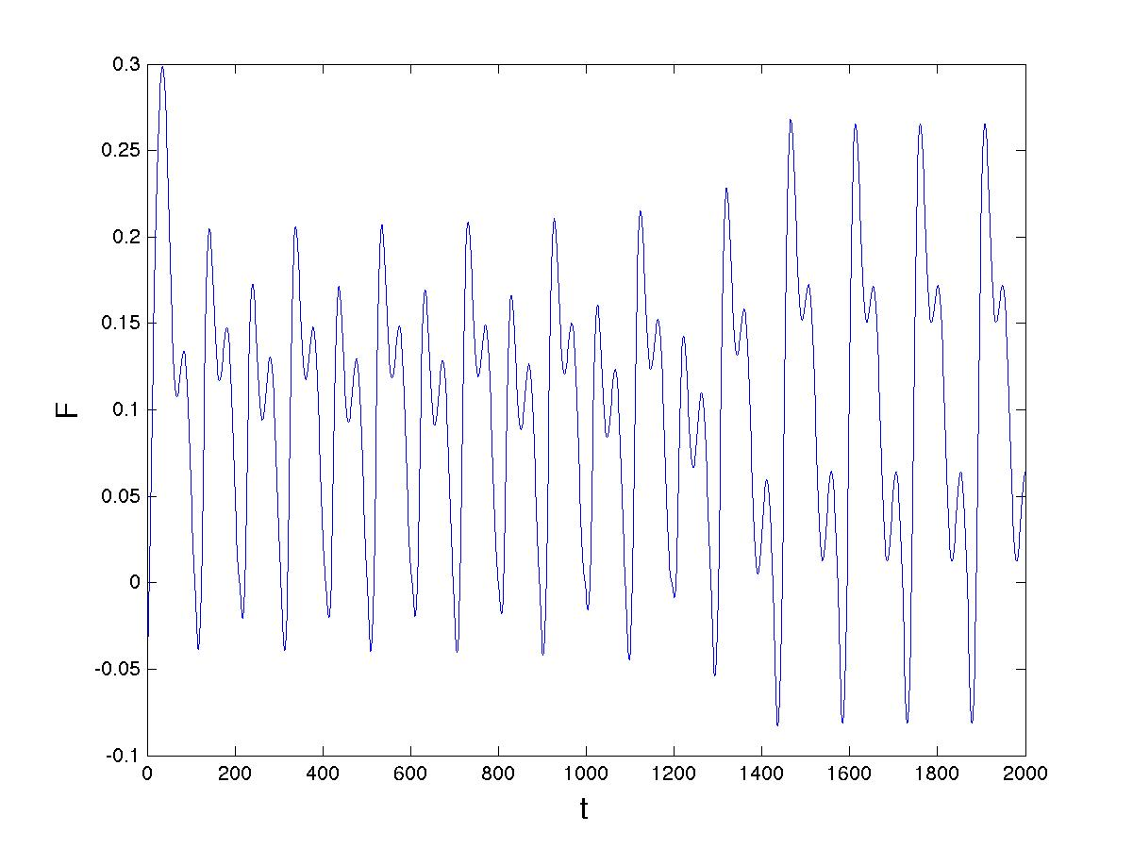
(1,3)
(2,4)
Graze
Transition similar to the MPT

Slide 44
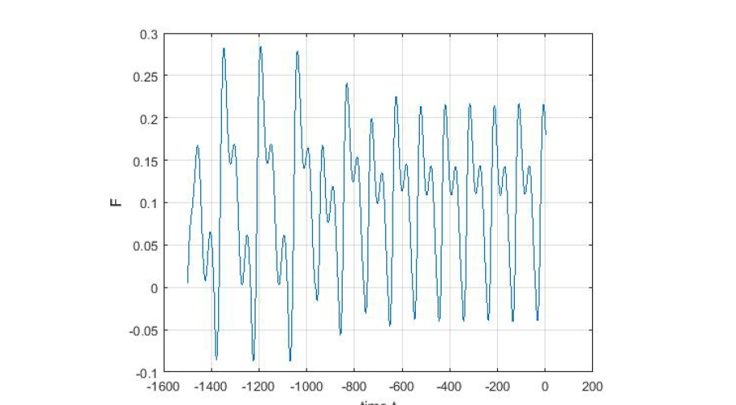
Co-existence of solutions leads to MPT-like behaviour
Graze

Slide 45
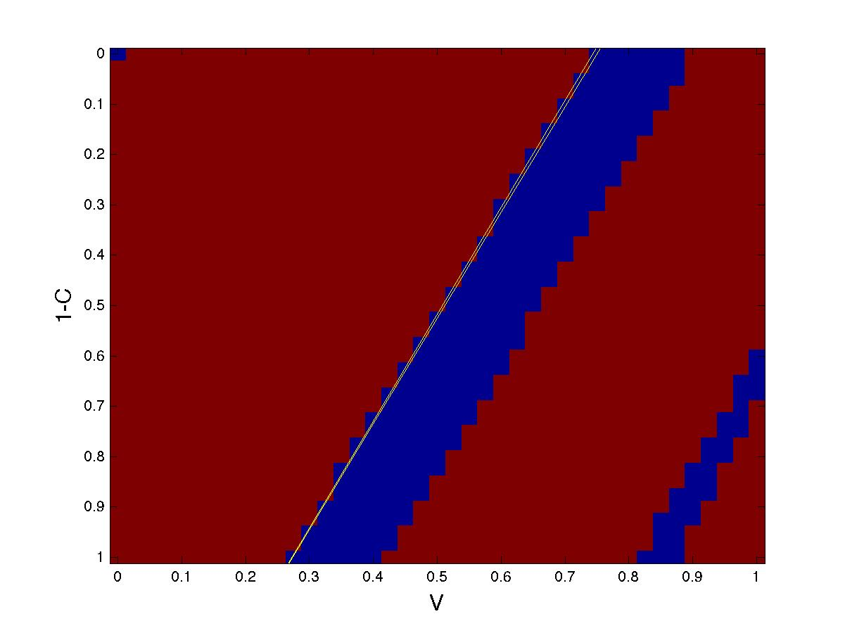
Domain of attraction
(1,3) orbit
(1,2)
(1,3) orbit

Slide 46
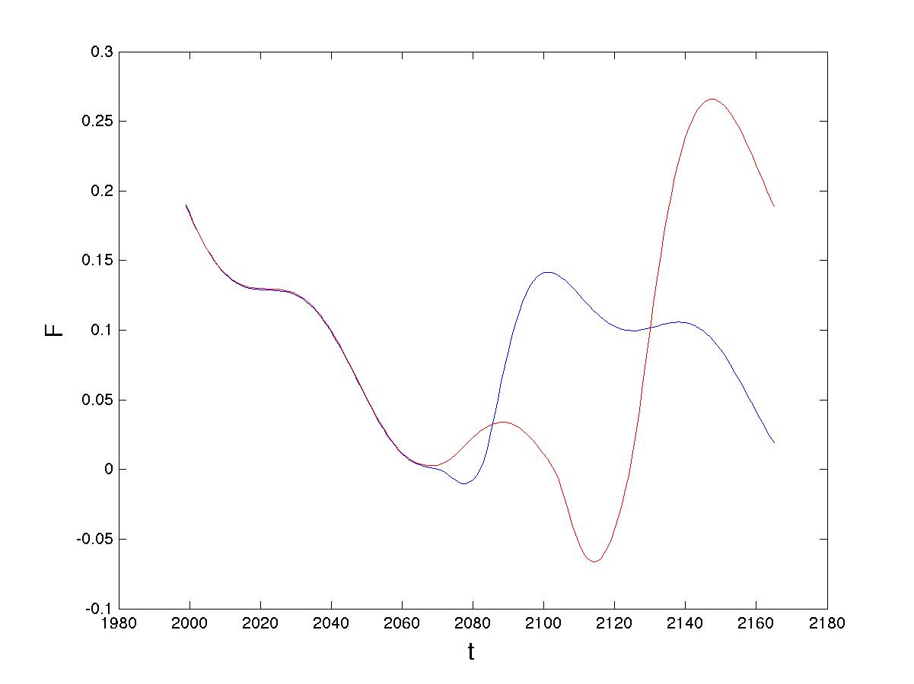
Grazing event
Almost identical
Very different

Slide 48
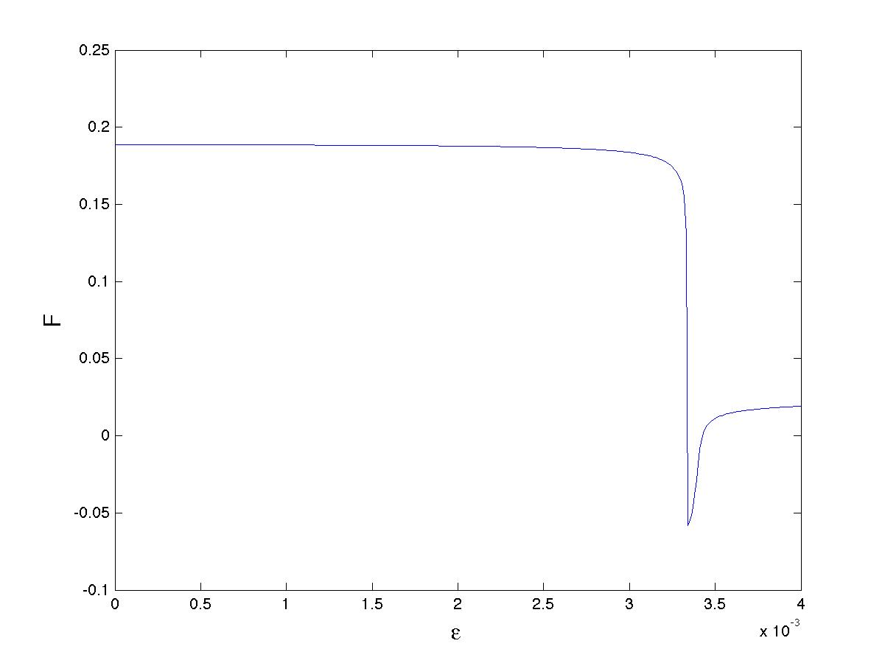
Grazing map
Poincare Map:
Smoothed discontinuity
Locally square-root behaviour

Slide 49
Local form of the Grazing Poincare Map
Introduces very significant stretching to the phase space
Leads to large transitions between states under small perturbations

Slide 50
The Grazing Set G
This plays a crucial role in determining what initial conditions lead to different events
Here i refers to the number of times that the trajectory intersects

Slide 51
The structure of the PP04 model means that we can deduce a lot about the structure of G and hence of the transitions.
Lemma
If t_0 is fixed then G takes the form of a set of near planar surfaces
The planes have the same normal vector

Slide 52
Before an impact
L has eigenvalues
Grazing when:
on a plane
almost independent of

Slide 53
Pull-backs
A
C
V

Slide 54
Cross Section of the Domain of attraction
(1,3) orbit
(1,2)
Grazing lines
(1,3) orbit

Slide 55
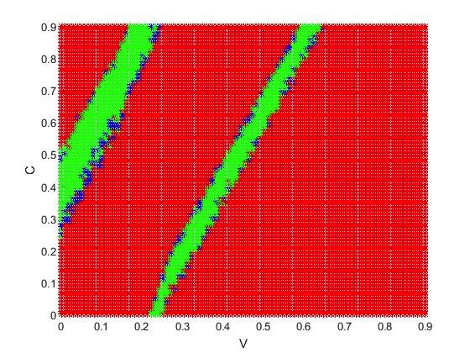
Domains of attraction

Slide 56
Links to climate
Milankovich forcing has dominant term of 41 kyr period which in non dimensional units has
For these values there exists a very stable (1,3) periodic orbit of period T = 123 kYr
Orbit persists when extra terms are added to the forcing

Slide 57
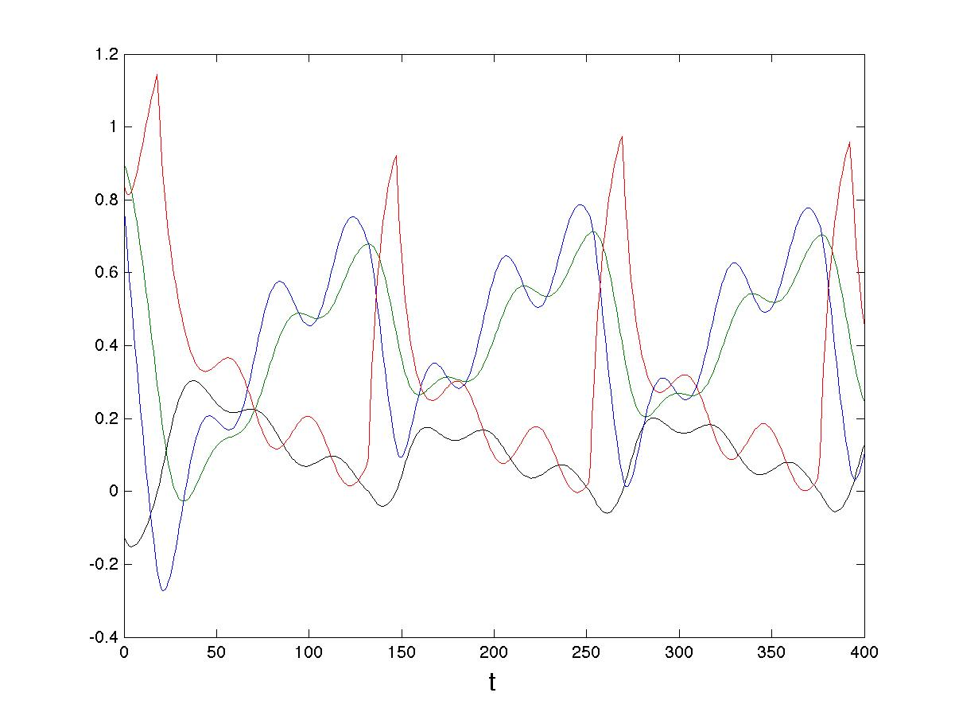

Slide 58
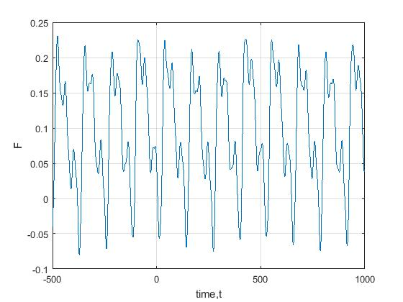
Weak Quasi-Periodic Forcing
Reasonable fit to observed data

Slide 59
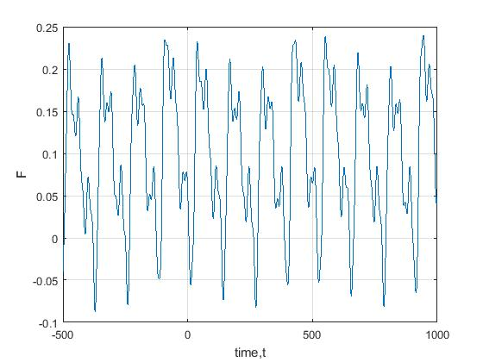
Larger amplitude secondary QP forcing term

Slide 60
PP04 model with quasi-periodic forcing
Observations

Slide 61
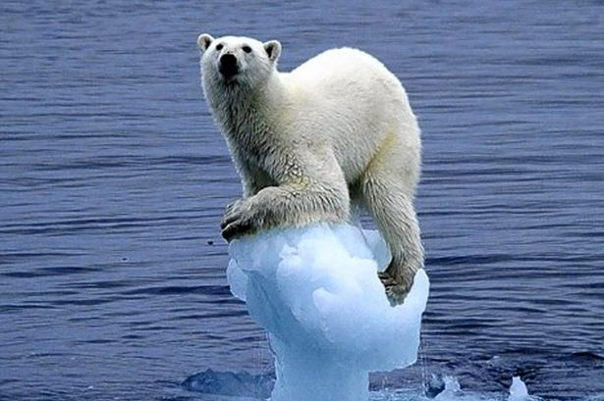
Conclusions
PP04 model gives a reasonable fit to observed climate dynamics
Model can be studied using techniques of non-smooth dynamical systems theory
Reasonable explanation for the MPT
Only one plausible solution amongst many

