Slide 1
PLAY TO WIN
Chloe Howcroft, Jodie Young, Joy Boh, Ashley Higgs, Lucia Lopez & Haranja Sivaneswaran
Notes:
Ask if they have heard about the Nim game before?

Slide 2
21
In pairs take turns in counting
Each of you can say one, two, or three numbers
The person who says 21 is the loser
1, 2
3, 4, 5
6
7, 8, 9
Notes:
Play in pair, who won? who went first? Who went second?
Pick a winner who went first to play against one of us

Slide 3
How To Win The Game of 21
1
2
3
4
5
6
7
8
9
10
11
12
13
14
15
16
17
18
19
20
21
Notes:
First or second

Slide 4
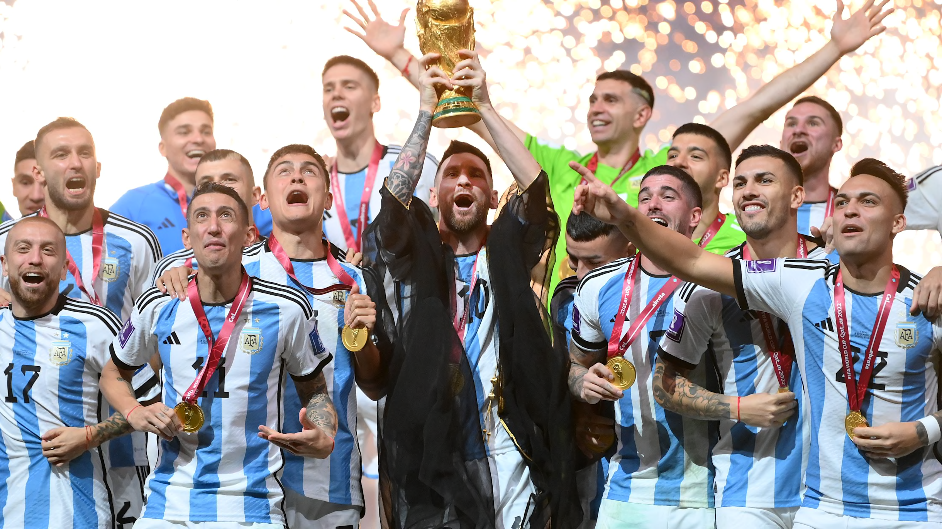

Slide 5
WE ARE THE CHAMPIONS

Slide 6
The Game Of Nim
Players take turns removing any number of sticks from any one row.
The winner is the person who takes the last stick.
Notes:
I claim to be the world champion in Nim
Packet of Oreos if you beat me
Play against them on the whiteboard

Slide 7
Actually World Champion?
… no

Slide 8
Can We Find A Strategy To Win Nim?

Slide 9
1
= 1
= 2⁰
3
= 1 + 2
= 2⁰ + 2¹
5
= 1 + 4
= 2⁰ + 2¹ + 2²
7
= 1 + 2 + 4
= 2⁰ + 2¹ + 2²
NIM SUM = 0
Notes:
First or second player has the advantage
Is it certain one player wins every time?

Slide 10
1
= 1
= 2⁰
2
= 2
= 2⁰ + 2¹
5
= 1 + 4
= 2⁰ + 2¹ + 2²
7
= 1 + 2 + 4
= 2⁰ + 2¹ + 2²
NIM SUM = 1
Notes:
First or second player has the advantage
Is it certain one player wins every time?

Slide 11
1
= 1
= 2⁰
5
= 1 + 4
= 2⁰ + 2¹ + 2²
= 2⁰ + 2¹ + 2²
7
= 1 + 2 + 4
= 2⁰ + 2⁰ + 2⁰ + 2²
2¹ = 2⁰ + 2⁰
NIM SUM = 1
Notes:
First or second player has the advantage
Is it certain one player wins every time?

Slide 12
1
= 1
= 2⁰
4
= 4
= 2⁰ + 2⁰ + 2¹
= 2⁰ + 2¹ + 2²
2² = 2⁰ + 2⁰ + 2¹
NIM SUM = 3
Notes:
First or second player has the advantage
Is it certain one player wins every time?

Slide 13
the remainder after pairing up powers of 2 across different rows
What is the Nim Sum?

Slide 14
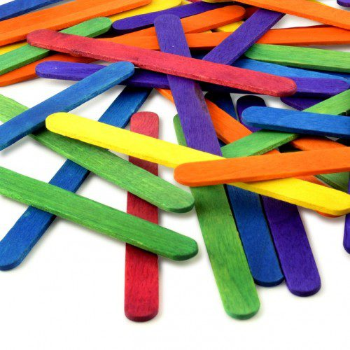
WORKSHOP 1
Play The Game & Deduce A Winning Strategy
Notes:
See if you can deduce a winning strategy

Slide 15
WINNING NIM The Secret Mathematical Strategy
Notes:
See if you can deduce a winning strategy

Slide 16
Introduction To Binary...
10
= 8 + 2
= ( 1 × 2³ ) + ( 1 × 2¹ )
 | 2⁴ = 16 | 2³ = 8 | 2² = 4 | 2¹ = 2 | 2⁰ = 1
10 | 0 | 1 | 0 | 0 | 1
10 = 01001 IN BINARY
Notes:
Numeral system values: 0,1,2,3,4,5,6,7,8 and 9
Binary numeral system values : 0 and 1
Specify row of zeros

Slide 17
Introduction To Binary...
17
= 16 + 1
= ( 1 × 2⁴ ) + ( 1 × 2⁰ )
 | 2⁴ = 16 | 2³ = 8 | 2² = 4 | 2¹ = 2 | 2⁰ = 1
17 | 1 | 0 | 0 | 0 | 1
17 = 10001 IN BINARY
Notes:
Numeral system values: 0,1,2,3,4,5,6,7,8 and 9
Binary numeral system values : 0 and 1
Specify row of zeros

Slide 18
Binary In The Game of Nim
Row size | 2² = 4 | 2¹ = 2 | 2⁰ = 1
1 | 0 | 0 | 1
3 | 0 | 1 | 1
5 | 1 | 0 | 1
7 | 1 | 1 | 1
Convert row sizes into binary numbers
Add binary numbers using the NIM ADDITION
Notes:
We are now going to look at our initial set up. Like before we are going to split the rows into powers of two and set them up into a table. This allows us to convert each number into binary. So 1 in binary is 100, 3 in binary is 110, 5 in binary is 101 and 7 in binary is 111.

Slide 19
Nim Addition
Row size | 2² = 4 | 2¹ = 2 | 2⁰ = 1
1 | 0 | 0 | 1
3 | 0 | 1 | 1
5 | 1 | 0 | 1
7 | 1 | 1 | 1
0 0 1
0 1 1
1 0 1
1 1 1
Even Number of 1’s Nim Sum = 0
Odd Number of 1’s Nim Sum ≠ 0
We Want all Nim Sums = 0
0
0
0
Notes:
So in our initial set up, before anyone takes a turn, we start with a nim sum of zero. Some of you may have looked at this during the workshop, however in pairs discuss who will win using this tactic, player A or B. Do you think that means player B always wins? Does the initial set up make a difference?
NIM ADDITION
Write binary numbers underneath each other
Look at columns independently

Slide 20
The Game Of Nim Using The Nim Sum
 | 2² = 4 | 2¹ = 2 | 2⁰ = 1
1 | 0 | 0 | 1
3 | 0 | 1 | 1
5 | 1 | 0 | 1
7 | 1 | 1 | 1
Binary | 0 | 0 | 0
Nim Sum = 0
Ash | 2² = 4 | 2¹ = 2 | 2⁰ = 1
1 | 0 | 0 | 1
3 | 0 | 1 | 1
2 | 0 | 1 | 0
7 | 1 | 1 | 1
Binary | 1 | 1 | 1
Nim Sum ≠ 0
Notes:
1: Player A removes 3 sticks of row 3
2: Player B removes all the last row
3: Player A removes 2 sticks of row 2
4: Player B removes two sticks of row 3
5: Player A removes either stick
6: Player B removes last stick

Slide 21
The Game Of Nim Using The Nim Sum
Haranja | 2¹ = 2 | 2⁰ = 1
1 | 0 | 1
3 | 1 | 1
2 | 1 | 0
Binary | 0 | 0
Nim Sum = 0
HARANJA WINS
Ash | 2¹ = 2 | 2⁰ = 1
1 | 0 | 1
1 | 0 | 1
2 | 1 | 0
Binary | 1 | 0
Nim Sum ≠ 0
Haranja | 2⁰ = 1
1 | 1
1 | 1
Binary | 0
Nim Sum = 0
Notes:
1: Player A removes 3 sticks of row 3
2: Player B removes all the last row
3: Player A removes 2 sticks of row 2
4: Player B removes two sticks of row 3
5: Player A removes either stick
6: Player B removes last stick

Slide 22
Ash
Haranja
Ash
Haranja
Notes:
Who Wins? Can you calculate the nim sum?
Split the hall in half, one half discuss the first scenario, other half discuss the other. Ask for volunteers to explain who wins and why.

Slide 23
Ash
Haranja
Ash
Haranja
A starts
H Wins
A starts
A Wins
 | 2¹= 2 | 2⁰ = 1
1 | 0 | 1
2 | 1 | 0
3 | 1 | 1
Binary | 0 | 0
 | 2¹= 2 | 2⁰ = 1
1 | 0 | 1
3 | 1 | 1
3 | 1 | 1
Binary | 0 | 1
Nim Sum = 0
Nim Sum ≠ 0
Notes:
Split the hall in half, one half discuss the first scenario, other half discuss the other. Ask for volunteers to explain who wins and why.

Slide 24
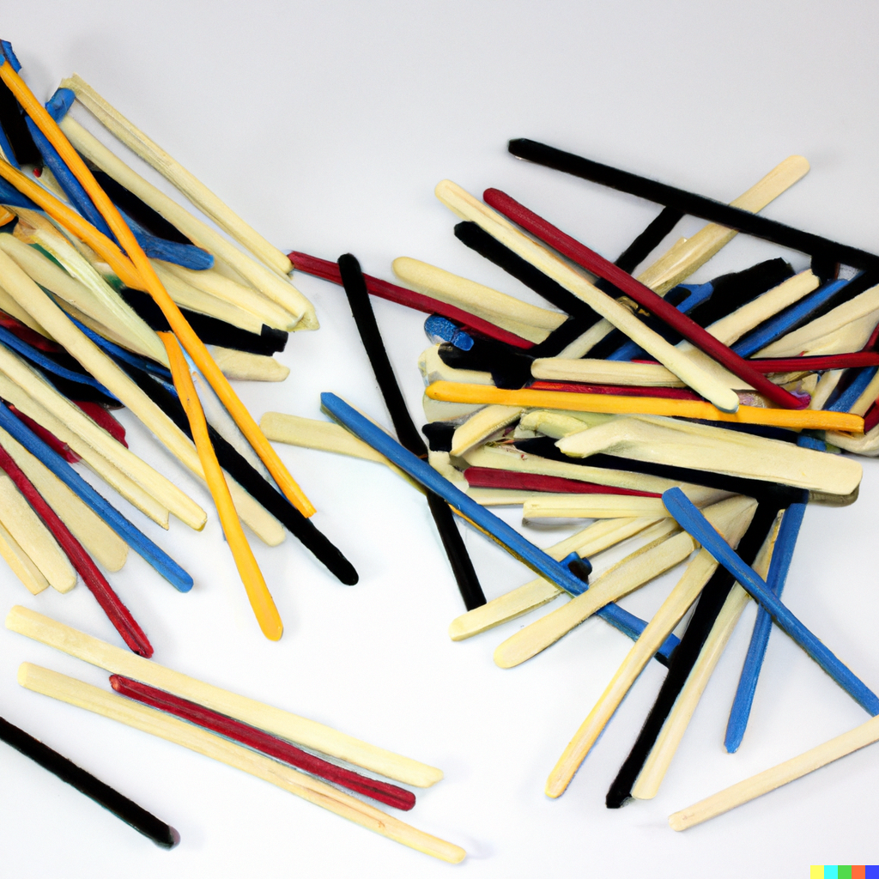
WORKSHOP 2
Using the Binary Nim Sum
Notes:
See if you can deduce a winning strategy

Slide 25
NIM ADDITION RULES THE WORLD
Notes:
Conclusion by Lucia
If extra time: ask and interact with the kids (possibility to play game at home against friends and family and be the champions?)

Slide 26
Student Feedback

