Slide 1
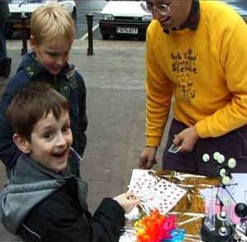




Mathematical Approaches To Toys
Chris Budd

Slide 2
What is a toy, and what has that got to do with maths?
Some dictionary definitions
An object for a child to play with
An object regarded as providing amusement for an adult
An object, often a small representation of something familiar
A thing or matter of little or no value or importance; a trifle.
Something that serves for or as if for diversion, rather than for serious practical use.

Slide 3
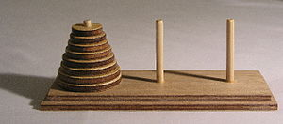
Mathematics and toys
A lot of mathematics can be learned through play! Toys are an excellent way of teaching, learning and discovering, mathematics

Slide 4
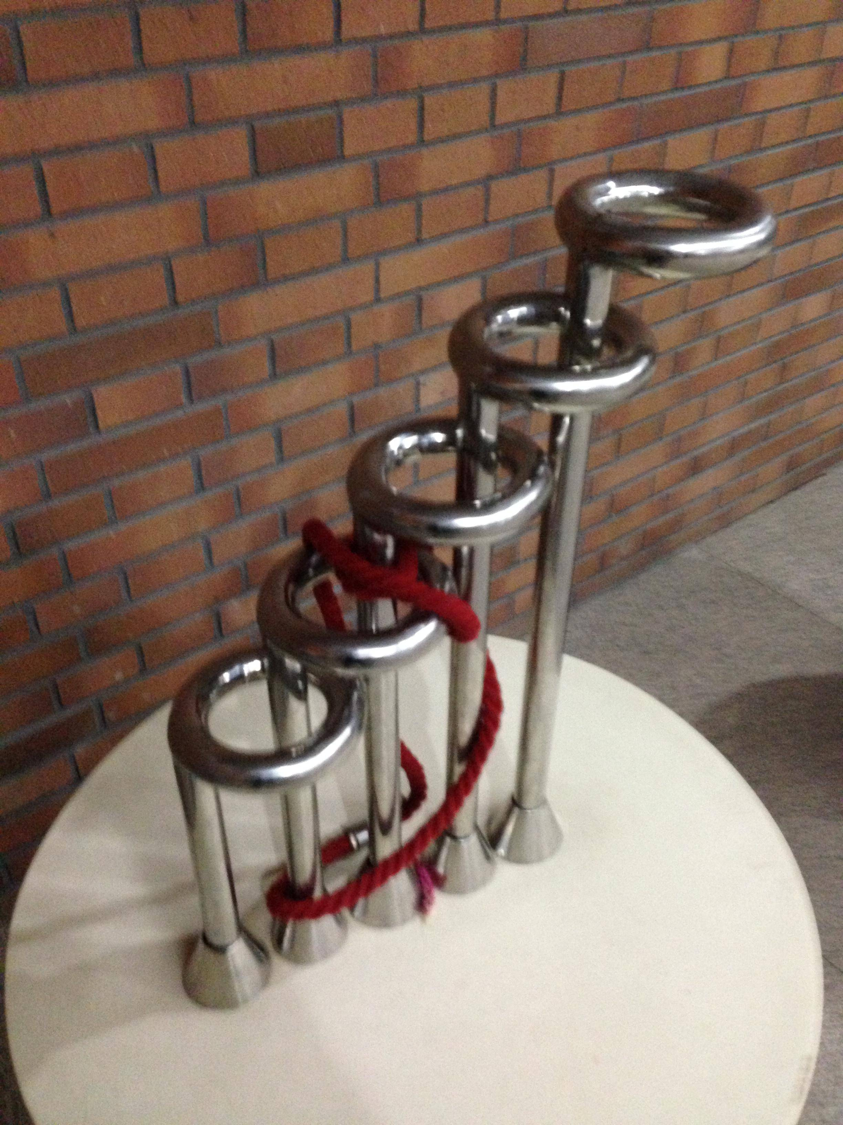
2. Many toys involve solving puzzles
This often involves maths!
Topology
Logic

Slide 5
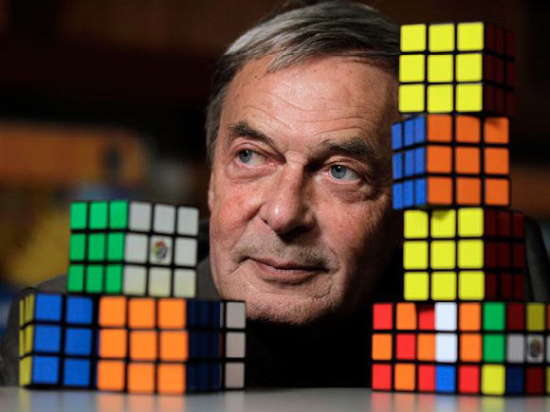
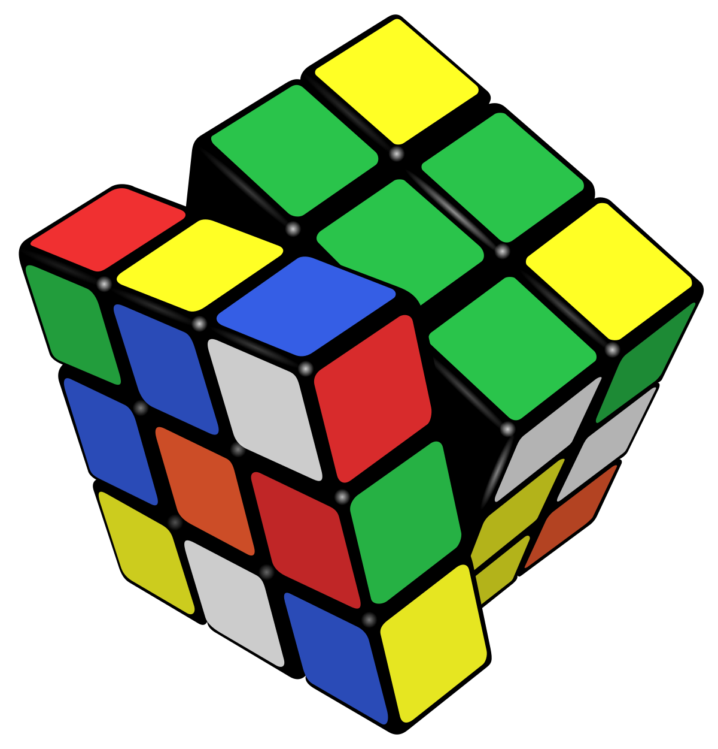
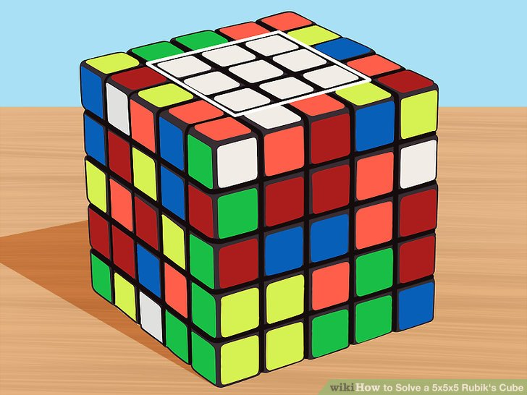
Rubik’s cube
group theory (alternating groups). God’s number!

Slide 6
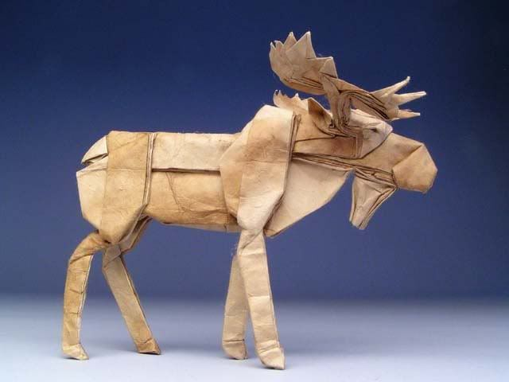
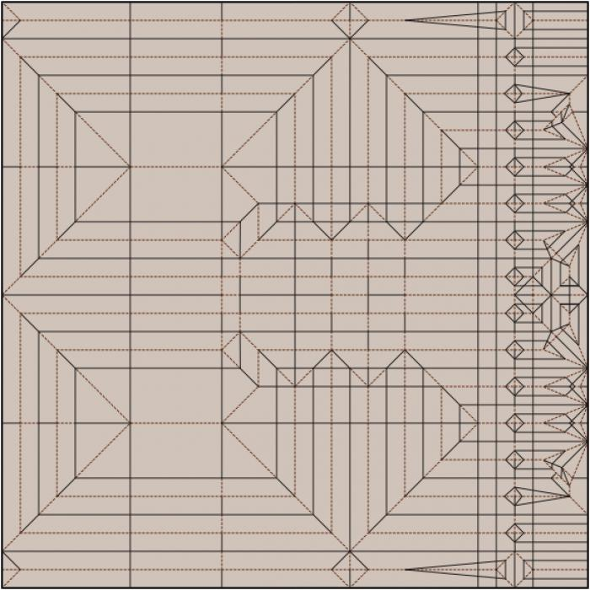
3. Mathematics and toys can be almost indistinguishable
Origami is now done by mathematicians eg. Robert Lang

Slide 7
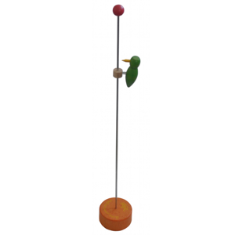
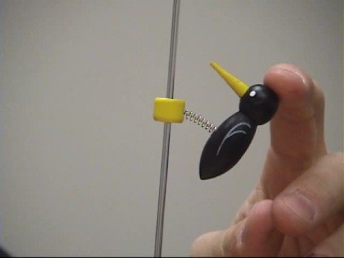
4. Maths is important in the design and study of toys
https://www.youtube.com/watch?v=s3YSnNAIHDg

Slide 8
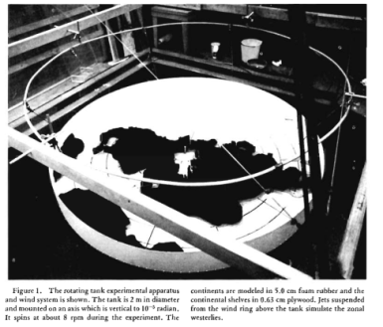
5. Toys can be very important in applications of maths
Toy: An object, often a small representation of something familiar
We use ‘toy models’ to help us to understand much more complex systems
Eg. Climate models,
models of the solar system,
models of human behaviour

Slide 9
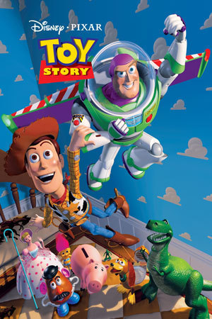
The rest of the talk ….
Toys in teaching maths
Art, maths and toys
Big toys
Chaotic toys
Toy models
Made using maths!!!
Show how toys can awaken our mathematical curiosity

Slide 10
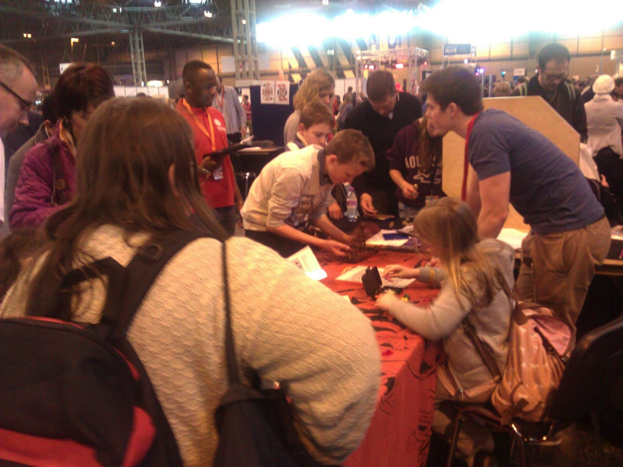
Toys in teaching maths
Big Bang
Fair
NEC
Capture, Captivate, build wonder in, and hold an audience
Explore ideas in a hands on way. Develop a sense of enquiry
Teach them maths at the same time

Slide 11
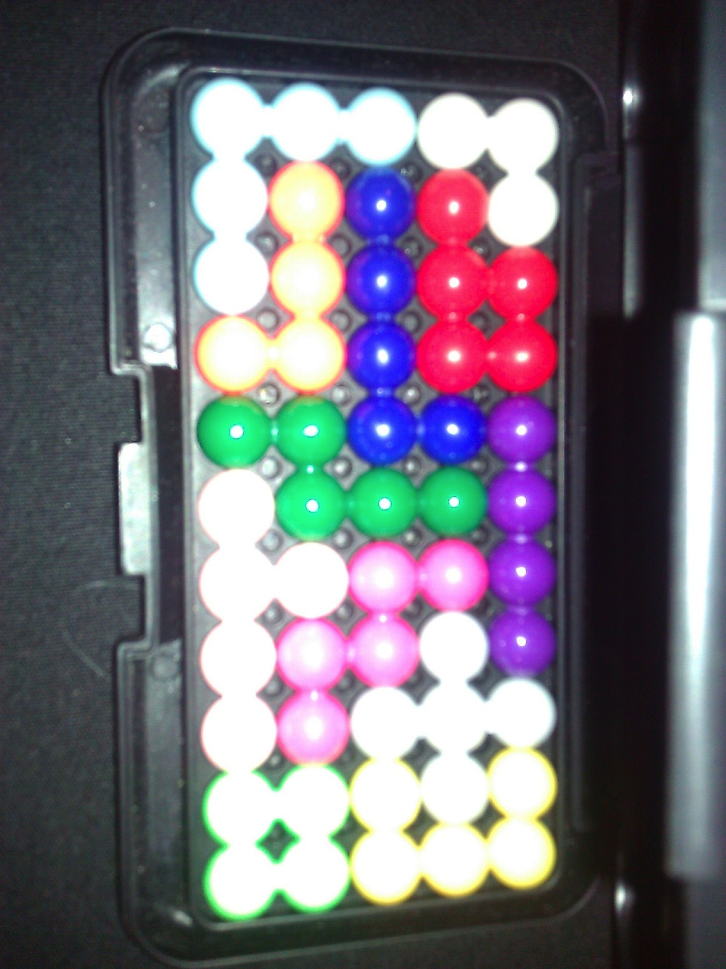
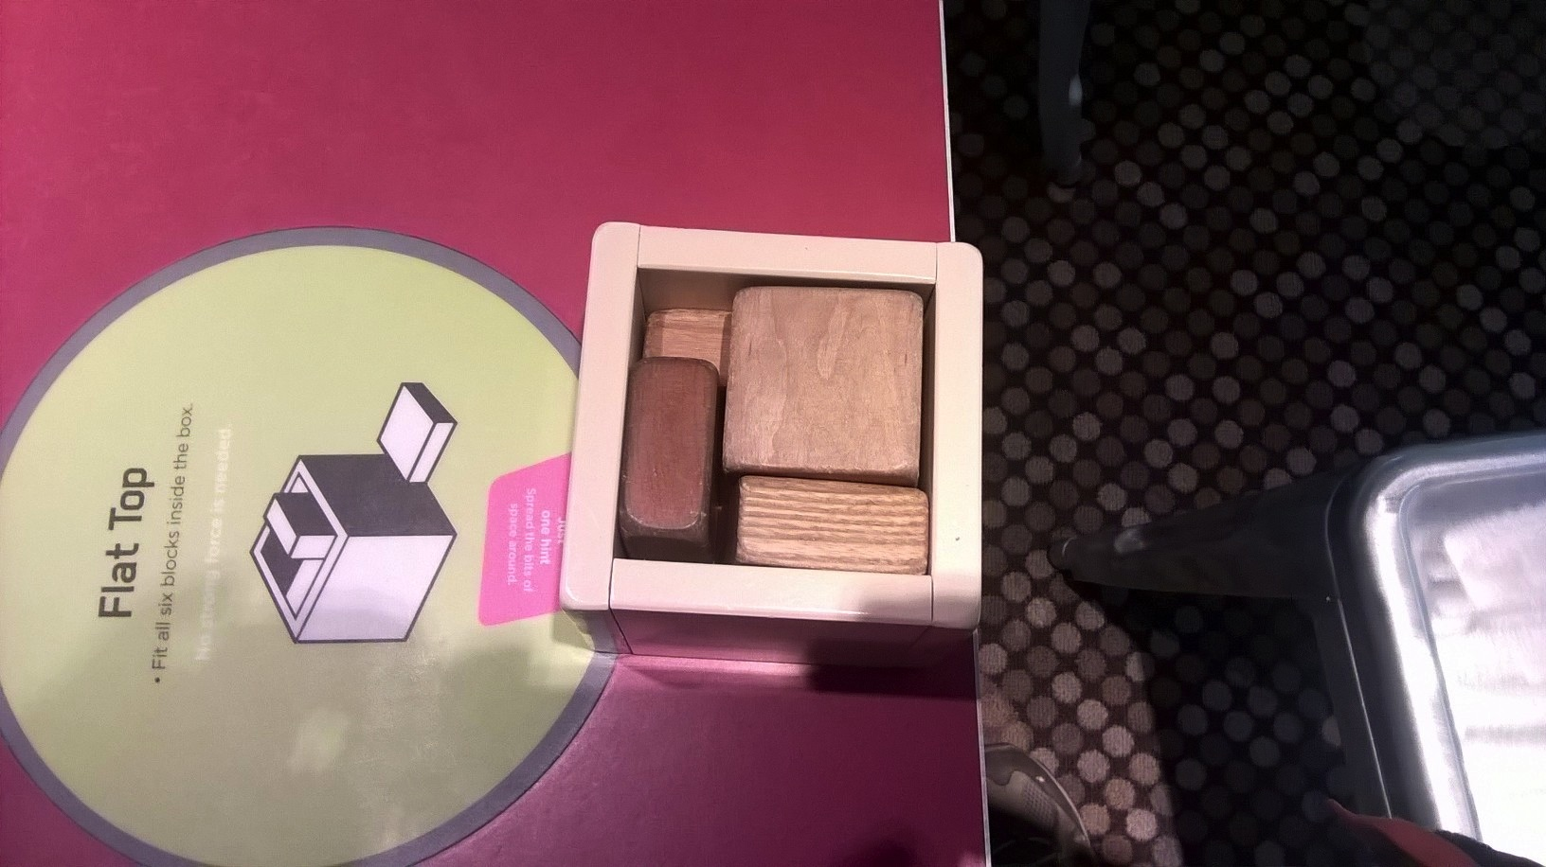
Examples
1. Packing problems (2D and 3D)
Knapsack problem, Optimisation, NP Hard, Sat-Nav

Slide 12
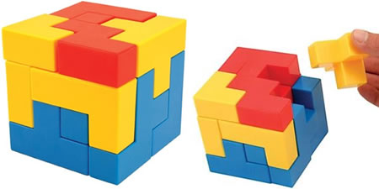
How to solve the 'Bedlam Cube' by Jasmine Age 8
https://www.youtube.com/watch?v=jhVgG_0-ln0

Slide 13
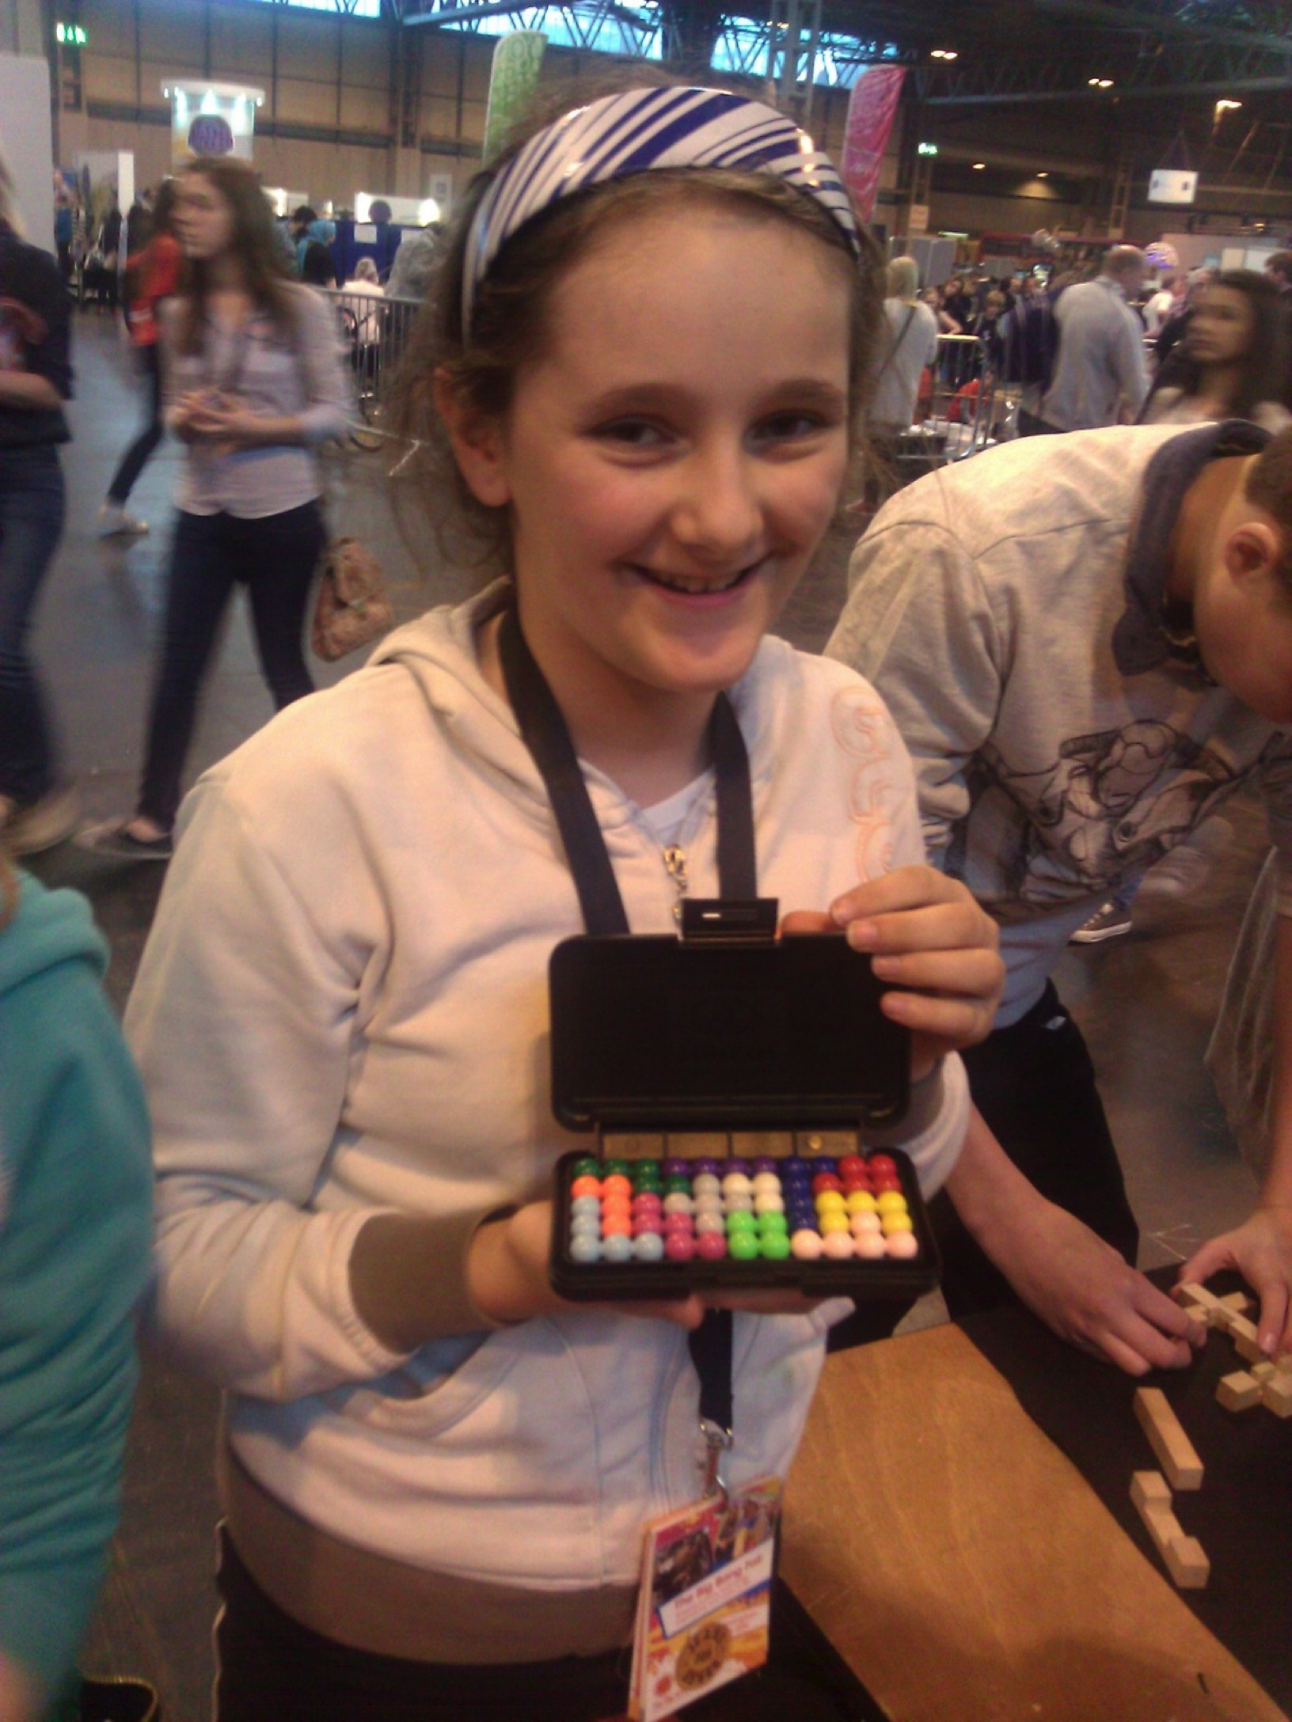
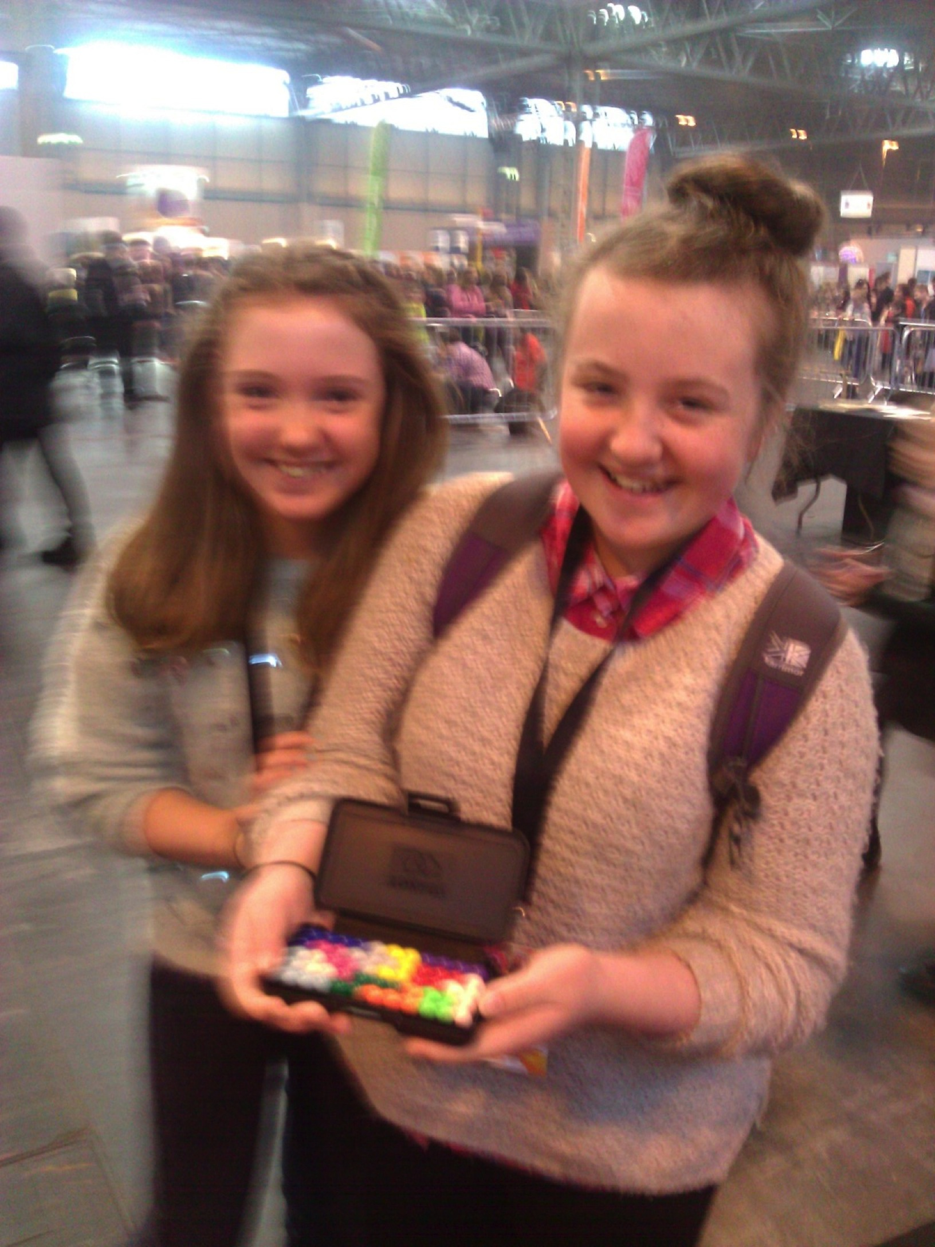
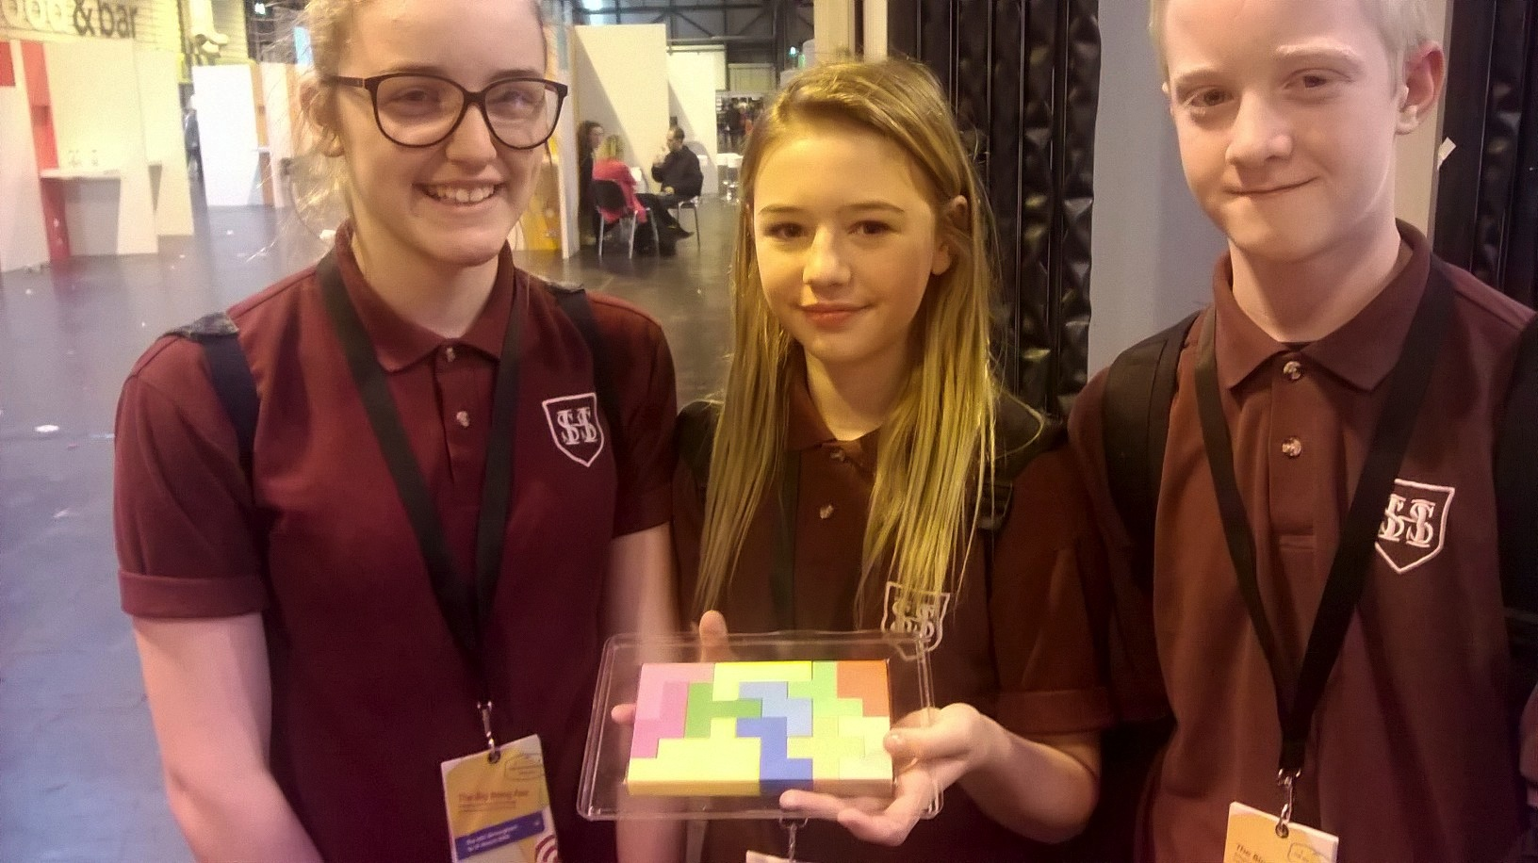
Huge sense of achievement on solving!!
Often spend an hour at the stall
Future mathematicians?

Slide 14
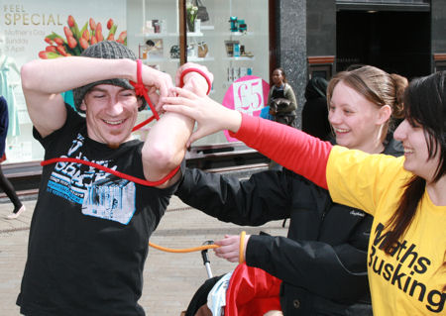
2. Topological toys
Zeeman’s ropes
Elementary topology, knot theory

Slide 15
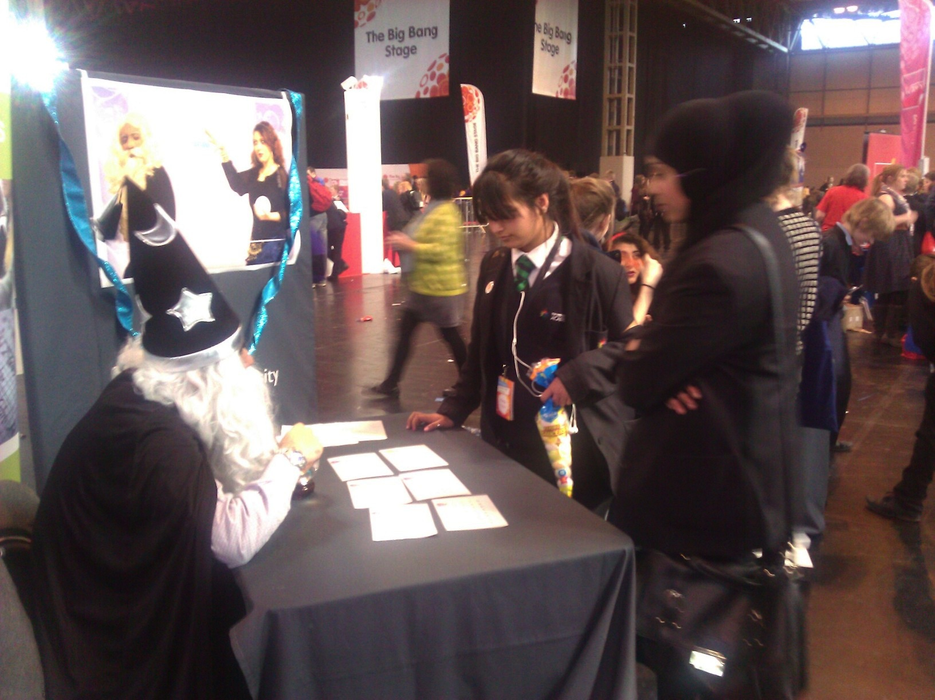
3. A touch of Magic
Number theory, fixed point theorems, probability, modular arithmetic

Slide 16
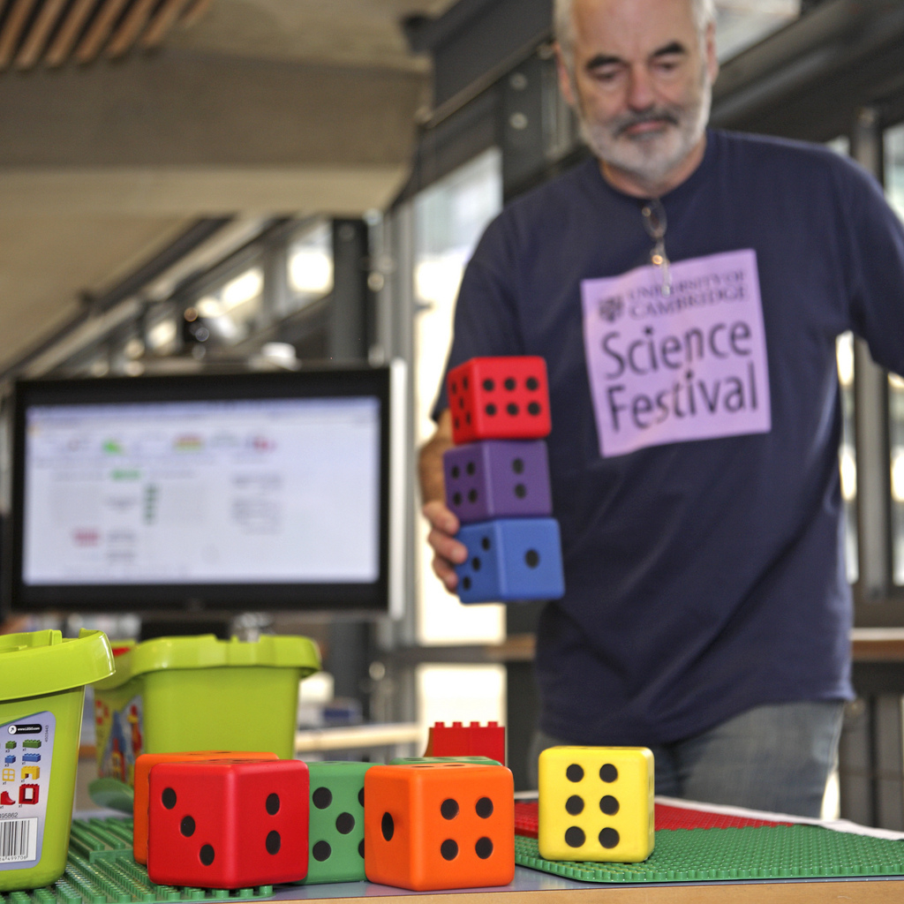
Cambridge Science Festival
Bath Taps Into Science

Slide 17
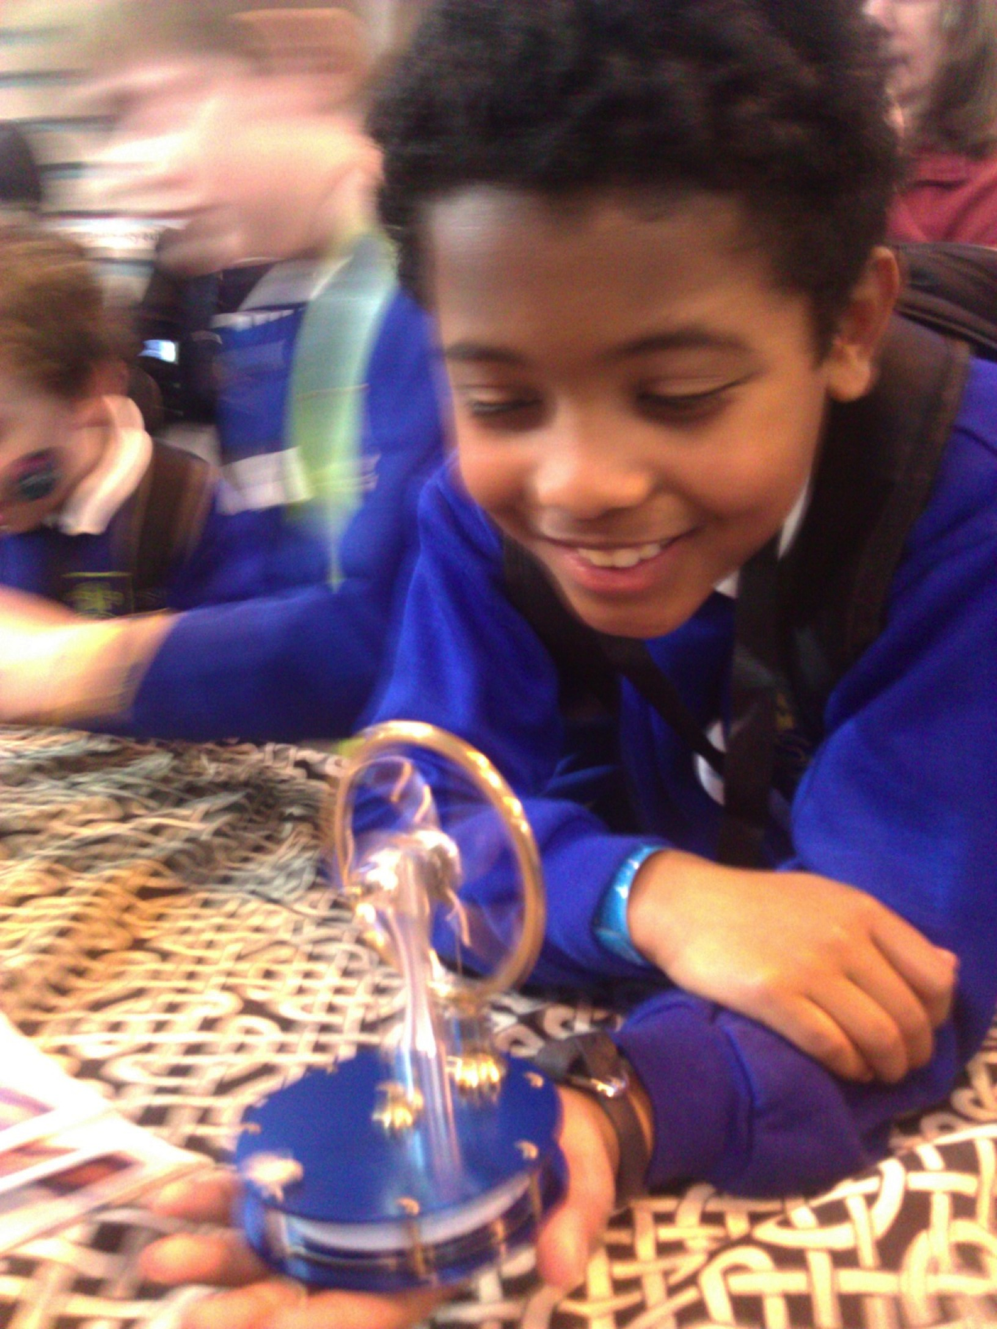
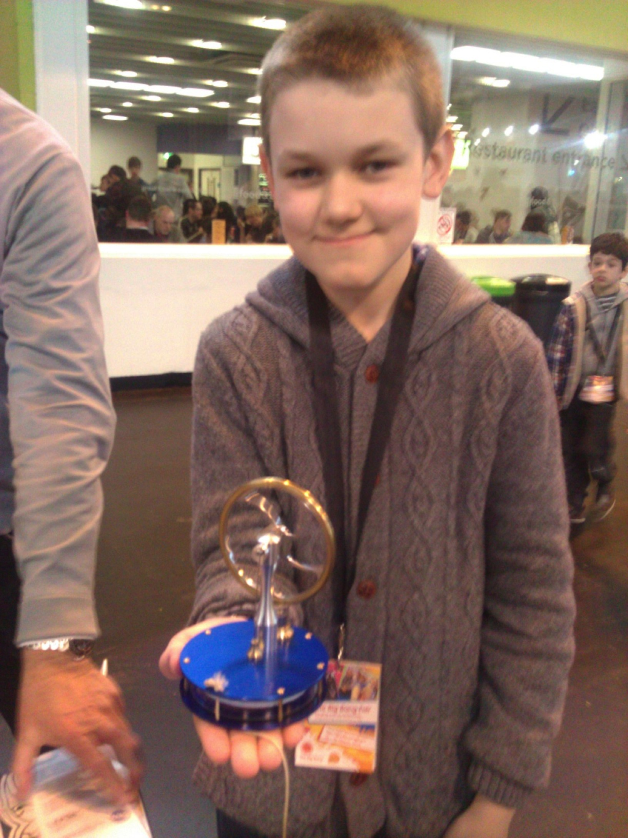
4. Mechanical toys
Stirling engine toys used to teach fluid mechanics and thermodynamics at the Big Bang Fair

Slide 18
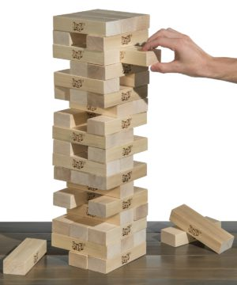
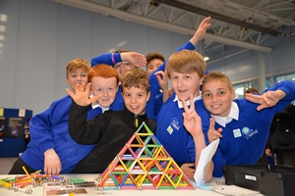
Also …
Bath taps construction
Jenga: Mechanics, moments, friction
Euler’s disc, Rattle back, gyroscopes, Newton’s cradle, ……

Slide 19
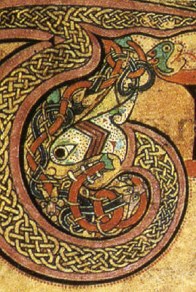

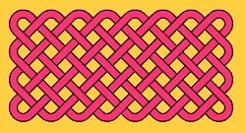
Art, maths and toys
Show that maths is a highly creative subject

Slide 20
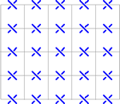
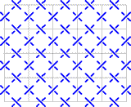
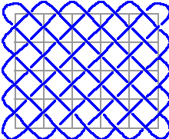
(5,6) Celtic Knot

Slide 21
(4,8) Celtic Knot
How many pieces of string are needed?

Slide 22
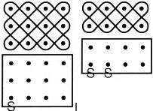
Simple Celtic Knots are very similar to plaited mat sona drawings
(2,4)
(3,4)
How many lines?
String and lines equal the Highest Common Factor of the two numbers
But why?

Slide 23
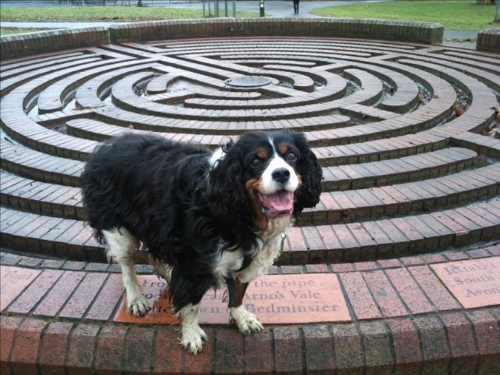
Big Toys Mazes and sundials

Slide 24
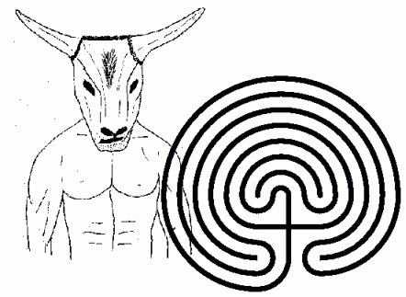

Cretan Labyrinth:
History of maths
Unicursal diagrams
Fractals
Hampton Court Maze:
Networks
Internet
Hamilton Circuits

Slide 25
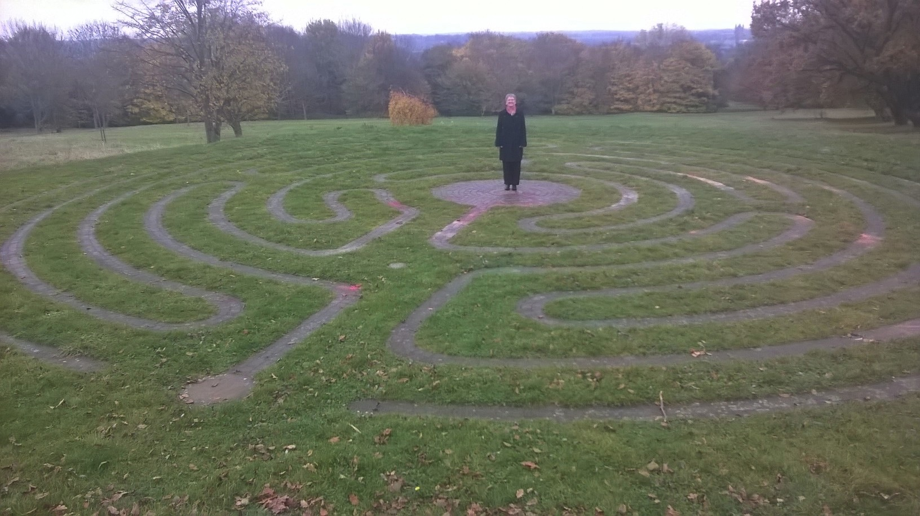
Large group projects: school/university Labyrinths

Slide 26
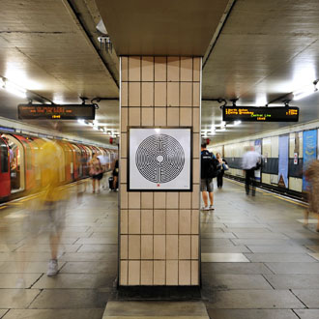
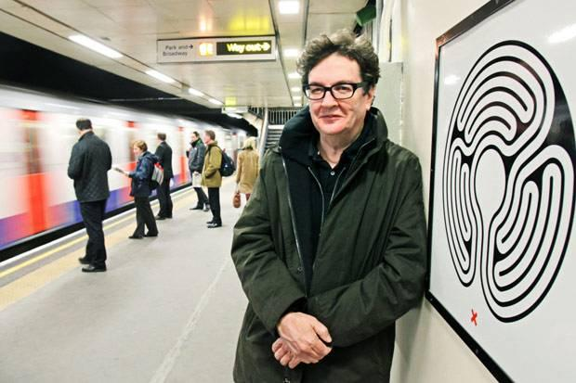
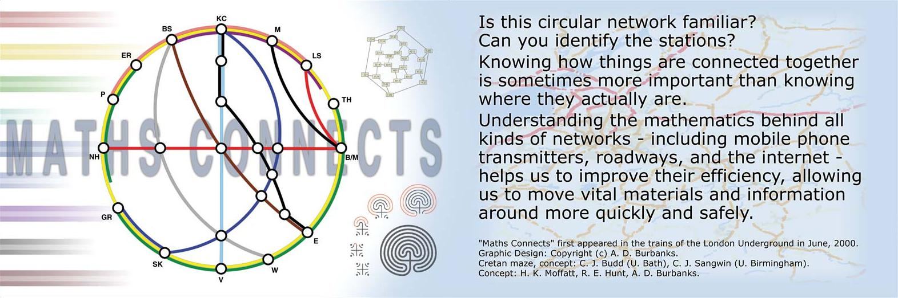
London Underground
Mark Wallinger Turner prize winning artist

Slide 27
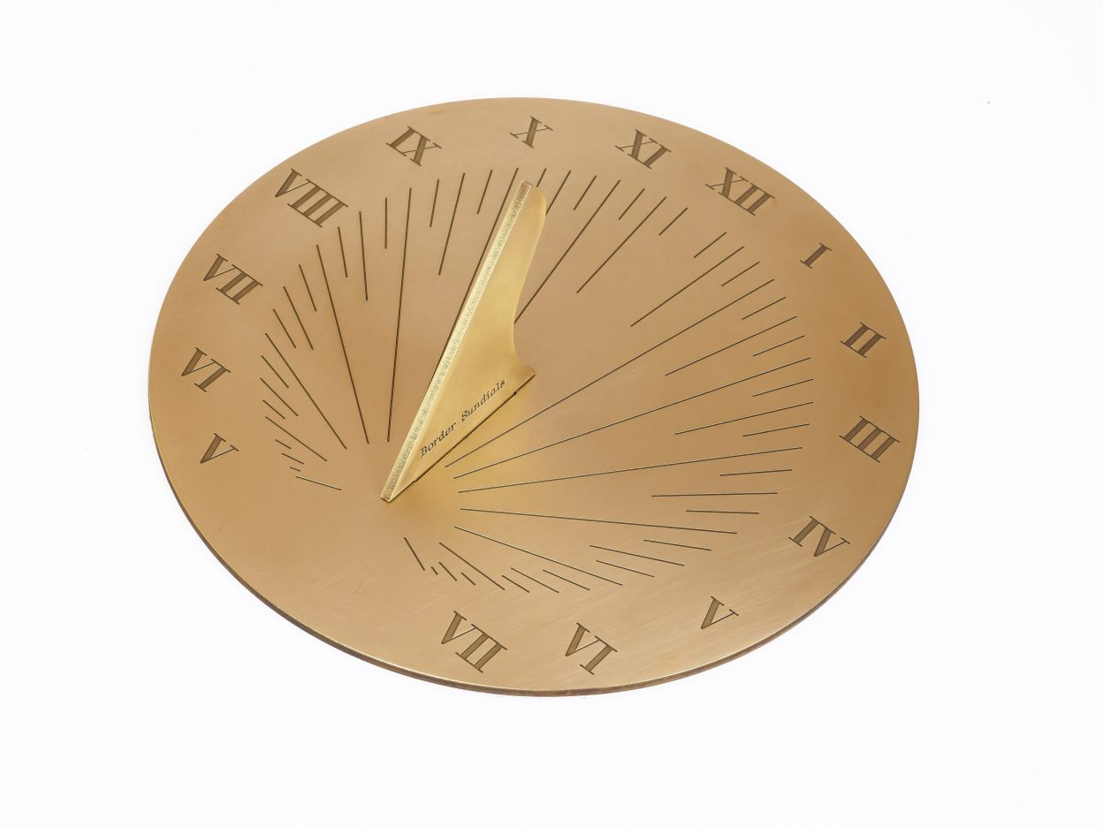

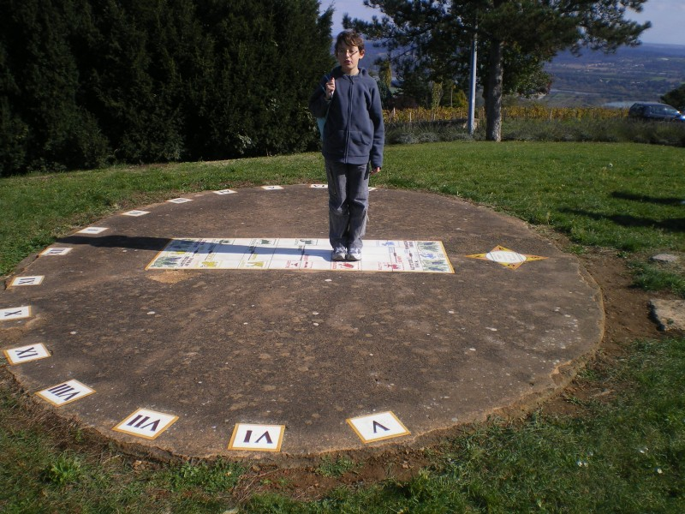
Sundials: Toys to tell the time
Traditional sundial
Corrected sundial
Analemmatic sundial
Heavy use of trigonometry and geometry. Great to build. Useful too!

Slide 28
Chaotic Toys

Slide 29
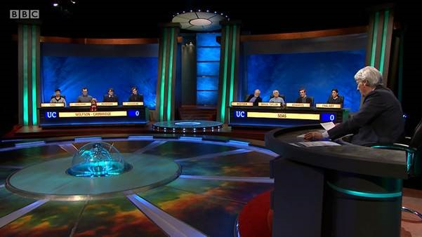
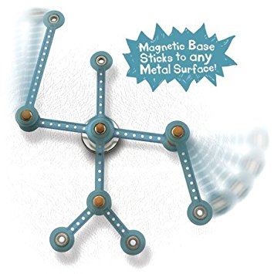
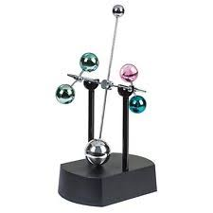
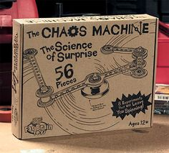
The discovery of chaos has led to a whole new industry in toy design

Slide 30

Chaos: Seemingly complex and unpredictable behaviour arising from predictable systems
VERY important in maths, physics and engineering:
Weather forecasting
Astronomy
Mechanics
Electronics
Optics
Also seems to resonate with the human psyche and gives us great toys

Slide 31
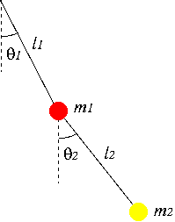
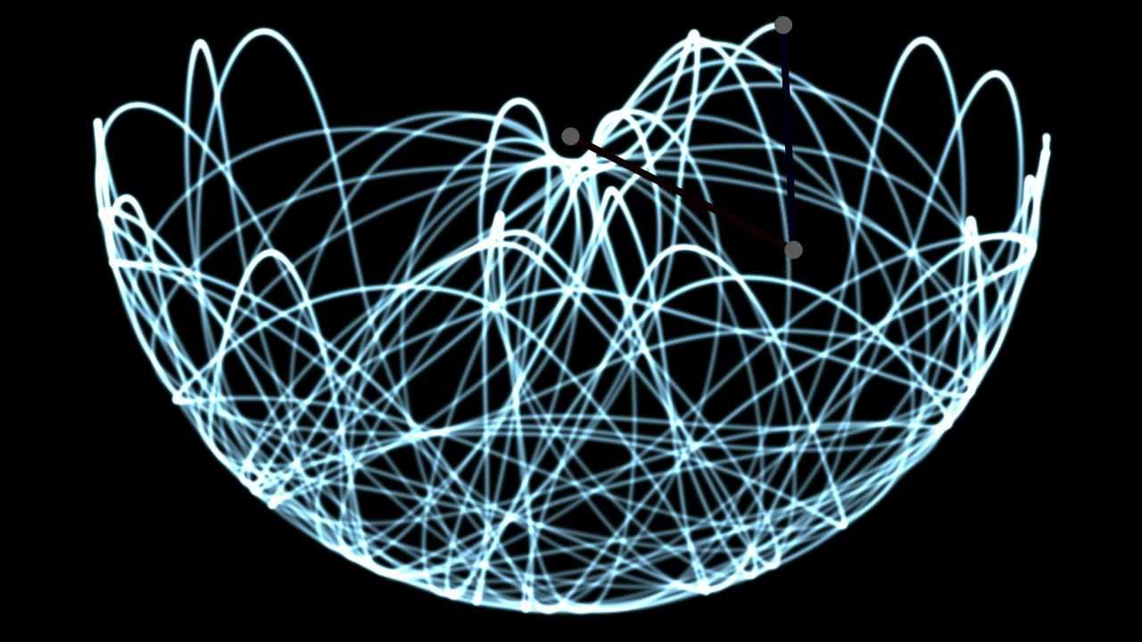
Do the math: Chaotic Double Pendulum
https://www.youtube.com/watch?v=U39RMUzCjiU

Slide 32
Equations of motion : )
https://www.myphysicslab.com/pendulum/double-pendulum-en.html

Slide 33
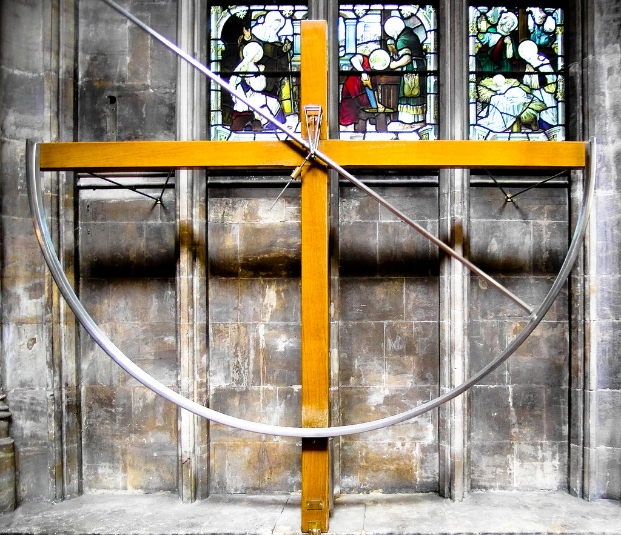
Chaotic water pendulum at St Mary Redcliffe Church, Bristol
Designed by Brian Pippard and Eric Albone
https://www.youtube.com/watch?v=hBLdBbmeWxE

Slide 34
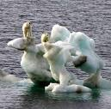
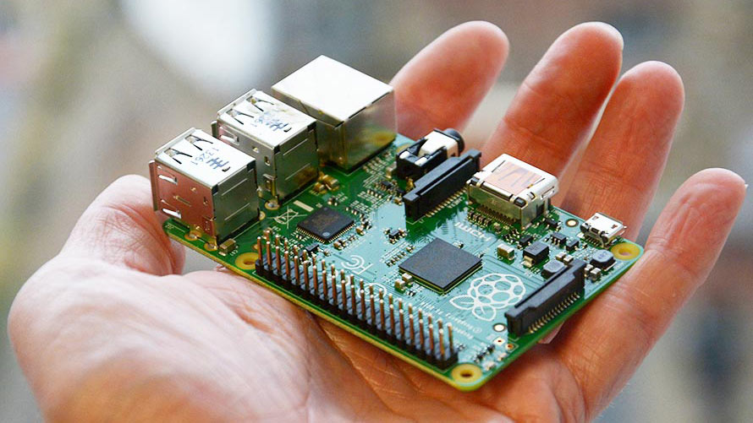
Mathematical Toys
An object, often a small representation of something familiar
The Climate-Pi Project (CliMathNet)
How can we understand, and teach, climate change?

Slide 35
Basic equations for weather were derived by Navier/Stokes and Kelvin
Motion
Density
Temperature
Moisture
Pressure
For climate add in ice, CO2, ocean currents, …
Tough to solve, understand and teach

Slide 36
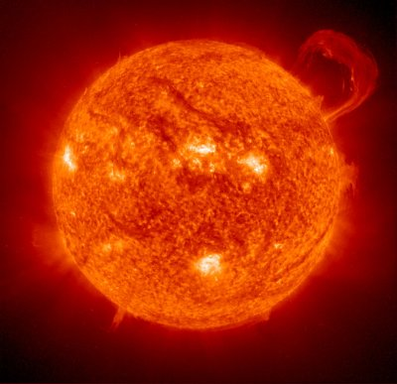

Toy model: Energy Balance
Heat into space
Heat from Sun: S
Earth’s mean temperature: T

Slide 37
Heat absorbed
a Albedo: How well the earth reflects the Sun’s rays
Heat radiated away
e emissivity: How much energy is radiated into space
Balance these to give a steady state

Slide 38

Toy model is simple enough to be implemented on any computer
Useful for predictions:
Can give the correct mean temperature for the Earth
AND for the moon
Easy for students to play with AND allows effects of climate change to be assessed

Slide 39

In Conclusion
Toys are wonderful for awakening our sense of mathematical curiosity, and for learning and doing maths
At all levels
And for all ages
Have fun!!!

