Slide 1
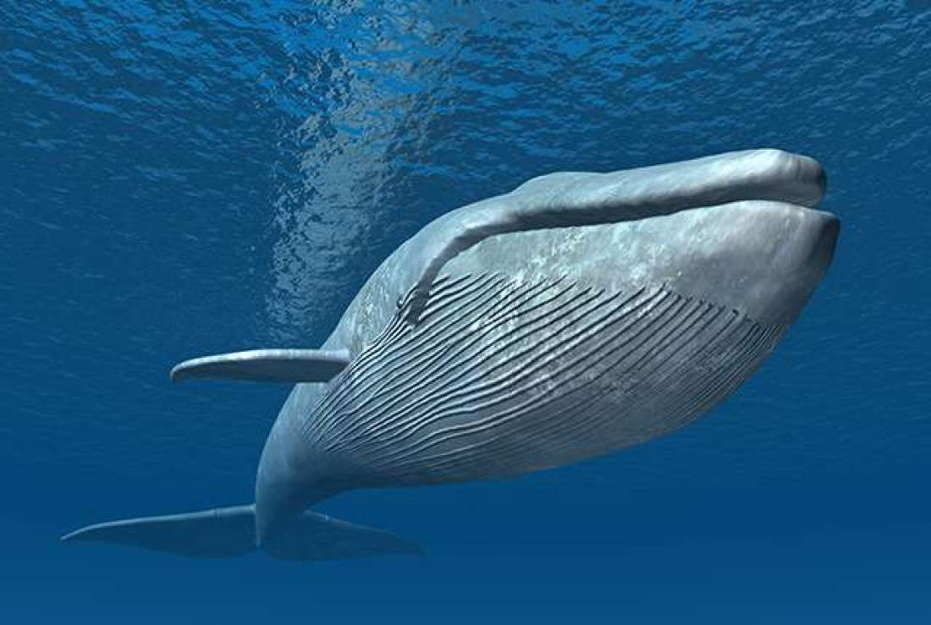
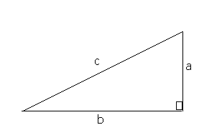


Maths Saves the Whales
Chris Budd OBE

Slide 2
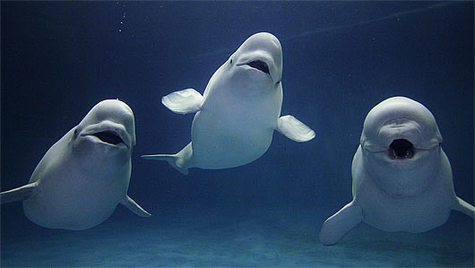
Who likes whales?

Slide 3
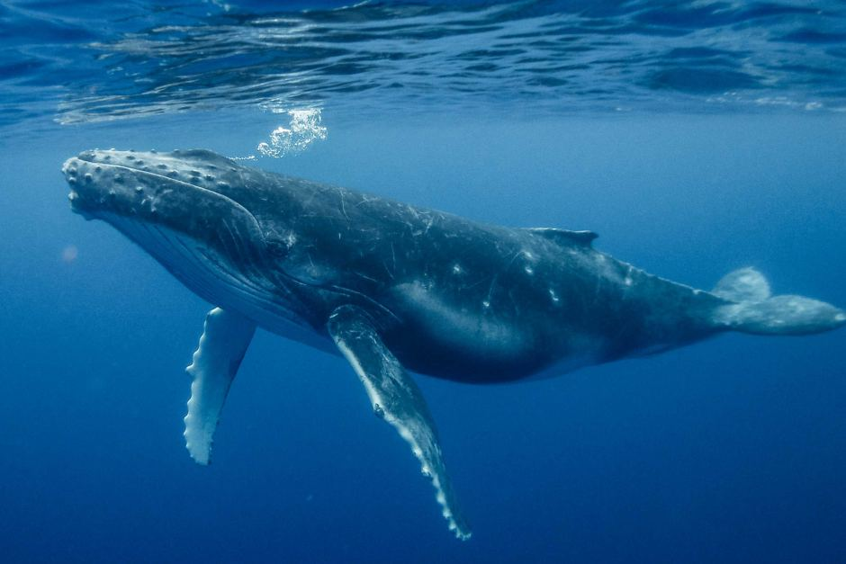

Slide 4
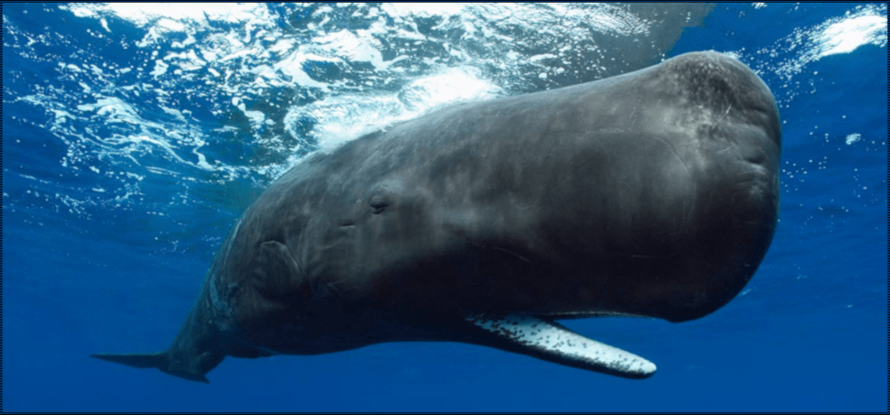

Slide 5
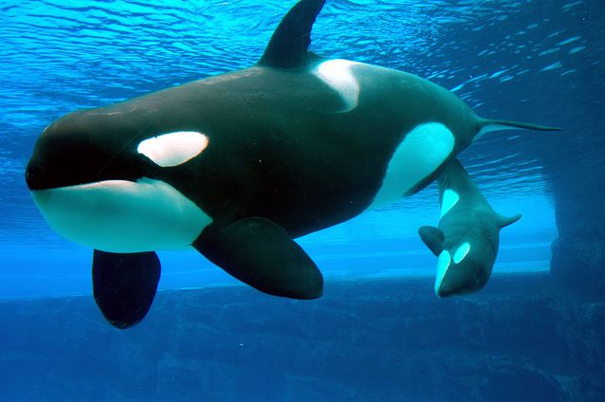

Slide 6
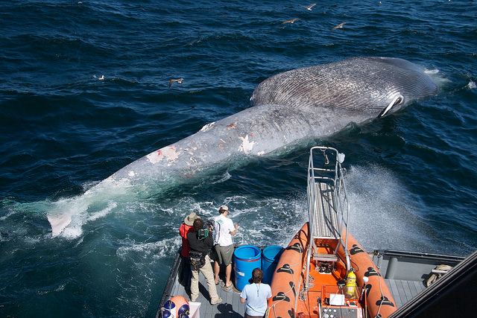
Whales are under
threat!

Slide 7
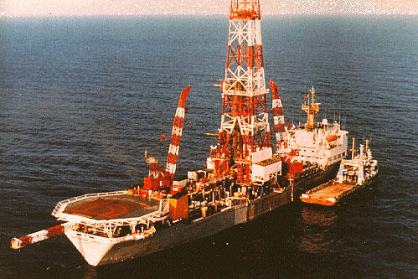
Threats to whales
Whaling
Fishing
Sonar
Climate change
Ships
Oil and gas prospecting
Toxins

Slide 8

Maths
S

Slide 9

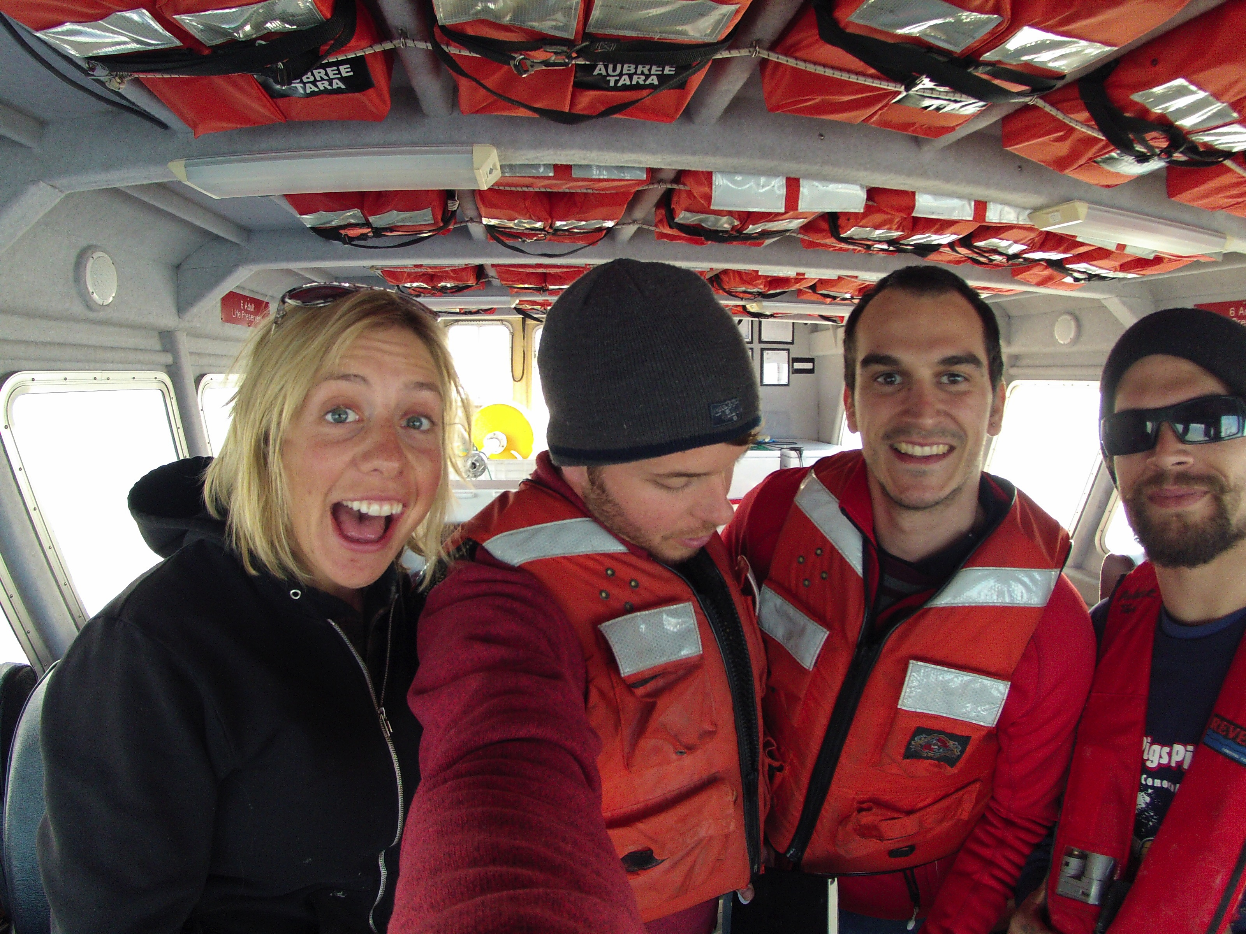
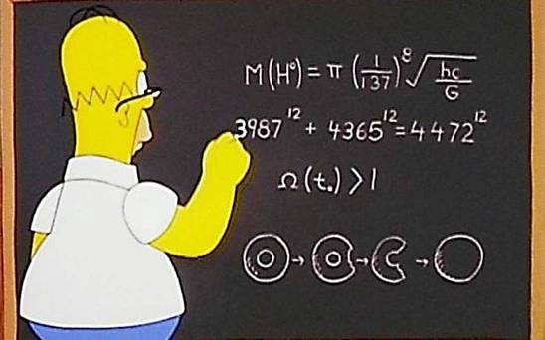
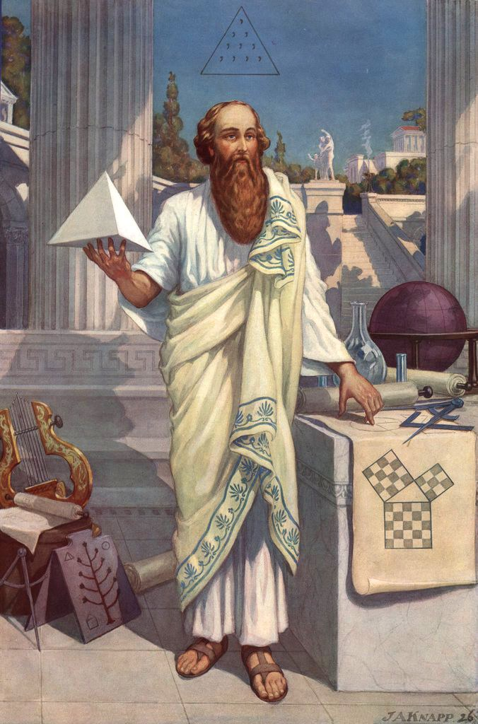
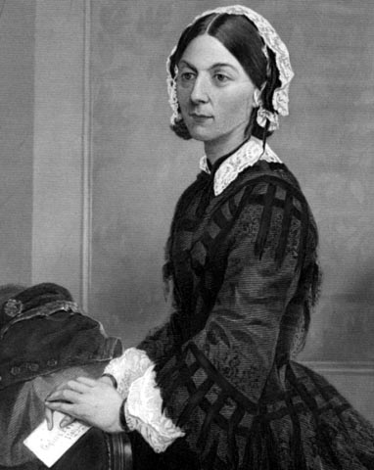
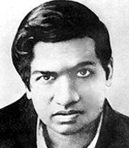
Spot the mathematician

Slide 10
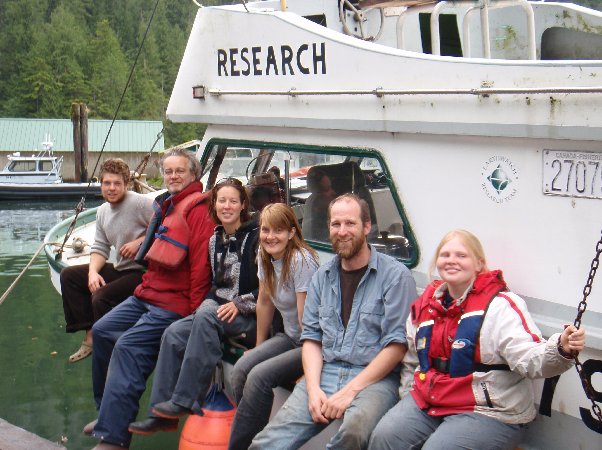
Mathematical
whale
savers

Slide 11
Another whale saver
Pythagoras!

Slide 12
Pythagoras’ Theorem

Slide 13
A right-angled triangle opined
My hypotenuse squared is refined
For if any one cares
It’s the sum of the squares
Of my other two sides when combined!

Slide 14
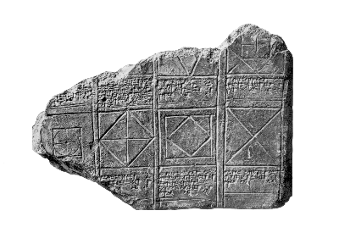
It was known to the Babylonians and Chinese many years before Pythagoras

Slide 15
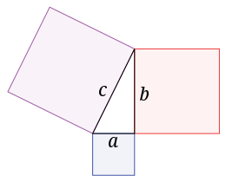
It is a theorem so it is always true
For every right angled triangle

Slide 16
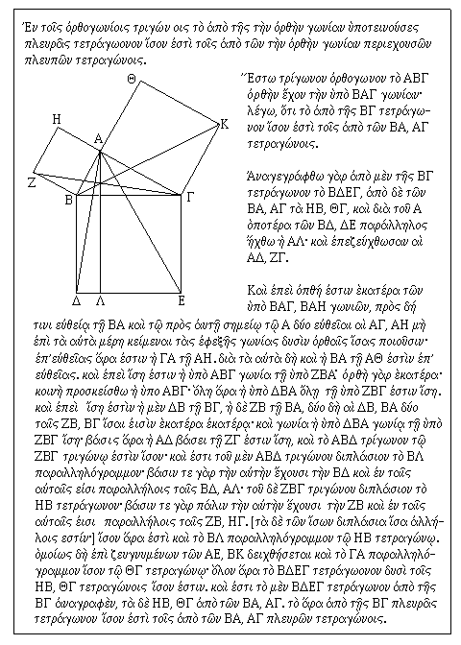
Euclid’s original proof

Slide 17
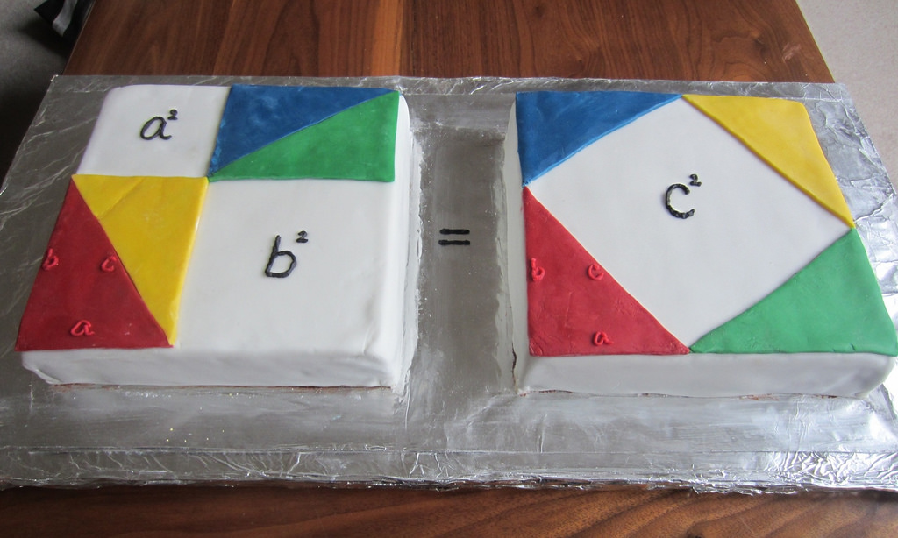
Proof of Pythagoras’ Theorem by Cake
Baked by Emiko Dupont

Slide 18
b
c
a

Slide 19
Proof of Pythagoras’ Theorem by Algebra
Need the following results to start
1.
2. Area of a right angled triangle
c
Area = ab/2
b
a

Slide 20
a
b
b
c
a
c
c
a
c
b
b
a
Area of big square =
Area of big square =

Slide 21
Hence:
Therefore:

Slide 22


Slide 23
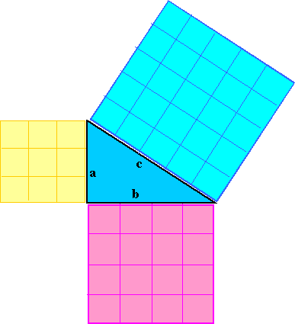
Pythagorean Triple
(5,12,13)
(7,24,25),
……

Slide 24
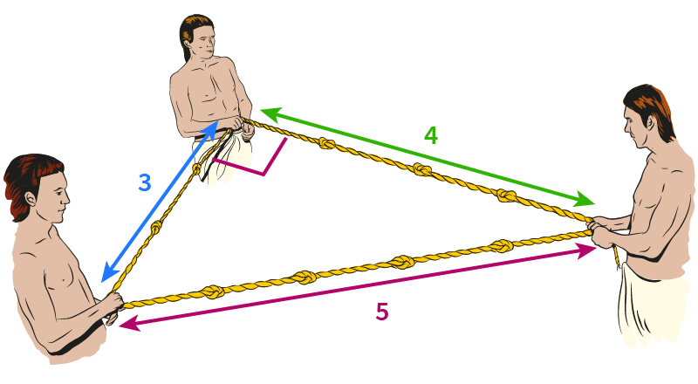
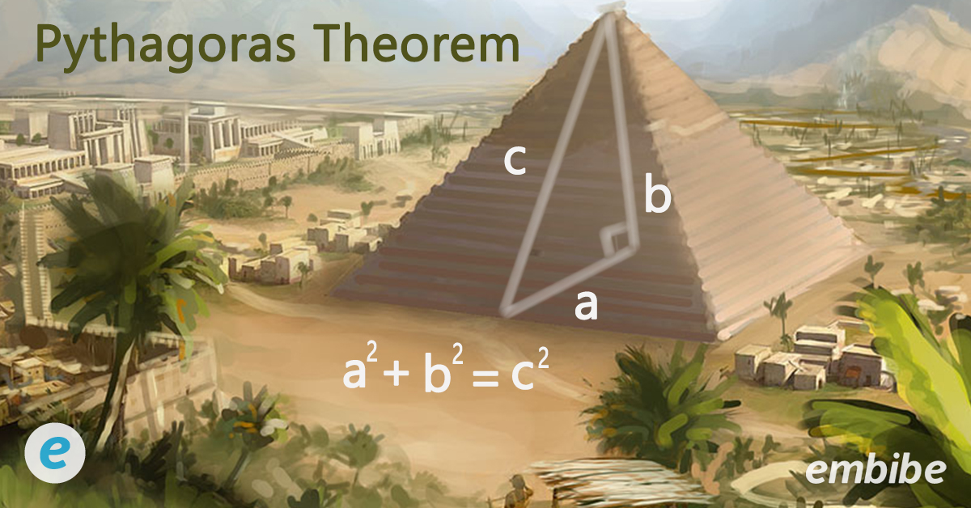
Building Pyramids

Slide 25
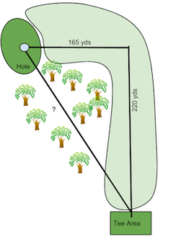
Pythagoras’ Theorem saves the whales
165
165
220
275
By finding distances

Slide 26
Go hear maths poetry

Slide 27
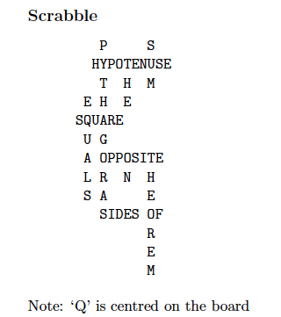

Slide 28
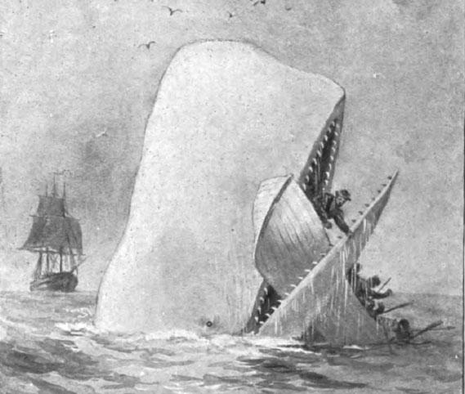
Saving the Whales
Whales can come close to ships
Moby Dick

Slide 29
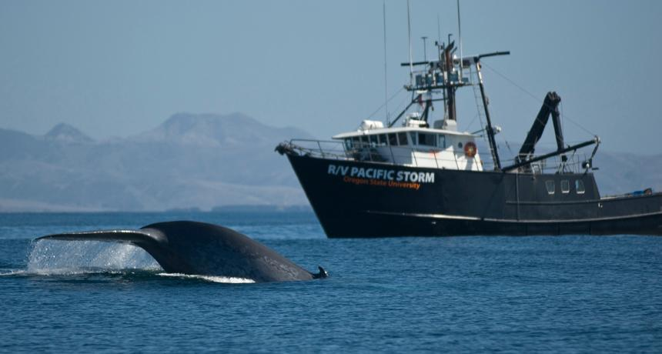
Modern day encounters with ships are best avoided

Slide 30
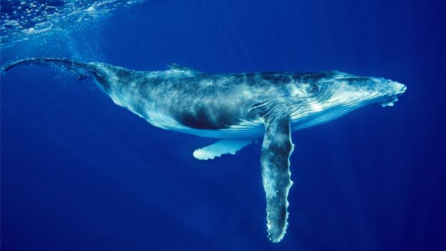
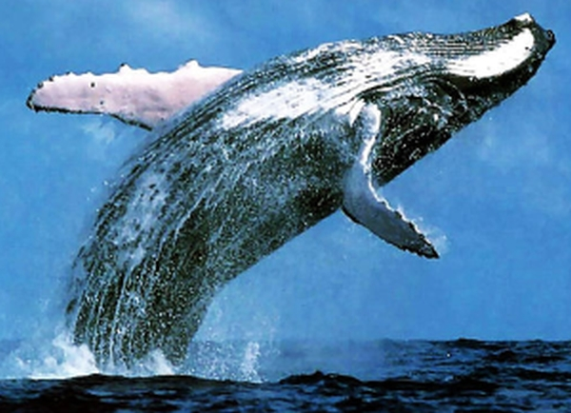
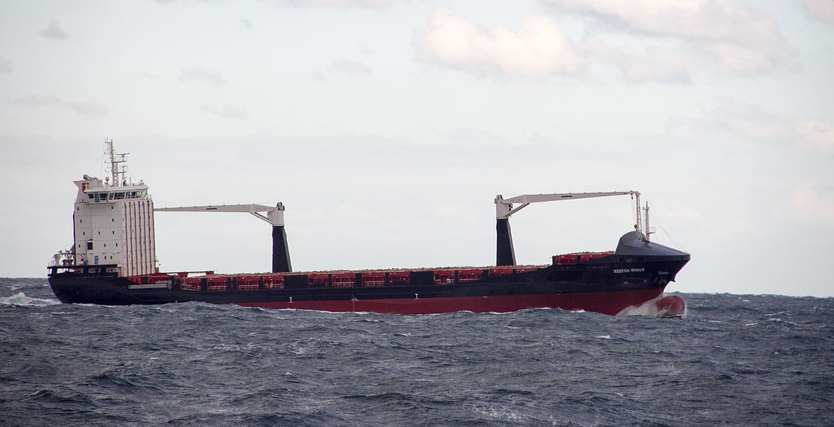
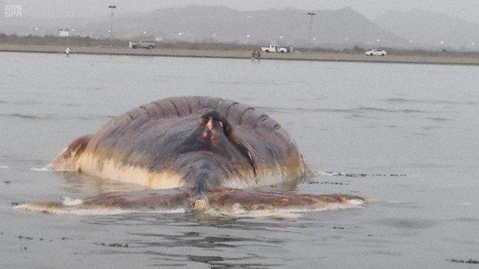
Safe Zone
Danger Zone
400m
Safe Zone
Safe Zone
Safe Zone

Slide 31

Want to detect the whales
Methods
Radar .. Doesn’t work underwater
Person with binoculars
Bumping into them
GPS for tagged whales
Satellites for whales on
the surface

Slide 32
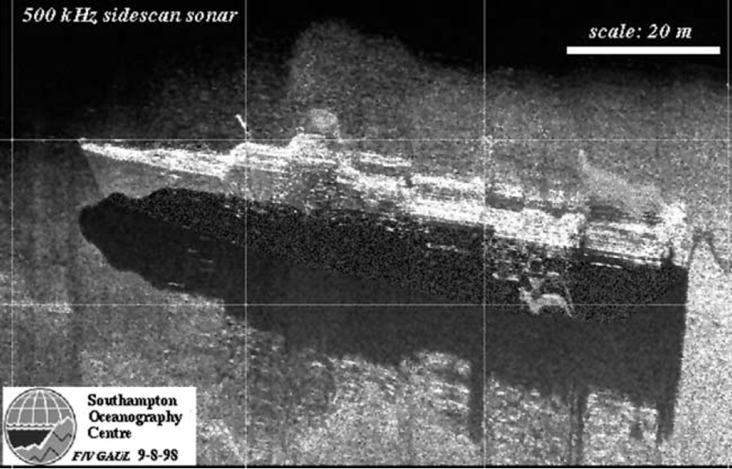
Active sonar. Good for finding fish and boats

Slide 33
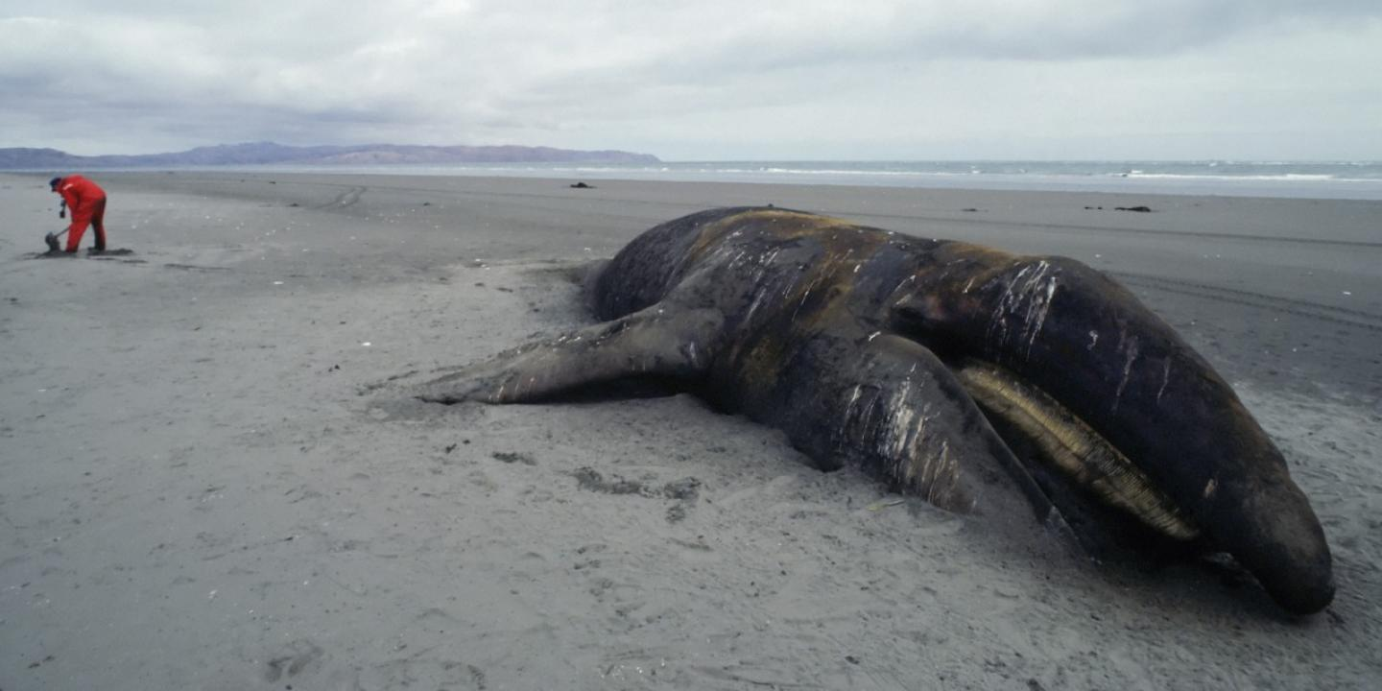
But not so good for whales

Slide 34

Answer: Listen to the whales singing
https://www.youtube.com/watch?v=WabT1L-nN-E

Slide 35

Can hear a whale but where is it?
?
?
?

Slide 36
L
Sea
Sounds from the whale travel a distance L
Sea Bed

Slide 37
How long does the sound take to arrive?
C = Speed of sound in salt water
C = 1500 metres per second
Problem! When did the whale make the sounds?

Slide 38
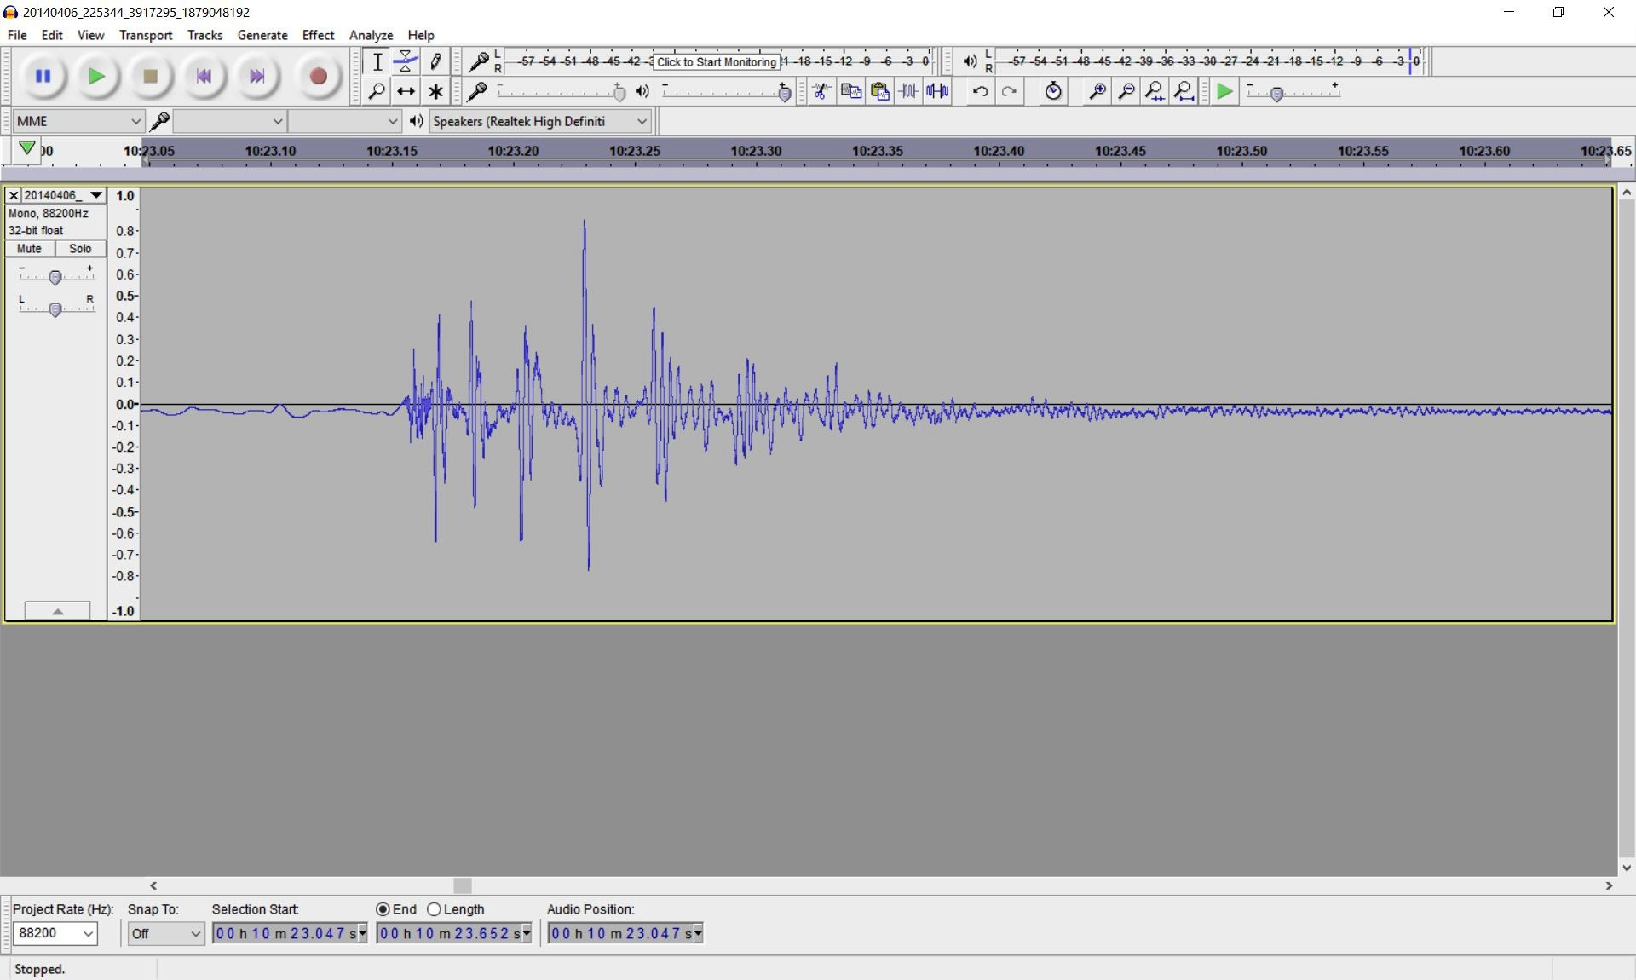
Multiple echoes

Slide 39
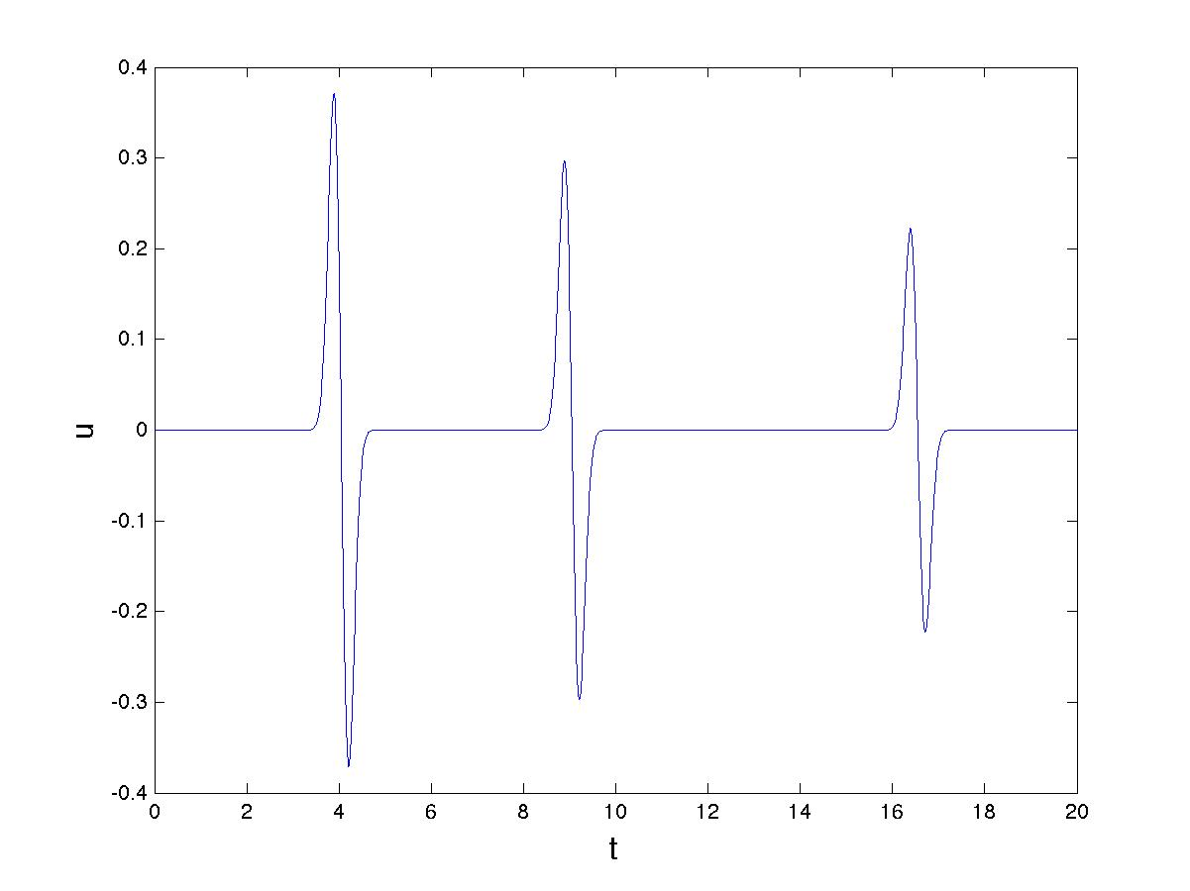
What we hear .. simplified

Slide 40
We hear an echo at a time t_2
L
Sea
Sea Bed
We can measure the time difference between the first sound and the echo

Slide 41
Back to Pythagoras!
We use Pythagoras’ theorem to work out when the echo will arrive
L/2
L/2
H
S

Slide 42
L/2
L/2
H
S

Slide 43
Total distance is 2 S
The arrival time for the echo is then given by the formula

Slide 45
Time difference between the first pulse at t_1
and the echo at t_2 is given by
Challenge:
If we measure and we know H can we find L

Slide 46
Square both sides

Slide 47
Knowing L we know how far away the whale is!!

Slide 49
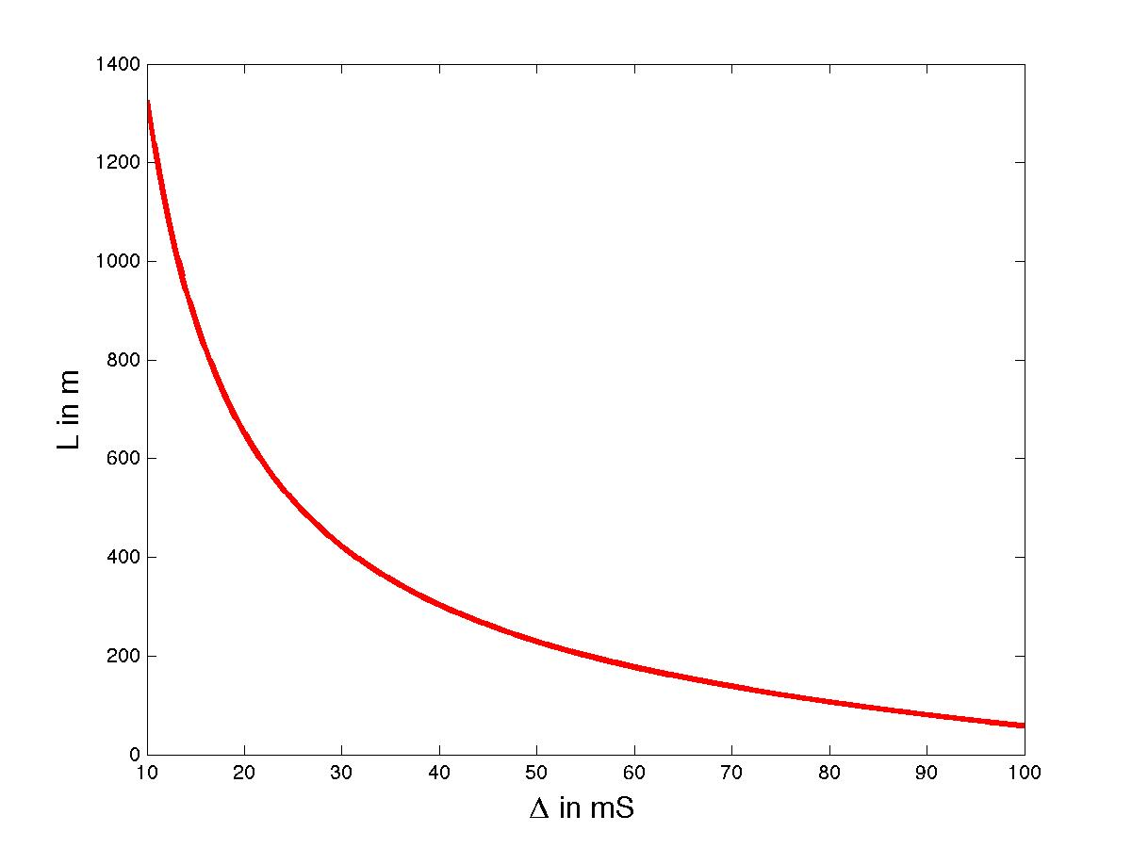
L
Safety zone
Danger

Slide 50
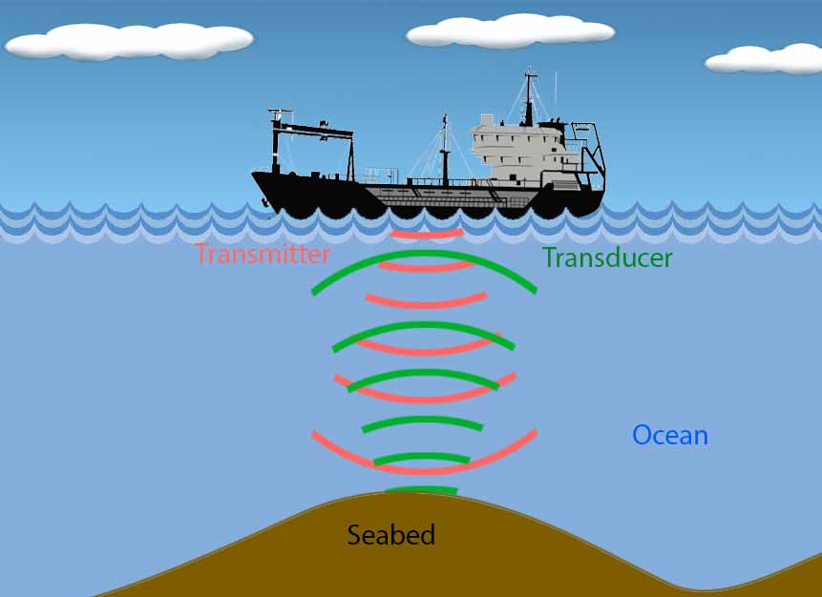
How to find out H
H
Can find the depth H of the sea using active sonar

Slide 51
As C is large, D is small
It is usually measured in
milli seconds mS
or thousandths of a second

Slide 52
Measure the time difference D between the pulses
Sound travels to the sea bed and back a distance of 2H
Example: D = 33 ms , C = 1500 m/s H = ????
H = (33/1000) * 1500 /2 = 24.75m

Slide 53
Problem with the method
It uses active sonar
By looking at multiple echoes we do not need
to know the value of H.
Avoids sonar altogether! See worksheet.

Slide 54
Sea
Sea Bed

Slide 55
Happy Whale!!!!

Slide 56

Summer special, 6th June 2020, University of Bath
Plus.maths.org
Nrich.maths.org
UKMT
We the curious
Royal Institution Christmas Lectures

Slide 57


