Slide 1
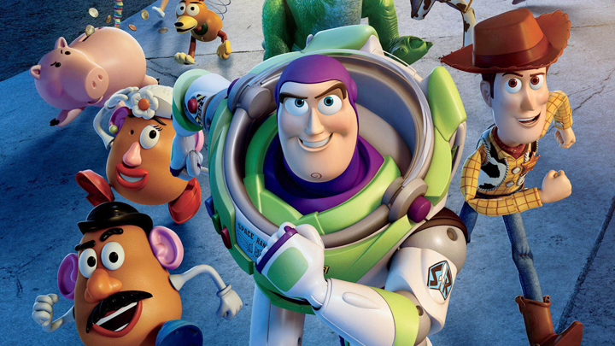
Maths Goes to the Movies
Chris Budd, University of Bath

Slide 2

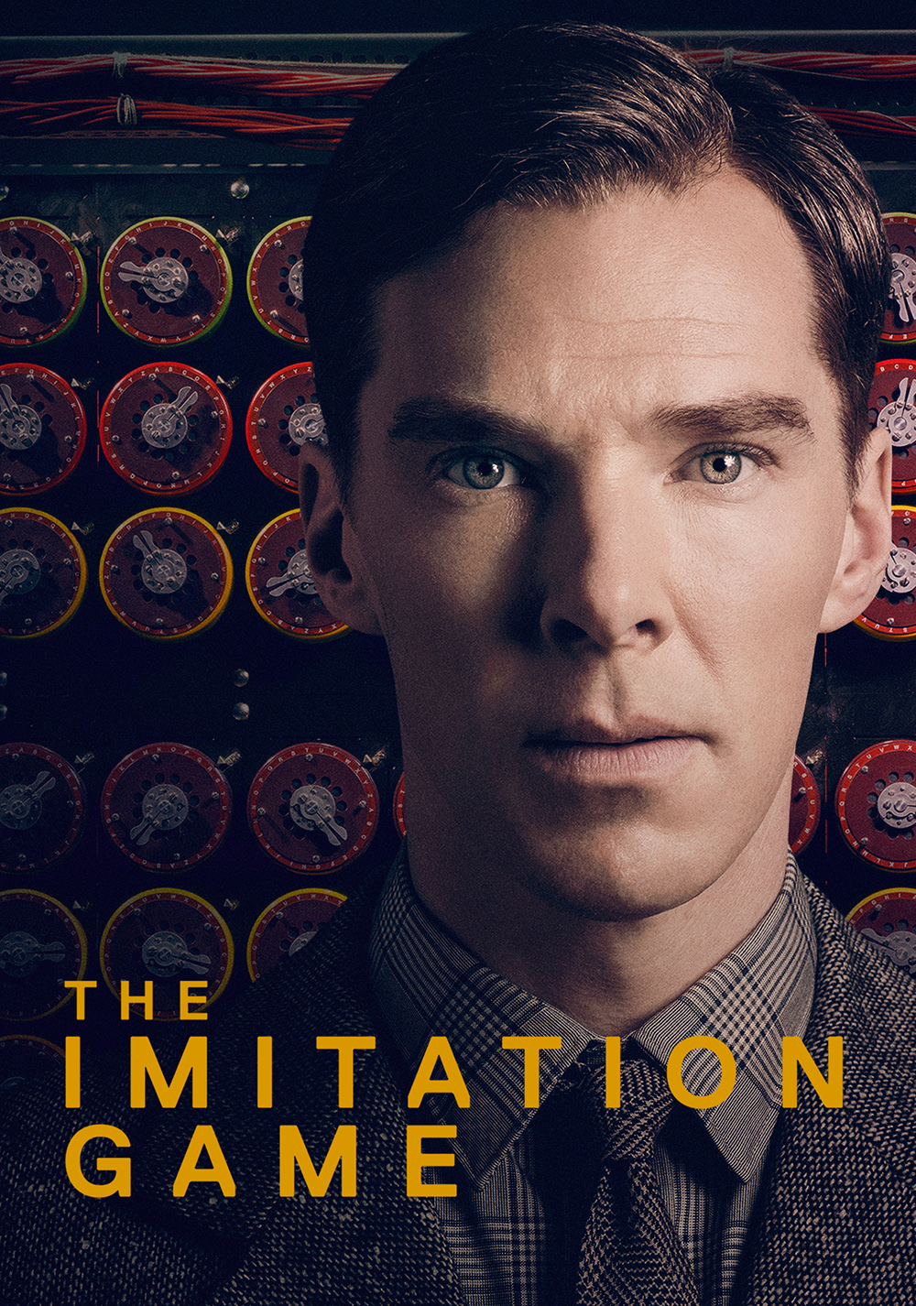
See maths in the movies in different ways
Some mathematicians are heroes

Slide 3
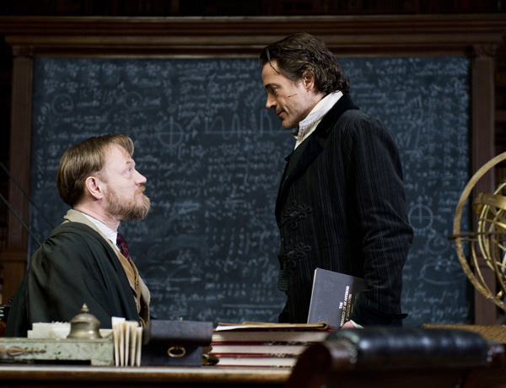
Some mathematicians are evil
Moriarty

Slide 4

Some mathematicians are lovers

Slide 5
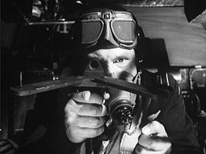
Some celebrate the uses of maths

Slide 6
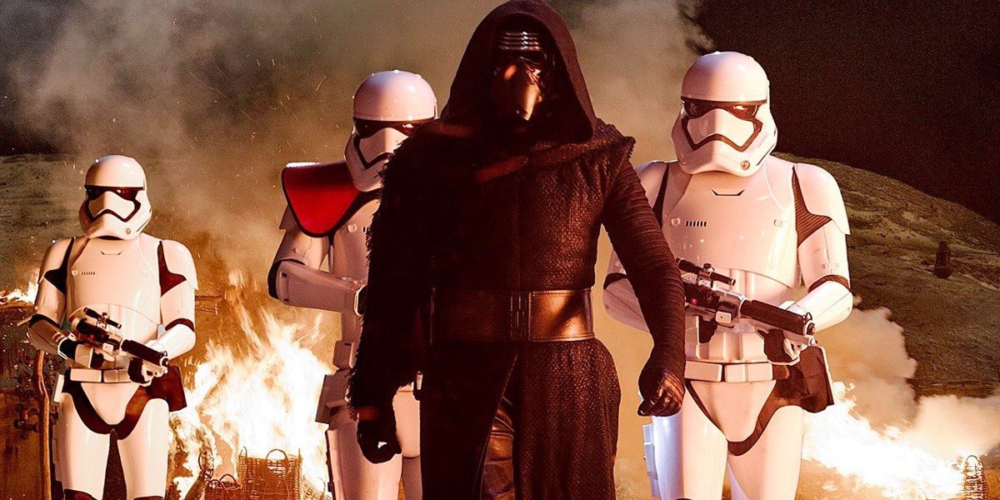
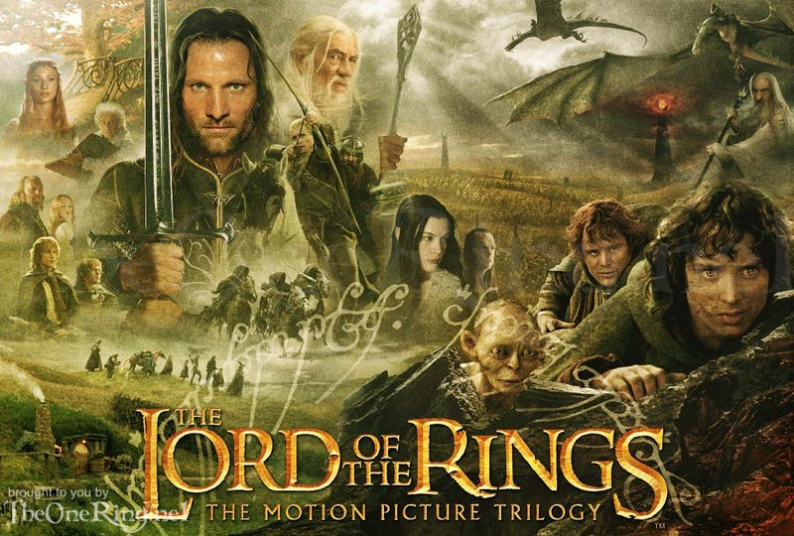
But without maths we could not make modern movies!
Two hundred and sixty visual effects artists worked on the Lord of the Rings trilogy
All of these used maths to do the effects!

Slide 7
What is your favourite movie?

Slide 8
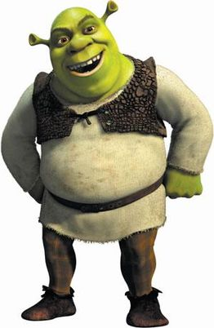
Creating the Image
Is Shrek a real Ogre?

Slide 9
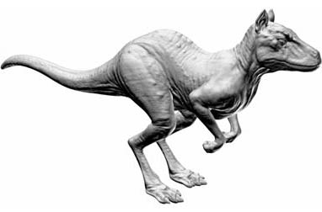
Here is a final image of a made up animal
How do we create and animate this?

Slide 10
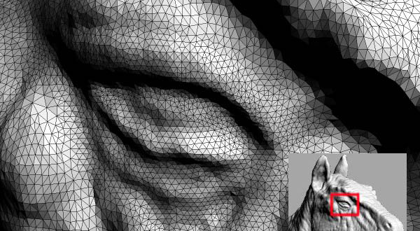
Step 1: Make a wire frame with lots of triangles
A 3D scan can produce a model with as many as six million triangles making up the surface. Store the coordinates of the triangles.

Slide 11
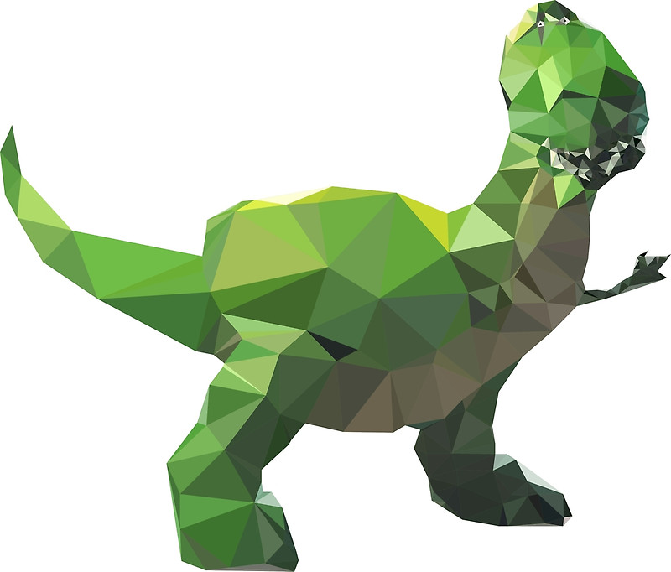
Do you recognise this?

Slide 12
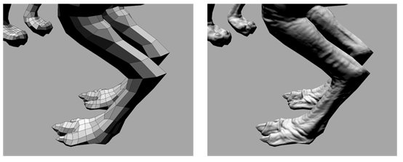
Step 2: Rendering
Make everything nice and smooth and add skin effects

Slide 13
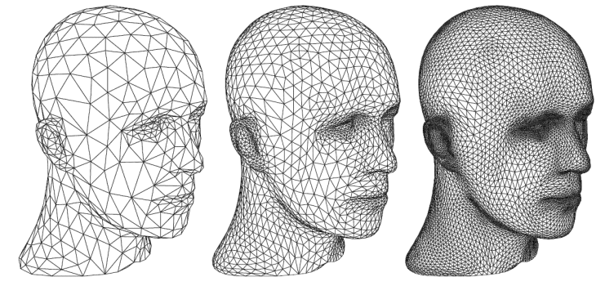
Successively subdivide each polygonal face into smaller faces
.

Slide 14
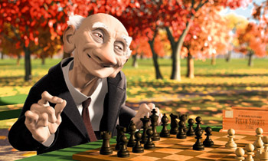
Geri’s game .. The first film to use subdivision
Subdivision invented by
Edwin Catmull, Jim Clark, Tony DeRose and Jos Stam

Slide 15
What .. No hair!!!!

Slide 16
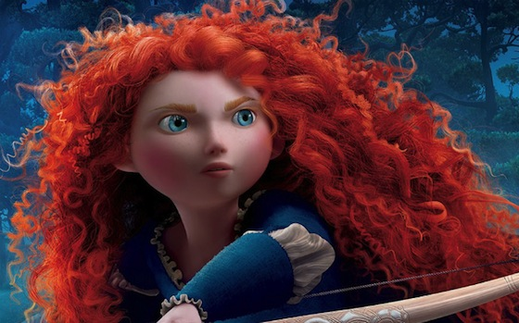
Step 3: Add fur and hair and water
Merida's hair is made of 100,000 individual elements.
Each hair satisfies a (differential) equation

Slide 17
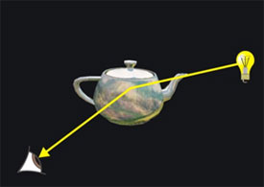
Step 4: Add Lighting effects
Trace millions of rays from a light source using vectors
Find which rays reflect from the image into your eye

Slide 18
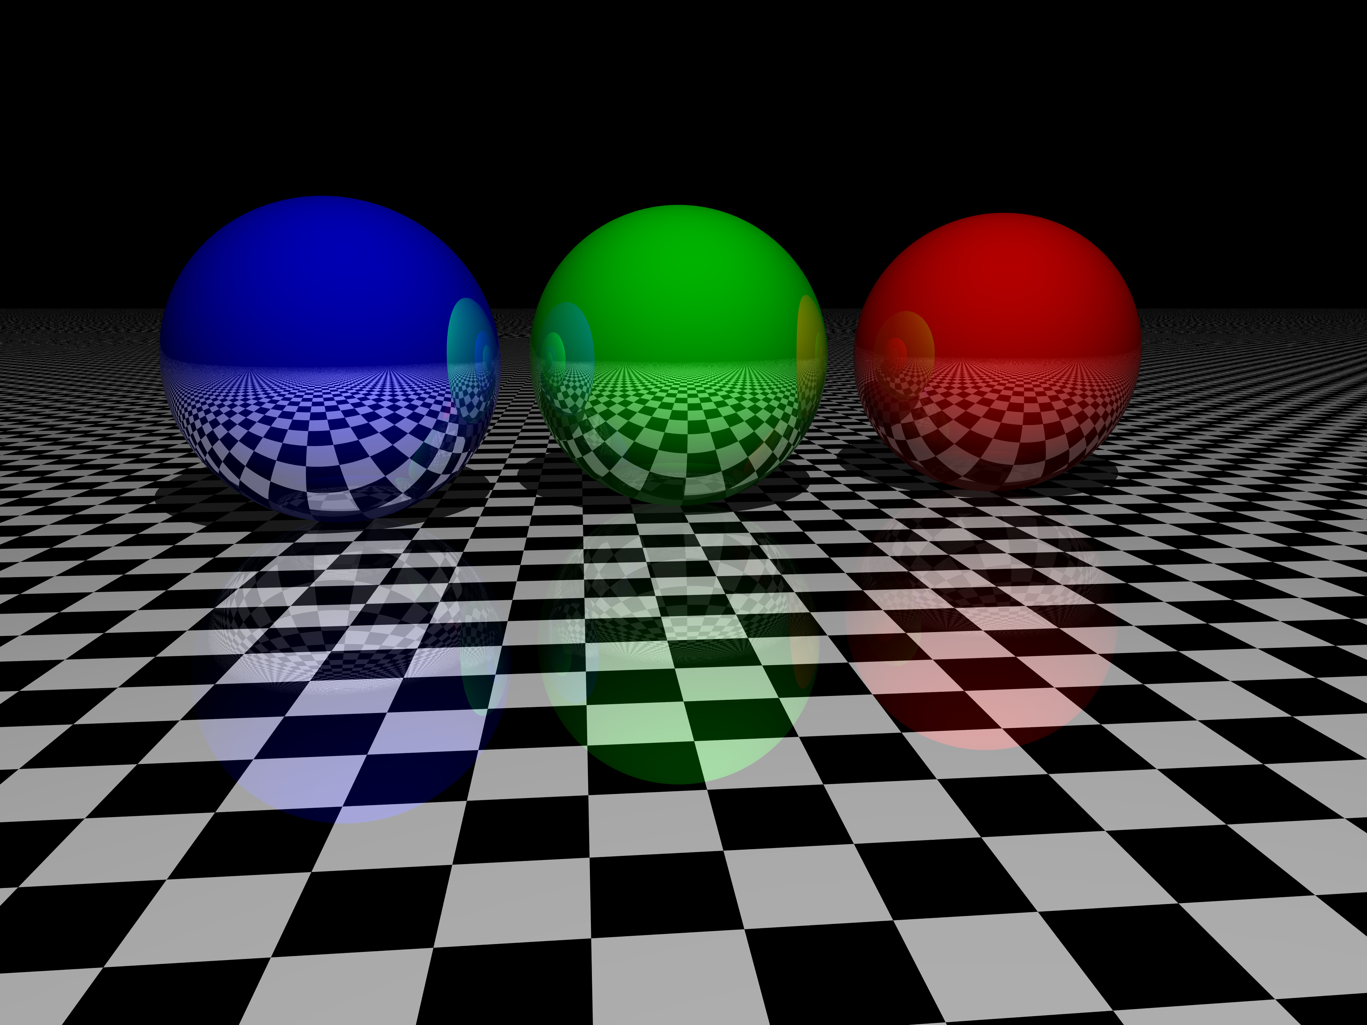
Effective but slow and expensive!
Time: 3 hours per frame, 24 frames per second in a movie
2 Hour movie needs 518 400 hours to render!

Slide 19
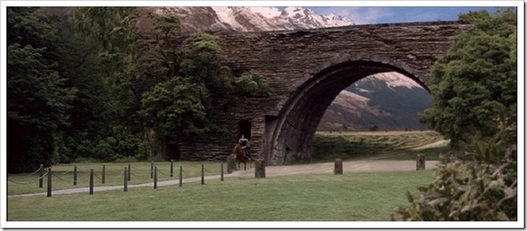
A sense of proportion: effects with real actors
How to make small things look big … ..
And big things look small
How big is this?

Slide 20
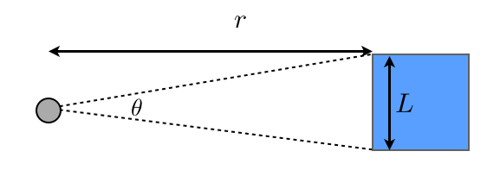
Forced Perspective
Small bridge close to the camera appears to be the same size as a large bridge further away
L
Angle at the camera is how big things appear

Slide 21
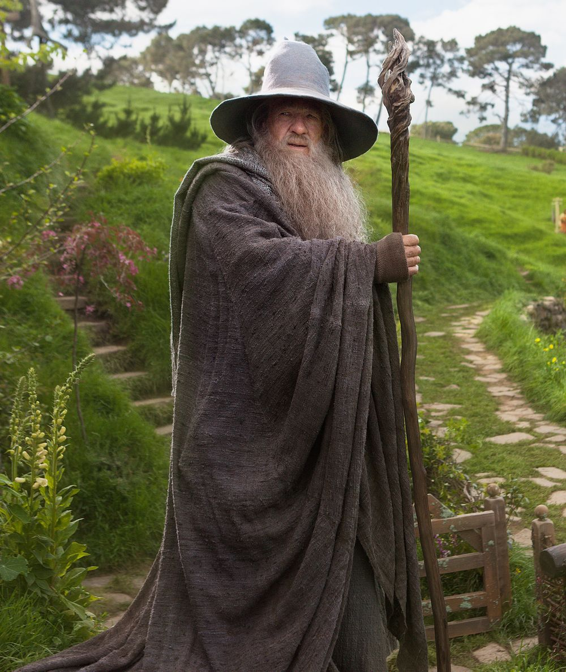
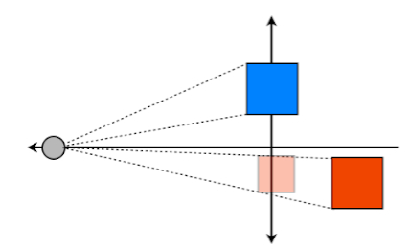
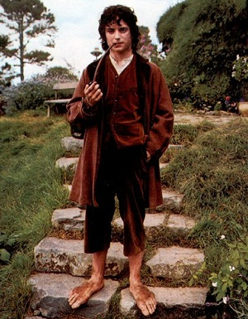
Trick: To make a large object appear small, move it further away
To make a small object appear large, move it closer
Gandalf
Actor
Actor
Hobbit
Make to make Hobbit appear smaller than Gandalf

Slide 22
The Director’s Formula

Slide 23
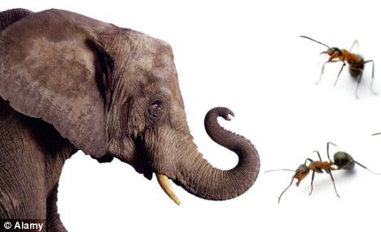
Which looks bigger
An ant 10cm away or an elephant 500m away?

Slide 24
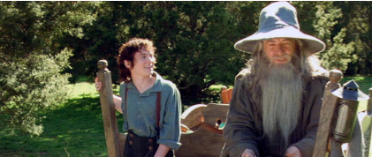
Different scales
Hobbits < Dwarves < Men < Elves
How do they make Frodo look so small?

Slide 25
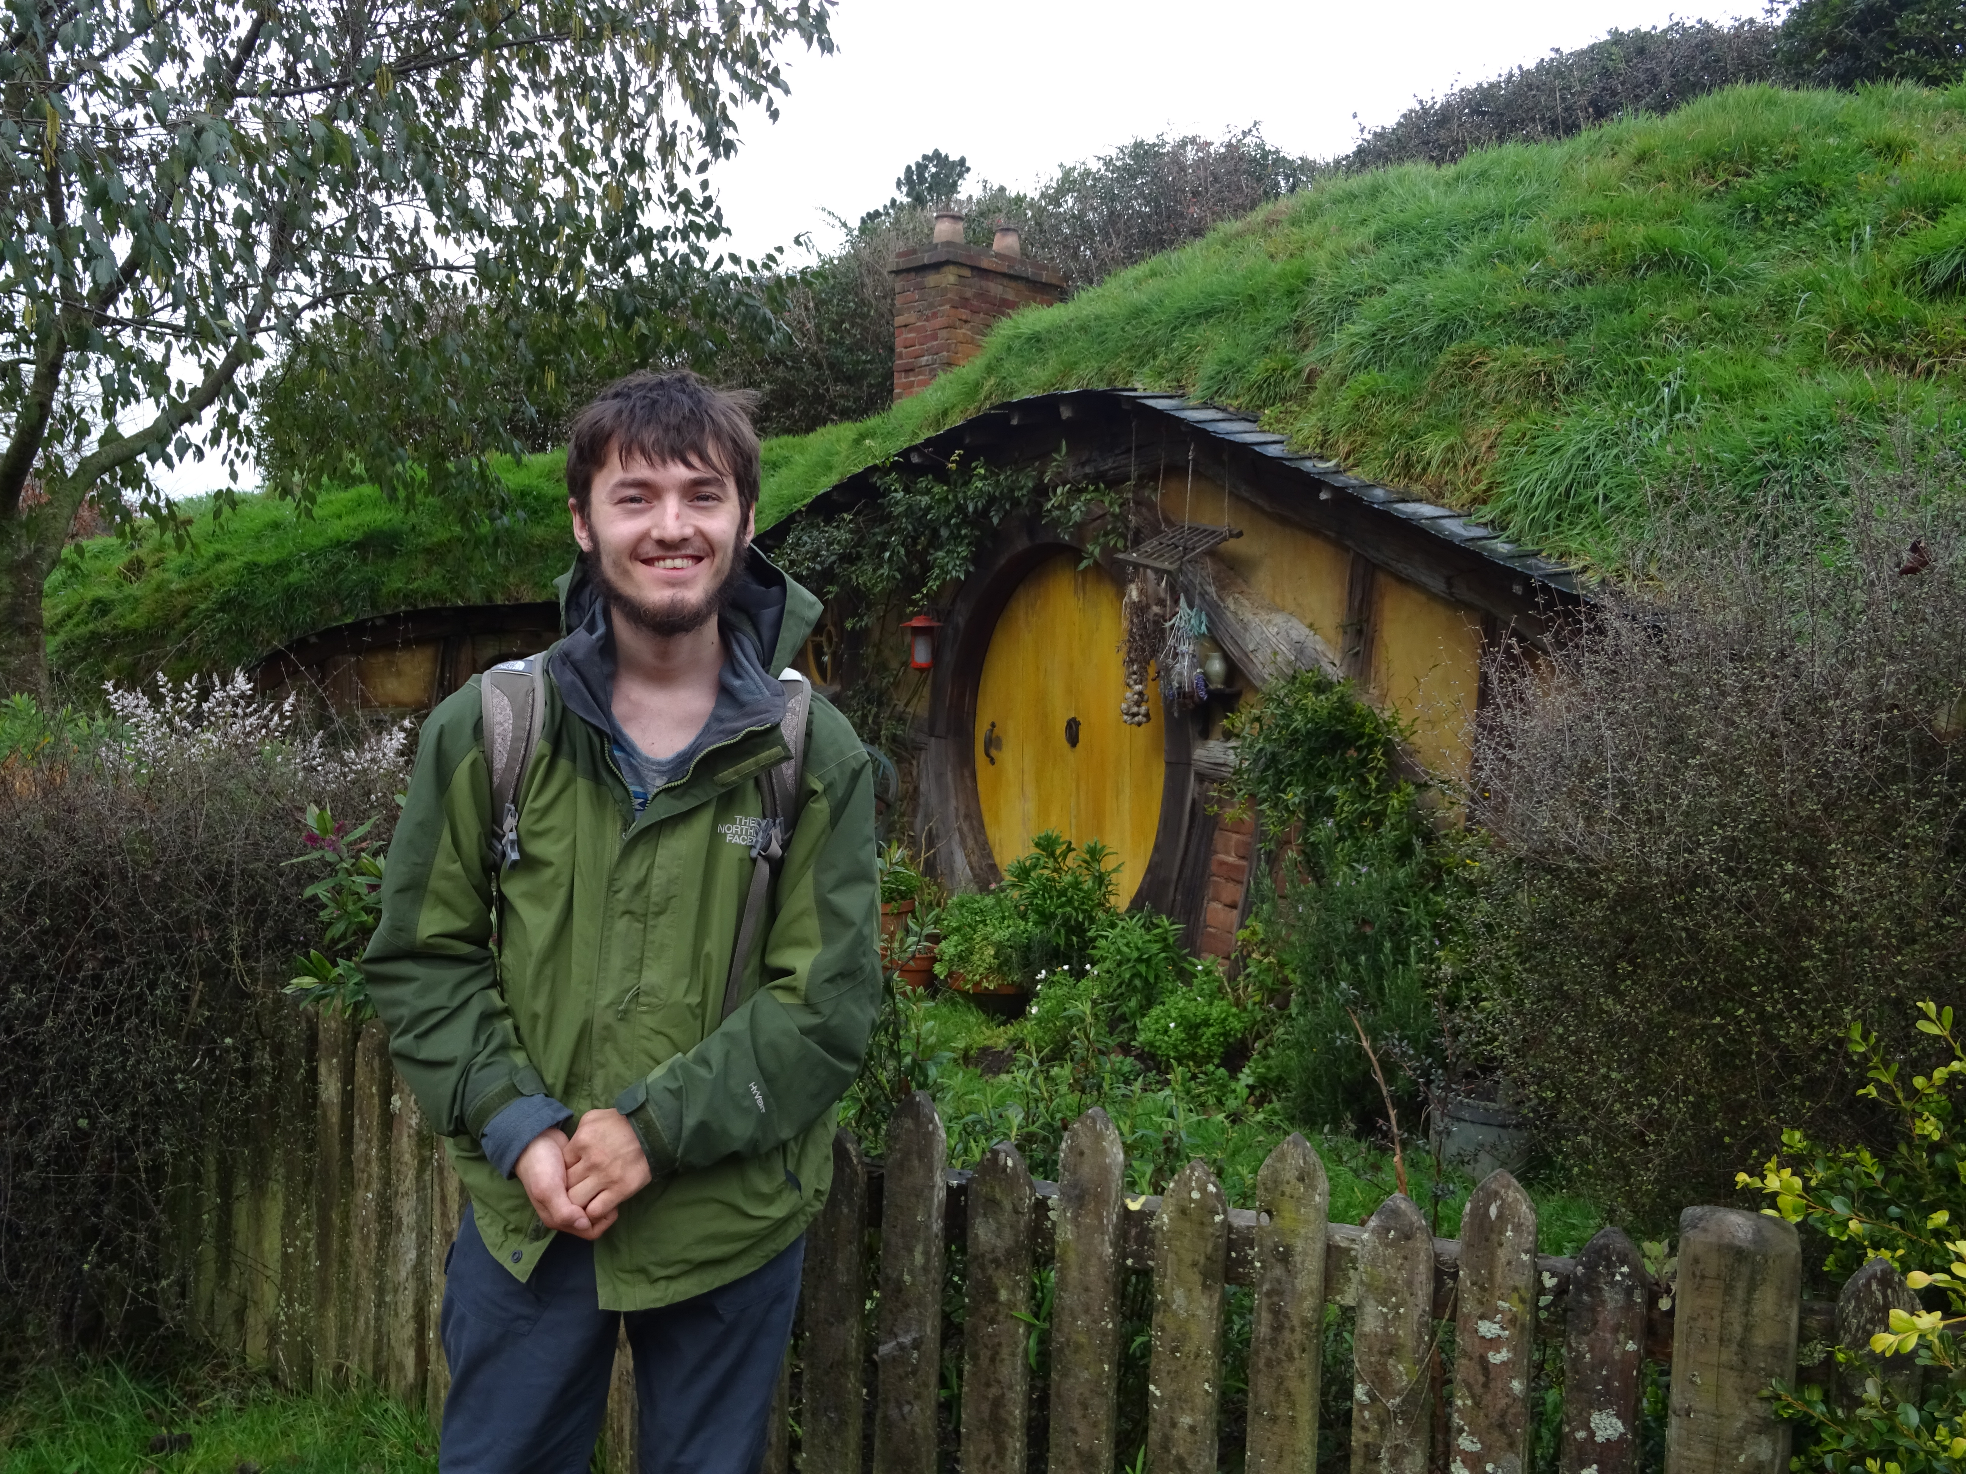
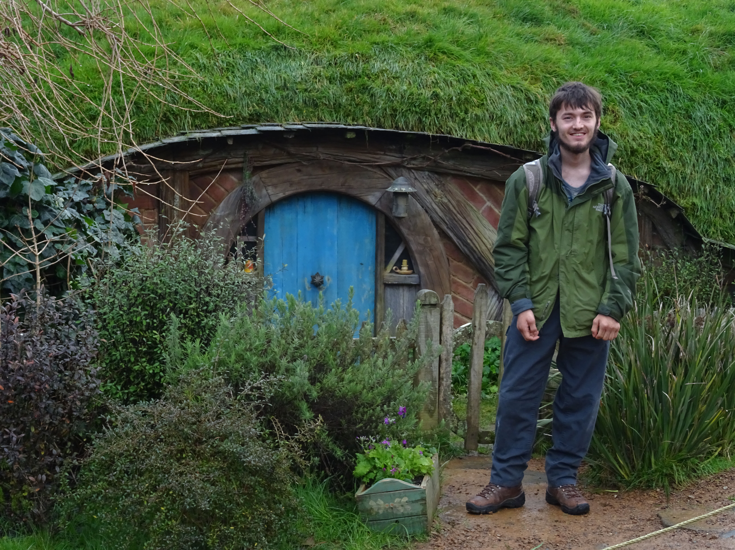
Two scales were used for many of the props:
Large Bag End for shots with Hobbits
Small Bag End for shots with Gandalf

Slide 26
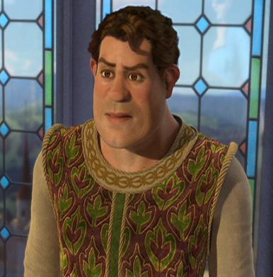
Animation
The whole point of movies is that the characters MOVE and change

Slide 27
Three types of motion:
Translation

Slide 28
Enlargement (or coming closer)

Slide 29
Rotation

Slide 30
All done using maths:
Translation: ADDITION
Enlargement: MULTIPLICATION
Rotation: TRIGONOMETRY
Need to use COORDINATES

Slide 31
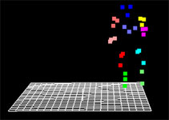
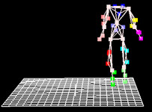
Represent a body by a skeleton of points
Then move the points around using mathematical formulae

Slide 32
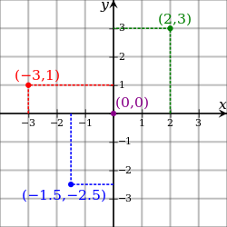
Points on the plane are given by two numbers: (x,y)
x = x-coordinate and y = y-coordinate

Slide 33
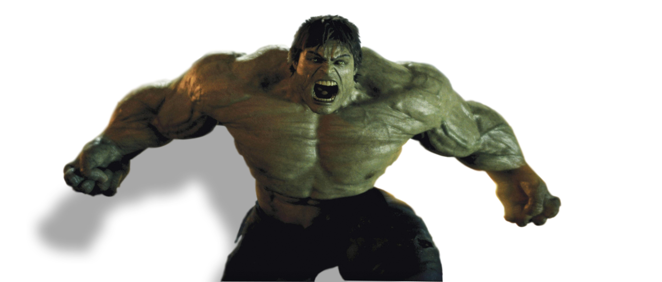
HUGE IDEA
By changing the x and y coordinates we can change the pictures

Slide 34
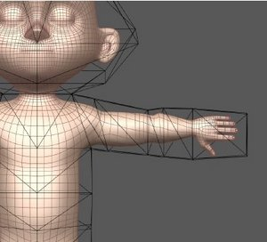
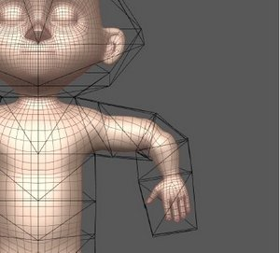
Old coordinates x and y
New coordinates X and Y
(x,y)
(X,Y)

Slide 35
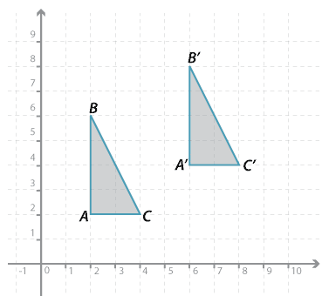
Translation: Add numbers to each coordinate
X = x + a Y = y + b
Add 4 to x
Add 2 to y

Slide 36
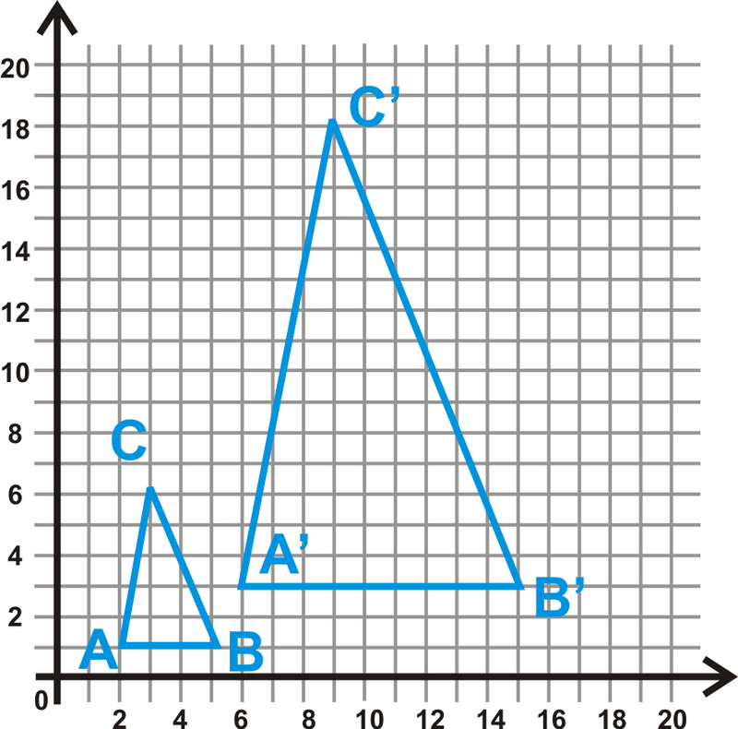
Enlargement: Multiply each coordinate by numbers
X = a x Y = b y
Multiply
x and y
by 3

Slide 37
Rotations
A’ = (X,Y)
A = (x,y)
O
= Angle of rotation

Slide 39
To make a rotation
Multiply coordinates by SIN and COS and add them up
Eg:
(x,y) = (1,4) (X,Y) = (-1.13,3.96)

Slide 40
To move complicated figures: use lots more points

Slide 41
Now
Translate
Enlarge
Rotate
the triangles to give the movement

Slide 42
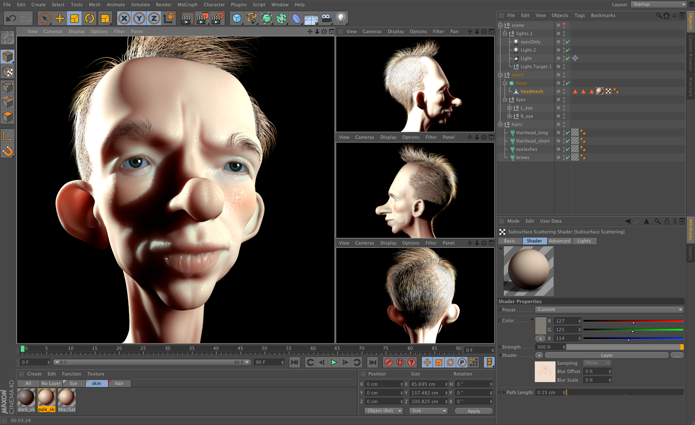
For motion in three dimensions film makers use three coordinates and more numbers, but it’s the same idea

Slide 43
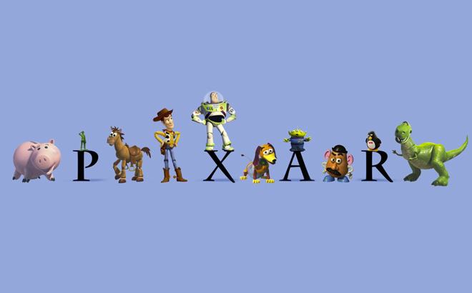
Now .. Join PIXAR

Slide 44
http://blog.ted.com/the-math-behind-the-movies-an-interview-with-tony-derose-of-pixar/
What advice would you give someone who wanted to use math to make movies?
Learn as much mathematics as you can, particularly applied math. The areas of mathematics we use most heavily today are Euclidean and affine geometry, trigonometry, linear algebra, calculus and numerical analysis. We don’t really know what the mathematical tools of tomorrow might be, so we’re counting on the next generation of employees to tell us.

Slide 45
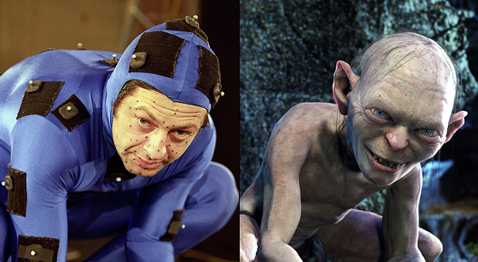
Yes .. You too could be Gollum

Slide 46
y
A’ = (X,Y) = (-1.13,3.96)
A = (x,y) = (1, 4)
x
O
Line joining point to the origin is rotated around by 30 degrees

Slide 47
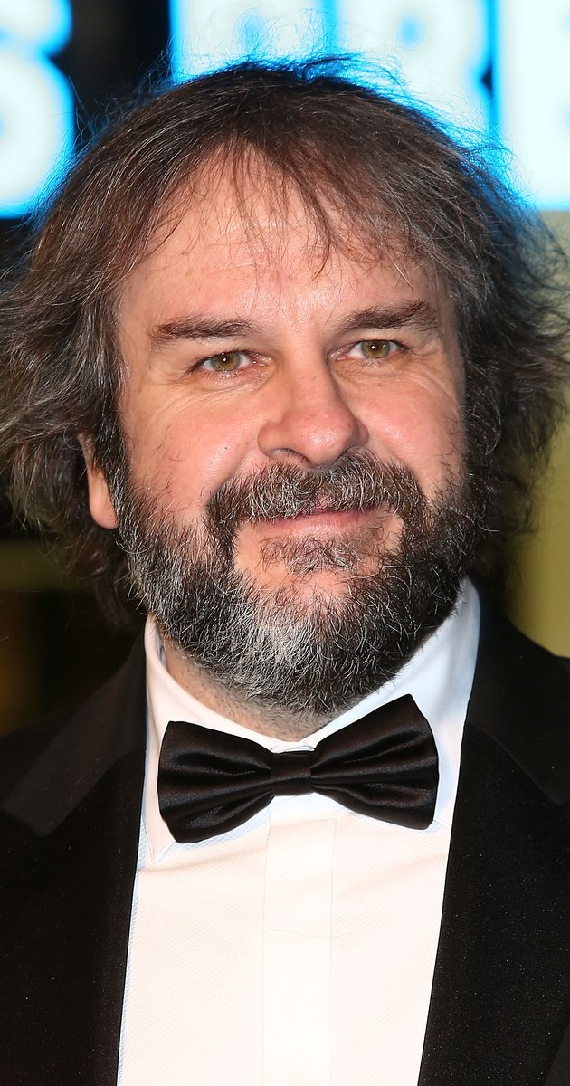
You are the director!
Elijah Wood is 1.68m tall
Frodo Baggins is 1.07m tall
Frodo is to appear to be 3m from the camera
Where should Elijah stand?
Angle of Frodo to camera is z = 1.07/3 = 0.357
Elijah is a distance r from the camera and makes an angle 1.68/r
So z = 1.68/r = 0.357
Therefore r = 1.68/0.357 = 4.7m from the camera

