Slide 1
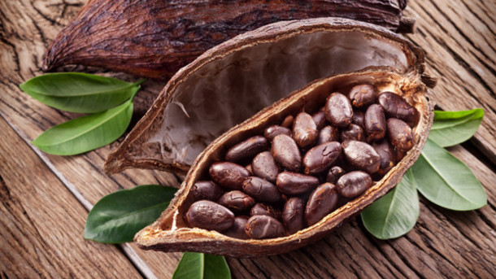



The Maths of Food and Drink
Chris Budd, Lorna Wilson
Katarzyna Tymkiewicz

Slide 2
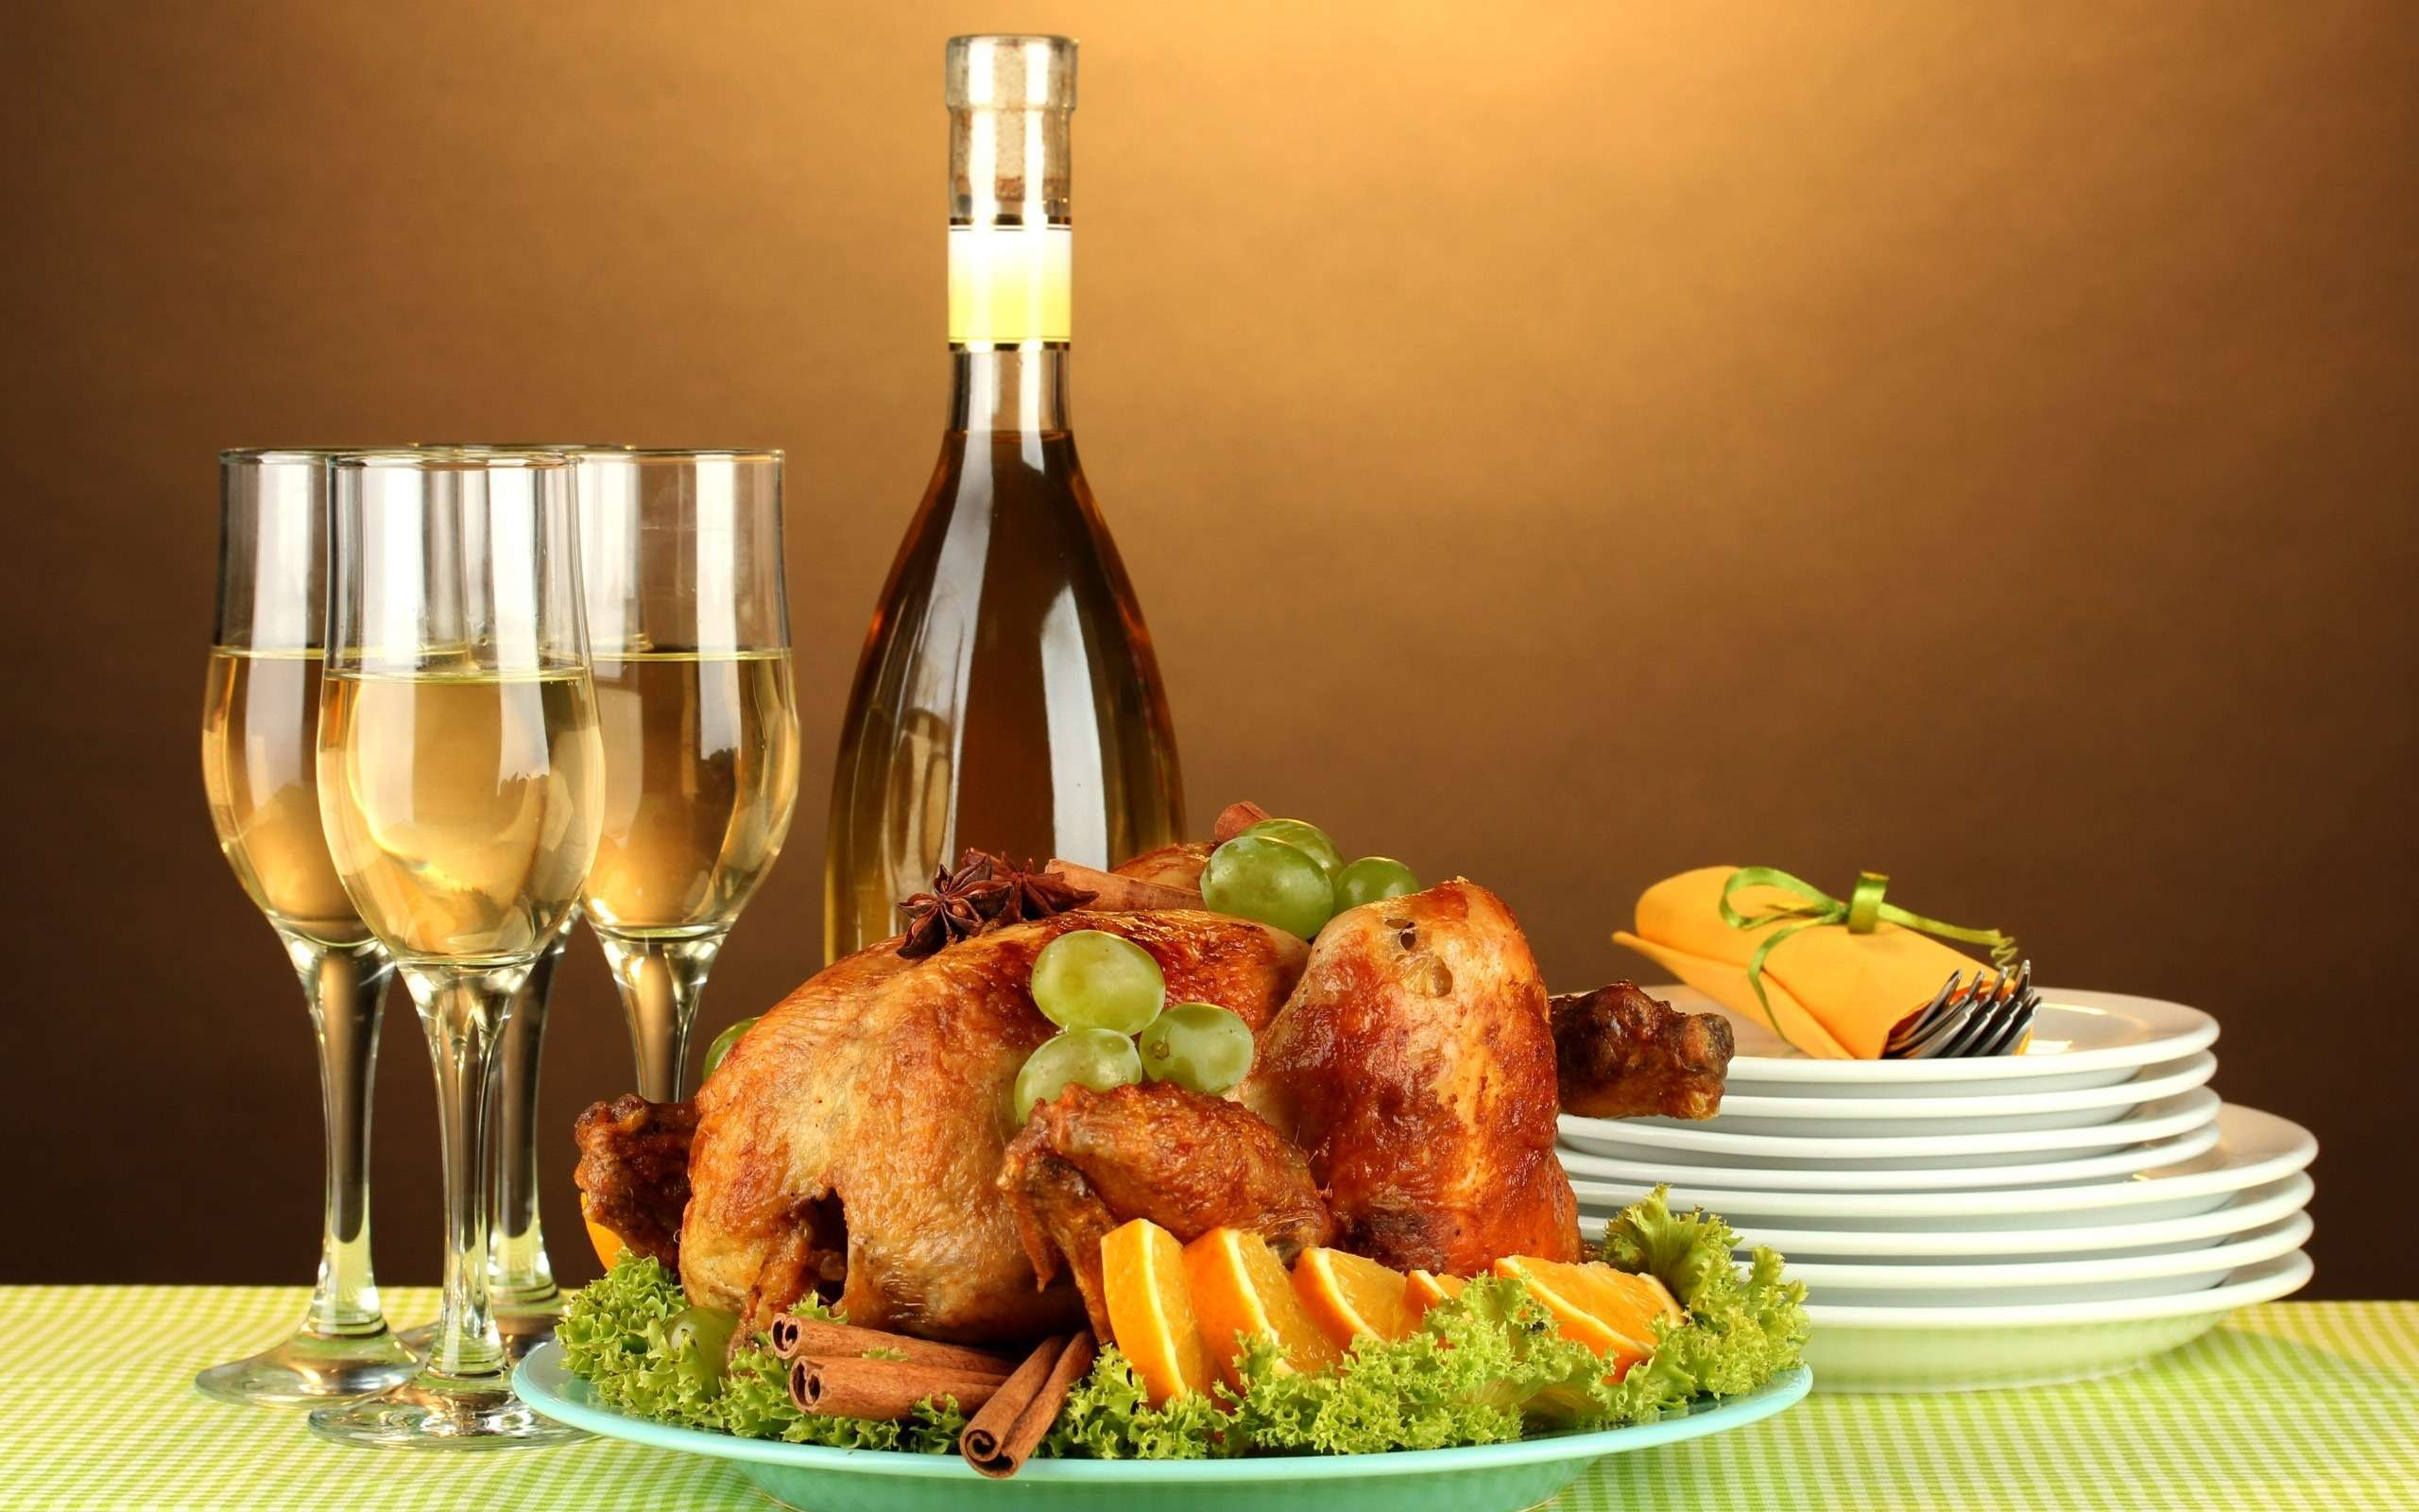
Nothing could be more important to us than food and drink!
Food and drink is THE largest industry in the world

Slide 3
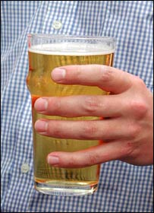
Some food facts
Agri-science is 6th on the list of
HM Government’s 8 Great Technologies
Food industry is worth £100 Bn per year to the
UK economy
Drink industry alone is worth £ 18 Bn per year
5 Bn Pints are drunk per year – 2 per person per week in the UK
We need to grow more food in the next 50 years than in the last 1 000 if we are to feed the world’s population.

Slide 4
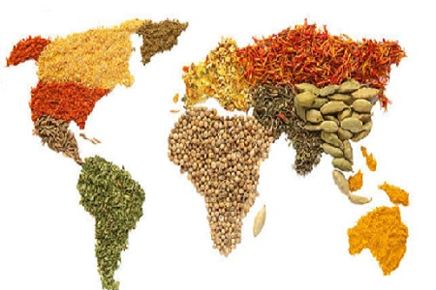
But, can maths feed the world?
Often asked question when I give a maths talk at school is:
Yes, but how is that helping the starving people in Africa?

Slide 5
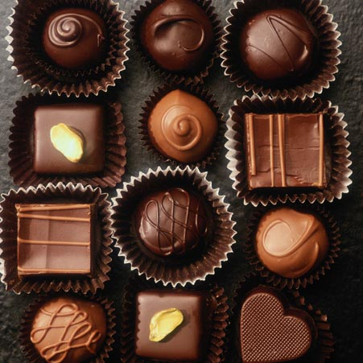
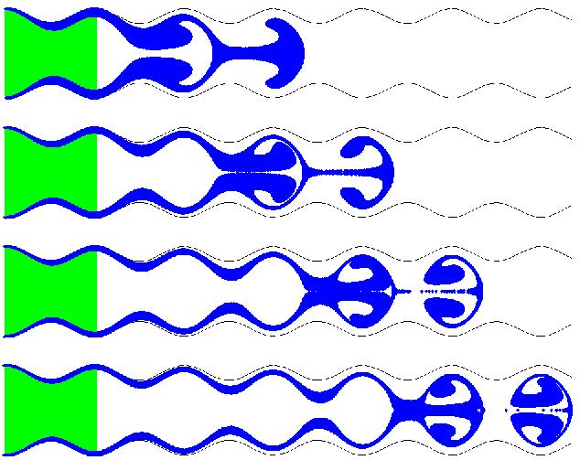
Yes!!!!
From Farm to Fork Mathematics plays an essential role in predicting, optimising and controlling the following food processes
Growing
Irrigation
Pest control
Harvesting
Feeding
Freezing
Storing
Packing
Transporting
Making
Cooking
Eating
Digesting
Getting rid of the waste
Mathematics involves differential equations and optimisation

Slide 6
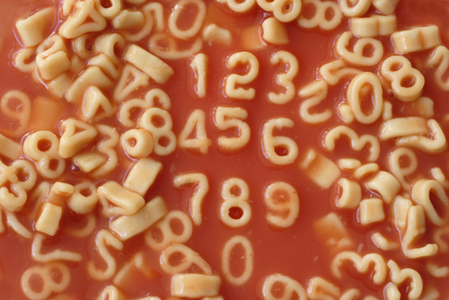
We will now look at some case studies showing maths in action to bring the food to your table

Slide 7
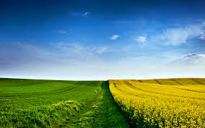
1. It all starts in a field or in the sea
Fields are highly complex systems
Growing food in them involves a careful
combination of
Planting the right seeds
Irrigating them correctly
Using the correct amount of pesticides and fertilisers
Accurate localised weather prediction
Critical to get right. A farmer may well invest their entire savings on the seeds for one harvest

Slide 8
Example: Farming cocoa in Ghana
Farmers grow cocoa bean which are affected by weather
Q. Can we model the growing and harvesting process?

Slide 9
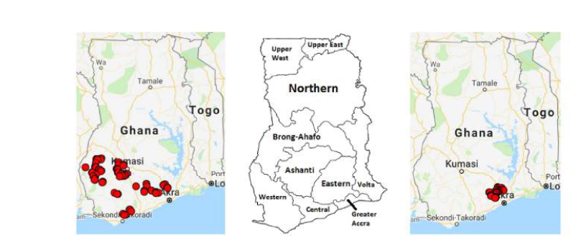
Farm location

Slide 10
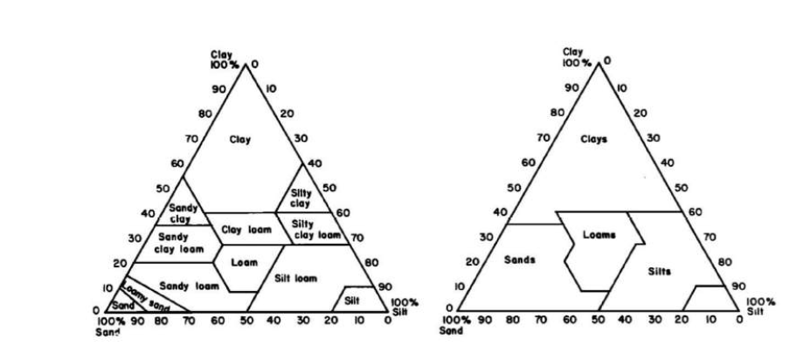
Cocoa growth depends on soil type and on climate Need to build a model which involves both
Rainfall
Water retention in soil
Growth of cocoa
Harvesting
Model this through delay differential equations

Slide 11
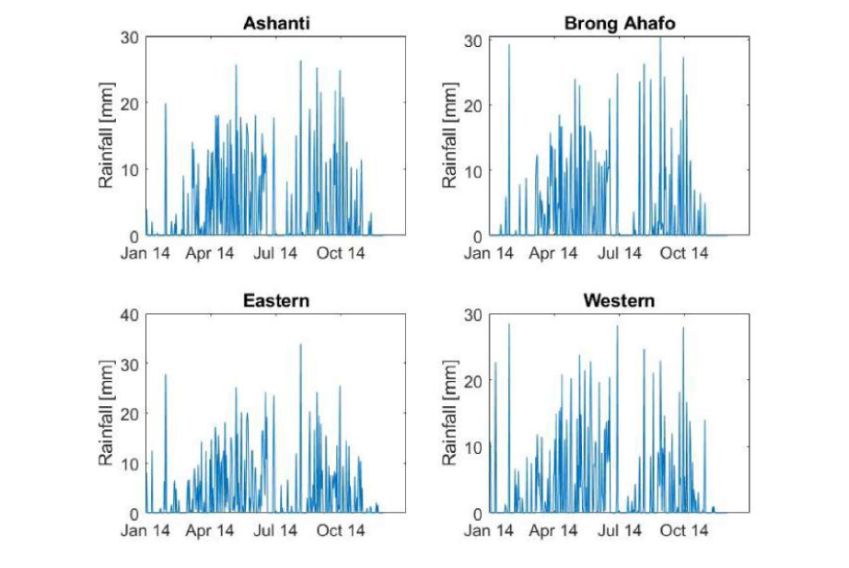
Tropical rainfall pattern shows two rainy seasons

Slide 12
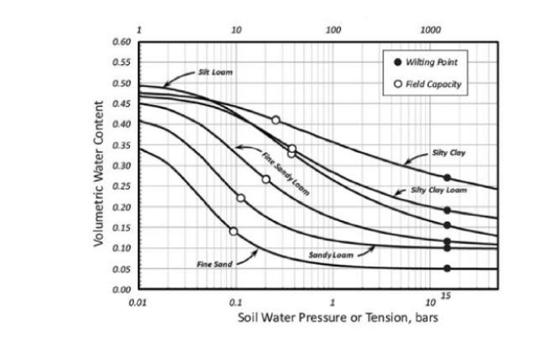
Water is retained in the soil

Slide 13
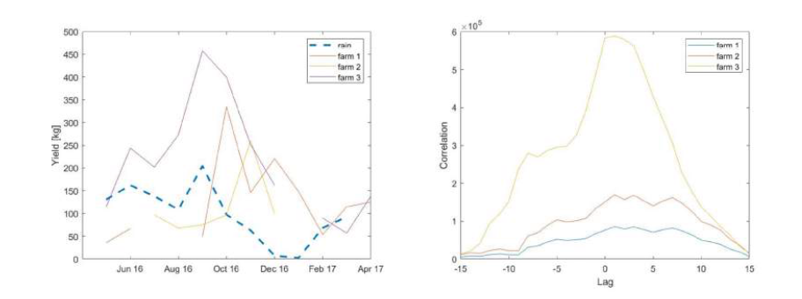
The effect of the soil retaining the water leads to a lag in the yield response to rainfall of 1-2 months.
This motivates using a delay differential equation model

Slide 14
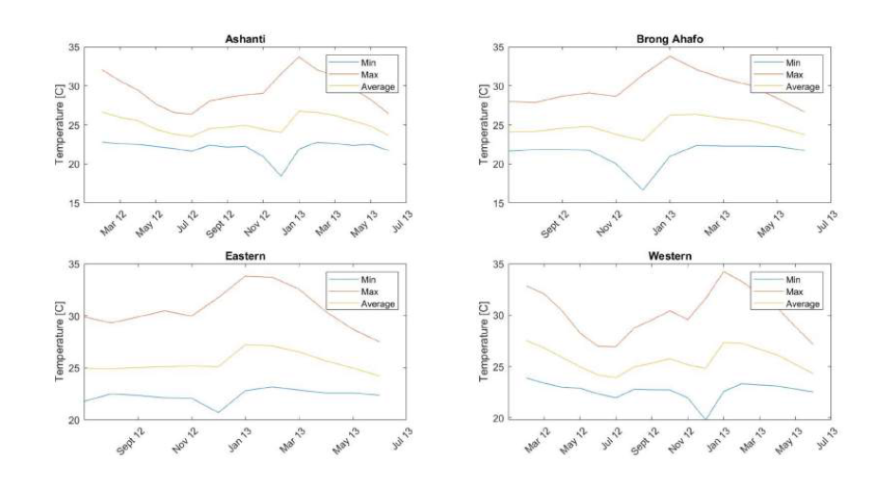
Growth is also affected by temperature variations

Slide 15
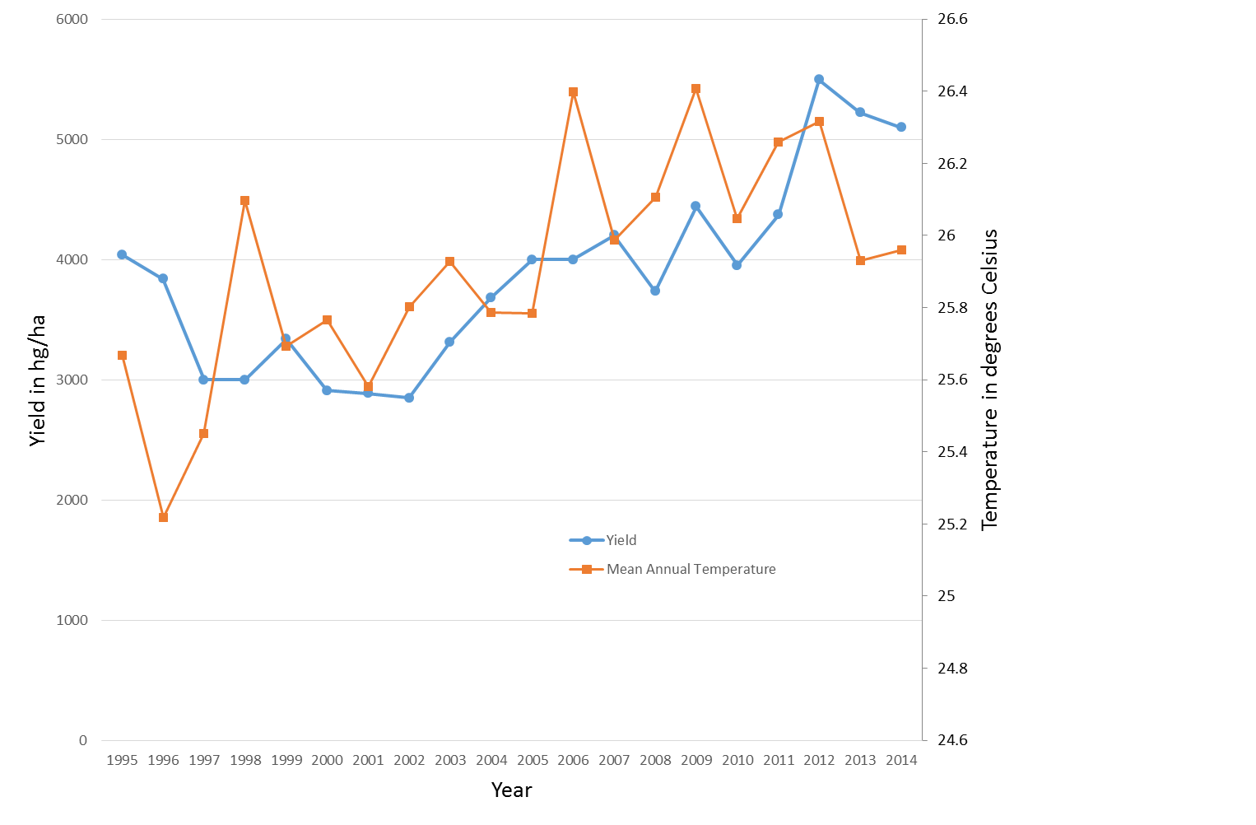
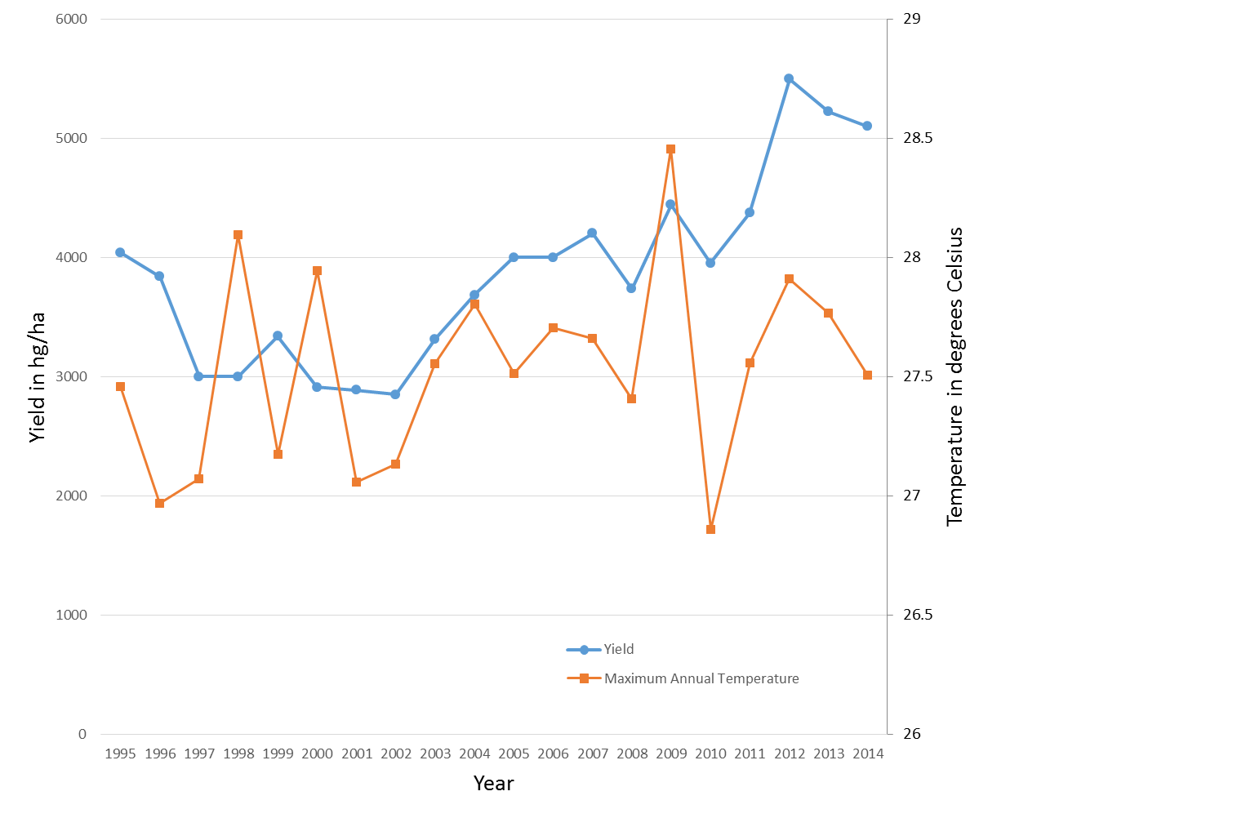
Effect of temperature on cocoa yield
Response is more immediate without a lag

Slide 16
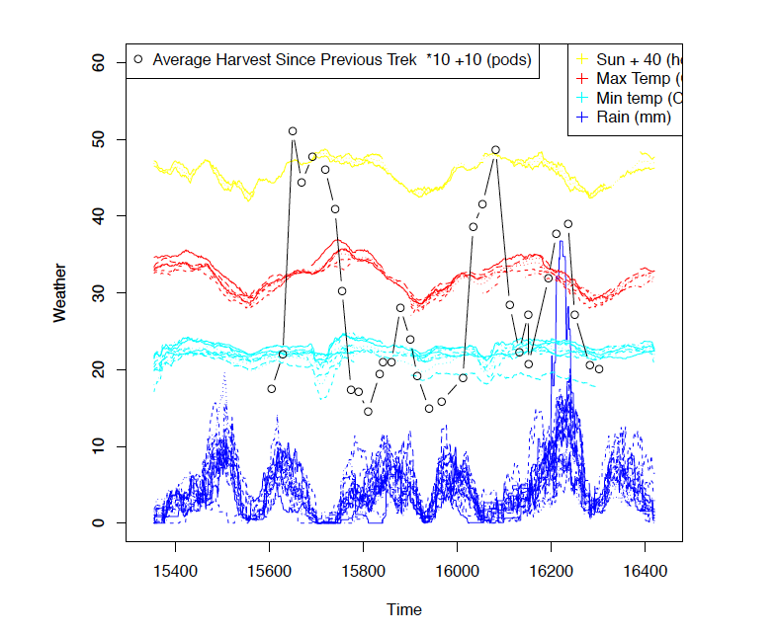

Slide 17

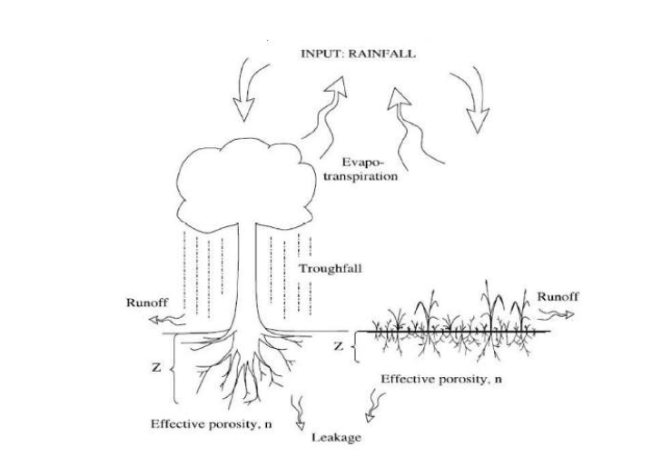
Phase 1: Soil moisture model: Piecewise smooth dynamical system
s: soil moisture, R: rainfall, ET: Evaporation, L: Leakage
Lumped model ignoring spatial variation!

Slide 18
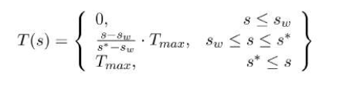
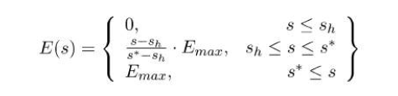
R(t): Climate data or Poisson process
Evaporation increases with s until a saturation level is reached
ET = Evaporation E + Transpiration T

Slide 19
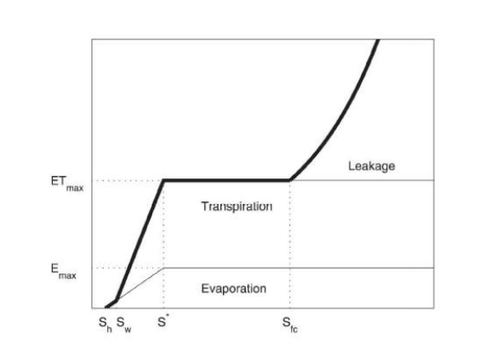
Cumulative loss
Piecewise smooth function

Slide 20

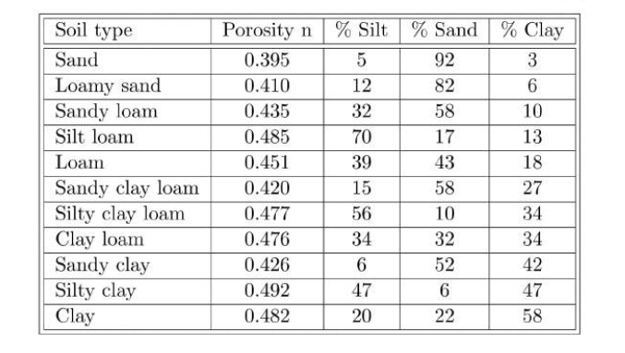
Simplified model for soil moisture:
Porosity n depends upon the soil type
a = 0.05-0.07

Slide 21

Approximate the two rainy seasons by a bi-modal distribution
Then solve the ODE system directly to give:
With an implicit lag of 1/a in the system

Slide 22
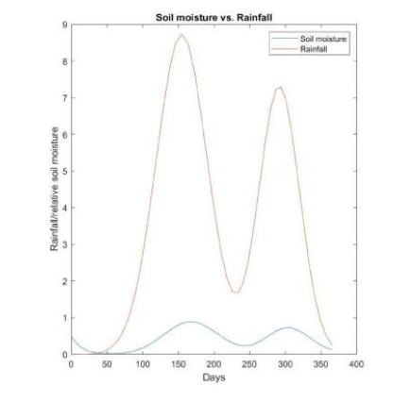

Slide 23
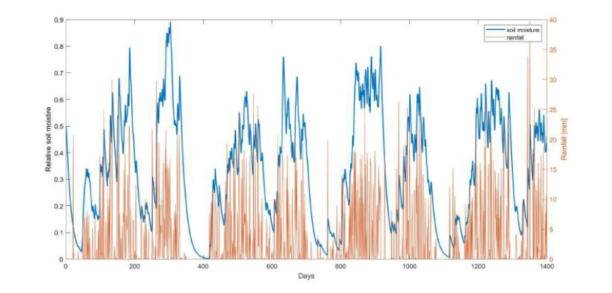
Comparison with observations in the Ashanti region
The lag is clearly visible

Slide 24
Phase 2: Model of the cocoa yield
IDEA: Plants respond to the water in the soil and take time to mature. This introduces a delay into the system.
Three things to consider:
F: Number of flowers on the cocoa trees … these turn into
P: Number of cocoa pods .. Which then become
H: number of harvested pods

Slide 25
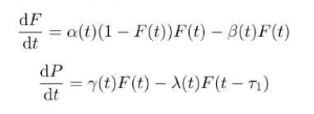


Slide 26
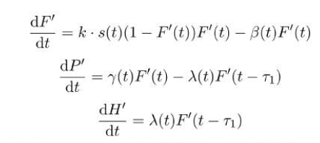
Time lag: is 183 days which is the time of flowering
Rate of flowering depends upon the soil moisture s(t) already calculated:

Slide 27
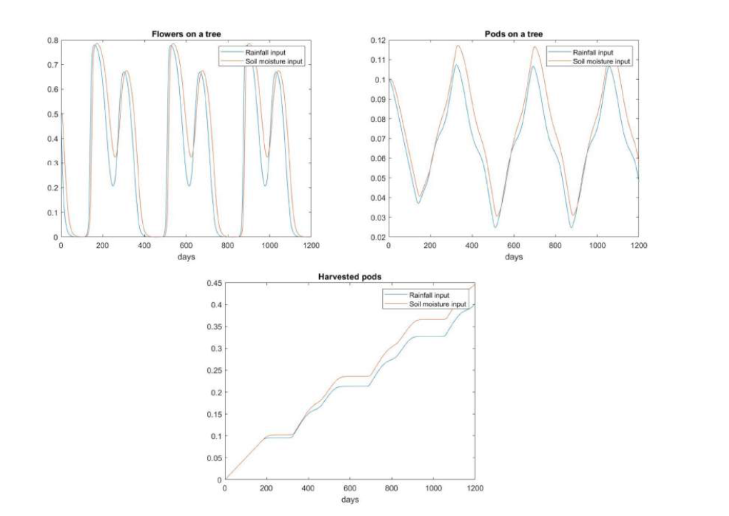
Solution for a double Gaussian rainfall pattern

Slide 28
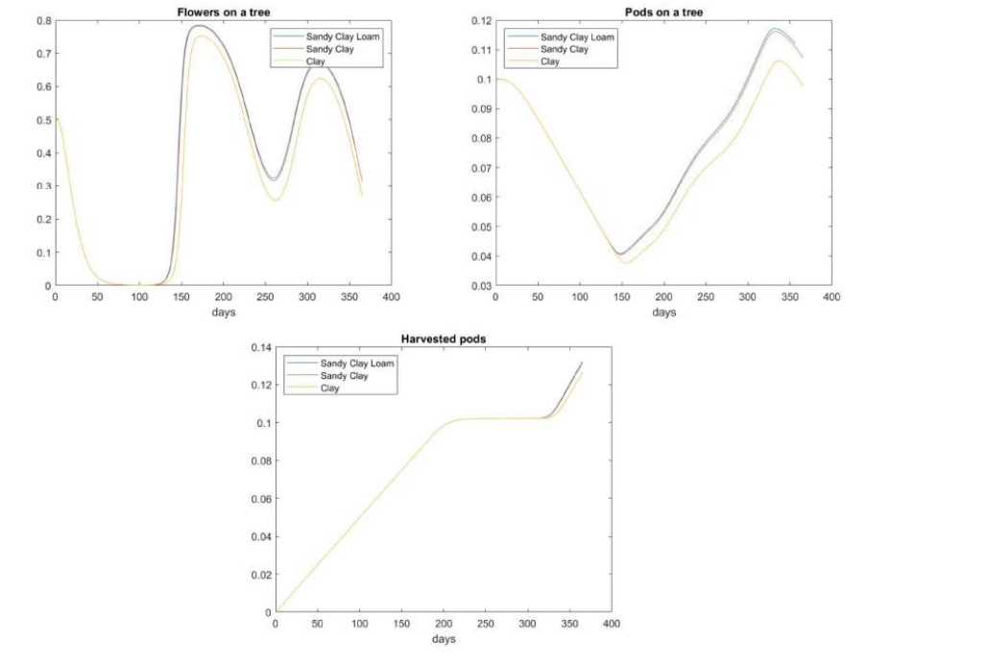
Different soil type calculation

Slide 29
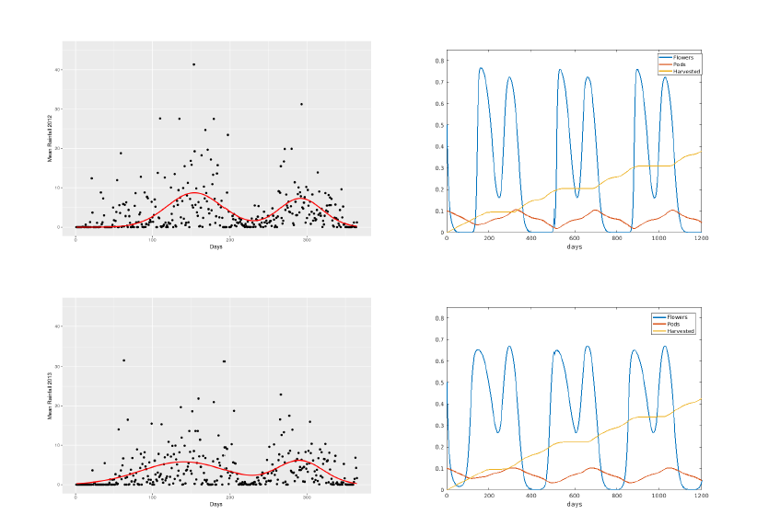

Slide 30
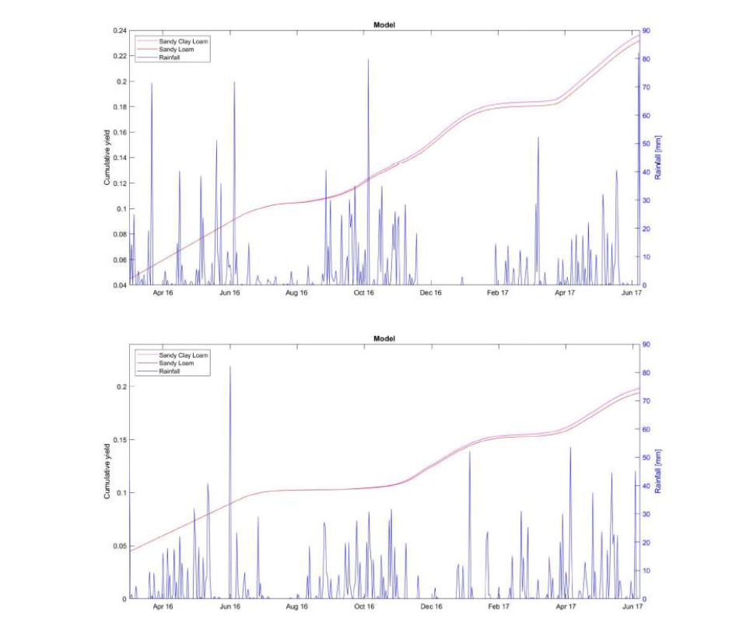
Solution for a realistic rainfall pattern

Slide 31
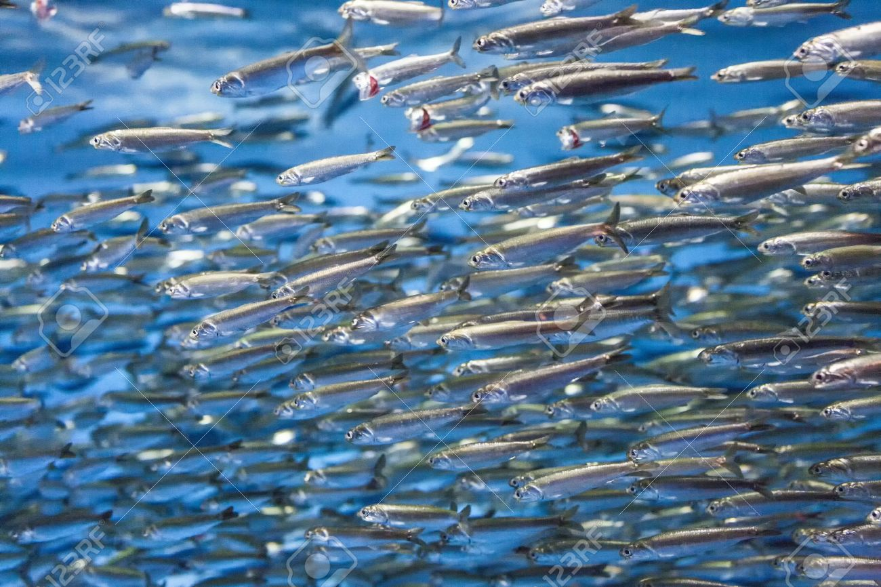
Fishes in the sea
Mathematics is also used to predict and to control fish stocks and fishing
f(t): amount of fish k: maximum sustainable population
a(t): growth rate of the fish b(t): harvesting rate
Logistic
equation

Slide 32
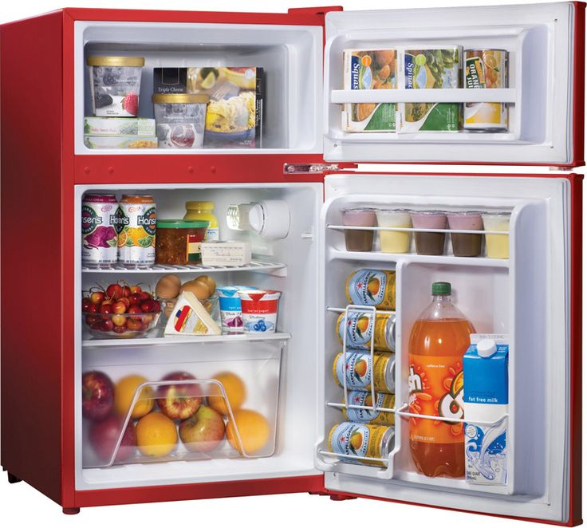
2. How to keep food fresh and test it for freshness
Major advance in 19th Century: Laws of thermodynamics (Kelvin)
Led directly to the development of refrigeration to store fresh food.

Slide 33
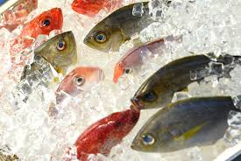
Q. How do we safely freeze food and keep it frozen?

Slide 34
Basic equation for all frozen food
N: Enthalpy T: Temperature
Can extend to a Stefan problem to work out the frozen region

Slide 35
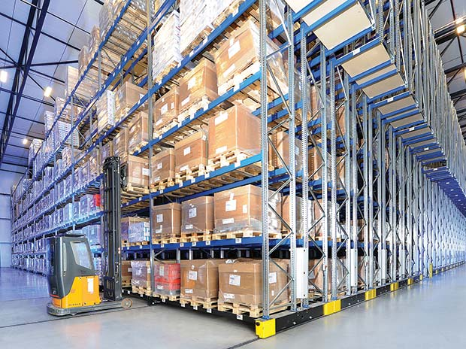
Used to design and maintain huge freezer wharehouses

Slide 36
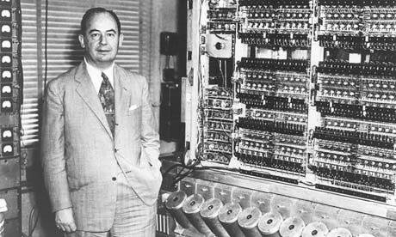
3. I’m Forever Blowing Bubbles
Mathematics can be used to put the foam onto beer
Lager:
Foam is made by bubbles of Carbon Dioxide
Small bubbles are eaten up by larger ones (Oswald Ripening)
Large bubbles make a pattern discovered by von Neumann
Eventually burst

Slide 37


A taste of Ireland
Bubbles in Guinness are smaller and longer lasting than those in other beers
Produced by introducing Nitrogen into the beer
In a pub this uses a pipe
In a can it uses a widget … lots of maths

Slide 38
Important maths paper from the MACSI group in Limerick Ireland
Who says mathematicians can’t have fun!

Slide 39
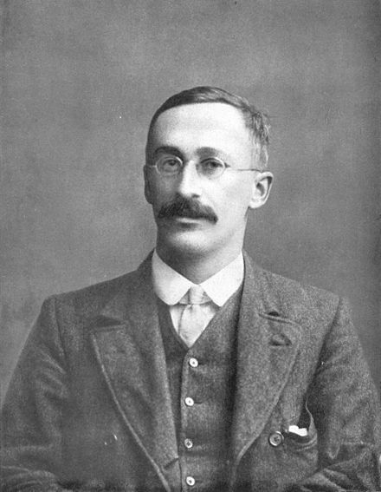
4. Why statisticians couldn’t organise a piss up in a brewery!!
Quality of Guinness in Dublin was monitored by using advanced statistical methods developed by Ghosset
He developed a test to determine
if two batches of Guinness were
Significantly from each other.
Published the test in 1908 under the
pseudonym of Student
Since then it has been known as
Student’s t-test It has very wide applications

Slide 40

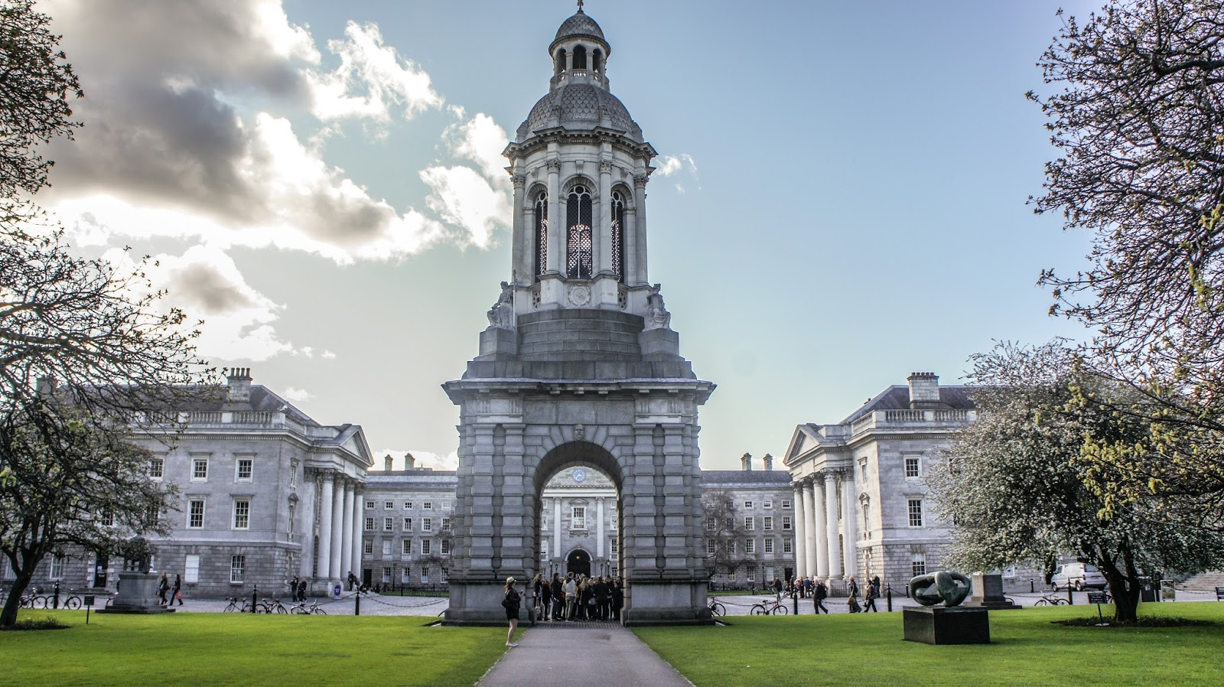

Slide 41

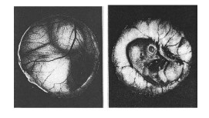
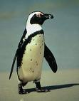
5. Incubation of eggs
Often have to incubate eggs artificially
Need to control
Temperature
Humidity
Turning of the egg
Very sensitive to the turning strategy!
Eggs are turned by mother every 20 minutes

Slide 42
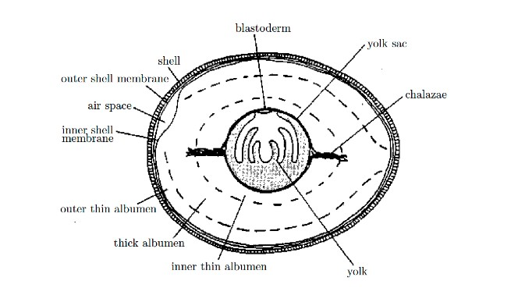
Blastoderm of lower density
Yolk is free to rotate

Slide 43
Some possible reasons for turning eggs ….
Conduction of heat … this is what Bristol zoo believed!
Dispersal of nutrients
Removal of waste products

Slide 44
Modelling the conduction of the heat
Q. Is turning needed to maintain an even temperature?
Radius of egg R = 2cm
Temperature = T
Thermal diffusivity k =
Heat equation

Slide 45
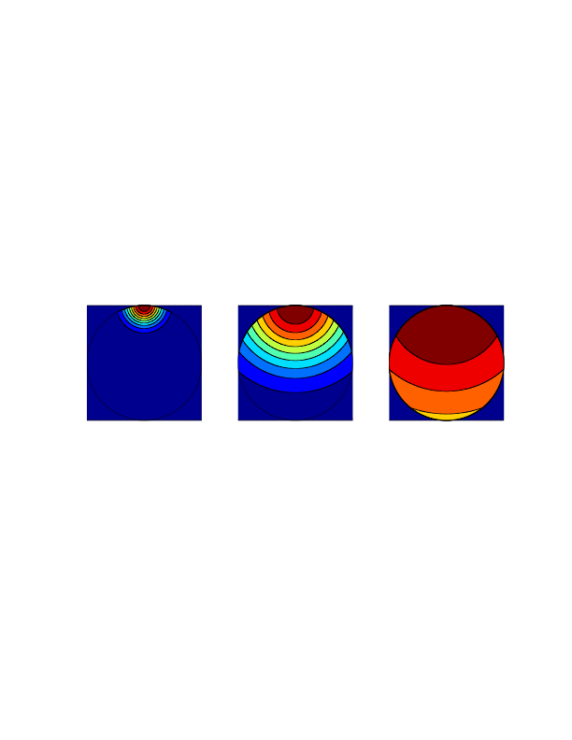
10 seconds
2 minutes
20 minutes
Too short!!! Consistent with results from incubator

Slide 46
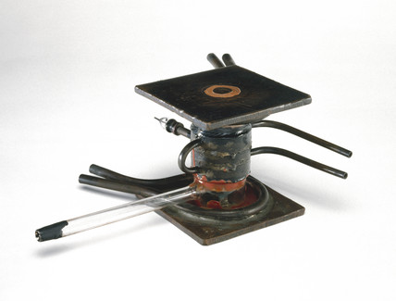
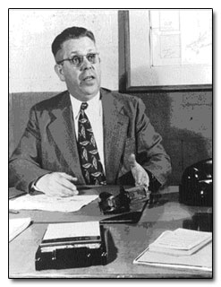
6. How to cook a potato
Cavity Magnetron
Invented by Randall and Boot during the war to produce high power radar waves at centimetre wavelengths
Realised by Percy Spencer that microwaves could be used to heat food (candy)
He invented the microwave cooker

Slide 47
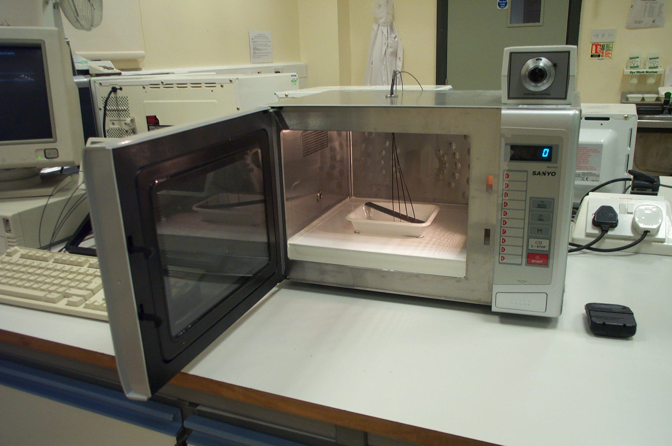
Microwave cooker

Slide 48
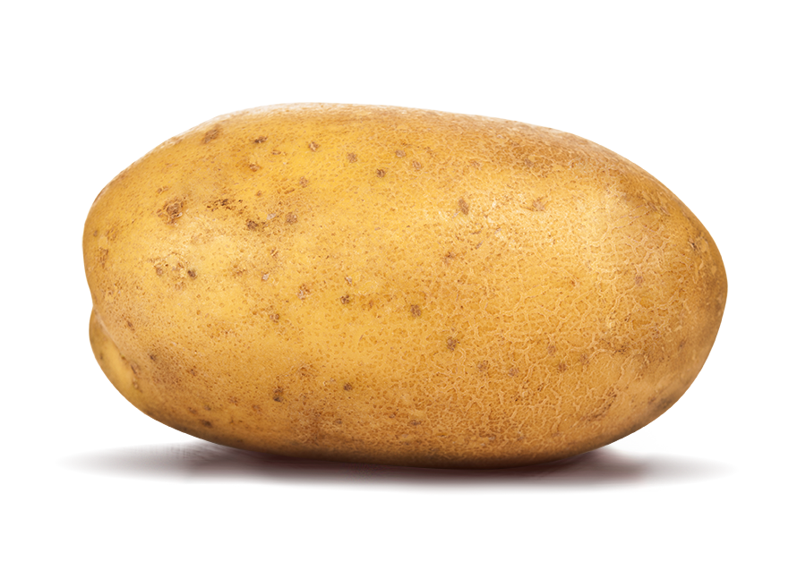
How safe is microwave cooking?
If you cook a potato in a microwave cooker what gets hotter?
The outside
The middle
Somewhere else?
What is the best design of a microwave cooker?
Mode stirred
Turntable

Slide 49
Thermal image of the food surface after 5 minutes heating (stirred oven)

Slide 50
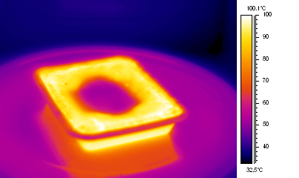
Turntable oven, thermal image taken after 5 minutes heating
Cold Spot

Slide 51
Thermal image of cross section after 3 minutes heating

Slide 52

Cavity .. Maxwells equations here
Foodstuff

Slide 53
Close to foodstuff
Heat loss by radiation and convection
Starchy food containing moisture
Food surface
L = 10cm
Temperature T,
Field strength E
Microwaves
Only really interested in what is happening in the food.
Microwaves absorbed and heat food

Slide 54
Computation of the Electric Field (Maxwell)
Microwaves decrease in strength as they penetrate the food and appear to take on a simple exponential form as the penetrate .. Vital clue!!

Slide 55
The resulting model.
Let N = Enthalpy of the food (thermal energy plus latent heat)
On the boundary
Uniform (stirrer), sine-wave (turntable)

Slide 56
650W Oven, Mode stirrer
Temperature

Slide 57
Compare to data : 650W Point Temperatures
Very good agreement

Slide 58
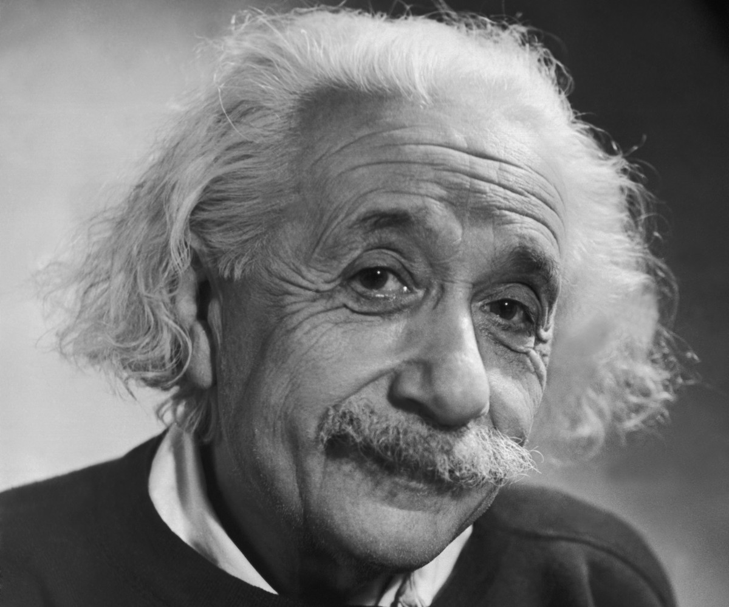
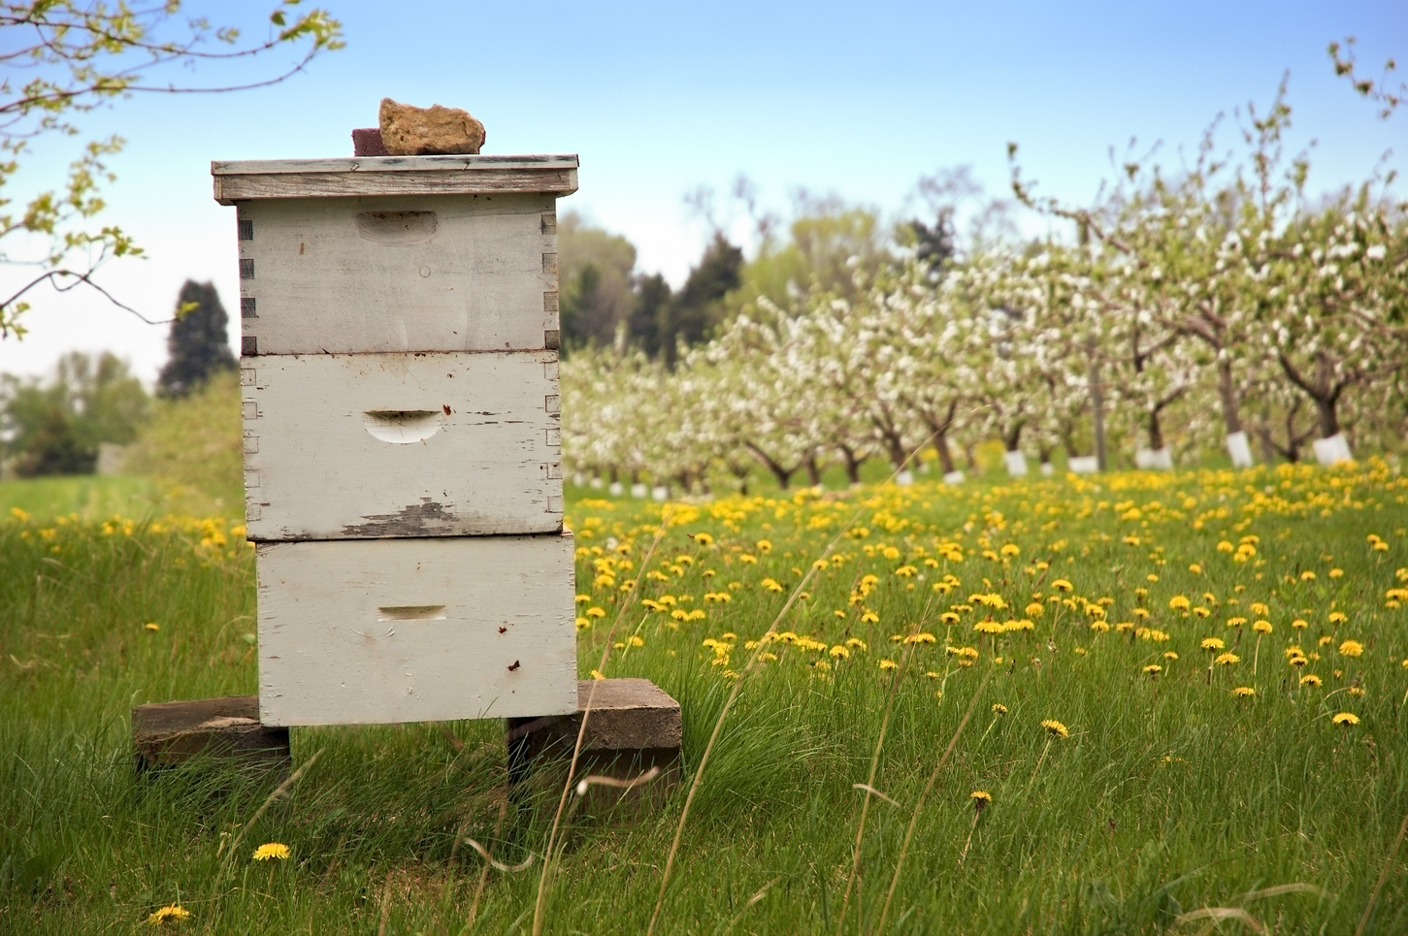
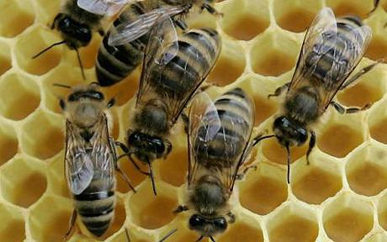
7. Where are the bees?
Einstein: The possible loss of the bees is the greatest threat to mankind

Slide 59
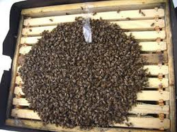
Maths can help the bees in many ways.
In particular to see how they respond to changes on their environment without disturbing them
Bees cluster together to keep themselves warm
Study using the same equation used for frozen food.

Slide 60

Can also use the maths of medical imaging to look inside a beehive
CT Image of a beehive
[Mark Greco]

Slide 61

8. Transport and delivery

Slide 62

Food distribution is a complex problem
Especially as food can perish quickly

Slide 63

Can be planned efficiently by solving a travelling salesman problem
using stochastic algorithms

Slide 64

In conclusion: three mathematicians go into a pub

