Slide 1
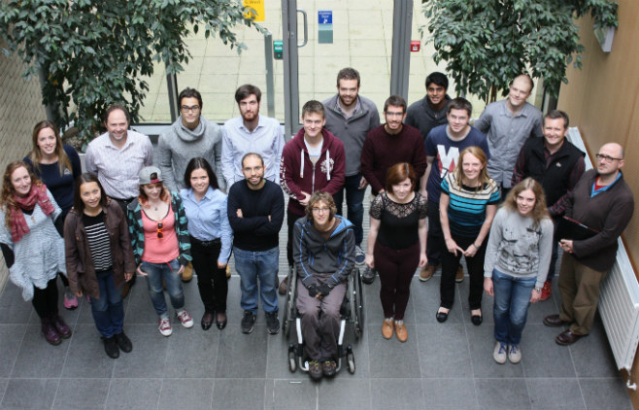

Diversity and Equality in Mathematics at Higher Education
Chris Budd

Slide 2
The big mission
To ensure that ALL students (undergraduate and postgraduate) in HE have the opportunity to access and get the most out of higher education and to have a very positive experience whilst they are there
For the same to be true of all staff in HE
To have no barriers for recruitment, studying and working in HE

Slide 3

The diverse Higher Education Community
The HE community (students and staff) is very diverse.
This is VERY GOOD and massively enhances everyone’s experience of university

Slide 4

But we need to make sure that no student or staff is disadvantaged by diversity
Aspects of diversity:
Gender
Race/religion
Nationality
Sexual orientation
Family background
School
Physical disability
Mental disability eg. Anxiety, Aspergers, Dislexia, ..
Subject
Age
Height
Left handed
…….

Slide 5
Is maths in HE a special case?
All of the above issues apply to maths as well as other subjects but there are some ‘special issues’
Positives
Maths is very socially diverse (though this is under threat). Anyone can be a good mathematician. Maths is the same anywhere in the world
Negatives
Maths has a bad public image. It is perceived as male dominated. Not cool to be seen to do maths (leads to bullying), high level of anxiety and mental health issues

Slide 6

Mathematicians are treated as freaks, mentally ill or even worse!

Slide 7
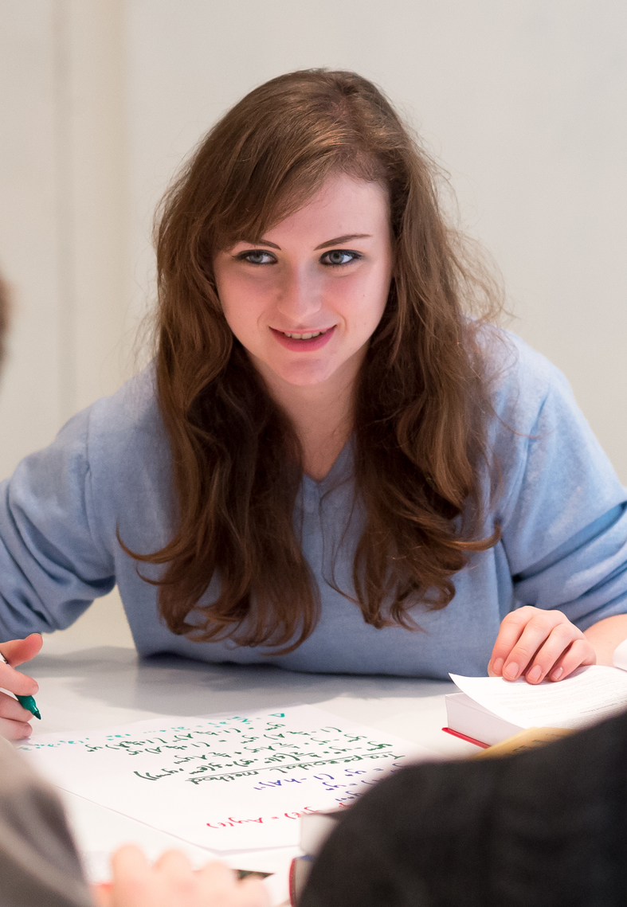
1. Gender diversity
Is there significant gender inequality in UK maths at HE?
Yes/No
Situation has been very bad in the past. Now improving but still a long way to go
All evidence is that women are just as good (if not better) at maths than men

Slide 8
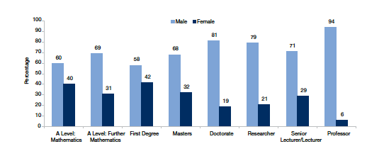
Some statistics from the LMS guide:
Advancing Women in mathematics
good practice in UK University departments
Not too bad at undergraduate level. Leakage at higher levels

Slide 9
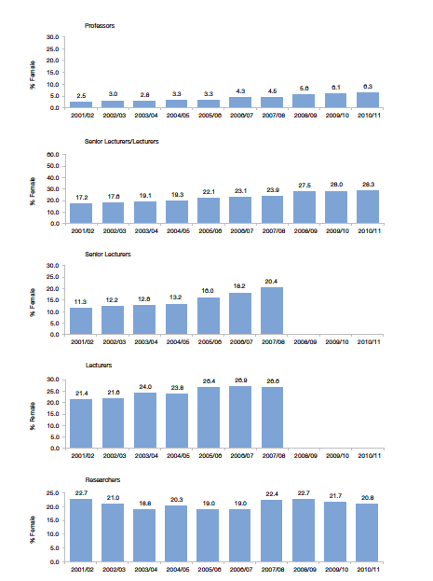
Things are improving slowly but a long way to go!

Slide 10
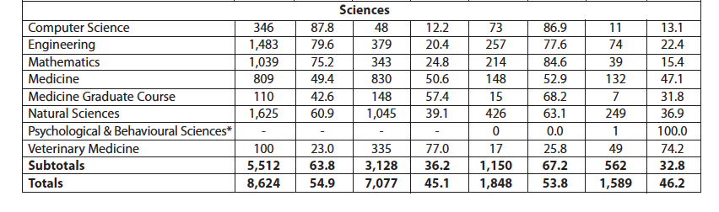
But statistics in Cambridge are not so good

Slide 11

Problems
Long hours culture and poor work/life balance
Competitive culture at ALL levels
STEP putting girls off. Low expectations and/or self esteem
Overuse of women on committees to the detriment of their careers
Poor support for those with caring responsibilities
Lack of cash .. Things done on the cheap eg. Travel
Maternity leave doesn’t work well with the REF or promotion
Mathematics is often regarded as unfeminine. Maths isn’t cool

Slide 12

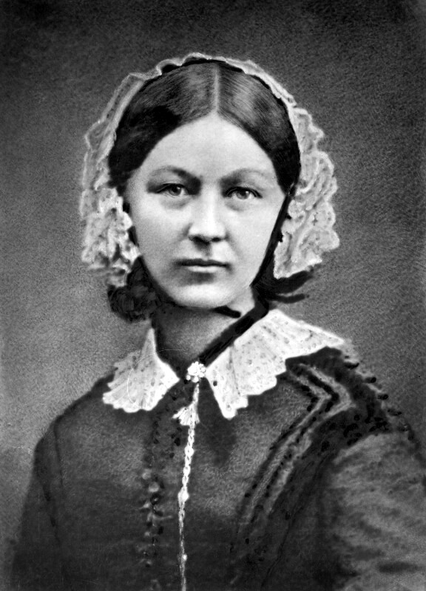
Some solutions
Athena Swan Programme
LMS Good Practice Guide
Constant awareness of issues in recruitment and promotion
Proactive policy in hiring
Proactive policy in conferences
Better work/life balance arrangements
Great role models and careers

Slide 13
2. School diversity issues
Problem: Lack of diversity of schools .. Lack of state school students
Better in maths than in some other subjects but still fragile
Typically students on maths degrees do A level maths AND A level further maths
In the past this restricted the schools students could come from
Currently situation is much better due to the FMSP
The proportion of state-funded schools and colleges with students taking A level Further Mathematics has increased from less than 40% in 2005 to over 65% in 2016.
BUT new government reforms may undermine this

Slide 14
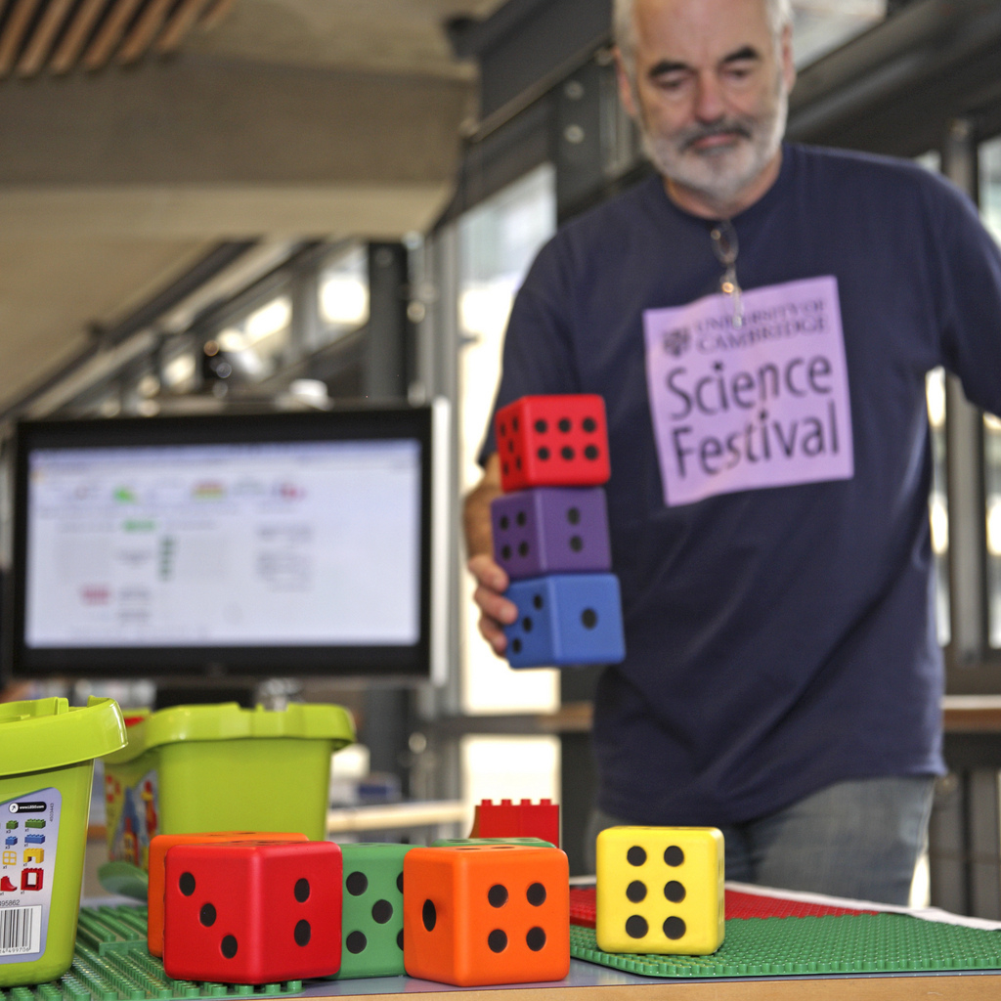
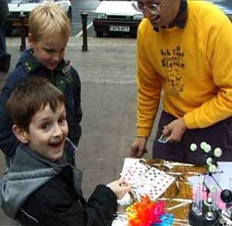

Need to make maths attractive to students from all backgrounds
Widening participation schemes
Open days
Science festivals
School visits
Masterclasses
Student ambassadors
Bursaries

Slide 15
However .. When you arrive ….
“In both Russell and non-Russell Group universities, students from independent schools were less likely to achieve either a first class degree or at least an upper second class degree than students from comprehensive schools with similar prior attainment.”
Dr Vidal Rodeiro, from Cambridge Assessment

Slide 16
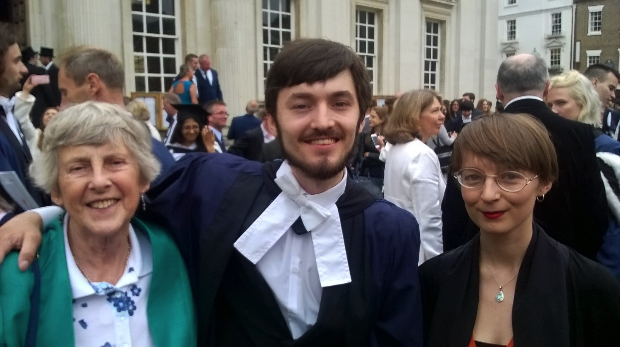
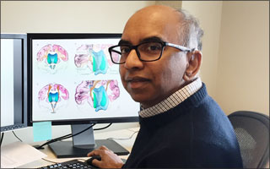
3. Physically Disabled students
My son is disabled! Now starting a PhD : )
Issues
Mobility
Sight
Hearing
Extreme tiredness
Allergies eg. eczema
Tilak Ratnanather

Slide 17
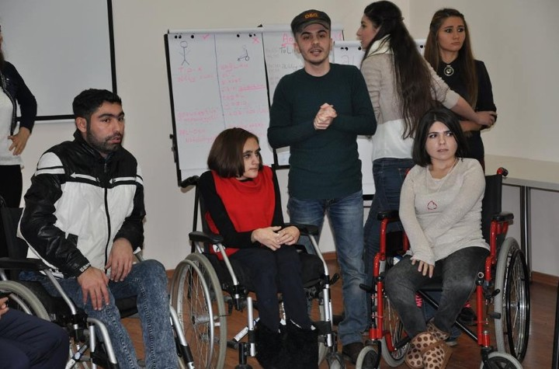
Some problems
Poor infrastructure
Stairs
Doors
Badly designed lecture theatres
Distances between lectures
limited visibility (hard for mathematics)
inappropriate computers
Poor expectations
Poor assessment procedures (at HE and at A level)

Slide 18
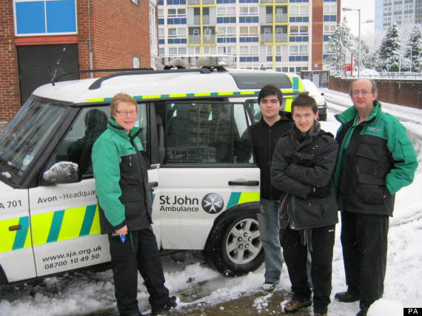
A-Level Results Day 2013: Jeremy Budd, Student Dashed To Exam By Ambulance, Gets To Cambridge

Slide 19
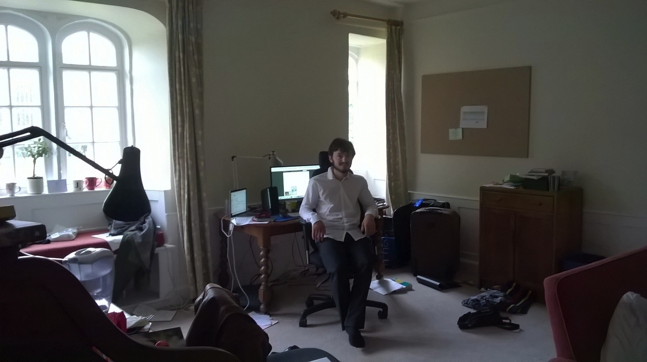
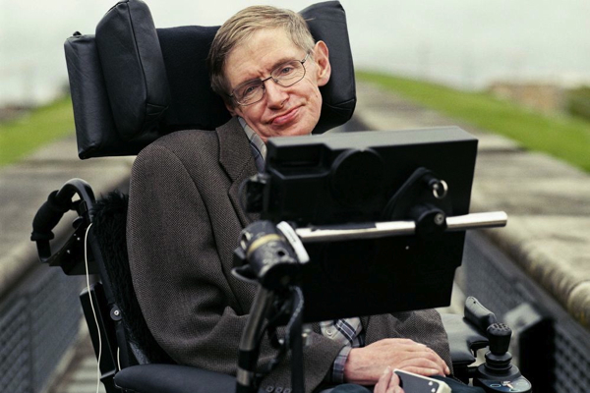
Some solutions
DSA: Disabled students allowance
Lots of forms and an assessment
Mentoring schemes
Individual Learning support eg. Scribes
Help with examinations
Better infrastructure
Special computers/equipment
Role models

Slide 20
Case Study: Putting Sam back into SAMBa
SAMBa students intake of 2015

Slide 21

Sam enters the SAMBa PhD programme as an able bodied student in 2014
Suffers a serious cycling accident in early 2015. Is confined to a wheel chair
Enters back into the 2015 programme
Special doors installed (after a HUGE effort by
Susie Douglas)
Now a full time student with bright prospects ahead
He is still cycling!!!

Slide 22
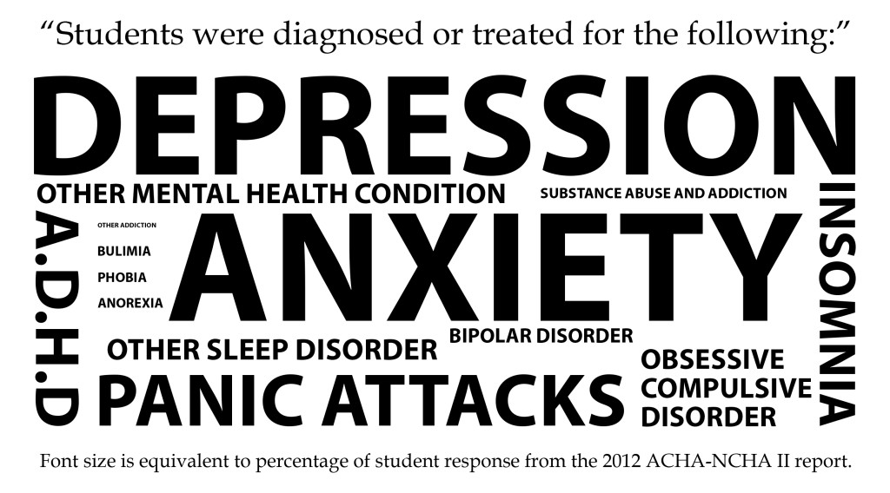
4. Mental Disability
We now have significant numbers of students with mental health problems (possibly exacerbated by the internet)
University is a stressful place for all of its members
Problems
Depression
Anxiety
Loneliness
Diagnosed illness: Aspergers (common in maths!), dislexia, …
Imposter syndrome

Slide 23

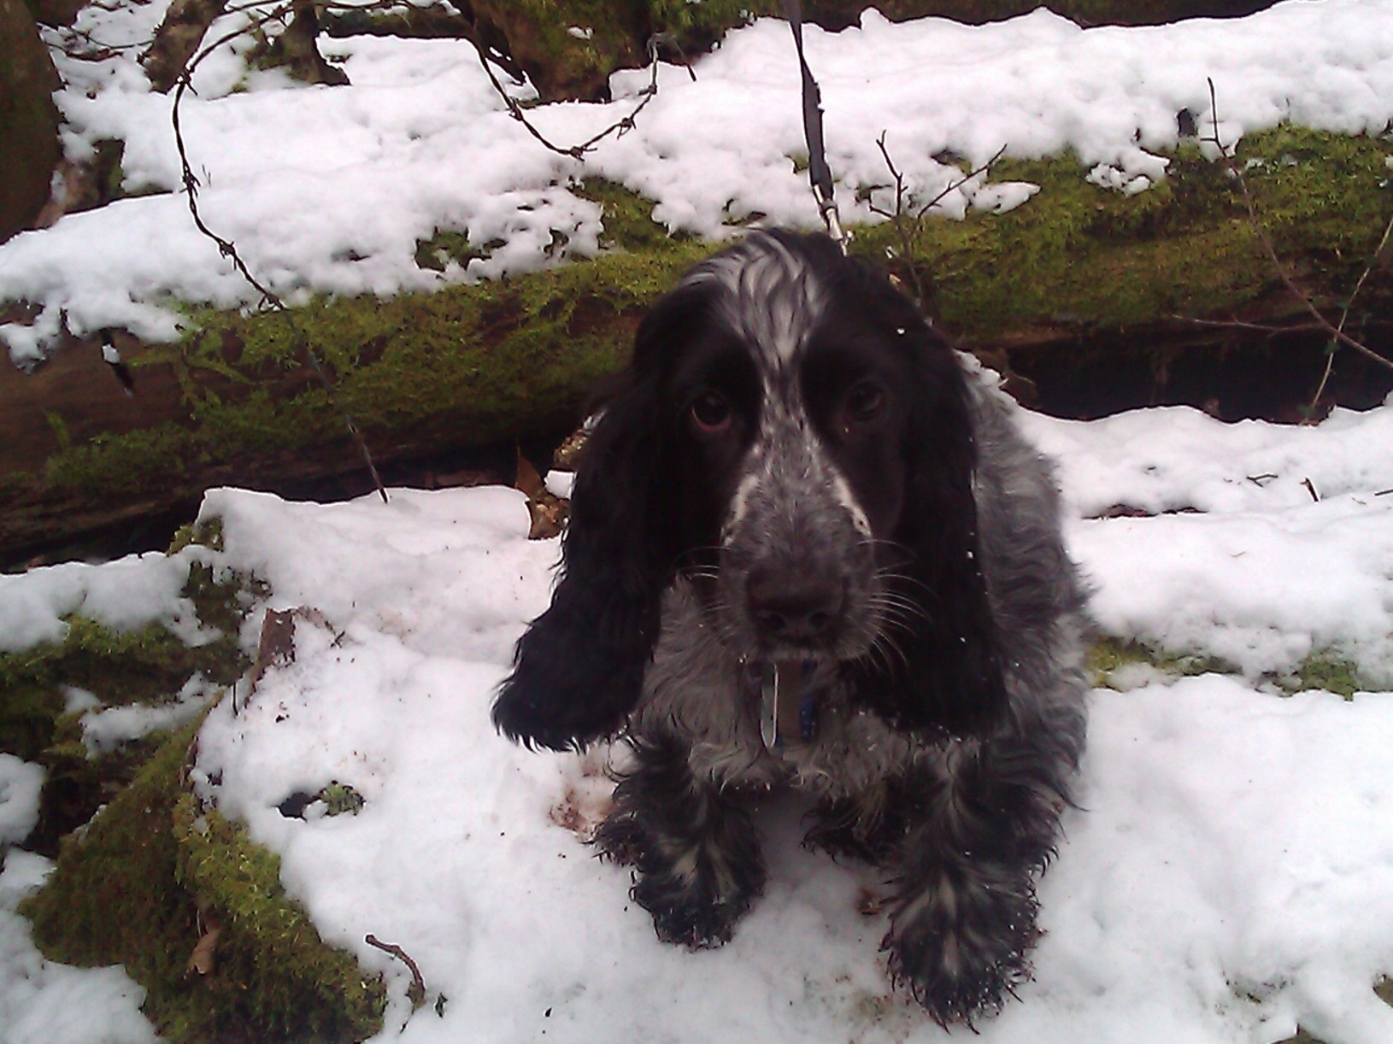
Some solutions
Awareness and understanding
Personal tutor system
Counseling service
Learning support, MASH
Better assessment procedures
Cuddly toys
Puppy therapy
But we are not allowed to contact parents!

Slide 24

Above All
Don’t let anyone tell you that you are a freak just because you are a mathematician!!!!
Mathematicians are cool

