Slide 1
How to A-Maze your Friends
Maths Masterclass – March 2023 – The University of Bath – Mark Lewis

Slide 2
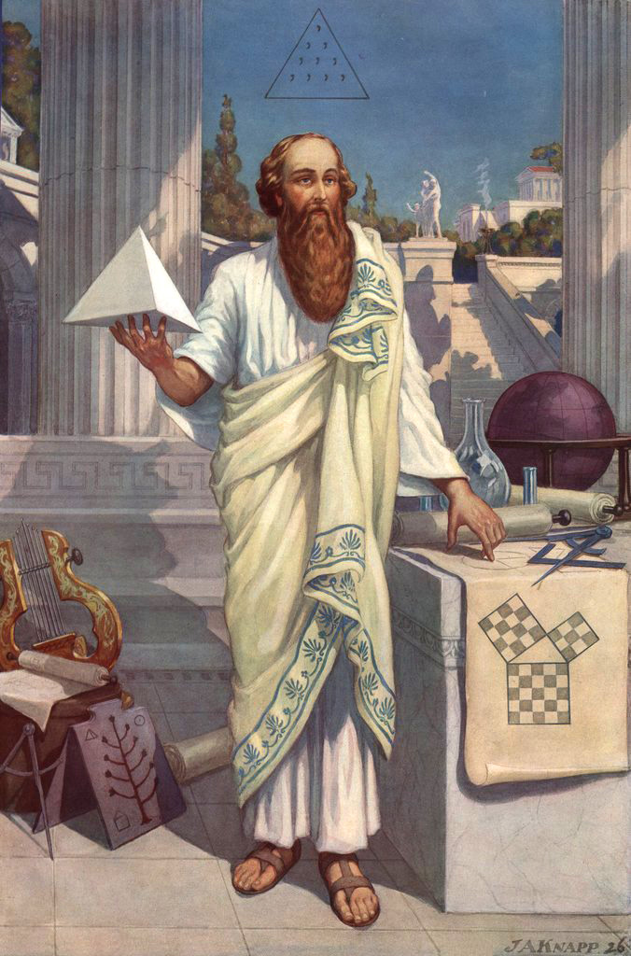
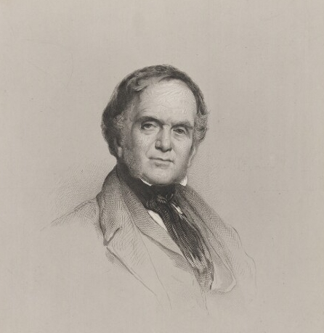
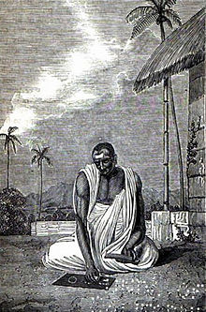
What’s the most up-to-date maths you have studied?

Slide 3
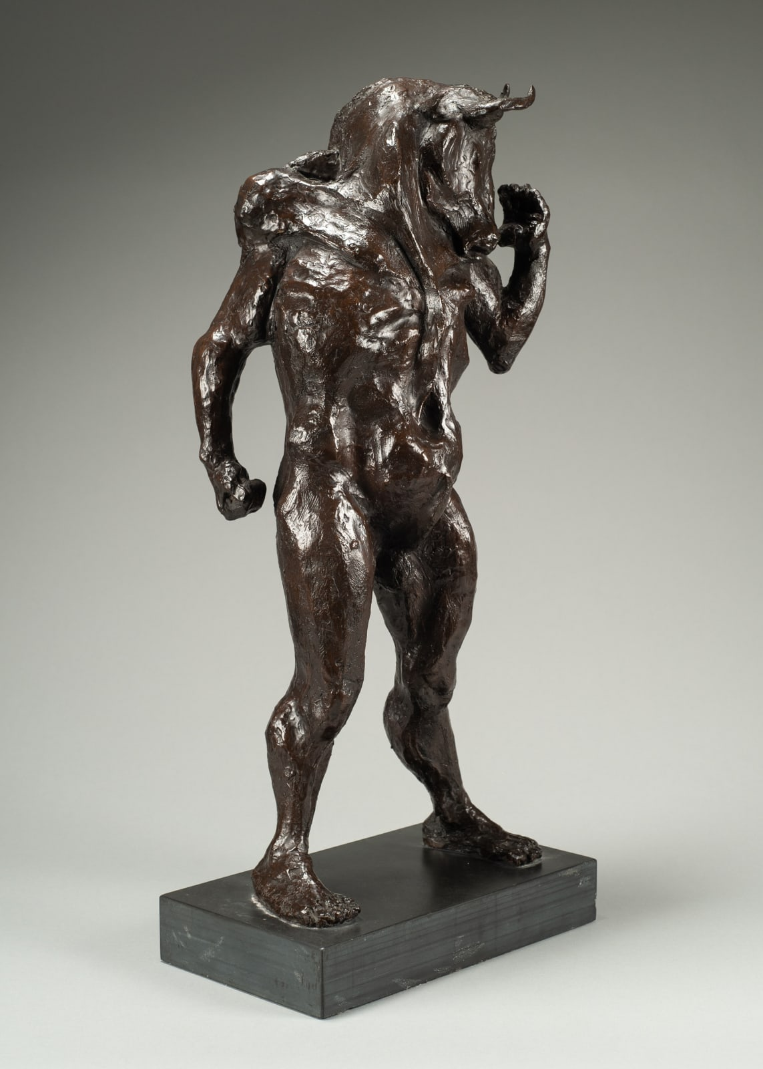
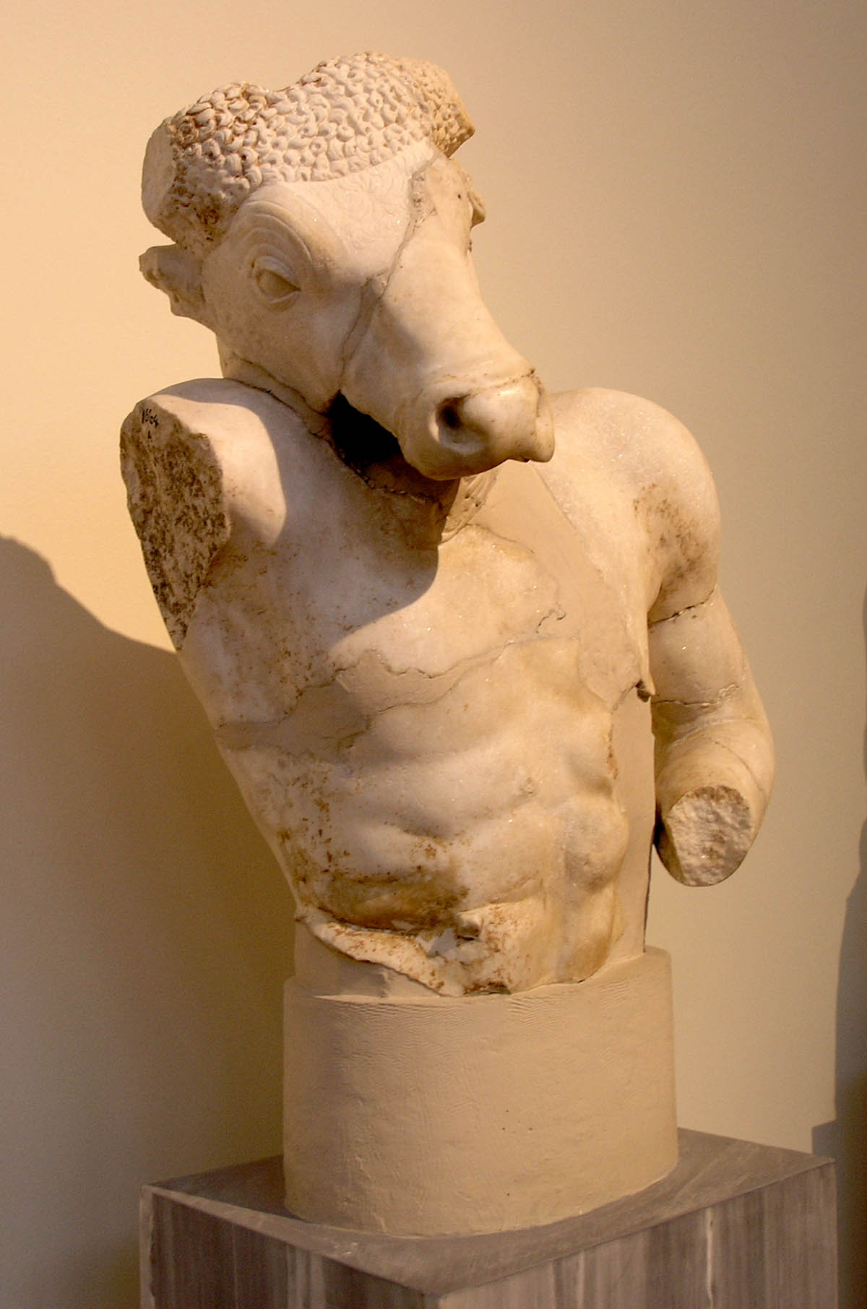
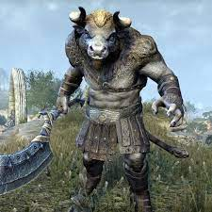
The Minotaur

Slide 4
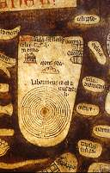
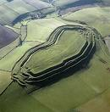
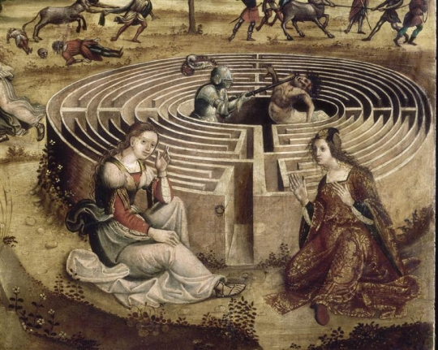
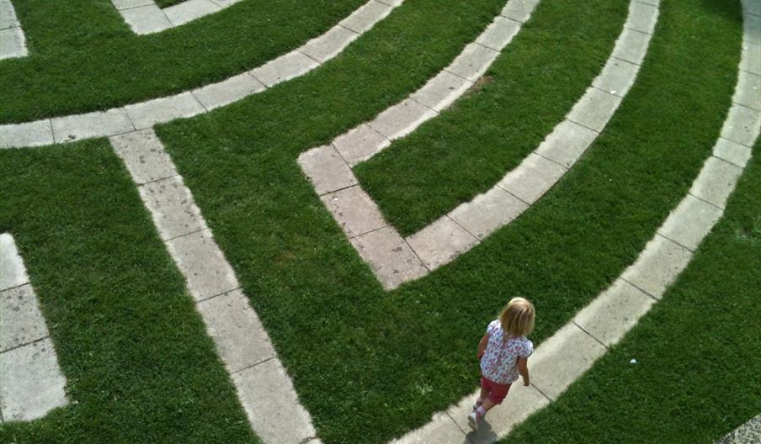
Labyrinths through the ages

Slide 5
the Cretan labyrinth

Slide 6
Seed for the Cretan labyrinth

Slide 7
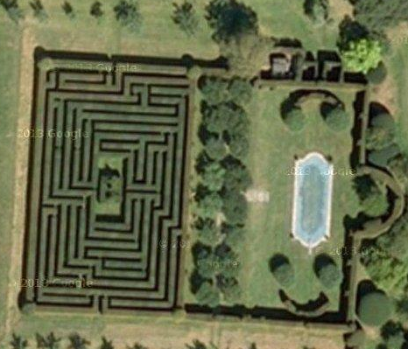
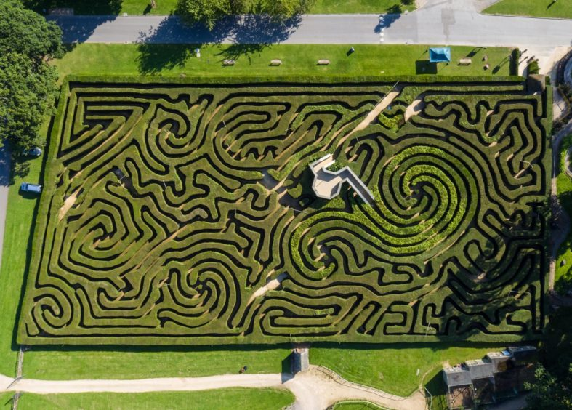
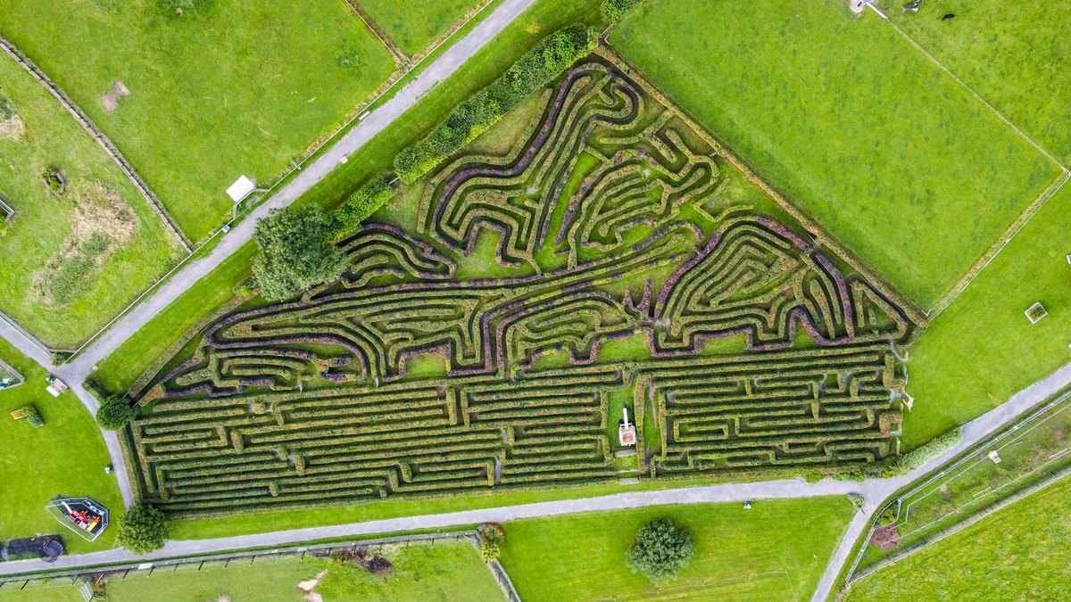
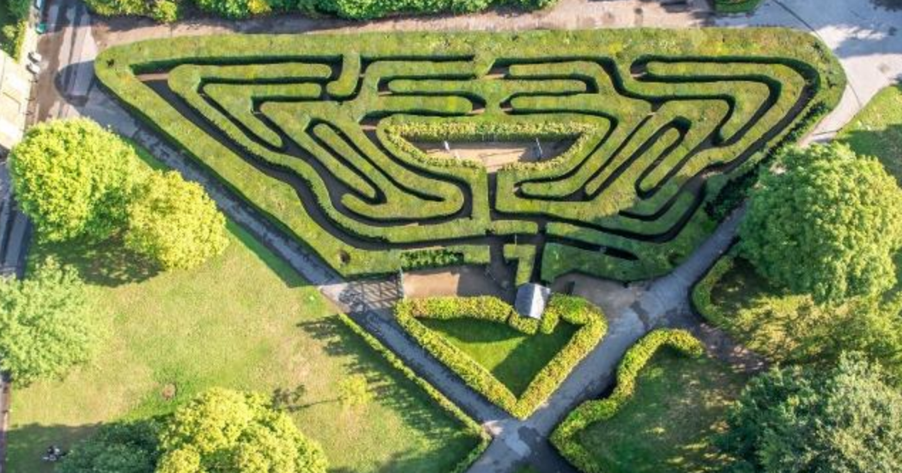
The Rise of the Maze

Slide 8
How to A-Maze your Friends
Maths Masterclass – March 2023 – The University of Bath – Mark Lewis

Slide 9
Method one .. The hand on the hedge method
X
Always keep turning left (or right)

Slide 10
Method one .. The hand on the hedge method
X
Add more hedges

Slide 11
Method one .. The hand on the hedge method
X
Add more hedges

Slide 12
Method one .. The hand on the hedge method
X
Will this always work?

Slide 13
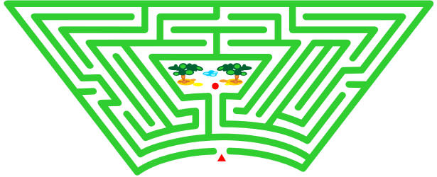
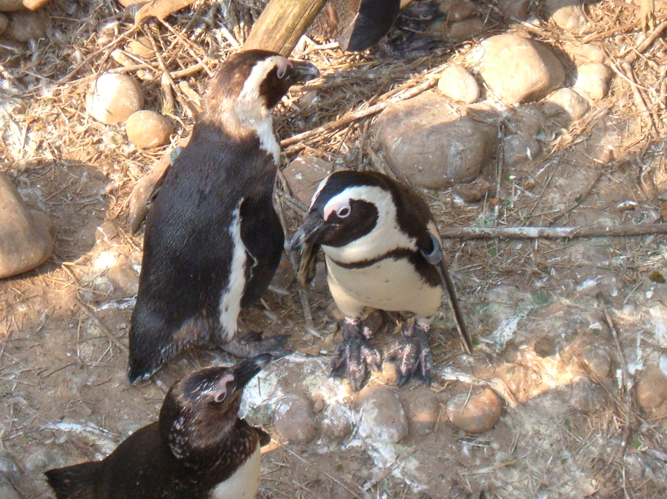
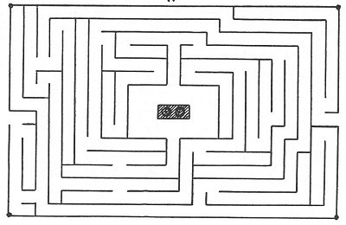
Method one .. The hand on the hedge method
If a bird can walk on a hedge from the entrance to the centre then you can solve the maze using the hand on the hedge method

Slide 14
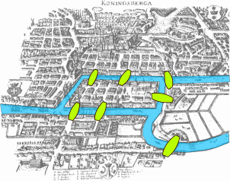
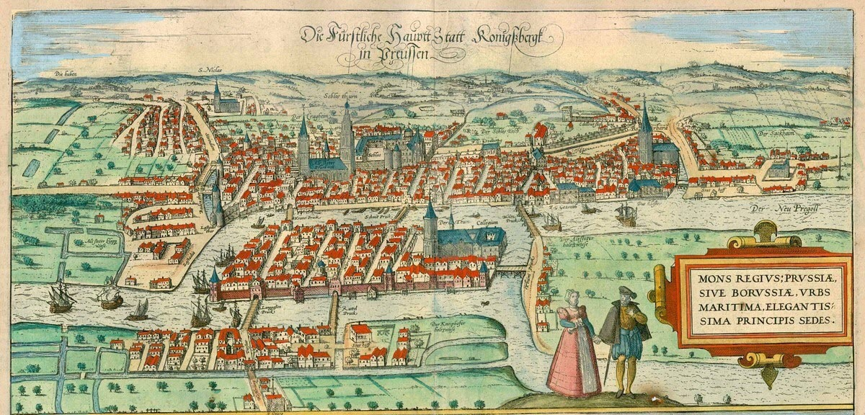
Method two – Using a Network
B
To solve a more general maze we need to learn about Networks
A
C
D

Slide 15
Network
Even Node
Odd Node
Edge

Slide 16
Maze Network
D
G
I
J
L
C
K
M
E
F
H
N
B
A
B
D
F
L
N
I
A
C
E
G
K
M
H
Centre
J

Slide 17
Other Networks
Bob
Social Network
Mary
Dave
Basil
Alice
Richard
Mark

Slide 18
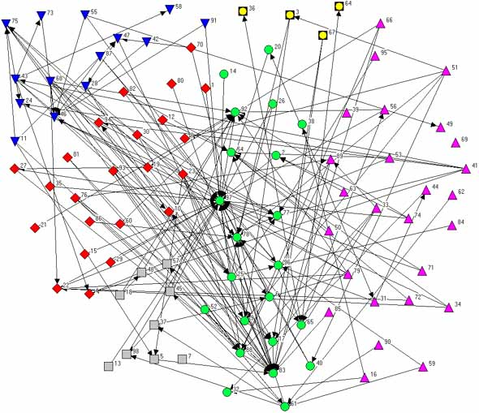
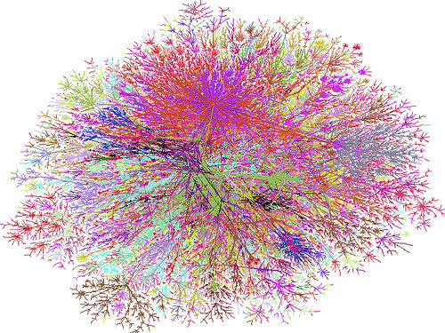
Other Networks
The internet

Slide 19
How to A-Maze your Friends
Maths Masterclass – March 2023 – The University of Bath – Mark Lewis

Slide 20
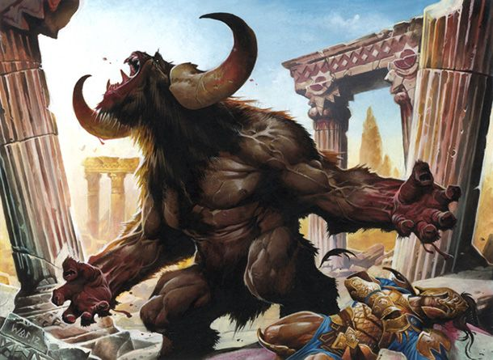
Use your network (and some peanuts) to solve a maze
Start at the entrance and take any path
If you come to a new node then leave a peanut and take any new path
If you come to an old node (or the end of a blind alley) and you are on a new path then turn back along this path
If you come to an old node and you are on an old path then take a new path (or another old path if no new path exists)
Never go down a path more than twice
Good luck!

Slide 21
Use your network (and some peanuts) to solve a maze
Start at the entrance and take any path
If you come to a new node then leave a peanut and take any new path
If you come to an old node (or the end of a blind alley) and you are on a new path then turn back along this path
If you come to an old node and you are on an old path then take a new path (or another old path if no new path exists)
Never go down a path more than twice
B
D
F
L
N
I
A
C
E
G
K
M
H
Finish
J

Slide 22
Method two – Using a Network
B
To solve a more general maze we need to learn about Networks
A
C
D

Slide 23
Some more doodling to finish…

Slide 24
How to A-Maze your Friends
Maths Masterclass – March 2023 – The University of Bath – Mark Lewis

