Slide 1
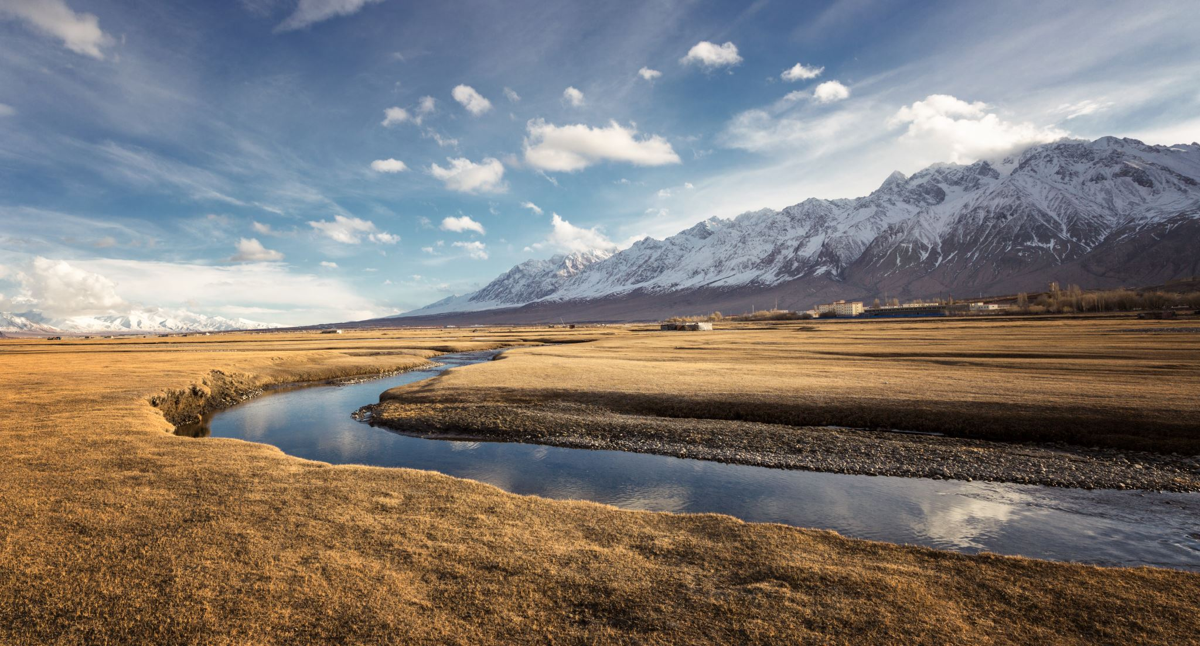



Mathematics of floods: developing an asymptotic framework for the unification of rainfall-runoff models
Piotr Morawiecki
SAMBa conference 6 July 2022

Slide 2
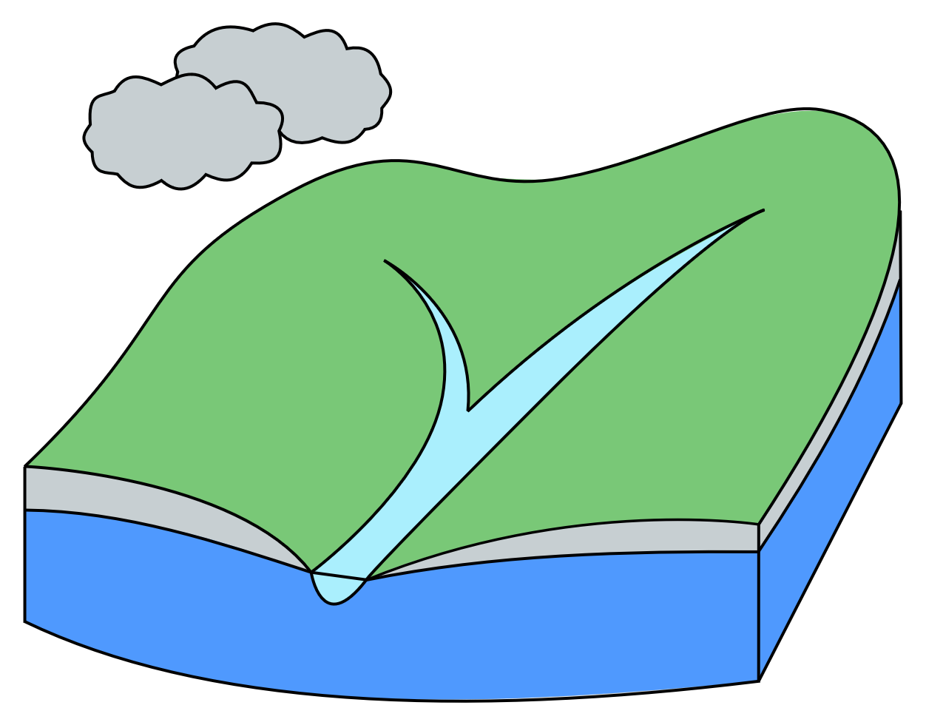
The Main problem
Annual peak flow
Hydrograph measured in a gauging site in Bath [source: NRFA]

Slide 3
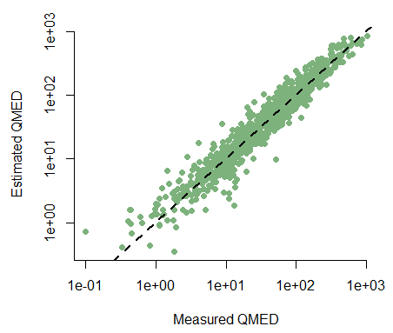
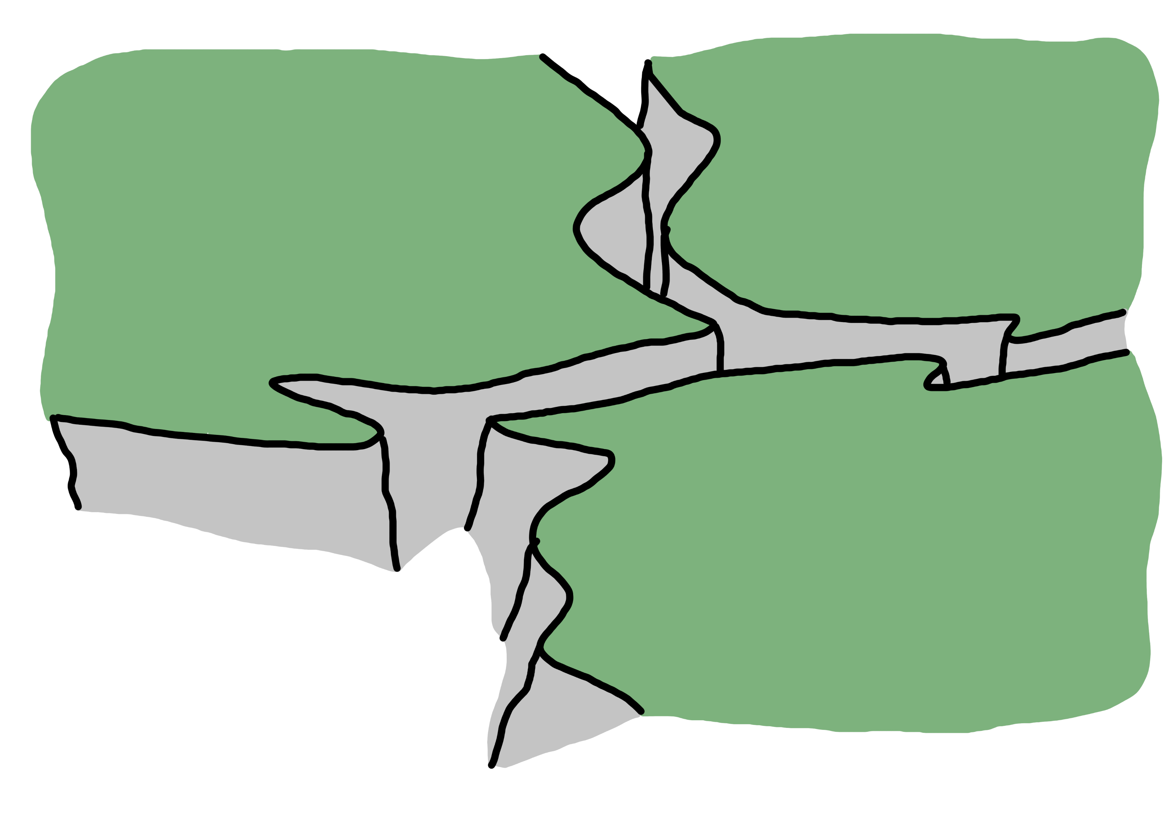


motivation
Conceptual models are based on physical principles, but represented by much simpler mathematical models.
Physical models are based on laws of fluid dynamics.
Statistical models use statistical methods (e.g. regression) based on selected catchment parameters.
“Chasm of ignorance”
represents the inconsistencies between models assumptions and predictions.
$$QMED=8.3602⋅{AREA}^{0.8510}⋅{0.1536}^{\frac{1000}{SAAR}}⋅{FARL}^{3.4451}⋅{0.0460}^{{BFIHOST}^{2}}$$

Slide 4
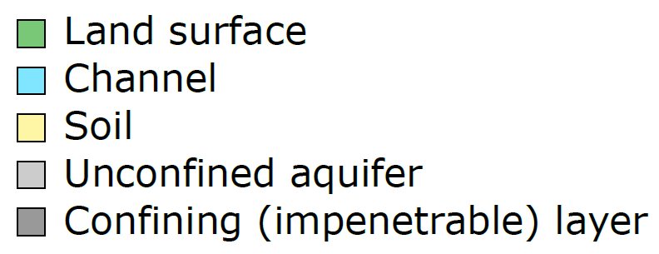
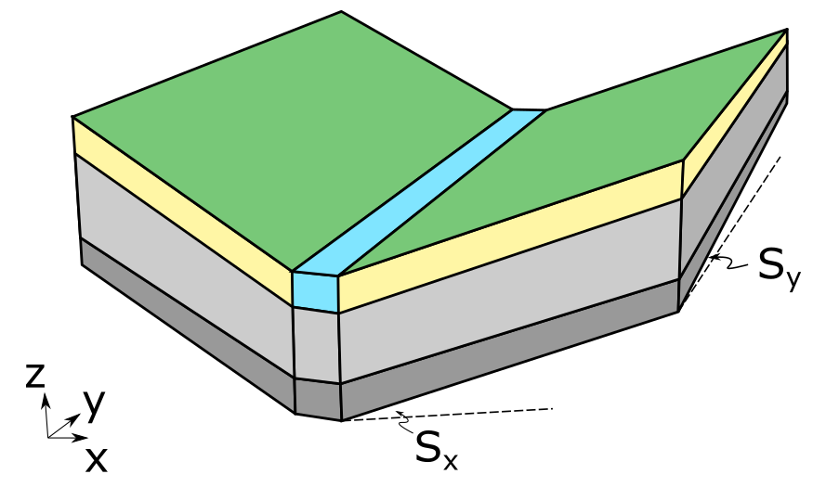
Asymptotic framework
2D Saint Venant equations for the overland flow
STEP 1. Construction of a simplified catchment model reflecting properties of the real-world systems.
STEP 2. Use nondimensionalisation and asymptotic analysis to extract key elements responsible for generating flow.
STEP 3. Analyse reduced models using asymptotic methods to extract scaling laws describing flow formation.
STEP 4. Compare the benchmark model with scaling laws predicted by other flood estimation models
3D Richards equations for the subsurface flow

Slide 5
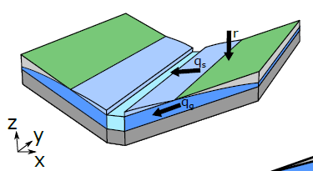


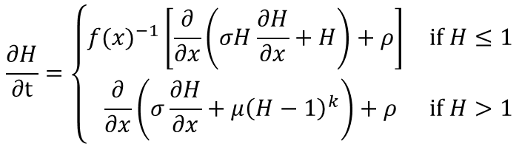

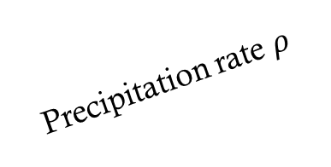
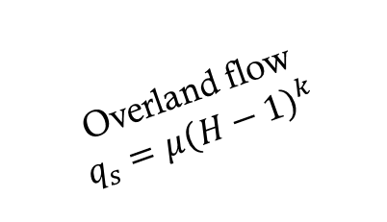
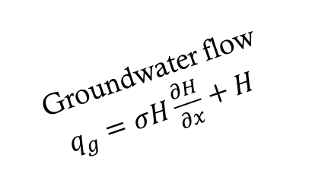

Coupled 1D Model formulation
Groundwater flow
Precipitation
Precipitation rate $ρ$
$$\frac{∂H}{∂t}=\left\{\begin{matrix}{f(x)}^{−1}\left[\frac{∂}{∂x}\left(σH\frac{∂H}{∂x}+H\right)+ρ\right] & if H≤1 \\ \frac{∂}{∂x}\left(σ\frac{∂H}{∂x}+μ{\left(H−1\right)}^{k}\right)+ρ & if H>1\end{matrix}\right.$$
Overland flow
$$q_{s}=μ{\left(H−1\right)}^{k}$$
$$H(x,t)$$
Groundwater flow $q_{g}=σH\frac{∂H}{∂x}+H$
Groundwater flow
Overland flow
$$y$$
Key question:
How does river flow changes over time during an intensive rainfall?
$$x$$
Saturated zone
Unsaturated zone
Saturation front

Slide 6




Structure of the solution
$$H$$
River flow, $Q(t)$
Early time rapid growth due to the rainfall over the initially saturated zone.
$$x$$
$$t$$

Slide 7
Structure of the solution
$$H$$
River flow, $Q(t)$
Late time behaviour caused by the growth of the saturation zone.
Early time rapid growth due to the rainfall over the initially saturated zone.
$$x$$
$$t$$

Slide 8
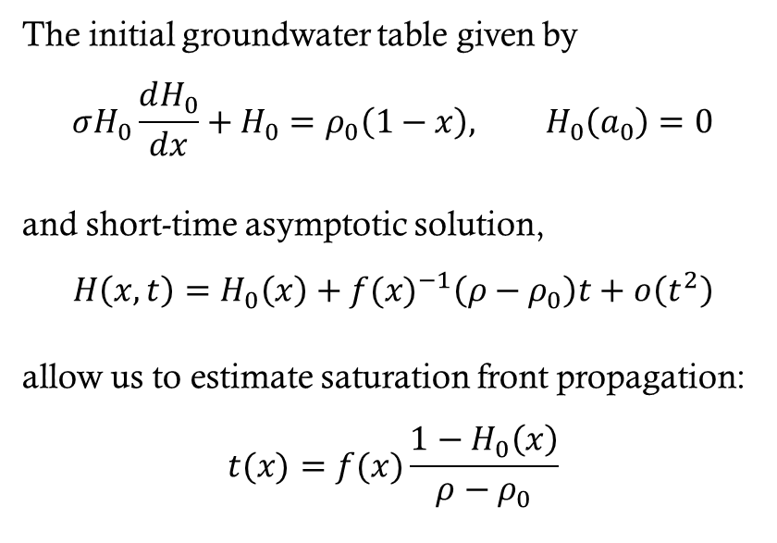
Saturation Front propagation
$$H$$
The initial groundwater table given by
$$σH_{0}\frac{dH_{0}}{dx}+H_{0}=ρ_{0}\left(1−x\right), H_{0}\left(a_{0}\right)=0$$
and short-time asymptotic solution,
$$H\left(x,t\right)=H_{0}\left(x\right)+{f(x)}^{−1}\left(ρ−ρ_{0}\right)t+o\left(t^{2}\right)$$
allow us to estimate saturation front propagation:
$$t(x)=f(x)\frac{1−H_{0}\left(x\right)}{ρ−ρ_{0}}$$
$$x$$

Slide 9
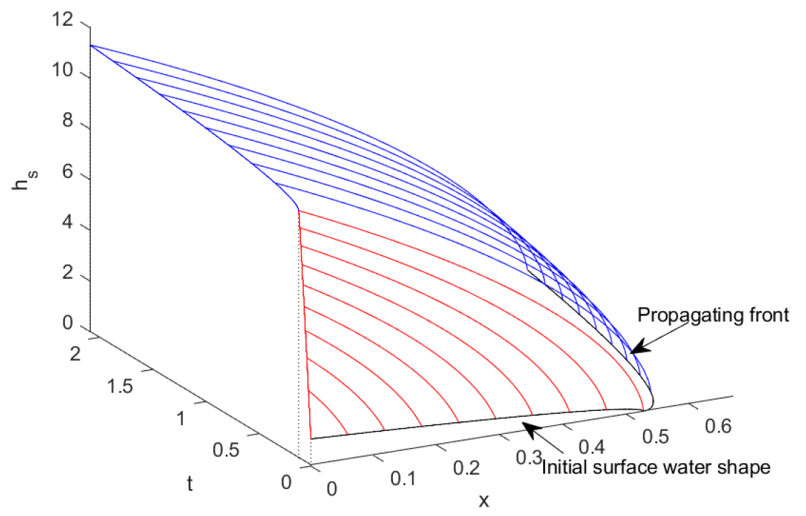
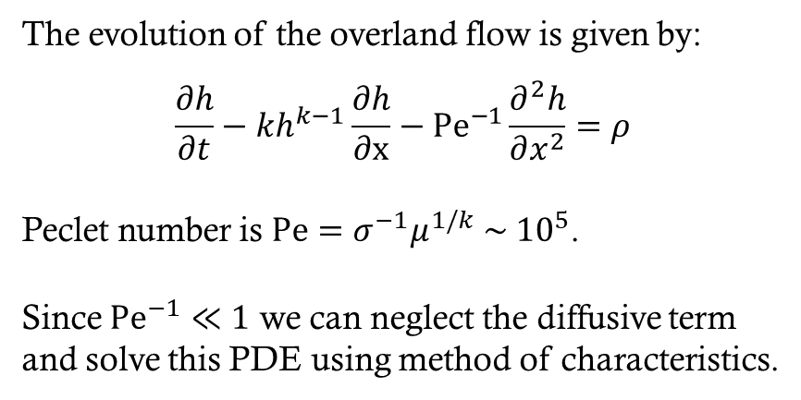
Evolution of Overland flow
The evolution of the overland flow is given by:
$$\frac{∂h}{∂t}−kh^{k−1}\frac{∂h}{∂x}−{Pe}^{−1}\frac{∂^{2}h}{∂x^{2}}=ρ$$
Peclet number is $Pe=σ^{−1}μ^{1/k} \sim {10}^{5}$.
Since ${Pe}^{−1}≪1$ we can neglect the diffusive term and solve this PDE using method of characteristics.

Slide 10
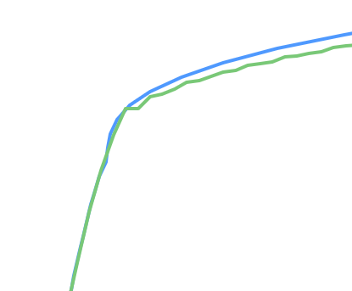
Analytic vs numeric solution

Slide 11
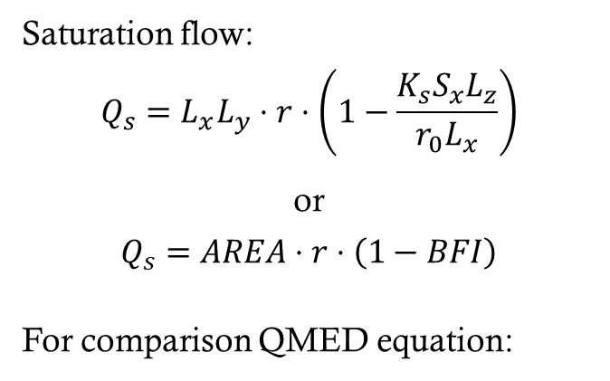
Analytic vs numeric solution
Saturation flow:
$$Q_{s}=L_{x}L_{y}⋅r⋅\left(1−\frac{K_{s}S_{x}L_{z}}{r_{0}L_{x}}\right)$$
or
$$Q_{s}=AREA⋅r⋅\left(1−BFI\right)$$
For comparison QMED equation:
$$QMED=8.3602⋅{AREA}^{0.8510}⋅{0.1536}^{\frac{1000}{SAAR}}⋅{0.0460}^{{BFIHOST}^{2}}$$

Slide 12
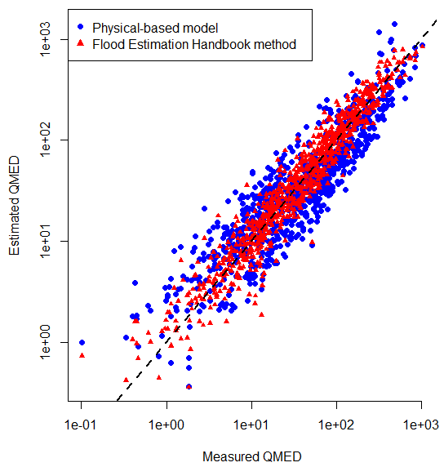
Real-world verification of 1D model predictions
Our simple physical-based model accurately describes peak flows observed in UK (confirmed using standard statistical tests).
Our prediction is less precise than FEH model, however:
it does not involve any calibration (there is no risk of overfitting),
it is based on well-founded assumptions and is easy to interpret,
it has known limits of applicability.

Slide 13
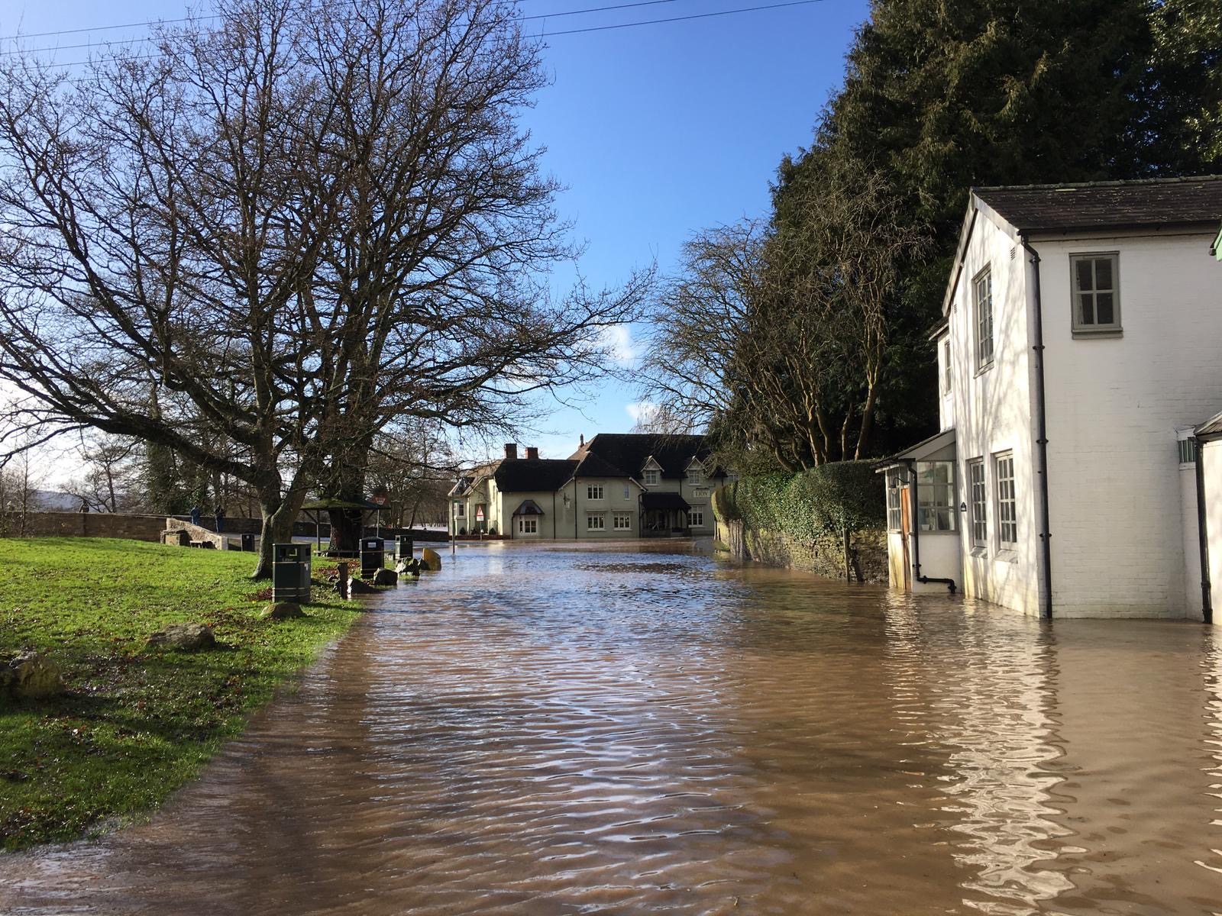
conclusions
The coupled surface-subsurface models are fundamental for the hydrology, however so far unexplored by mathematical community.
Despite computational models complexity, simple benchmark scenarios can be investigated analytically giving scaling laws consistent with the real-world data.
The analytical scaling laws extracted from physical catchment models can be used to better understand limitations of data-driven flood models.
Peter Evans / River Teme floods at Leintwardine, February 2020 / CC BY-SA 2.0
Contact: Piotr Morawiecki, pwm27@bath.ac.uk
Website: https://people.bath.ac.uk/pwm27/

Slide 14
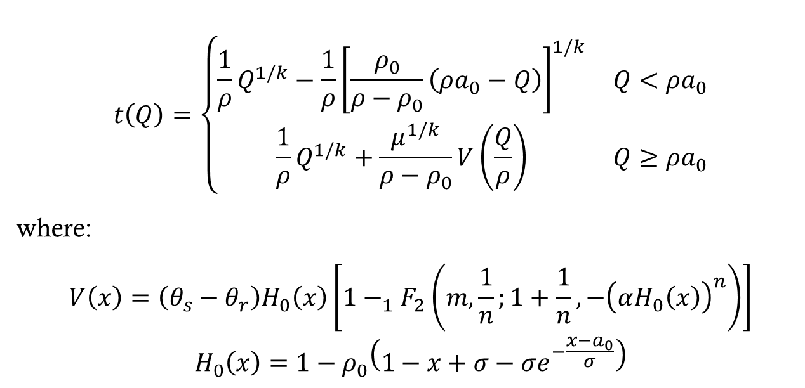
Appendix a. Analytic approximation
$$t\left(Q\right)=\left\{\begin{matrix}\frac{1}{ρ}Q^{1/k}−\frac{1}{ρ}{\left[\frac{ρ_{0}}{ρ−ρ_{0}}\left(ρa_{0}−Q\right)\right]}^{1/k} & Q<ρa_{0} \\ \frac{1}{ρ}Q^{1/k}+\frac{μ^{1/k}}{ρ−ρ_{0}}V\left(\frac{Q}{ρ}\right) & Q≥ρa_{0}\end{matrix}\right.$$
where:
$$V\left(x\right)=\left(θ_{s}−θ_{r}\right)H_{0}\left(x\right)\left[1−_{1}F_{2}\left(m,\frac{1}{n};1+\frac{1}{n},−{\left(αH_{0}\left(x\right)\right)}^{n}\right)\right]$$
$$H_{0}\left(x\right)=1−ρ_{0}\left(1−x+σ−σe^{−\frac{x−a_{0}}{σ}}\right)$$

