Slide 1



Lubrication layer cushioned capillary scale rebound dynamics
Kat Phillips
Supervised by: Paul Milewski, Jonathan Evans & Phil Trinh
Notes:
I wanted to do a bit of a lighter talk right before lunch, and luckily Eileen has done most of the heavy lifting for me in her talk. So you should already have a good idea of the complex behaviours that droplets on a liquid surface can undertake, though if not we’ll have brief recap. I’ll then spend most of the talk explaining the mechanics behind what allows the droplet to have this behaviour, and at the very end show you some pretty results from a numerical simulation of a rebounding drplet

Slide 2

A little bit of self promotion
Joined SAMBa, Sept 2019
Started ‘KatDoesMaths’, May 2021
Started work with SAMBa & the Faculty of Science ‘Employer’s Advisory Board’ as EDI Research Coordinator, Feb 2022 – June 2022
1

Slide 3
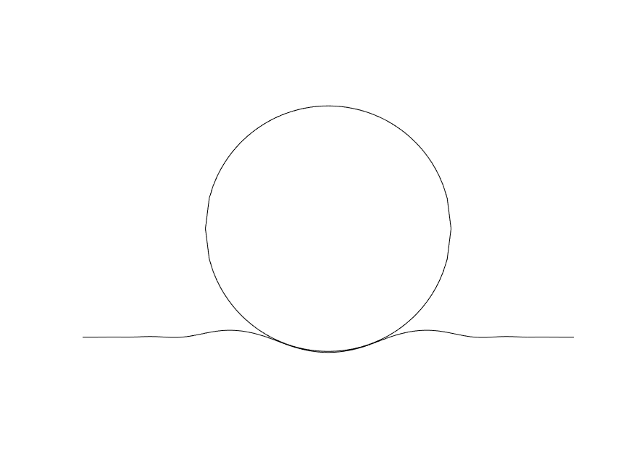




Lubrication layer cushioned capillary scale rebound dynamics
2

Slide 4
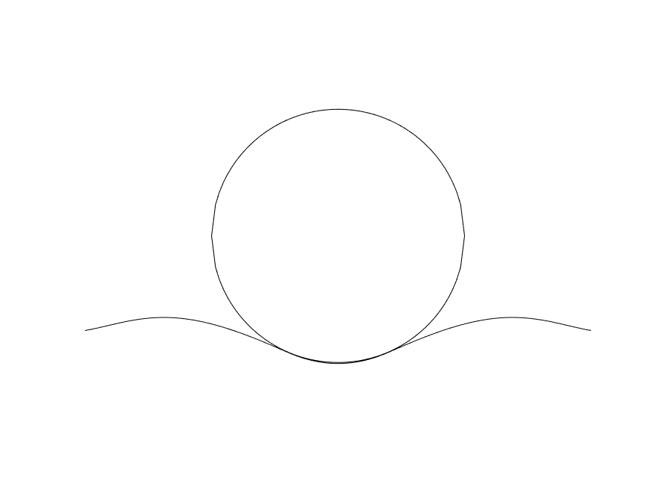
Cut to Camera
3

Slide 5
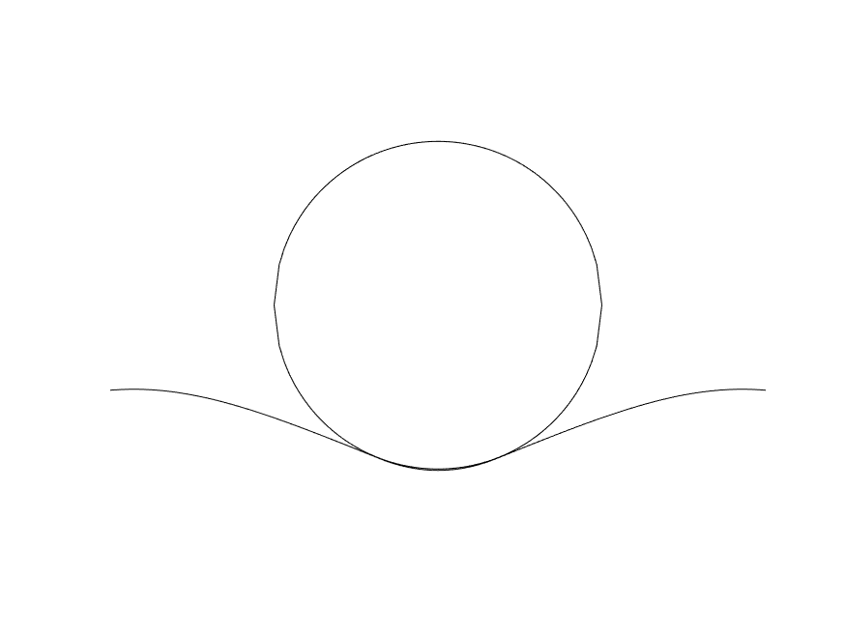
The system
4

Slide 6
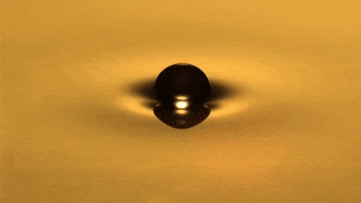

Droplet Dynamics
Speed
Surface Tension
Radius
Body Forces
Location of Free Surface
Density
5
[1]: Veritasium – Is this what Quantum Mechanics Looks Like, https://www.youtube.com/watch?v=WIyTZDHuarQ
Notes:
When we talk about droplets the most interesting (to me) system to consider is that of rain on a puddle. Here the size and speed of the raindrops are unknown, and thus chaotic. Whats more there are many droplets hitting the free surface at different times, so the wavefields generated affect the impact site of the next droplet. However we can derive a sense of qualitatively what happens to the different droplets under different regimes.
Firstly we need to consider the forces at play:
Speed, Size, Surface Tension, The position of the free surface prior to impact.
There’s one more that is perhaps unseen, and this is the role of the air in the system. If two liquids were to approach eachother in a vacuum, then the van der waals forces acting between the two droplets would cause instant coalescence. So what Is happening here that allows the droplet to rebound? In This case we hav the behaviour of

Slide 7
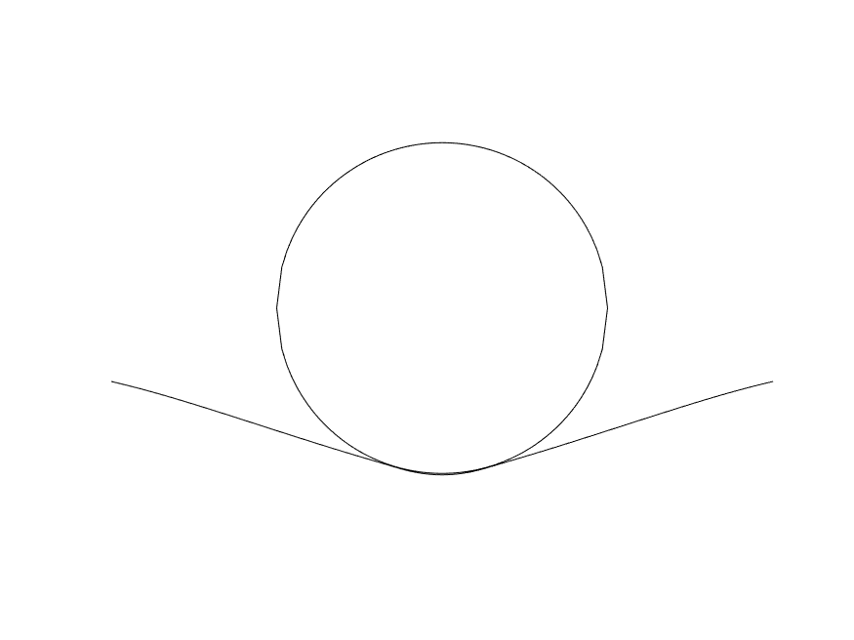
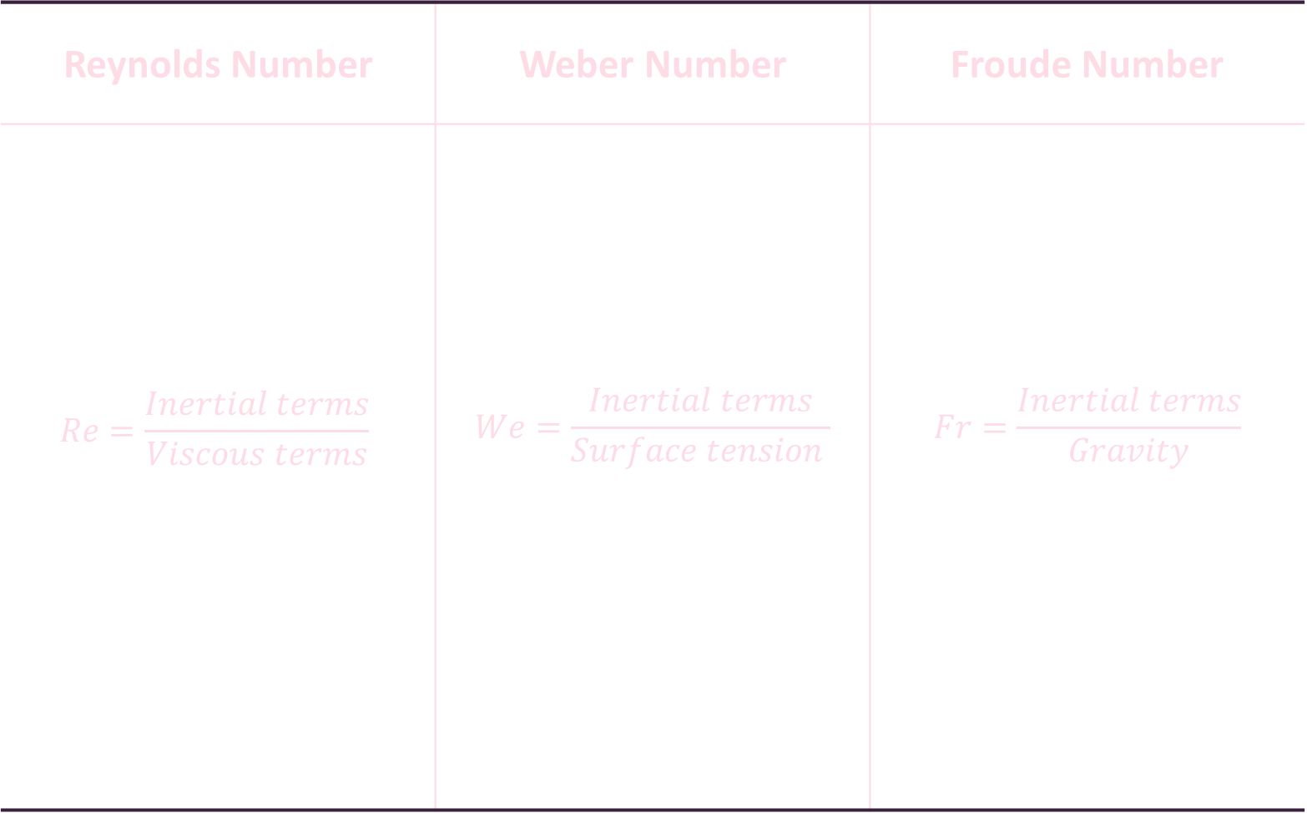
Reynolds Number | Weber Number | Froude Number
$$Re=\frac{Inertial terms}{Viscous terms}$$ | $$We=\frac{Inertial terms}{Surface tension }$$ | $$Fr=\frac{Inertial terms}{Gravity}$$
Viscosity
Surface tension
Gravity
Laminar vs turbulent flow
Kinetic vs surface tension energy
Presence of gravity waves
6
Notes:
Talk here about the fact that there are multiple dimensionless quantities that we are therefore interested in within this system.
Weber number – used as a ratio between surface tension and inertia. Commonly used for multilayer flows especially with large curvature
Reynolds number – used for viscous vs inviscid flow
Froude number – inertial vs external forces (gravity) discussion on the behaviour of

Slide 8


$$R$$
$$R$$
$$𝒪(Re^{−1/2})$$
$$𝒪(ε^{2}R)$$
$$𝒪(εR)$$
$$𝒪(εR)$$
Initially: Droplet in free-fall
Free surface unaffected
Droplet and free surface interact but are kept separate by a layer of air
Air layer height order of magnitude thinner than length of layer
7

Slide 9
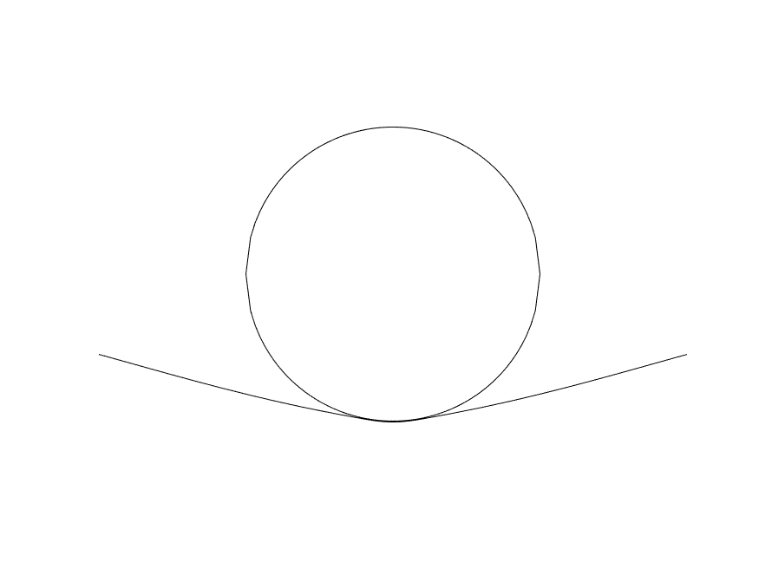
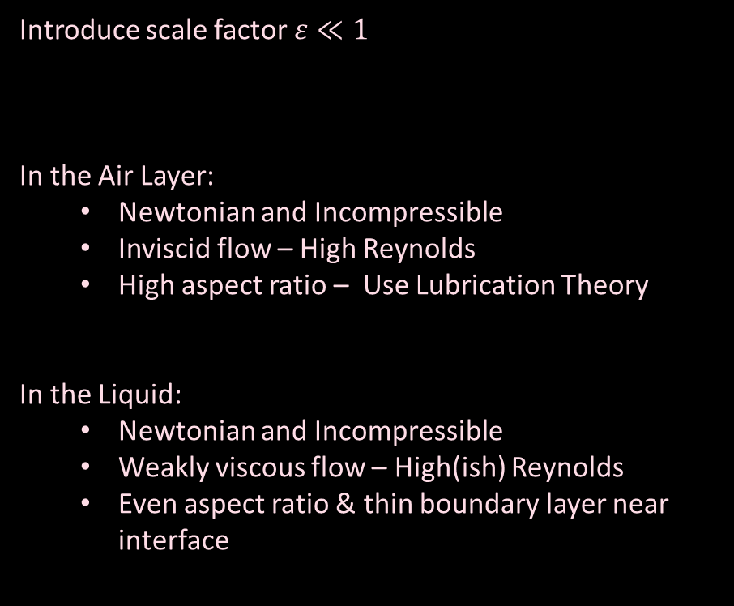





Introduce scale factor $ε≪1$
In the Air Layer:
Newtonian and Incompressible
Inviscid flow – High Reynolds
High aspect ratio – Use Lubrication Theory
In the Liquid:
Newtonian and Incompressible
Weakly viscous flow – High(ish) Reynolds
Even aspect ratio & thin boundary layer near interface
$$𝒪(Re^{−1/2})$$
$$R$$
$$𝒪(ε^{2}R)$$
$$𝒪(εR)$$
$$𝒪(εR)$$
8
Notes:
Include conversation about what happens in the close regime, when the droplet is very close to the free surface – we talk very close with the

Slide 10
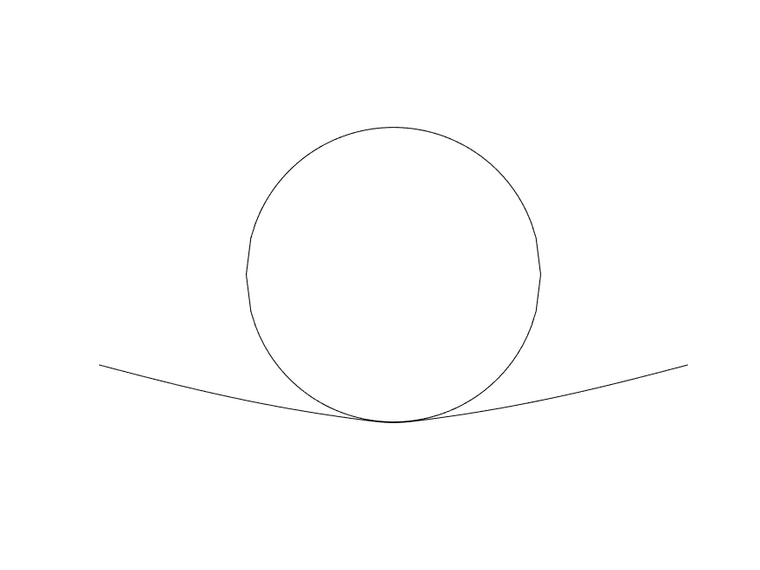
Time for the equations
9

Slide 11
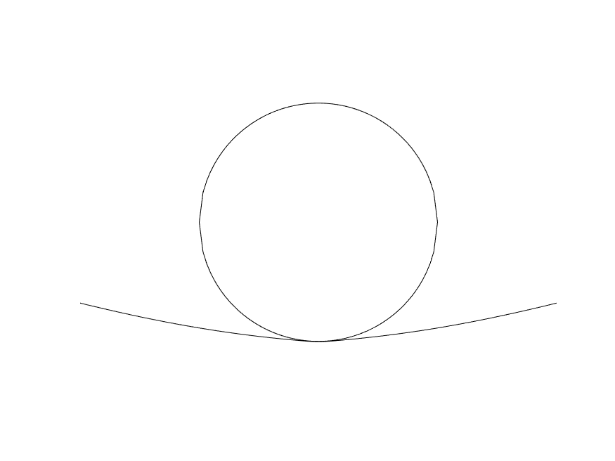
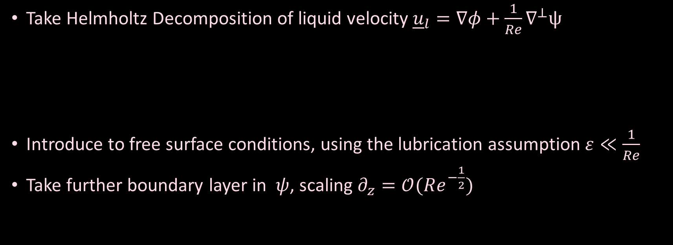

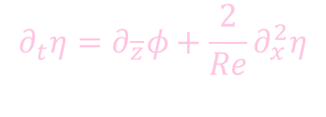
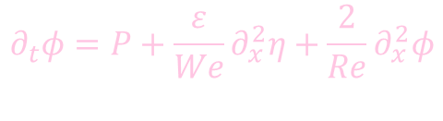
Liquid Regime – Deep Bath
Take Helmholtz Decomposition of liquid velocity ${\underline{u}}_{l}=∇φ+\frac{1}{Re}∇^{⊥}ψ$
Introduce to free surface conditions, using the lubrication assumption $ε≪\frac{1}{Re}$
Take further boundary layer in $ψ$, scaling $∂_{z}=𝒪(Re^{−\frac{1}{2}})$
$$∇^{2}φ=0$$
$∂_{t}φ={−p}_{l}$
$${ ∂}_{t}ψ=\frac{1}{Re}∇^{2}ψ$$
$$∂_{t}φ=P+\frac{ε}{We}∂_{x}^{2}η+\frac{2}{Re}∂_{x}^{2}φ$$
$$∂_{t}η=∂_{\overline{z}}φ+\frac{2}{Re}∂_{x}^{2}η$$
10
[2]: Milewski, P.A., Galeano-Rios, C.A., Nachbin, A. and Bush, J.W. (2015) Faraday pilot-wave dynamics: modelling and computation. Journal of fluid mechanics

Slide 12
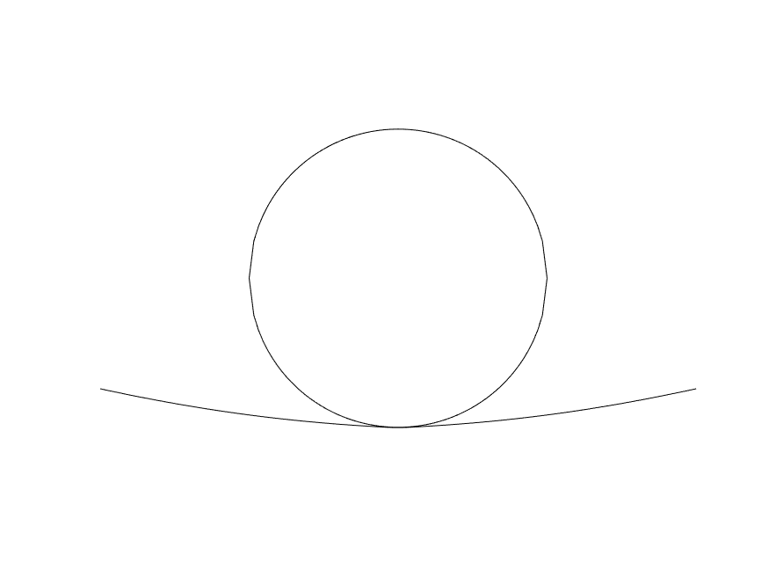
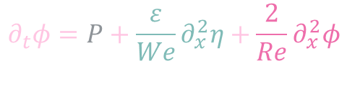
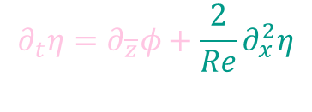
Liquid Regime – Deep Bath
Take Helmholtz Decomposition of liquid velocity ${\underline{u}}_{l}=∇φ+\frac{1}{Re}∇^{⊥}ψ$
Introduce to free surface conditions, using the lubrication assumption $ε≪\frac{1}{Re}$
Take further boundary layer in $ψ$, scaling $∂_{z}=𝒪(Re^{−\frac{1}{2}})$
$$∇^{2}φ=0$$
$∂_{t}φ={−p}_{l}$
$${ ∂}_{t}ψ=\frac{1}{Re}∇^{2}ψ$$
Pressure from Air Equations
Surface Tension
$$∂_{t}φ=P+\frac{ε}{We}∂_{x}^{2}η+\frac{2}{Re}∂_{x}^{2}φ$$
$$∂_{t}η=∂_{\overline{z}}φ+\frac{2}{Re}∂_{x}^{2}η$$
Viscous Effects
11
[2]: Milewski, P.A., Galeano-Rios, C.A., Nachbin, A. and Bush, J.W. (2015) Faraday pilot-wave dynamics: modelling and computation. Journal of fluid mechanics

Slide 13
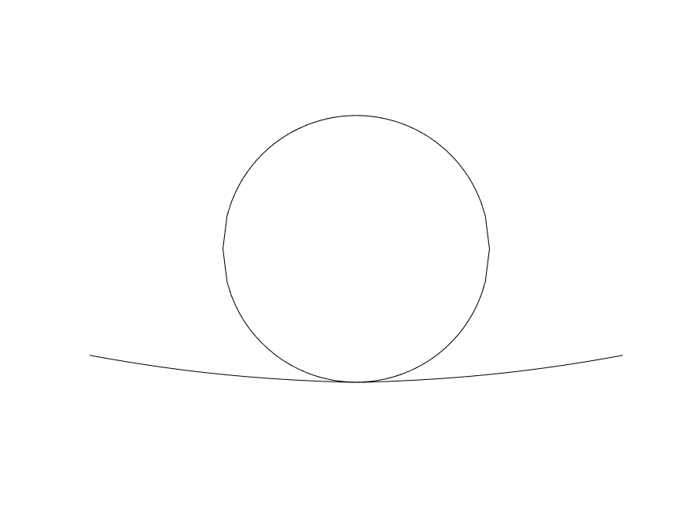
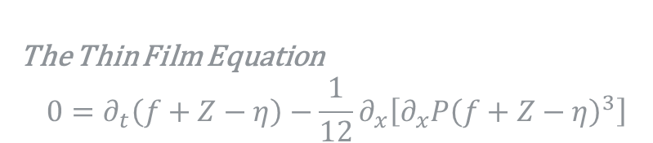


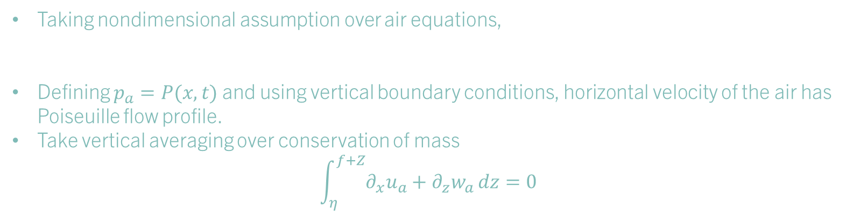
Air Regime – lubrication theory
Taking nondimensional assumption over air equations,
Defining $p_{a}=P(x,t)$ and using vertical boundary conditions, horizontal velocity of the air has Poiseuille flow profile.
Take vertical averaging over conservation of mass
$$\int_{η}^{f+Z}{∂_{x}u_{a}+∂_{z}w_{a}}dz=0$$
$$∂_{\overline{z}}p_{a}=0$$
$$u_{a}=\frac{1}{2}∂_{x}P[{\left(\overline{z}−η\right)}^{2}−\left(f+Z−η\right)\left(\overline{z}−η\right)]$$
The Thin Film Equation
$$0=∂_{t}\left(f+Z−η\right)−\frac{1}{12}∂_{x}\left[∂_{x}P{\left(f+Z−η\right)}^{3}\right]$$
12
[2]: Ross, S., & Hicks, P. D. (2019). A comparison of pre-impact gas cushioning and Wagner theory for liquid-solid impacts. Physics of Fluids,
Notes:
Why parabolic – ratios of viscosities (look at boundary conditions
The shear or jump is negligible in this regime, so assume both are zero

Slide 14
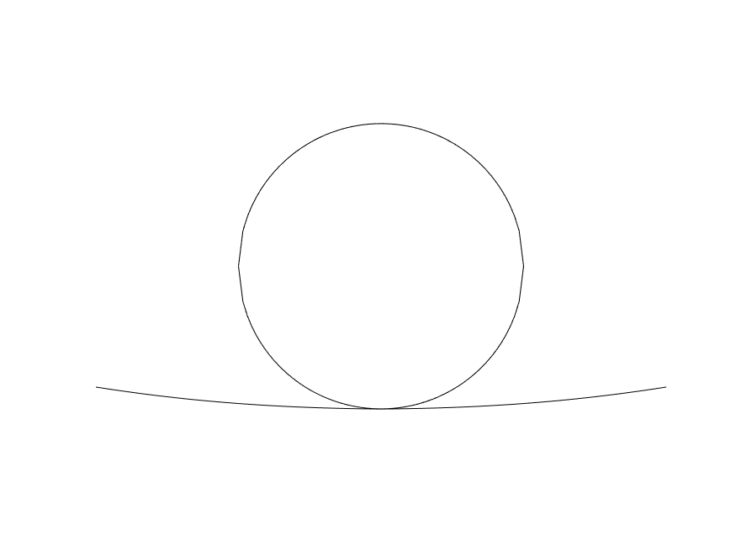


Droplet Motion
Describe motion of sphere using $F=ma$
Gravity scales with $\frac{ε^{2}}{Fr^{2}}$ in the lubrication regime – small enough to be neglected
Force given by integral of pressure over projected area of sphere
$F=\frac{ε^{2}}{π}∫P dA_{p}$
$$\frac{d^{2}Z}{dt^{2}}=\frac{ε^{2}}{π}∫P dA_{p}$$
13

Slide 15
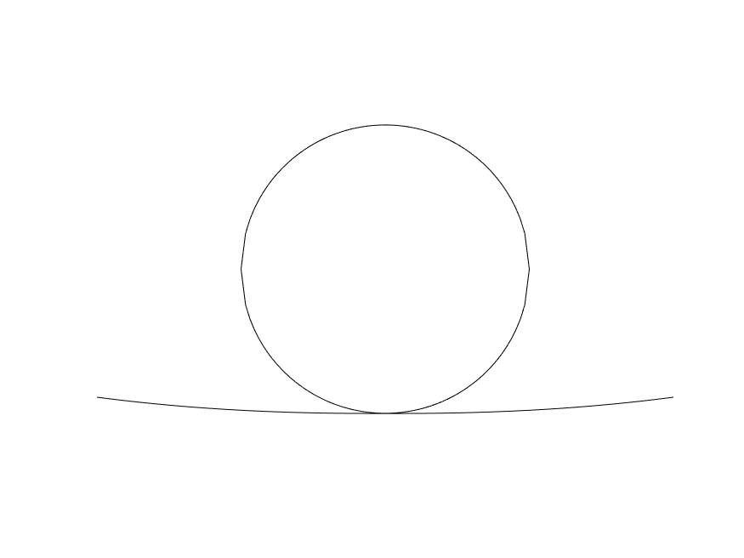

Droplet Motion
Describe motion of sphere using $F=ma$
Gravity scales with $\frac{ε^{2}}{Fr^{2}}$ in the lubrication regime – small enough to be neglected
Force given by integral of pressure over projected area of sphere
$F=\frac{ε^{2}}{π}∫P dA_{p}$
$$\frac{dZ}{dt}=W$$
$$\frac{dW}{dt}=\frac{ε^{2}}{π}∫P dA_{p}$$
14

Slide 16


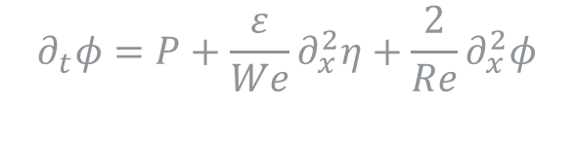
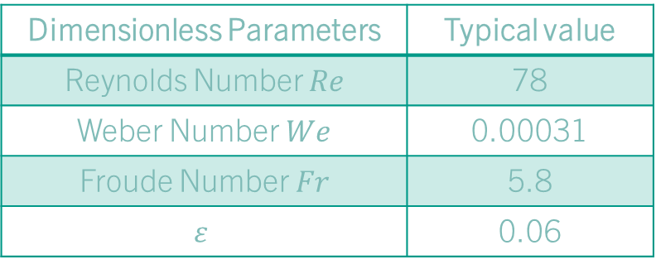
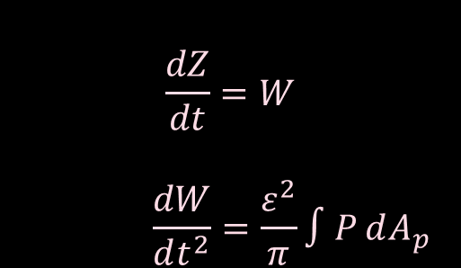

Governing Equations
$$0=∂_{t}\left(f+Z−η\right)−\frac{1}{12}∂_{x}\left[∂_{x}P{\left(f+Z−η\right)}^{3}\right]$$
$$∂_{t}φ=P+\frac{ε}{We}∂_{x}^{2}η+\frac{2}{Re}∂_{x}^{2}φ$$
Dimensionless Parameters | Typical value
Reynolds Number $Re$ | 78
Weber Number $We$ | 0.00031
Froude Number $Fr$ | 5.8
$$ε$$ | 0.06
$$∂_{t}η=∂_{\overline{z}}φ+\frac{2}{Re}∂_{x}^{2}η$$
$$\frac{dZ}{dt}=W$$
$$\frac{dW}{dt^{2}}=\frac{ε^{2}}{π}∫P dA_{p}$$
15

Slide 17
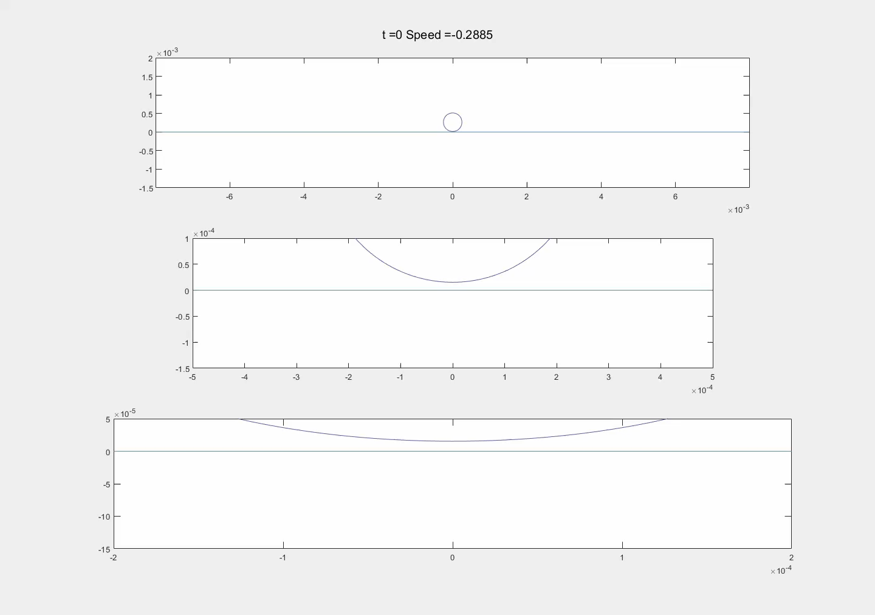
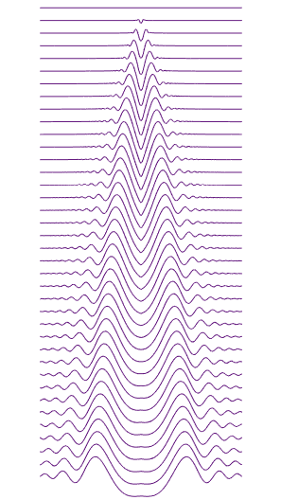
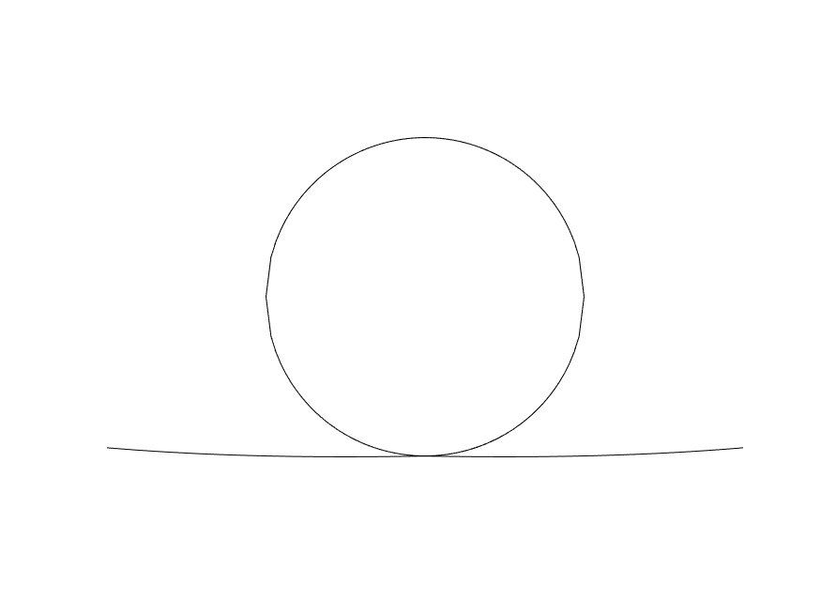
16

Slide 18

Thank you for listening Any questions?
Email: kap39@bath.ac.uk
Twitter: @KatDoesMaths
Website: katdoesmaths.me
17

Slide 19
Future Work
Extension to model to fit quantitative results as well as numerical ones
Improvement to numerics – potential step away from pseudo-spectral methods to compensate
Full expansion to 3D, and periodic bouncing, or complex behaviours

Slide 20


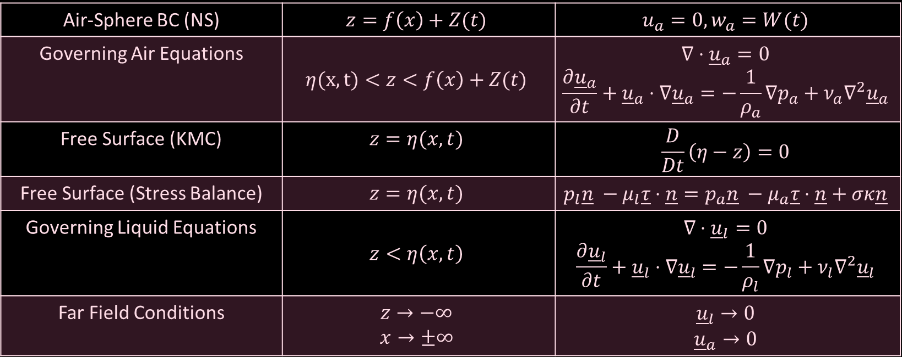


$$f+Z$$
$${\underline{u}}_{a}$$
$$η$$
$${\underline{u}}_{l}$$
Air-Sphere BC (NS) | $$z=f\left(x\right)+Z(t)$$ | $$u_{a}=0, w_{a}=W(t)$$
Governing Air Equations | $$η(x,t)<z<f\left(x\right)+Z(t)$$ | $$∇⋅{\underline{u}}_{a}=0$$ $$\frac{∂{\underline{u}}_{a}}{∂t}+{\underline{u}}_{a}⋅∇{\underline{u}}_{a}=−\frac{1}{ρ_{a}}∇p_{a}+ν_{a}∇^{2}{\underline{u}}_{a}$$
Free Surface (KMC) | $$z=η(x,t)$$ | $$\frac{D}{Dt}\left(η−z\right)=0$$
Free Surface (Stress Balance) | $$z=η(x,t)$$ | $$p_{l}\underline{n} −μ_{l}\underline{τ}⋅\underline{n}=p_{a}\underline{n} −μ_{a}\underline{τ}⋅\underline{n}+σκ\underline{n}$$
Governing Liquid Equations | $$z<η\left(x,t\right)$$ | $$∇⋅{\underline{u}}_{l}=0$$ $$\frac{∂{\underline{u}}_{l}}{∂t}+{\underline{u}}_{l}⋅∇{\underline{u}}_{l}=−\frac{1}{ρ_{l}}∇p_{l}+ν_{l}∇^{2}{\underline{u}}_{l}$$
Far Field Conditions | $$z→−∞$$ $$x→±∞$$ | $${\underline{u}}_{l}→0$$ $${\underline{u}}_{a}→0$$
10

Slide 21
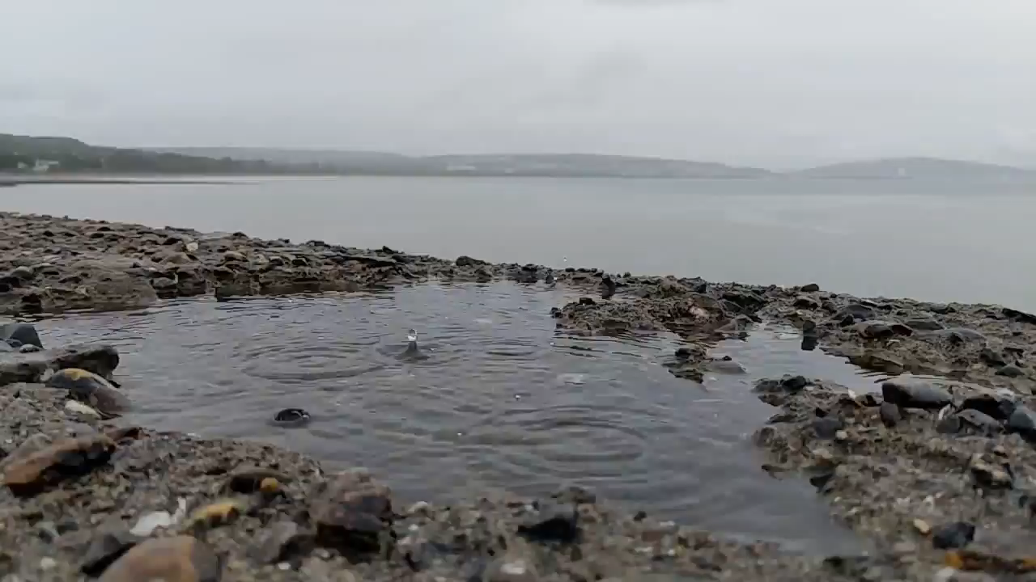
Droplets in Nature
Surface Tension
Radius
Speed
Location of Free Surface
Density
Notes:
When we talk about droplets the most interesting (to me) system to consider is that of rain on a puddle. Here the size and speed of the raindrops are unknown, and thus chaotic. Whats more there are many droplets hitting the free surface at different times, so the wavefields generated affect the impact site of the next droplet. However we can derive a sense of qualitatively what happens to the different droplets under different regimes.
Firstly we need to consider the forces at play:
Speed, Size, Surface Tension, The position of the free surface prior to impact.
There’s one more that is perhaps unseen, and this is the role of the air in the system. If two liquids were to approach eachother in a vacuum, then the van der waals forces acting between the two droplets would cause instant coalescence. So what Is happening here that allows the droplet to rebound? In This case we hav the behaviour of

Slide 22
Recap
The behaviour of droplets impacting on a free surface have many applications as shown in the previous talk – thanks Eileen.
So as a quick recap I’d like to take you back through the complex behaviours that droplets could present. This time working from the complex to the minimal.
We begin by considering a fully chaotic faraday system (show demonstration) and see how the droplets are generated on the free surface from the instability caused by the oscillatory nature of the speaker.
If we reduce the amplitude to below the faraday threshold then we have the ability to consider the behaviour of steady state repeated rebounds. In the higher amplitudes we see walkers, and in the lower amplitude we see stationary bouncers.
This is an incredible application of the system, but what if we remove the vibrations on the free surface? We get a single bounce perhaps? Instant coalescence? The system is so fast and small it is hard to see. So perhaps another model may be more useful to look at.

Slide 23


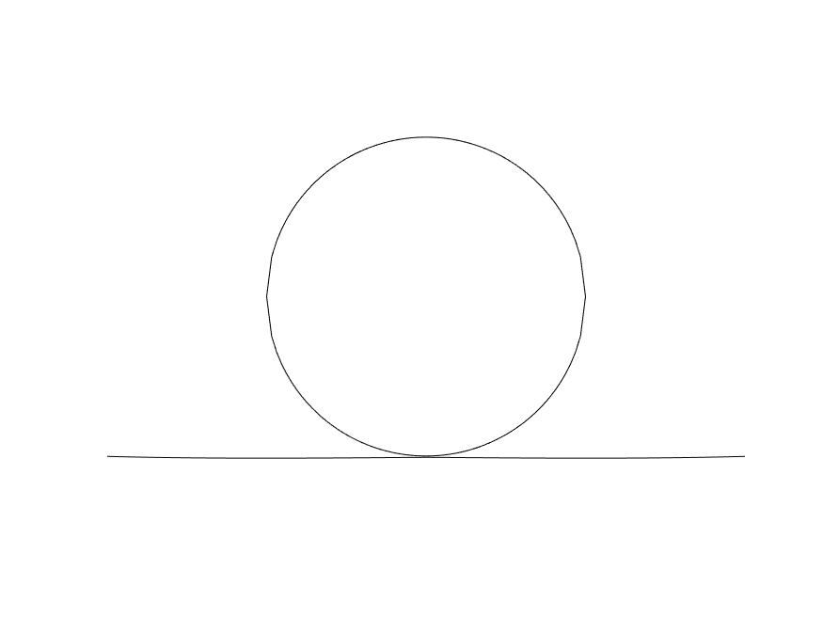
1
11
2
12
3
13
4
14
5
15
6
16
7
17
8
18
9
19
10
20

