Slide 1
SELECTION MECHANISMS AND COMPLEX SINGULARITIES IN THE FALLING JET PROBLEM
Cecilie Andersen
(Phil Trinh, University of Bath &
Tom Chandler, University of Wisconsin-Madison)

Slide 2
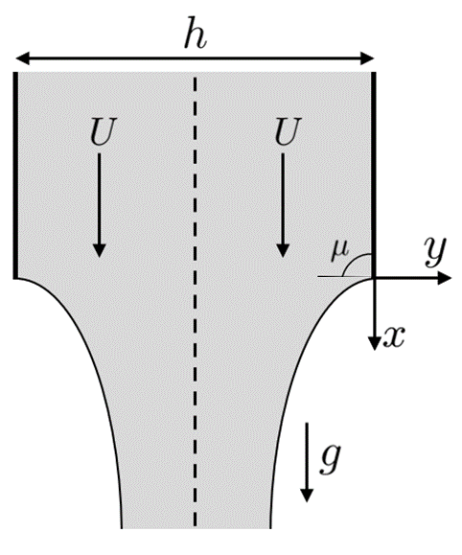
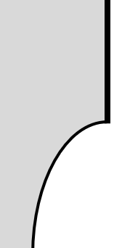

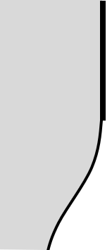



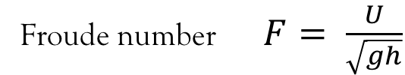


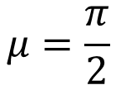




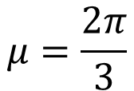

motivation
Consider a steady-state, gravity driven fluid that separates from a solid object.
There are only three values the separation angle can take.
$$F<F∗_{2}$$
$$F=F∗_{2}$$
$$F>F∗_{2}$$
$$μ$$
$$μ$$
$$μ$$
$$μ=\frac{π}{2}$$
$$μ=\frac{2π}{3}$$
$$μ=π$$
Key parameter:
Froude number $F= \frac{U}{\sqrt{gh}}$
$$0$$
$$F∗_{2}$$
$$F$$

Slide 3

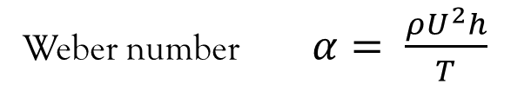

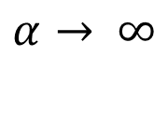
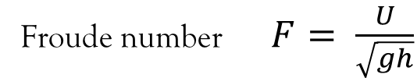








motivation
$$μ$$
Key parameter:
Froude number $F= \frac{U}{\sqrt{gh}}$
Weber number $α= \frac{ρU^{2}h}{T}$
(Surface tension parameter)
Zero surface tension: $α=∞$
$$μ=\frac{π}{2}$$
…
$$F_{3}(α)$$
$$F_{2}(α)$$
$$F_{1}(α)$$
$$0$$
$$α→ ∞$$
$$F∗_{1}$$
$$F∗_{2}$$
$$F$$
There exist many open questions.

Slide 4
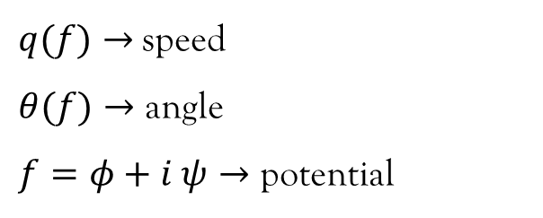

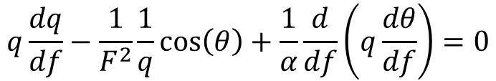

Problem formulation
A two-dimensional, inviscid, incompressible fluid jet falls under gravity.
Governing equations:
$$q\frac{dq}{df}−\frac{1}{F^{2}}\frac{1}{q}\cos\left(θ\right)+\frac{1}{α}\frac{d}{df}\left(q\frac{dθ}{df}\right)=0$$
$$\log{q}+iθ=\frac{1}{π}ℋ\left[θ\right]\left(f\right)$$
(Hilbert transform)
Variables:
Key parameters:
$$F= \frac{U}{\sqrt{gh}}→ \text{Froude} \text{number}$$
$α= \frac{ρU^{2}h}{T}≫1 →$Weber number
$q(f)→$speed
$θ(f)→$ angle
$f=φ+i ψ→$ potential

Slide 5
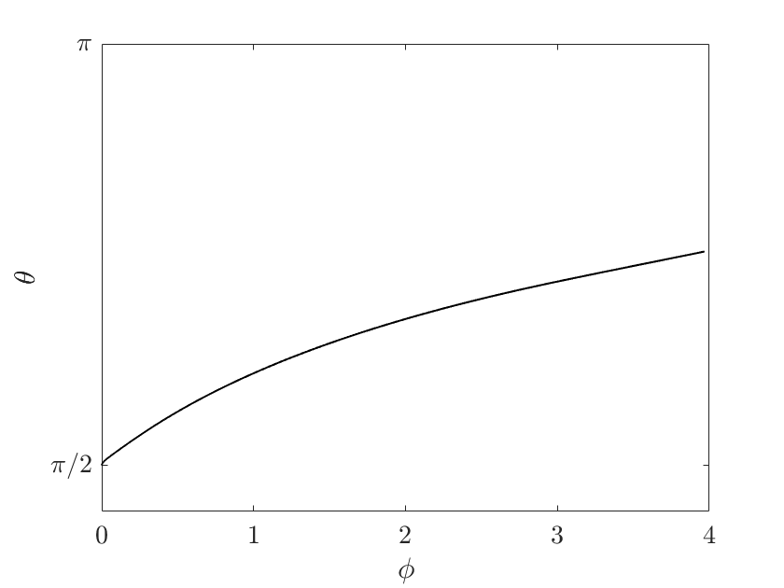
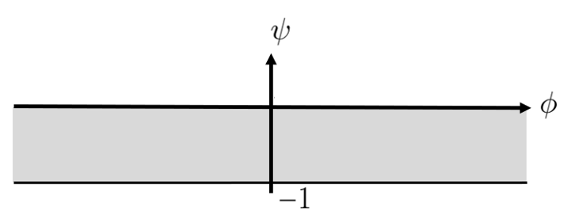
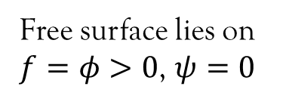

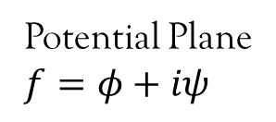
potential plane
A two-dimensional, inviscid, incompressible fluid jet falls under gravity.
Governing equations:
$$q\frac{dq}{df}−\frac{1}{F^{2}}\frac{1}{q}\cos\left(θ\right)+\frac{1}{α}\frac{d}{df}\left(q\frac{dθ}{df}\right)=0$$
$$\log{q}+iθ=\frac{1}{π}ℋ[θ](f)$$
Potential Plane
$$f=φ+iψ$$
Free surface lies on
$f=φ>0$, $ψ=0$

Slide 6
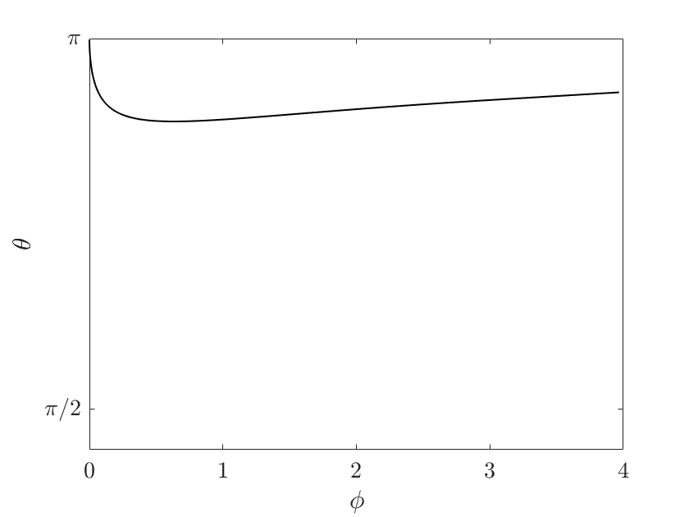
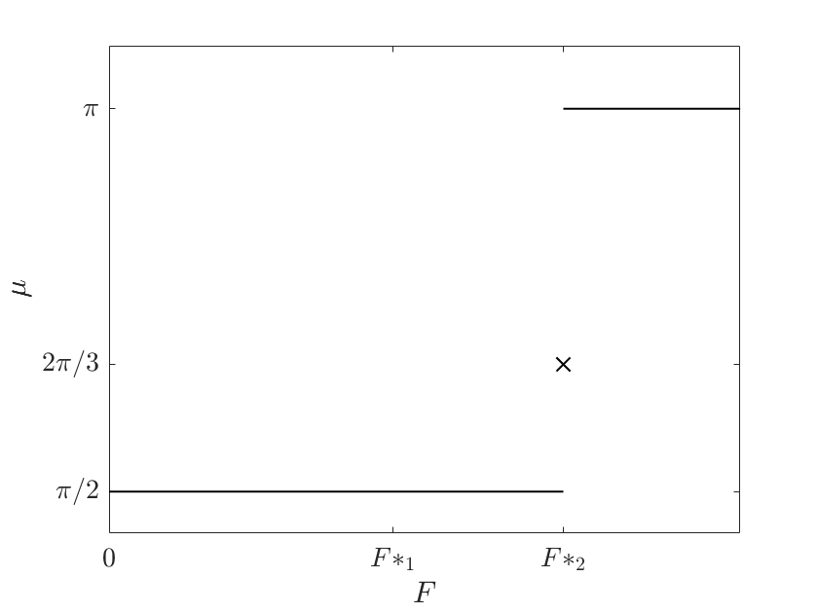
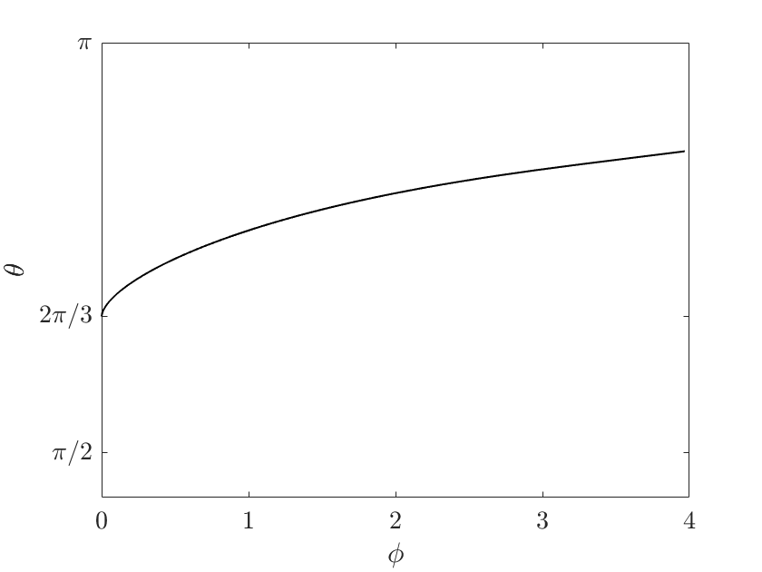

Zero surface tension
Issue:
Smoothly changing F, discontinuously changes $μ$.

Slide 7
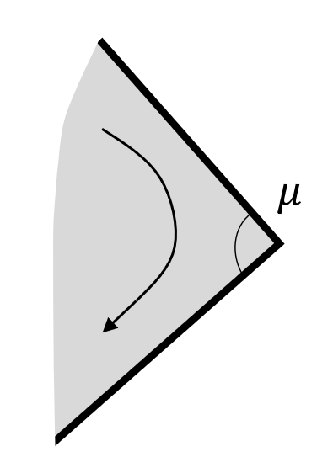






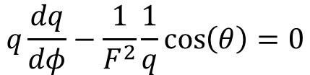

dominant balance
As $φ→0$the solution resembles a flow around a corner with angle $μ.$
For Bernoulli’s equation:
$$q\frac{dq}{dφ}−\frac{1}{F^{2}}\frac{1}{q}\cos\left(θ\right)=0$$
$$\sim$$
Consider a local solution:
$$\sim ae^{iμ}φ^{\frac{μ}{π}}+be^{iδ}φ^{\frac{ν}{π}}+…$$
$$as φ→0$$
Integrated Bernoulli equation:
$$\sim$$
$$\frac{π^{2}}{2a^{2}μ^{2}}φ^{2−\frac{2μ}{π}}+…$$
$$\sim$$
$$−\frac{a}{F^{2}}\cos{μ}φ^{\frac{μ}{π}}−\frac{b}{F^{2}}\cos{δ}φ^{\frac{ν}{π}}+…=B$$

Slide 8
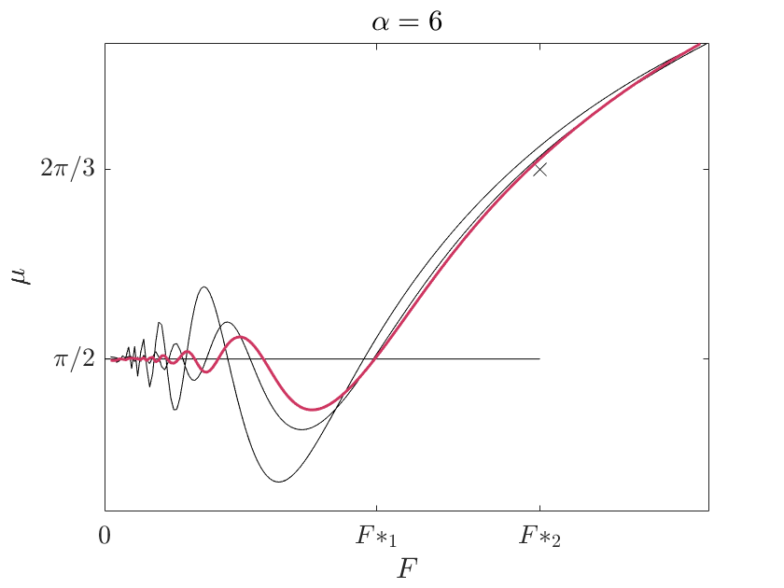
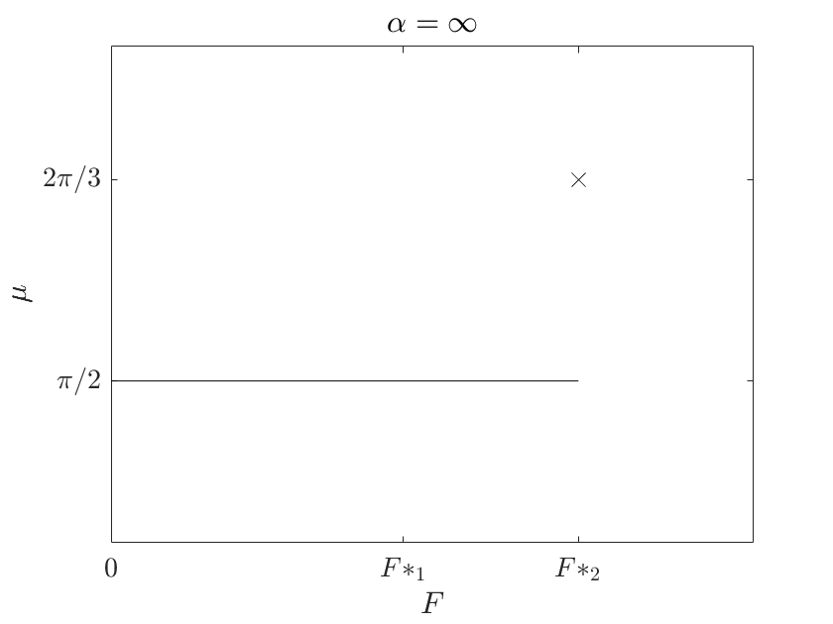
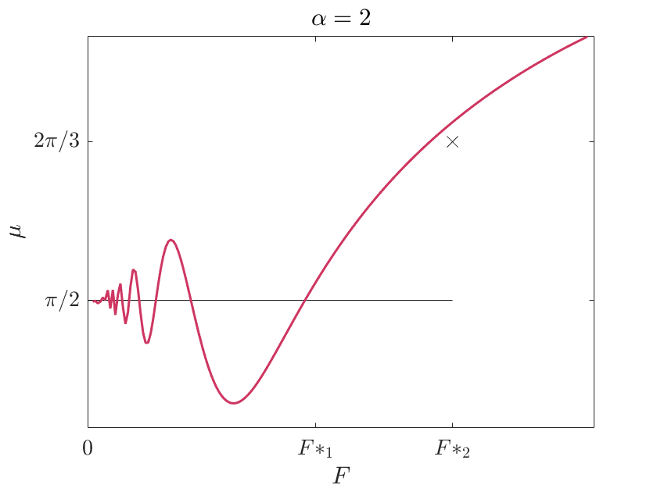
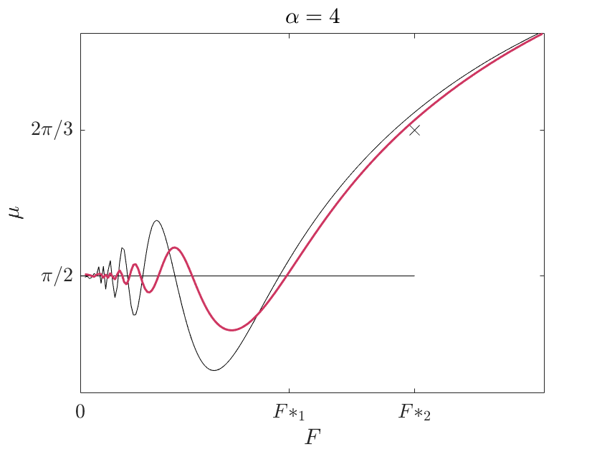
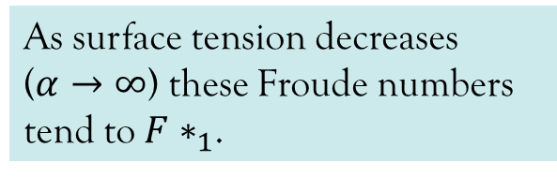
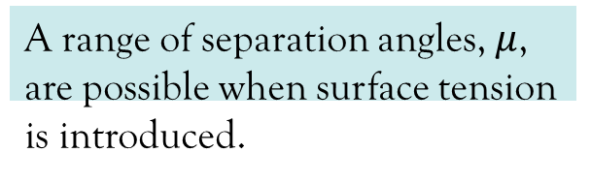
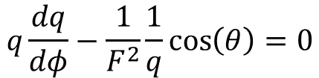
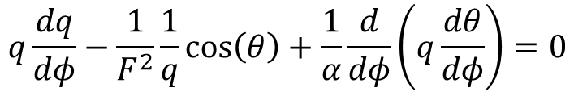

Surface tension
$$q\frac{dq}{dφ}−\frac{1}{F^{2}}\frac{1}{q}\cos\left(θ\right)=0$$
$$q\frac{dq}{dφ}−\frac{1}{F^{2}}\frac{1}{q}\cos\left(θ\right)+\frac{1}{α}\frac{d}{dφ}\left(q\frac{dθ}{dφ}\right)=0$$
A range of separation angles, $μ$, are possible when surface tension is introduced.
For given $α$ there exists a countable sequence of Froude numbers where $μ= \frac{π}{2}$,
$${…F_{3}\left(α\right)<F_{2}\left(α\right)<F}_{1}\left(α\right).$$
As surface tension decreases ($α→∞$) these Froude numbers tend to $F∗_{1}$.

Slide 9
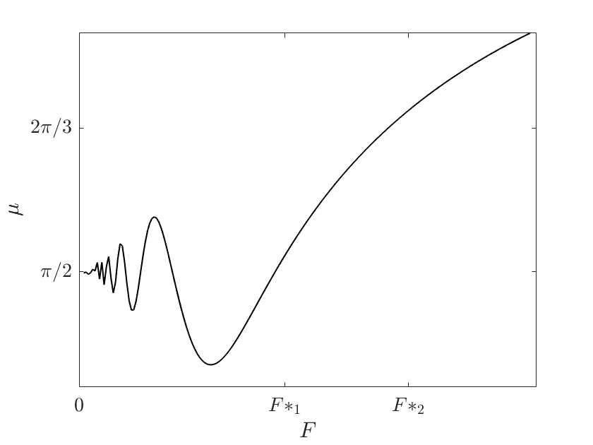
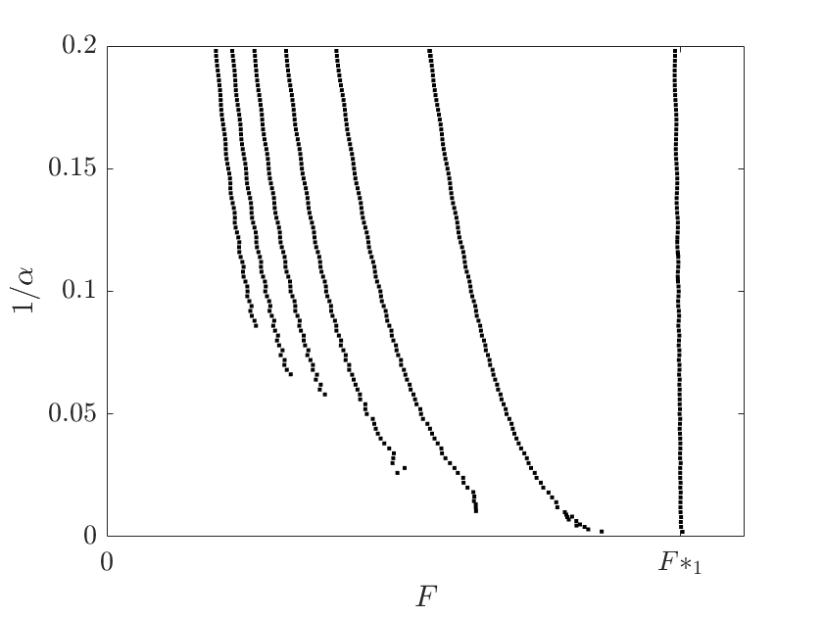
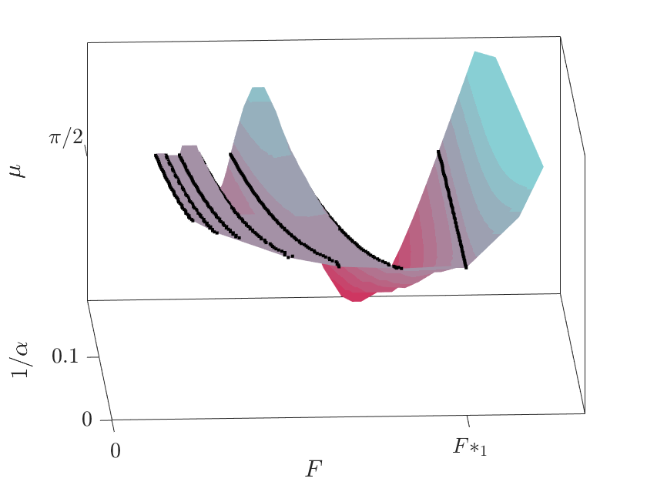



selection mechanism
$$α=8$$
…
$$F_{3}(α)$$
$$F_{2}(α)$$
$$F_{1}(α)$$

Slide 10
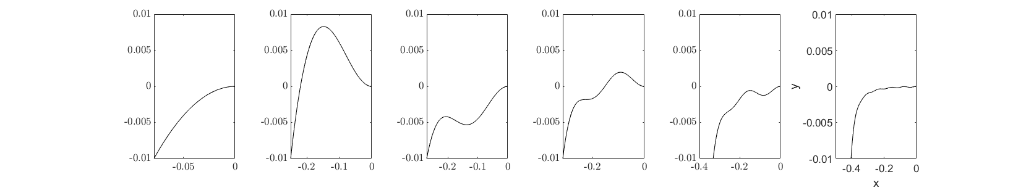
ripples

Slide 11
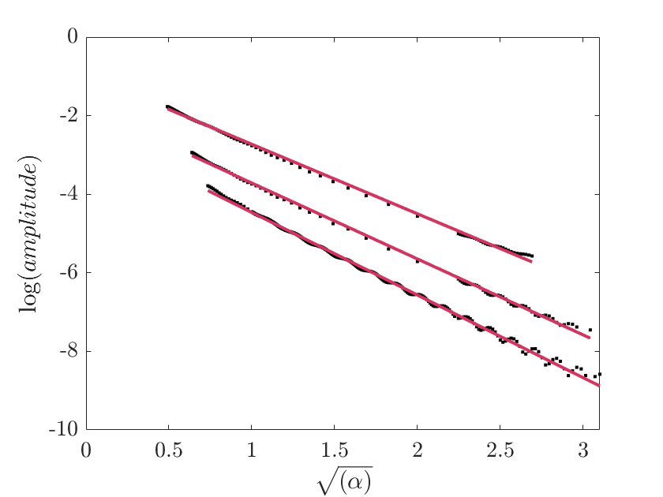
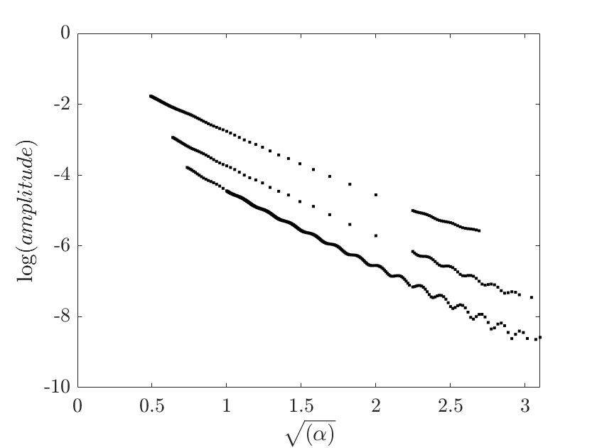
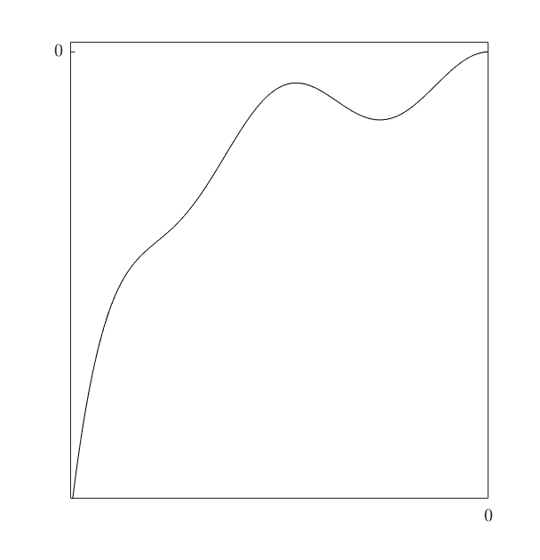
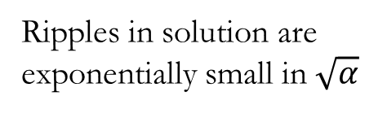
ripples
Ripples in solution are exponentially small in $\sqrt{α}$
$θ(f)= …+Ae^{−χ\sqrt{α}}+ …$ $as α→∞$

Slide 12
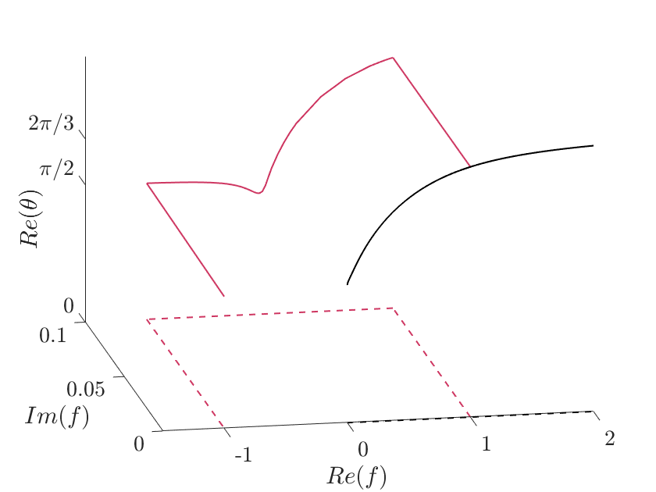
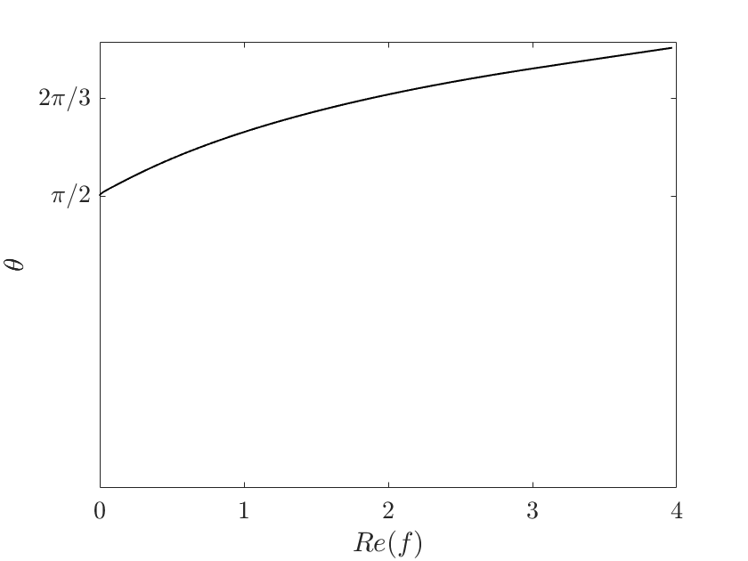
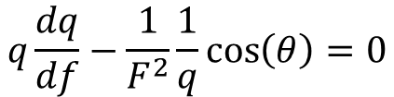
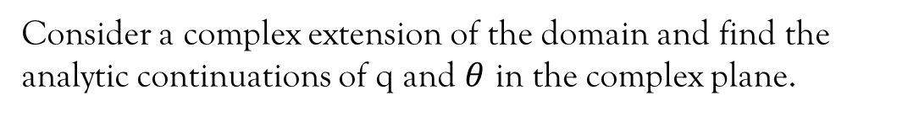

analytic continuation
Consider a complex extension of the domain and find the analytic continuations of q and $θ$ in the complex plane.
$$q\frac{dq}{df}−\frac{1}{F^{2}}\frac{1}{q}\cos\left(θ\right)=0$$
Analytic continuation
$$\log{q}+iθ=\frac{1}{π}ℋ[θ](f)$$
Free surface
Free surface
Idea:
Singularities in the analytic continuation of the solution are key features required for an analytic theory of this problem.

Slide 13
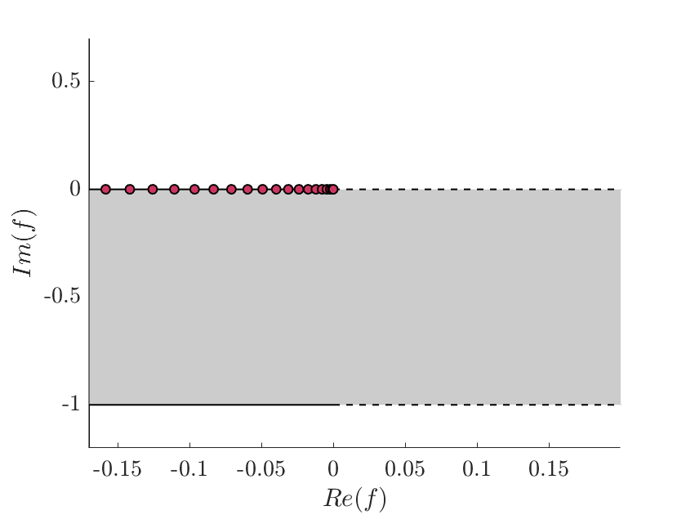

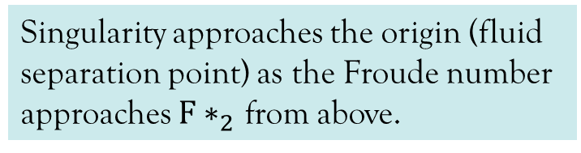
a singularity
Singularity approaches the origin (fluid separation point) as the Froude number approaches $F∗_{2}$ from above.
$$F→_{+}F∗_{2}$$
Free surface
Wall

Slide 14
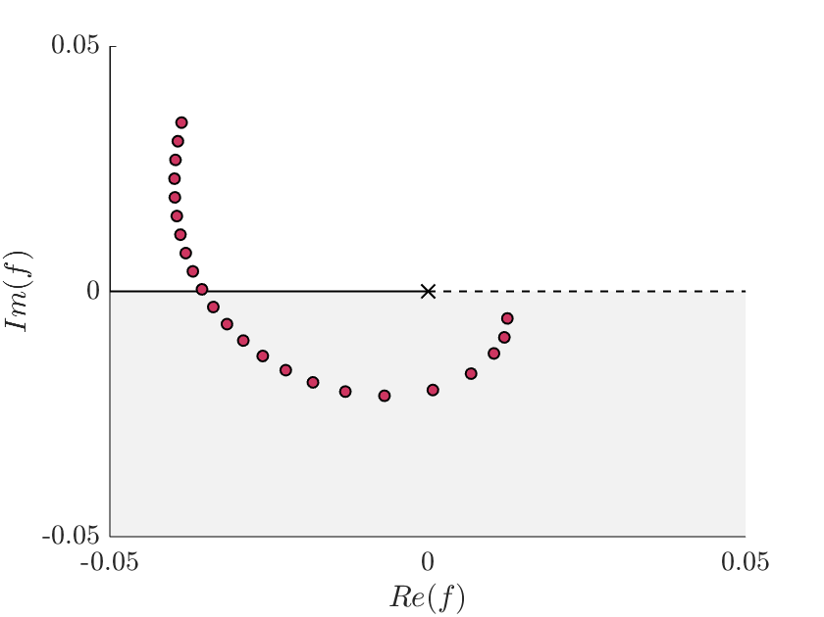

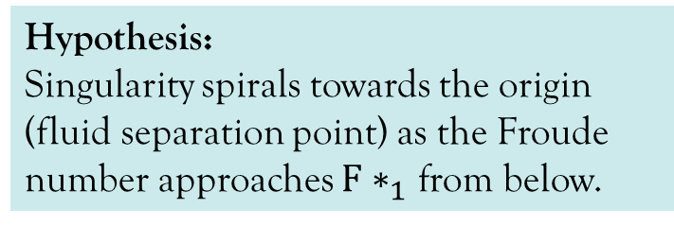
Another singularity
Hypothesis:
Singularity spirals towards the origin (fluid separation point) as the Froude number approaches $F∗_{1}$ from below.
Wall
Free surface
$$F→_{−}F∗_{1}$$

Slide 15






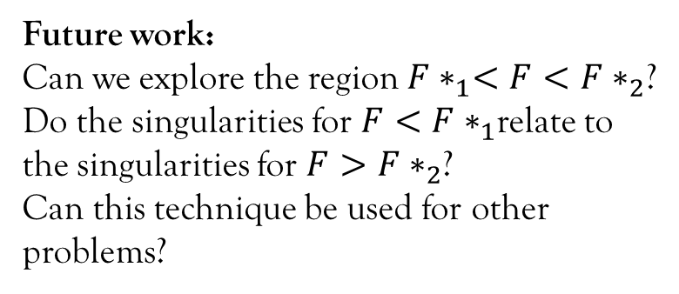

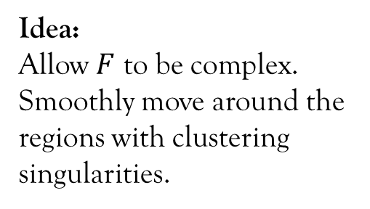
complexifying the Froude number
$$Im(F)$$
Questions?
$$0$$
$$F∗_{1}$$
$$F∗_{2}$$
$$Re(F)$$
$$F$$
Issue:
Singularities cluster at origin for $F$ near $F∗_{1}$ and $F∗_{2}$.
Numerics become difficult.
Idea:
Allow $F$ to be complex.
Smoothly move around the regions with clustering singularities.
Future work:
Can we explore the region $F∗_{1}<F<F∗_{2}$?
Do the singularities for $F<F∗_{1}$relate to the singularities for $F>F∗_{2}$?
Can this technique be used for other problems?

