Slide 1
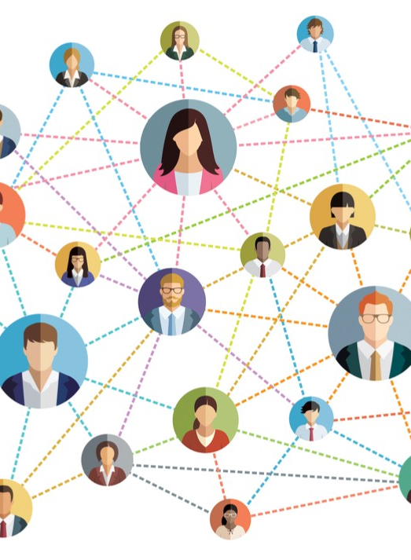


Awareness spread and the effects of (mis)information on epidemics
Andrei Sontag
Supervisors: Tim Rogers and Kit Yates

Slide 2
Contents
Motivation and introduction
A model for the feedback of non-pharmaceutical interventions on epidemics
Results
Discussions
Final remarks

Slide 3
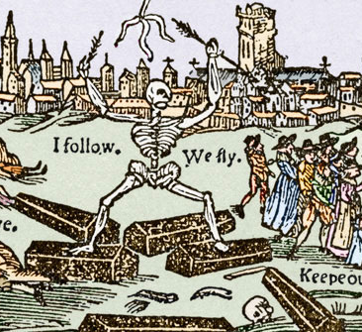
Epidemics and behaviour
Disease outbreaks have been part of human history for thousands of years.
The bubonic plague caused most people to ‘shun and flee from the sick’.
Behaviours such as mask-wearing and social-distancing became ingrained in the culture of many countries.
Notes:
When we talk about epidemics, you might first think about the coronavirus pandemic that has been affecting our lives for over two years.
However, disease outbreaks have been part of human history for thousands of years.
Arguably, one of the most striking aspects of these outbreaks were the reactions to the disease.
Historically, human behaviour has been entwined with the spread of infectious diseases. In medieval times, the lethality of the bubonic plague caused most people to ‘shun and flee from the sick’, whilst citizens of the Yorkshire village of Eyam would voluntarily quarantine themselves to prevent spread of the plague from the village.
More recently, during the influenza pandemic of the early 20th century, we observed an increase in the use of face covering and social distancing, with people eventually staying away from congregated places to avoid transmission. These behaviour changes became ingrained in most of Asian societies ever since.
Similarly, during the coronavirus pandemic, we have seen governments worldwide enforcing public health measures such as school closures and lockdowns. Nonetheless, self-initiated adoption of non-pharmaceutical interventions have had substantial impact on the control of the disease.

Slide 4

Non-pharmaceutical interventions are important tools to tackle emergent epidemics.
Effectiveness of social distancing strategies relies upon behaviour of individuals.
Previous studies examined the interplay between risk perception, behaviour, and disease dynamics.
Notes:
Non-pharmaceutical interventions, such as mask-wearing and social distancing, have become important tools to tackle the spread of emergent pandemic diseases. They can be used to slow the progress of an outbreak or suppress it completely if carefully implemented and strictly adhered to.
Much of the effectiveness of social distancing strategies relies upon the behaviours of individuals; how conscientiously they follow advice and how successfully they encourage others to do the same.
Many factors affect the degree to which individuals will change their behaviours: perception of the risk to themselves and to others; quality and availability of information; trust in the government; and the attitudes of their social contacts. Importantly, there is considerable feedback between these factors and the progression of the epidemic itself.
In the past, models have examined the interplay between risk perception (modelled as an information spreading process), behaviour, and epidemic dynamics. These models consider the population to have homogeneous behaviour.

Slide 5

Model for behavioural feedback in a population with heterogeneous behaviour.
Awareness spread reduces the number of infected and increases the final susceptible population.
A phase-transition separates between regions of suppression and mitigation of the disease.
Notes:
In this work, we developed a model where individuals can have one of two distinct behaviours with respect to the quality of information they are exposed to.
Using this model, we showed that awareness spread can reduce the number of infected and increase the final susceptible population.
We also observed a new dynamical threshold corresponding to a phase transition between regimes of successful disease suppression and large outbreaks, and obtained a theoretical estimate of the critical parameters for this transition in the limit of fast information spread. I will come back to these results later on.

Slide 6
Published title:
Misinformation can prevent the suppression of epidemics¹
A model for the feedback of non-pharmaceutical interventions on epidemics
¹Sontag A., Rogers T. and Yates C. A. 2022. R. Soc. Interface.192021066820210668

Slide 7
The Model
Population of fixed size, N
SIR dynamics for disease spread
    S – Susceptible
    I – Infectious
    R – Recovered
Two subpopulations:
Trusting individuals
Distrusting individuals
Notes:
The model we considered is an extension to a previous model in the literature. We considered a population of fixed size N in which a disease spreads according to the SIR dynamics.
In the SIR model, the population is categorised into three compartments, the susceptible, the infected and the recovered.
We also considered two subpopulations that distinguish by the way they seek information and comply to government advice.
These two subpopulations are the trusting individuals, who seek information of higher quality and will take precautionary measures, and the distrusting individuals, who are susceptible to misinformation.

Slide 8










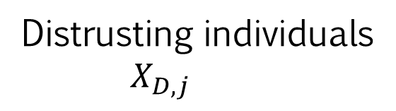
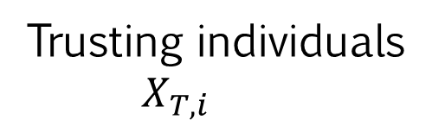
Trusting individuals
$$X_{T,i}$$
Distrusting individuals
$$X_{D,j}$$
Either
$$X∈\{S,I,R\}$$
Best
0
Information quality
1
2
3
4
5
6
Worst
Notes:
In this model, we identify subpopulations with indices T or D for the trusting or distrusting population, and another index that gives the quality of information an individual possess. In this case, this information relates to the predominance of the disease in the proximity of an individual. Hence, index 0 corresponds to information of the best quality and higher index values correspond to worse quality.
As I mentioned, these two subpopulations distinguish by the way they obtain information.
The trusting individuals will update their information when encountering any individual with better quality of information. Information loses quality when passed, so the index increases by 1 every time it is transmitted. Here is an example, the trusting individual with information of quality 5 meets another individual, either trusting or distrusting with information of quality 3 which is transmitted to the trusting individual losing quality in the process.
In contrast, distrusting individuals will update their information when meeting any individual with worse quality of information than them. Again, information loses quality in the process and the index increases by 1. In this example, a distrusting individual with info of quality 2 meets the individual with quality 3 and decides to take his word for it.
We can represent these interactions more clearly by the following chemical reactions.

Slide 9
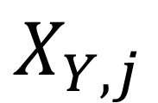


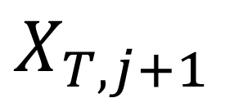
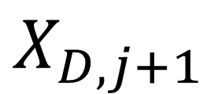

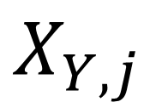
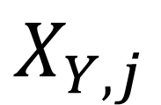

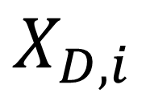
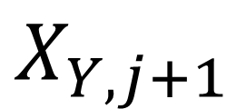
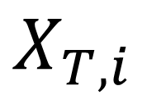


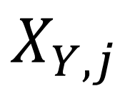
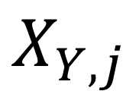

Trusting individuals
$$X_{T,i}$$
Distrusting individuals
$$X_{D,j}$$
Either
$$X∈\{S,I,R\}$$
$$α_{T}$$
$$X_{T,i}$$
$$X_{Y,j}$$
$$X_{T,j+1}$$
$$X_{Y,j}$$
$$i>j$$
Information Transmission
$$Y∈\{D,T\}$$
$$α_{D}$$
$$X_{D,i}$$
$$X_{Y,j}$$
$$X_{D,j+1}$$
$$X_{Y,j}$$
$$i<j$$
Information Fading
$$X_{Y,j}$$
$$λ$$
$$X_{Y,j+1}$$
Notes:
These two interactions correspond to information transmission in the population.
To account for a memory loss process we included a information fading mechanism where the information an individual possess will lose quality over time with a rate given by a parameter lambda. This leads to the more realistic situation in which the population becomes completely unaware of the disease if it is eradicated.

Slide 10
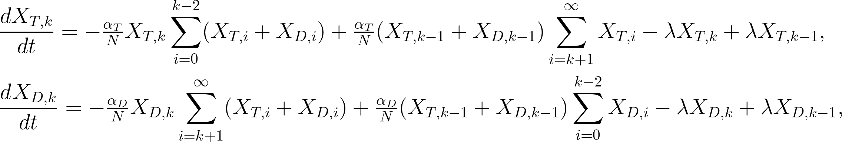
Information spread dynamics
Notes:
These information dynamics lead to the following equations for the trusting and distrusting populations with information of quality k.
The first term in both equations correspond to individuals updating their index when encountering someone with better quality of information, in the case of trusting individuals, and worse quality of information in the case of distrusting individuals. The second terms are the individuals joining the group as they interact with populations with quality of information k-1, since the index increases by 1 when info is transmitted. The final terms are the changes due to the fading effect.

Slide 11
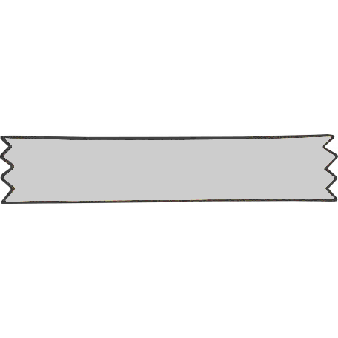





Linking behavioural reactions and disease dynamics
Reduction in transmission rate
$β$ – Disease transmission rate
$ρ$ - Information-mediated protection ($0<ρ<1$)
Information refreshing
Susceptible
$$β(1−ρ^{i})(1−ρ^{j})$$
Infected
i
j
i
j
Recovered
$$ω$$
i
0
Notes:
Ok, cool. So far I told you that the disease spreads through a SIR model and explained the information dynamics, but I didn’t explain how these two are linked.
To give the feedback loops we were looking for we assumed that disease transmission is reduced by informed individuals. The better informed, the lower the transmissibility. This is implemented as the factors (1-rho^i) and (1-rho^j), with rho between 0 and 1, corresponding to the reduction in contact rates of both the susceptible and infected individuals.
The second link between behaviour and disease is given by the information refreshing effect. Infected individuals will refresh their information index from any value to zero with some rate given by omega. This models individuals realising they are infected and hence taking protective measures to reduce transmission, such as quarantining. This delay also accounts for diseases for which the symptoms are not clear or that might be mistaken for something else as in the case of coronavirus and the flu, for instance.
This set of interactions leads to an extensive system of ODEs that we studied to obtain a series of interesting results that I will show you now.

Slide 12
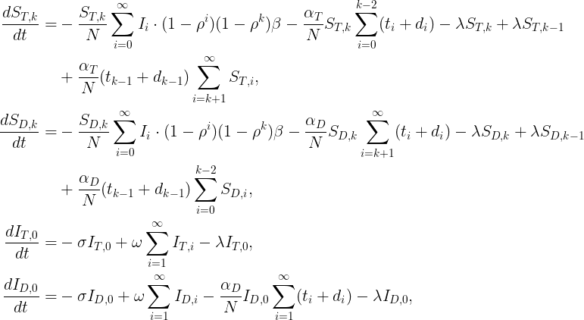


Rates:
$β$ – Disease transmission
$σ$ – Recovery
$λ$ – Fading
$ω$ – Refreshing
$α_{T},α_{D}$ – Information transmission
$ρ$ - Information-mediated protection parameter
Notes:
This is the first part of the resulting system of equations. I don’t really expect you to understand the equations this fast, I just want to show what the model looks like.
The first terms in the equations are the usual disease dynamics. Notice the reduction in transmissibility arising from awareness and behavioural change. The remaining terms come from information transmission, fading and refreshing.

Slide 13
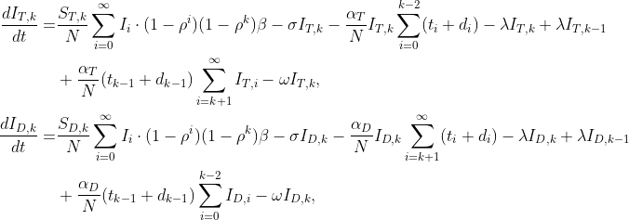
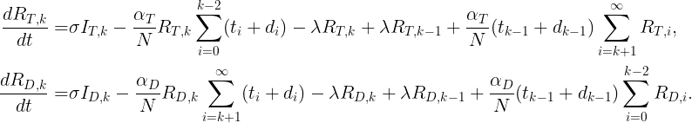
Notes:
These are the remaining equations for the infected and recovered populations. Similarly, the first terms correspond to disease dynamics whilst the remaining are the information dynamics. As you can see, it is a fairly complicated system to solve analytically but is quite feasiable numerically.

Slide 14

Results

Slide 15
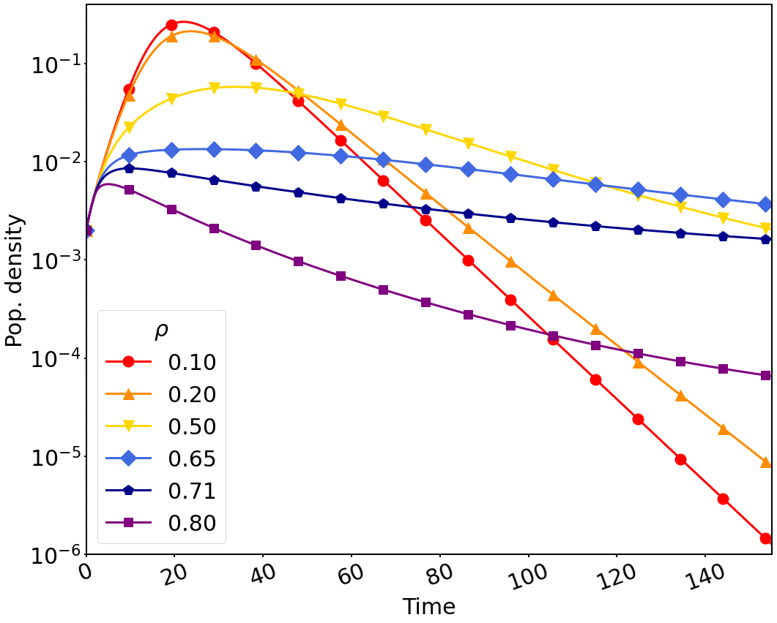
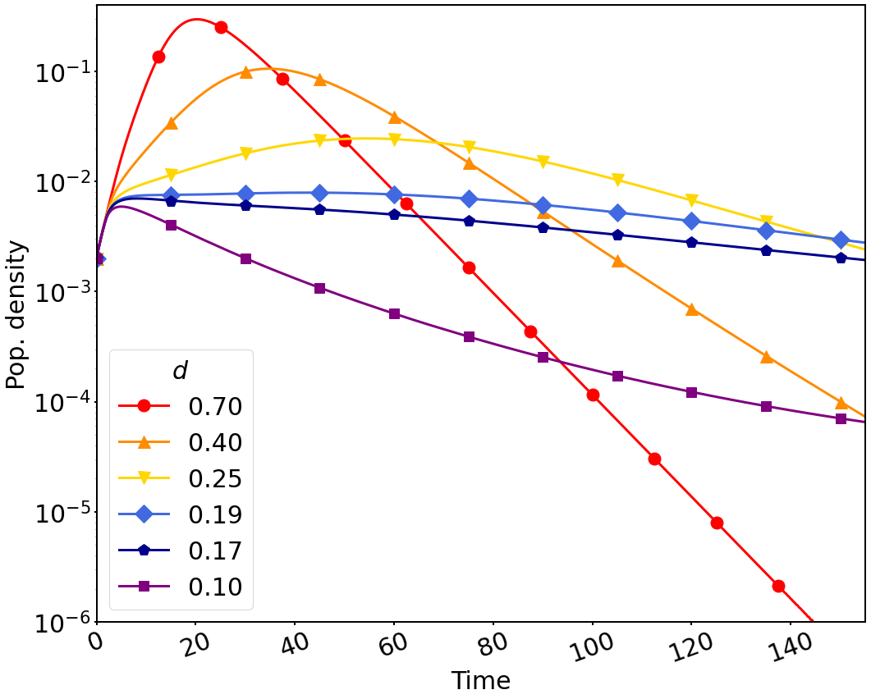


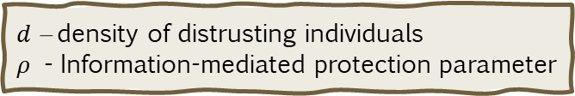
Infected population curves
Varying $ρ$
Varying distrusting population density ($d$)
$d$ – density of distrusting individuals
$ρ$ - Information-mediated protection parameter
Notes:
This first figure is not exactly a result, but it helps to understand what is happening in the system later. Here, we show the aggregated infected population curves for different values of the informed-mediated protection parameter, rho, and distrusting population density, d. There are two main things to notice:
First, if the population is completely unaware at the start of the epidemic, there will be an initial phase of free infection and all curves will follow the same trajectory independently of rho or d. As the number of cases increase and infected individuals realise they are infected, awareness will be generated and individuals will start to take precautionary measures to avoid transmission. Hence, for higher values of rho, that is, higher protective measures taken by informed individuals, we will observe a reduced number of infections in the population. A similar effect is observed for lower density of distrusting individuals as they are less prone to follow health recommendations.
The second key point to observe is that there is a value for rho and distrusting population density for which the infected population becomes almost constant. Of course it’s not a stable state, because the population has finite size and the disease will ramp over the population, but we will take advantage of this metastability later to obtain theoretical approximations.
Notice further how the peak of the infection curve moves as rho and d vary. Initially, increasing rho reduces and delays the peak, in a similar way as reducing the transmission rate in the SIR model. However, after reaching a critical value where the curve becomes almost constant, further increasing rho will reduce the peak, but it occurs earlier instead. A similar behaviour is observed when varying the distrusting population density.
These two distinct dynamical behaviours indicate the existence of a phase transition, a critical or threshold value for rho and density that divides between regions in which the epidemics behave differently. To see that more clearly, we plotted a 2D map of the time when the peak of infection occurs varying simultaneously rho and distrusting population density.

Slide 16
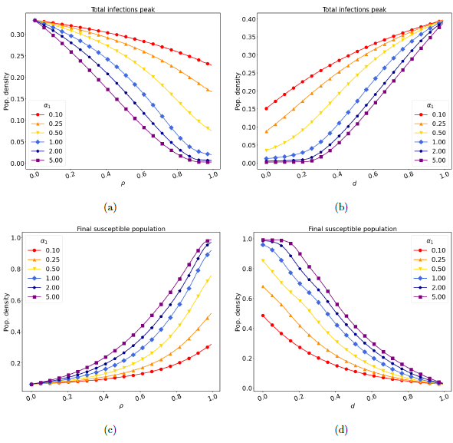
Total Infections Peak and remaining susceptible population

Slide 17
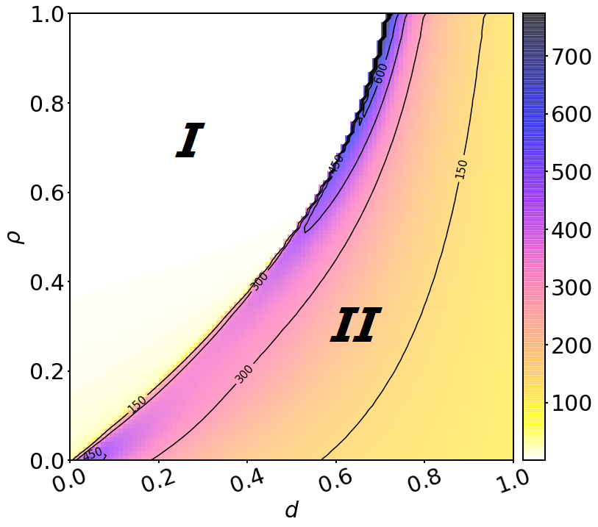
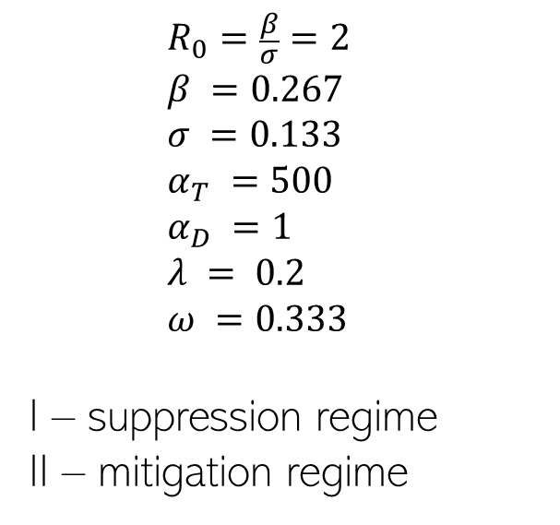
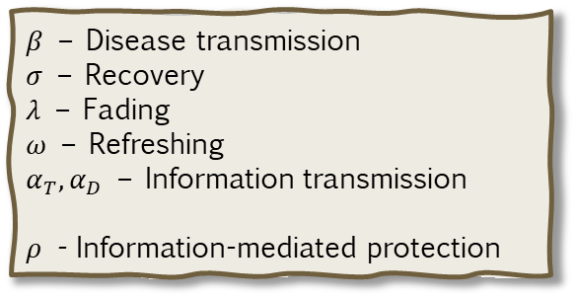
Timing of peak of infection
    $$R_{0}=\frac{β}{σ}=2$$
    $$β =\text{0.267}$$
    $$σ =0.133$$
    $$α_{T} =500$$
    $$α_{D} =1$$
    $$λ = 0.2$$
    $$ω =0.333$$
I – suppression regime
II – mitigation regime
$β$ – Disease transmission
$σ$ – Recovery
$λ$ – Fading
$ω$ – Refreshing
$α_{T},α_{D}$ – Information transmission
$ρ$ - Information-mediated protection
Notes:
This figure shows the timing of the peak of infection for varying rho and distrusting population density, d. In this figure we can see more clearly the two regions. The region marked with I corresponds to the suppression regime, where the behavioural reaction and precautionary measures taken by the informed population is sufficient to suppress the spread of the disease. In contrast, the region marked with II corresponds to the mitigation regime, where the reduction in transmission elicited by informed individuals is not sufficient to contain the spread of the disease, only being able to mitigating it instead, this can be caused by either the effectiveness of the non-pharmaceutical interventions not being strong enough or the number of individuals not complying to health recommendations being high.
Our next result concerns a theoretical estimate of this phase transition in the regime of fast spread of information by both distrusting and trusting individuals.

Slide 18
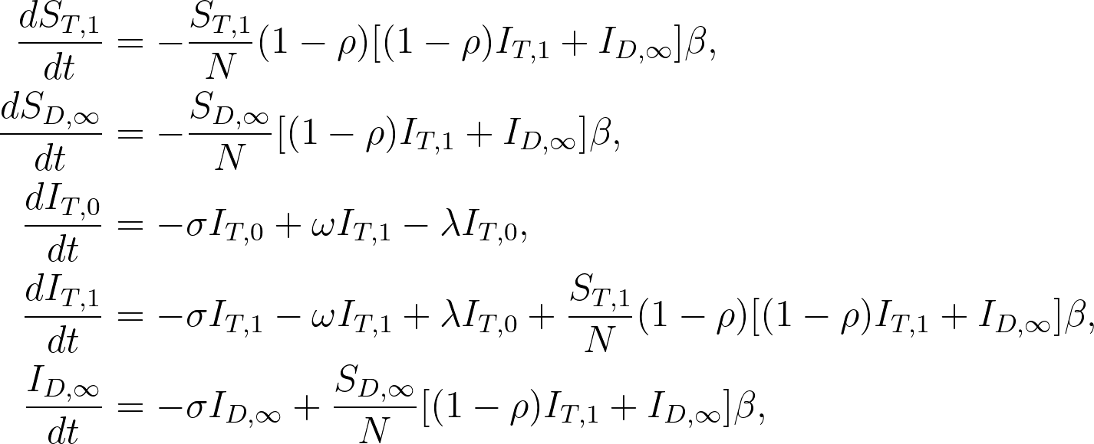
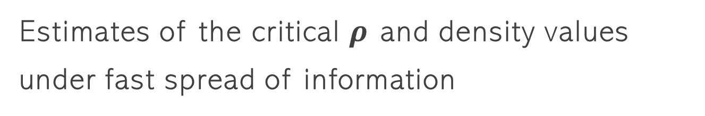
Estimates of the critical $ρ$ and density values under fast spread of information
In the limit $α_{T},α_{D}→∞$, the system of equations reduces to
Notes:
In the limit of fast information spread, the distribution of the population in the information levels collapses in the levels 0 and 1 for the trusting population, and infinity for the distrusting population. Consequently, our model reduces to this more amenable system of equations where we have omitted the equations for the recovered populations. The only information dynamics occurring are the fading and refreshing of information in the trusting population.

Slide 19

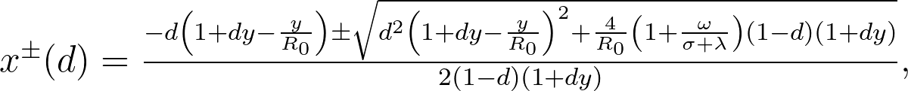

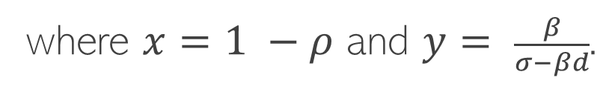
Estimates of the critical $ρ$ and density values under fast spread of information
Assuming metastability at the phase transition,
we can obtain an estimate for the critical $ρ$ and density values
where $x=1 −ρ$ and $y= \frac{β}{σ−βd}.$
$$d_{M}= \frac{σ}{β}$$
Notes:
From the simplified set of equations, if we assume metastability at the phase transition, that is, the curve of infection is constant for some length of time, we can obtain an estimate for the critical rho and density values. I won’t give you all the steps here, but they result in this expression for x equals 1 – rho and y equals to beta over sigma – beta d.
The first thing to note from this expression is that there is a critical density of distrusting population given by sigma/beta where the denominator of y goes to zero. For densities above this value, the suppression of the disease is not achievable for any value of rho. Secondly, the x+ solution is always positive, giving a critical value for rho smaller than 1. This means that there is always a suppression region in the parameter space independently of the other parameters, even if this region is small and requiring a distrusting population close to zero.

Slide 20
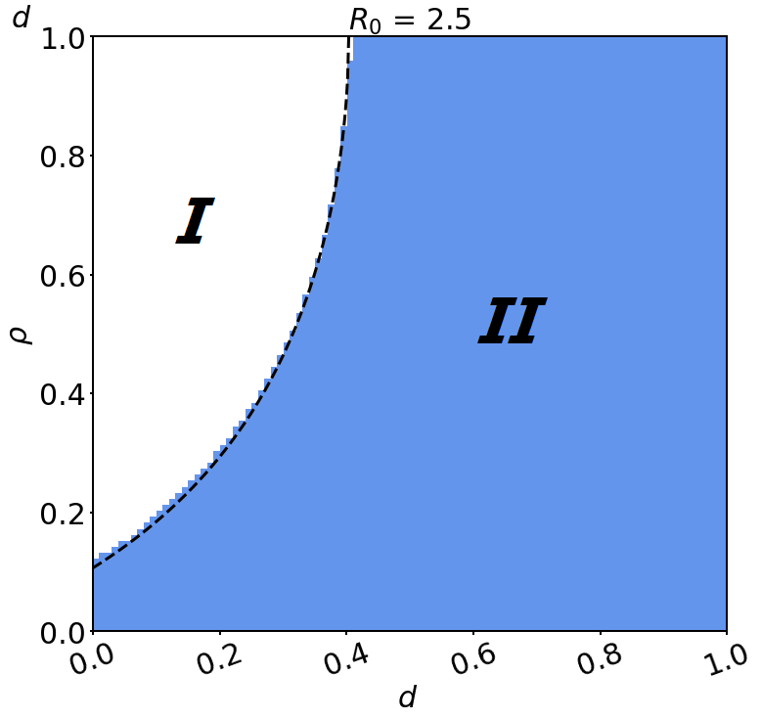
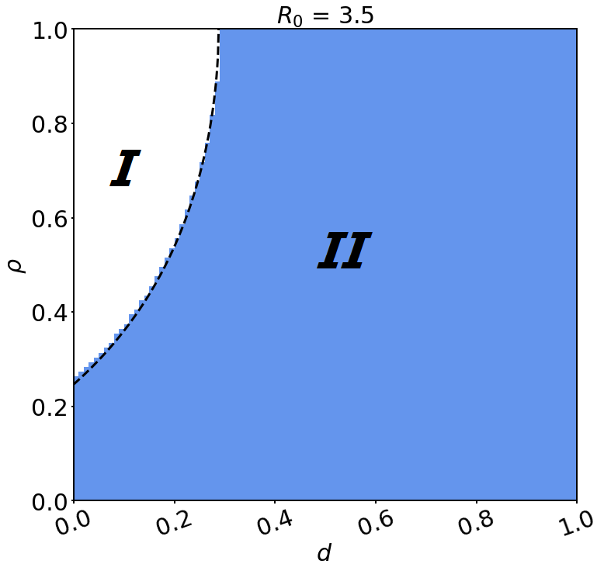
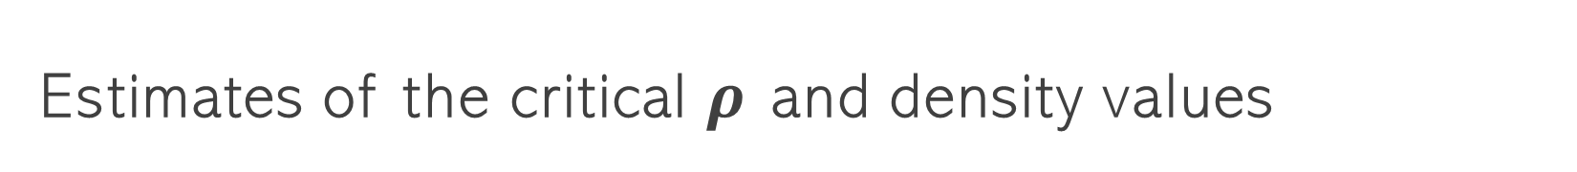
Estimates of the critical $ρ$ and density values
Notes:
This final plot compares the two regions obtained through numerical solutions of the complete system of equations and the threshold estimate obtained through the fast information spread approximation given by the dashed line. As you can see, this estimate is quite good under the assumption taken.

Slide 21

Discussions and further work
Notes:
Finally, some discussions and further work regarding this project.

Slide 22
Discussions and further work
We developed a model that merges these two dynamics in a heterogeneous population.
The surge in awareness reduces the peak of infection and lead to a larger population that remains uninfected by the end of the outbreak.
We also observed a phase transition between mitigation and suppression regimes.
Notes:
Past epidemiological models failed to account for the important aspect of behavioural responses to diseases in human populations.
Recent work has been done in this area, but they usually only consider homogeneous populations.
In this research, we developed a model that merged epidemiological dynamics with information spread and behavioural change interactions of both trusting and distrusting individuals in a population. Using our model, we were able to highlight the mechanisms by which the burden of epidemics can be lightened.
Our results show that awareness driven behavioural changes can reduce the peak of infection during an epidemic, and increase the size of the population that remains uninfected by the end of the outbreak.
We also observed a phase transition between regimes of suppression and mitigation of the disease.

Slide 23
Discussions and further work
Theoretical estimate for the phase transition in the fast information spread regime.
There is a maximum proportion of distrusting individuals for which suppression of the outbreak is achievable.
Separation of timescales framework developed by Parsons and Rogers to obtain better approximations.
Development of the model on graphs and networks to account for spatial structure.
Notes:
In addition, we derived a theoretical estimate for the phase transition in the fast information spread regime.
One key result stemming from this estimate is the existence of a maximum density of distrusting individuals for which suppression of the outbreak is achievable.
Regarding further work on this topic, there are two main prospective directions to follow.
The first one concerns the analysis of the stochastic version of the system using a separation of timescales framework developed by Parsons and Rogers to obtain approximations for realistic information transmission parameter values, but that still exhibit slow and fast dynamics.
Another direction is linked to the development of the model on graphs and network to account for the spatial structure that is missing in our original model.

Slide 24
Information spread on networks
Notes:
One of the problems with the deterministic approach used in the previous model is the assumption of a well-mixed system and the absence of spatial
dynamics. Spatial structures influence how often individuals encounter each other, and consequently, how information spreads within the population. We can imagine that every time two individuals meet and exchange information, a connection between them is formed. New information is then passed along these links and structures arise, taking the shape of a network.
This second project focused on the information dynamics alone. This time we considered the stochastic process arising from the interactions between individuals and the network formed by those interactions. The aim was to understand how this network evolves with time and to explore its interesting dynamics.

Slide 25
The model
1 root node with best quality of information
N unaware nodes
Same information spread dynamics as in the trusting population
Links are created when information is exchanged, forming a graph G(t).
Individual-based interactions
Notes:
The model developed in this second project considers again the information spread dynamics in the trusting population presented previously but with density-dependent transmission of information. This time, however, we investigate the stochastic dynamics arising from the individual-based interactions in this case of a population composed of 1 root node with best quality of information and N unawares nodes at the start of the process.
To give the network dynamics we considered that a link is formed between nodes that exchange information.

Slide 26
2
1
∞
9
∞
∞
0
5
7
0
∞
∞
Root
3
∞
8
4
∞
6
∞
∞
Unaware nodes
Notes:
Just to give you a quick reminder of how the interactions work.
Here we have one root node with information of quality zero, and a bunch of unaware nodes with information index infinity.
As time passes, these nodes will interact with each other, and upon meeting someone with better quality of information than them, they will update their index to be the same of their match plus one, because information loses quality when transmitted.

Slide 27
1
2
1
9
∞
∞
0
5
7
0
∞
∞
Root
3
∞
8
4
∞
6
∞
∞
Notes:
In this case, the node labelled 1 interacted with the root and obtained information of quality one.
Since information was exchanged between them, a link was constructed.

Slide 28
1
2
1
9
∞
∞
0
5
7
0
∞
∞
Root
3
1
8
4
∞
6
∞
∞
Notes:
Now, the node labelled 3 interacted with the root and obtained status 1 as well. Again, a link was created between the root and node 3.

Slide 29
5
2
1
2
1
9
∞
Root
∞
0
7
0
∞
3
1
8
4
∞
∞
6
1
Notes:
As time progresses, more nodes will interact with the root or with other informed nodes in the population. Here, node 5 interacted with node 1 obtaining information of quality 2 and creating a link between them.

Slide 30

5
2
Information quality is equivalent to distance to root!
9
3
1
2
1
2
Root
0
7
0
3
3
1
4
2
8
∞
6
1
Notes:
As the nodes interact and create links between them, a network is formed. Once every unaware node is attached to the network, the resulting graph will be a tree, which we call the tree of knowledge. However, attaching is not the only interaction happening in this tree. Nodes can also reattach when interacting with other nodes with even better quality of information.

Slide 31
5
2
9
3
1
2
1
2
Root
0
7
0
3
3
1
4
2
8
∞
6
1
Notes:
For instance, consider the node labelled 2. It is attached to node 1 and has information of quality 2. Suppose, at some instant of time, it meets the root and exchange information.

Slide 32
5
2
9
2
1
2
1
1
Root
0
7
0
2
3
1
4
2
8
∞
6
1
Notes:
Since information was transmitted between the root and node 2, the old link is erased and a new link between 0 and 2 is created. The information is then transmitted along the branch updating all indices in it. Note that in this process, the information quality a node possess is equivalent to its distance to the root.
If we let the process run for sufficiently long time, all nodes will interact with the root at some point, leading to a final state which is a star graph.

Slide 33
6
7
1
1
5
8
1
1
0
4
0
1
9
1
3
1
1
1
2
1

Slide 34
Results
Notes:
Now a few results we obtained.

Slide 35
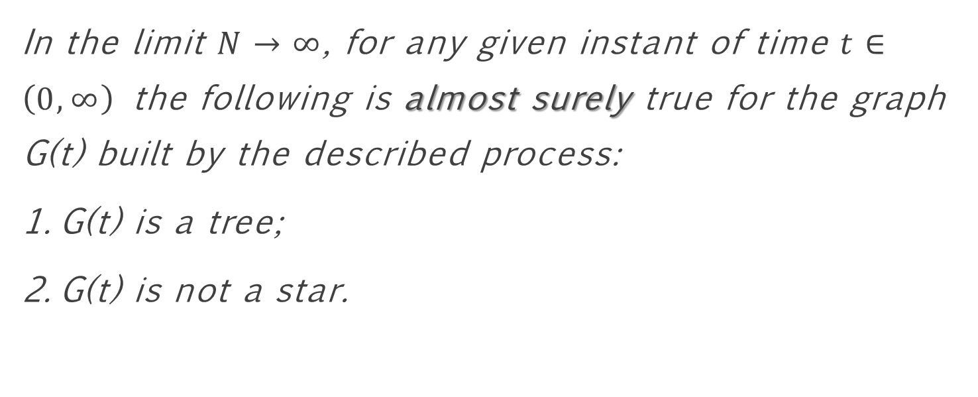
A brief theorem of time
In the limit $N→∞$, for any given instant of time $t∈\left(0,∞\right)$ the following is almost surely true for the graph G(t) built by the described process:
  G(t) is a tree;
  G(t) is not a star.
Notes:
The first interesting result from the analysis of the model is the following theorem:
In the limit $N→∞$, for any given instant of time $t>0$ the following is almost surely true for the graph G(t) built by the described process:
G(t) is a tree;
G(t) is not a star.
I won’t show you the proof for time constrain reasons, but it’s been proved in my report.
Basically, what the theorem says is that, in the limit where the number of nodes tends to infinity, this information spread process becomes explosively fast and every node becomes aware in a fraction of time. However, since all nodes must interact with the root to reach the stationary state, it takes an infinite amount of time to reach it.
Since this graph is a tree, but not a star, we can ask questions about the height of this tree and how close to a recursive random tree our network is. This will give us an idea of how distant nodes are from the source of information.

Slide 36
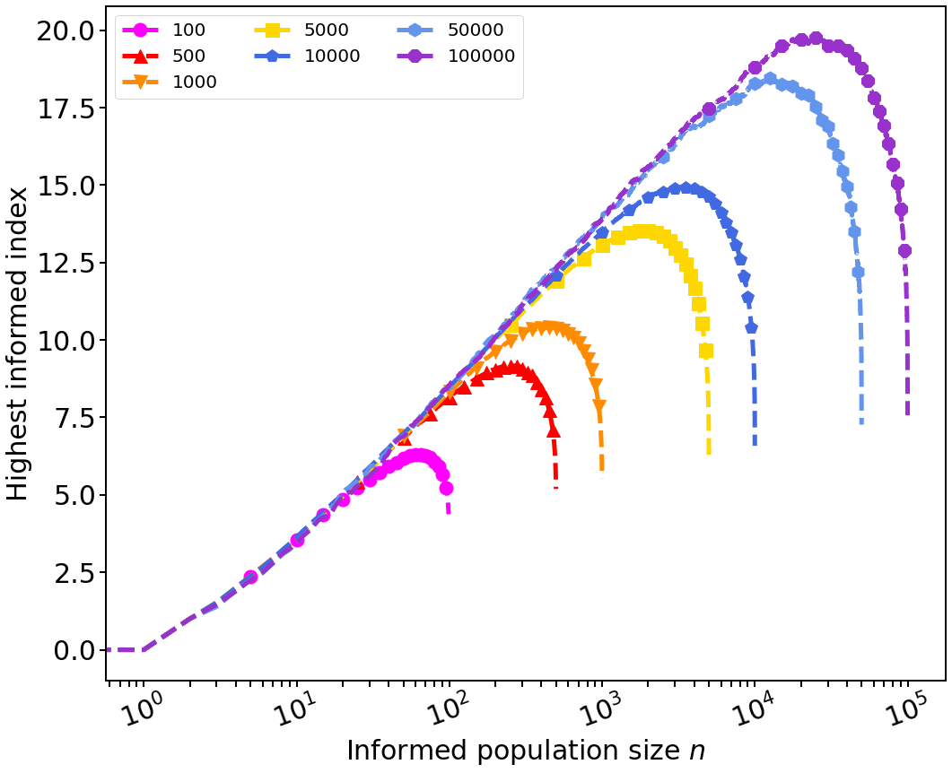
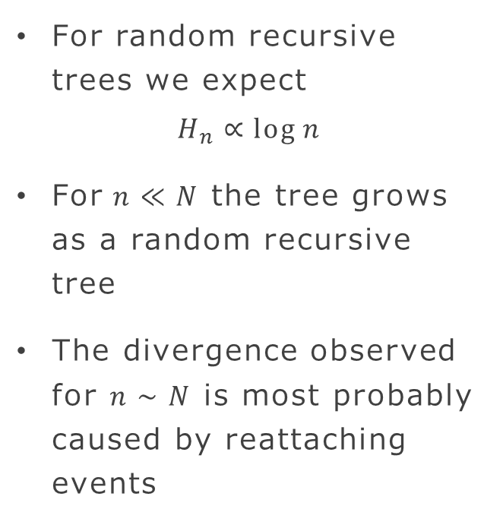
The average height of the tree
For random recursive trees we expect
$$H_{n}∝\log{n}$$
For$n≪N$ the tree grows as a random recursive tree
The divergence observed for $n∼N$ is most probably caused by reattaching events
Notes:
If we plot the highest index of an informed node as a function of the informed population size as the network is built, we obtain this fabulous figure for different total population sizes.
For random recursive trees, we expect the height of the tree to grow as log n. As we can see, the tree built by our process follow this prediction quite well when its size is small compared to the size of the whole population. However, as the size increases, we observe a deviation. This deviation is caused by reattaching events, where nodes more distant from the root interact with nodes at lower depth, reattaching to the tree closer than they were before and carrying the whole branch with them.

Slide 37
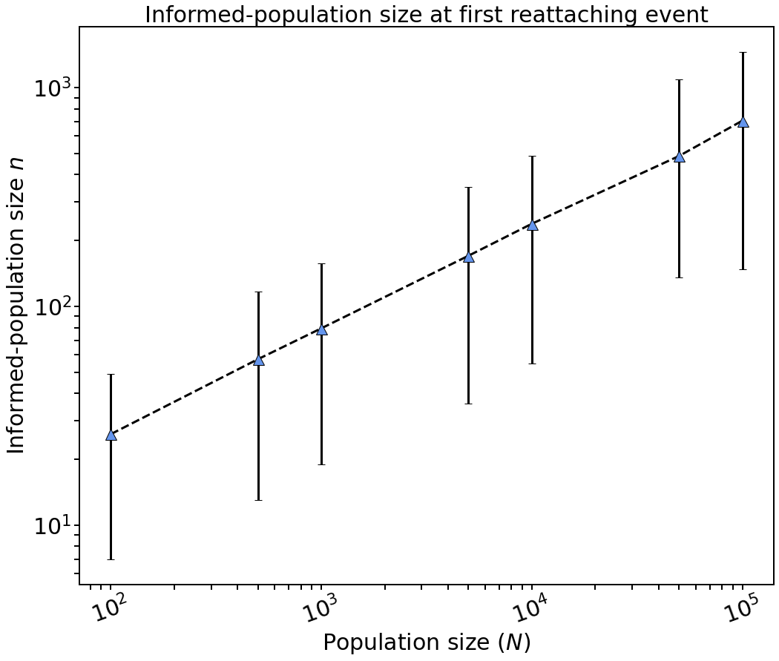
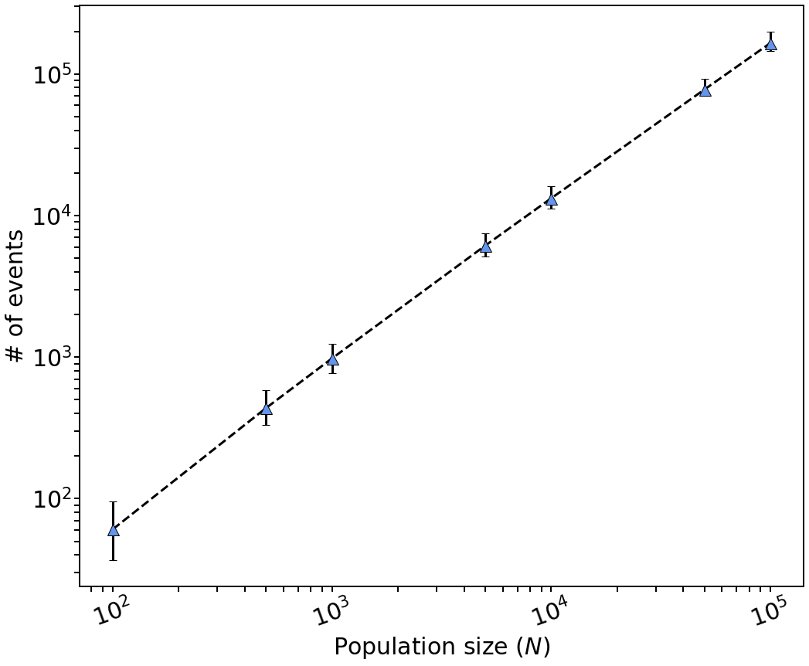
The size of the informed population at the first reattaching event and the total number of reattaching events
Notes:
The left plot shows the 95% confidence interval of the informed-population size at the first reattaching event obtained from thousand simulations of the process for different total population sizes. As we can see, the first reattaching event occurs really early in the process and has a large variance. The size of the tree when the first reattaching event occurs grows approximately as square root of the total population size.
This result tells us how early in the tree formation the assumptions of a random recursive tree begin to fail, but it does not tell us how many times the assumption breaks
before the tree is completely formed. Certainly, if only a few rearranging events occur, even if at the early stages of the tree formation, we could still consider the random
recursive tree to be a good approximation. To assess the quality of the approximation, we then need to have an idea of how many rearranging events occur before the last
uninformed individual attaches to the tree. This is shown in the right plot. From the figure, we note that the number of such events is approximately of the same order of magnitude as N. This means that, until the whole knowledge tree is formed, as many reattaching events as attaching events occur. Consequently, the random recursive
tree approximation does not hold satisfactorily for the whole tree building process.
######## increasing proportionally to N^c, where c = 1.14.

Slide 38

Discussions and further work
Notes:
To end this section, a few discussion points.

Slide 39

Discussions and further work
We investigated the spread of information on graphs.
In the limit $N→∞$, G$(t)$is a tree but not a star.
Early, the tree grows as a random recursive tree.
The random recursive tree approximation does not hold for very long.
Further work:
  Use the preferential attachment scheme to analyze the evolution of the tree.
  Include the fading and refreshing of information effects.
Notes:
In this second project we started the investigation of information spread on graphs.
We showed that in the limit that the population sizes goes to infinity, the graph built by our process is a tree, but it has not reached the stationary state.
We saw that in the early stages of the process, the number of reattaching events is low and the tree grows similarly to a random recursive tree.
However, as the process continues, reattaching events occur more frequently and the random recursive tree approximation does not hold for very long.
For further work on this project, a prospective direction is to use the preferential attachment scheme to analyse the tree’s evolution. In this scheme, the nodes attach to the tree with probabilities that depend on characteristics of the nodes. In our case, we could consider probabilities that depend on the depth of the node.
Another direction is the addition of the fading and refreshing of information effects presented in the first project, but that have been ignored in this model.
To end this presentation, just a quick recap.

Slide 40


Key takeaways
We developed a model for the feedback of behavioural reaction to a disease on epidemics.
Awareness reduces the peak of infection and leads to a larger population that remains uninfected by the end of the outbreak.
We observed a phase transition between mitigation and suppression regimes, and obtained a theoretical estimate for it.
There is critical distrusting population density above which suppression of the disease is not achievable.
$$d_{M}= \frac{σ}{β}$$
Notes:
To end, some key takeaways of this presentation.
First, we developed a model for the feedback of behavioural reaction to a disease on epidemics for a population with two distinct behaviours.
From this model, we observed that awareness reduces the peak of infection and leads to larger populations that remains uninfected by the end of the outbreak.
We also observed a phase transition between mitigation and suppression regimes and obtained a theoretical estimate for it in the fast spread of information regime.
We found a critical distrusting population density above which suppression of the disease is not achievable.
Finally, these results highlight the urgent need for effective measures to combat the spread of misinformation.
That is all I had to say. Thank you very much for your attention!

Slide 41


Thanks for your attention!
ams284@bath.ac.uk
@ams284_
This Photo by Unknown Author is licensed under CC BY-SA

