Slide 1
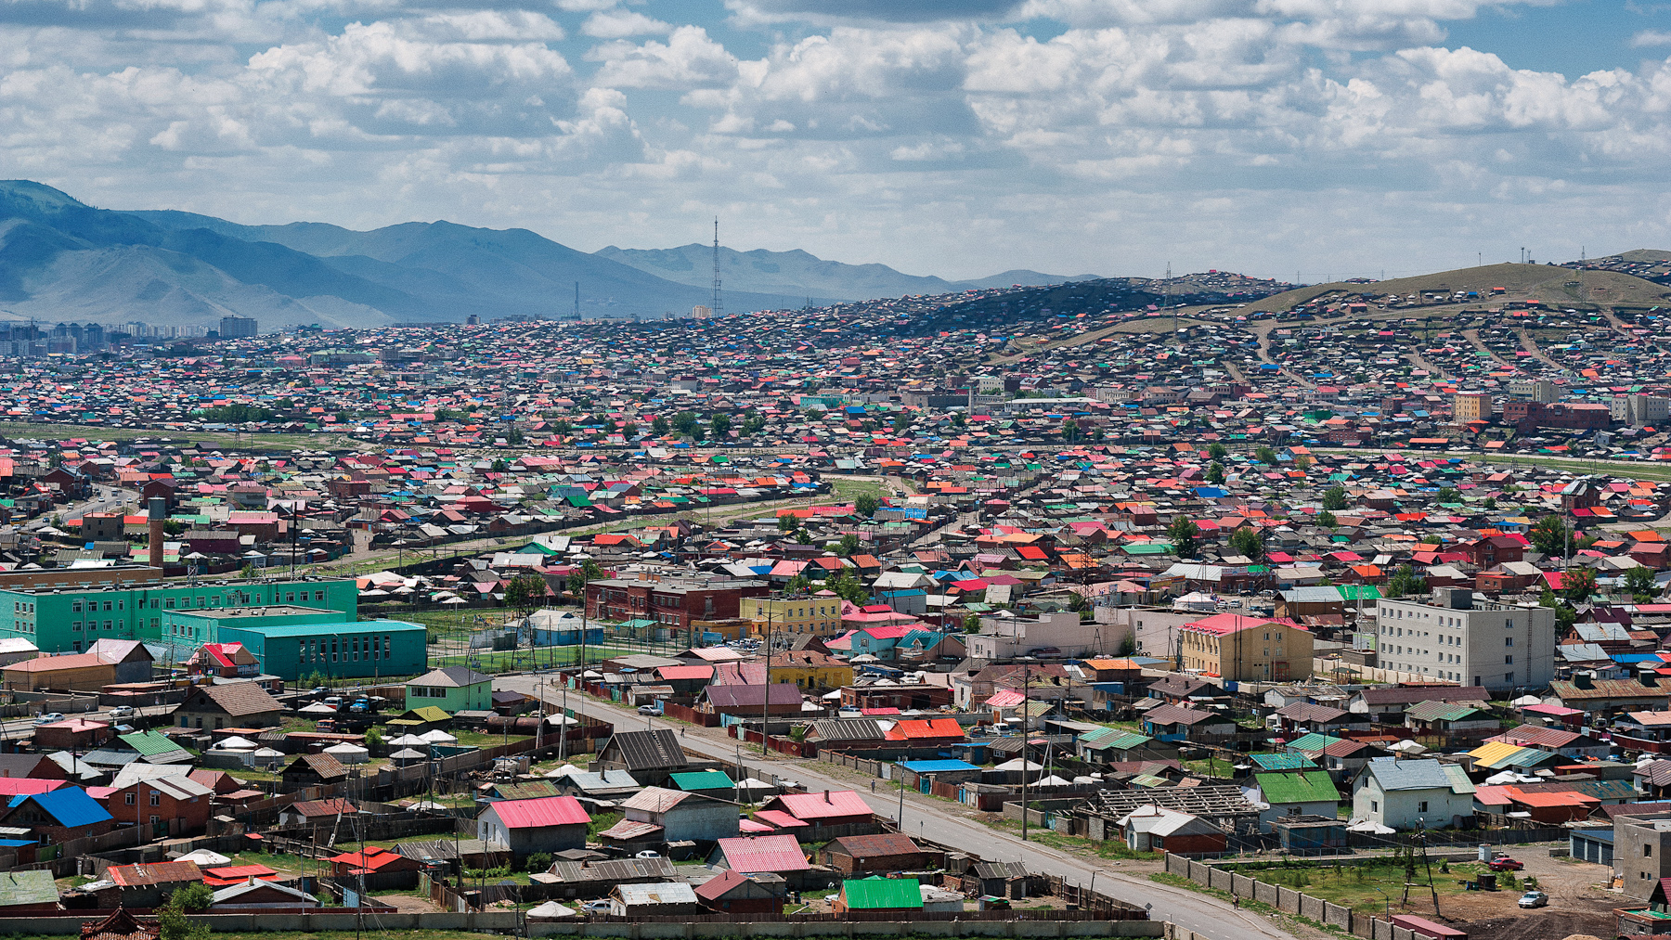


The role of households and neighbourhoods in the early stages of an epidemic
Abby Barlow
Supervisors: Ben Adams & Sarah Penington

Slide 2


Background and motivation
Notes:
We can incorporate spatial structuring by assuming a metapopulation framework. These types of models have been around since the late 1900s, first developed by Levins in ecology (and Hanski).
The premise is to divide the population into subpopulations dependent on their spatial separation, yielding a more realistic contact structure.
Common metapopulation frameworks include: large spatially segregated subpopulations – traditionally for investigating local/global extinction and disease persistence i.e. of country regions; subpopulations of households – household models – typically more challenging since stochasticity becomes more important and contacts may be more frequent/ longer; hosts as subpopulations of parasites.
Transmission in the household will be stronger than that in the wider community and we cannot assume random mass action transmission.
Household structure important because individuals often have longer, closer and frequent contacts, vaccination and social distancing stance decided at household level, when sick stay at home etc…

Slide 3
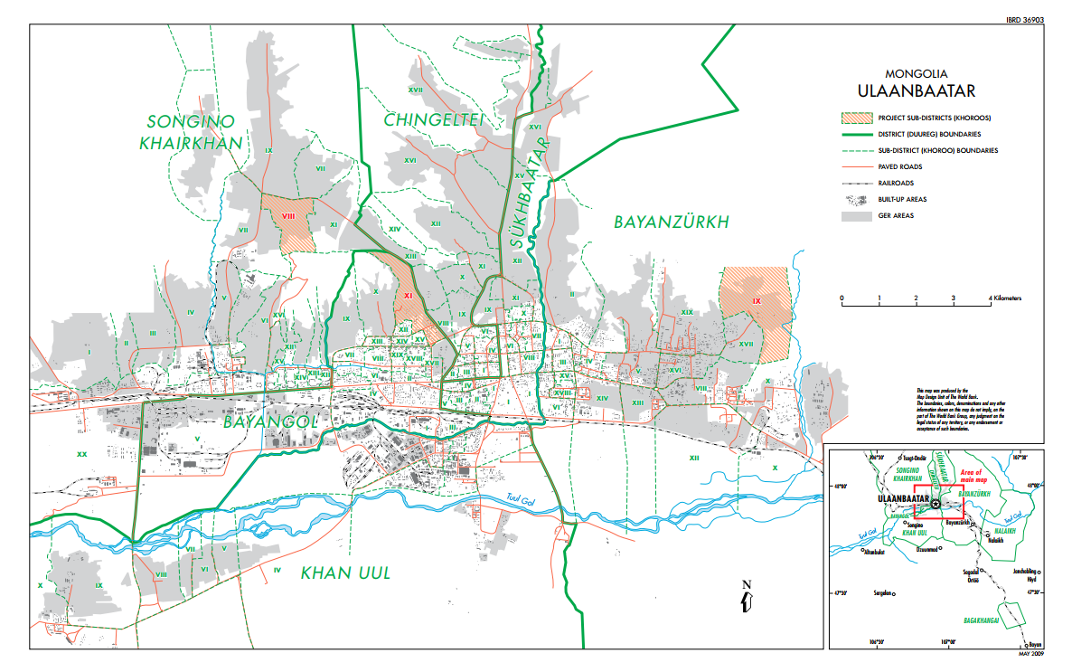
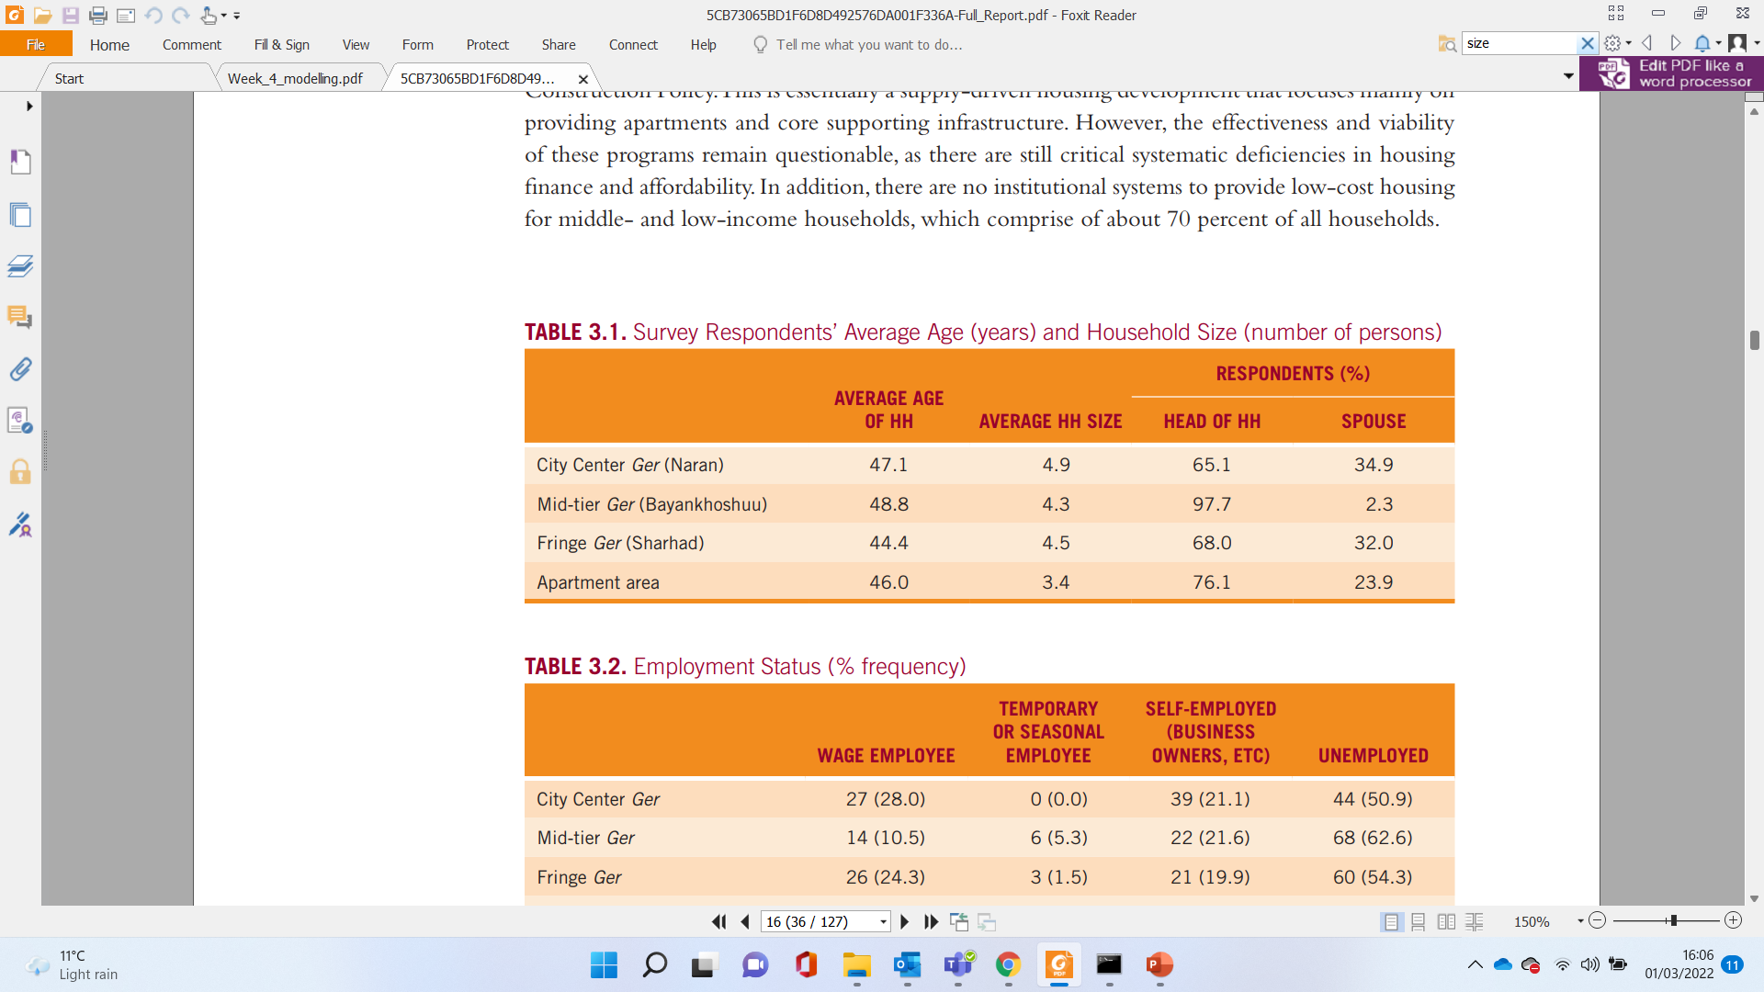
Our project
General hypothesis :
“Spatial demographic variability is epidemiologically important.”
Notes:
Came up with the idea for this project after the summer work on modelling covid in Mongolia, specifically UB, capital city.
We want to incorporate a more realistic spatial structure at a household level.
Researching the demography of UB we found that household sizes to vary between different areas, in particular in the informal settlements vs apartments but also between ger areas.
We hypothesis that the differences in these household distributions between ‘neighbourhoods’ are epidemiologically important in that…
But also sanitary conditions, space, mixing etc…

Slide 4
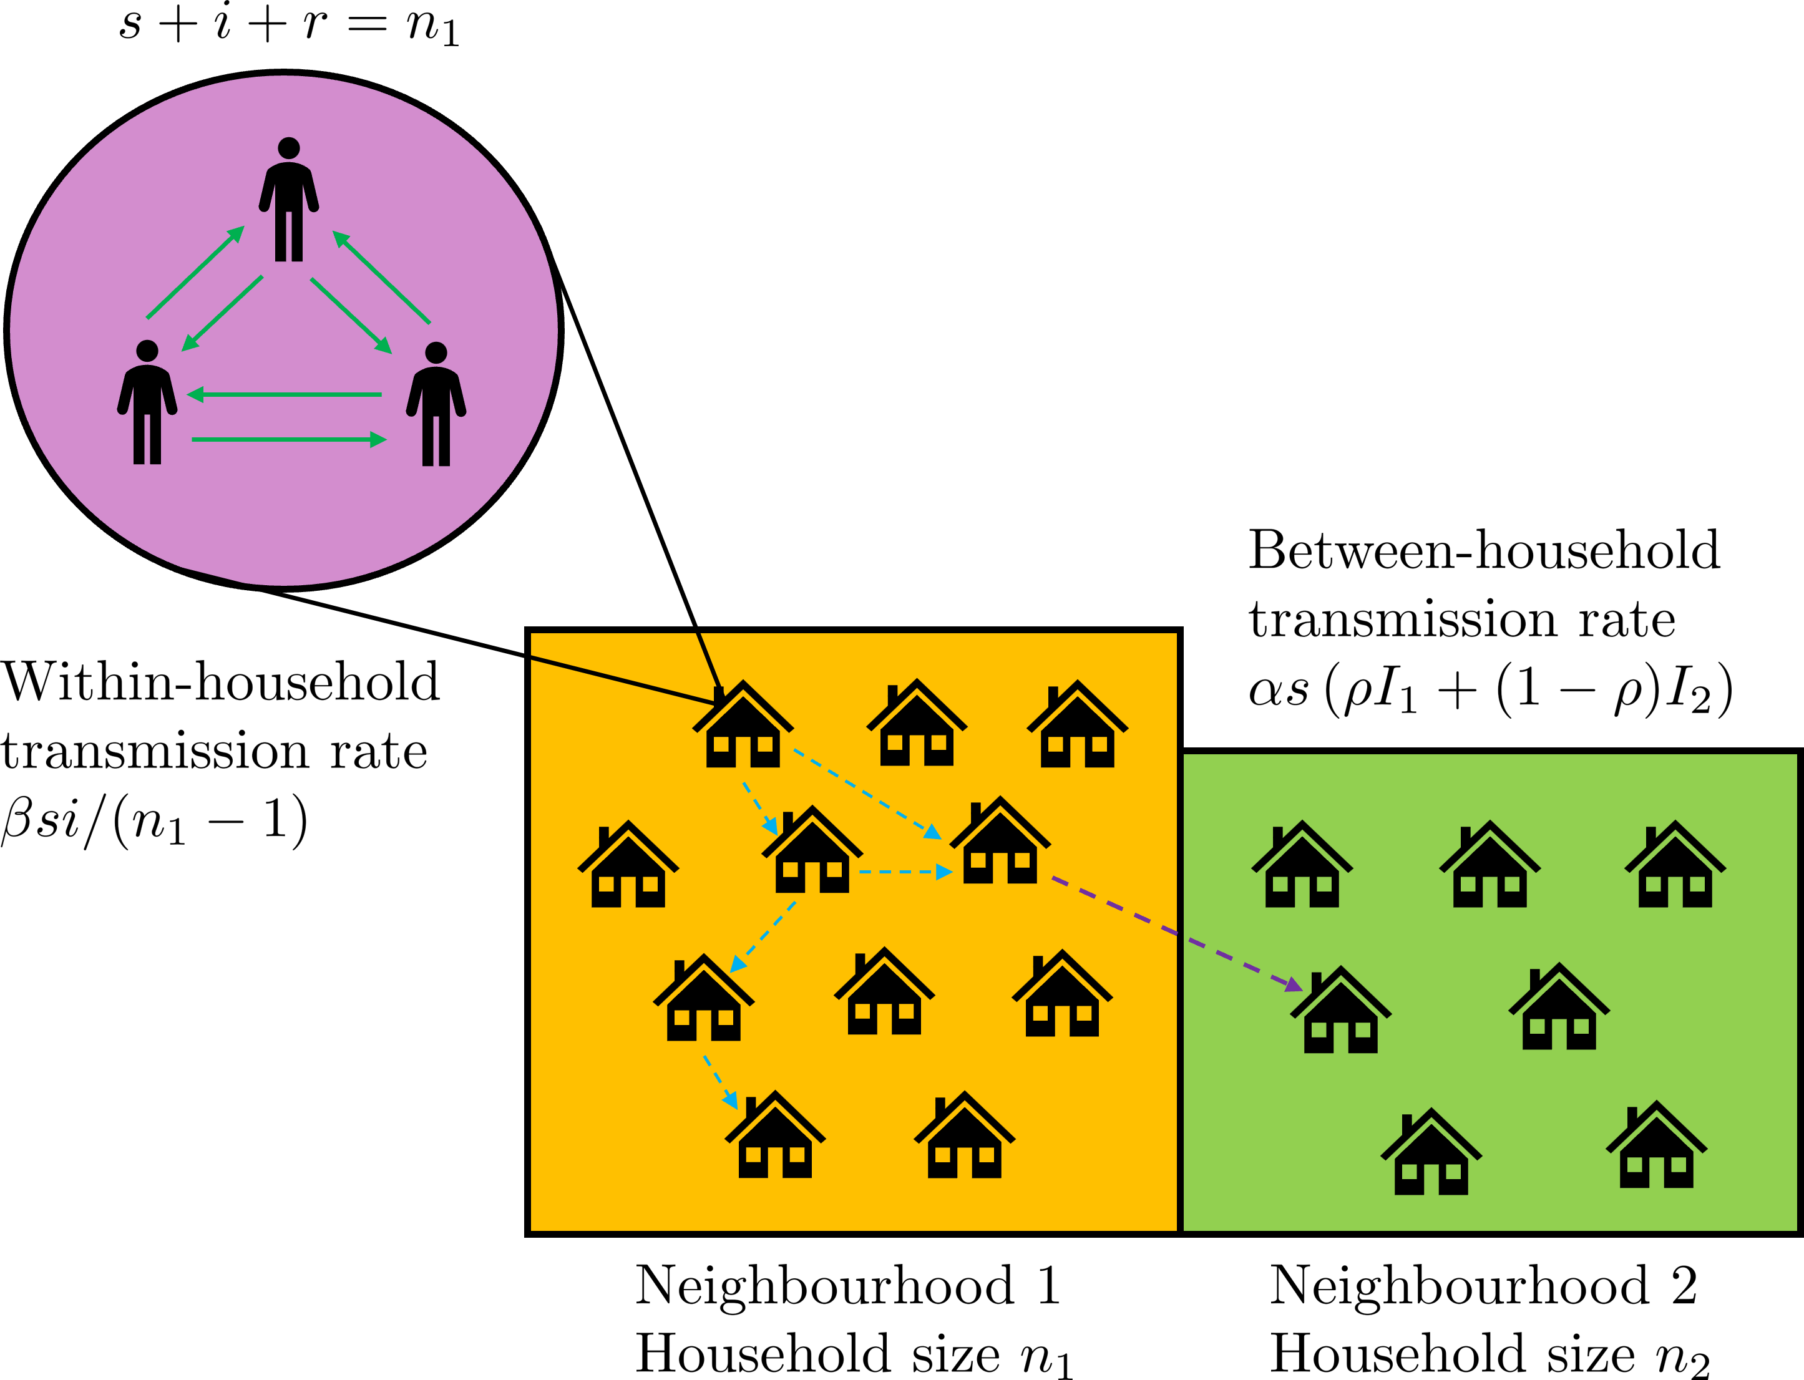
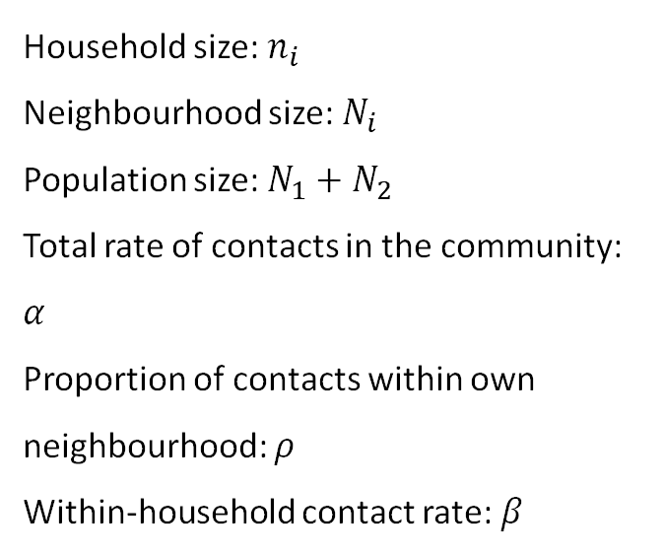
Initial model: 2 neighbourhoods
Household size: $n_{i}$
Neighbourhood size: $N_{i}$
Population size: $N_{1}+N_{2}$
Total rate of contacts in the community: $α$
Proportion of contacts within own neighbourhood: $ρ$
Within-household contact rate: $β$
Notes:
Integrating metapopulation and household frameworks.
Different household sizes (fixed) or distribution per neighbourhood.
Assume overall rate of contacts same for each neighbourhood.

Slide 5
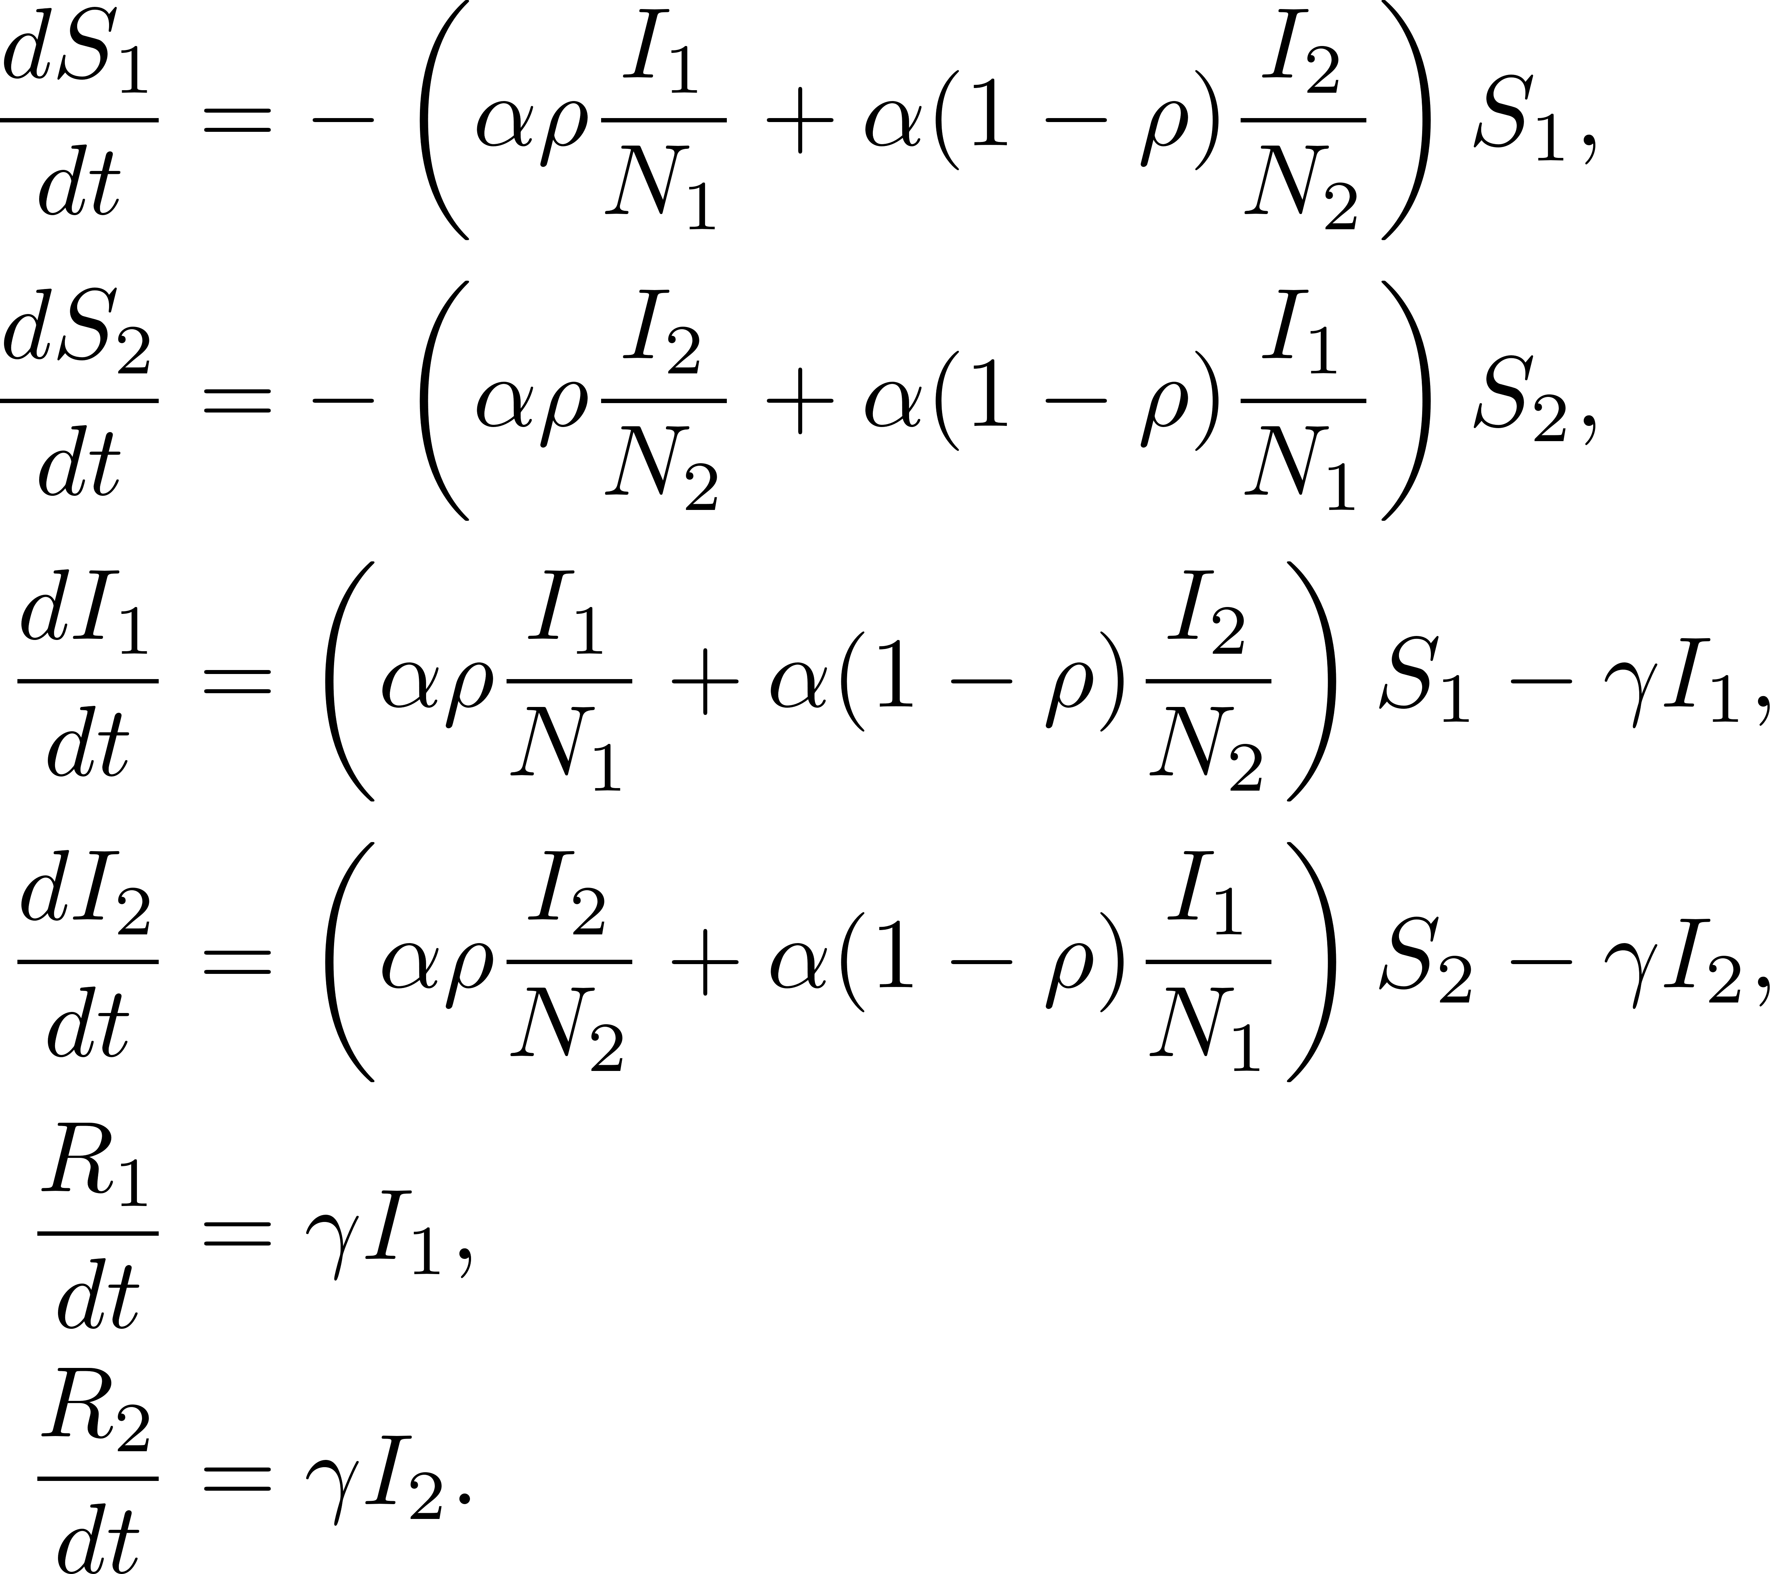
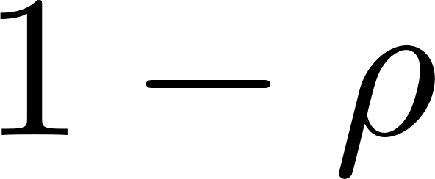


Deterministic model for households size 1
Basic reproduction number is
$$R_{0}=α/γ$$
Notes:
Write as a simple metapopulation model, where households of size 1 effectively just represent individuals.

Slide 6
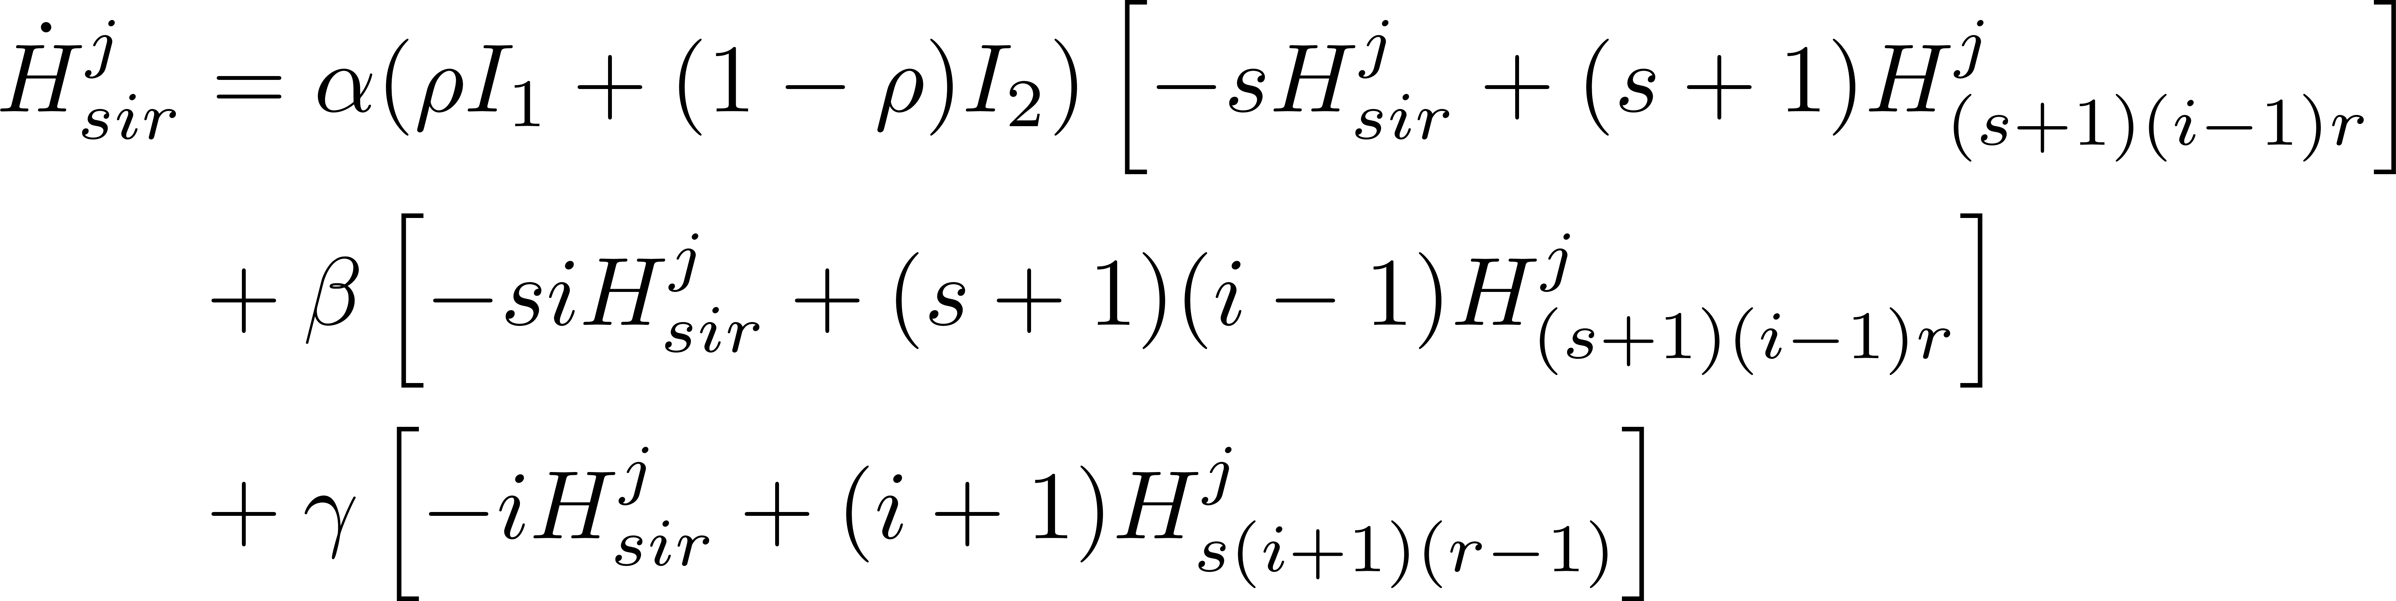






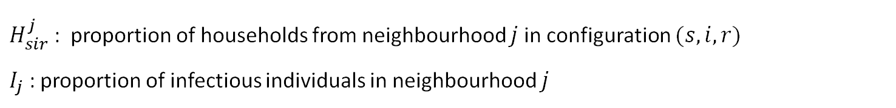

ODE model for households size 2
Neighbourhood $j=1,2$ equations:
External infection
Within household infection
recovery
$H_{sir}^{j}$ : proportion of households from neighbourhood $j$ in configuration $(s,i,r)$
$I_{j}$ : proportion of infectious individuals in neighbourhood $j$
Notes:
Need to use our coupled ODE framework. This is for 2 neighbourhoods.

Slide 7
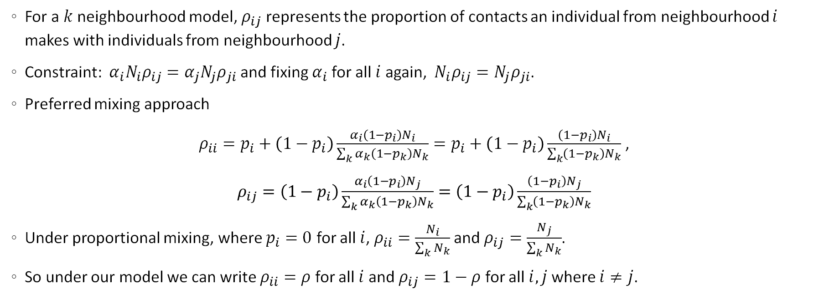
Coupling rate between the neighbourhoods
For a $k$ neighbourhood model, $ρ_{ij}$ represents the proportion of contacts an individual from neighbourhood $i$ makes with individuals from neighbourhood $j$.
Constraint: $α_{i}N_{i}ρ_{ij}=α_{j}N_{j}ρ_{ji}$ and fixing $α_{i}$ for all $i$ again, ${ N}_{i}ρ_{ij}=N_{j}ρ_{ji}$.
Preferred mixing approach
$ρ_{ii}=p_{i}+\left(1−p_{i}\right)\frac{α_{i}\left(1−p_{i}\right)N_{i}}{\sum_{k}{α_{k}\left(1−p_{k}\right)N_{k}}}=p_{i}+\left(1−p_{i}\right)\frac{\left(1−p_{i}\right)N_{i}}{\sum_{k}{\left(1−p_{k}\right)N_{k}}}$ ,
$ρ_{ij}=\left(1−p_{i}\right)\frac{α_{i}\left(1−p_{i}\right)N_{j}}{\sum_{k}{α_{k}\left(1−p_{k}\right)N_{k}}}=\left(1−p_{i}\right)\frac{\left(1−p_{i}\right)N_{j}}{\sum_{k}{\left(1−p_{k}\right)N_{k}}}$
Under proportional mixing, where $p_{i}=0$ for all $i$, $ρ_{ii}=\frac{N_{i}}{\sum_{k}{N_{k}}}$and $ρ_{ij}=\frac{N_{j}}{\sum_{k}{N_{k}}}$.
So under our model we can write $ρ_{ii}=ρ$ for all $i$ and $ρ_{ij}=1−ρ$ for all $i,j$ where $i≠j$.
Notes:
Constraint: total contacts individuals from neighbourhood $i$ have with individuals from neighbourhood $j$ is equal to the total number of contacts individuals from neighbourhood $j$ have with those from neighbourhood $i$. Therefore,
So, contacts by neighbourhood $i$ individuals, within neighbourhood $i$, are composed of dedicated local contacts, and random contacts that are local by chance.
Let us denote the fraction of neighbourhood $i$ individuals whose contacts are reserved as local to be $p_{i}$.
So, the contact rate is proportional to the (effective) population size (i.e. contact rate * population size).

Slide 8


Calculating the household reproduction number $R_{∗}$, households size 2
$R_{∗}$ is the expected number of secondary households infected by the primary household.
For a single neighbourhood,
$$R_{∗}=\left(1+\frac{β}{β+γ}\right)\left(\frac{α}{γ}\right)$$
For multiple neighbourhoods, $R_{∗}$ is the dominant eigenvalue of the matrix
$$\left(\begin{matrix}R_{∗}^{11} & R_{∗}^{12} \\ R_{∗}^{21} & R_{∗}^{22}\end{matrix}\right)$$
where $R_{∗}^{11}=\left(1+\frac{β}{β+γ}\right)\left(\frac{ρα}{γ}\right)$, $R_{∗}^{12}=\left(1+\frac{β}{β+γ}\right)\left(\frac{\left(1−ρ\right)α }{γ}\right)$, etc..
Expected no. cases in primary household
Expected no. cases an individual produces outside household
Notes:
First, thinking about this intuitively, we can write down R* for a single neighbourhood …
Where R^{12}_* is the expected no. of infections produced by a primary individual in neighbourhood 1 IN neighbourhood 2.

Slide 9


Calculating the household reproduction number $R_{∗}$, households size 3
For a single neighbourhood,
For larger household sizes we can calculate $R_{∗}$ numerically using the methods presented in Ross et al. 2010.
Notes:
Analytic expression from R^* gets increasingly more complex as household size increases.
Simpler & efficient method which works for any household size is to solve the following linear system of equations… see Ross 2010

Slide 10
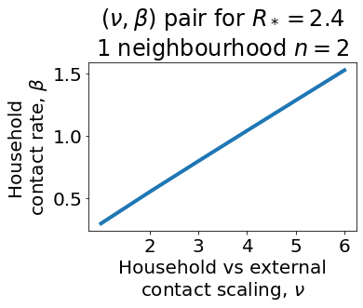
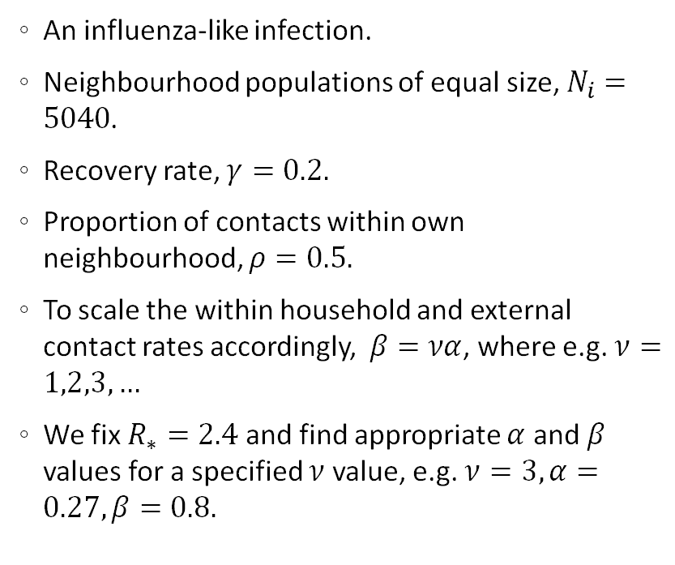
Parametrisation
An influenza-like infection.
Neighbourhood populations of equal size, $N_{i}=5040$.
Recovery rate, $γ=0.2.$
Proportion of contacts within own neighbourhood, $ρ=0.5.$
To scale the within household and external contact rates accordingly, $β=να$, where e.g. $ν=1,2,3,…$
We fix $R_{∗}=2.4$ and find appropriate $α$ and $β$ values for a specified $ν$ value, e.g. $ν=3, α=0.27, β=0.8.$
Notes:
Consider a single neighbourhood of households size 2.

Slide 11

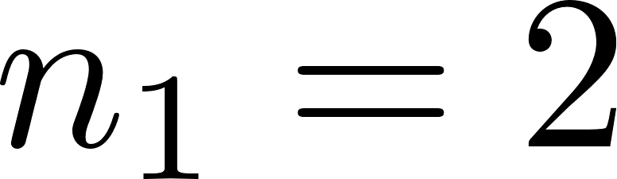
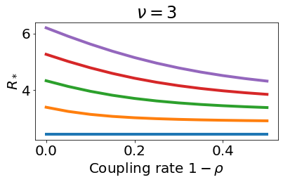
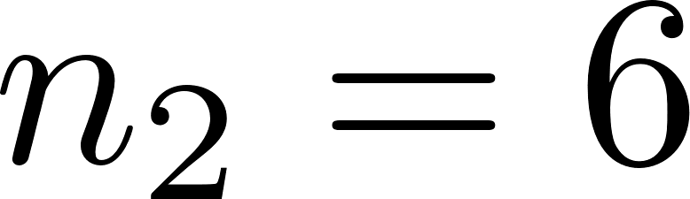
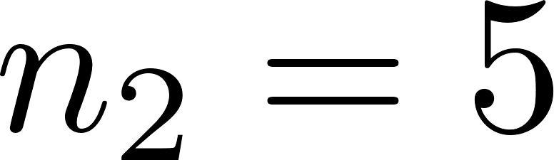
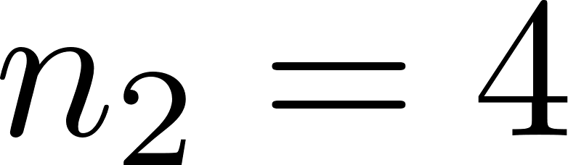
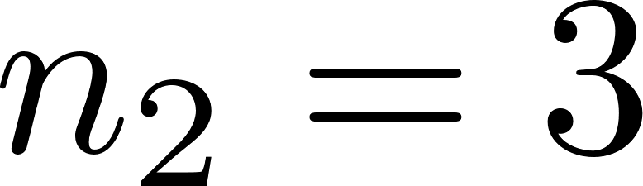
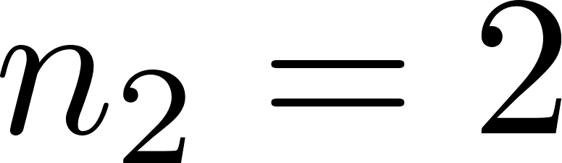
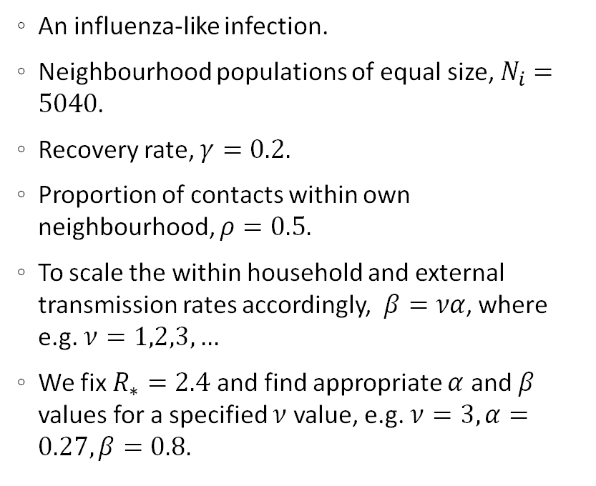
Parametrisation
An influenza-like infection.
Neighbourhood populations of equal size, $N_{i}=5040$.
Recovery rate, $γ=0.2.$
Proportion of contacts within own neighbourhood, $ρ=0.5.$
To scale the within household and external transmission rates accordingly, $β=να$, where e.g. $ν=1,2,3,…$
We fix $R_{∗}=2.4$ and find appropriate $α$ and $β$ values for a specified $ν$ value, e.g. $ν=3, α=0.27, β=0.8.$
isolated neighbourhoods
proportional mixing
Notes:
Each curve is for a different household size in neighbourhood 1. n1 = 3, 4, 5, 6 corresponds to the blue, orange, green and red lines respectively.
$R_{∗}$ increases with household size but decreases with increased mixing over neighbourhoods with differing fixed household sizes. Same result holds for a wide range of nu.
Increased mixing initially reduces the infection spread in the neighbourhoods with larger households.

Slide 12
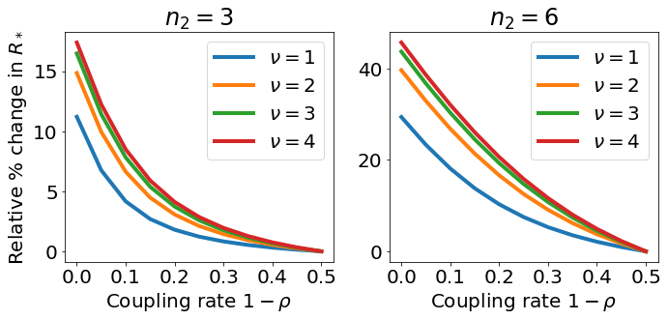
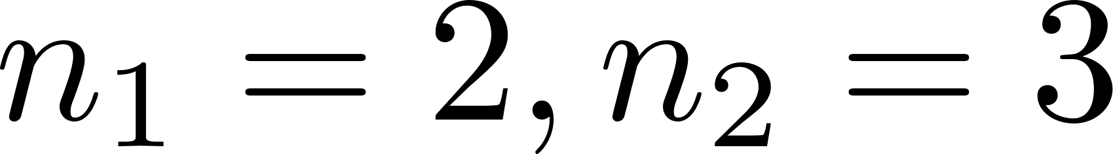
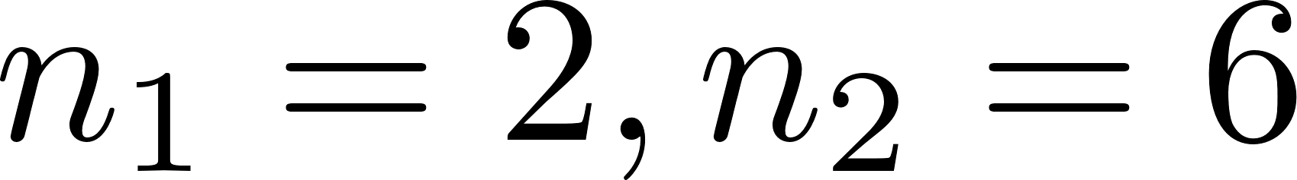


Results – the impact of mixing on the initial stages of infection
$$6$$
$$6$$
isolated neighbourhoods
proportional mixing
Notes:
Relative increase in R_* when one neighbourhood fixed at households sized 2 and the other size 3 and 6 for comparison as we increase the strength of mixing between the 2 neighbourhoods from completely isolated to proportional mixing.
For larger household sizes $≥6$ an increase to proportional mixing between neighbourhoods can lead to a decrease in $R_{∗}$ of over 40% for $ν≥2$.

Slide 13
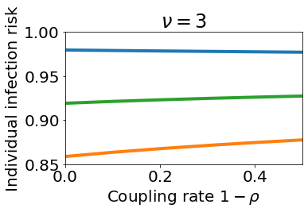
Results – the impact of mixing on individual infection risk
$$6$$
$$6$$
overall
Figure: orange bottom curve – neighbourhood with household size 2; blue top curve – neighbourhood with household size 6; middle green curve – across both neighbourhoods.
isolated neighbourhoods
proportional mixing
Notes:
Individual infection risk – the probability/ proportion of individuals infected by the end of the outbreak.
Increasing the mixing between the neighbourhoods increases infection risk in the neighbourhood with smaller households but only reduces the risk slightly for those in the larger household neighbourhood.
Increased neighbourhood household size increases infection risk for individuals from the neighbourhood but the impact is mainly localised.

Slide 14
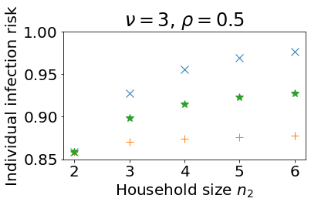
Results – the impact of household size on individual risk of infection
neighbourhood 2
Figure: orange pluses – fixed neighbourhood (1); green stars – across both neighbourhoods; neighbourhood; blue crosses – neighbourhood of varying household size (2).
overall
neighbourhood 1
Notes:
Increasing the mixing between the neighbourhoods increases infection risk in the neighbourhood with smaller households but only reduces the risk slightly for those in the larger household neighbourhood.
Increased neighbourhood household size increases infection risk for individuals from the neighbourhood but the impact is mainly localised.

Slide 15
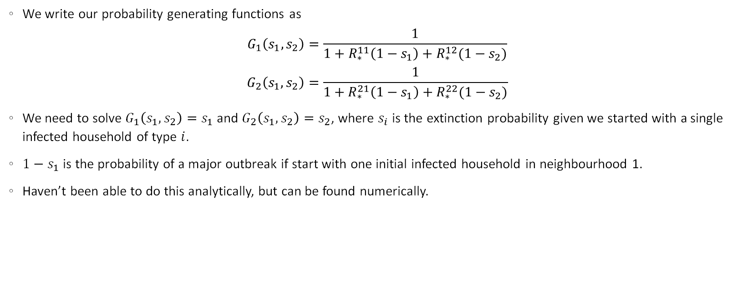
Probability of a major outbreak
We write our probability generating functions as
$$G_{1}\left(s_{1},s_{2}\right)=\frac{1}{1+R_{∗}^{11}\left(1−s_{1}\right)+R_{∗}^{12}(1−s_{2})}$$
$$G_{2}\left(s_{1},s_{2}\right)=\frac{1}{1+R_{∗}^{21}\left(1−s_{1}\right)+R_{∗}^{22}(1−s_{2})}$$
We need to solve $G_{1}\left(s_{1},s_{2}\right)=s_{1}$ and $G_{2}\left(s_{1},s_{2}\right)=s_{2}$, where $s_{i}$ is the extinction probability given we started with a single infected household of type $i$.
$1−s_{1}$ is the probability of a major outbreak if start with one initial infected household in neighbourhood 1.
Haven’t been able to do this analytically, but can be found numerically.
Notes:
How does the outbreak probability differ if initial chain is in neighbourhood 1 vs 2?

Slide 16
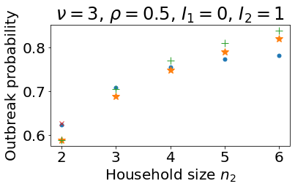

Probability of a major outbreak
$$1−1/R_{∗}^{2}$$
BP approximation
simulation
Figure: The probability of an outbreak seeded with one infectious individual in neighbourhood 2, as we vary the household size in that neighbourhood.
The simulation result is found by Gillespie SSA with 10,000 repeats – blue dots. Other results plotted are various analytic approximations tried which do not correctly approximate the outbreak probability.
Thompson approximation
Notes:
We wanted to use our model to consider a surveillance perspective. i.e. given that we know which neighbourhood an individual is from and the household size (and connectivity), what is the probability of an outbreak if that individual is infectious?
What about if we only have partial or no information about where an individual lives?
This could inform surveillance and control strategies i.e. we may be able to work out when an outbreak is likely to occur/ could impose neighbourhood based restrictions.
Analytic approximations in some cases solved numerically.
We think the reason our branching process approximation doesn’t match up is that we make the assumption that the offspring distribution is always geometric but this is only the case for households size 1.

Slide 17

Thanks for listening!
Any questions or ideas?
Email: ahb48@bath.ac.uk
Twitter: @abby_barlow_h
Webpage: people.bath.ac.uk/ahb48/index.html

