Slide 1
SAMBa Writing Sprint for ITT9 Assignment
07 March 2019, 13:15-15:15
Notes:
Who am I?

Slide 2
What is a writing sprint?
Based on the theory of ‘Free Writing’ –
  “Free-writing is all about loosening and limbering the thought process, not about a product or a performance”
  “The writer writes without regard to spelling, grammar, etc., and makes no corrections. If the writer reaches a point where they can't think of anything to write, it is presumed they will write that they can't think of anything or repeat words, until they find another line of thought.”
  Write about what you know, what you are currently thinking, and also what you don’t yet know…
Ref: https://en.wikipedia.org/wiki/Free_writing
Notes:
10.30-10.35
Put any draft you do have to one side, start with a blank sheet of paper and see where it takes you! You can add this to your existing draft later on.

Slide 3
Writing Sprint format
It’s fast! For each section:
  What is required
  Any questions, comments or points to discuss
  Write!
  Any further questions, comments or points to discuss
  Next section
Sections:
  Background / Introduction
  Impact
  Hypothesis & Objectives
  Programme & Methodology

Slide 4
Writing Tips
Write clearly so a non-expert can understand
Avoid “empty generalities”, e.g. “The proposed state of the art study is expected to advance the field significantly.” Say HOW!
Avoid acronyms and abbreviations
Be assertive, e.g. “will” not “may”
Use a positive tone

Slide 5
Contrasting perspectives
Academic writing
Grant writing
Researcher-centered:
Scholarly passion
Past oriented:
Work you have done
Expository:
Explaining to reader
Impersonal:
Objective, dispassionate
Specialized terminology:
“Insider jargon”
Funder-centered:
Service attitude
Future oriented:
Work you wish to do
Persuasive:
“Sell” the reader
Personal:
Convey excitement
Accessible language:
Broad audience
World of ideas
Thesis, theme, theory
World of action
Project, activities, outcomes

Slide 6
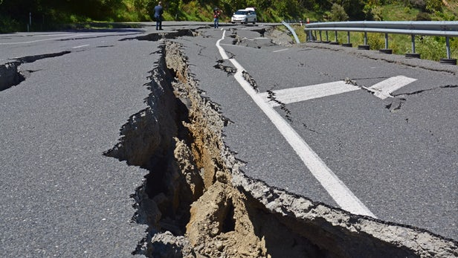




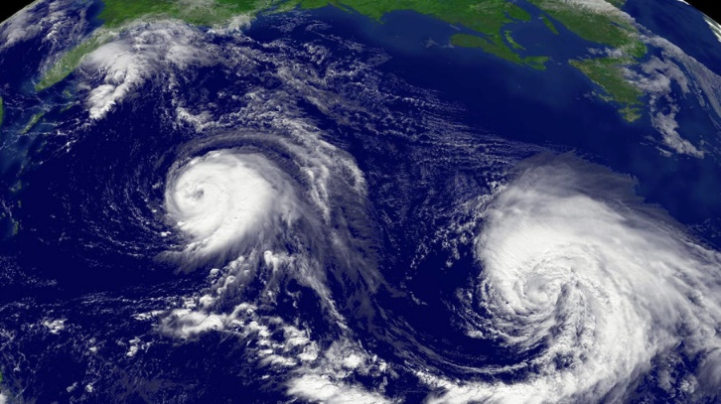
Warm-Up Exercise – “random” topic free writing
Batteries
Earthquakes
Volcanoes
Ice Cream
Hurricanes
Anything else that pops into your head

Slide 7
Background / Introduction
What problem are you trying to solve?
Why is it important?
How are you going to do it?
Why do you think it will work?
Why has this not been done already?
Why is now the ideal time for this project?
What will the project contribute and who will benefit from it?

Slide 8
Impact
Who will benefit from this research?
How will they benefit?
How will you engage with them?
How will you evaluate the effectiveness?
Think of at least two academic beneficiaries
Think of at least two non-academic beneficiaries
Stakeholder | How they will benefit | When should you engage? | How will you engage? | How will you evaluate effectiveness?

Slide 9
Hypothesis & Objectives
Purpose of the project - focus on outcome instead of process
Think of 2 to 4 objectives. Objectives should be:
Specific – target a specific area for improvement
Measurable – quantify or suggest an indicator of progress
Assignable – who will do it.
Realistic – results that are realistically achieved, with available resources
Time-related – when result(s) can be achieved
Outcome (WHY are you doing this?) | Process (HOW are you doing this?)
To identify / characterise / confirm / demonstrate… | To survey / study / interrogate / test …

Slide 10
Programme & Methodology
HOW are you going to do it?
Most technical section
Clear work plan broken down into steps (sometimes called “Work Packages” / “Tasks” / “Strands”)
Link work plan steps to Objectives
Indicate (with a diagram) how steps relate to each other
What are the main steps in your work programme?
Who will be doing what?

Slide 11

Well done!

