Slide 1
A Primer on Natural Hazard Risk
PSS – 6th December 2018
Tom Smith

Slide 2
Introduction
Natural hazards: bad
Statistics: good
Want to understand the rick pose to us by the rarest and most extreme natural hazards
Typical question “What’s the largest flood which we might expect to see (or exceed) in a 100-year period?”
This is known as the 100-year flood
Issue is that we haven’t been making records of natural events long enough to have accurate estimates!
A Primer on Natural Hazard Risk | Tom Smith | 6th December 2018 | PSS

Slide 3
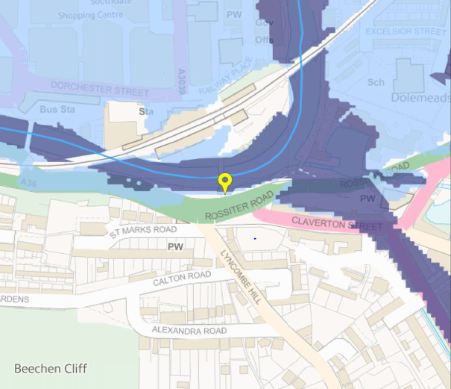
Natural Hazard Risk Visualisation (Flooding)
Flood map for near Bath Spa train station
Shows extent of 100- and 1000-year floods
No idea of the uncertainties involved ¯\_(ツ)_/¯
A Primer on Natural Hazard Risk | Tom Smith | 6th December 2018 | PSS

Slide 4
Exceedance Probabilities and Return Periods
For a natural hazard, the T-year event is the event where the average time between occurrence is T years
It has a probability 1/T of happening, or being exceeded, in any given year
Also has a probability 1 – (1 – (1/T))^k of happening at least once in a k-year period
A Primer on Natural Hazard Risk | Tom Smith | 6th December 2018 | PSS

Slide 5
Types of Data
Typically we only care about the extremes
Block Maxima
Split data into sequential blocks
Take maximum of each block – fit model to these
E.g. Annual Maxima (AMAX)
Peaks-Over-Threshold (POT)
Fit model to all events which exceed a defined threshold
A Primer on Natural Hazard Risk | Tom Smith | 6th December 2018 | PSS

Slide 6
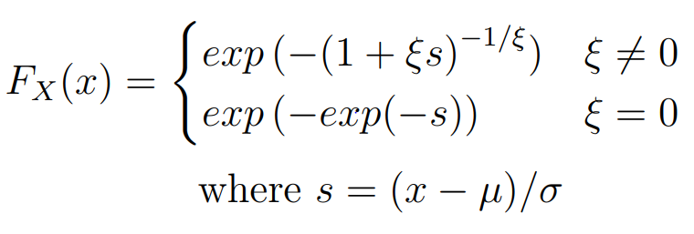
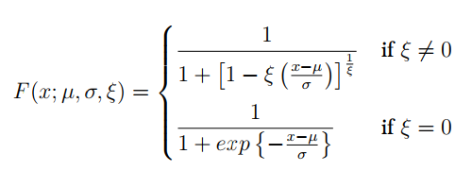
Standard Distributions for Extremes
Generalised Extreme Value (GEV)
Generalised Logistic (GLO)
Theoretically motivated
Empirically motivated
Encompasses Gumbel, Weibull, and Fréchet distributions
Recommended for UK annual maxima
Other choices include Generalised Pareto, Generalised Log-Normal, Kappa, many more…
A Primer on Natural Hazard Risk | Tom Smith | 6th December 2018 | PSS

Slide 7
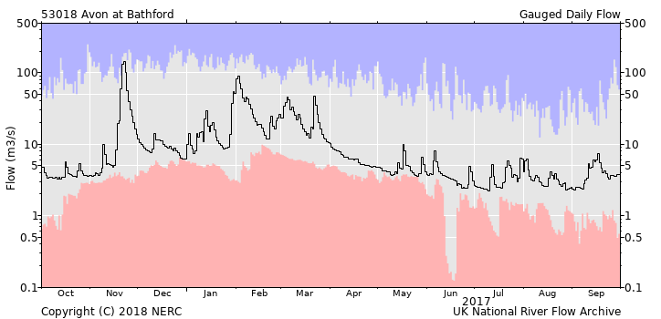
Why aren’t annual maxima GEV?
Daily flow rates are not stationary
Asymptotic result – finite data
Despite this, GEV usually quite good
A Primer on Natural Hazard Risk | Tom Smith | 6th December 2018 | PSS

Slide 8
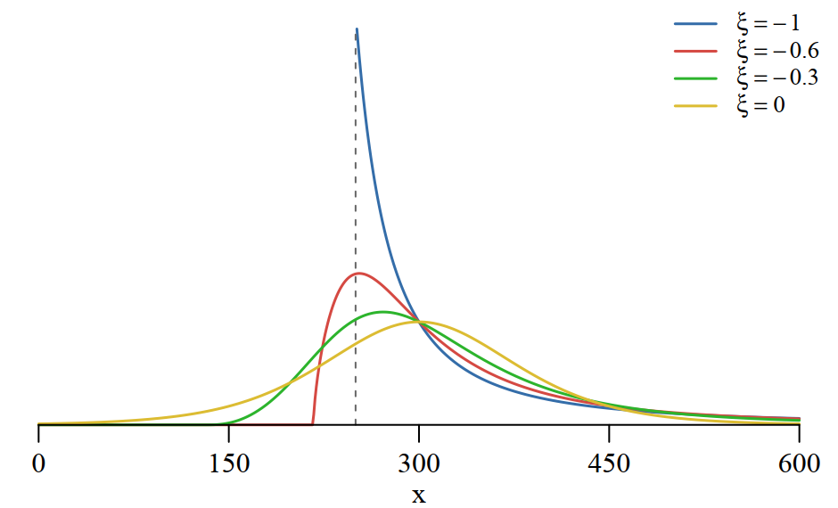
GLO: A Closer Look
ξ = -1 is Generalised Pareto
Usual asymptotic properties of MLEs might not apply!
A Primer on Natural Hazard Risk | Tom Smith | 6th December 2018 | PSS

Slide 9
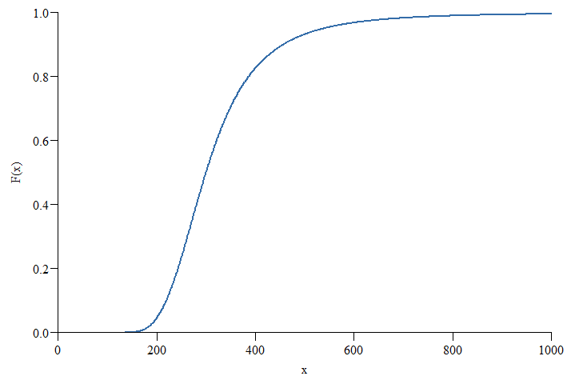
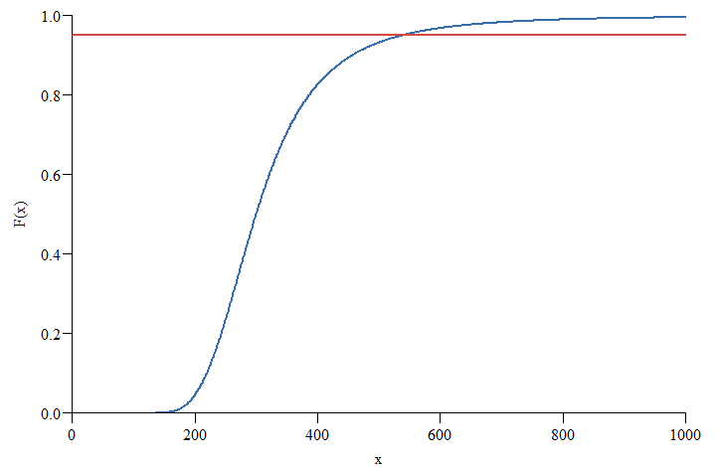
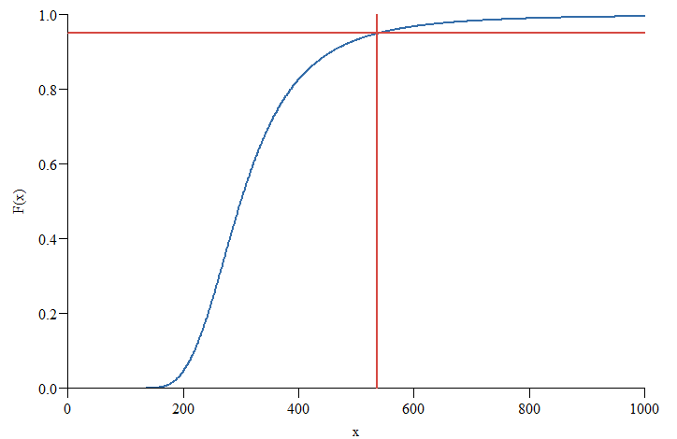
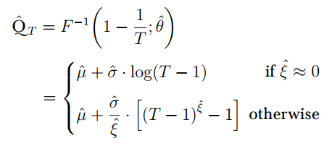
Estimating the 20-year flood
In practice, done through analytical or numerical inversion of the CDF
For a GLO distribution:
A Primer on Natural Hazard Risk | Tom Smith | 6th December 2018 | PSS

Slide 10
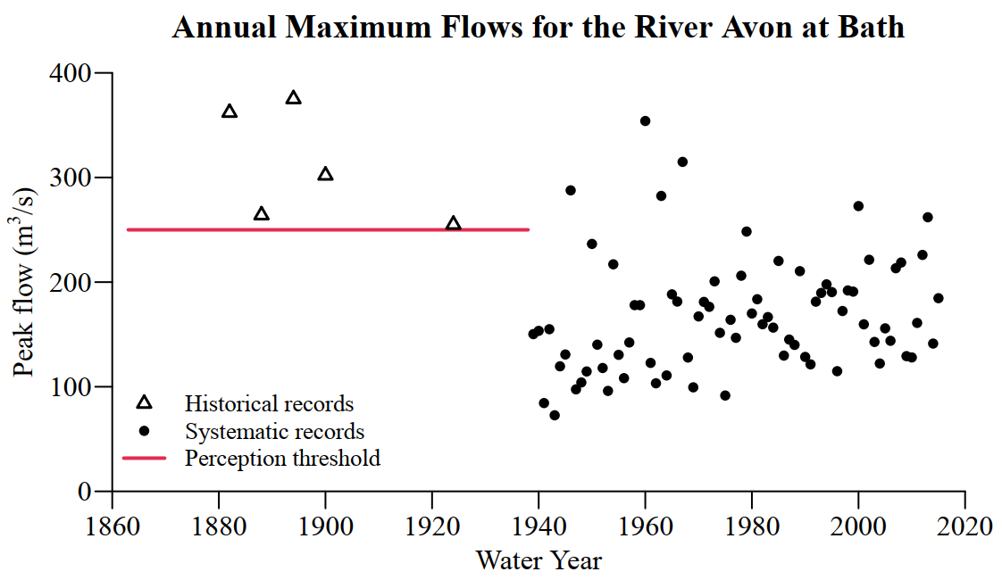
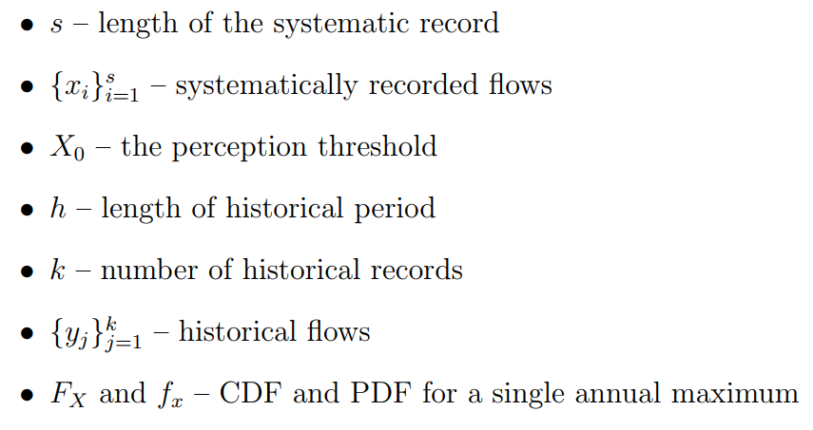
Parameter Estimation for Block Maxima
Systematic record
Observing exactly k floods over $X_{0}$ in h years
Historical flood magnitude
A Primer on Natural Hazard Risk | Tom Smith | 6th December 2018 | PSS

Slide 11
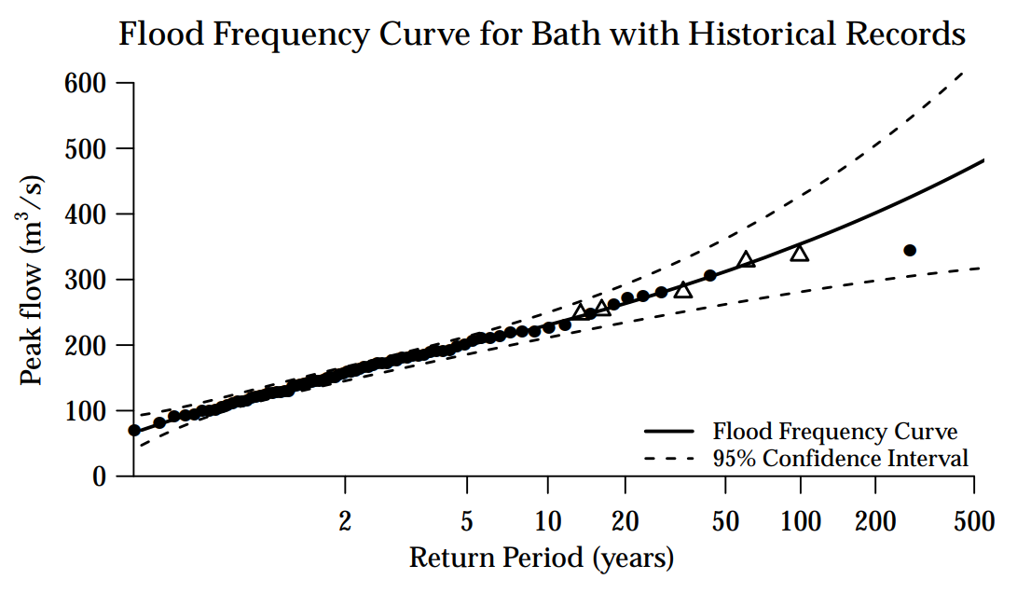
Return Curves (aka Flood Frequency Curve)
A Primer on Natural Hazard Risk | Tom Smith | 6th December 2018 | PSS

Slide 12
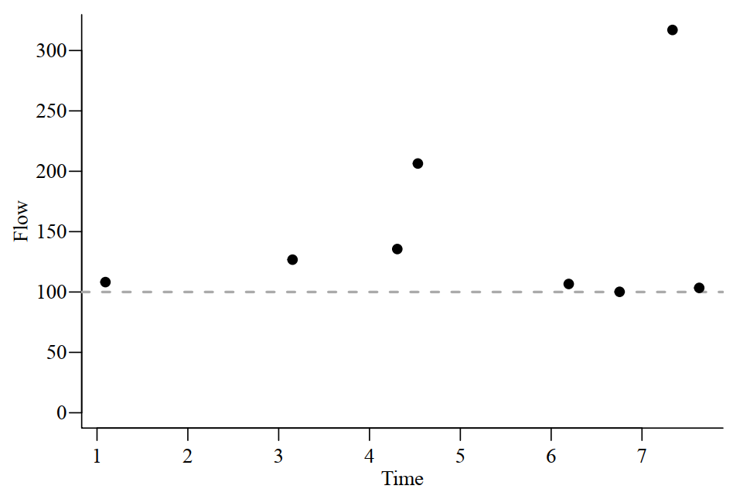
The Poisson-Pareto Model
Events arrive as a Poisson Process
Waiting times ( ) are iid Exponential($\text{λ}\text{)}$
Exceedances are iid GPD
Change of threshold – still GPD
Applications: Volcanism, Earthquakes, River flow…
A Primer on Natural Hazard Risk | Tom Smith | 6th December 2018 | PSS

Slide 13
Modelling Damages
Can use a Damage Function D(q) which related event magnitude q to its expected damages
How to choose this function is not obvious…
A Primer on Natural Hazard Risk | Tom Smith | 6th December 2018 | PSS

Slide 14
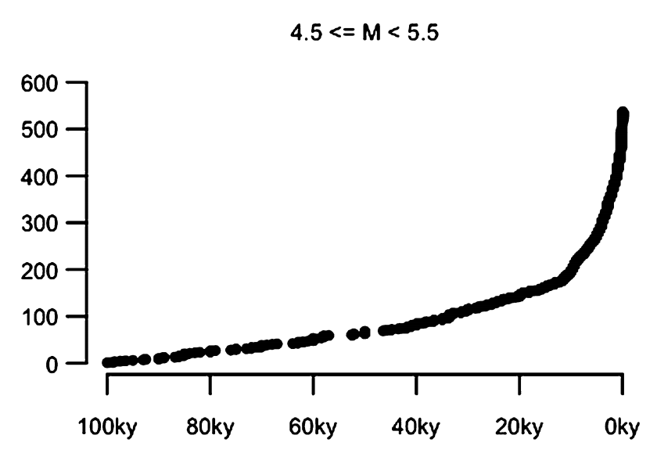
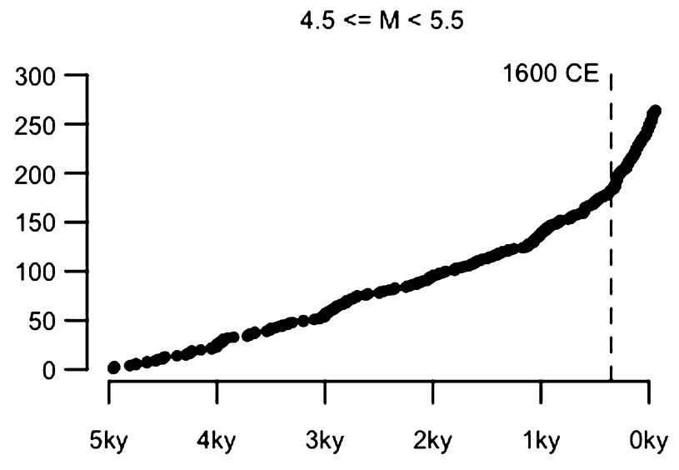
Complication: Under-recording
This subset modelled as Poisson-Pareto
Suitable for data-rich processes
Images: J. Rougier et al. (2018) Earth and Planetary Science Letters 482:621–629
A Primer on Natural Hazard Risk | Tom Smith | 6th December 2018 | PSS

Slide 15
Complication: Non-Stationarity
Systematic increase in flood magnitudes mean we’re under-prepared for the future
Particularly important if including historical data
What is a 100-year event in a non-stationary world?
A Primer on Natural Hazard Risk | Tom Smith | 6th December 2018 | PSS

Slide 16
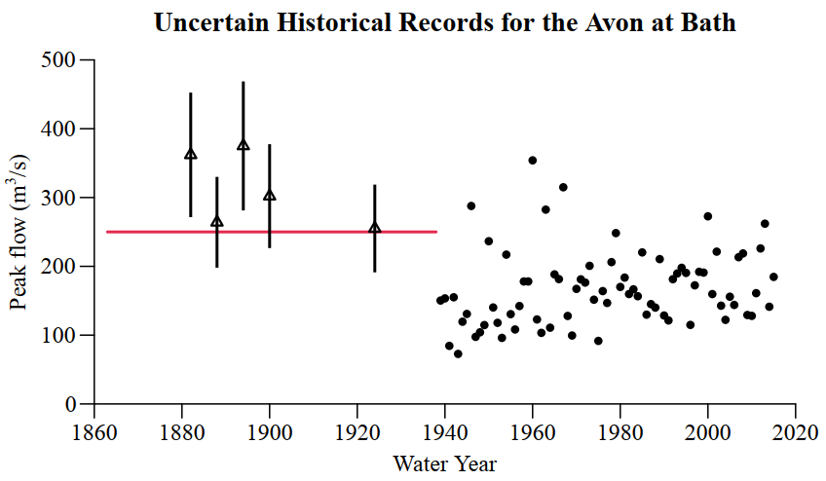
Other Complications
Independence?
Estimation of nuisance parameters??
Measurement uncertainty???
A Primer on Natural Hazard Risk | Tom Smith | 6th December 2018 | PSS

Slide 17
References
Coles, S. G. (2001). An Introduction to Statistical Modeling of Extreme Values. Springer Series in Statistics. Springer, London, UK.
Reis, D. S. and Stedinger, J. R. (2005). Bayesian mcmc flood frequency analysis with historical information. Journal of Hydrology, 313(1):97–116
J. Rougier et al. (2018). The global magnitude–frequency relationship for large explosive volcanic eruptions. Earth and Planetary Science Letters 482:621–629
A Primer on Natural Hazard Risk | Tom Smith | 6th December 2018 | PSS

