Slide 1
ITT - Environment Agency
Challenges
Spatial Data
Mark Whitling
Senior Scientist
09 November 2017

Slide 2
Contents:
Introduction
Digital Terrain Models - LiDAR
Rainfall radar
Above ground - land cover
Below ground – geology & soils
Topographic mapping
Wrap-up and links

Slide 3
Introduction – today is:
Some examples of useful open data
Descriptions
Coverage
Images
Nearly all is available to download or view on data.gov.uk; signposts where not.
There are more!

Slide 4
LiDAR
Digital terrain models
Two versions:
Ground terrain
With objects
2m, 1m, 0.5m, 0.25m
Coverage reduces with increased resolution
High accuracy (cm and better)
Available to download or as a web map

Slide 5
LiDAR Coverage
2m coverage
0.25m coverage

Slide 6
LiDAR Samples
2m surface model
0.25 m detail
2m terrain model

Slide 7
Rainfall radar (spatial)
Continuous data from radar
Radar returns are processed to determine rain rate (mm/hr at ground level)
Less accurate than gauges, but full coverage
Can be reconciled with gauges to improve accuracy
Viewing images can be free, using the data may be chargeable
Not always possible to access long term archives
Not on data.gov.uk

Slide 8
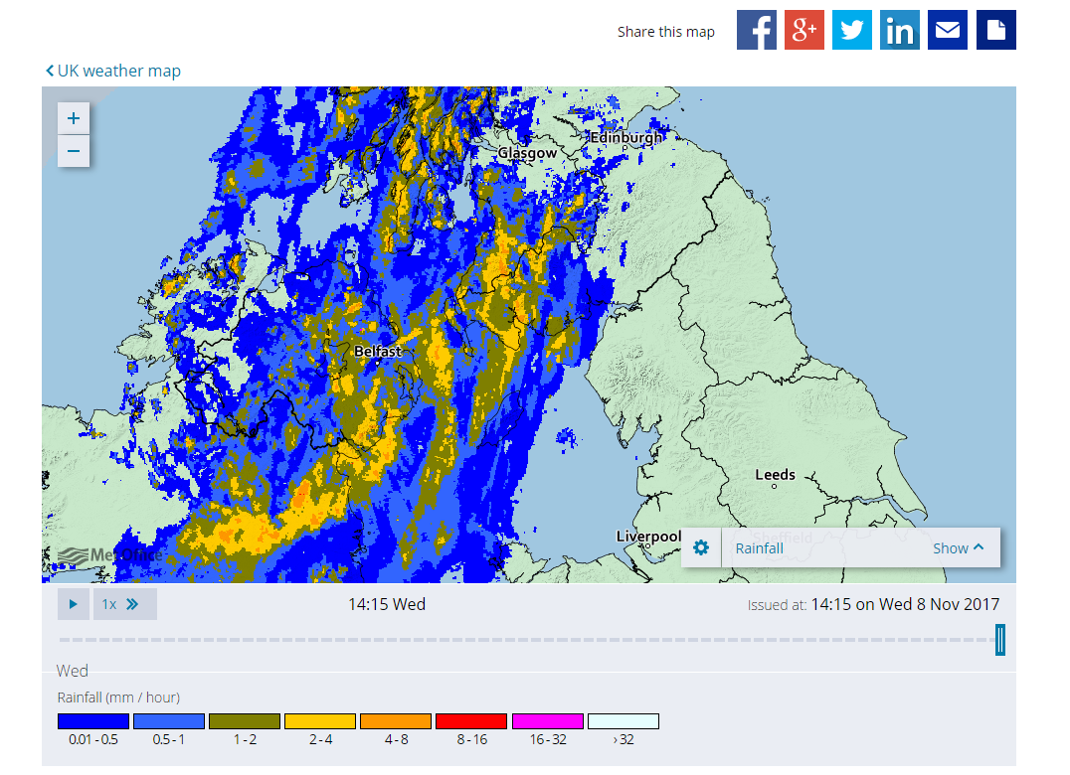
Examples of rainfall radar
Metoffice.gov.uk
meteoradar.co.uk
Meteox.co.uk

Slide 9
Land cover
Various free sources – all linked on data.gov.uk
These can be used to infer the hydrological properties of the surface water landscape
Continuous | Discrete
Corine 2016 (European Env. Agency) | Upland Blanket Bog (Natural England)
Agricultural Land Classification (Natural England) | National Woodland Inventory (Forestry Commission)
Water Framework Directive data Environment Agency | Flood maps (surface, rivers and the sea, groundwater). Deterministic and Probabilistic (Environment Agency)
 | Tree cover, waterbody cover, highways etc Ordnance Survey (open data)
 | Priority Habitat Layers – i.e. peat, moorland etc (natural England)

Slide 10
Corine Landcover

Slide 11
Agricultural land classification

Slide 12
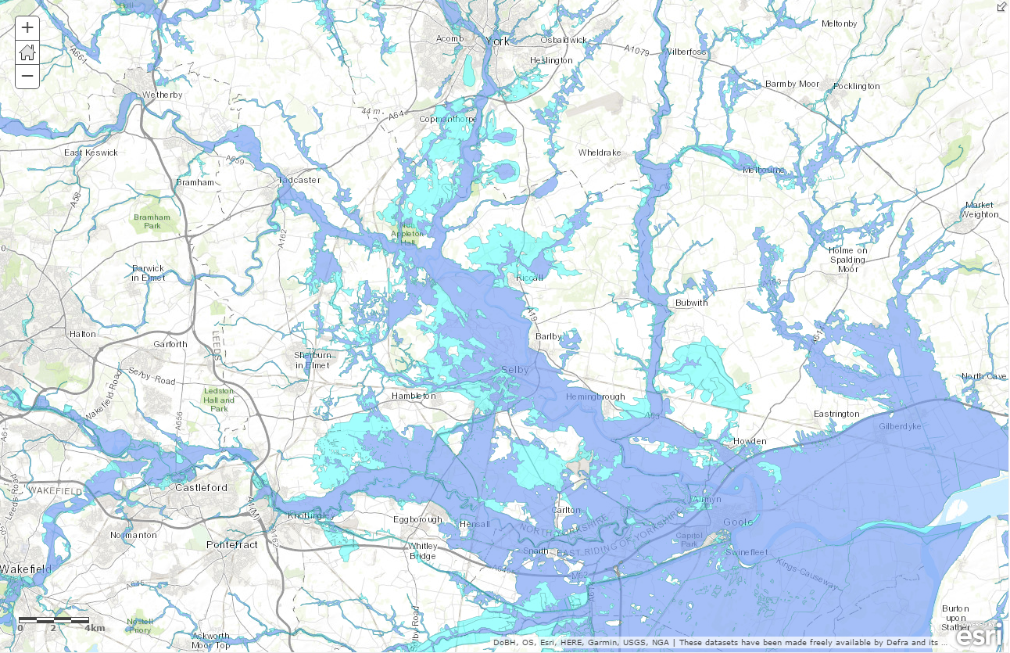
EA Flood Data
Probabilistic flood data (ROFRS)
Deterministic flood data (Flood Zones for Planning)

Slide 13
Subsurface – geology and soils
A host of services/data sources
Some open, not that great. Some not open, but accessible by negotiation/partnership working (BGS)
Main sources:
BGS bedrock maps (subsurface geology)
BGS drift maps (superficial geology)
EEA soils maps (European soil data centre)
https://esdac.jrc.ec.europa.eu/content/european-soil-database-v20-vector-and-attribute-data#tabs-0-description=0

Slide 14
British Geological Survey
Too many datasets to list here. Visit:
http://www.bgs.ac.uk/data/home.html
Key data includes:
BGS Geology 50
BGS Geology 250
BGS Geology 625
Groundwater Flooding
Aquifer Designations
Permeability
Geosure
SUDS
Parent materials
Superficial thickness
Understanding of soils
Impact on surface flows

Slide 15
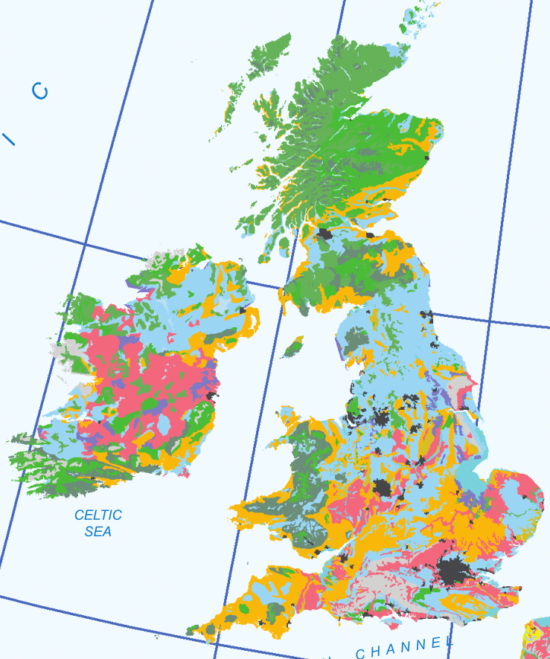
Geological maps
BGS Geology
Euro-soils data
Far more than just lines on a map
Standardised attributes are very flexible

Slide 16
2. Small catchment hydrology
Challenge: Could you take the data we have available and devise a way of estimating low probability flood flows (0.5% - 0.01%+ chance of occurring in a given year)?
Alternative Challenge: If we were to look at the available data and methods today, would we still apply regression analysis? Have new techniques emerged that could reduce uncertainty? Would we do the same – but differently?
Variation on the above – What if we limit ourselves to “open data”

Slide 17
General mapping
Plenty of feature-level open topographic mapping available
Can be used to tease out important local features which may impact hydrology
Ordnance Survey open data products
Open Street Map
Can be used to map (for example):
Tree cover, lakes, impermeable surfaces

Slide 18
There is more!
Small sample
We can help you access some non-open data
E.g. BGS 1:50k geology may be accessible for free if certain parts are not published
Very happy to talk details/data/insights
Intentionally scant on details – don’t want to predetermine outcome

Slide 19
Links
UK open data portal
https://data.gov.uk/
EU open data portal
http://data.europa.eu/euodp/en/home
British Geological Survey data explorer
http://www.bgs.ac.uk/data/home.html
Ordnance Survey Open Data
https://www.ordnancesurvey.co.uk/opendatadownload/products.html
ArcGIS Online Open Data Portal
https://hub.arcgis.com/pages/open-data

Slide 20
Reminder:
flood estimation handbook (FEH) details statistical methods for estimating maximum flows during times of flood at given frequencies
methods are based around a theoretical statistical framework based on regression models, parameters quantifying geography, and flow records from proximal, or physically similar sites
catchments less than 25km² are the focus
high uncertainty with these methods
early indications suggest that current methods have reached their limits – and even large increases of data used to train the regression analysis provide a limited reduction in the overall error

Slide 21
The challenge
Challenge: Could you take the data we have available and devise a way of estimating low probability flood flows (0.5% - 0.01%+ chance of occurring in a given year)?
Alternative Challenge: If we were to look at the available data and methods today, would we still apply regression analysis? Have new techniques emerged that could reduce uncertainty? Would we do the same – but differently?
Variation on the above – What if we limit ourselves to “open data”

Slide 22
Specifics
Can methods be made widely available? i.e. simple spreadsheet or web-based execution as opposed to requiring complex statistical software?
Can methods rely solely on open-data?
Methods would probably need to describe the potential flows against their probability of occurring – and uncertainty
Can hydrograph shapes be extrapolated from catchment descriptors (geography) and existing flow records?

