Slide 1
ITT - Environment Agency Challenges
Dr Sean Longfield
Lead Scientist, Flood & Coastal Risk Management Research
9 November 2017

Slide 2
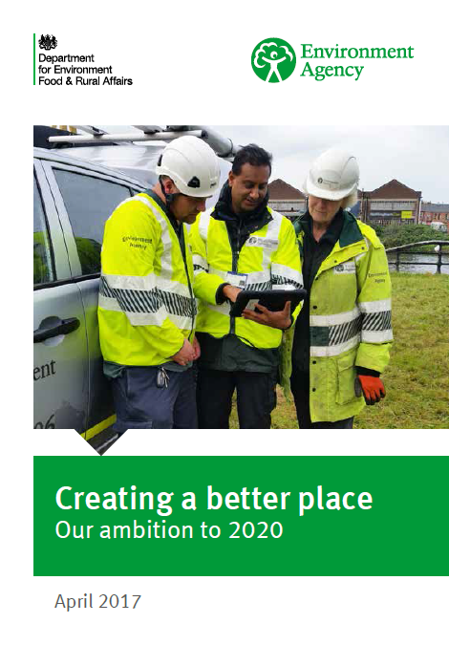
The Environment Agency
we work as part of the Defra group (Department for Environment, Food & Rural Affairs)
a cleaner, healthier environment which benefits people and the economy
a nation better protected against natural threats and hazards, with strong response and recovery capabilities

Slide 3
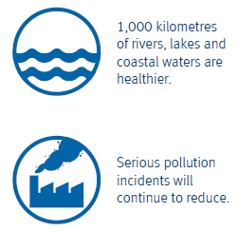
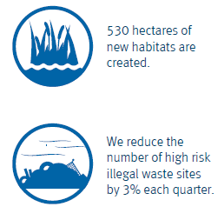

Slide 4
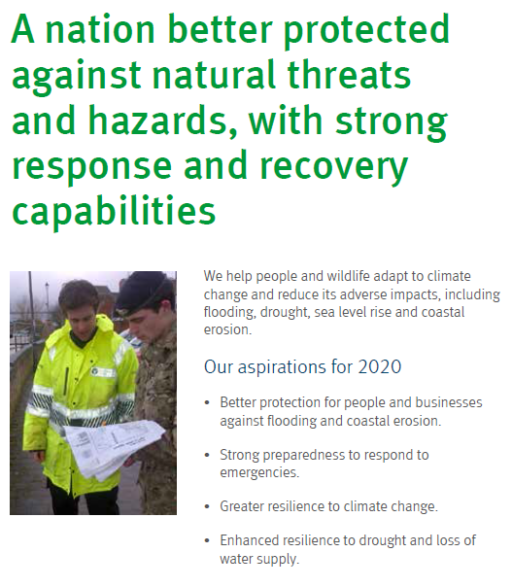
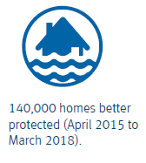
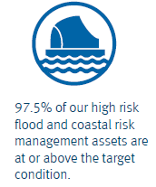

Slide 5
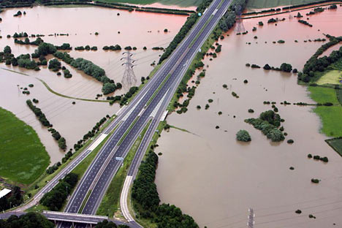
Research at the Environment Agency
Flood and coastal risk management
Small catchments
River flow trends
Air, land and water
Nitrate vulnerable zones (NVZs)
Climate change and resource efficiency

Slide 6
Flood and Coastal Risk Management Research
Joint Defra/EA Flood and Coastal Risk Management Research and Development Programme…. The Joint Programme
Policy, Strategy and Investment
Asset Management
Incident Management and Modelling
To find out more, visit: http://evidence.environment-agency.gov.uk/FCERM/

Slide 7
Research Partnerships
PRIME - Proactive Infrastructure Monitoring and Evaluation System | Flood Memory | NERC Green Infrastructure Bid - fluvial | Improving research-industry coordination to optimise coastal restoration efforts in the UK
Coastal landfill and shoreline management: implications for coastal adaptation | Biological and Lithological processes Underpinning the Evolution of the Coast (BLUECOAST) | GRIN ( Green Infrastructure for disaster risk reduction and infrastructure protection: evidence, policy instruments and marketability) | Estimating flood frequency in the Trent and Yorkshire Ouse rivers using documentary and floodplain sedimentary archives to extend flood series (PhD)
Geophysical methods for reservoir safety investigations | CONCEAL | Street-scale Urban Runoff estimates and Forecasts from Multi-sensOr Rainfall (SURF-MOR) | Flood Frequency Estimation in the Presence of Historical Data
DANUBIUS-RI | Seismic imaging for improving flood defence management | Developing an UK-wide NFM network | Flood frequency estimation using POT data
(FAST) Foreshore Flood Analysis using Sentinel Satellite Space Technology | FRANC and SINATRA | Engineering Nature’s Infrastructure to provide Real Options for water management (NIRO) | Attribution and prediction of change in flood propabilities
NERC - Assess NFM Measures | WISER | Credible/Reliable | Integrative Think Tank (ITT)
NERC SWEEP | INTERREG Building with Nature | NERC Urgent grant - Cumbria floods | RISC-KIT
ENABLE: Horizon 2020 | Nature-based solutions for Disasters risk reduction | Does Sediment Go with the Flow? The Engineering-Geomorphology-Hydrology Flood Nexus | Numerical Simulation of Bed Hysteresis During Turbulent Flood Wave
Integrating Grey Green Infrastructure - NERC GI | Using lake sediments to extend flood series and improve flood estimation (PhD) | Natural Hazards Partnership | Flood Risk Assessment of Masonry Bridges: Hydrodynamic Effects of Debris Blockage
Effect of Climate on Internal Erosion in Embankment Dams and Flood Defences | NERC Natural Flood Management Research Call | Sea Level SpaceWatch | Wearable Asset Inspection Technology for Evaluating Deformation
Stream Flow | RisingTide | BioShield | IMMERSE
Sediment, debris and Water: Impacts, Measurement and Modelling of Uncertainty and Risk for natural flood management (SWIMMUR) | E Rise | (SUCCESS) Synthesising Unprecedented Coastal Conditions: Extreme Storm Surges | Real-time optimal urban & natural flood control for Wetropolis and Leeds’ Aire River
Accounting for Climate Change Uncertainty in Floodplain Delineation | Debris Effects on BRIdge resiliencE and Flooding (DEBRIEF) | ENABLE | Optimal flood control theory for generic use in mitigating flooding

Slide 8
1. Nitrate Vulnerable Zones (NVZs)

Slide 9
1. Nitrate Vulnerable Zones (NVZs)
Nitrate Vulnerable Zones (NVZs) are areas designated as being at risk from agricultural nitrate pollution
they include about 58% of land in England
borehole network across England (points)
what might the nitrate concentration be in groundwater between these points?
currently use Kriging to interpolate between points
this doesn’t take account of underlying geology, which can have a large impact
need a method of interpolation that can account for geology

Slide 10
1. Nitrate Vulnerable Zones (NVZs)
disjunctive Kriging?
not a uniform geographical distribution of boreholes
boreholes at different depths
lots of data from the 1980s onwards
approx. 3,500 borehole sites
Challenge: develop a new method for interpolating nitrate concentrations in groundwater from borehole data in England that takes account of underlying geology

Slide 11
2. Statistical Flood Frequency Estimation: Fundamentals
estimate a flood peak (m³s⁻¹) of a given rarity, the T-year flood
where T expresses event rarity as a return period in years
the return period of a given flood is the average interval between floods of this magnitude or greater
gauged records are rarely long enough to allow direct estimation
we often need to estimate at ungauged sites

Slide 12
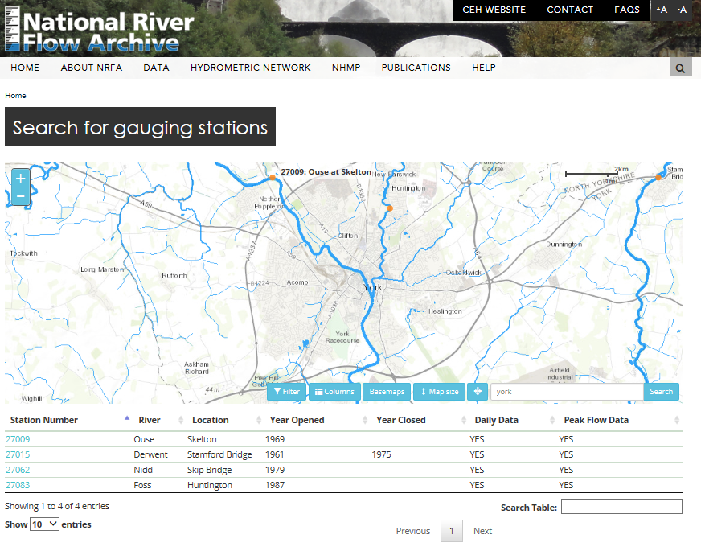
2. Statistical Flood Frequency Estimation: Data

Slide 13
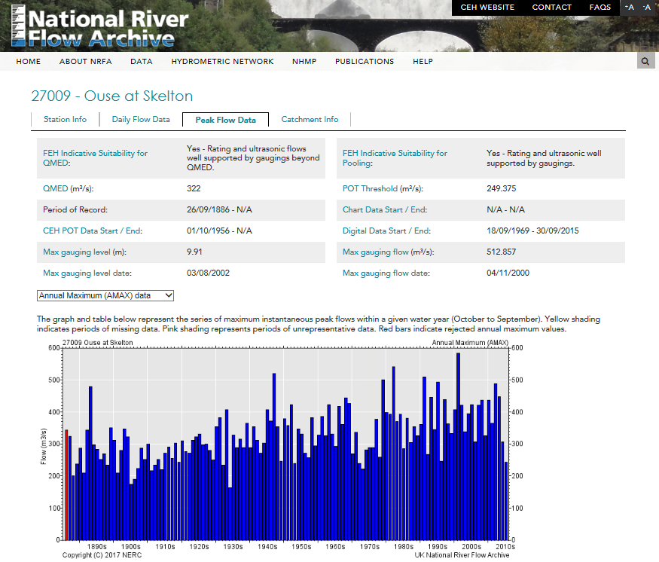
2. Statistical Flood Frequency Estimation: Data

Slide 14
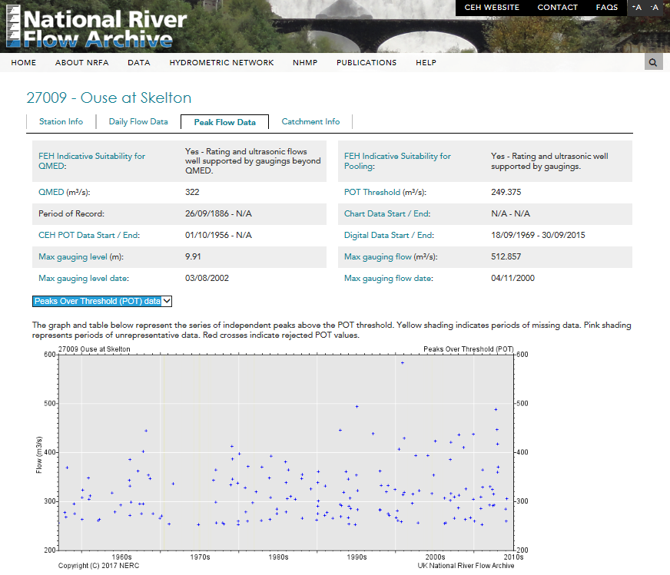
2. Statistical Flood Frequency Estimation: Data

Slide 15
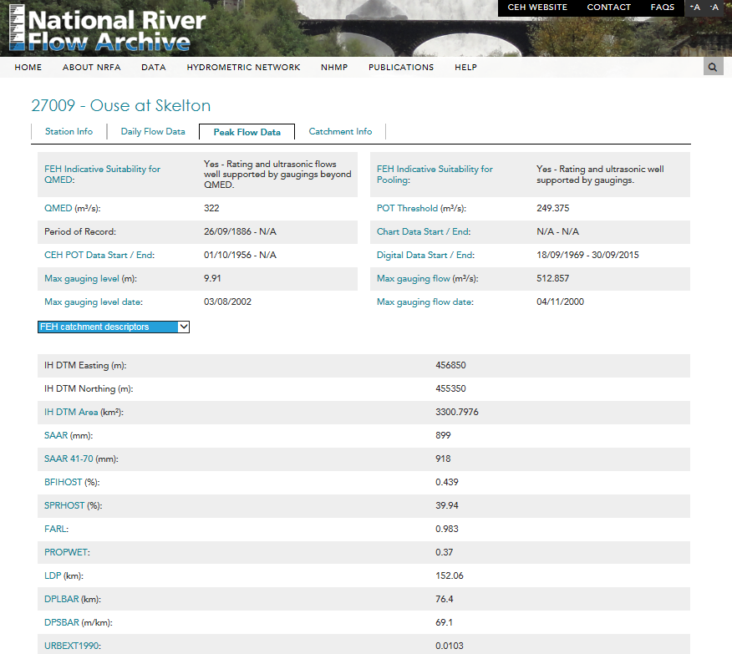
2. Statistical Flood Frequency Estimation: Data

Slide 16
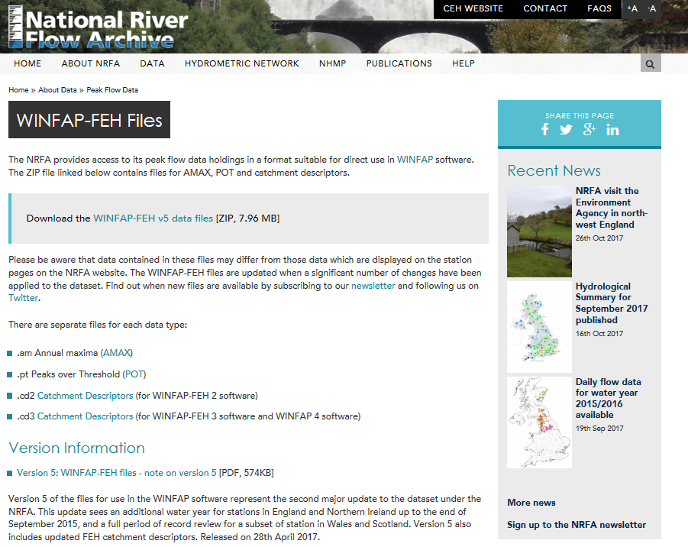
2. Statistical Flood Frequency Estimation: Data

Slide 17
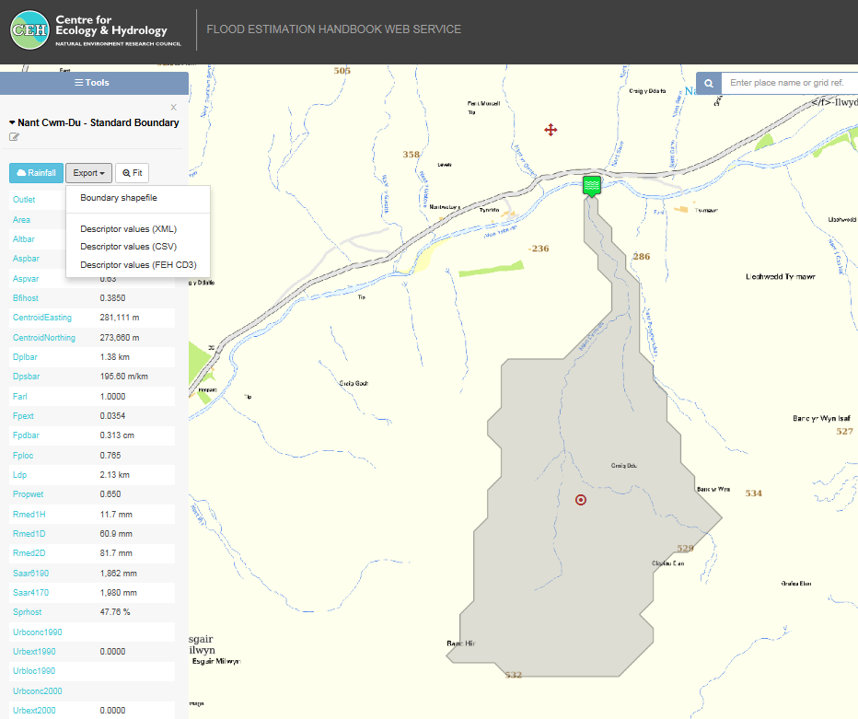
2. Statistical Flood Frequency Estimation: Data

Slide 18
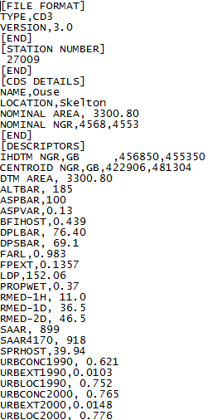
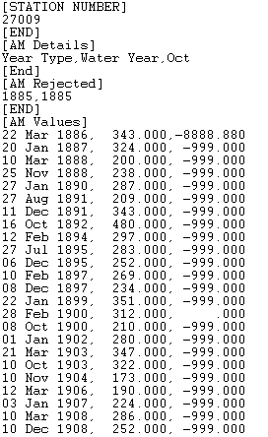
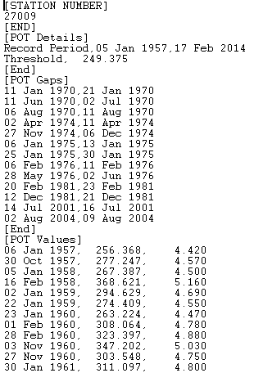
2. Statistical Flood Frequency Estimation: Data
Catchment Descriptors
POT
AMAX

Slide 19
2. Statistical Flood Frequency Estimation Median annual flood (QMED)
QMED, 2-year return period flood
exceeded on average “every other year” – the index flood
With gauged data
median of AMAX data
from POT data
Without gauged data
from catchment descriptors

Slide 20
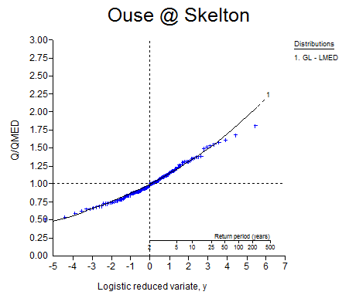
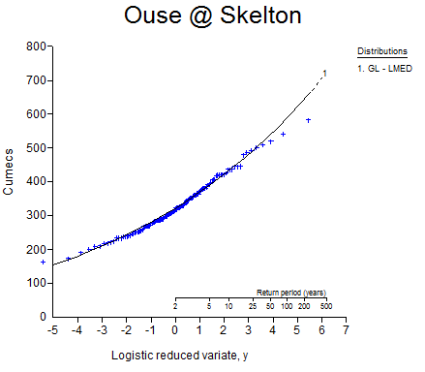
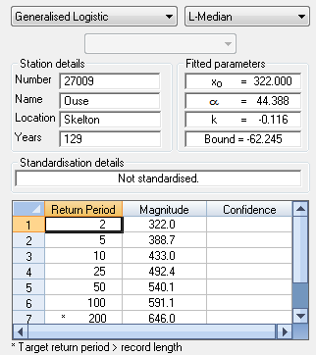
2. Statistical Flood Frequency Estimation Single site
fit a distribution to AMAX data (GLO, GEV, log-normal, kappa…)
estimate parameters using L-moments
derive a growth curve (scaled to 1 at QMED)
derive a flood frequency curve (product of QMED and growth curve)

Slide 21
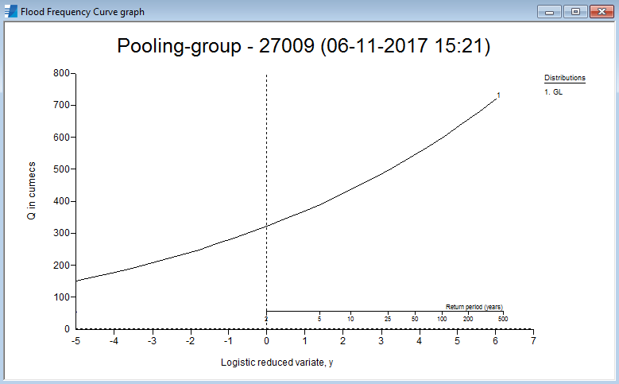
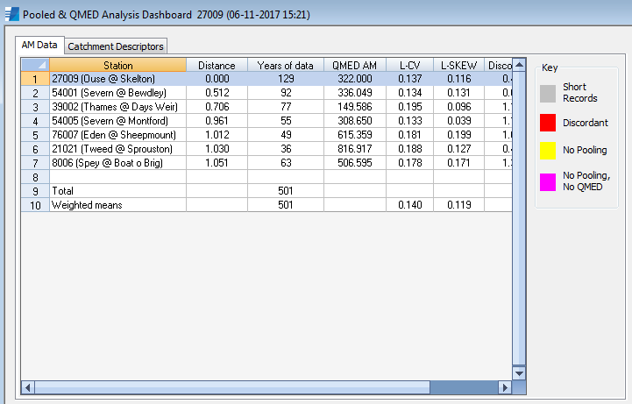
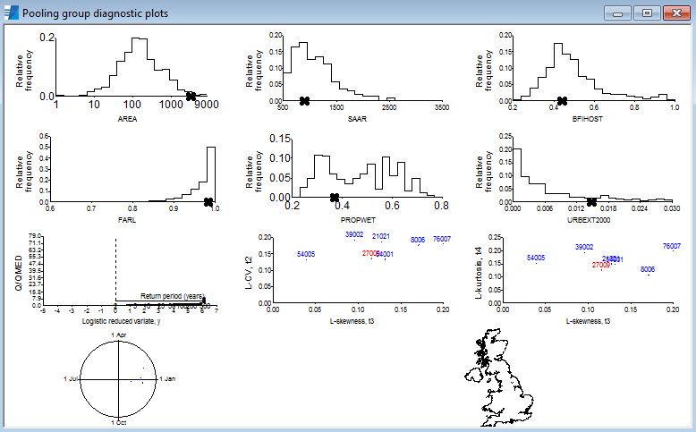
2. Statistical Flood Frequency Estimation Enhanced single site
pooling group created based on hydrological similarity
derive pooled growth curve
more weight at the site of interest
select suitable distribution (GLO, GEV, log-normal, kappa…)
estimate parameters using pooled L-moments
derive a flood frequency curve

Slide 22
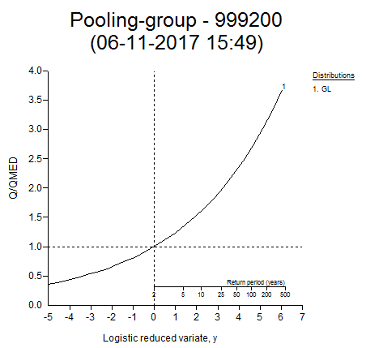
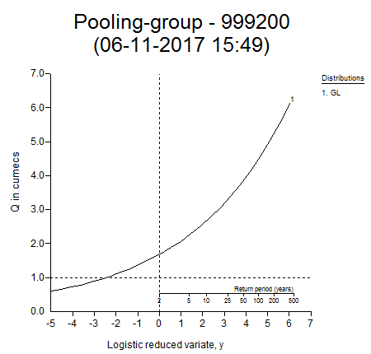
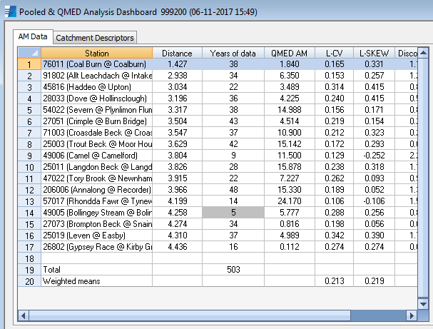
2. Statistical Flood Frequency Estimation Ungauged site
create pooling group based on catchment descriptors
derive pooled growth curve
Select suitable distribution (GLO, GEV, log-normal, kappa…)
estimate parameters using pooled L-moments
derive a flood frequency curve

Slide 23
2. Changing flood return periods of over time
Flood frequency estimation
estimation of peak river flow of a given frequency (rarity)
we know that design flood estimates for a site can vary dependant on the time period chosen for analysis
There are well known, ‘flood-rich’ and ‘flood-poor’ periods over the past 100-years or so.

Slide 24
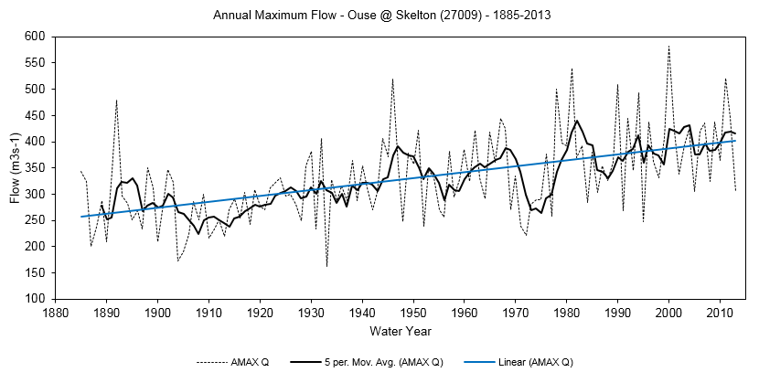
2. Changing flood return periods of over time

Slide 25
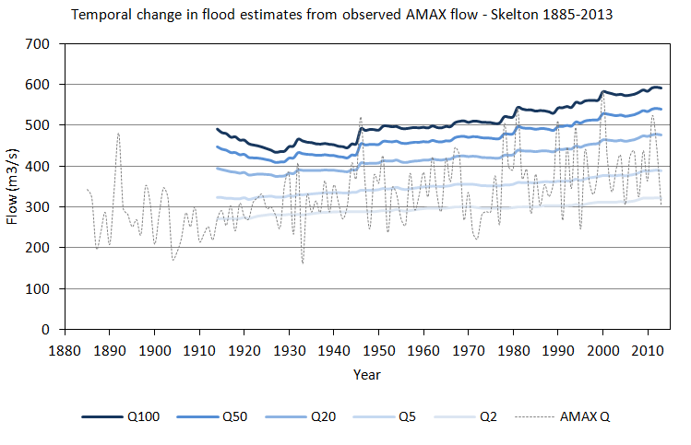
2. Changing flood return periods of over time

Slide 26
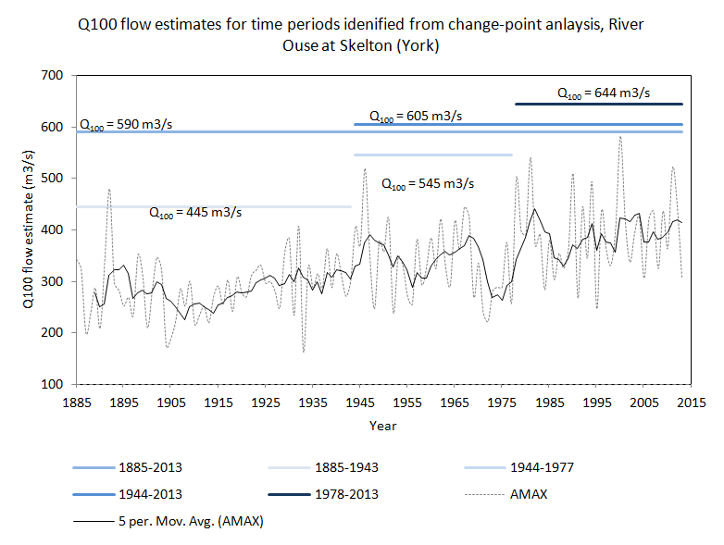
2. Changing flood return periods of over time

Slide 27
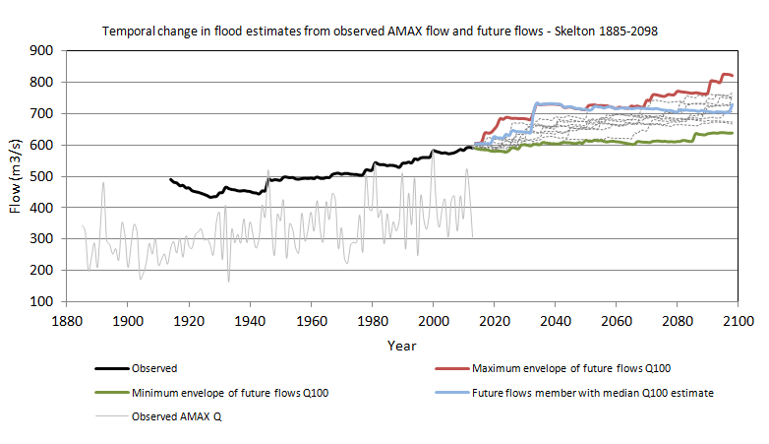
2. Changing flood return periods of over time

Slide 28
2. Changing flood return periods of over time
Challenges:
Can we develop an indicator, or measure for river gauging stations that tell us how sensitive a flood record is to the time period chosen?
How does that vary across the country?
How sensitive are design flow estimates at individual sites to ‘extreme’ events – can one big event change design flows significantly, or is the site relatively insensitive to high magnitude events?

Slide 29
2. Clustering of floods events
There is a perception that flooding is happening more often (rightly or wrongly)
This raises some interesting questions/challenges:
how can we detect significant clusters of flood events?
are there any statistical methods that can be used to describe ‘clustering’ of flood events (say from POT data), and how that might have changed over time?
does flooding happen more now that in the past?
if a 10-year event has occurred one year, what is the probability that a 100-year event might happen the next year, or in the next 5-years…

Slide 30
2. River flow trends
we have many decades of river flow (and water level) data at point locations in the UK
we often try to look for evidence of river response to climate change (and/or land use change) in these records
Challenges:
what is the best data to use to look for temporal trends – AMAX, POT, monthly, daily, 15-minute, and why?
how many years will it be before we can say with confidence that there is or is not a trend in river flows (daily, AMAX, POT).
how much river flow data do we need before we can say if climate change is having an impact or not?

Slide 31
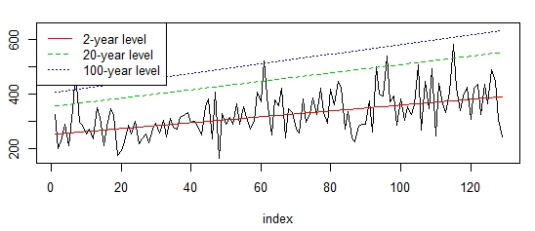
2. Non-stationarity

Slide 32
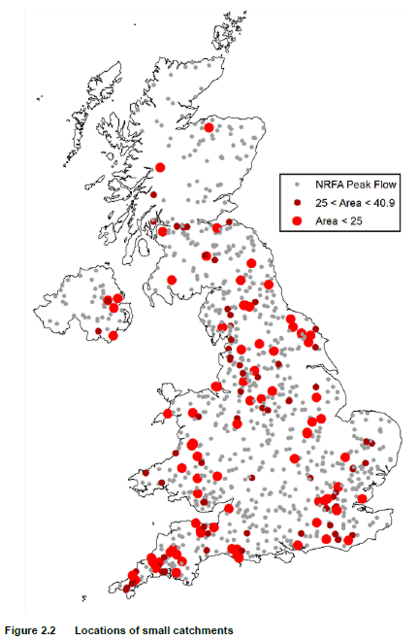
3. Small catchment hydrology

Slide 33
3. Small catchment hydrology
catchments less than 25km²
usually no gauged data
high uncertainty with these methods
Challenge: Could you take the data we have available and devise a way of estimating low probability flood flows (0.5% - 0.01%+ chance of occurring in a given year)?
Alternative Challenge: If we were to look at the available data and methods today, would we still apply regression analysis? Have new techniques emerged that could reduce uncertainty? Would we do the same – but differently?
Variation on the above – What if we limit ourselves to “open data”

Slide 34
3. Small catchment hydrology
Can methods be made widely available? i.e. simple spreadsheet or web-based execution as opposed to requiring complex statistical software?
Can methods rely solely on open-data?
Methods would probably need to describe the potential flows against their probability of occurring – and uncertainty
As a bonus – can hydrograph shapes be extrapolated from catchment descriptors (geography) and existing flow records?

Slide 35
3. Small catchment hydrology
Potentially useful data:
Flow and level records (15 minute) (some open)
Conversions between level and flows (some open)
FEH Catchment descriptors (not open)
Rainfall radar (spatially continuous) archives (not open)
Rainfall gauges (point sources) (part open)
Potential alternative catchment descriptors:
BGS Geological data (Partly open)
Various continuous DTMs (OS/USGS/Global DTM) (various – open to not open)
EA LiDAR (has gaps) (open)
Open environmental mapping (OS, OSM, Natural England, Environment Agency)

