Slide 1
Adaptive Sampling for Imaging

Slide 2
The Problem
X-Ray scanning of a battery to understand chemical composition
Currently:
Raster scan, constant velocity
Fix x-ray energy, scan entire sample
Change energy, repeat
Also rotating sample in space
Too long for multiple experiments
Can we find a more efficient sampling scheme?

Slide 3
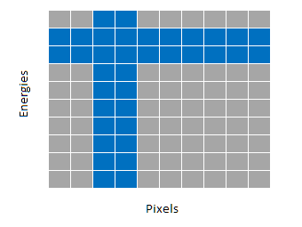
Current Ideas
Faster low-res initial scan (all energies), then more detailed scans of most representative energies
Scan parts of sample in full detail, then infer the gaps

