Slide 1
Image Alignment / Reconstruction
Evelyn Cueva, Matthias Ehrhardt, Paul Quinn,
Shaerdan Shataer, Jordan TayloR

Slide 2
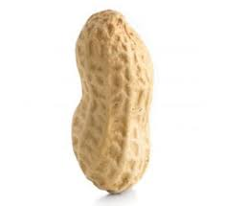
The Problem
Object

Slide 3
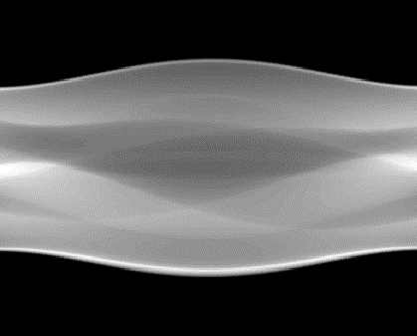
The Problem
Object
Ideal Sinogram

Slide 4
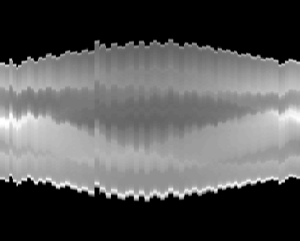
The Problem
Object
Reality

Slide 5
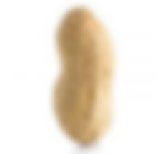
The Problem
Reconstruction
Reality

Slide 6
Options
De-jitter the sinogram before image reconstruction (Variational Method; Machine Learning)
Joint de-jitter and image reconstruction from sinogram data

Slide 7
De-noising using Auto-Encoders

Slide 8
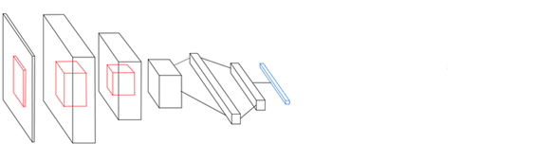

What are Auto-Encoders?
$$\text{X}$$

Slide 9

What are Auto-Encoders?
$$\text{X}$$
Encoder $f$

Slide 10
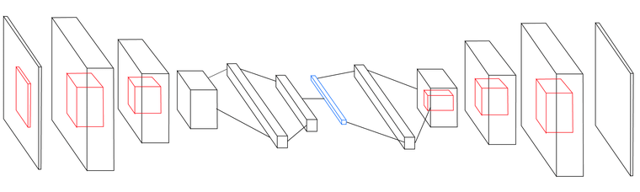


What are Auto-Encoders?
$$\text{X}$$
$$\text{X}\text{′ }=f(g\left(\text{X}\right))$$
Decoder $g$

Slide 11
What are Auto-Encoders?
$$\text{X}$$
$$\text{X}\text{′ }=f(g\left(\text{X}\right))$$
$$\min_{\text{θ}}\left\|\text{X}−\text{X}\text{′}\right\|$$

Slide 12


De-jitter Auto-Encoders
$$\tilde{\text{X}}$$
$$\text{X}\text{′ }=f(g\left(\tilde{\text{X}}\right))$$
$$\min_{\text{θ}}\left\|\tilde{\text{X}}−\text{X}\text{′}\right\|$$

Slide 13


Direct Reconstruction
$$θ_{i}$$
$$u$$

Slide 14

Direct Reconstruction
$$θ_{i}$$
$$u$$
$$s_{i}$$

Slide 15

Direct Reconstruction
$$θ_{i}$$
$$u$$
$$R\text{(}T_{s_{i},θ_{i}^{⊥}}\text{(}u\text{)) = }\tilde{x_{i}}+ ε$$
$$s_{i}$$

Slide 16

Direct Reconstruction
$$θ_{i}$$
$$u$$
$$R_{θ_{i}}\text{(}T_{s_{i},θ_{i}^{⊥}}\text{(}u\text{)) = }\tilde{x_{i}}+ ε$$
$$\min_{u, s_{i}}{\sum_{i}{{\left\|R_{θ_{i}} \text{(}T_{s_{i},θ_{i}^{⊥}}\text{(}u\text{))} −\tilde{x_{i}}\right\|}^{2}}}$$
$$s_{i}$$

Slide 17
Going Forward
• Sinogram reconstruction (Variational Method; Machine Learning)
• Direct image reconstruction

