Slide 1
Early drought detection: an optimal stopping approach

Slide 2
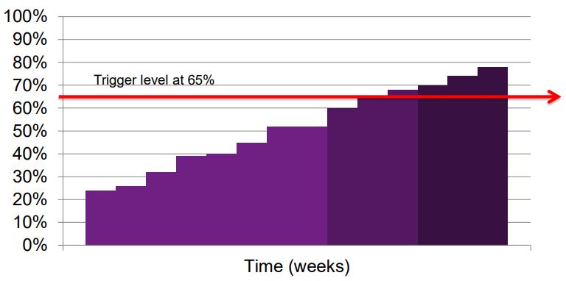
Trigger level
Where should the trigger be set?
Precipitation measures typically detect drought earlier because rainfall is a primary source.
The usefulness of an early warning system is determined by the ratio of hits to false alarms.

Slide 3
Optimal stopping
Goal: choose a time to take a particular action, in order to maximise an expected reward or minimise an expected cost.
Consider a stochastic process and detect a stopping time at which some gain function is maximised or some risk function is minimised.
In this case, find the optimal stopping time (trigger level) when to send humanitarian aids.

Slide 4
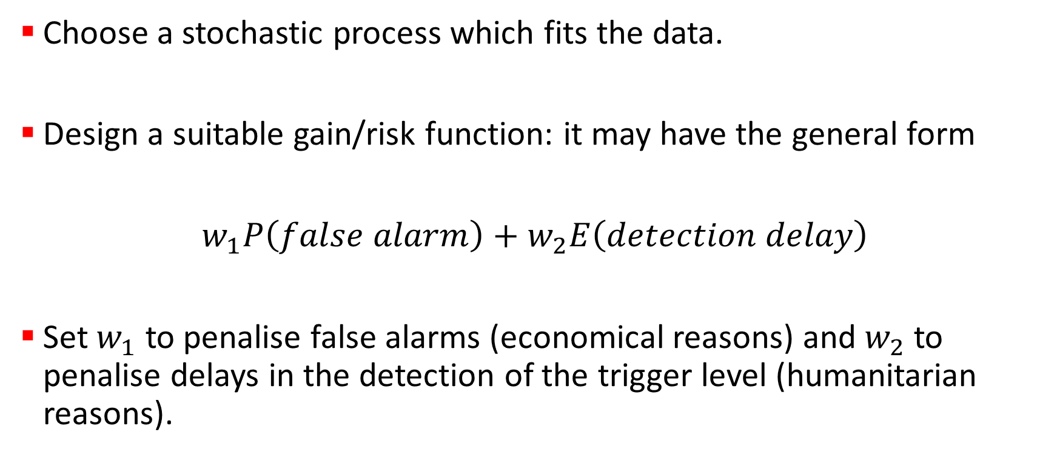
Tasks
Choose a stochastic process which fits the data.
Design a suitable gain/risk function: it may have the general form
$w_{1}P\left(false alarm\right)+w_{2}E\left(detection delay\right)$
Set $w_{1}$ to penalise false alarms (economical reasons) and $w_{2}$ to penalise delays in the detection of the trigger level (humanitarian reasons).

