Slide 1
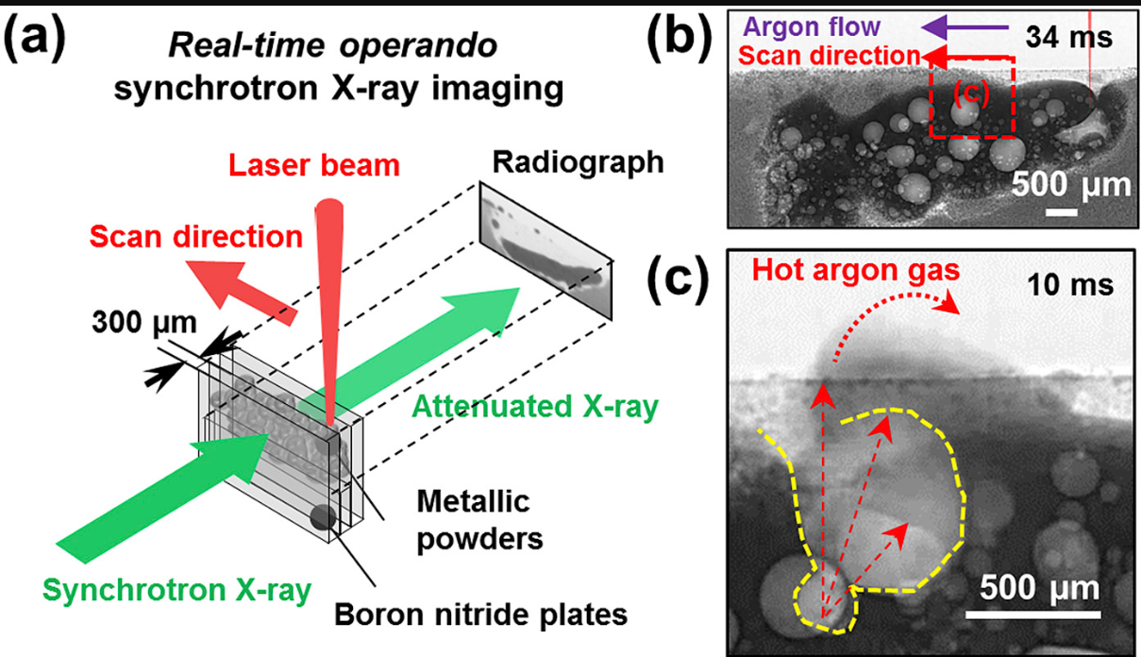
Additive Manufacturing: Denoising and Particle Tracking
AIM: To find velocity vectors for flying particles and molten mass in the images
Problems:
Very low signal-to-noise ratio and poor contrast of the radiographs
Particles are small and intensity-wise can be at the noise level
Particles are disappearing/appearing in frames
Noisy video here???
Additive Manufacturing: Denoising and Particle Tracking | ITT9 | January 2019

Slide 2
Avenue 1 – Tracking evolution of objects and denoising
We want to use a Kalman filter to track the evolution of the blobs and the particles
Forward step${\hat{x}}_{k}=F{\hat{x}}_{k−1}+ε$ for some linear forward operator $F$
Observation step $y_{k}=H{\hat{x}}_{k}+η$for some linear observation model $H$
Take the “true values” $x_{k}$ to be our denoised image.
We need a forward map acting on the images:
We could model the evolution of images as a time series of images
Could look at physical models e.g. explosions, wind and sand models
Use echo state networks to learn the forward map
Additive Manufacturing: Denoising and Particle Tracking | ITT9 | January 2019

Slide 3
Avenue 2: Computing an average velocity field
WANT: velocity field $v\left(x,t\right), x∈ℝ^{2}, t∈ℝ_{+}$
“Have” density field $ρ\left(x,t\right)∈ℝ$ at each time step where $ρ=ρ_{m}+ρ_{ε}$
Similarly decompose velocity field $v=v_{m}+v_{ε}$
Sparse linear solve for the velocity field
IDEA: Short time or space average of noise velocity field is zero because it bounces around at high frequency with zero mean velocity
Thus assume $\int_{0}^{τ}{v_{ε}dτ=0 }$for all s$ufficiently large τ$
Can we use this idea to characterise the velocity field $v_{m}$from the noisy data without tracking individual particles?
Additive Manufacturing: Denoising and Particle Tracking | ITT9 | January 2019

