Slide 1
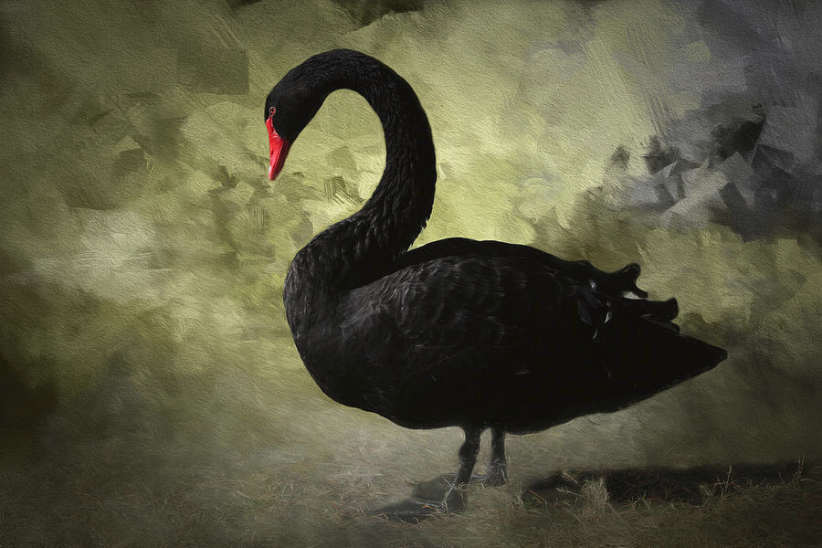
Willis Towers Watson
Assigning probability to hypothetical hurricanes

Slide 2
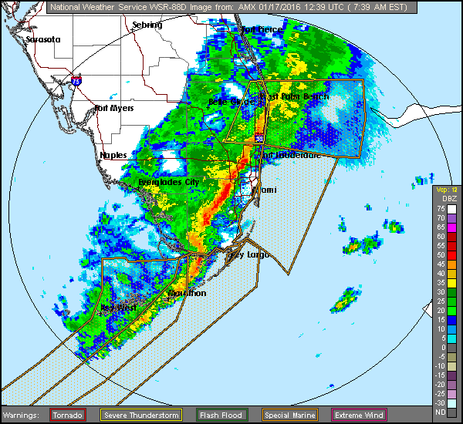
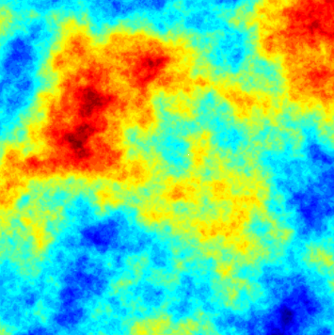
Air pressure as a (Gauß?) field on space-time
Air pressure
An instantiation of a GF

Slide 3
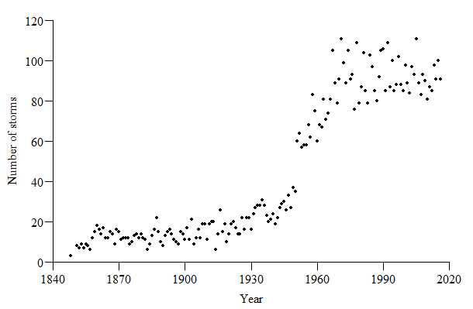
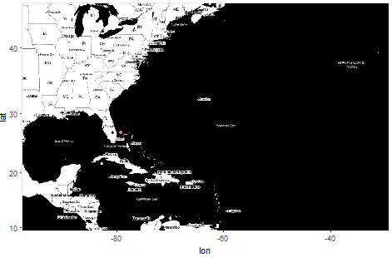
Preliminary data exploration

