Slide 1
Changepoint detection
Dan, Paolo, Gianluca, Ramsés

Slide 2
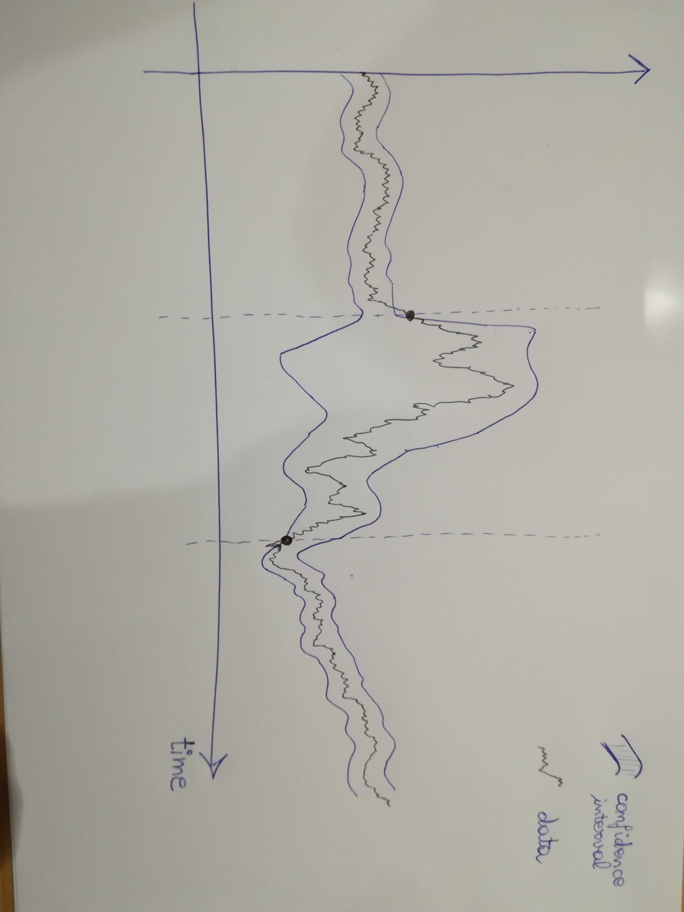

Slide 3
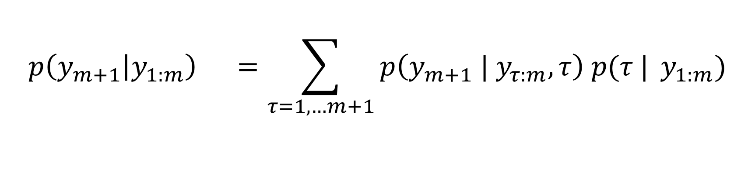
Bayesian online changepoint detection [Adams & MacKay, 2007]
$$p\left(y_{m+1} | y_{1:m}\right) =\sum_{τ=1,…m+1}{p\left({y_{m+1} | y}_{τ:m}, τ\right) p(τ |} y_{1:m})$$
Predictive model
Changepoint posterior

Slide 4
Future goals
Apply BOCPD to catastrophe data (droughts, windstorms, volcanoes…)
Generalize BOCPD to non-conjugate models (e.g. LSTM Neural Networks)

Slide 5
Insert applause here

