Slide 1
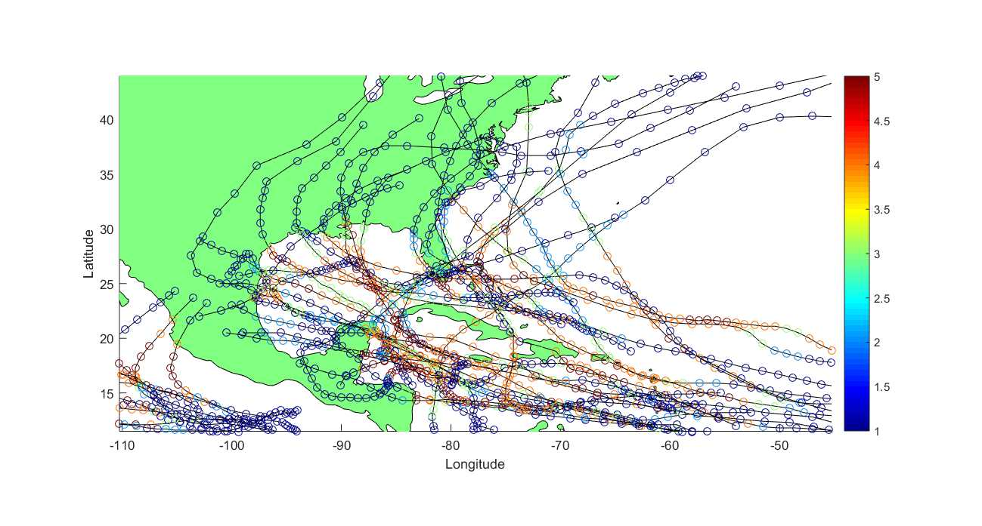
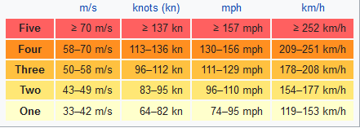
Physical and Numerical Analysis for Hurricanes
Simone Appella, Chris Budd, Johnathan Dawes, Yyanis Johnson-Llambias, Tony Shardlow Kate Powers, Jason Wood
https://en.wikipedia.org/wiki/Saffir%E2%80%93Simpson_scale

Slide 2
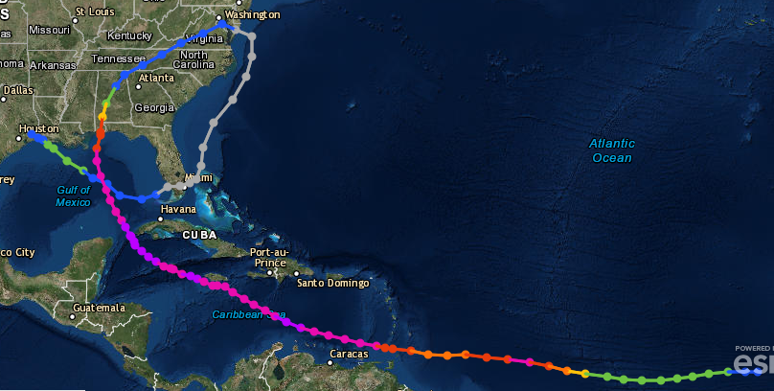
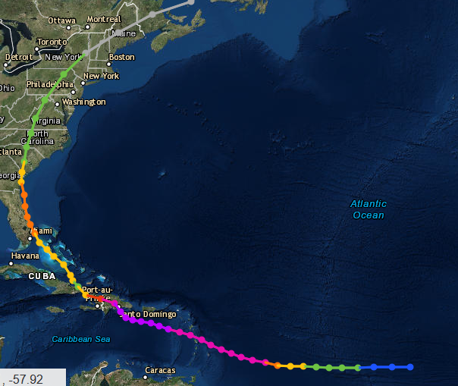
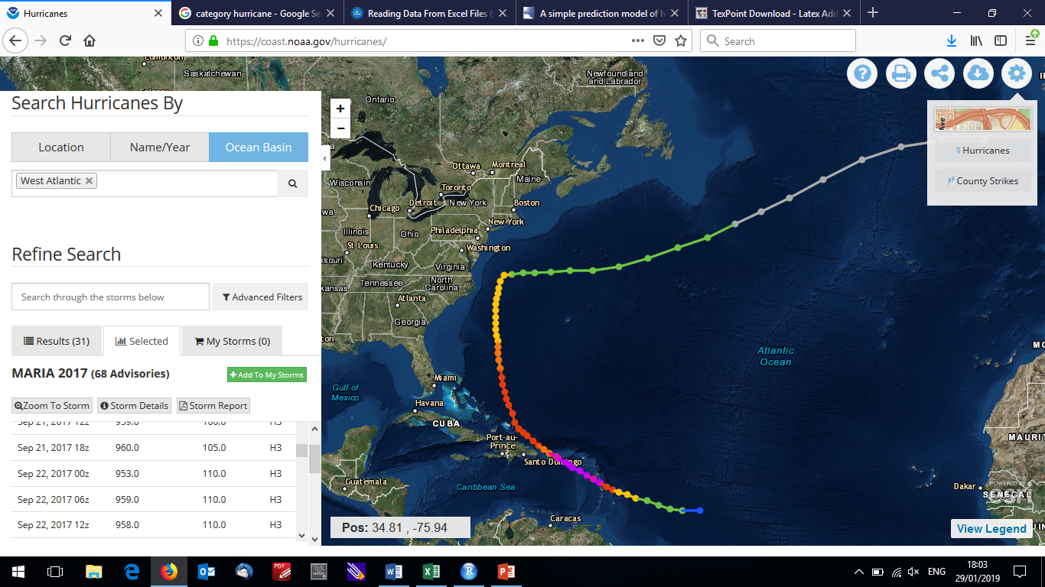
https://coast.noaa.gov/hurricanes/

Slide 3
Moving forward
Physics is complicated, some things poorly understood
Weak consensus that they are carried by large-scale environmental winds, but hurricanes change these winds
Coriolis effect
Some simple models exist for near the equator – can use these to build physical intuition and then predict unprecedented paths
ECMWF and MET Office

