Slide 1
Challenges for ice cream
During transportation temperature cycles alter the ice crystals geometry.
Segmentation + classification problem (Ice, Air, Matrix).
Currently computationally expensive to process large amount of data (3TB).
Guo, E., Kazantsev, D., Mo, J., Bent, J., Van Dalen, G., Schuetz, P., ... & Lee, P. D. (2018). Revealing the microstructural stability of a three-phase soft solid (ice cream) by 4D synchrotron X-ray tomography. Journal of Food Engineering.

Slide 2
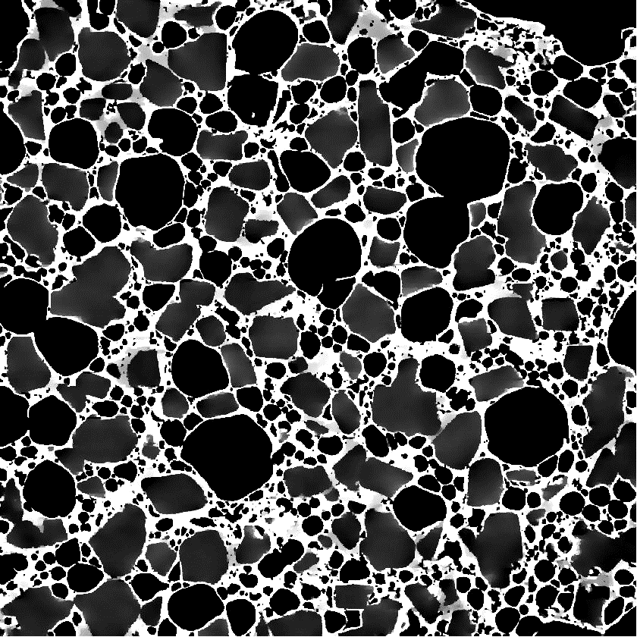
Improved image analysis
Hypothesis: curvature can be used to classify phases.
Computationally cheap
Keep track of evolution over time
R

Slide 3
Physical insights
Model for time evolution of ice crystals and air bubbles under temperature cycles.
Use model to classify phases.
Model gives insights into rheology of ice cream?

