Slide 1
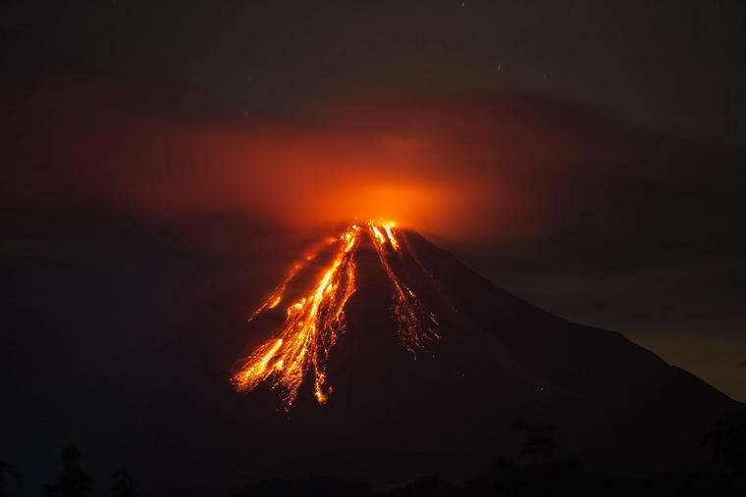
Parametric Models for Volcanic Risk
ITT9
Thomas Bartos Michele Firmo
Stefano Bruno
Ramses H. Mena

Slide 2
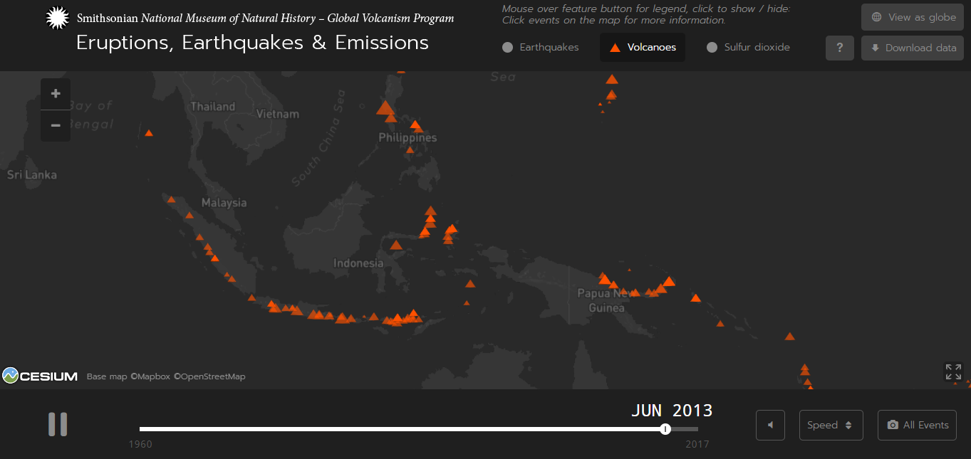

Slide 3
Modelling Approach
Create a risk map.
  Grid layout.
  Concentric rings.
For each volcano, simulate the loss associated to the eruption impact.
  Bayesian mixture models.
  Consider alternatives to kriging.
Data sources:
  Smithsonian Global Volcanism Program data.
  Use satellite images to assess exposure.

