Slide 1
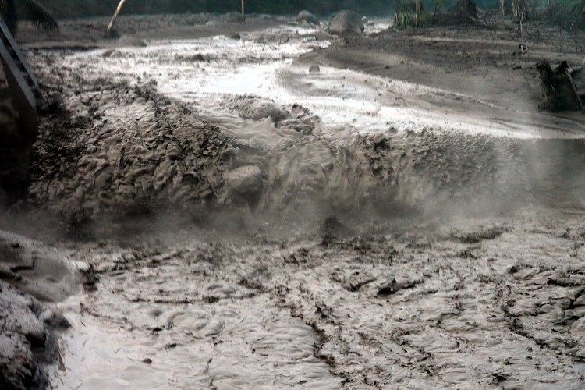
Physical Model of Lahars.
Jaqueline Wharton (WTW), Shaunagh Downing, Jenny Delos Reyes, Will Graham, Laura Hattan (IMI), Eileen Russell, Philippe Trinh.

Slide 2
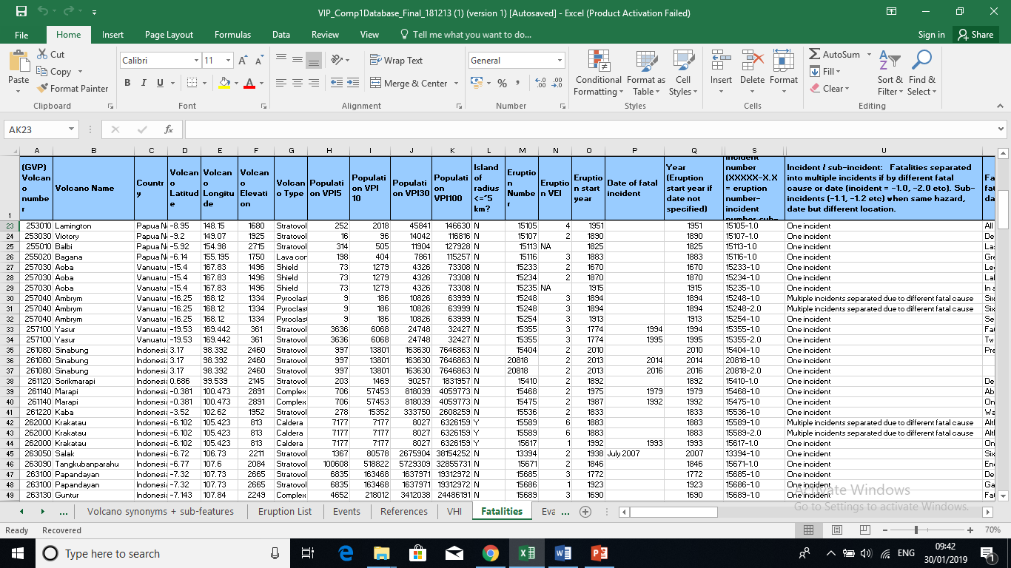
Motivation:
VEI (Volcanic Explosivity Index) not sufficient.
17% of deaths due to volcanic eruption is a result of lahars (Tanguy 1998).
WTW Database is extensive
No analysis preformed yet.
Attempt to cluster or characterise lahars.
Extract broad features common to lahars.

Slide 3
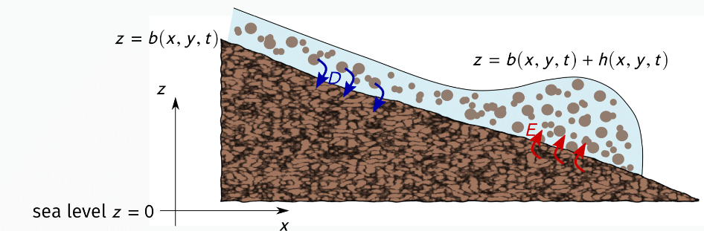
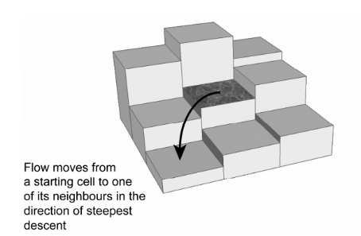
Literature on Existing Models.
Some approaches:
Differential Equations
Topographical Approach
Can we create a simpler model?
Focused on key features identified in data analysis (height, topography, geology, runoff).
Powerlaw, Box/Transport, continuum model.
Output quantifying the potential damage.

Slide 4
Questions:
What is the feasibility of models based on key features in predicting risk of lahars? Do correlations exist between severity of the lahars and coarse physical characteristics of the site?
With the above known, what is the type of physical modelling that can be done. What are the typical predictions such models can provide and how much work would they require?

