Slide 1
Assessing the risk of hypothetical windstorms
University of Bath SAMBa ITT 2019
Sam Phibbs, Model Research & Evaluation, Willis Re

Slide 2
Agenda
Introduction to tropical cyclones
Motivation of assessing risk beyond historical data
Current tools and what’s missing – assigning probability to a scenario
Examples of useful scenarios
The challenge

Slide 3
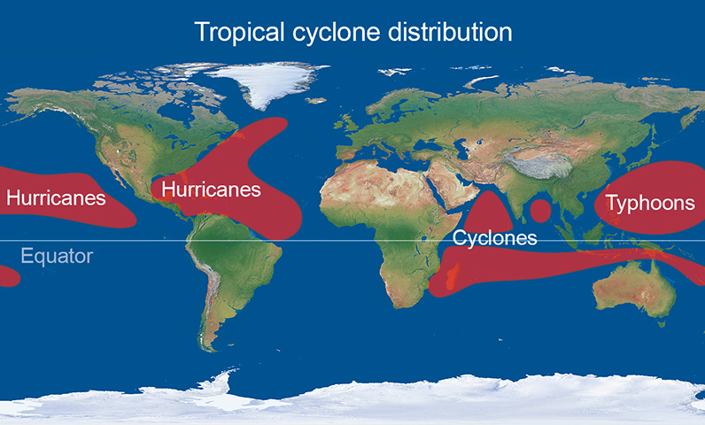
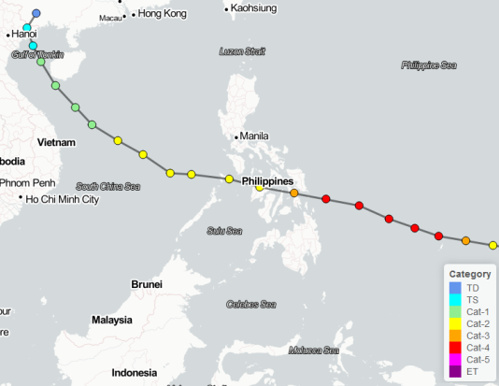
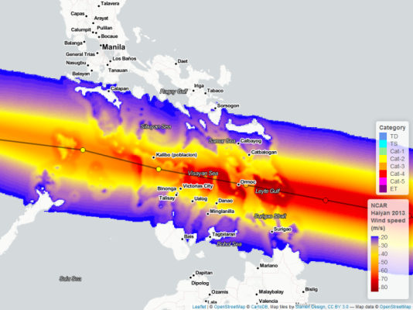
Tropical Cyclones
Introduction
Notes:
Example is typhoon Haiyan 2013

Slide 4
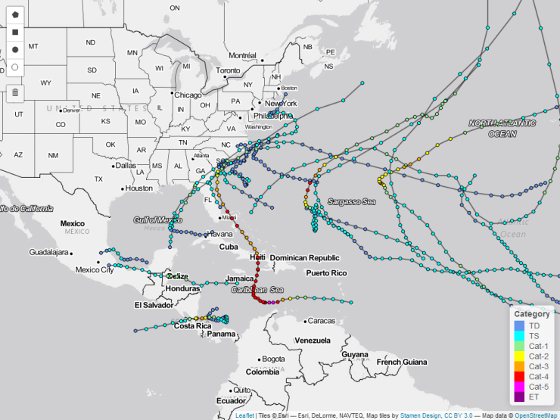
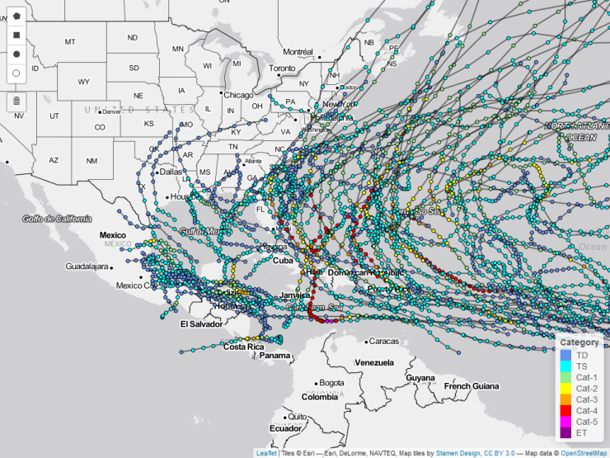
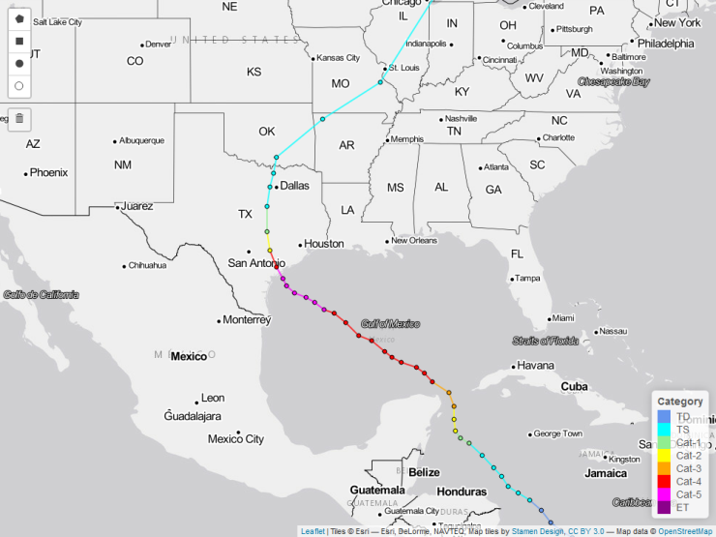
Motivation of assessing risk beyond historical data
2016 Hurricane Season
2010-2016 Hurricane Seasons
1961 Hurricane Carla

Slide 5
Motivation
Overview
Assessing the risk of natural catastrophes is essential
  Insurers need to ensure they have adequate capital and re-insurance
Catastrophe models are the tool of choice
  Stochastic catalogue of events e.g. 10,000 years of tropical cyclones
  Events have a probability of occurrence or return period assigned to them by simply ranking the events by loss and considering the length of the catalogue
Realistic disaster scenarios / counterfactual scenarios also widely used
  Assessment of potential damage
  No method of establishing probability of occurrence

Slide 6
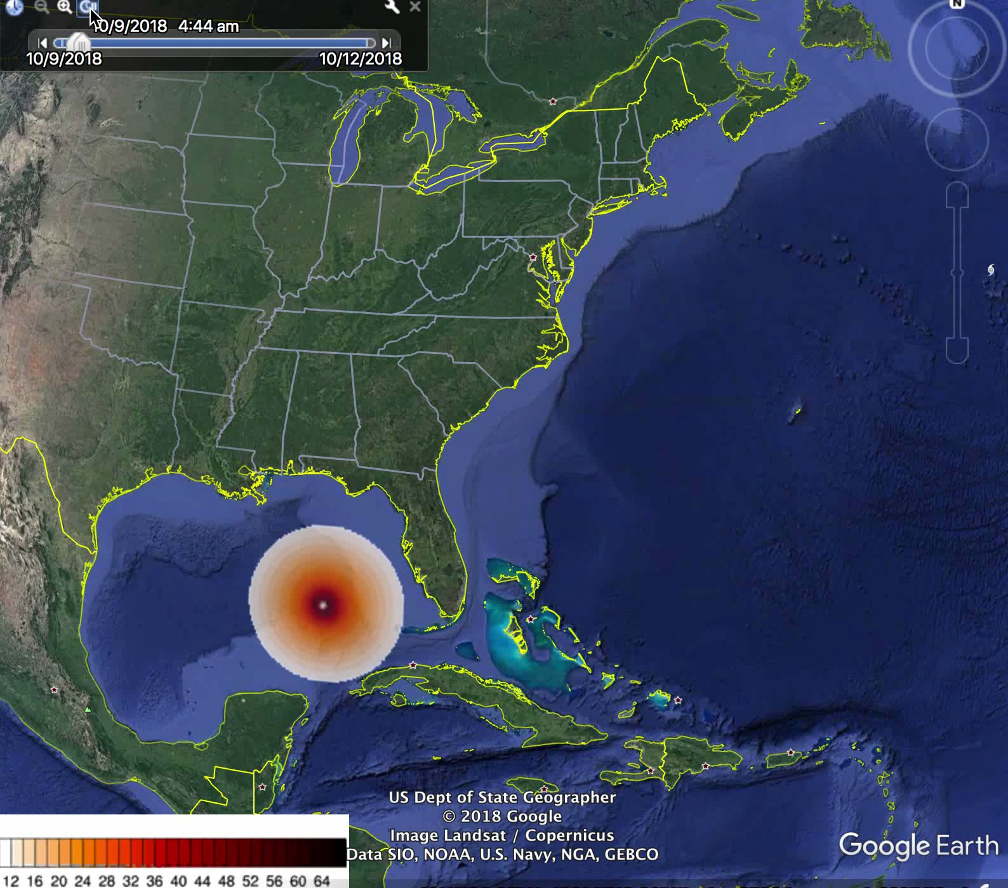
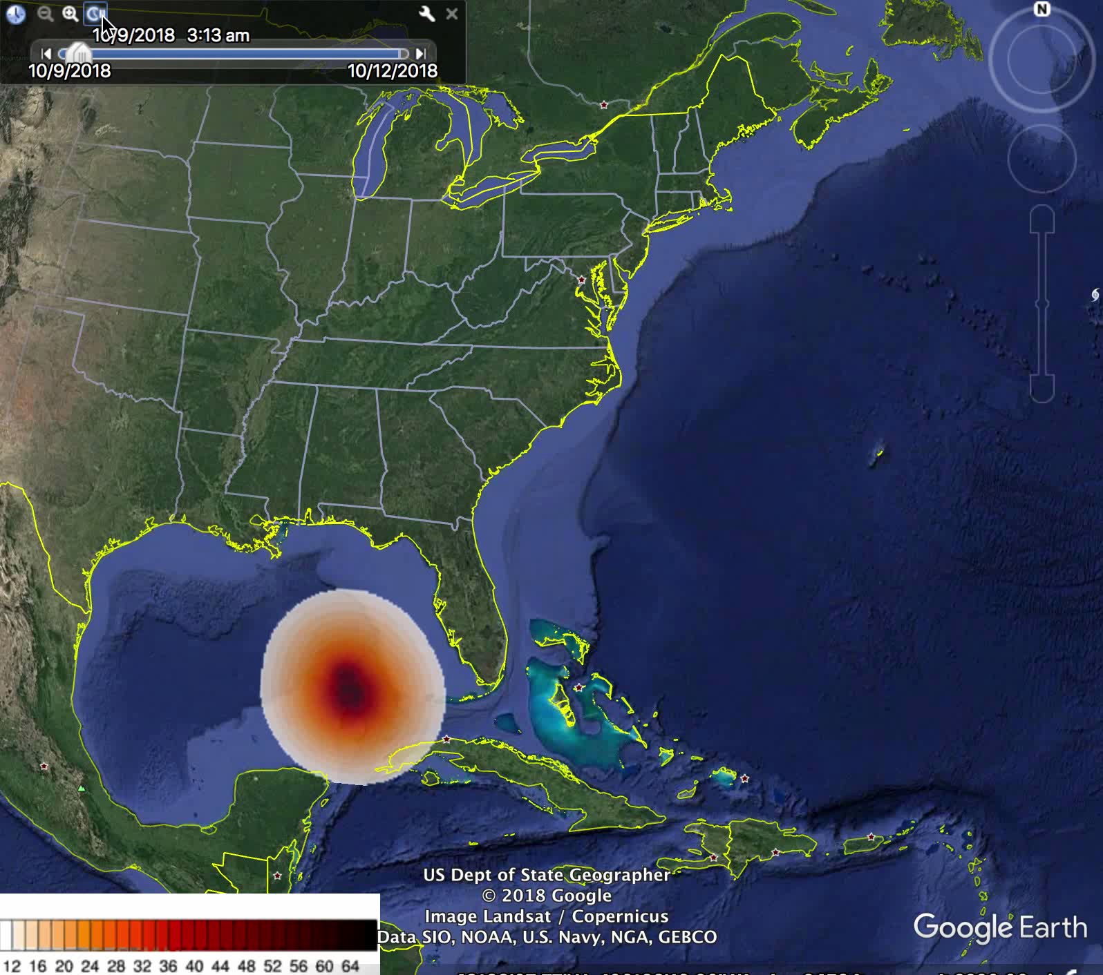
Scenarios
What Michael could have been like under continued climate change?

Slide 7
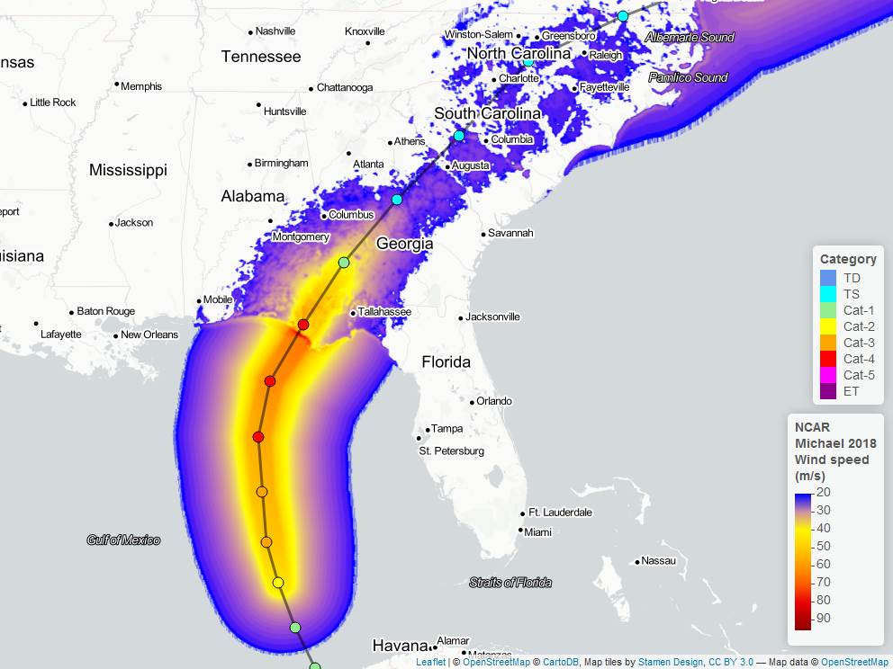
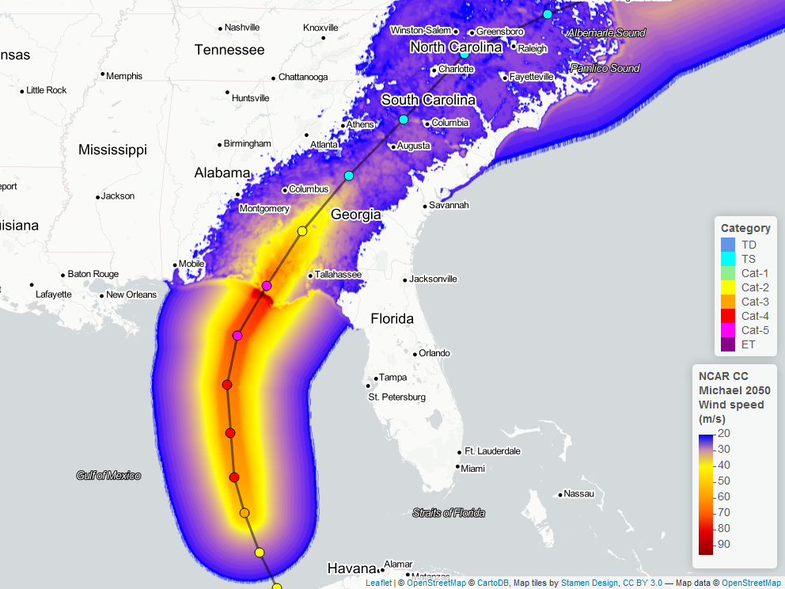
Scenarios
What Michael could have been like under continued climate change?
Michael: Original
Michael: Category 5

Slide 8
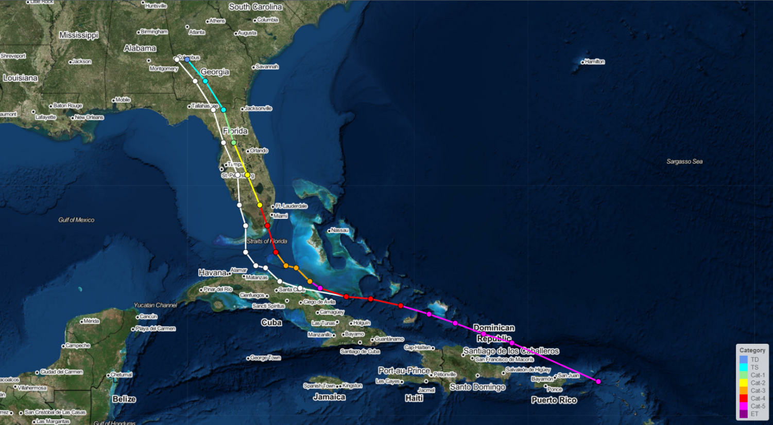
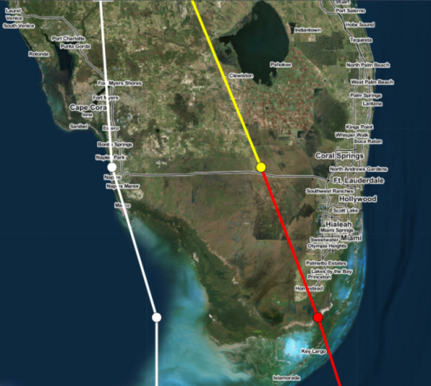
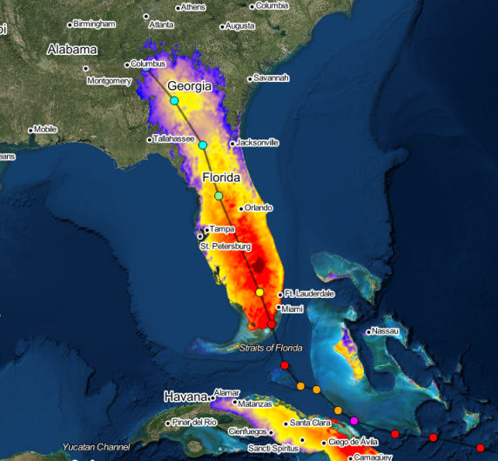
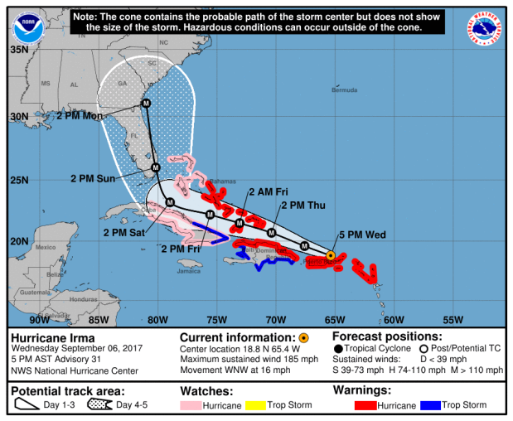
Scenarios
What if Irma hit Miami?
Scenario track
Original track
Scenario footprint
Miami
A forecast issued for Irma was for a hit on Miami

Slide 9
Challenge
Overview
Establish method of assigning probability to hypothetical natural catastrophes
Starting point
  Tropical cyclones
  Freely available tropical cyclone track data*
  Find probability of occurrence for any imagined track
Obstacles
  Probability of exact hypothetical track occurring is extremely small and not helpful. Need work out important characteristics, then assign probability
  Whether the storm hits exposure is an important characteristic

Slide 10
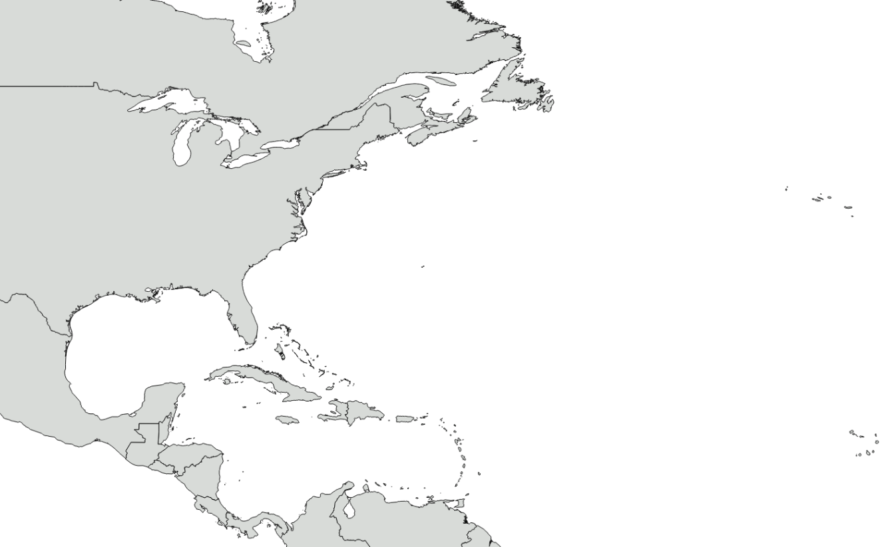
Challenge
Example
New York
No historical data to assess risk
Need to consider if small chance it hits exposure is taken into account
Very small chance of exact track further North,
What about important characteristics?
E.g. intensity at landfall, similar track…
Recent storm

Slide 11
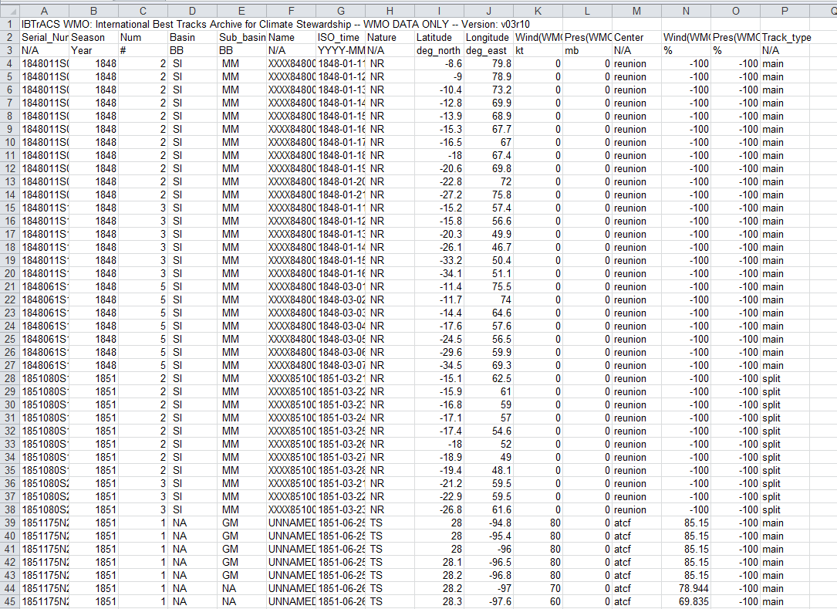
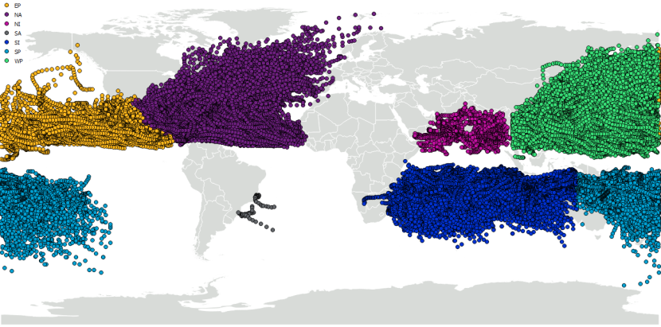
Challenge
Global Tropical Cyclone Data
Position and intensity of storms back to 1851 dependent on basin
Important fields:
  Latitude, Longitude, Time, Central Pressure

Slide 12
Challenge
Data location: FTP site
https://eft-eu.willisre.com/
Username: SAMBa
Password: Y0y7NseS
Allstorms.ibtracs_wmo.v03r10.csv

Slide 13
Willis Re disclaimers
This analysis has been prepared by Willis Limited and/or Willis Re Inc. and/or the “Willis Towers Watson” entity with which you are dealing (“Willis Towers Watson” is defined as Willis Limited, Willis Re Inc., and each of their respective parent companies, sister companies, subsidiaries, affiliates, Willis Towers Watson PLC, and all member companies thereof) on condition that it shall be treated as strictly confidential and shall not be communicated in whole, in part, or in summary to any third party without prior written consent from the Willis Towers Watson entity with which you are dealing.
Willis Towers Watson has relied upon data from public and/or other sources when preparing this analysis. No attempt has been made to verify independently the accuracy of this data. Willis Towers Watson does not represent or otherwise guarantee the accuracy or completeness of such data nor assume responsibility for the result of any error or omission in the data or other materials gathered from any source in the preparation of this analysis. Willis Towers Watson shall have no liability in connection with any results, including, without limitation, those arising from based upon or in connection with errors, omissions, inaccuracies, or inadequacies associated with the data or arising from, based upon or in connection with any methodologies used or applied by Willis Towers Watson in producing this analysis or any results contained herein. Willis Towers Watson expressly disclaims any and all liability, based on any legal theory, arising from, based upon or in connection with this analysis. Willis Towers Watson assumes no duty in contract, tort or otherwise to any party arising from, based upon or in connection with this analysis, and no party should expect Willis Towers Watson to owe it any such duty.
There are many uncertainties inherent in this analysis including, but not limited to, issues such as limitations in the available data, reliance on client data and outside data sources, the underlying volatility of loss and other random processes, uncertainties that characterize the application of professional judgment in estimates and assumptions. Ultimate losses, liabilities and claims depend upon future contingent events, including but not limited to unanticipated changes in inflation, laws, and regulations. As a result of these uncertainties, the actual outcomes could vary significantly from Willis Towers Watson’s estimates in either direction. Willis Towers Watson makes no representation about and does not guarantee the outcome, results, success, or profitability of any insurance or reinsurance program or venture, whether or not the analyses or conclusions contained herein apply to such program or venture.
Willis Towers Watson does not recommend making decisions based solely on the information contained in this analysis. Rather, this analysis should be viewed as a supplement to other information, including specific business practice, claims experience, and financial situation. Independent professional advisors should be consulted with respect to the issues and conclusions presented herein and their possible application. Willis Towers Watson makes no representation or warranty as to the accuracy or completeness of this document and its contents.
This analysis is not intended to be a complete actuarial communication, and as such is not intended to be relied upon. A complete communication can be provided upon request. Subject to all terms of this Disclaimer, Willis Towers Watson actuaries are available to answer questions about this analysis.
Willis Towers Watson does not provide legal, accounting, or tax advice. This analysis does not constitute, is not intended to provide, and should not be construed as such advice. Qualified advisers should be consulted in these areas.
Willis Towers Watson makes no representation, does not guarantee and assumes no liability for the accuracy or completeness of, or any results obtained by application of, this analysis and conclusions provided herein.
Where data is supplied by way of CD or other electronic format, Willis Towers Watson accepts no liability for any loss or damage caused to the Recipient directly or indirectly through use of any such CD or other electronic format, even where caused by negligence. Without limitation, Willis Towers Watson shall not be liable for: loss or corruption of data, damage to any computer or communications system, indirect or consequential losses. The Recipient should take proper precautions to prevent loss or damage – including the use of a virus checker.
This limitation of liability does not apply to losses or damage caused by death, personal injury, dishonesty or any other liability which cannot be excluded by law.
This analysis is not intended to be a complete Financial Analysis communication. A complete communication can be provided upon request. Subject to all terms of this Disclaimer, Willis Towers Watson analysts are available to answer questions about this analysis.
Willis Towers Watson does not guarantee any specific financial result or outcome, level of profitability, valuation, or rating agency outcome with respect to A.M. Best or any other agency. Willis Towers Watson specifically disclaims any and all liability for any and all damages of any amount or any type, including without limitation, lost profits, unrealized profits, compensatory damages based on any legal theory, punitive, multiple or statutory damages or fines of any type, based upon, arising from, in connection with or in any manner related to the services provided hereunder.
Acceptance of this document shall be deemed agreement to the above.

Slide 14
Vendor disclaimers – 1 of 2
Work containing Risk Management Solutions (RMS) output
“This report, and the analyses, models and predictions contained herein ("Information"), are based on data provided by Willis Re Inc., Willis Limited and their respective affiliates (hereinafter collectively “Willis”) and compiled using proprietary computer risk assessment technology of Risk Management Solutions, Inc. ("RMS"). The technology and data used in providing this Information is based on the scientific data, mathematical and empirical models, and encoded experience of scientists and specialists (including without limitation: earthquake engineers, wind engineers, structural engineers, geologists, seismologists, meteorologists, geotechnical specialists and mathematicians). As with any model of physical systems, particularly those with low frequencies of occurrence and potentially high severity outcomes, the actual losses from catastrophic events may differ from the results of simulation analyses. Furthermore, the accuracy of predictions depends largely on the accuracy and quality of the data used by Willis. The Information is provided under license to Willis and is RMS’ proprietary and confidential information and may not be shared with any third party without the prior written consent of both Willis and RMS. Furthermore, this Information may only be used for the specific business purpose specified by Willis and for no other purpose, and may not be used under any circumstances in the development or calibration of any product or service offering that competes with RMS.
The recipient of this Information is further advised that RMS is not engaged in the insurance, reinsurance, or related industries, and that the Information provided is not intended to constitute professional advice. RMS SPECIFICALLY DISCLAIMS ANY AND ALL RESPONSIBILITIES, OBLIGATIONS AND LIABILITY WITH RESPECT TO ANY DECISIONS OR ADVICE MADE OR GIVEN AS A RESULT OF THE INFORMATION OR USE THEREOF, INCLUDING ALL WARRANTIES, WHETHER EXPRESS OR IMPLIED, INCLUDING BUT NOT LIMITED TO, WARRANTIES OF NON-INFRINGEMENT, MERCHANTABILITY, AND FITNESS FOR A PARTICULAR PURPOSE. IN NO EVENT SHALL RMS (OR ITS PARENT, SUBSIDIARY, OR OTHER AFFILIATED COMPANIES) BE LIABLE FOR DIRECT, INDIRECT, SPECIAL, INCIDENTAL, OR CONSEQUENTIAL DAMAGES WITH RESPECT TO ANY DECISIONS OR ADVICE MADE OR GIVEN AS A RESULT OF THE CONTENTS OF THIS INFORMATION OR USE THEREOF.”
Work containing AIR Worldwide Corporation (AIR) Touchstone output
IMPORTANT NOTICE and DISCLAIMER
AIR Worldwide Corporation and Willis Re Inc. or Willis Limited
The attached Touchstone reports are provided to you in confidence, and you may not cause or permit disclosure, copying, display, loan, publication, transfer of possession (whether by sale, exchange, gift, operation of law or otherwise) or other dissemination of the Touchstone reports (or details of the methodology and analysis employed to develop the Touchstone reports) in whole or in part, to any third party without the prior written consent of Willis Re Inc. or Willis Limited and AIR Worldwide Corporation (“AIR”).
Notwithstanding the foregoing, you may disclose the Touchstone reports associated with your reinsurance or risk transfer programs to insurance regulators and disclose, in confidence, to your rating agencies, reinsurers, actuarial consultants, managing general agencies, risk managers, investment bankers (but not in connection with the placement of any insurance-linked securities) and auditors (but in no event to any entity in the business of developing loss estimation models), provided that, in the event of any such disclosure, you clearly acknowledge in writing that AIR owns the exclusive right and title to the Touchstone reports and the methods employed to develop them.
You may not alter or remove any copyrights, trade secret, patent, proprietary and/or other legal notices contained on or in copies of the Touchstone reports. The existence of any such copyright notice on the Touchstone reports shall not be construed as an admission, or be deemed to create a presumption, that publication of such materials has occurred.
The Touchstone reports are intended to function as one of several tools which you will use in analyzing your estimated and potential losses from certain natural hazards. The estimation of hazards and potential losses involves uncertainties and depends on environmental, demographic and regulatory factors beyond the control of Willis Re Inc., Willis Limited and AIR. The Touchstone reports depend on data and inputs which you have supplied. The assumptions and methodologies used by AIR in creating Touchstone may not constitute the exclusive set of reasonable assumptions and methodologies, and the use of alternative assumptions and methodologies could yield materially different results. The loss probabilities indicated by the Touchstone reports are estimates of the magnitude of losses that may occur in the event of such natural hazards; they are not factual and do not predict future events. Actual loss experience can differ materially.
No responsibility is or shall be assumed or implied by Willis Re Inc., Willis Limited or AIR for loss or damage to you resulting from inaccuracies contained therein nor shall Willis Re Inc., Willis Limited or AIR be liable to you or others for any adverse results experienced in utilizing the Touchstone reports

Slide 15
Vendor disclaimers – 2 of 2
Work containing CoreLogic output
This report contains CoreLogic Confidential Information and i) recipient agrees to treat this report as strictly confidential; and ii) in consideration of having been provided access to this report, recipient agrees that CoreLogic has no liability for such report or other information derived from the report or any use that may be made thereof by recipient.
Work containing/using Kinetic data
The TAOS real-time hazard and impact forecast information is provided "as is" and without warranties as to performance or any other warranties whether expressed or implied. The user is strongly cautioned to recognize that natural hazards modeling and analysis are subject to many uncertainties. These uncertainties include, but are not limited to, the uncertainties inherent in weather and climate, incomplete or inaccurate weather data, changes to the natural and built environment, limited historical records, and limitations in the state of the art of modeling, as well as limits to the scientific understanding of storm weather phenomena. Anyone making use of the hazard and impact information provided by KAC, or the information contained within, assumes all liability deriving from such use, and agrees to "hold harmless" any and all agencies or individuals associated with its creation. The user agrees to provide any subsequent users of this data with this disclaimer. The publication of the material contained herein is not intended as a representation or warranty that this information is suitable for any general or particular use.
Work using S&P ratings
Copyright © 2018, S&P Global Market Intelligence (and its affiliates, as applicable). Reproduction of any information, data or material, including ratings (“Content”) in any form is prohibited except with the prior written permission of the relevant party. Such party, its affiliates and suppliers (“Content Providers”) do not guarantee the accuracy, adequacy, completeness, timeliness or availability of any Content and are not responsible for any errors or omissions (negligent or otherwise), regardless of the cause, or for the results obtained from the use of such Content. In no event shall Content Providers be liable for any damages, costs, expenses, legal fees, or losses (including lost income or lost profit and opportunity costs) in connection with any use of the Content. A reference to a particular investment or security, a rating or any observation concerning an investment that is part of the Content is not a recommendation to buy, sell or hold such investment or security, does not address the suitability of an investment or security and should not be relied on as investment advice. Credit ratings are statements of opinions and not statements of fact.
Work including MarketStance material or data (credit such information in exhibits)
This report contains material from Intellistance LLC, DBA MarketStance© and Intellistance LLC retains copyright to such material.
© 2018 Insurance Services Office, Inc. All rights reserved. Confidential and Proprietary

