Slide 1
Forecast-based Financing for Drought
The optimal stopping problem
SAMBa ITT9: Challenges in environmental risk
28th January 2019

Slide 2
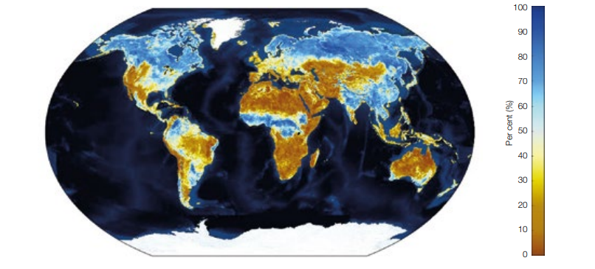
Forecast-based Financing
Early action to save lives and loss
A window between a forecast and a disaster – most climate related hazards can be forecast
Populations, corporates and governments can engage in protective actions if they have prior warning
Contingency plans are linked to the severity of the forecast: as simple as ‘high risk’ and ‘low risk’
Pioneered by the Red Cross Red Crescent Climate Centre to improve the ‘proactiveness’ of the humanitarian response
Increasingly possible through earth observation data
Remote sensing data are crucial in places such as east Africa, where historic and real time variables are generally lacking
Evidence-based, trigger activated response
Interest in slow onset events
Drought – when does a drought start?
Source: IFAD, 2017

Slide 3
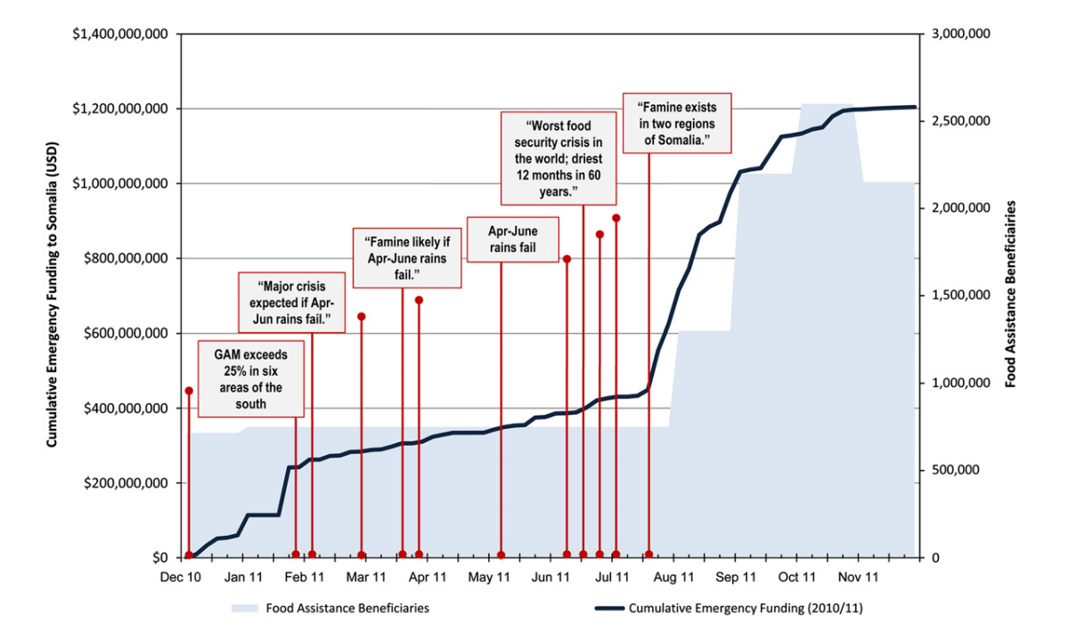
FbF: Drought in Somalia, 2011
Source: Hillbruner and Moloney, 2012

Slide 4
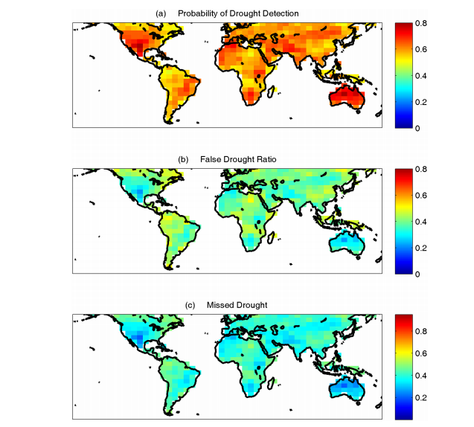
Index Choice
Indices demonstrate substantial variation in skill
Droughts can be monitored by precipitation, runoff and soil moisture
Precipitation measures typically detect drought earlier because rainfall is a primary source
A wide variety in hybrid indices
Innovation to improve forecasting skill
Innovation to meet data scarcity
An exceptionally dynamic field with overwhelming institutional support (UN, WFP, Red Cross Red Crescent etc.)
Drought early warning is concerned with monitoring and early detection, rather than forecasting
Source: Farahmand et al. 2015

Slide 5
Methodological problems
The usefulness of an early warning system is determined by the ratio of hits to false alarms
 | Yes extreme event | No extreme event
Yes forecast-based action | Correct prediction - worthy action | False alarm – act in vain
No forecast-based action | Miss – response cost | Correct rejection – no cost
Source: Coughlan de Perez et al. 2015
Contingency table of possible outcomes
Forecast-based warnings are probabilistic, rather than deterministic
A range of risk perception challenges
False alarms bring reputational and trust issues – not to mention cost
A key question: what is the balance between an accurate warning compared with an early warning?

Slide 6
Conceptual solution
Rolling index of probabilities
A distillation of seasonal forecasts, such as El Nino and seasonal rainfall, with sub-seasonal (monthly)
Percentage of exceeding the 1 in 10 year return period, 3 months in advance
Setting the trigger level
The trigger is an indicator of the confidence in monitoring
Where should the trigger be set?
Trigger level at 65%

Slide 7
Data sources & references
Standardised Precipitation Index
NDVI / WRSI / CHIRPS
FEWS NET
http://stream.princeton.edu/redirect.html
Cancelliere et al. 2007 ‘Drought forecasting using the Standardized Precipitation Index’, Water Resources Management
Coughlan de Perez et al. 2015 ‘Forecast-based financing: an approach to catalyzing humanitarian action based on extreme weather and climate forecasts’, Natural Hazards and Earth System Sciences
Farahmand et al. 2015 ‘A Vantage from Space Can Detect Earlier Drought Onset: An Approach Using Relative Humidity’, Scientific Reports
IFAD, 2017 Remote sensing for index insurance: Findings and lessons learned for smallholder agriculture
Stephens et al. 2015 ‘Forecast-based Action: SHEAR Final Report’, University of Reading

Slide 8
About Willis Towers Watson
Willis Towers Watson (NASDAQ: WLTW ) is a leading global advisory, broking and solutions company that helps clients around the world turn risk into a path for growth. With roots dating to 1828, Willis Towers Watson has 40,000 employees in more than 140 countries. We design and deliver solutions that manage risk, optimize benefits, cultivate talent and expand the power of capital to protect and strengthen institutions and individuals. Our unique perspective allows us to see the critical intersections between talent, assets and ideas — the dynamic formula that drives business performance. Together, we unlock potential. Learn more at willistowerswatson.com.

Slide 9
Willis Limited Analytical Disclaimer
This analysis has been prepared by Willis Limited on condition that it shall be treated as strictly confidential and shall not be communicated in whole, in part, or in summary to any third party without written consent from Willis Limited.
Willis Limited has relied upon data from public and/or other sources when preparing this analysis. No attempt has been made to verify independently the accuracy of this data. Willis Limited does not represent or otherwise guarantee the accuracy or completeness of such data nor assume responsibility for the result of any error or omission in the data or other materials gathered from any source in the preparation of this analysis. Willis Limited, its parent companies, sister companies, subsidiaries and affiliates (hereinafter “Willis”) shall have no liability in connection with any results, including, without limitation, those arising from based upon or in connection with errors, omissions, inaccuracies, or inadequacies associated with the data or arising from, based upon or in connection with any methodologies used or applied by Willis Limited in producing this analysis or any results contained herein. Willis expressly disclaims any and all liability arising from, based upon or in connection with this analysis. Willis assumes no duty in contract, tort or otherwise to any party arising from, based upon or in connection with this analysis, and no party should expect Willis to owe it any such duty.
There are many uncertainties inherent in this analysis including, but not limited to, issues such as limitations in the available data, reliance on client data and outside data sources, the underlying volatility of loss and other random processes, uncertainties that characterize the application of professional judgment in estimates and assumptions, etc. Ultimate losses, liabilities and claims depend upon future contingent events, including but not limited to unanticipated changes in inflation, laws, and regulations. As a result of these uncertainties, the actual outcomes could vary significantly from Willis Limited’s estimates in either direction. Willis makes no representation about and does not guarantee the outcome, results, success, or profitability of any insurance or reinsurance program or venture, whether or not the analyses or conclusions contained herein apply to such program or venture.
Willis does not recommend making decisions based solely on the information contained in this analysis. Rather, this analysis should be viewed as a supplement to other information, including specific business practice, claims experience, and financial situation. Independent professional advisors should be consulted with respect to the issues and conclusions presented herein and their possible application. Willis makes no representation or warranty as to the accuracy or completeness of this document and its contents.
This analysis is not intended to be a complete actuarial communication, and as such is not intended to be relied upon. A complete communication can be provided upon request. Willis Limited actuaries are available to answer questions about this analysis.
Willis does not provide legal, accounting, or tax advice. This analysis does not constitute, is not intended to provide, and should not be construed as such advice. Qualified advisers should be consulted in these areas.
Willis makes no representation, does not guarantee and assumes no liability for the accuracy or completeness of, or any results obtained by application of, this analysis and conclusions provided herein.
Where data is supplied by way of CD or other electronic format, Willis accepts no liability for any loss or damage caused to the Recipient directly or indirectly through use of any such CD or other electronic format, even where caused by negligence. Without limitation, Willis shall not be liable for: loss or corruption of data, damage to any computer or communications system, indirect or consequential losses. The Recipient should take proper precautions to prevent loss or damage – including the use of a virus checker.
This limitation of liability does not apply to losses or damage caused by death, personal injury, dishonesty or any other liability which cannot be excluded by law.
Acceptance of this document shall be deemed agreement to the above.

