Slide 1
Environmental Statistics
Working with Natural Hazard Data
Aoibheann Brady and Tom Smith
ITT9 Background Presentation

Slide 2
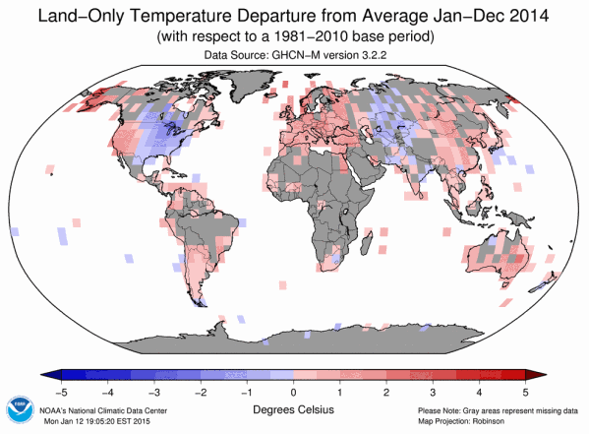
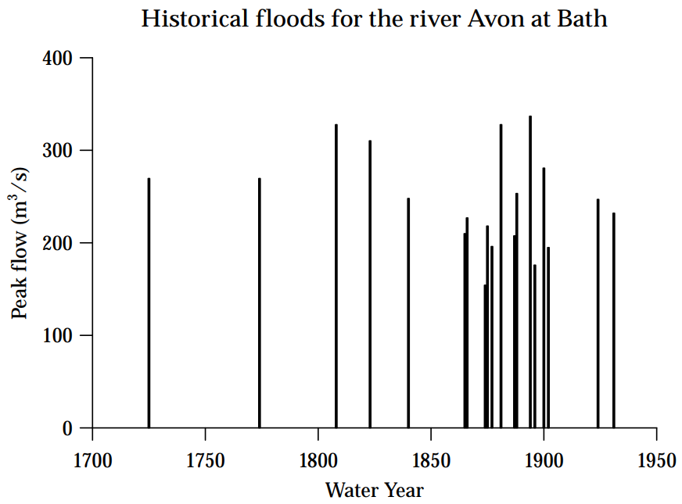
Key issues when dealing with environmental data
Dealing with very sparse data - both in space…
… and in time
Monitoring stations often scattered & coverage of locations can be poor
Events which are extreme in nature tend to be spread out in time
Environmental Statistics: Working with Natural Hazard Data | Aoibheann Brady & Tom Smith | ITT9 | January 2019

Slide 3
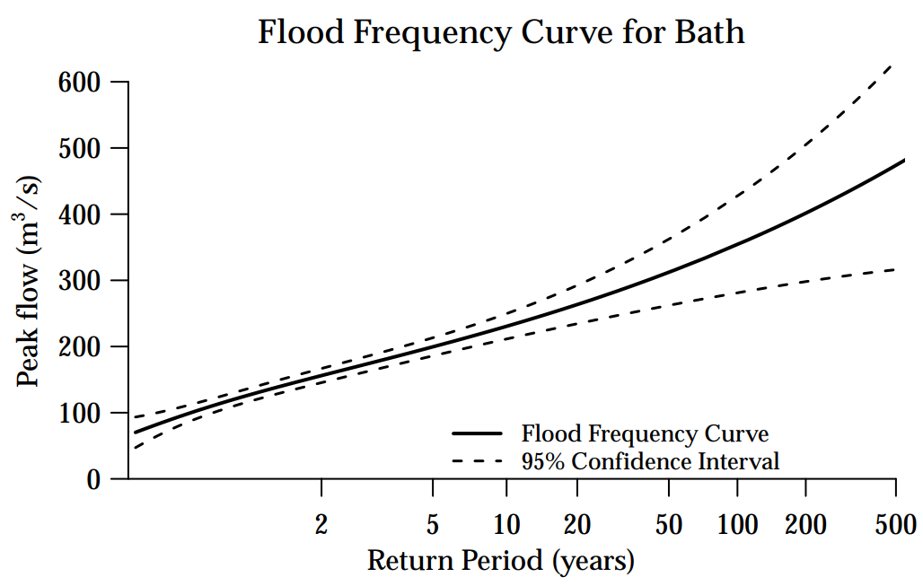
Exceedance Probabilities and Return Periods
For a natural hazard, the T-year event is the event where the average waiting time between occurrences is T years
It has a probability $\frac{1}{T}$ of happening, or being exceeded, in any given year
Estimates of the T-year event are usually obtained from analysing reduced data sets, e.g. annual maxima
Environmental Statistics: Working with Natural Hazard Data | Aoibheann Brady & Tom Smith | ITT9 | January 2019

Slide 4
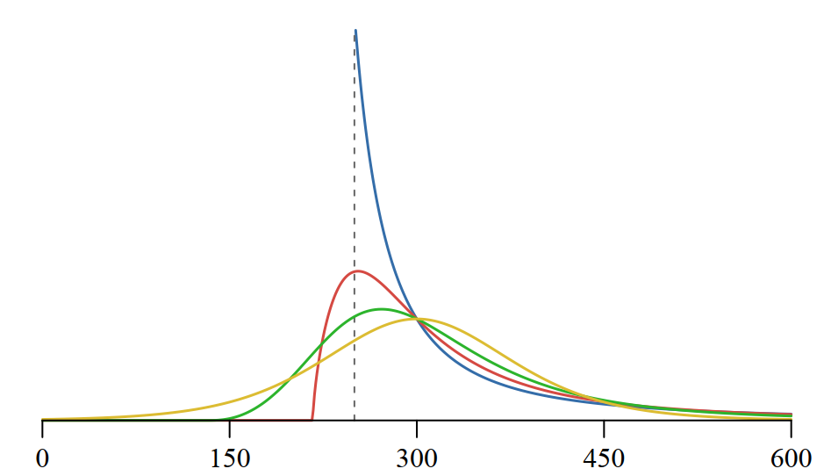
Standard Distributions for Natural Hazard Extremes
Generalised Extreme Value (GEV)
Generalised Logistic (GLO)
Theoretically motivated
Empirically motivated
Encompasses Gumbel, Weibull, and Fréchet distributions
Recommended for UK river flow annual maxima
Other choices include Generalised Pareto, Generalised Log-Normal, Kappa, many more…
Distributions with 3+ parameters are very flexible
Environmental Statistics: Working with Natural Hazard Data | Aoibheann Brady & Tom Smith | ITT9 | January 2019

Slide 5
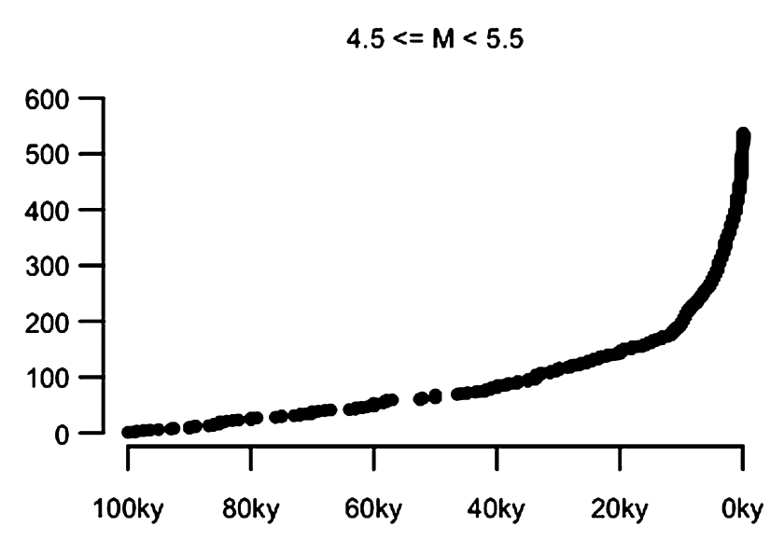
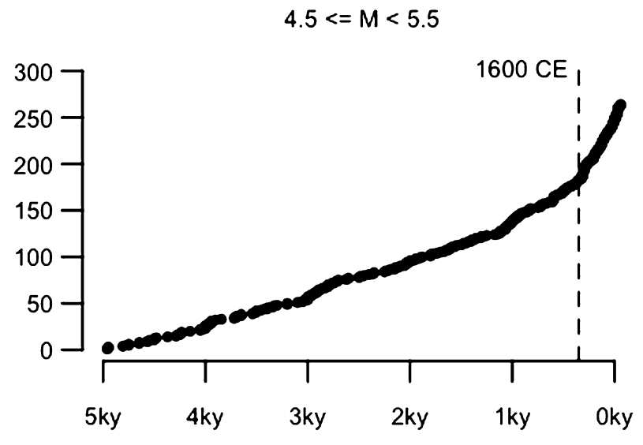
Under-recording
Wrongly assuming you have all the data can seriously bias your analysis
This method is suitable for data-rich processes or global analyses
Images: J. Rougier et al. (2018) Earth and Planetary Science Letters 482:621–629
Environmental Statistics: Working with Natural Hazard Data | Aoibheann Brady & Tom Smith | ITT9 | January 2019

Slide 6
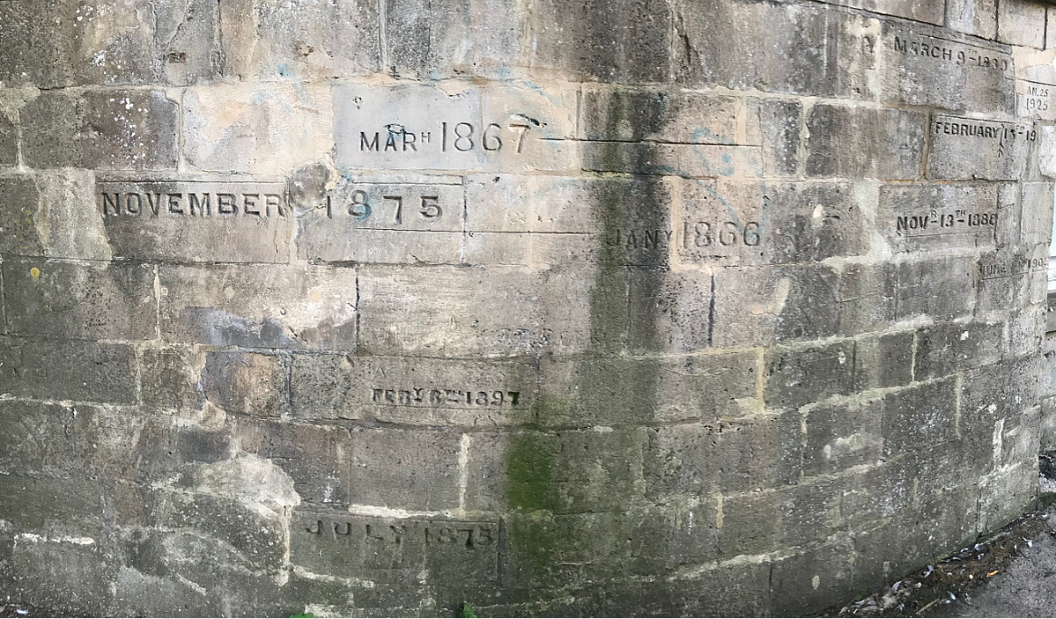
Historical Records
In data-poor domains, additional data may be available from before the start of systematic measurement
One common approach is to assume all occurrences of the hazard which exceeded some specified magnitude (the ‘perception threshold’) have been recorded
Care must be taken due to possible difficulties in using these records, e.g. quality, completeness…
Historical flood marks at Widcombe, Bath
Environmental Statistics: Working with Natural Hazard Data | Aoibheann Brady & Tom Smith | ITT9 | January 2019

Slide 7
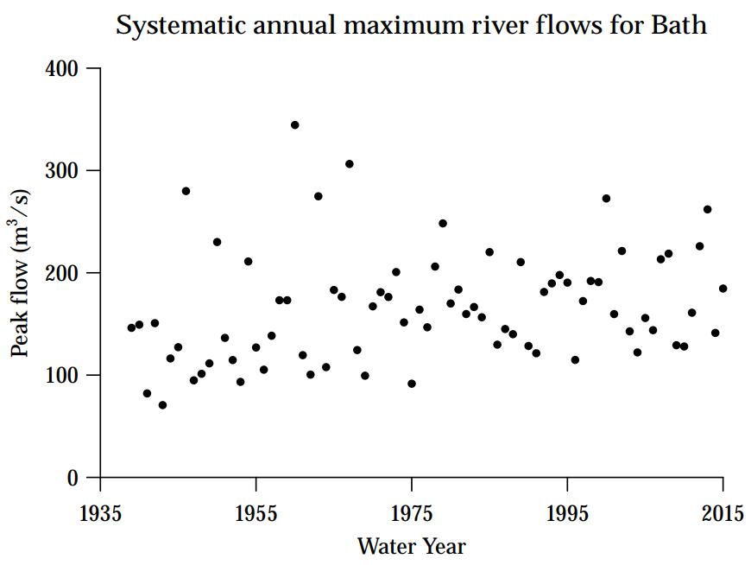
Non-Stationarity
Systematic increase in flood magnitudes mean we’re under-prepared for the future
Especially important if including historical data
What is a 100-year event in a non-stationary world?
Environmental Statistics: Working with Natural Hazard Data | Aoibheann Brady & Tom Smith | ITT9 | January 2019

Slide 8
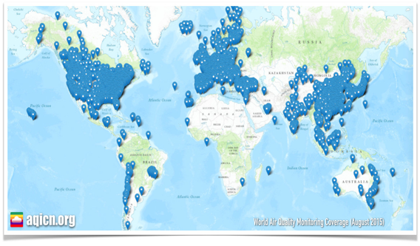
Combining sources - why?
Need to accurately assess exposure (e.g. in volcanic eruption) & estimate financial or health risks
Directly measured data provides a finer level on a spatial scale but has considerable missingness
Data from monitoring stations
Modelling involves numerically solving complex systems of differential equations capturing various physical processes. Output spans large spatial domains with no missingness
Numerical model output
Environmental Statistics: Working with Natural Hazard Data | Aoibheann Brady & Tom Smith | ITT9 | January 2019

Slide 9
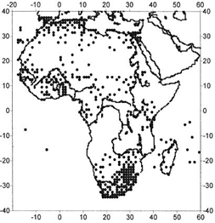
Data fusion
Advantages:
Can improve assessment of exposure at high resolution.
Allows us to combine observational data on the current atmospheric state with a short-range numerical forecast to obtain initial conditions for a numerical atmospheric model.
Disadvantages:
Many methods proposed in atmospheric data assimilation are ad-hoc, algorithmic and don’t address the “change of support” problem.
The change of support problem is concerned with inference about values of a variable at a level different from which it has been observed.
Environmental Statistics: Working with Natural Hazard Data | Aoibheann Brady & Tom Smith | ITT9 | January 2019

Slide 10
Methods of data fusion/interpolation
Kriging, a method of interpolation for which the interpolated values are modelled by a Gaussian process, used to interpolate between sites. Not ideal when data is sparse!!
If one is interested at a grid level, can use upscaling to make area-level inferences based on point data.
Conversely, can use downscaling when observing at an area level (e.g. gridded data) and want to make point-level inferences.
Environmental Statistics: Working with Natural Hazard Data | Aoibheann Brady & Tom Smith | ITT9 | January 2019

Slide 11
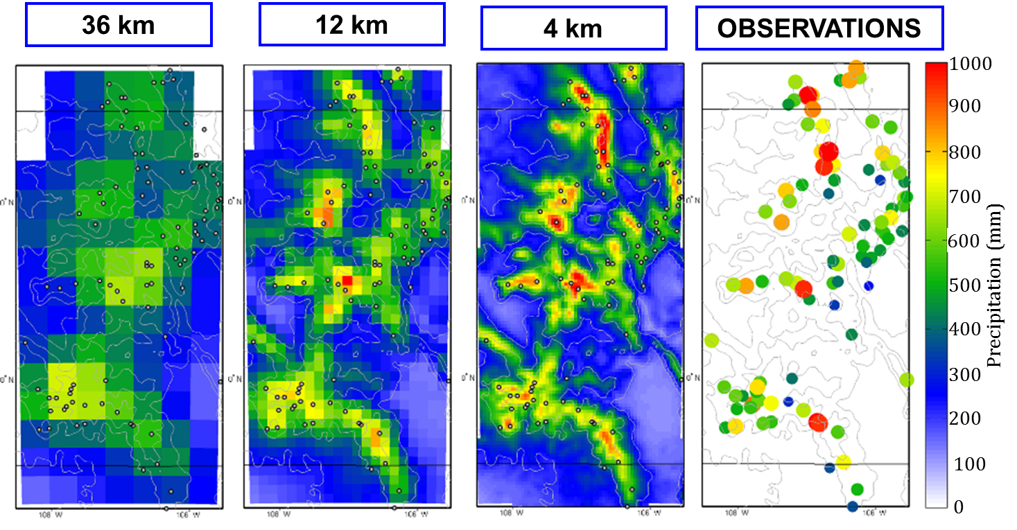
Downscaling
Two main types:
1. Dynamical downscaling: Output from Global Climate Models used to drive regional numerical model in higher spatial resolution. Physical/numerical approach!
2. Statistical downscaling: A statistical relationship is established from observations between large scale variables (e.g. atmospheric surface pressure) and a local variable (a site’s wind speed). This is used on the GCM data to obtain the local variables from the GCM output.
Environmental Statistics: Working with Natural Hazard Data | Aoibheann Brady & Tom Smith | ITT9 | January 2019

Slide 12
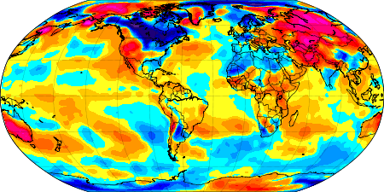
Extreme weather indices
Values derived from daily temperature & precipitation data.
Focus on changes in extremes rather than usual change in means.
Examples: annual count of days when rain exceeds 10mm, days when temperature exceeds long-term 90th percentile.
Environmental Statistics: Working with Natural Hazard Data | Aoibheann Brady & Tom Smith | ITT9 | January 2019

Slide 13
How to calculate extreme weather indices
Two potential options:
Station-level index to gridded index
Calculate the index at a station level (e.g. calculating threshold exceedances by GPD or contour sets).
Grid these indices using techniques such as cubic spline interpolation.
2. Gridded value to gridded index
Simulate from posterior distribution having fitted a spatial model.
Grid these indices as before.
Problem: Stations not evenly distributed, so difficult to accurately compute global averages [see earlier for solution]
Environmental Statistics: Working with Natural Hazard Data | Aoibheann Brady & Tom Smith | ITT9 | January 2019

Slide 14
References and further reading
Coles, S. G. (2001). An Introduction to Statistical Modeling of Extreme Values. Springer Series in Statistics. Springer, London, UK.
J. Rougier et al. (2018). The global magnitude–frequency relationship for large explosive volcanic eruptions. Earth and Planetary Science Letters 482:621–629
V. J. Berrocal, A. E. Gelfand & D. M. Holland (2012). Space-Time Data Fusion under Error in Computer Model Output: An Application to Modeling Air Quality. Biometrics 68, 837-848
S. Banerjee, B. P. Carlin & A. E. Gelfand (2004)Hierarchical Modelling and Analysis for Spatial Data. Chapman & Hall/CRC.
Alexander, L. V., et al. (2006) Global observed changes in daily climate extremes of temperature and precipitation. Journal of Geophysical Research: Atmospheres 111.D5
A tutorial on working with spatial data & downscaling can be seen at: http://www.wmo.int/pages/prog/wcp/agm/meetings/korea2016/documents/Tutorial_Statistical_Downscaling.pdf
Another good source is this paper by Shaddick, Thomas et al (2018) which explains how to fit it within a Bayesian framework. https://pubs.acs.org/doi/10.1021/acs.est.8b02864
Environmental Statistics: Working with Natural Hazard Data | Aoibheann Brady & Tom Smith | ITT9 | January 2019

