Slide 1
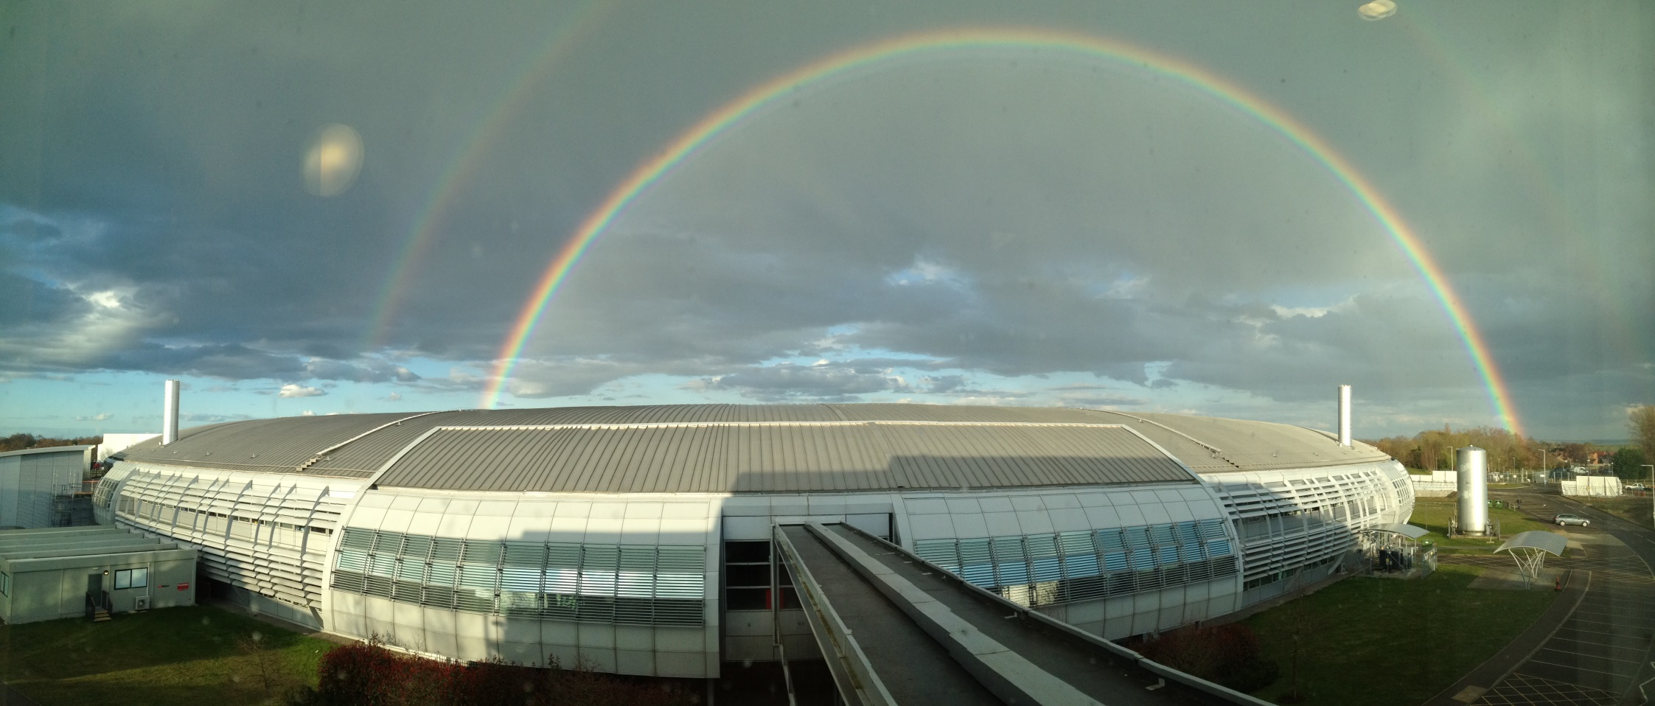
Imaging Challenges at Diamond
Annual Review Launch
Paul Quinn, Daniil Kazantsev, Diamond Light Source
Bath 28th Jan – 1st Feb 2019
Notes:
Talk – 30 mins, including 5 for questions
Aims: (i) Outline strong commitment at Diamond to imaging – 10 beamlines (out of 33 total)
(ii) Part of strong environment for imaging at Harwell – EM, neutrons ,lasers…
(iii) Imaging activities set to expand further – Diamond II, XFEL, University partnerships
Q for CR – ‘what is microscopy’ (in this context ???)

Slide 2
Sampling
Science focus:
Battery and electrochemistry challenge
Imaging Experiments at Diamond:
Overview of a scanning experiment
Overview of a 3D and 4D tomography experiment
Challenge - how can make experiments faster with sampling.

Slide 3
Faraday Challenge
Government's programme to develop cost-effective, high-performance, durable, safe, low-weight and recyclable batteries.
The ambition of the programme is to make the UK the go-to place for the research, development, manufacture and production of novel battery technologies for both the automotive and the wider relevant sectors.
£246 million in funding
£42 million allocated to first 4 projects (2017)
Call for next 4 projects just issued
Ability to characterize battery materials is a key aspect

Slide 4
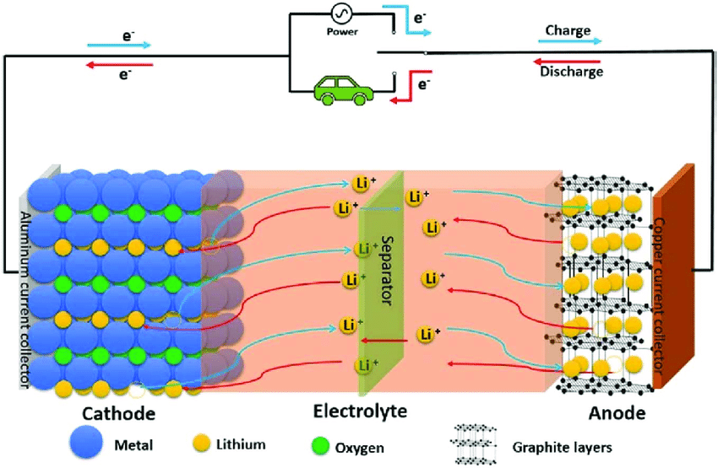
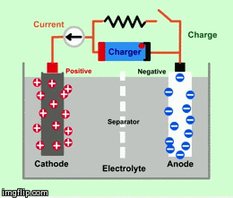
How does a battery work ?

Slide 5
Why does it fail ?
It’s a chemical reaction – lots of reasons..
  The internal structure of the particles
  Defects
  Contaminants
  The charge/discharge cycle time
  We need to be able to follow/measure changes to understand the underlying mechanisms

Slide 6
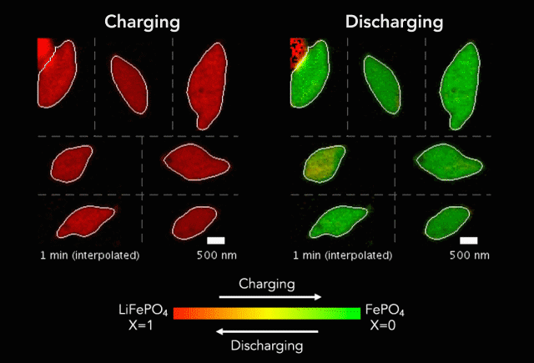
X-ray measurements..
“Origin and hysteresis of lithium compositional spatiodynamics within battery primary particles”, J. Lim,Y. Li, D. H. Alsem, H. So, S. C. Lee, P. Bai, D.A. Cogswell, X. Liu, N. Jin, Y. Yu, N. J. Salmon, D. A. Shapiro, M. Z. Bazant, T.Tyliszczak, W. C. Chueh, Science 05 Aug 2016
Only in the last 2-3 years that people have started to successful image systems in operation

Slide 7
The Challenge
How to perform experiments fast enough to watch evolving systems in operation
Example –
  Experiment in March 19 which takes 20 hours to acquire a single 3D data set from a battery sample
  A 5 day expt will allow you to look at 1 sample and 5 conditions
  A moderate 3-4 fold increase in speed would make a substantial impact

Slide 8
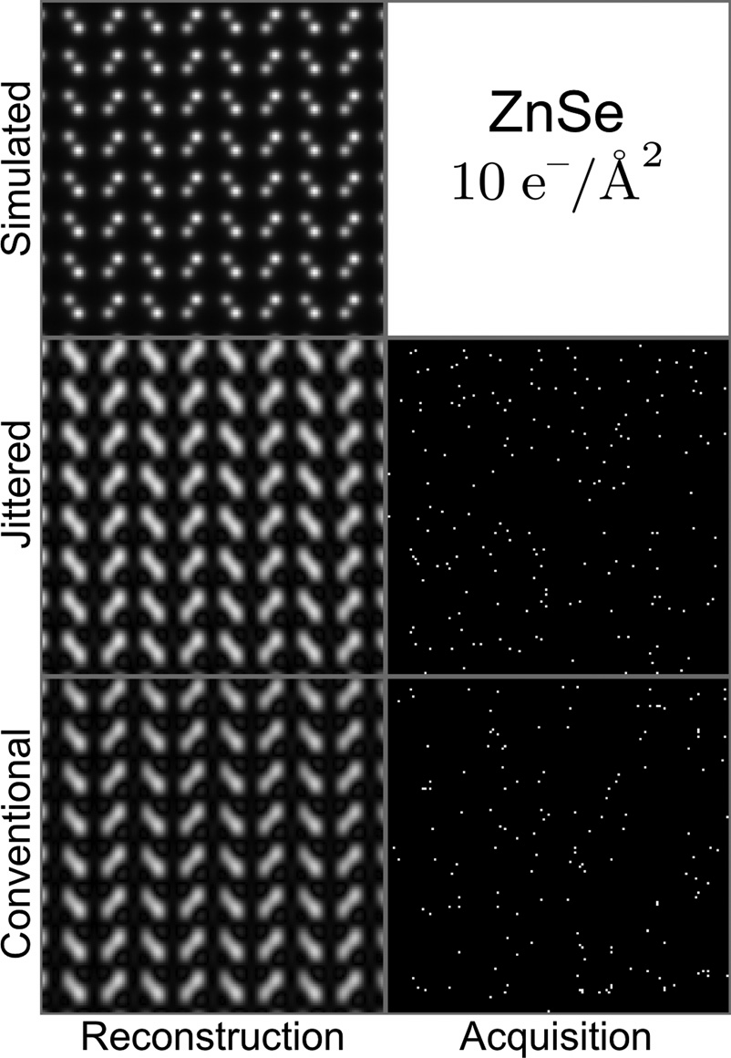
Examples in electron microscopy..
Appl. Phys. Lett. 112, 043104 (2018);

Slide 9
Examples in electron microscopy..
Appl. Phys. Lett. 112, 043104 (2018);

Slide 10
X-ray scanning spectroscopy experiment :
Current experiment….
Raster scan a sample at constant velocity
Collect signal at fixed time intervals
Rotate sample or change energy to get 3D or spectroscopic information
Sample can follow a continuous path – spiral, raster, snake – dictated by motorized motion

Slide 11
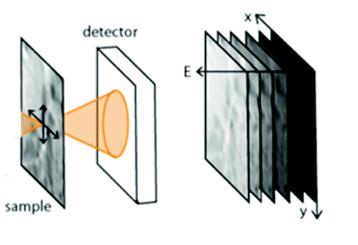
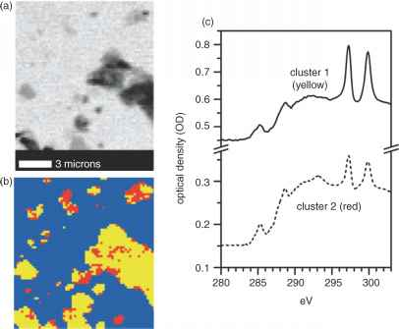
Take maps at a range of energies
Take 2D map
Change energy
Stack and align
PCA/Cluster analysis

Slide 12
Data Live Example
Sampling data set 1

Slide 13
Sampling
Can we produce an optimized sampling scheme to reduce the experiment time?
  With the data provided – could we have measured faster ?
  Optimal Trajectory from scan to scan to optimize collection?
  How to apply compressed sampling to hyper-spectral data ?
  Optimal scan sequence ? (currently sequential energies…)
The spectroscopy data provided is for one condition –
  If I measure one full data set can I reduce the time for the subsequent sets – e.g. when charging and discharging the battery ?
  If something drastic happens during battery cycling would the scheme capture this ?

