Slide 1
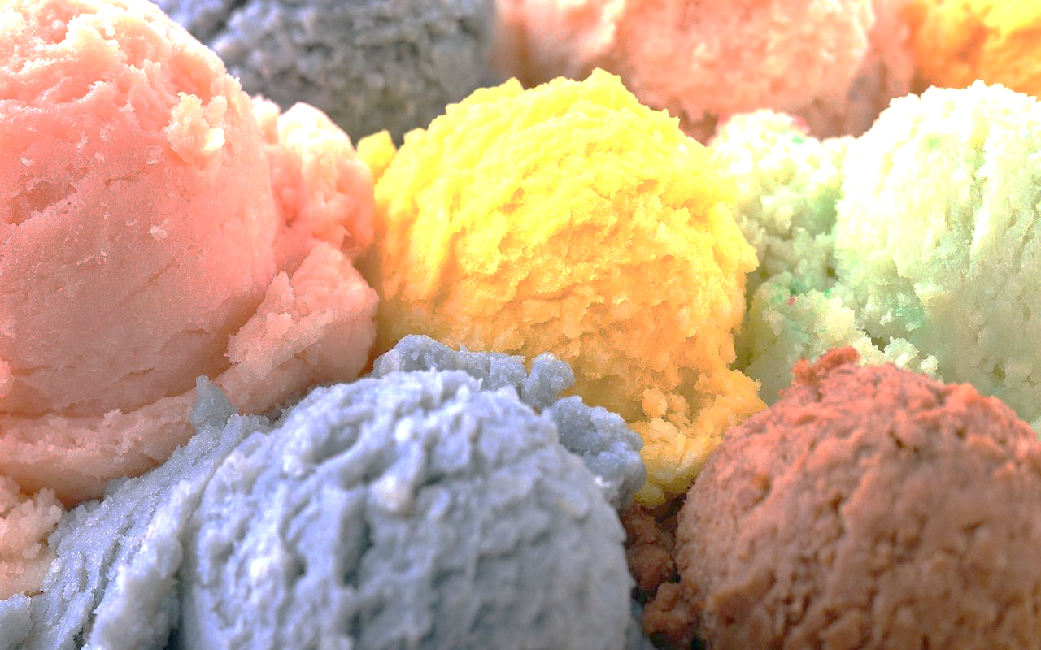
Microstructural ice-cream melting/freezing processes
Antonio Capella, Anton Souslov, Josh Shelton, Laura Oporto
ITT9
University of Bath

Slide 2
Mathematical Challenge: Model-informed data analysis
Data
Model
Large volume data analysis (fast)
Slow analysis
Model-informed analysis
Image processing can be computationally intensive, but modelling insight can be used to inform a fast algorithm.

Slide 3

Large Amount of Data
Each 2D slice 50MB
Each 3D picture 20GB
Each simulation (multiple time-steps) 1000GB
H-Drive 2.5GB

Slide 4
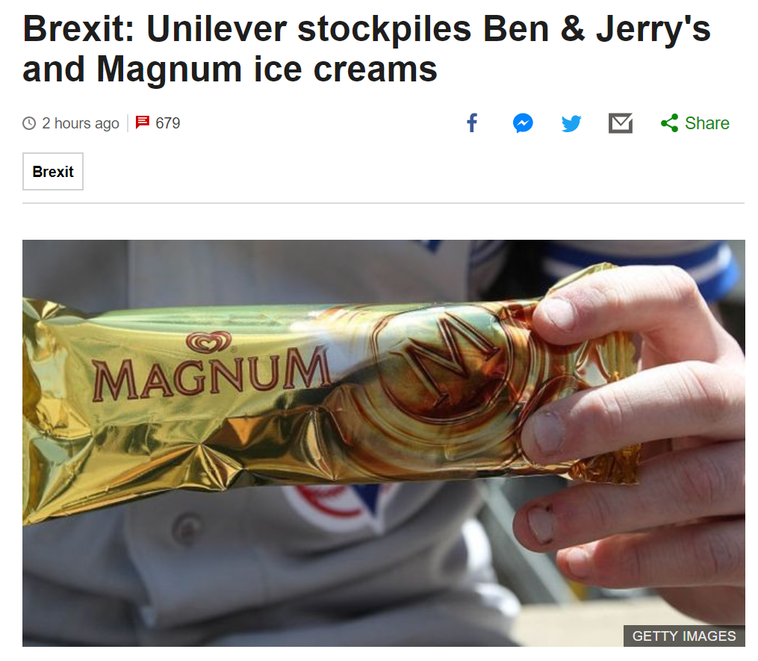

Slide 5
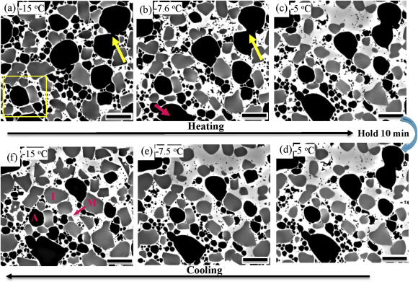
Temperature cycles during transportation/storage of ice cream changes the ice crystals geometry
Guo, E., Kazantsev, D., Mo, J., Bent, J., Van Dalen, G., Schuetz, P., & Lee, P. D. (2018). Revealing the microstructural stability of a three-phase soft solid (ice cream) by 4D synchrotron X-ray tomography. Journal of Food Engineering.

Slide 6
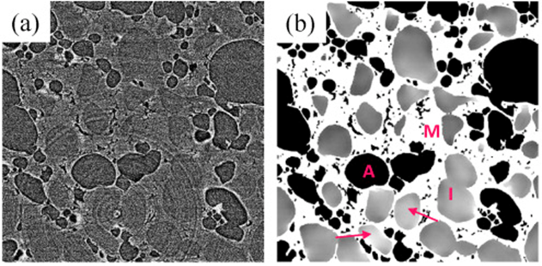
Segmentation + classification problem (Ice, Air, Matrix).
Guo, E., Kazantsev, D., Mo, J., Bent, J., Van Dalen, G., Schuetz, P., & Lee, P. D. (2018). Revealing the microstructural stability of a three-phase soft solid (ice cream) by 4D synchrotron X-ray tomography. Journal of Food Engineering.

Slide 7
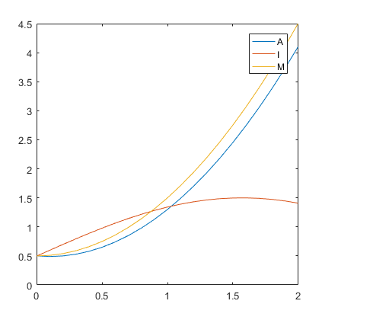
The Challenge
Classify image feature into Air, Ice, or Matrix based on structure and dynamics.
Two steps: Segmentation (easy), Classification (hard)
(image just for illustration)

Slide 8
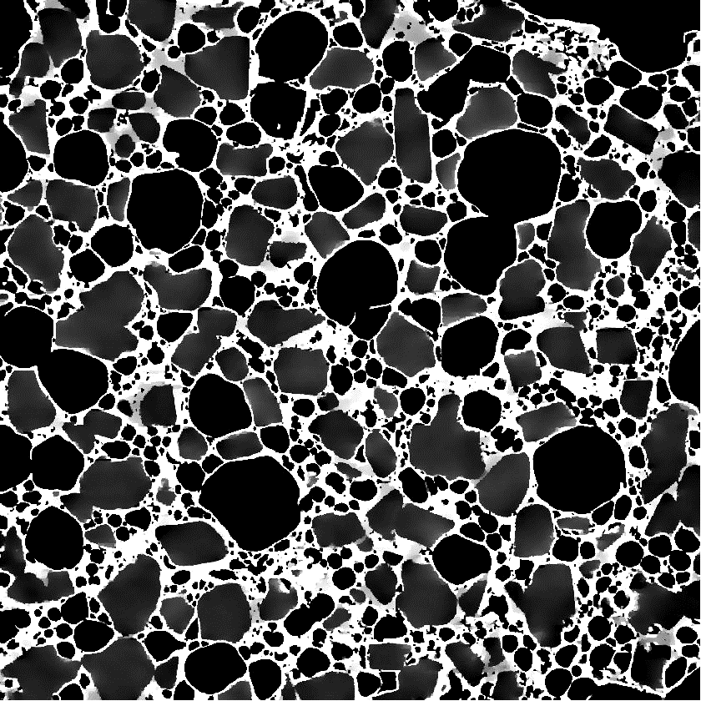
During ITT - Improving image analysis
Hypothesis: curvature can be used to classify phases.
Computationally cheap
Can keep track of evolution over time
R

Slide 9
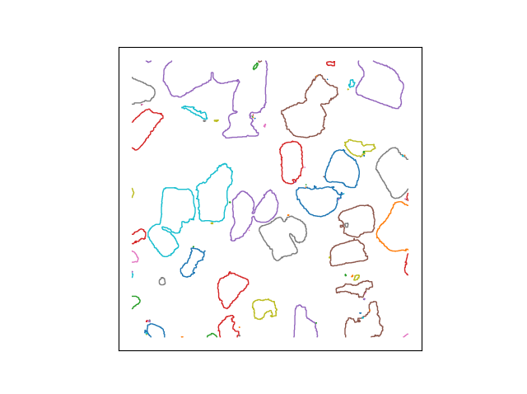
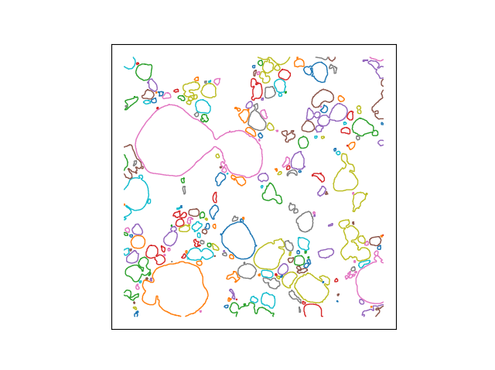
During ITT - Improving image analysis
Left. Segmented image. Middle. Ice contours. Right. Air bubbles contours

Slide 10
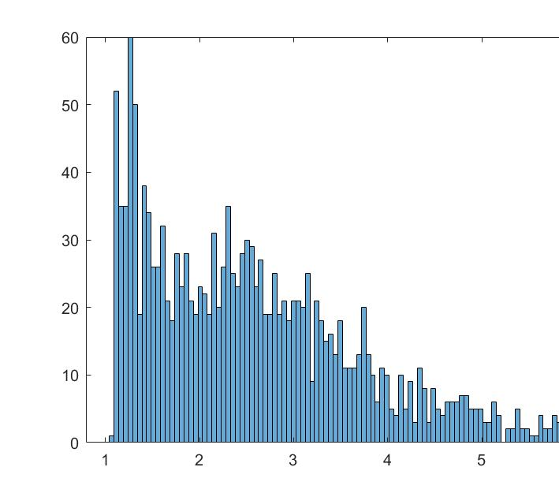
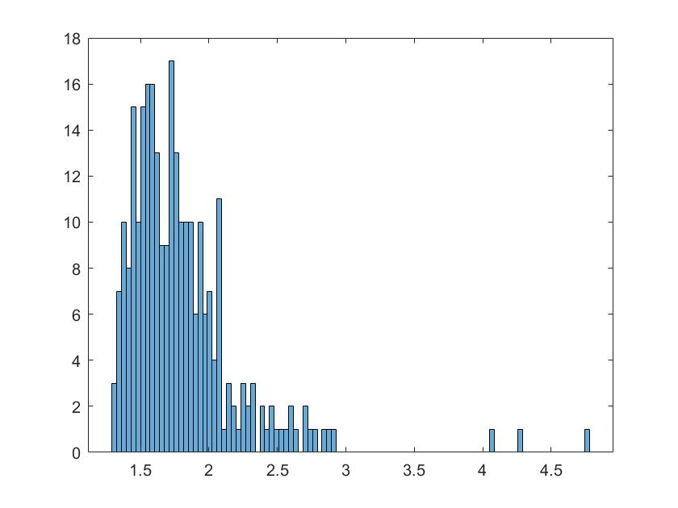
Sphericity
Bubbles
Crystals

Slide 11
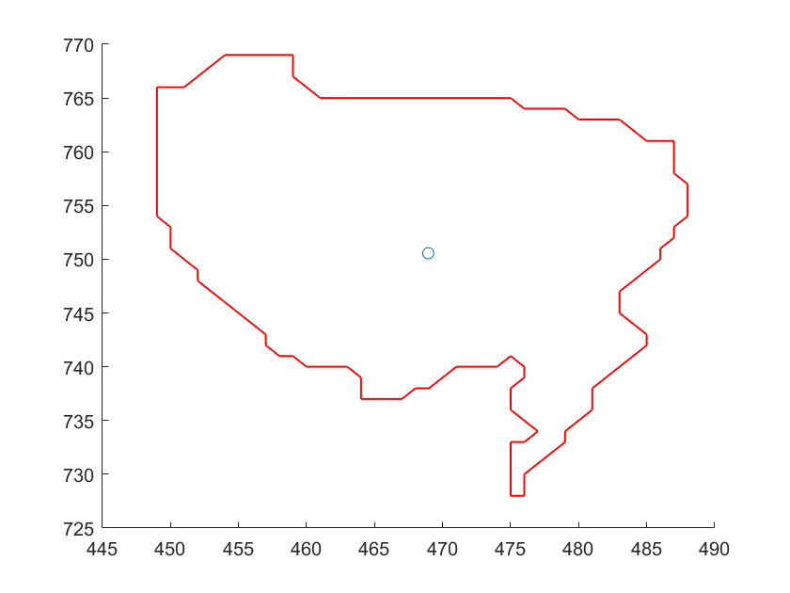
Particle tracking - central position
Track particles, use dynamics to inform classification
At each time step, find centre.
Next time step, assign particle with closest centre.

Slide 12
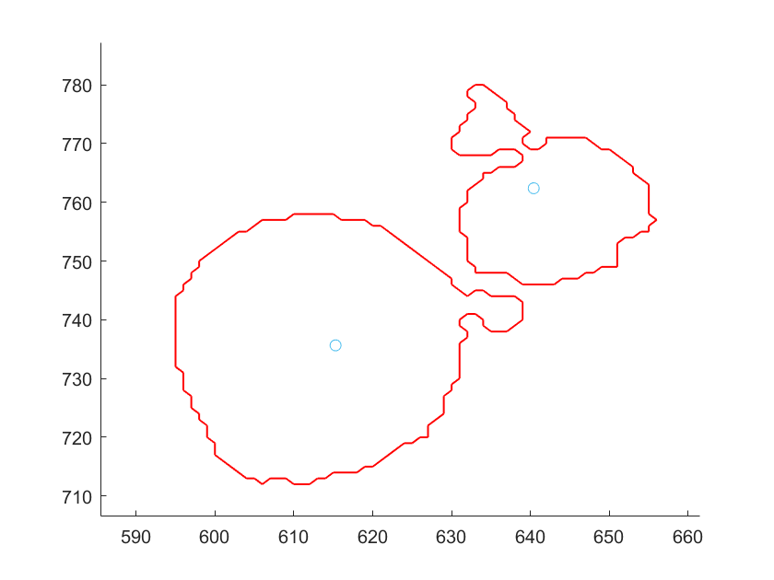
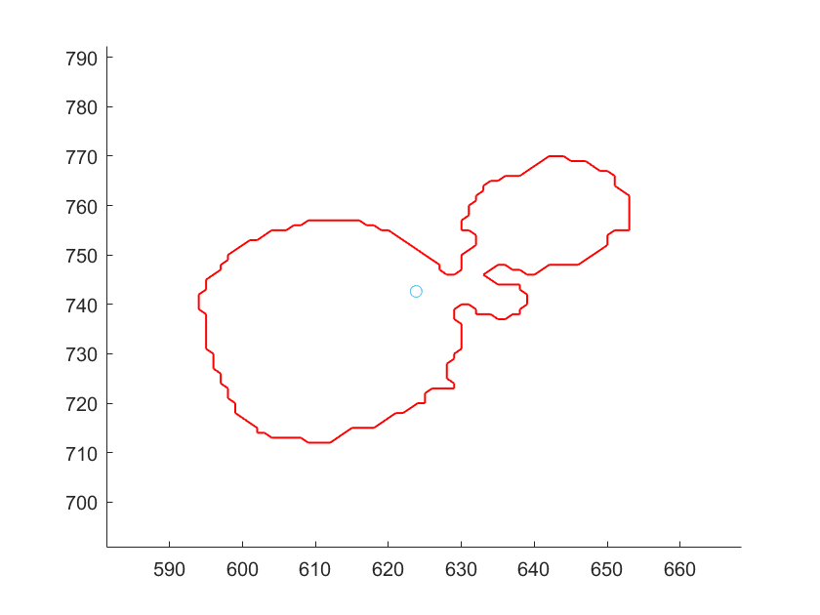
Particle tracking - central position
Challenges (beyond ITT):
Particles move in and out of 2D plane
Merging of ice crystals – topological transition

Slide 13
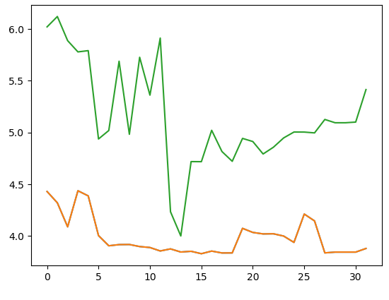
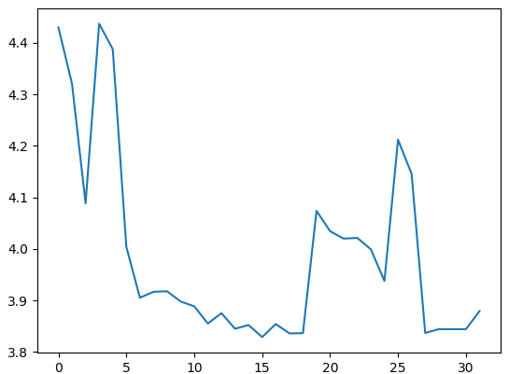
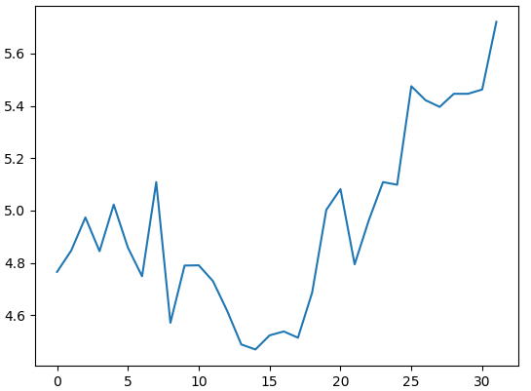
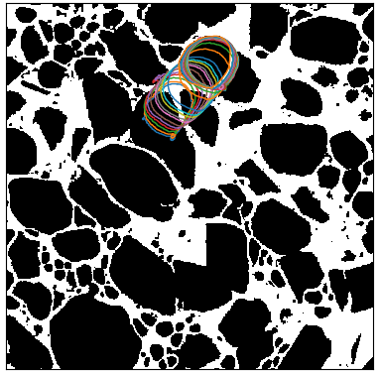
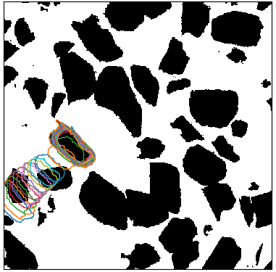
Particle tracking – checking sphericity
Left. Crystal+Air.
Middle. Air bubble.
Right. Crystal

Slide 14
Particle tracking – checking sphericity
Issues:
Difficult to locate one specific air bubble/crystal
Some air bubble/crystals appear/disappear in different time steps

Slide 15
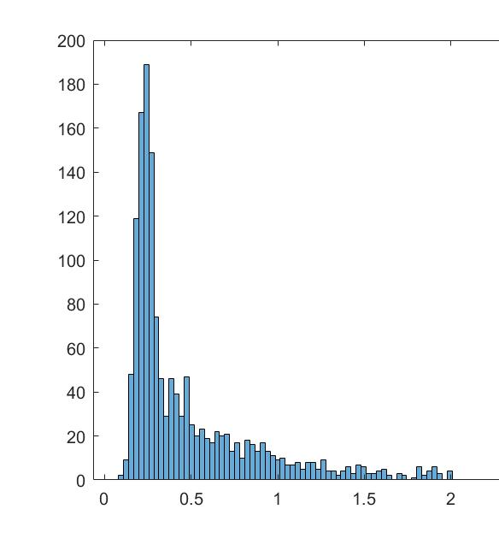
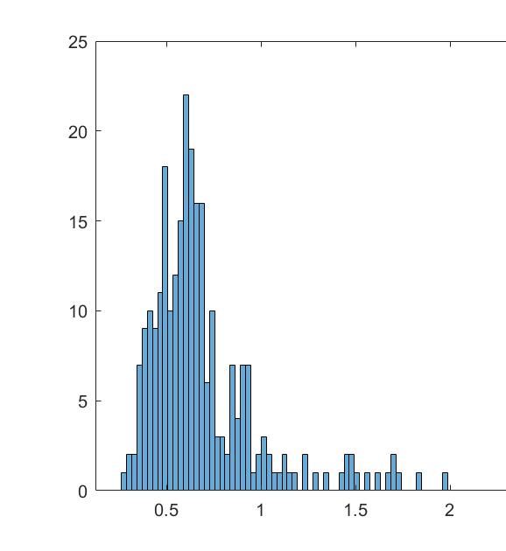
Normalised standard deviation of curvature
Count
Count
Bubbles
Crystals
Standard deviation
Standard deviation
How to distinguish: Bubbles are more circular, crystals are more angular

Slide 16
Summary
Geometry and dynamics of particles can be used for classification.
Use mathematical modelling to inform data analysis
Outlook: create a robust algorithm to classify based on raw data.
Data
Model
Large volume data analysis (fast)
Slow analysis
Model-informed analysis

Slide 17
Thank you

