Slide 1


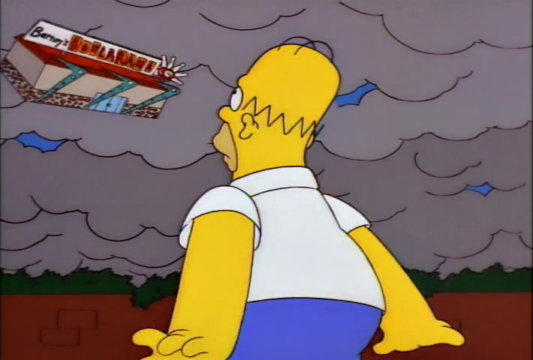
Hypothetical Windstorms
Willis Towers Watson ITT9 Problem
Beate Ehrhardt, Allen Hart, Nadeen Khaleel, and Tom Smith

Slide 2
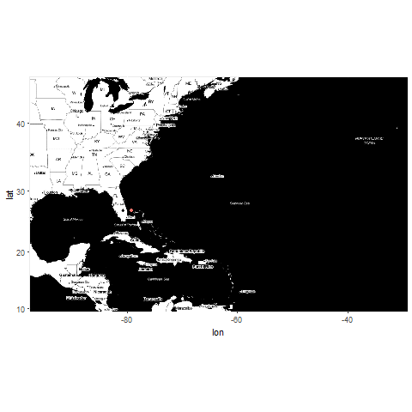
Our Challenge
Assign probability to the event that a hurricane passing through a particular area.
Hypothetical Windstorms | B. Ehrhardt, A. Hart, N. Khaleel, T. Smith | ITT9 | February 2019

Slide 3
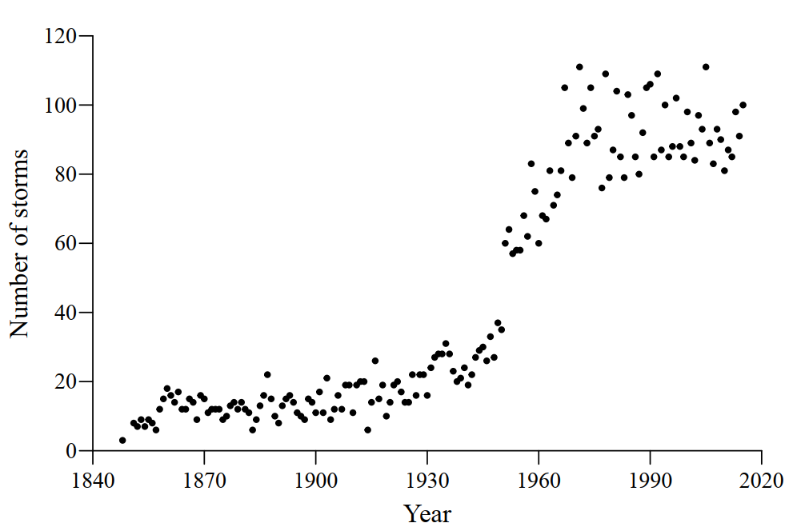
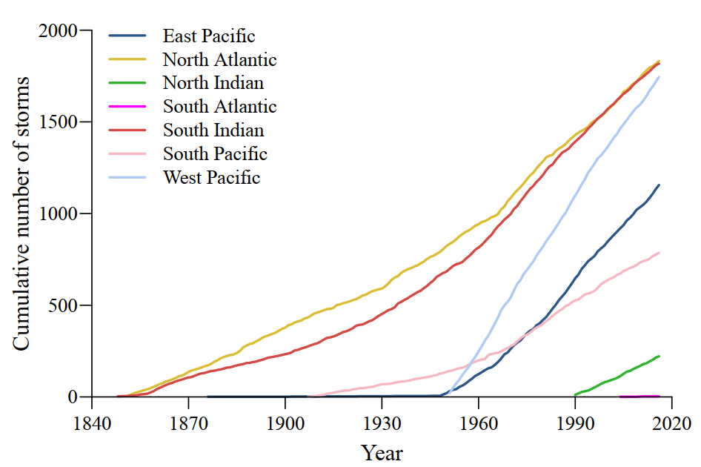
The Data
Storm observations from the International Best Track Archive for Climate Stewardship database IBTrACS
7,357 from across the world between 1848 and 2017
Hypothetical Windstorms | B. Ehrhardt, A. Hart, N. Khaleel, T. Smith | ITT9 | February 2019

Slide 4
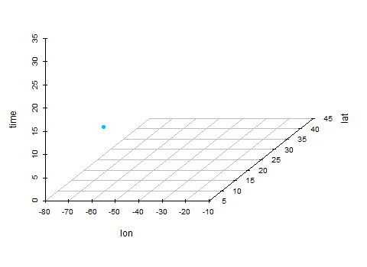
A Gaussian Process on Space-time
Hypothetical Windstorms | B. Ehrhardt, A. Hart, N. Khaleel, T. Smith | ITT9 | February 2019

Slide 5
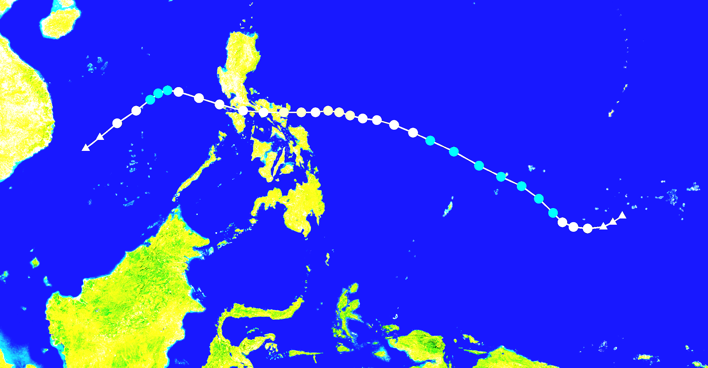
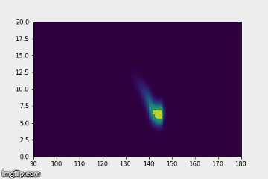
A Gaussian Field over Typhoon Nina (2016)
Hypothetical Windstorms | B. Ehrhardt, A. Hart, N. Khaleel, T. Smith | ITT9 | February 2019

Slide 6
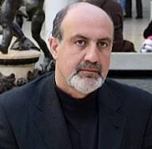
Future Work
But isn’t the Gaussian a great intellectual fraud?
Hypothetical Windstorms | B. Ehrhardt, A. Hart, N. Khaleel, T. Smith | ITT9 | February 2019

Slide 7
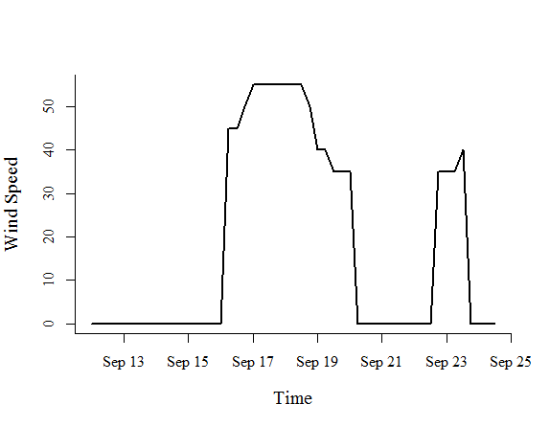
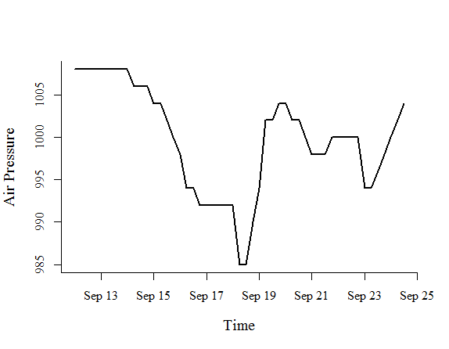
Data Imputation
Hypothetical Windstorms | B. Ehrhardt, A. Hart, N. Khaleel, T. Smith | ITT9 | February 2019

Slide 8
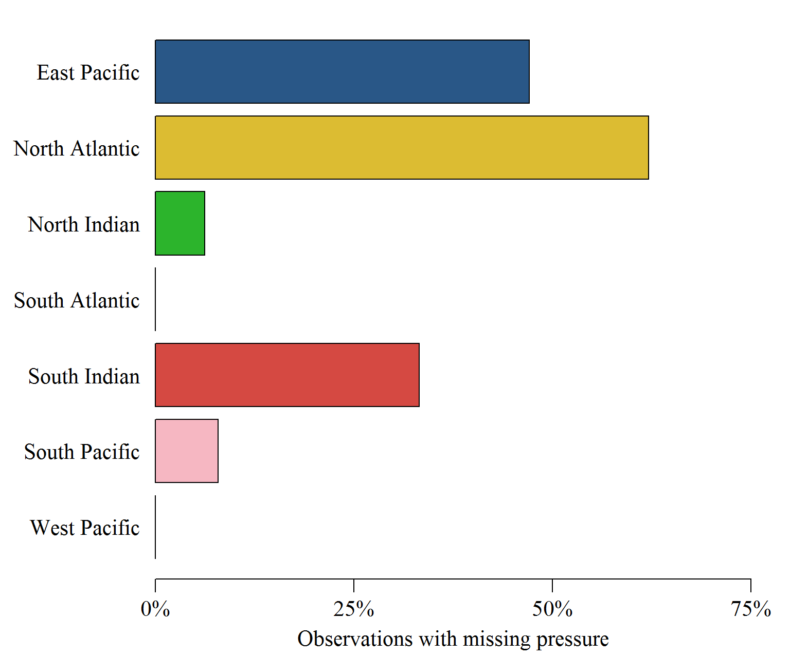
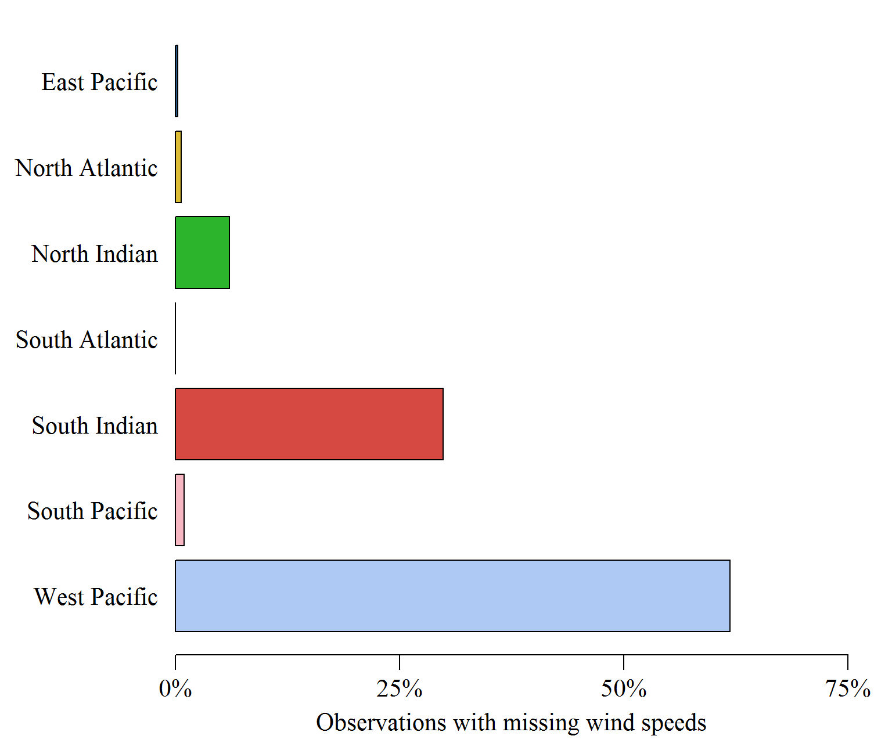
Data Imputation
Hypothetical Windstorms | B. Ehrhardt, A. Hart, N. Khaleel, T. Smith | ITT9 | February 2019

Slide 9
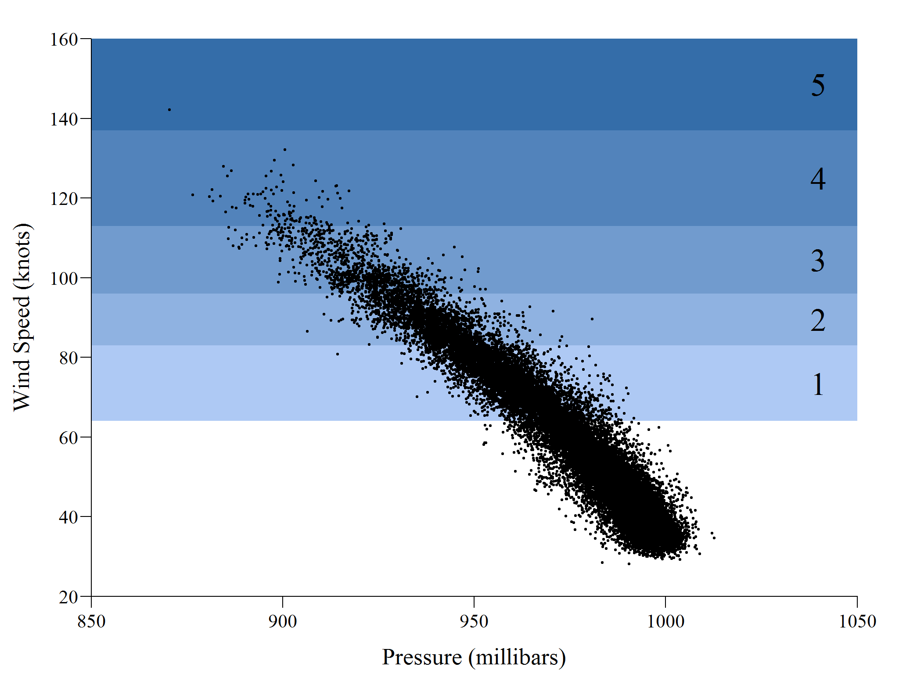

Data Imputation
Hypothetical Windstorms | B. Ehrhardt, A. Hart, N. Khaleel, T. Smith | ITT9 | February 2019

Slide 10
Here’s some eye candy – any questions?
Hypothetical Windstorms | B. Ehrhardt, A. Hart, N. Khaleel, T. Smith | ITT9 | February 2019

