Slide 1

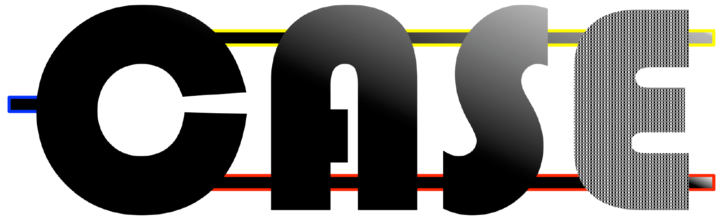
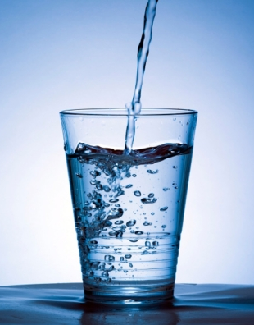

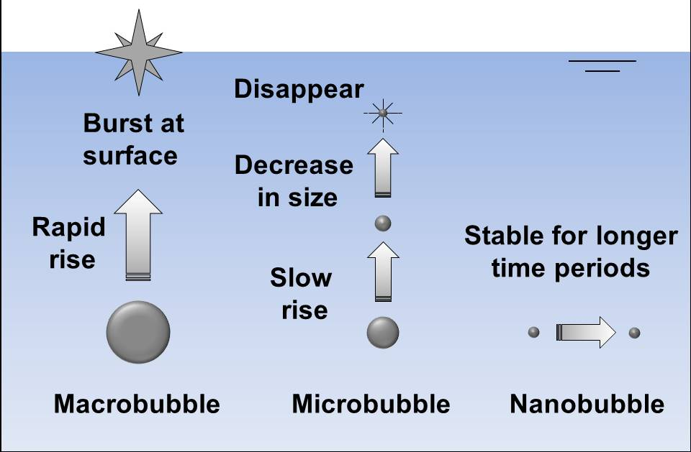

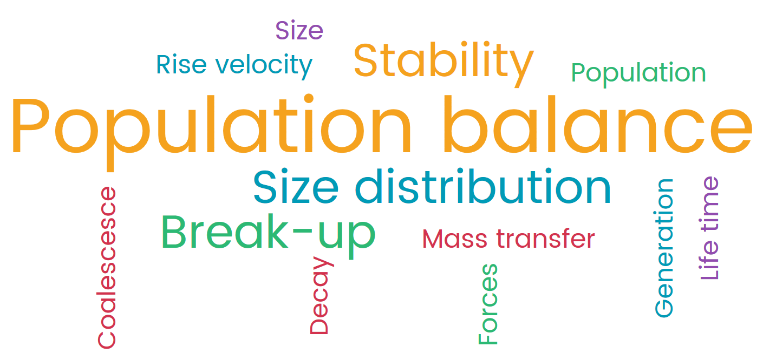
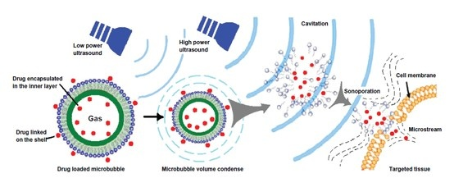
SAMBA ITT6
John Chew & Jannis Wenk
Department of Chemical Engineering
Monday, 5 June, 2017
Growth and Break-up of Microbubbles
Gas-Liquid
Size of Bubbles

Slide 2
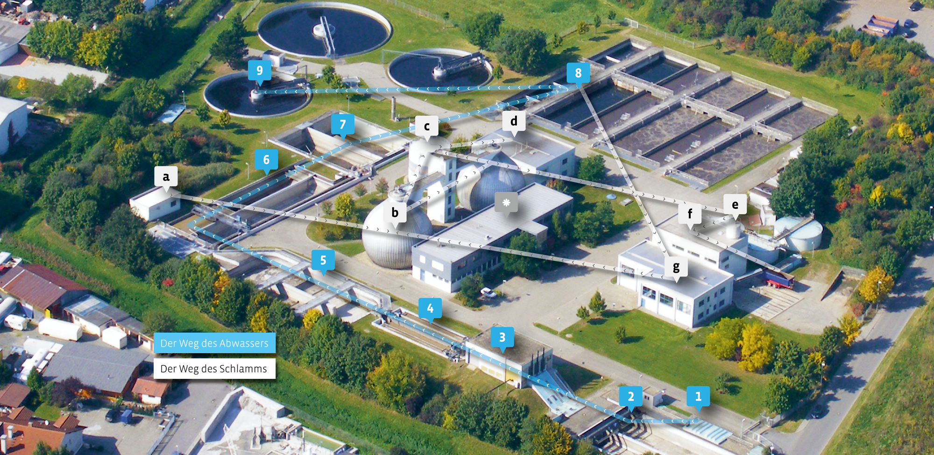
Applications
Modern wastewater treatment plant of a medium sized city (Example Bensheim / Germany population 100.000)
Jannis to modify this slide

Slide 3
Cost breakdown for wastewater treatment

Slide 4
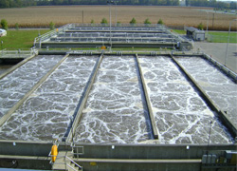
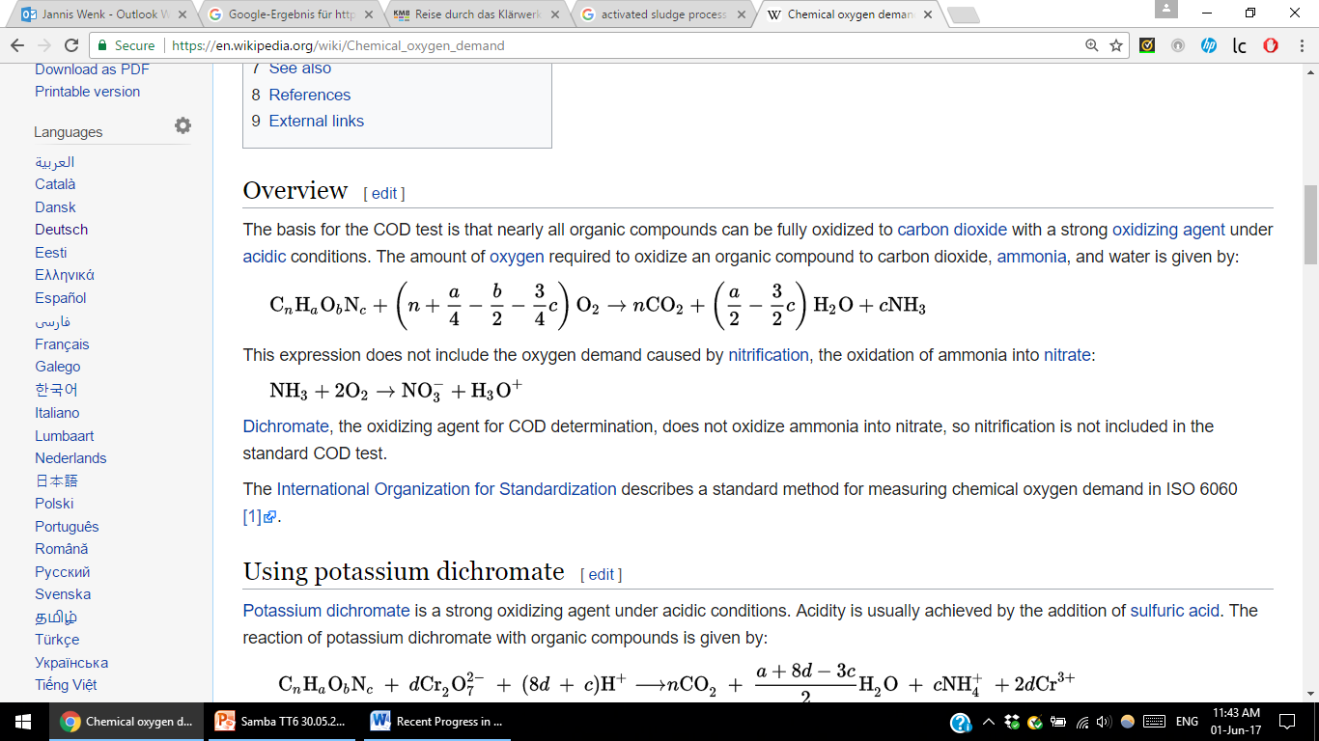
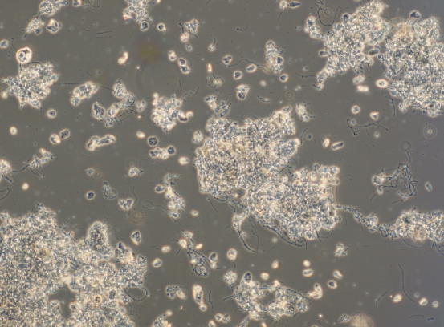
Why aeration is needed for wastewater treatment?
Wastewater contains carbohydrates, lignin, fats,
soaps, synthetic detergents, proteins and their
decomposition products.
In the activated sludge process and other
biological treatment processes beneficial
microorganisms degrade this organic matter.
Wastewater aeration
Stoichiometric equations for oxygen demand of wastewater
‘Natural’ aeration is not efficient enough.
Activated sludge microbial community

Slide 5
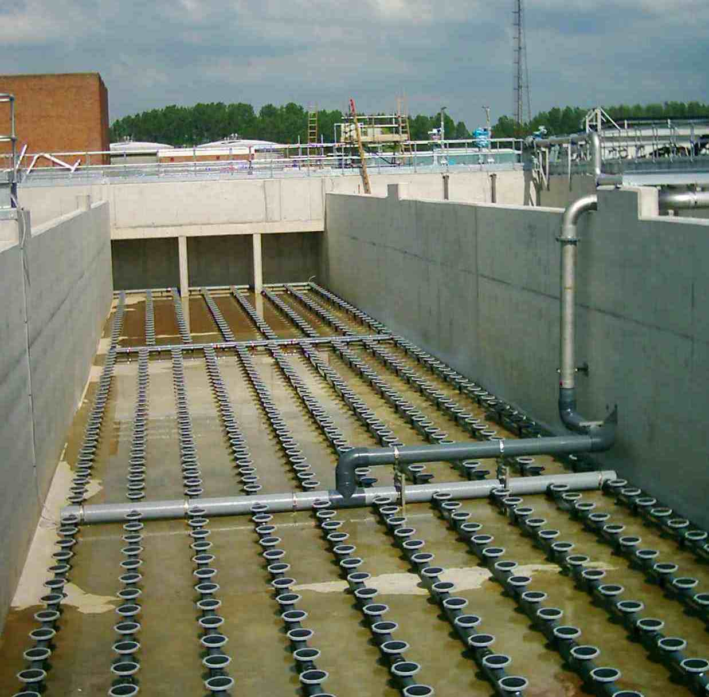
Traditional aeration equipment and fine bubble behaviour

Slide 6
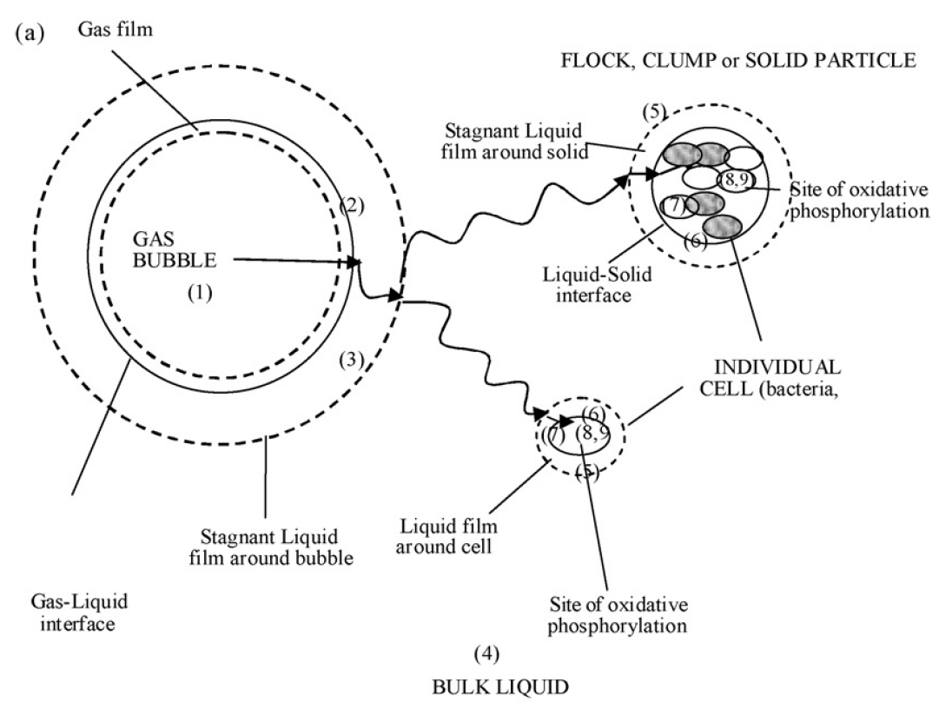
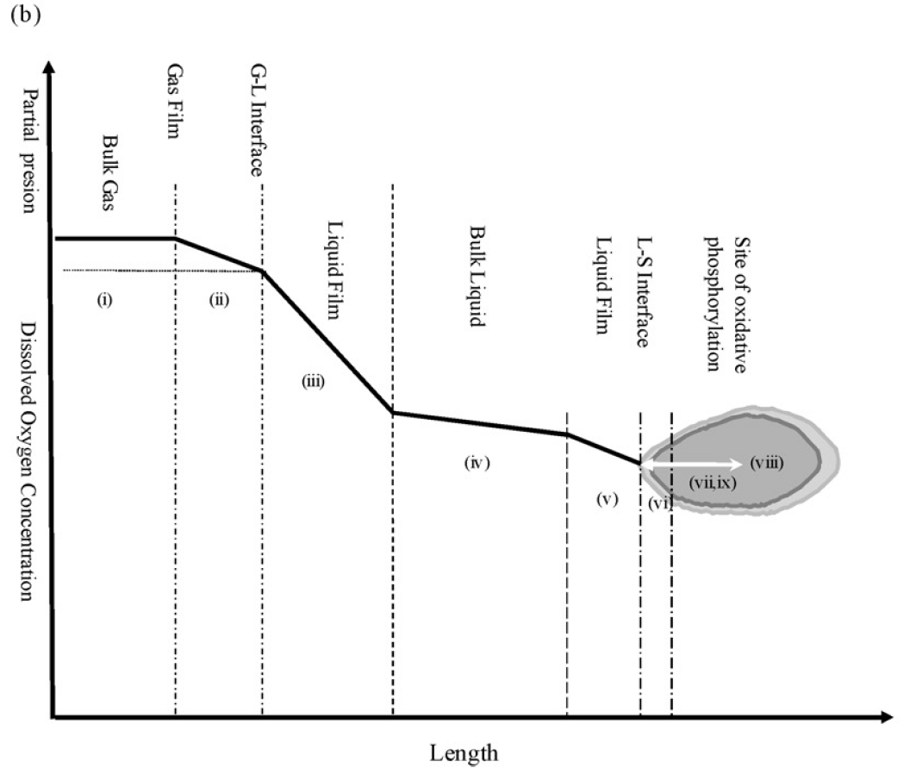
Transport Mechanisms
Garcia-Ochoa et al. (2010) Biochemical Engineering Journal 49 pp. 289–307

Slide 7
Hypothesis
Small scale bubbles will significantly improve the mass transfer of oxygen from gas to liquid phase
The technology can be retrofitted to existing wastewater treatment plants
The potential energy savings from using small scale bubbles in large scale waste water treatment is significant
Smoother process control can be achieved due to improved mixing conditions

Slide 8
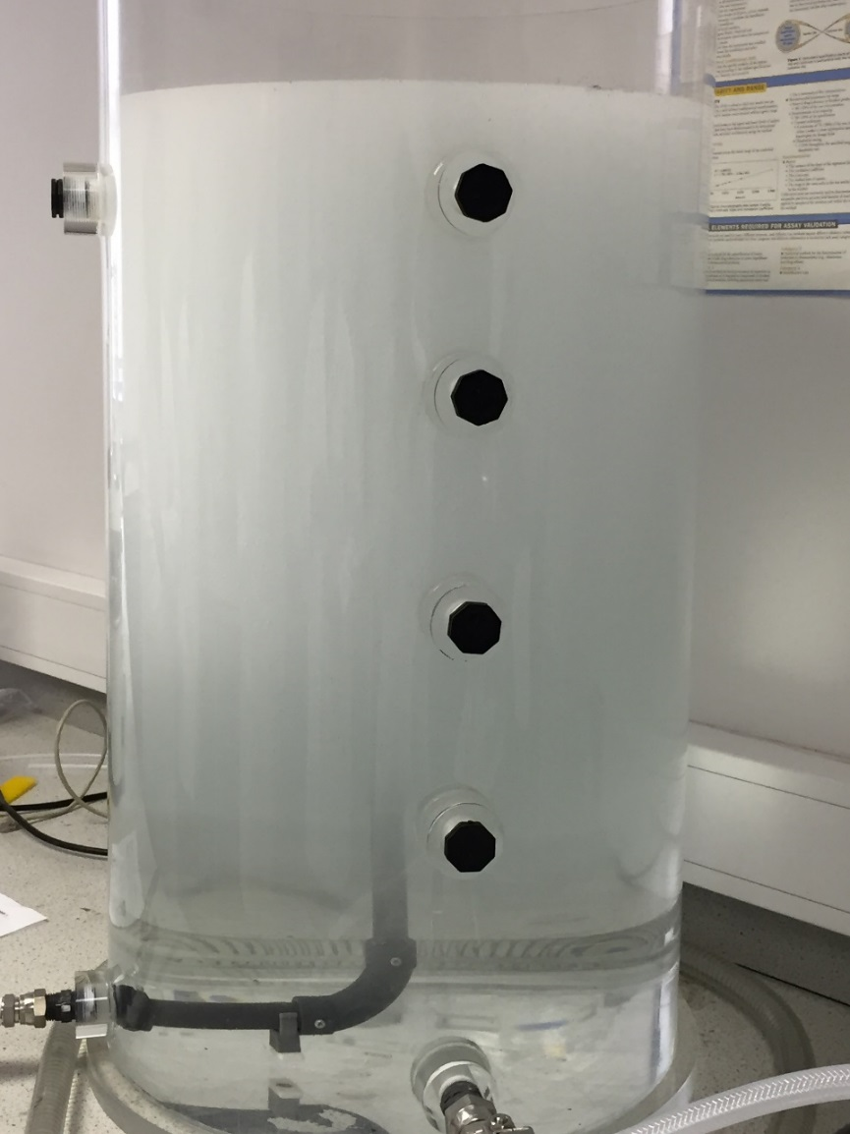
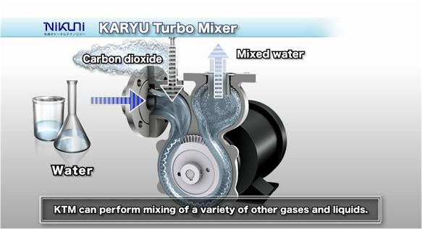
Microbubble Generation
Notes:
Use R-P equation to describe the growth and break-up of microbubbles
Population balance to model bubble size distribution
Main resistance to mass transfer

Slide 9
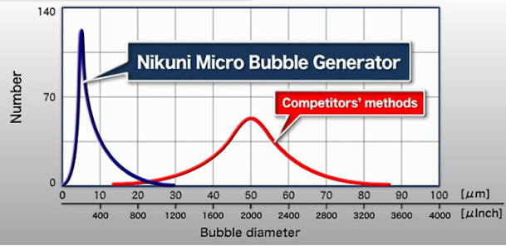
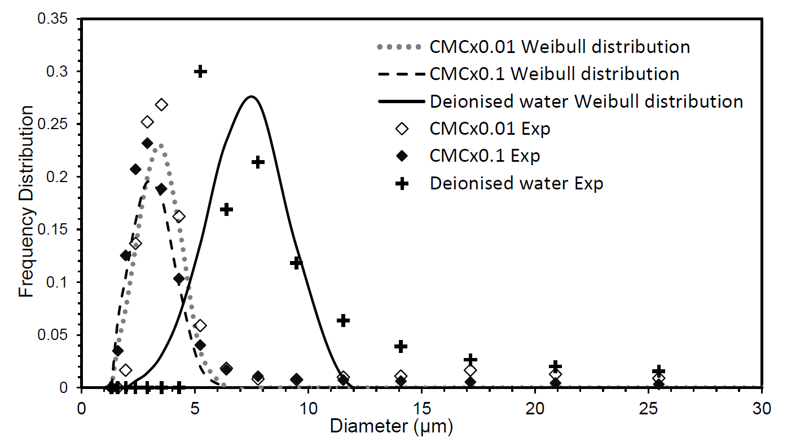
MB Particle Size Distribution
Notes:
Use R-P equation to describe the growth and break-up of microbubbles
Population balance to model bubble size distribution
Main resistance to mass transfer

Slide 10
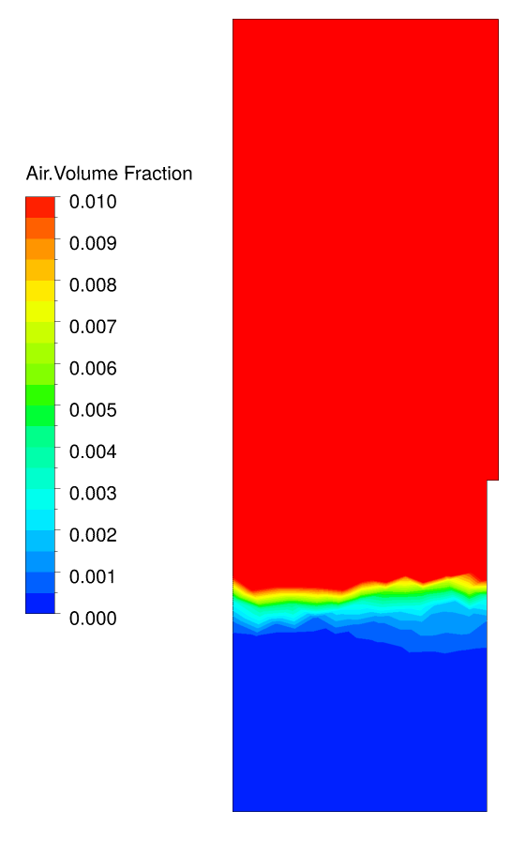
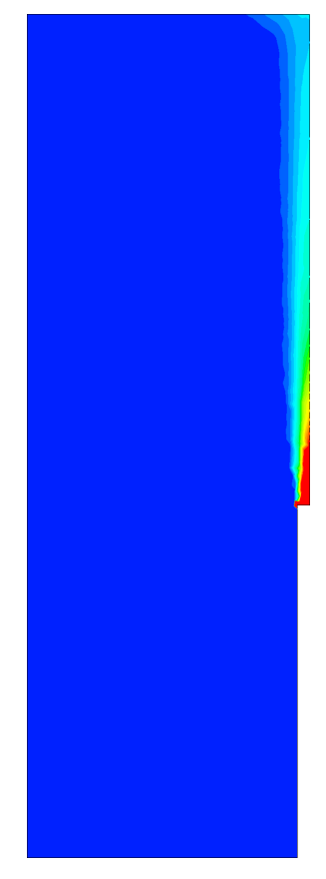
Computational Modelling
Constant 5 μm diameter
MUSIG
11 groups
1-100 μm
Notes:
Use R-P equation to describe the growth and break-up of microbubbles
Population balance to model bubble size distribution
Main resistance to mass transfer

Slide 11
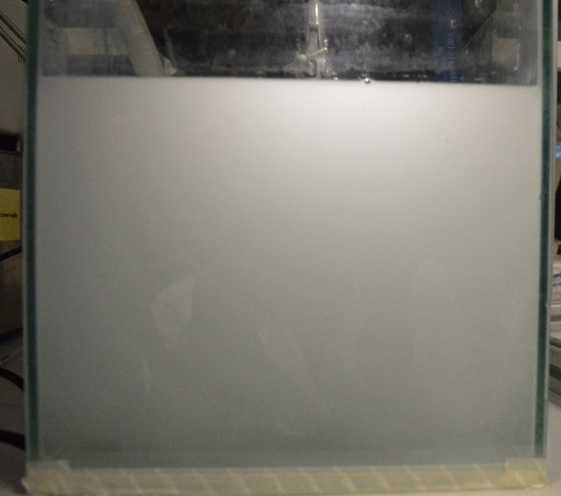
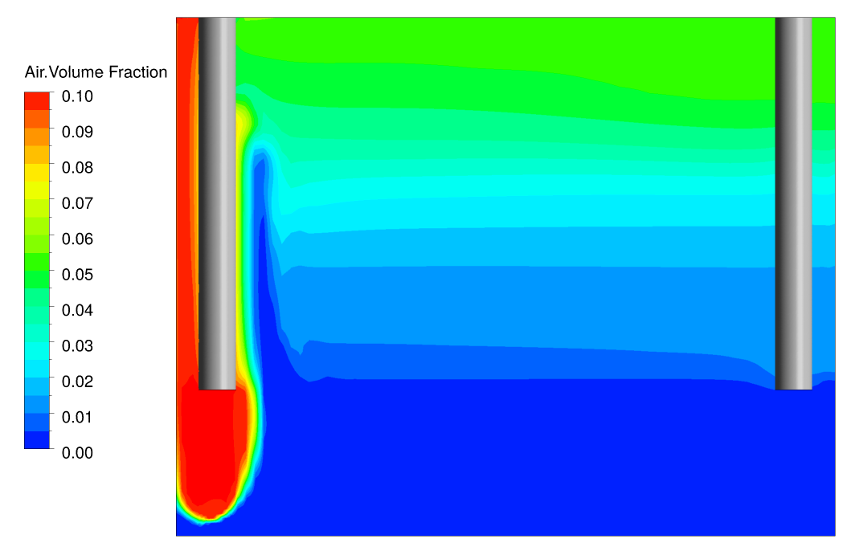
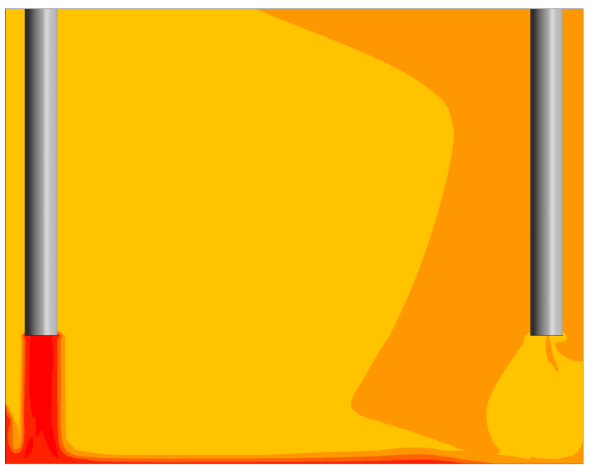
Computational vs. Experimental
Experimental
MBs
Experimental rig
Buoyant
Non-buoyant
Inlet
Outlet
Inlet
Outlet
Notes:
Use R-P equation to describe the growth and break-up of microbubbles
Population balance to model bubble size distribution
Main resistance to mass transfer

Slide 12

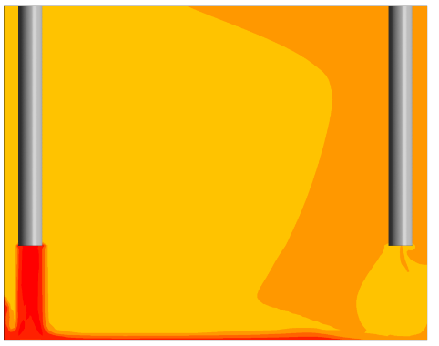
Limitations
Key Questions to Answer
Inaccuracy of drag model – affects the rise velocity and bubble coalescence
Buoyancy effect is less significant for MBs

Slide 13
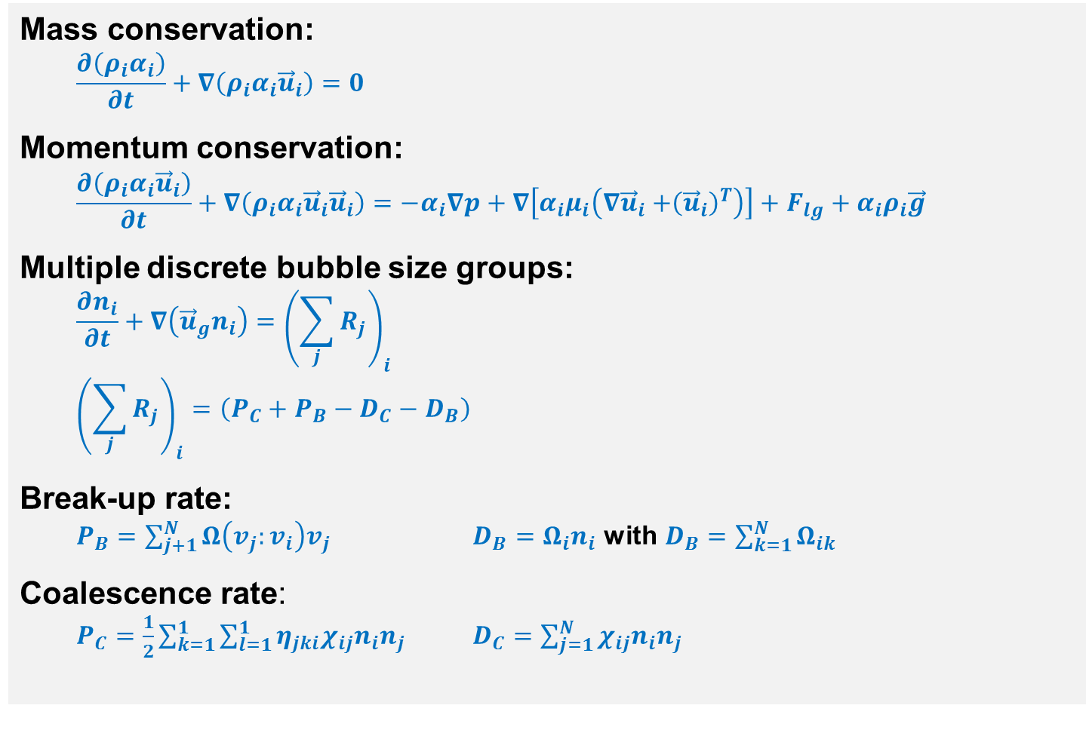
Population Balance Method
Mass conservation:
  $$\frac{∂\left(ρ_{i}α_{i}\right)}{∂t}+∇\left(ρ_{i}α_{i}{\vec{u}}_{i}\right)=0$$
Momentum conservation:
  $$\frac{∂\left(ρ_{i}α_{i}{\vec{u}}_{i}\right)}{∂t}+∇\left(ρ_{i}α_{i}{\vec{u}}_{i}{\vec{u}}_{i}\right)=−α_{i}∇p+∇\left[α_{i}μ_{i}\left(∇{\vec{u}}_{i}{+\left({\vec{u}}_{i}\right)}^{T}\right)\right]+F_{lg}+α_{i}ρ_{i}\vec{g}$$
Multiple discrete bubble size groups:
  $$\frac{∂n_{i}}{∂t}+∇\left({\vec{u}}_{g}n_{i}\right)={\left(\sum_{j}{R_{j}}\right)}_{i}$$
  $${\left(\sum_{j}{R_{j}}\right)}_{i}=\left(P_{C}+P_{B}−D_{C}−D_{B}\right)$$
Break-up rate:
  $P_{B}=\sum_{j+1}^{N}{Ω\left(v_{j}:v_{i}\right)v_{j}}$ $D_{B}=Ω_{i}n_{i}$ with $D_{B}=\sum_{k=1}^{N}{Ω_{ik}}$
Coalescence rate:
  $P_{C}=\frac{1}{2}\sum_{k=1}^{1}{\sum_{l=1}^{1}{η_{jki}χ_{ij}n_{i}n_{j}}}$ $D_{C}=\sum_{j=1}^{N}{χ_{ij}n_{i}n_{j}}$
Garcia-Ochoa et al. (2009) Ocean Engineering 36 pp. 863–872
Notes:
Production rates dues to and death rate

