Slide 1

A Quick Intro to Clinical Trials and Pharmaceutical Statistics Workshop
Robbie Peck University of Bath
SLS
16th Feb 2016 10th Nov 2016

Slide 2


Slide 3
1.1 six Definitions
Clinical Trial “A planned experiment on human beings designed to evaluate the effectiveness of one, or more, forms of treatment”
Experiment (or assay) “A series of observations made under controlled conditions”
Treatment “A drug or other form of medical process (e.g. surgery, radiotherapy, diet, counselling)

Slide 4
1.1 six Definitions
Effect “Difference between what happened as a result of the treatment and what would have happened without the treatment”
Efficacy “True biological effect of a treatment”
Effectiveness “Effect of a treatment when used in general practice”

Slide 5
1.2 SOME objectives of a clinical trial
Therapeutic: treatment is believed to benefit the subjects in some way. e.g. pain relief, prolong life
Prevention treatment is believed to help prevent a future illness. e.g. statins
Screening Trials treatment/procedure is believed to help diagnose an illness. e.g. cancer screening

Slide 6
1.3 PhaseS i-IV
It can take a long time to develop a drug (6-15yrs). Phases I-IV are all in human only.
Phase I Small trials to investigate: Pharmacokinetics (effect the body has on the drug), Pharmacodynamics (effect the drug has on the body), and safety.
Phase II Small trials to find the optimal dose, early indications of efficacy, and side effects.
Phase III Large Randomised Controlled Trial to evaluate efficacy of the drug. ?LICENSE?
Phase IV Post-marketing surveillance to evaluate effectiveness of the drug.

Slide 7
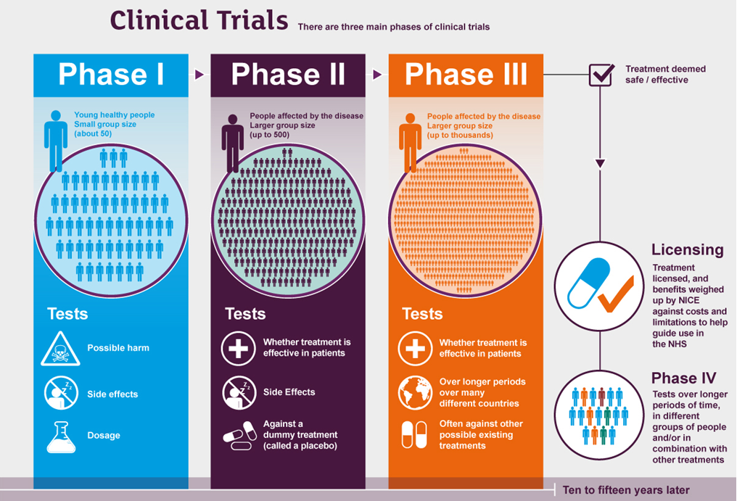

Slide 8
1.4 REDUCING bias
Reliable inference relies on good design and trial conduct.
Control Group (who take a placebo) to compare treatment effect to. - Patient/Researchers expectations about effect might affect their judgement. - Conditions may depend upon time.
Randomisation of patients to control and treatment groups. - Reduces selection bias.
Treatment Blinding double-blinding: neither patient nor physician knows the treatment allocation.
Gold Standard: Randomised double-blind controlled trial (RCT)

Slide 9
1.5 Randomised controlled trial (RCT)
Treatment Group (drug)
Randomise
Eligible
Informed Consent
Control Group (placebo)
Exclude

Slide 10
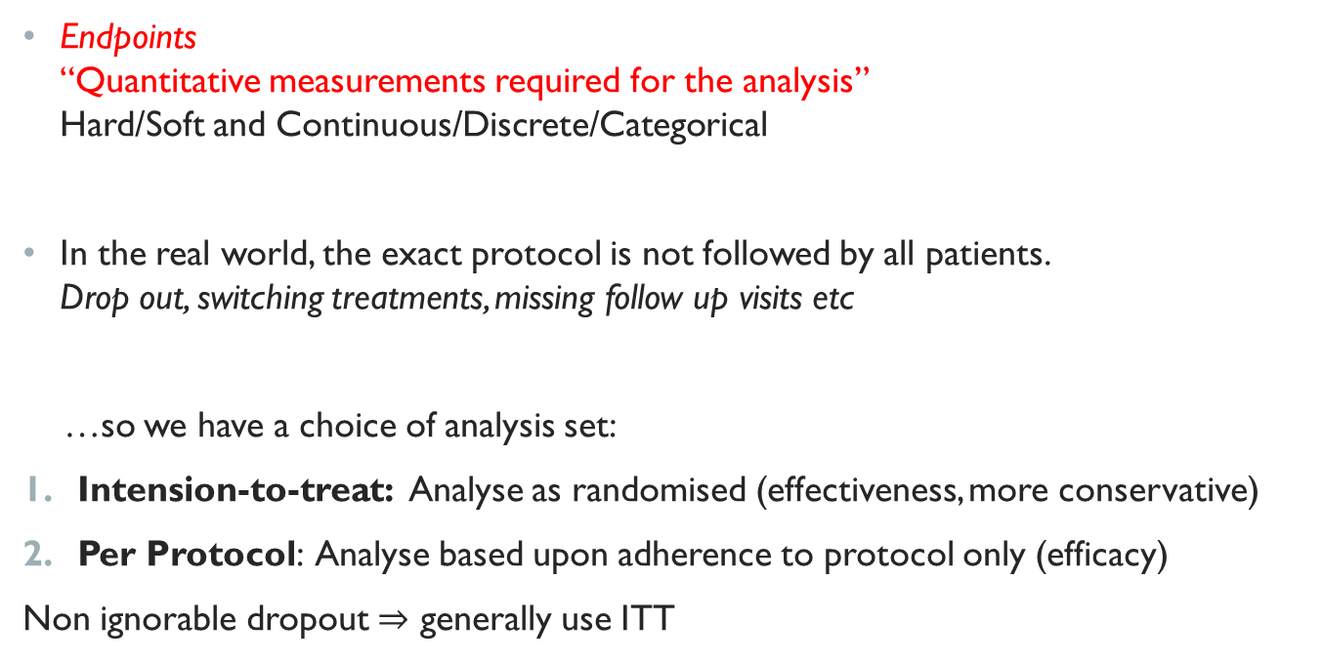
1.6 endpoints
Endpoints “Quantitative measurements required for the analysis” Hard/Soft and Continuous/Discrete/Categorical
In the real world, the exact protocol is not followed by all patients. Drop out, switching treatments, missing follow up visits etc
…so we have a choice of analysis set:
Intension-to-treat: Analyse as randomised (effectiveness, more conservative)
Per Protocol: Analyse based upon adherence to protocol only (efficacy)
Non ignorable dropout $⇒$ generally use ITT

Slide 11
Section 1 exercise: Read the abstract of “Rifaximin Therapy for Patients with Irritable Bowel Syndrome without Constipation”
What treatment is being tested? What is the condition the treatment aims to treat?
What are the endpoints of the clinical trial?
What stage clinical trial is this (I-IV)?
Does the trial have a control group?
Were the subjects randomised into control and treatment groups? Can you think of a way they may have done this?
Is treatment blinding used?
It turns out the analysis uses intension-to-treat rather than per-protocol. Why do you think this is?
Given the results, would you recommend this drug gets a license to go to market?

Slide 12
2. Statistical analysis of A rct
To analyse the data (responses) collected in a clinical trial, one must consider:
The endpoint type, and a measure of the difference between the endpoint responses (e.g. a test statistic).
Distributional assumptions of the endpoints.
The analysis set (Intension to treat/Per protocol)
Define a clinically relevant difference $∆^{∗}$ “Smallest change in a treatment outcome that the physician would identify as important”

Slide 13
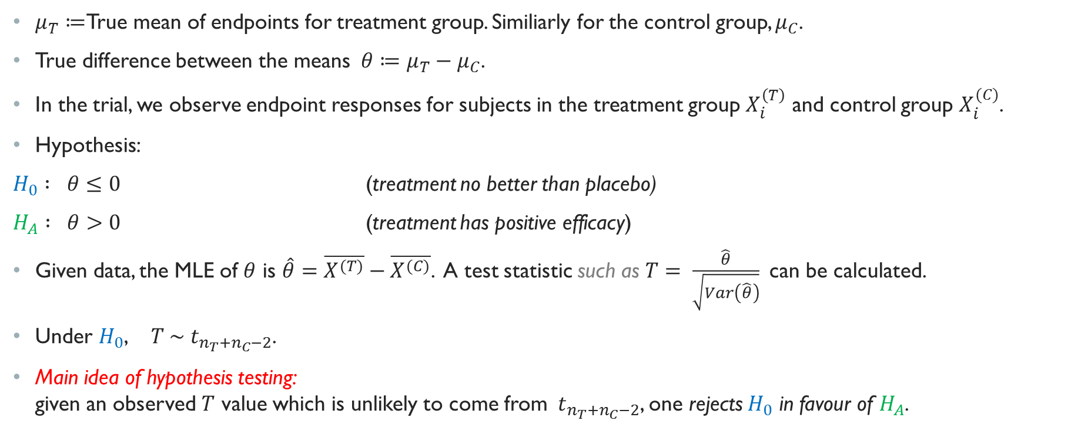
2.1 Analysis of continuous RCT Data
$μ_{T}≔$True mean of endpoints for treatment group. Similiarly for the control group, $μ_{C}$.
True difference between the means$θ≔μ_{T}−μ_{C}$.
In the trial, we observe endpoint responses for subjects in the treatment group $X_{i}^{\left(T\right)}$ and control group $X_{i}^{(C)}$.
Hypothesis:
$H_{0} : θ≤0$ (treatment no better than placebo)
$H_{A} : θ>0$ (treatment has positive efficacy)
Given data, the MLE of $θ$ is $\hat{θ}=\overline{X^{(T)}}−\overline{X^{(C)}}$. A test statistic such as $T= \frac{\hat{θ}}{\sqrt{Var\left(\hat{θ}\right)}}$can be calculated.
Under $H_{0}$, $T \sim { t}_{n_{T}+n_{C}−2}$.
Main idea of hypothesis testing: given an observed $T$ value which is unlikely to come from ${ t}_{n_{T}+n_{C}−2}$, one rejects $H_{0}$ in favour of $H_{A}$.

Slide 14

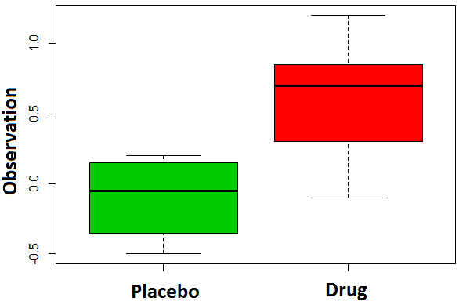
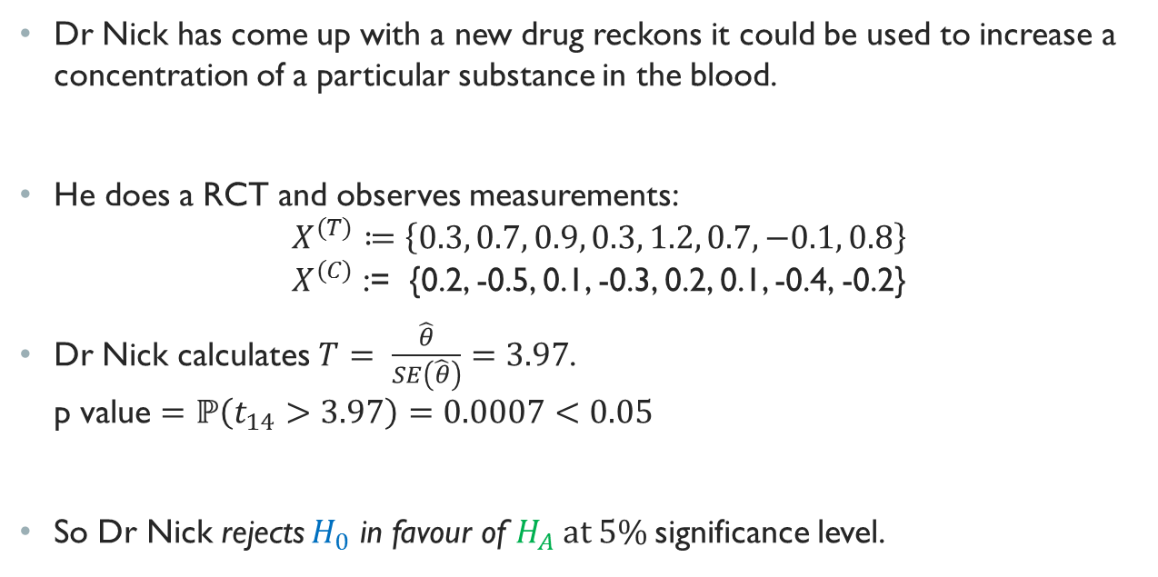
2.2 Example
Dr Nick has come up with a new drug reckons it could be used to increase a concentration of a particular substance in the blood.
He does a RCT and observes measurements: $X^{(T)}≔\left\{0.3, 0.7, 0.9, 0.3, 1.2, 0.7, −0.1, 0.8\right\}$ $X^{(C)}$ := {0.2, -0.5, 0.1, -0.3, 0.2, 0.1, -0.4, -0.2}
Dr Nick calculates $T= \frac{\hat{θ}}{SE\left(\hat{θ}\right)}=3.97$. p value $=ℙ\left(t_{14}>3.97\right)=0.0007<0.05$
So Dr Nick rejects $H_{0}$ in favour of $H_{A} at 5\%$significance level.

Slide 15
2.3 Analysis of other structures of trials
This method of hypothesis testing applies for different types of trial, and different distributional assumptions about the endpoints.
E.g.
Success/Failure responses: the proportion of successes is considered instead of the mean response.
Survival Response Trials: Measure the time until an event.
Cross-over trials- half the subjects take the placebo and half the treatment, then they swap over (though subjects are blinded to the medication they are taking).
Paired Design- e.g. use one eye as control and one as treatment
Equivalence trials- aim to show 2 treatments are equivalent.
Non-inferiority- aim to show a treatment is not inferior (as opposed to superior).

Slide 16
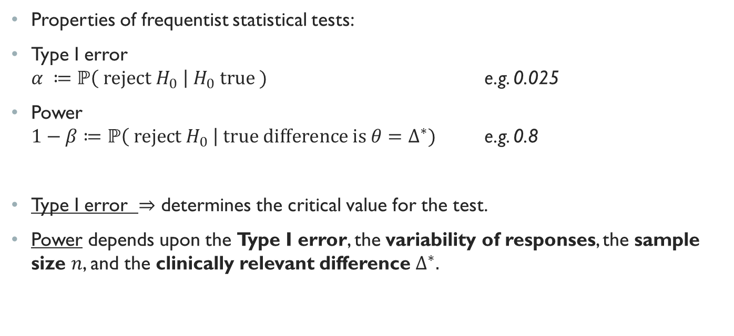
2.4 SIZe and power
Properties of frequentist statistical tests:
Type I error $α ≔ℙ\left( reject H_{0} \right| H_{0} true )$ e.g. 0.025
Power $1−β≔ℙ\left( reject H_{0} \right| true difference is{ θ=∆}^{∗})$ e.g. 0.8
Type I error $⇒$ determines the critical value for the test.
Power depends upon the Type I error, the variability of responses, the sample size $n$, and the clinically relevant difference $∆^{∗}.$

Slide 17
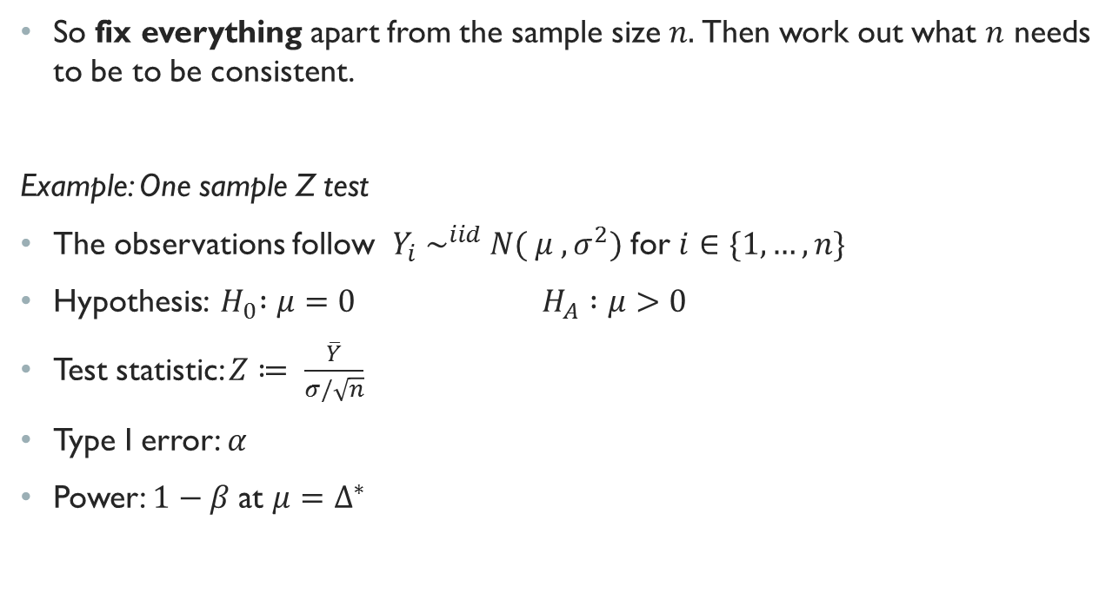
2.5 Sample size calculations
So fix everything apart from the sample size $n.$Then work out what $n$ needs to be to be consistent.
Example: One sample Z test
The observations follow $Y_{i} \sim ^{iid} N( μ , σ^{2})$ for $i∈\{1,…,n\}$
Hypothesis: ${ H}_{0} :μ=0$ $H_{A} :μ>0$
Test statistic: $Z≔ \frac{\overline{Y}}{σ/\sqrt{n}}$
Type I error: $α$
Power: $1−β$ at $μ=Δ^{∗}$

Slide 18

2.5 Sample size calculations
T$ype I error is α$: . $α=ℙ($ $reject H_{0} \left| H_{0} true\right)$ definition of Type I error . $=ℙ\left( Z >c \right| H_{0}$ true) reject $H_{0}⇔Z>$ critical value $c$
Under $H_{0}$ we have that$Z$ $\sim N\left(0,1\right)$ $=1−Φ\left(c\right)$
Rearrange for $c$ $c=Φ^{−1}\left(1−α\right)$
i.e. critical value $c$ directly determined by the Type I error.

Slide 19
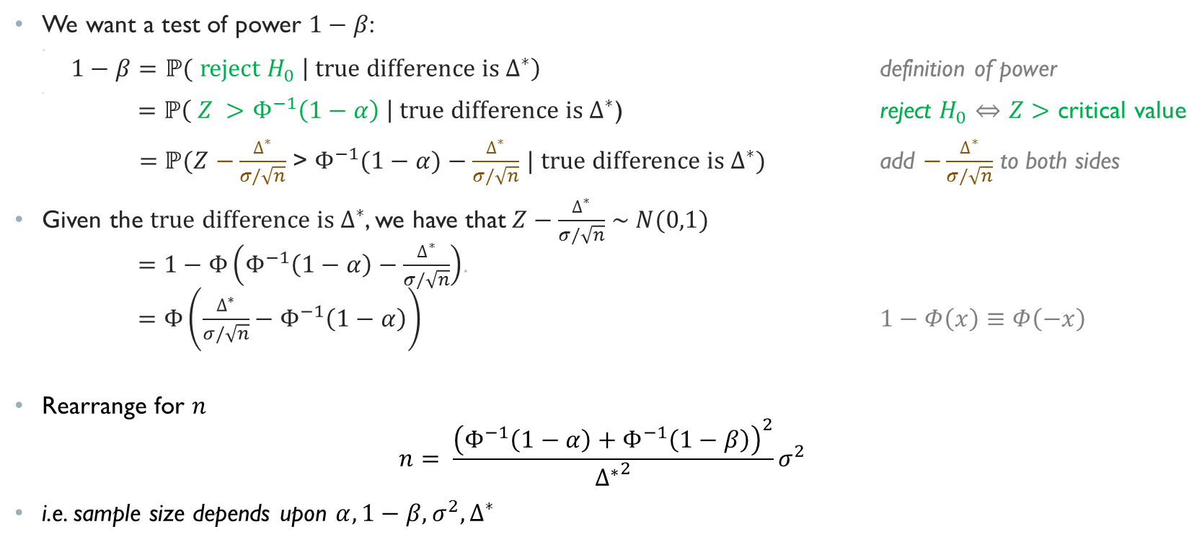
2.5 Sample size calculations
We want a test of power $1−β$: . $1−β=ℙ($ $reject H_{0} \left| true difference is{ ∆}^{∗}\right)$ definition of power . $=ℙ\left( Z >Φ^{−1}\left(1−α\right) \right| true difference is{ ∆}^{∗}$) reject $H_{0}⇔Z>$ critical value
$=ℙ(Z$ $−\frac{∆^{∗}}{σ/\sqrt{n}}$ > $Φ^{−1}(1−α)−\frac{∆^{∗}}{σ/\sqrt{n}}$ $| true difference is{ ∆}^{∗})$ add $−\frac{∆^{∗}}{σ/\sqrt{n}}$ to both sides
Given the $true difference is{ ∆}^{∗}$, we have that$Z−\frac{∆^{∗}}{σ/\sqrt{n}}$ $\sim N(0,1)$ $=1−Φ\left(Φ^{−1}\left(1−α\right)−\frac{∆^{∗}}{σ/\sqrt{n}}\right)$. $=Φ\left(\frac{∆^{∗}}{σ/\sqrt{n}}−Φ^{−1}\left(1−α\right)\right)$ $1−Φ\left(x\right)≡Φ\left(−x\right)$
Rearrange for $n$ $n= \frac{{\left(Φ^{−1}\left(1−α\right)+Φ^{−1}\left(1−β\right)\right)}^{2}}{{∆^{∗}}^{2}}σ^{2}$
i.e. sample size depends upon $α, 1−β, σ^{2}, {∆^{∗}}^{ }$

Slide 20
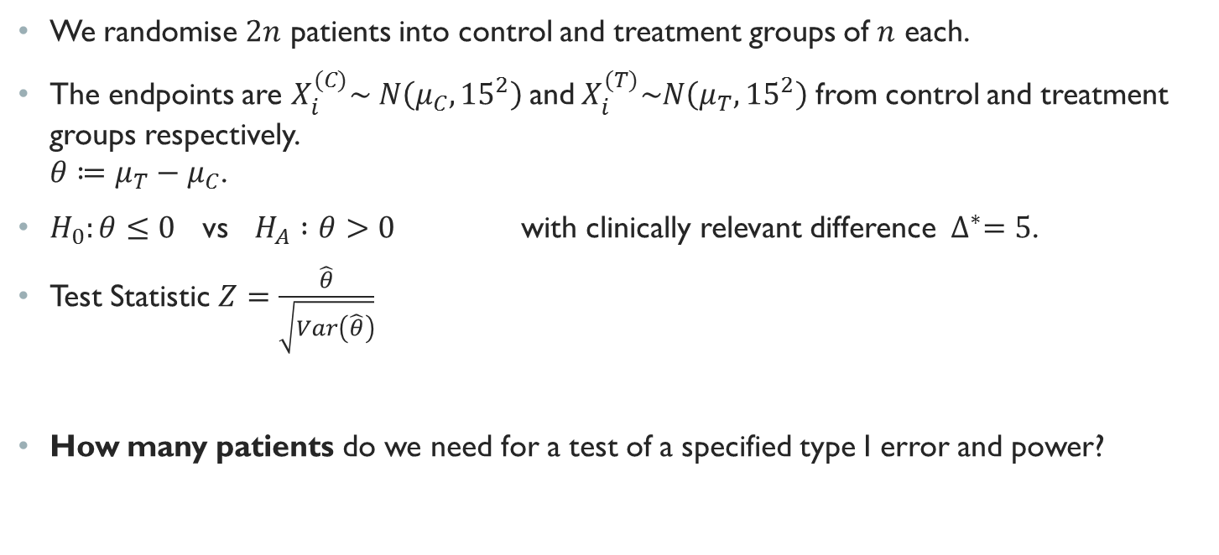
Section 2 exercise: 2 sample z test Sample size calculation
We randomise $2n$ patients into control and treatment groups of $n$ each.
The endpoints are $X_{i}^{(C)}\sim N\left(μ_{C},{15}^{2}\right)$and${ X}_{i}^{(T)}\sim N\left(μ_{T},{15}^{2}\right)$ from control and treatment groups respectively. $θ≔μ_{T}−μ_{C}$.
$H_{0}:θ≤0$ vs $H_{A} :θ>0$ with clinically relevant difference ${ ∆}^{∗}=5$.
Test Statistic $Z=\frac{\hat{θ}}{\sqrt{Var\left(\hat{θ}\right)}}$
How many patients do we need for a test of a specified type I error and power?

