Slide 1
Ranking chemicals based on heterogeneous data
Jan 2017

Slide 2
Ranking chemicals based on heterogeneous data
Different herbicide screens: A, B, C
Differ in scale, amount of test chemical required, duration
Species tested, eg tropical grasses vs temperate grasses, or broadleaved vs grasses
Application timing: seed i.e. pre-emergence vs seedling i.e. post-emergence
Each screen incudes several plants of several species
Each chemical is tested at a few application rates
Chemicals are run through screens in batches
There is run to run variation in results of a screen
The percent control of each species is scored, ie 0% = the chemical did nothing, 100% = the chemical completely killed all plants. These data are used to fit a logistic regression model and an ED50 (effective dose, 50%) number is calculated
How can we rank all the tested chemicals across a series of screens?
How can we take uncertainty into account?

Slide 3
Ranking chemicals based on heterogeneous data
Results for 1 chemical in 1 screen
 | Species | A | B | C | D | E | F | G | H
Score at each application rate | 100g/ha | 10 | 0 | 0 | 0 | 20 | 0 | 0 | 0
 | 500g/ha | 20 | 40 | 30 | 0 | 80 | 10 | 20 | 0
 | 1000g/ha | 30 | 90 | 75 | 10 | 100 | 50 | 40 | 10
 | ED50 | 1500 | 600 | 750 | >1000 | 280 | 1000 | 1200 | >1000

Slide 4
Ranking chemicals based on heterogeneous data

Slide 5
Ranking chemicals based on heterogeneous data
Traditional approach
Pairwise comparisons with “best”
If better than the “best” then you have a new winner
But now we want to rank all chemicals tested
To spot trends
To better understand chemical space
To direct chemistry towards better areas

Slide 6
Ideas for literature starting points
One of FIFA’s systems for ranking national football teams: https://en.wikipedia.org/wiki/FIFA_World_Ranking_system_(1999%E2%80%932006)
The ELO system used for chess ratings: https://en.wikipedia.org/wiki/Elo_rating_system this article has lots of references including some statistical literature
“The predictive power of ranking systems in association football” Lasek et al DOI: 10.1504/IJAPR.2013.052339
Major differences for our case are that
we have multiway comparisons, not just two way
results have uncertainty (eg chemical A score 80% and B score 70%, but these figures should really have error bars, whereas if Team A beat Team B this is unambiguous)
we have a lot of missing data in the overall matrix

Slide 7
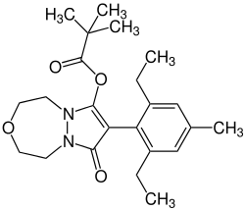
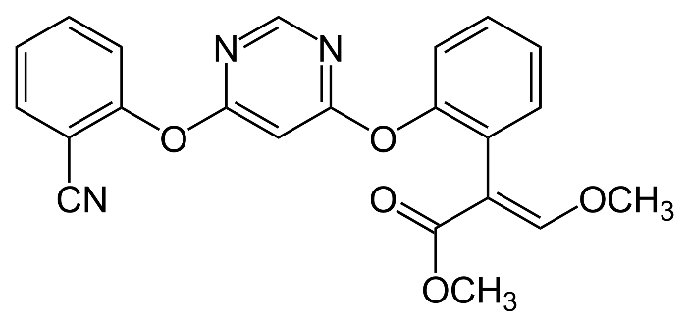
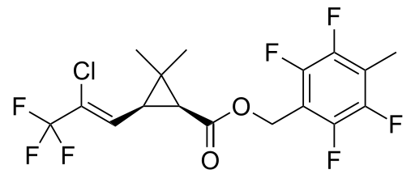
Formulation toxicity
Syngenta designs, makes and tests organic chemicals, to seek to invent new active ingredients (AIs)
azoxystrobin pinoxaden tefluthrin
fungicide herbicide insecticide

Slide 8
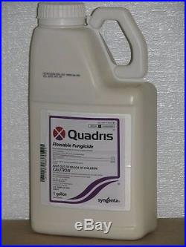
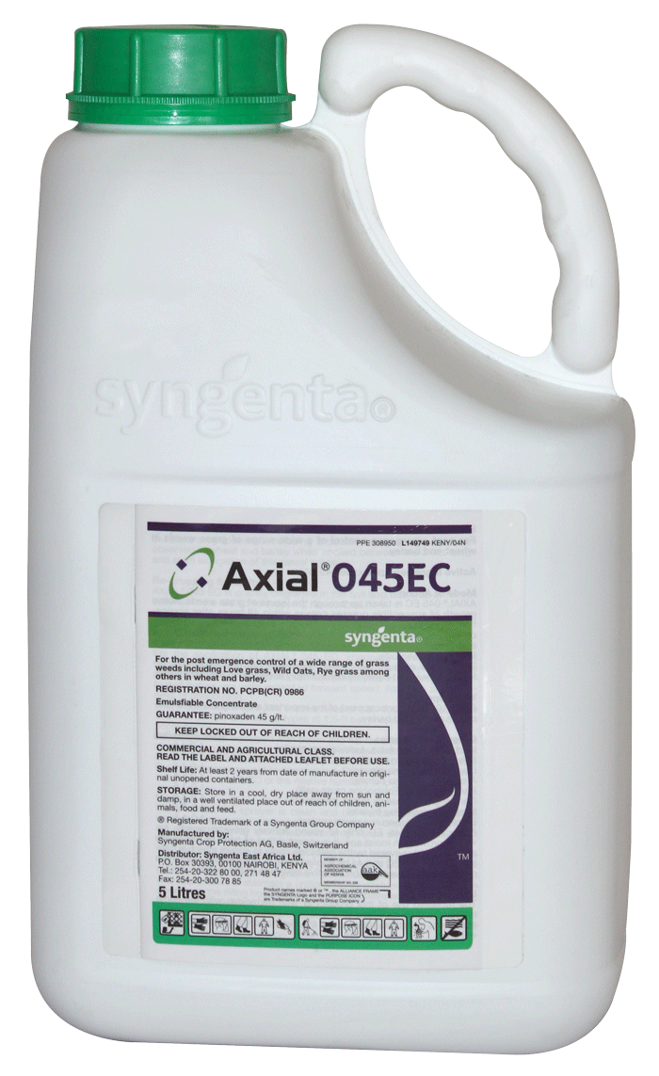
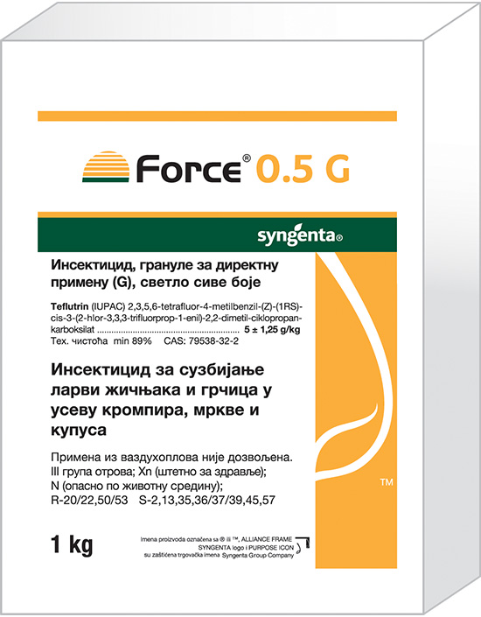
Formulation toxicity
But we not sell active ingredients – our products are formulations
Quadris Axial 45 EC Force 0.5 GR
azoxystrobin pinoxaden tefluthrin
A3245B A6897D A3214A

Slide 9
Formulation toxicity
Formulations (formulated products) may contain many ingredients with different roles:
1 or more AIs
Everything else, which are collectively called co-formulants
solvents, surfactants, preservatives, colour, stabilisers, anti-oxidants, anti-foams, sunscreens
There is toxicity data for many ingredients, but it is often only available to as a range eg MLD of 300-2000 mg/kg, > 5000 mg/kg
For every formulation we either test its acute toxicity (6-pack), or we bridge to data for a similar formulation
Acute oral toxicity
Acute dermal toxicity
Acute inhalation toxicity
Eye irritation
Skin irritation
Skin sensitisation (an allergic response)

Slide 10


Formulation toxicity
Industry needs to generate information for every formulation, but…
Most new formulations are variants of existing ones
There is a finite list of ingredients (our cupboards contain much the same set of ingredients), many of which have been tested singly somewhere sometime
Bridging arguments, read-across, in vitro and in silico methods are great, but have had incremental benefits, i.e. we still test a lot of animals
It is time for the regulatory science to come together and end the great majority of acute animal studies for pesticide formulations
Syngenta and Dow Agroscience are sponsors of an NC3Rs CRACK IT project to seek to achieve this:
Maximise: maximising confidence whilst minimising data generation for acute hazard classification of mixtures
However, there is a maths challenge here too, which could help reduce animal testing…

Slide 11
Formulation toxicity
We know the toxicity of all the formulations
We can assume additive toxicity for formulation ingredients
We know the toxicity of some ingredients tested singly (either as a number or as a range)
How can be back out toxicity estimates for as many ingredients as possible?
How can we spot non-additive effects?

Slide 12
More about acute toxicity
Measures of acute toxicity vary in nature.
For acute oral toxicity, the Median Lethal Dose (MLD) is used, which in principle is on a continuous scale.
327 mg/kg – interpolated from results at a range of doses
or >3000 mg/kg – no toxicity seen at the top dose (perhaps the only one tested)
or <200 mg/kg – lots of toxicity seen at the lowest dose (perhaps only the only one tested)
If the data is not ours but someone else’s, then often only the resulting acute toxicity class is available, eg Category 4, meaning 300-2000 mg/kg.
For other types of acute toxicity, eg skin irritation, usually only class data is available (non irritant vs irritant vs severe irritant), and toxicity on a continuous scale could be thought of as a hidden variable.

Slide 13
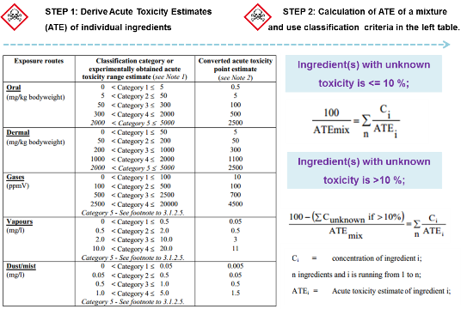
More about acute toxicity
An ATE (acute toxicity estimate) is an estimate of acute toxicity of a formulation based on the toxicity of its components. Toxicity of a mixture is obtained by adding the toxicity of each component, taking into account the proportion of each component. But to make it additive you need to take the inverse of the toxicity value, eg MLD (an MLD of 5 mg/kg is very toxic and 5000 mg/kg is very non-toxic).
Significant deviation from additivity is rare, and is either synergism (1+1>2) or antagonism (1+1<2). Acute oral tox categories and ATE calculation is shown below.

