Slide 1
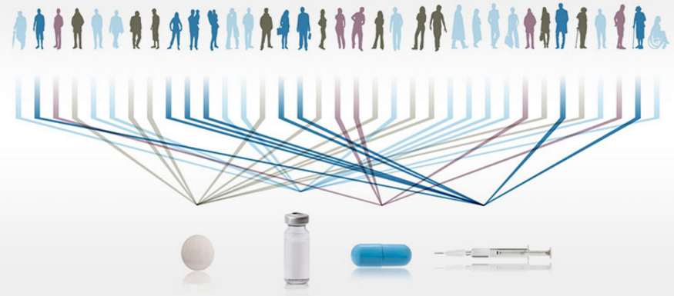
Biomarkers & Personalised Healthcare
Chris Harbron
Roche Biostatistics: Methods Collaborations & Outreach (MCO)
ITT5 : 30th January – 3rd February 2017

Slide 2

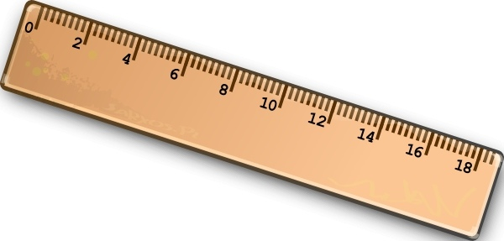
What Is A Biomarker?
A characteristic that is objectively measured and evaluated as an indicator of normal biological processes, pathogenic processes, or pharmacologic responses to a therapeutic intervention.
the National Institutes of Health Biomarkers Definitions Working Group
Bio-
-Marker

Slide 3
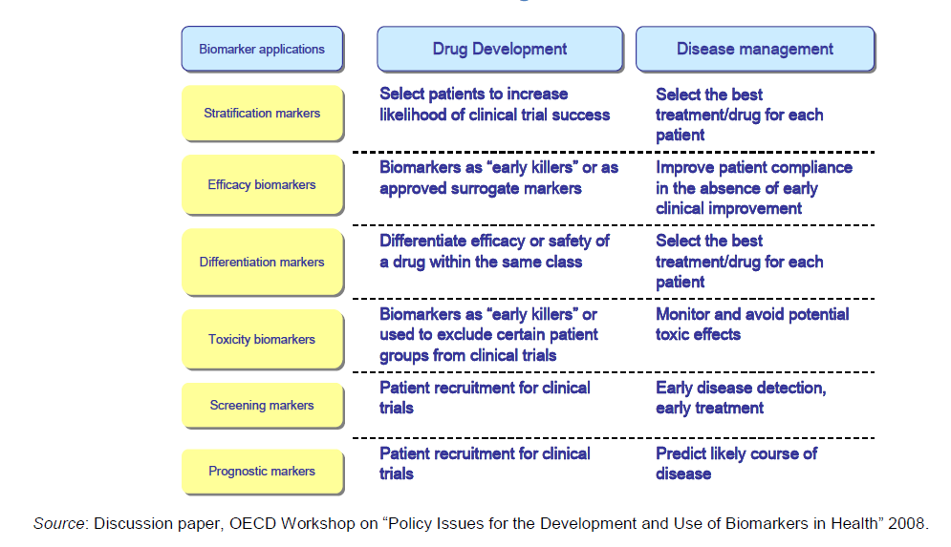
What is a Biomarker?

Slide 4
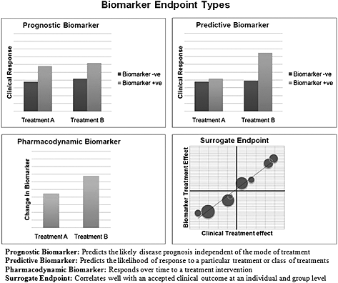
What is a Biomarker?
A statistician's perspective on biomarkers in drug development Pharmaceutical Statistics
Volume 10, Issue 6, pages 494-507, 8 DEC 2011 DOI: 10.1002/pst.532
http://onlinelibrary.wiley.com/doi/10.1002/pst.532/full#pst532-fig-0001

Slide 5
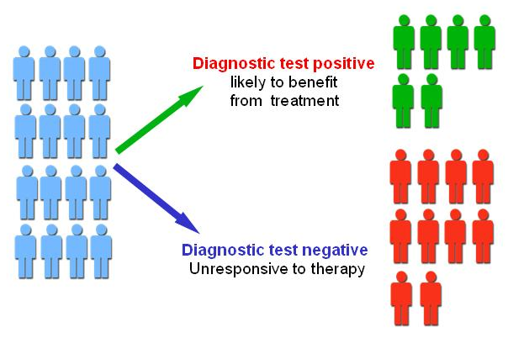
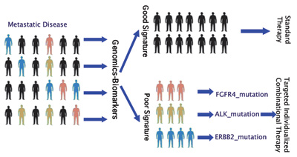
Personalised Medicine

Slide 6
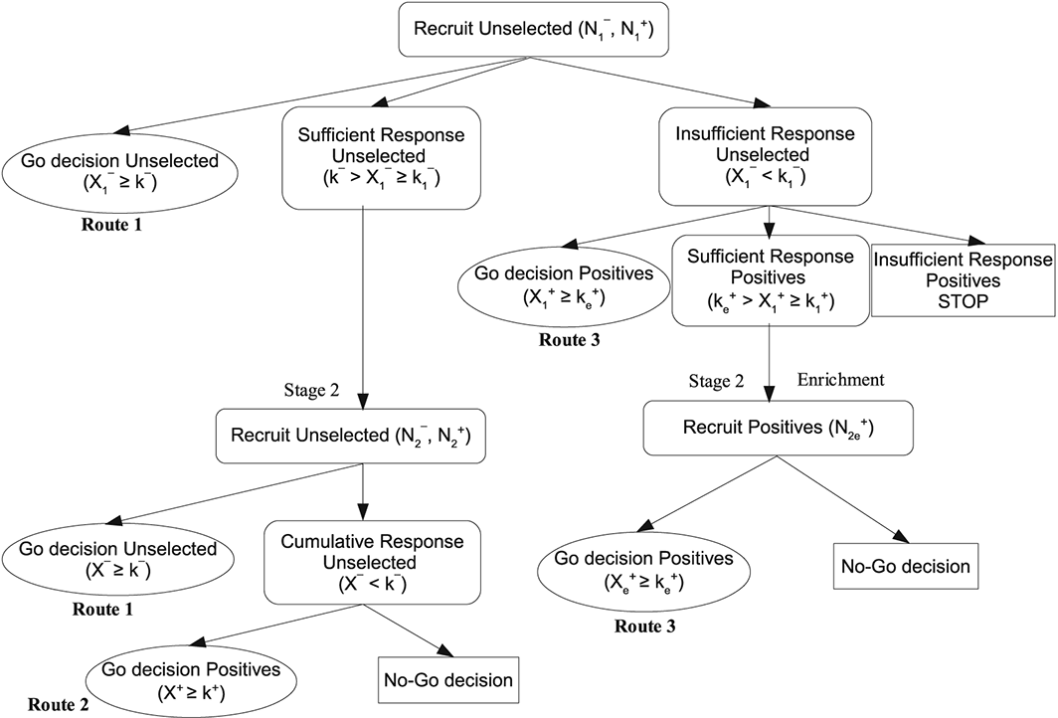
“Simple” Biomarkers -> New Adaptive Designs
Decisions both on stop/continue and patient populations
An optimal stratified Simon two‐stage design – Deepak Parashar et al
Pharmaceutical Statistics
Volume 15, Issue 4, pages 333-340, 2 MAR 2016 DOI: 10.1002/pst.1742
http://onlinelibrary.wiley.com/doi/10.1002/pst.1742/full#pst1742-fig-0001
Notes:
A schematic for the adaptive enrichment stratified design.
IF THIS IMAGE HAS BEEN PROVIDED BY OR IS OWNED BY A THIRD PARTY, AS INDICATED IN THE CAPTION LINE, THEN FURTHER PERMISSION MAY BE NEEDED BEFORE ANY FURTHER USE. PLEASE CONTACT WILEY'S PERMISSIONS DEPARTMENT ON PERMISSIONS@WILEY.COM OR USE THE RIGHTSLINK SERVICE BY CLICKING ON THE 'REQUEST PERMISSIONS' LINK ACCOMPANYING THIS ARTICLE. WILEY OR AUTHOR OWNED IMAGES MAY BE USED FOR NON-COMMERCIAL PURPOSES, SUBJECT TO PROPER CITATION OF THE ARTICLE, AUTHOR, AND PUBLISHER.

Slide 7
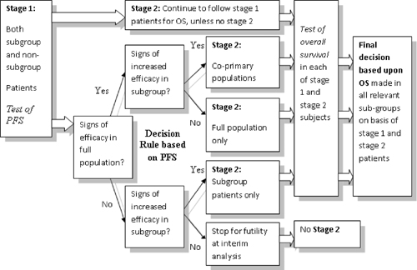
“Simple” Biomarkers -> New Adaptive Designs
Decisions both on stop/continue and patient populations
An adaptive seamless phase II/III design for oncology trials with subpopulation selection using correlated survival endpoints – Jenkins, Stone & Jennison
Pharmaceutical Statistics
Volume 10, Issue 4, pages 347-356, 8 DEC 2010 DOI: 10.1002/pst.472
http://onlinelibrary.wiley.com/doi/10.1002/pst.472/full#fig1
Notes:
Flow chart of the adaptive seamless design.
IF THIS IMAGE HAS BEEN PROVIDED BY OR IS OWNED BY A THIRD PARTY, AS INDICATED IN THE CAPTION LINE, THEN FURTHER PERMISSION MAY BE NEEDED BEFORE ANY FURTHER USE. PLEASE CONTACT WILEY'S PERMISSIONS DEPARTMENT ON PERMISSIONS@WILEY.COM OR USE THE RIGHTSLINK SERVICE BY CLICKING ON THE 'REQUEST PERMISSIONS' LINK ACCOMPANYING THIS ARTICLE. WILEY OR AUTHOR OWNED IMAGES MAY BE USED FOR NON-COMMERCIAL PURPOSES, SUBJECT TO PROPER CITATION OF THE ARTICLE, AUTHOR, AND PUBLISHER.

Slide 8
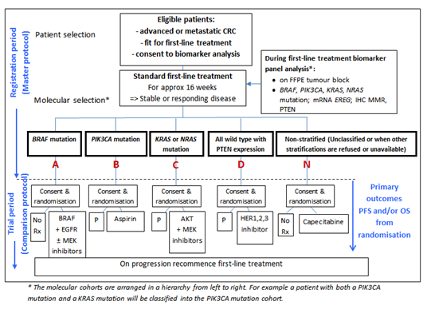
“Simple” Biomarkers -> New Designs
FOCUS 4

Slide 9
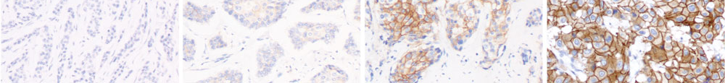
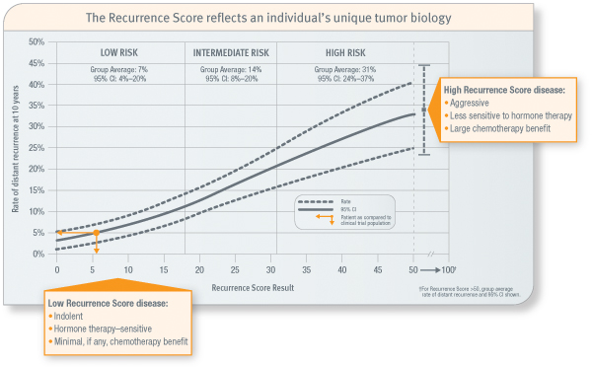
Continuous Biomarkers
Biomarker Type | Example | Measurement | Treated As
Host genetic polymorphism | CYP inhibitors | Binary | Binary
Tumour genetics | BRCA mutations | Continuous (% of tumour with mutation) | Binary (detected or not)
IHC | Her2 | Continuous | Categorical
Gene / protein expression | OncoType Dx | Continuous | Continuous
0
1+
2+
3+

Slide 10
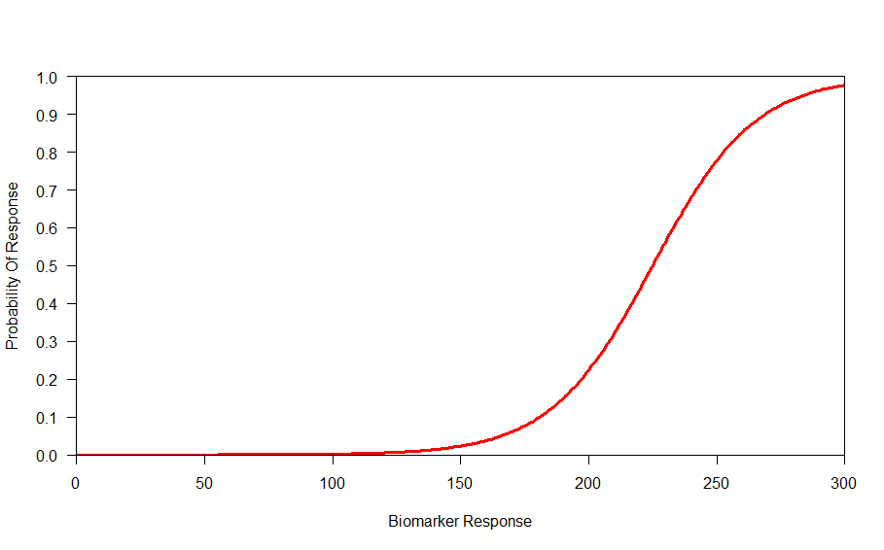
Continuous Biomarkers
How To Define The Biomarker Positive Patients?

Slide 11
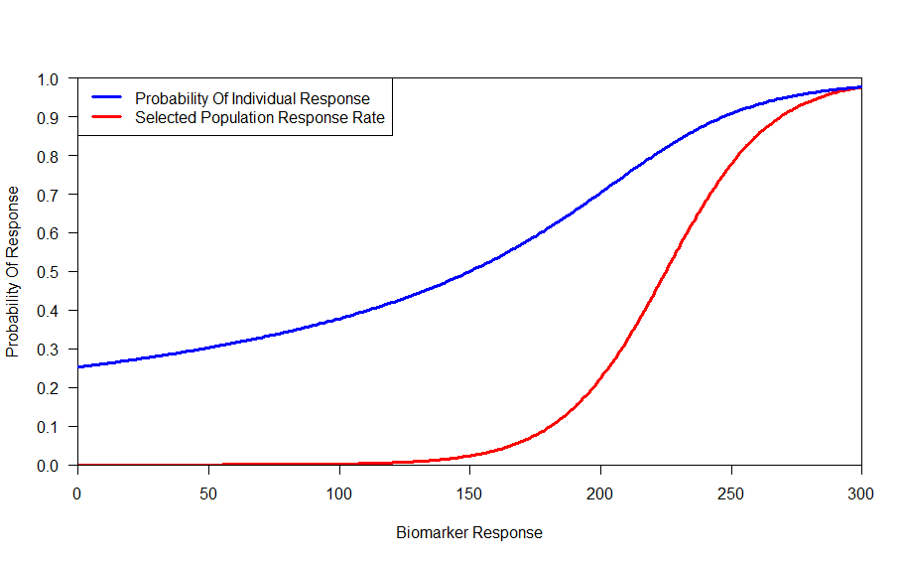
Continuous Biomarkers
How To Define The Biomarker Positive Patients?

Slide 12
Continuous Biomarkers
How To Define The Biomarker Positive Patients?

Slide 13
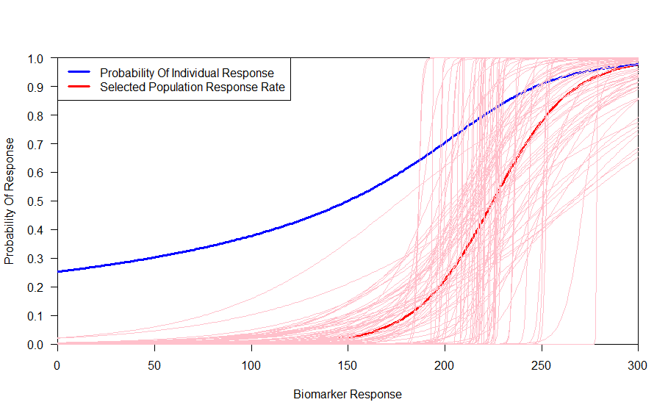
Continuous Biomarkers
How To Define The Biomarker Positive Patients?

Slide 14
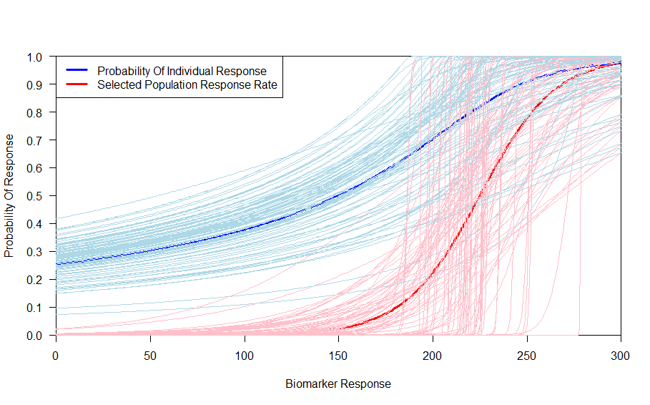
Continuous Biomarkers
How To Define The Biomarker Positive Patients?

Slide 15
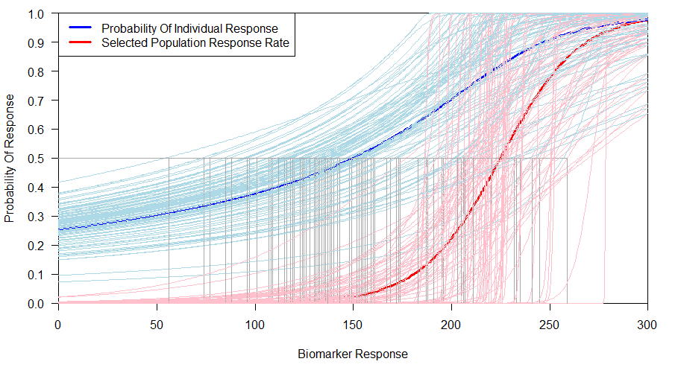
Continuous Biomarkers
How To Define The Biomarker Positive Patients?
Small Sample Size -> High Variability

Slide 16
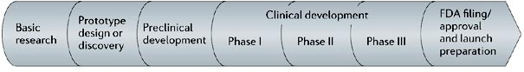
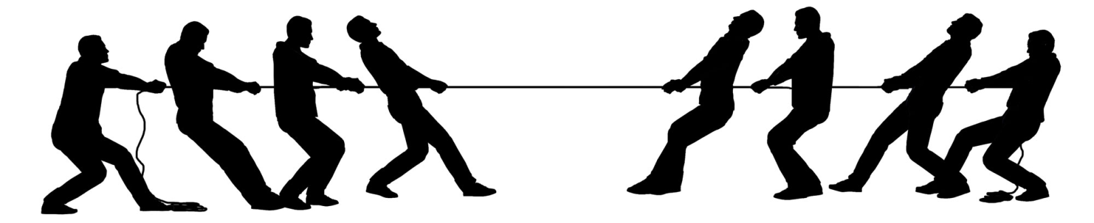
Continuous Biomarkers
Tension
Drug development wants a pre-specified biomarker as early as possible
Specifying a cutoff on more data will be more accurate

Slide 17
Biomarker Adaptive Designs
An adaptive design for updating the threshold value of a continuous biomarker
Statistics in Medicine
Amy V. Spencer
Chris Harbron
Adrian Mander
James Wason
Ian Peers

Slide 18

Setting Thresholds Within Confirmatory Trials Based Upon A Target Efficacy
Simultaneously use Phase 3 Data to both :
Demonstrate efficacy within a patient population and
Identify what that population is
Make the estimation of the cut-off with less variability from a larger sample size
Maintain rigour in confirmatory evidence that the agent is working by addressing multiplicity issues from looking at multiple populations
Idea : Combination of
Model with Spines
Permutation Testing

Slide 19
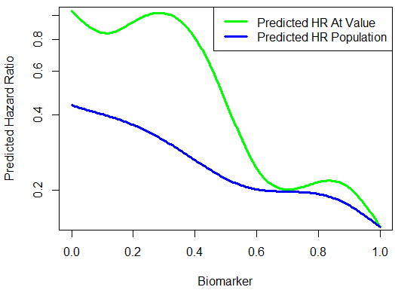
Spline Modelling

Slide 20
Permutation Testing
Test In
Allcomers Population
α<0.04
Meaningful Subpoplation HR<target⁺
p<0.04
equivalently
HR<target ⁺
Any Suggestion Of A Detrimental SubGroup?
Permutation Test*
p<0.01?
STOP
Sub-Population
Think
All-Comers
* Through permutation of treatment labels (and appropriate recalculation of interaction term), maintaining any prognostic relationship
⁺ Subpopulation target may be less than allcomers target

Slide 21
Issues To Consider
Optimising spline fits
Selection of smoothness of spline models
Modelling prognostic and predictive effects
Bias and variability of threshold estimation and its impact on patients and the selected population
Powering
Understanding of operating characteristics
  under which scenarios does the method gives an advantage?

Slide 22
Doing now what patients need next

Slide 23
Setting Thresholds Within Confirmatory Trials Based Upon A Target Efficacy
Simultaneously use Phase 3 Data to both demonstrate efficacy of the agent within a patient population and identify what that population is
Cox Proportional Hazard Modelling incorporating Splines to model biomarker effect
  Spline models for both prognostic & predictive effects
  Smoothness / Degrees Of Freedom determined by monotonicity over a target range
Permutation testing with a split alpha to maintain Type 1 error

Slide 24
Spline Modelling
Fit model :
  Log(HR) = Treatment + Spline(Biomarker) + Spline(Interaction)
Prognostic Effect
Predictive Effect
= Biomarker : Treatment=Novel Agent
= mean(Biomarker for treated patients) : Treatment = Placebo
Ref : Therneau , Eilers et al

Slide 25
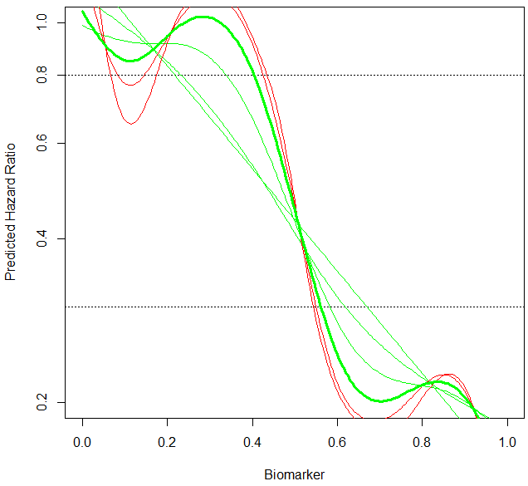
Spline Modelling
Selecting Smoothness Parameters
(Degrees Of Freedom)
Default methodology in R based upon Akaike Information Criterion (AIC) tends to overfit
Start with DF=1 (linear relationship)
Fit model
If relationship monotonic within a target range of predicted HRs, increase DF by 1 (up to a maximum of 6) and repeat, otherwise stop
Select model with the minimum AIC from the monotonic models
Actually doing this for two splines, prognostic and predictive, simultaneously

Slide 26
Spline Modelling
Integration
We model the hazard ratio at a specific value of the biomarker HR(BM)
We are interested in the hazard ratio within the population defined as greater than the biomarker . This can be calculated by numerical integration:

Slide 27
Doing now what patients need next

