Slide 1
Ranking with PageRank algorithm

Slide 2
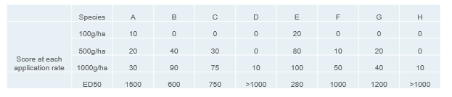
Problem

Slide 3
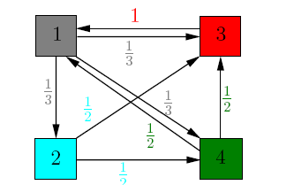
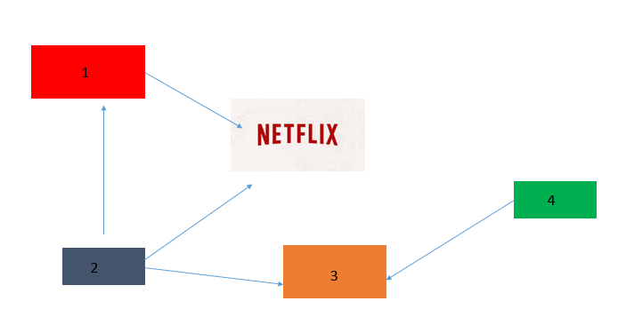
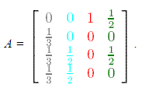

Ranking with PageRank
We can view the importance of a page as the probability than a surfer visits this page by clicking randomly on hyperlinks.
If we consider at first that the pages have the same probability to be taken as starting point so x=[ 1/4 ¼ ¼ ¼ ]
The probability than the page 1 will be visited afer one step is Ax and k steps $A^{k}$x. If A is irreductible ( there is a path from every edges i to j)
We have an eigen-value problem
$$πA=π$$
In the case where we don’t have a “nice” graph (not irreductible) we have to introduce a dumping factor in order to keep on navigating in the graph. So we introduce a matrix T (teleportation) the constant matrix Tij=1 such that the new transition matrix is:
Q=d*A+(1-d)*T
With d dumping factor close to 1
The eigenvalue problem is:
xQ=x
That we can solve by a power method algorithm.

Slide 4
What to do next?
-We need to find the graph of a data and try different weighted functions that can fit: we can approach it by ranking page methods in sports: create a link between from A to B if the teams A beats the team B and weights by the difference of goals.

