Slide 1
Setting the scene

Slide 2
Clinical Pharmacology
Science that studies the characteristics, effects, reactions and uses of drugs. Notes: it spans from FiH to market access.
pharmacokinetics
pharmacodynamics
DOSE
EXPOSURE
RESPONSE
To describe these relationships, we use models.

Slide 3
Aims of Clinical Pharmacology
“The right dose for the right patient”
Covariates
Benefit : risk
assessment
&
Decision
making
PK
PD
DOSE
EXPOSURE
RESPONSE(S)
PLACEBO
Regimen
To describe this,
we use deterministic models
To support this, we use statistic models

Slide 4
Pharmacometrics as a discipline
‘Pharmacometrics’¹ has emerged as a discipline thanks to the introduction of a new tool designed to address the specifics needs of clinical pharmacology.
NONMEM was created in the 70’s by L. Sheiner and S. Beal.
Bottom-up approach (using prior knowledge)
a towards more mechanistic models
Parameter estimates are conditional to the observed data
a more Bayesian than frequentist – in spirit
ODE, non-linear longitudinal mixed-effects models
a PK and disease (progression) modeling
¹Word used for the 1st time in JPKPD in 1982.

Slide 5





Pharmacometrics in the OrgCharts
20
50
5
Roche (PMx$⊂$CP)
Novartis (PMx$⊂$Stat)
Sanofi (PMx$⊂$Stat)
35
35
GSK (CPMS)
J&J (PMx$⊂$Stat)
AZ (PMx$⊂$CP)

Slide 6
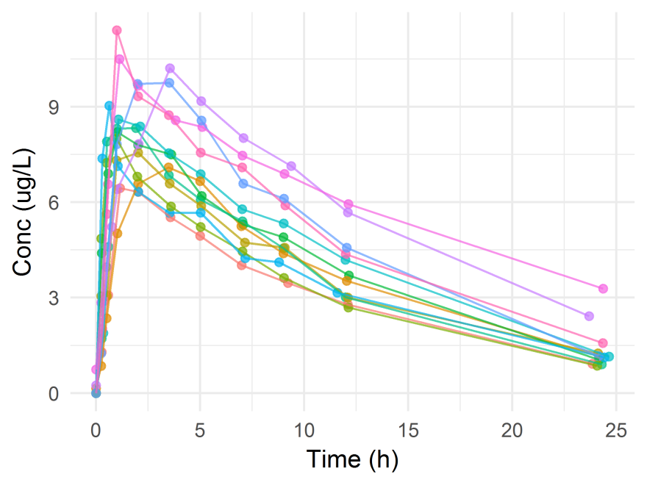
Theophylline: the PK model example
Serum concentrations of the drug theophylline are measured in 12 subjects over a 25-hour period after oral administration¹.
2. Distribution
3. Elimination (k_{e})
[Metabolism+Excretion]
1. Absorption (k_{a})
¹Pinheiro and Bates (1995).

Slide 7






Theophylline: a PK model example
Oral dose D
M
k_{a}
k_{e}
$$\frac{dM}{dt}=k_{a}A−k_{e}M$$
Deterministic (a.k.a. structural) model
$$M\left(0\right)=0$$
$$\frac{dA}{dt}={−k}_{a}A$$
$$A\left(0\right)=D$$
$A\left(t\right)$ is the amount of drug at absorption site (e.g. vein)
Concentration at t:
$$m\left(t\right)=\frac{M}{V}=\frac{k_{a}D}{V(k_{a}−k_{e})}\left[exp⁡({−k}_{e}t)−exp⁡(−k_{a}t)\right]$$
$$k_{e}=\frac{CL}{V}$$
clearance
volume of distribution

Slide 8

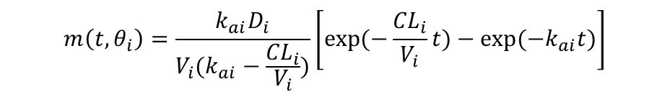

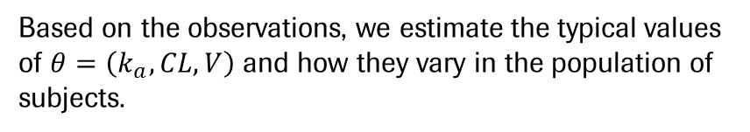




Theophylline: a PK model example
Statistical model
Based on the observations, we estimate the typical values of $θ=\left(k_{a},CL, V\right)$ and how they vary in the population of subjects.
$$Y_{ij}=m\left(t_{ij},{ θ}_{i}\right)+ε_{ij}$$
$$ε_{ij}\sim N\left(0, σ^{2}\right)$$
$$m\left(t, θ_{i}\right)=\frac{k_{ai}D_{i}}{V_{i}(k_{ai}−\frac{{CL}_{i}}{V_{i}})}\left[exp⁡(−\frac{{CL}_{i}}{V_{i}}t)−exp⁡({−k}_{ai}t)\right]$$
$$k_{ai}=exp⁡\left(θ_{1}+η_{1i}\right)$$
$$V_{i}=exp⁡\left(θ_{2}+η_{2i}\right)$$
$$η_{i}\sim MVN\left(0, Ω\right)$$
$${CL}_{i}=exp⁡\left(θ_{3}+η_{3i}\right)$$
Enforced positivity,
log-normal distribution

Slide 9
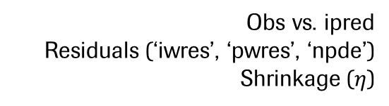
Model building
AIC
3. Model selection
1. Data inspection
2. Model development
4. Model diagnostic
5. Model validation
Obs vs. ipred
Residuals (‘iwres’, ‘pwres’, ‘npde’)
Shrinkage ($η$)
k-fold CV
External validation

Slide 10
R packages to fit NLME (ODE) models
Package | nlmeODE | FME
Likelihood estimation | 2-steps likelihood approxim¹: Penalized non-linear least squares (PNLS) Linear mixed-effect (LME) | MCMC sampling
Main authors | J. Pinheiro, D. Bates, C. Tornøe² | K. Soetaert, T. Petzoldt³
Maintenance | Minimal (2004) | Active (2016)
Model diagnostics | Basic | Very basic
Model validation | None | None
Solution 1: Work out the analytical solution of the ODE and use R packages with better GoF/model qualification suit (e.g. nlme, saemix⁴)
Solution 2: Use other tools (e.g. Monolix, NONMEM)
¹Lindstrom and Bates (1990) Biometrics; ²Tornoe et al. (2004) CMPB; Soetaert and Petzoldt (2010) JSS; ⁴Comets et al. (2011) PAGE meeting.

Slide 11
ITT5

Slide 12
Motivation: Clin dev in Oncology
Clinical dev.:
Ph1 HV (SAD, MAD)
Ph2 (DR inc. Pbo)
Ph3 (x2) (pivotal)
Clinical dev. in Onco:
Ph1 CRM (SAD)
Ph2 (1 dose vs. SoC)
Ph3 (x1) (pivotal)
Clinical dev. in Onco, in 2017:
Ph1 CRM (all)
expansion (target pop.)
Ph3 (x1) (pivotal)
external data SoC
In solid tumors, decision to initiate Ph3 activities are typically based on tumor size data.
Key investment point

Slide 13
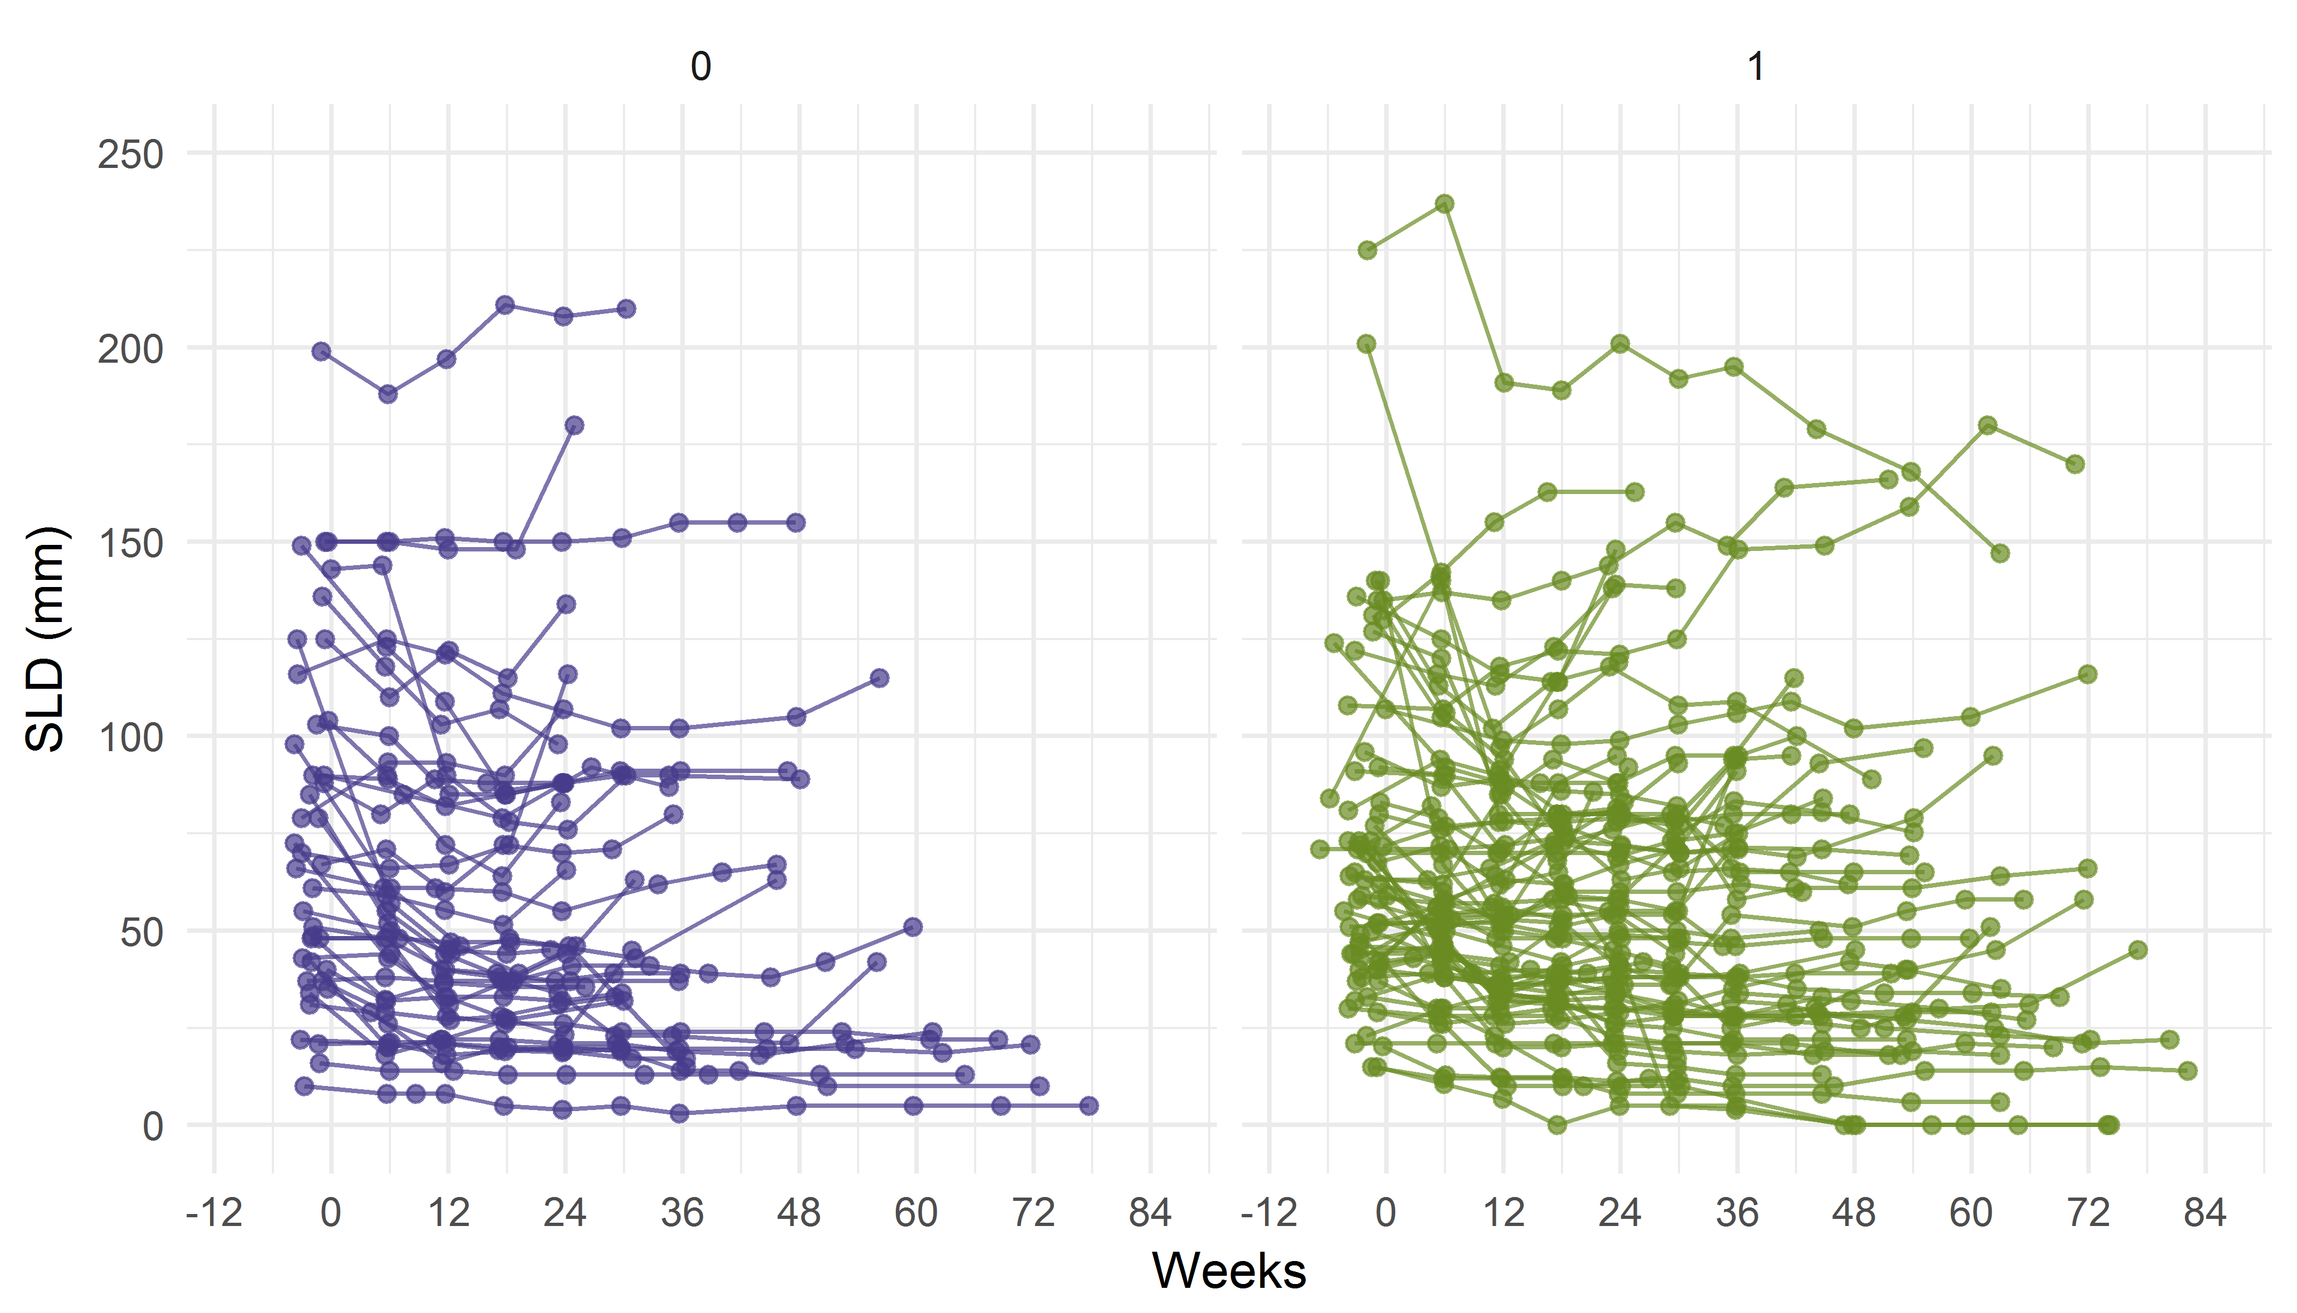
Tumor size (SLD) data

Slide 14
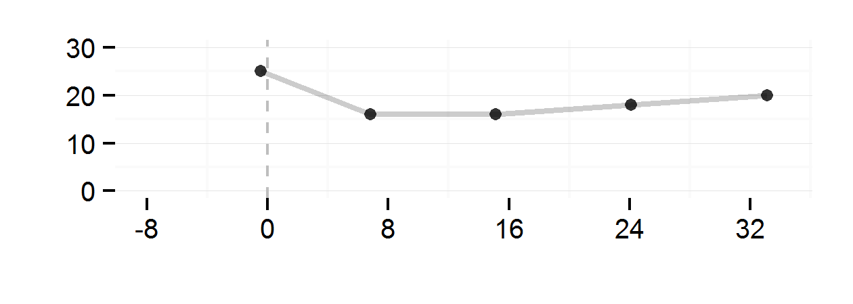


Tumor size dynamics
$\frac{dY}{dt}=aY−bY∙exp⁡(−λt)$ (1)
$$MaxSh$$
SLD (mm)
Tumor size ratio at a given date or Maximum shrinkage
Time to (re)growth or time below threshold
Resistance and/or Tumor growth rate
TS at baseline

Slide 15
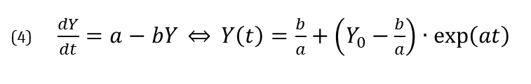



Tumor size dynamics – structural models¹
(1) $Y(t)=Y_{0}∙\exp\left(−dt\right)+gt$
(2) $Y(t)=Y_{0}∙\left(\exp\left(−dt\right)+exp\left(gt\right)−1\right)$
Depending on random effects two (or more) different models may have similar ‘performance’ (AIC, diagnostic tools).
Yet, these models may lead to different predictions (in particular w.r.t. IIV).
Which model should be retained?
(3) $Y\left(t\right)=Y_{0}∙\exp\left(−dt\right)+gt+ht^{2}$
(4) $\frac{dY}{dt}=a−bY \underset{⇔}{} Y\left(t\right)=\frac{b}{a}+\left(Y_{0}−\frac{b}{a}\right)∙exp\left(at\right)$
(5) $\frac{dY}{dt}=aY∙\left(Y_{0}b−Y\right)$
(6) $\frac{dY}{dt}=aY−bY∙exp⁡(−λt)$
(7) $\frac{dY}{dt}=aY∙\log\left(\frac{θ}{Y}\right)−bY∙exp⁡(−λt)$
¹Ribba et al. (2014) CPT:PSP.

Slide 16
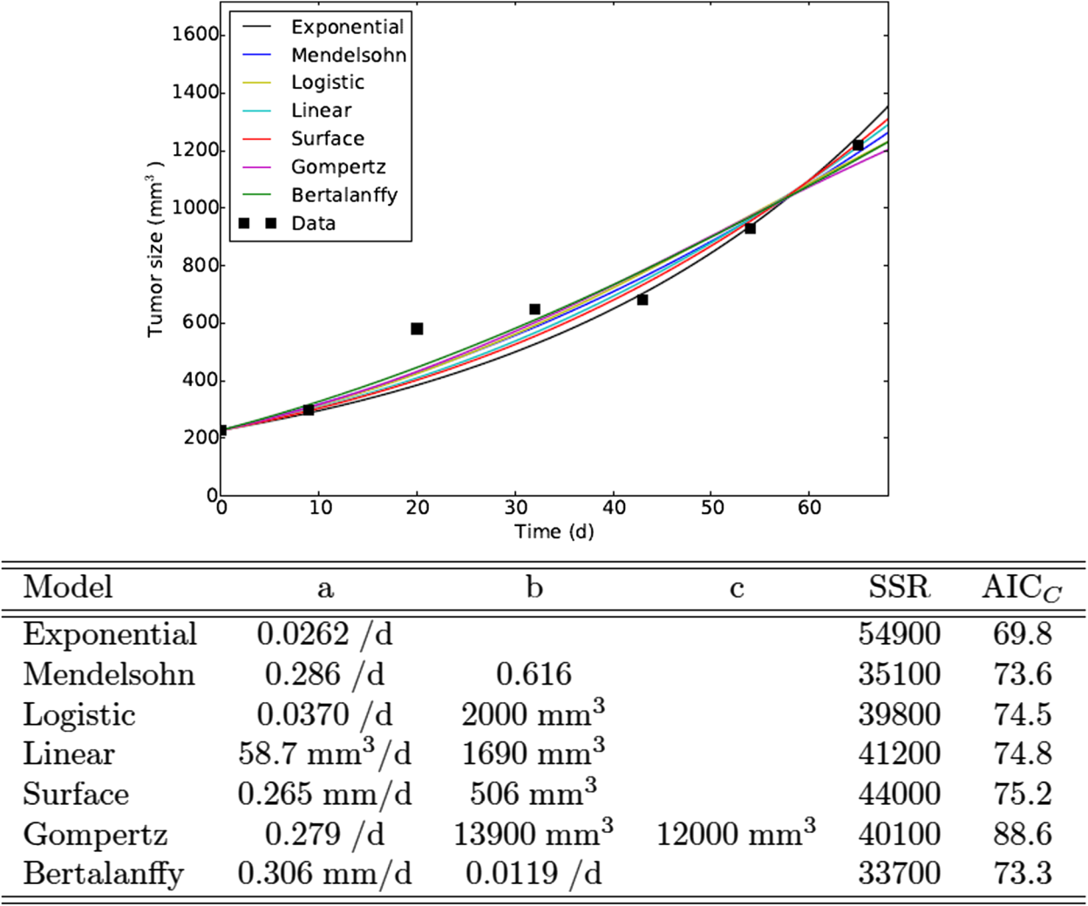
Illustration (1/2) - Murphy et al. (2016)¹
Various models lead to AIC within a 4 points range.
¹Murphy et al. (2016) BMC Cancer, 16:163.

Slide 17
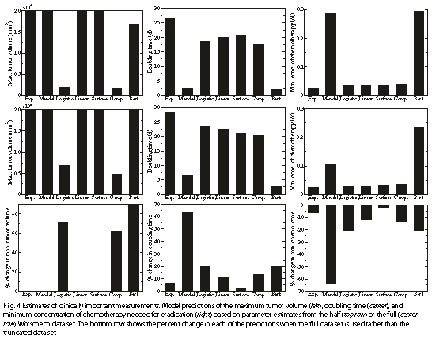
Illustration (2/2) - Murphy et al. (2016)¹
¹Murphy et al. (2016) BMC Cancer, 16:163.

Slide 18
Doing now what patients need next

