Slide 1
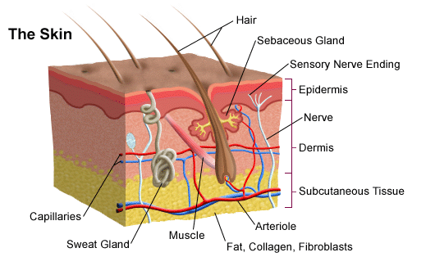
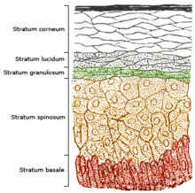
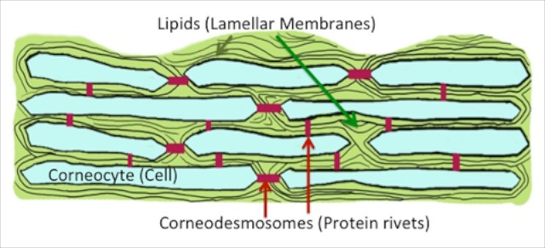
Mathematical models for dermal absorption
https://en.wikipedia.org/wiki/Epidermis
http://www.stanfordchildrens.org/
Key Considerations
Spatially heterogeneous domain
Boundary conditions
Dynamic processes
http://eliasandwilliams.com/skin-barrier/

Slide 2

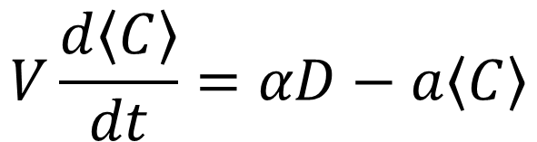

PK (Pharmacokinetic) modelling
Volume V
$$D$$
$$\left\langle C\right\rangle$$
a
Conservation equation
$$V\frac{d\left\langle C\right\rangle }{dt}=αD−a\left\langle C\right\rangle$$
McCarley & Bunge (2001) J. Pharm. Sci. 9: 1699-1719
Key Considerations
What information is lost by assuming average concentration?
Should the model have multiple compartments?
Should other dynamic behaviours be included in model?
Potential to estimate parameters from literature.

Slide 3
Drug Kinetics: ADME processes
Dose
Absorption
Distribution
Metabolism
Excretion
Unbound drug
Bound drug
Key Considerations
Mechanisms for binding
Reversible process?
Differences bound vs. unbound drug
Eliminated (Metabolism and excretion)

Slide 4
Movement in skin
/
/
D
v
Desquamation
Skin
Tissues
Key Considerations
Components of movement
Routes through skin – aqueous vs lipid
Spatial domain
Path length
Boundary conditions

Slide 5
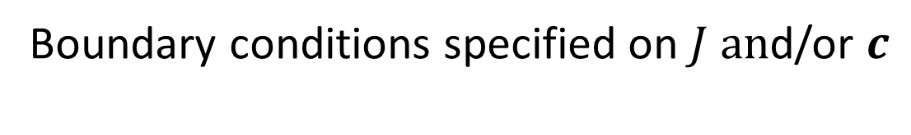
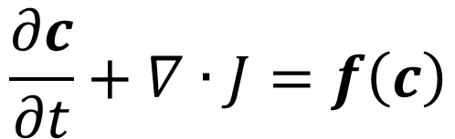
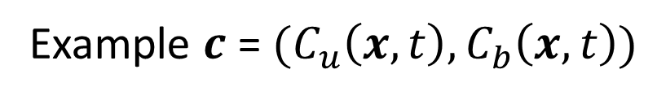
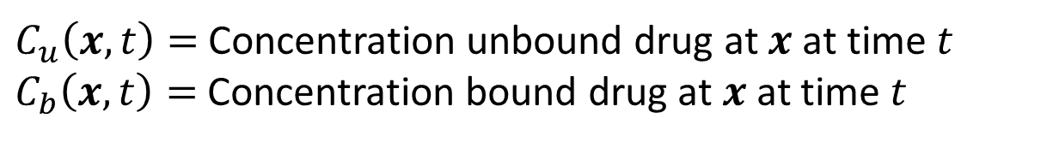
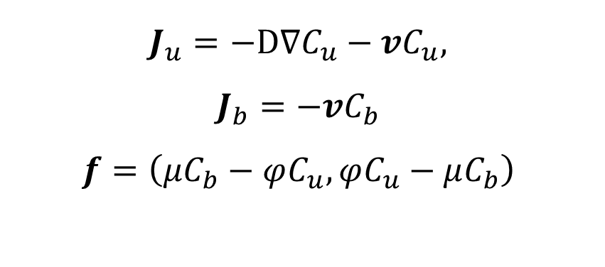
Conservation equation
$$\frac{∂c}{∂t}+∇∙J=f\left(c\right)$$
Boundary conditions specified on $J an$d/or $c$
Example $c$ = ${(C}_{u}\left(x,t\right), C_{b}\left(x,t\right))$
$C_{u}\left(x,t\right)=$ Concentration unbound drug at $x$ at time $t$
$C_{b}\left(x,t\right)=$ Concentration bound drug at $x$ at time $t$
$J_{u}=−D∇C_{u}−vC_{u},$
$$J_{b}=−vC_{b}$$
$$f=\left(μC_{b}−φC_{u},φC_{u}−μC_{b}\right)$$

Slide 6
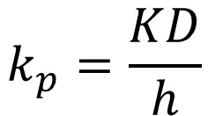
Relationship between movement and physico-chemical properties of drugs
Partition between skin and formulation
Diffusion coefficient
$$k_{p}=\frac{KD}{h}$$
Permeability coefficient
Path length
$$\log\left[k_{p}(cmh^{−1})\right]=−2.7+0.71\log{K_{oct}−0.0061MW}$$
Octanol-water partition coefficient
Molecular weight
Potts & Guy (1992) Pharm. Res. 9: 663-669
Hadgraft(2004) Eur. J. Pharm. & Biopharm. 58: 291-299

Slide 7
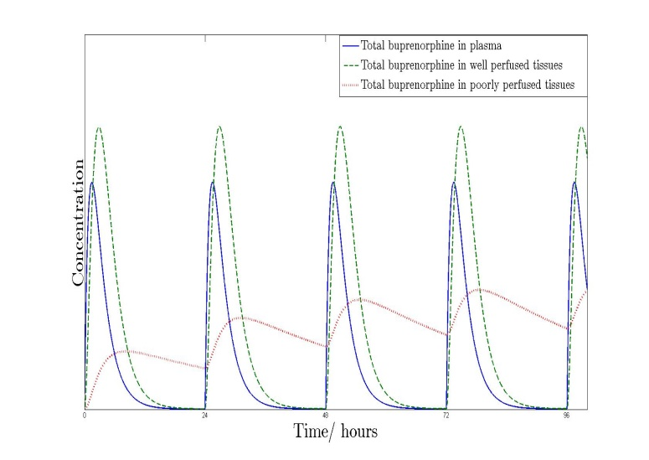
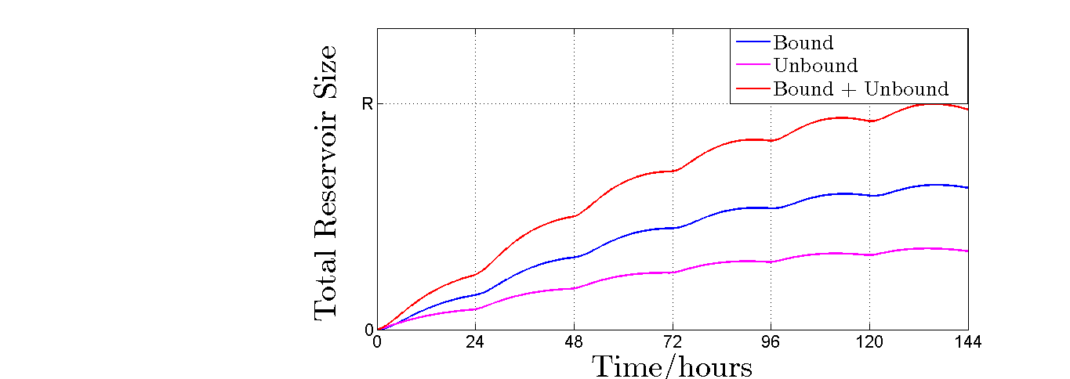
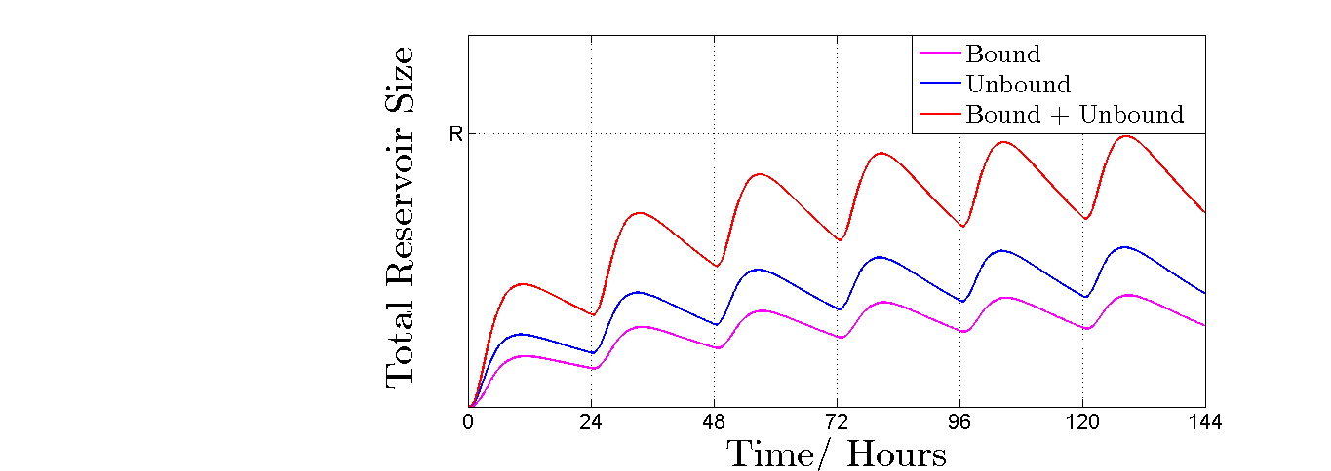
Impact of diffusion rate on skin drug reservoir
Systemic drug
concentration
D

Slide 8
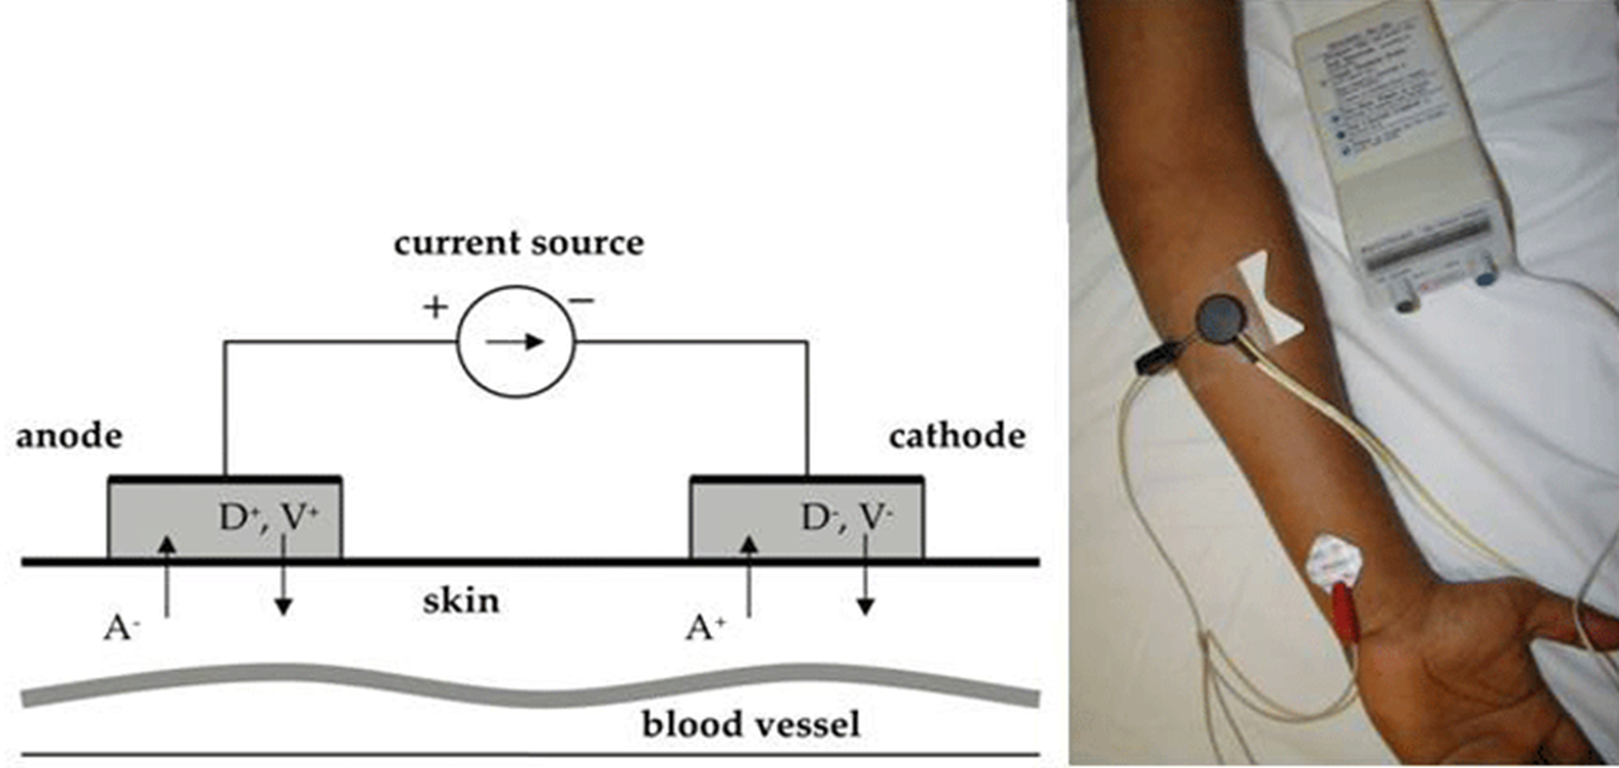
Drug extraction from skin reservoir

