Slide 1

Design of First in Human Trials
Alun Bedding

Slide 2
FIH - Introduction
First time the drug is given to a human subject following extensive animal trials.
Can be in healthy volunteers or patients.
Doses are escalated to a scheme – which could be pre-defined.
A single dose is given to a subject. A second study looks at multiple acsending doses (although these could be combined)
Escalation could be within a subject or between subjects.
Primary objective is safety and tolerability but there is an ever increasing need to look at early efficacy using biomarkers
Drugs may be single agents or in combination

Slide 3
Typical looking First in Human Studies
Single Ascending Dose – 7 doses in cohorts
3 D1 + 1 P
3 D2 + 1 P
3 D3 + 1 P
3 D4 + 1 P
Total n = 28
3 D5 + 1 P
3 D6 + 1 P
3 D7 + 1 P
Multiple Ascending Dose – 3 doses in cohorts
6 MD1 + 2 P
Total n = 24
6 MD2 + 2 P
6 MD3 + 2 P
Dose
Follow-Up
Notes:
3

Slide 4
Dose Escalation – Continual Reassessment Method – mainly used in Oncology
The Continual Reassessment Method (CRM) was proposed by O’Quigley, Pepe and Fisher (1990) for the Phase I dose finding trials in cancer, to address concerns in standard designs (3 +3) that were in use:
Inactivity of the treatment at low doses
Severe toxic effects expected at high doses
Poor knowledge of the dose toxicity relationship at the start of the trial
Potential therapeutic benefit for the patient
Need for efficient design with a small number of patients

Slide 5
Background to the CRM
The CRM, as its name suggests, is a continually adapting design, but just for binary data
Uses all data accumulated so far to determine the target dose, reassessing the target dose after each subject provides data
Assumes dose toxicity follows some montonic relationship
Also uses prior information, employing Bayesian methodology
Initially designed for toxicity studies, but equally applicable to efficacy, or both efficacy and toxicity in the bivariate CRM
Toxicity study targets the Maximum Tolerated Dose (MTD)
Efficacy study targets the Minimum Efficacious Dose (MED)

Slide 6
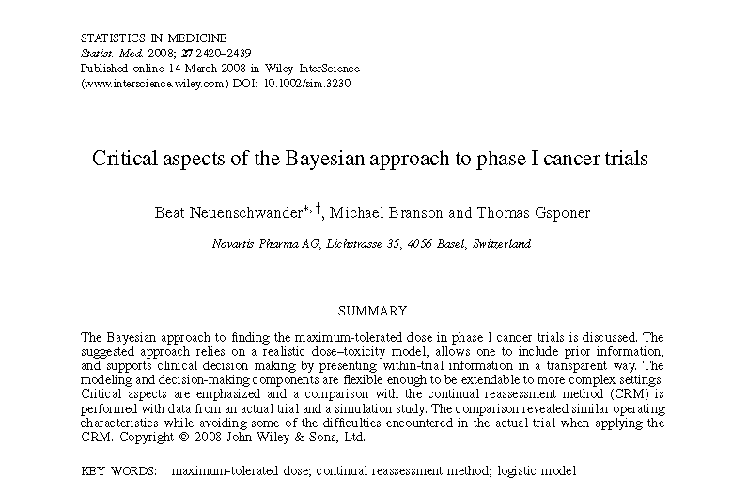
Neuenschwander et al (2008)
Uses a two parameter logistic model instead of one-parameter
Targets an acceptable region and has restrictions on other regions:
Under dosing, excessive toxicity and unacceptable toxicity

Slide 7
Example Escalation
1/3
1/2
0/3
1/2
1/3
0/3
0/2
0/3
0/1
0/1
=MTD
Notes:
This is FAK113517 Study
Things to point out:
Notice that we started with only 1 and titrated up quickly through the very low doses (modified 3+3)
Notice that we did not always have exactly N=3 or N=6 and that technically at 1250 doses we should have enrolled one more patient.
In the first cohort of 1250, there was a patient that had Grade 2 fatigue (as well as N/V), although this was not considered as a DLT. However, the event was similar to what happened to one of the patients with a DLT at 1500mg. Upon review of the 1250 and 1500 mg data, as noted in the meeting minutes, the investigators thought the tolerability and toxicities were similar between the 1250 and 1500 mg cohorts. In addition there was no significant difference in the PK profiles at 1000mg vs 1250mg so for these reasons we selected 1000 as the MTD.
These sort of discussions are typical for dose escalation studies. More than just the number of DLT’s is taken into account.

Slide 8
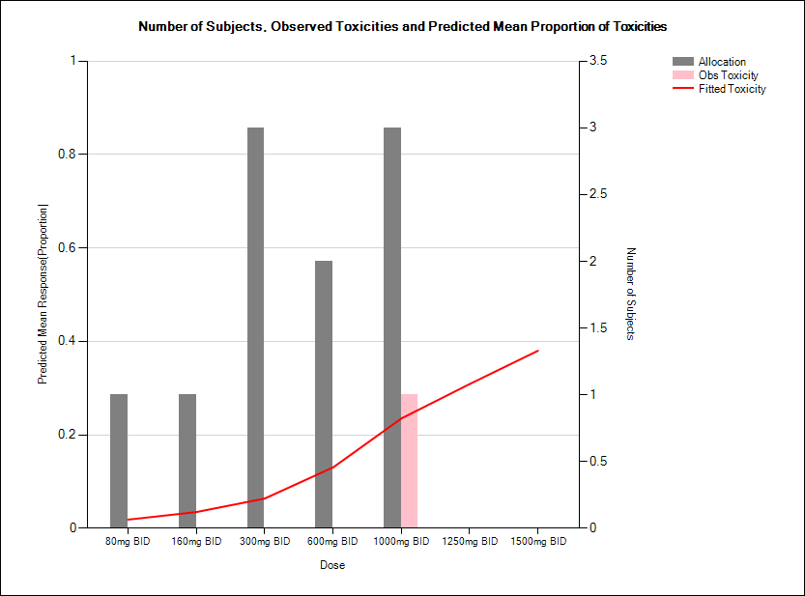
You might then fit a model

Slide 9
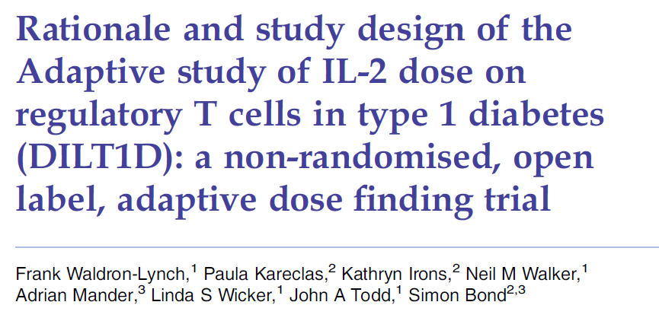
Example Adaptive FIH Study

Slide 10
What was the design of this study?
Primary outcome – dose response of the maximum % increase in regulatory T-cells over baseline.
Two parts – learning phase, adaptive phase
Learning phase
First 10 patients receive doses 0.04, 0.16, 0.6,1, 1.5 IU/m² in ascending order.
Two targets are identified – maximal and minimal T-reg increase.
Adaptive phase
Interim analysis after every patient to determine the optimal dose for the next patient.
Based on minimizing the variance-covariance matrix of the targets
Total sample size was 40.

Slide 11
Learnings from this trial
The adaptive design was more than flexible enough to quantify the dose response curve and identify the dose which achieve the targets.
However, the team thought it could have been done with less patients.
The following is an idea of a design !!!!!

Slide 12
Example Combined SAD and MAD trial
SD
MD
N=2
N=2
N=2
N=2
N=2
N=2
N=2
N=2
N=2
N=2
Dose
Follow-Up
Analysis
Notes:
12

Slide 13
Adaptive Randomisation (applied at every analysis )
The process for adaptation uses the methods as outlined by the paper “Dose-Finding Based On Efficacy-Toxicity Trade-Offs” by Peter F. Thall and John D. Cook, Biometrics Sep 2004.
Dose response models updated after every patient has PD and safety data after both single and multiple dose.
For this study the utility is a balance PD effect (clinically relevant effect = 15%) and safety:
For PD we assign the utility U_{PD}
PD < 0 then U_{PD} = 0
0 ≤ PD ≤ 15% then U_{PD} = PD * 6.67
PD > 15% then U_{PD} = PD
Then for each safety parameter (1 to X) we assign the following utility (U_{Sx}):
Pr(safety exceeding threshold) < 20% then U_{Sx} = 1
Pr(safety exceeding threshold) ≥ 20% then U_{Sx} = 0
Then the joint utility or gain is: U_{PD} * U_{S1} * U_{S2} ……..* U_{Sx} where X is the total number of safety endpoints.
Pick the next dose which has the highest probability of having the highest utility.

Slide 14
Escalation could be within a subject instead of between subjects

Slide 15
Model within subject dose escalation

Slide 16
Other things to take think about
Should escalation be done only on toxicity? Could we use some bivariate – biomarker and toxicity – some work done by Thomas Jaki at Lancaster
TGN1412 Story – taking this into account
Combinations – PIPE designs by Adrian Mander (MRC) but are these the best approach?
We don’t use pre-clinical information well – can we incorporate this into a prior of some sort?

Slide 17
Doing now what patients need next

