Slide 1
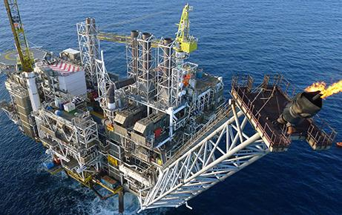
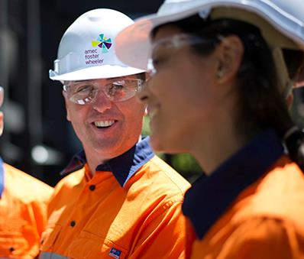
Amec Foster Wheeler Overview
Paul N Smith
28 February 2015

Slide 2
Global
40,000 staff;
150+ years of history, operating in over 50 countries;
We serve the oil & gas, clean energy, environment & infrastructure and mining markets;
We offer consultancy, engineering, project management, operations and construction services, project delivery and specialised power equipment services to our customers worldwide;
Our customers, in both the private and public sector, are among the world’s biggest and best in their fields - BP, Shell, BR Petrobras, KNPC, Ontario Power Generation, GDF Suez, Sempra, ExxonMobil, Dow, Ineos Bio, EDF, U.S. Dept of Homeland Security, Hyundai, Ministry of Transportation, Rio Tinto, Northumbrian Water, Codelco, Chevron, K+S, Saudi Aramco, Petronas, Pemex, Marubeni Corporation, Duke Energy,

Slide 3
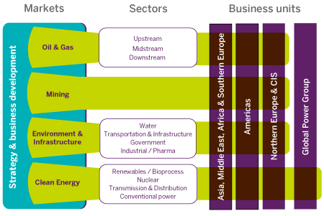
Structure

Slide 4
Nuclear
More than 3,000 nuclear specialists
Operating from our main locations in:
UK
Canada
US
Amec Foster Wheeler partners with key customers such as:
EDF
the Nuclear Decommissioning Authority,
Bruce Power
BAE Systems
Rolls Royce

Slide 5
Nuclear Services
We offer the full range of nuclear services from site management through to waste management and decommissioning.
We are providing:
architect engineer services to EDF for their UK new build programme
Support to one of the largest and most challenging nuclear engineering projects at Bruce Power in Canada
site management as part of Nuclear Management Partners to Sellafield in the UK
technological and analytical services to our customers and their subcontractors through our world class radiochemistry laboratories
Advanced software tools via the ANSWERS Software Service

Slide 6
Thank you!

