Slide 1
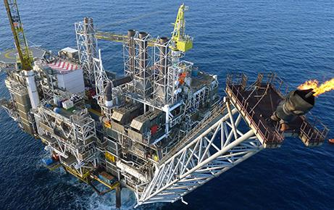
Why is Monte Carlo Reactor Physics Difficult?
Paul N Smith
26 February 2015

Slide 2
Introduction
Nuclear Data
Geometry
Reactor Physics vs Criticality
Starting Guess / Settling Stages

Slide 3
Nuclear Data – Schematic Cross-Section

Slide 4
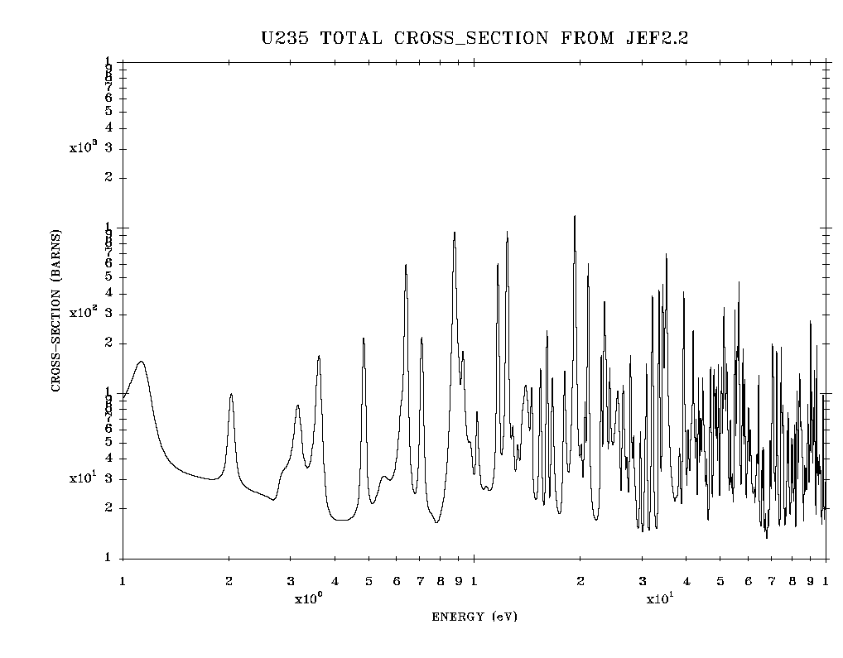
Nuclear Data – Example Resonance Region

Slide 5
Nuclear Data – Continuous Energy Representation
Reaction cross-sections are stored in evaluated nuclear data files using analytic expressions
For computation a fine energy grid is used of order 2x10⁵ nodes to create a nuclear data library for a code
A different, optimised energy grid is used for each nuclide
Searching through different non-uniform energy grids is a computationally intensive task
A typical nuclear data library takes ~ several Gb of space
We typically ship many libraries with a code: JEFF, ENDF/B, CENDL & JENDL

Slide 6
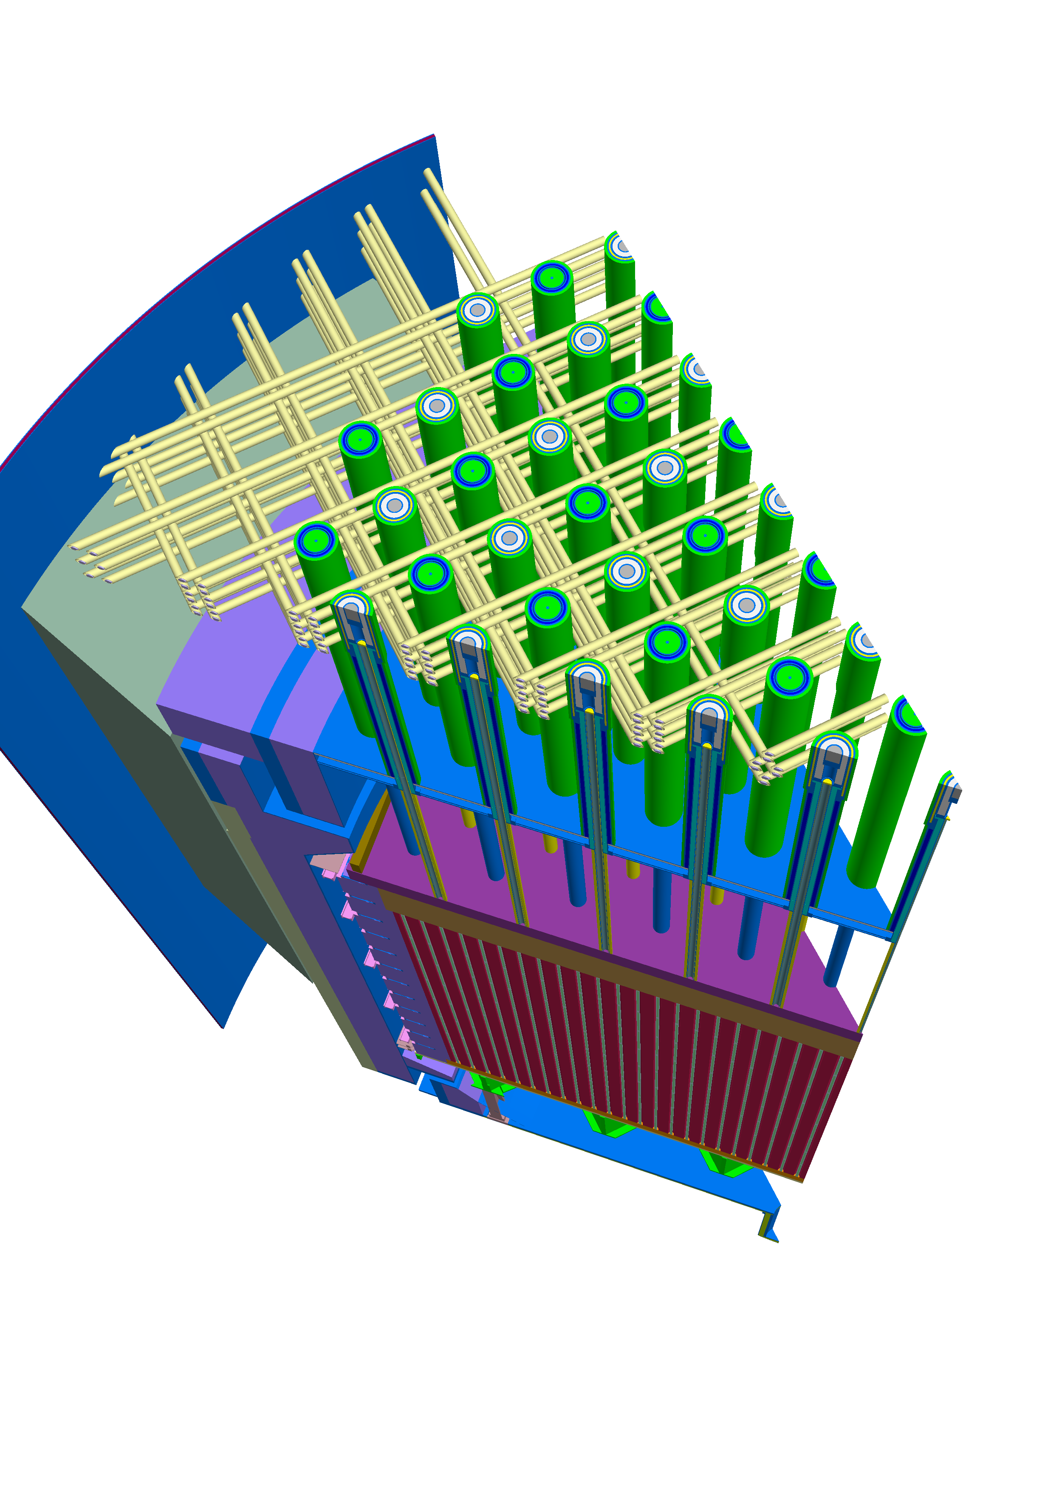
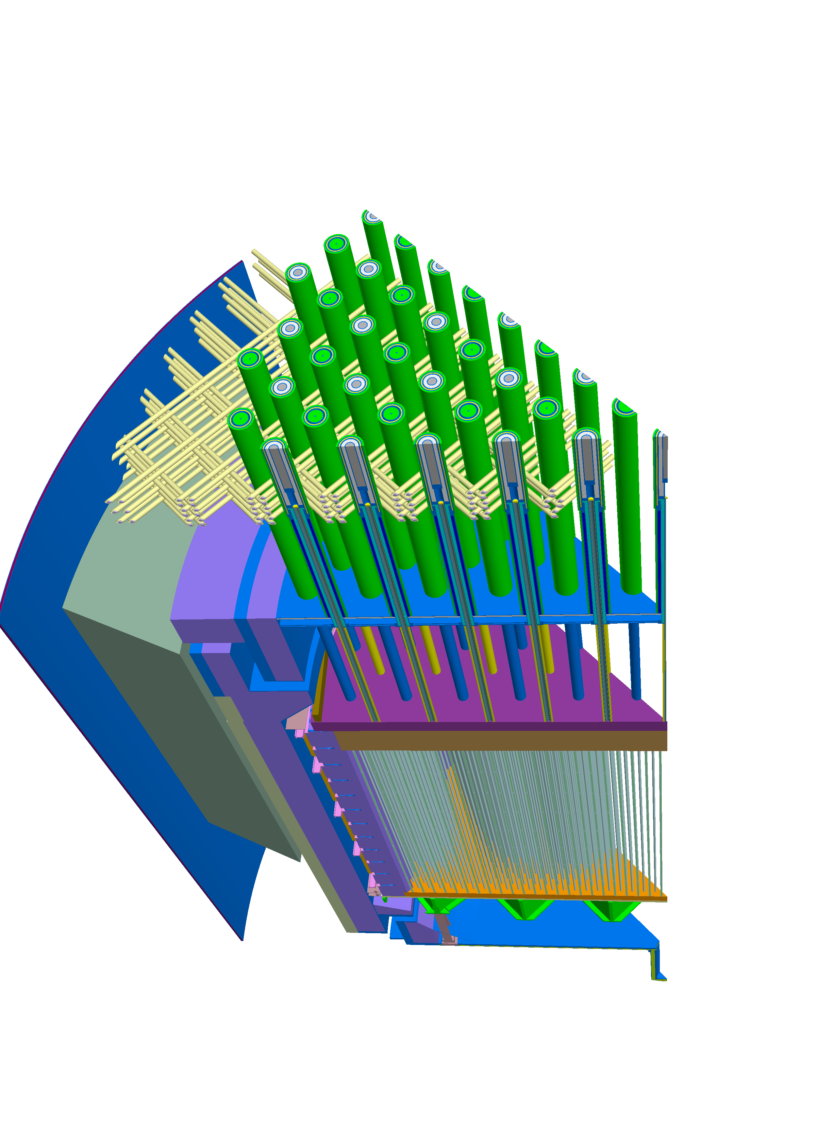
Geometry: Example AGR Core

Slide 7
PWR Core
~300 fuel pins in a fuel assembly
~200 fuel assemblies in the core
~100 axial nodes required for power distribution
~10 regions for each axial slice
=> ~6x10⁷ cells

Slide 8
PWR Core Flux/Power Distribution
Flux requires ~6x10⁷ tallies cf 1 tally for criticality
Every collision produces a tally for k_{eff} cf only one collision in 6x10⁷ produces a tally for the flux in a given cell
Assume10⁻² (1%) accuracy for flux cf 10⁻⁴ (10 pcm) for k_{eff}
SD ~ N^{-1/2}
Hence flux solution requires 6000 times as many samples as criticality calculation
I.e. 1 hr criticality calculation becomes a 1 year flux calculation

Slide 9
Reactor Depletion/Burnup
Need to tack the evolution of ~ 100 nuclides in each of 60 million cells
Hence require ~6x10⁹ = 6 billion tallies
Now a 1 hr criticality calculation corresponds to a 100 year depletion calculation at every timestep of the depletion cycle (or ~ 1 year on 128 cores).
Have tens of burnup steps.

Slide 10
Representation of Distributions
In a computer calculation have discrete events – how best to construct continuous distributions?
Above approach is to mesh the domain and calculate average values for each cell.
How to interpolate between cell averages?
How to optimise the mesh?
Cell average values are subject to stochastic noise.
Can results from neighbouring cells be combined to give trends and reduced noise?

Slide 11
Representation of Distributions - 2
Alternative approaches are possible.
For example, expand the distributed parameter(s) in terms of a set of basis functions.
Use Functional Expansion Tallies (FETs) to score the coefficients of the basis functions.
How to optimise choice of basis functions?
FET Reference: Griesheimer, Martin and Holloway, “Convergence properties of Monte Carlo functional expansion tallies”, J. Comp. Phys., 211, pp129-153, 2006.

Slide 12
Boltzmann Transport Equation
Ivan Vis 2:
For a nuclear reactor
Hence want to solve
This is an eigenvalue problem so actually solve
Where it is straightforward to show that the eigenvalue is given by:

Slide 13
Source Starting Guess
Want to solve
The source on the RHS is proportional to the flux that we are trying to solve for.
Need to supply an initial guess for the source distribution.
The initial guess is used to define the source particles for the first stage of the MC calculation
This guess will usually be a poor representation of the source distribution and so the first stage will give inaccurate (biased) results.
However it should give an improved source distribution for stage 2.

Slide 14
Settling Stages
The second stage will be an improvement on the first stage and will provide an improved source distribution for the third stage, which should therefore be an improvement on the second stage, and so on.
The early stages will bias the final result, but as the number of stages tends to infinity the bias will be reduced by dilution with numerous accurate stages.
In order to reduce the bias without resorting to an infinite number of stages, the early stages are discarded – these are referred to as Settling Stages and the stages that are retained are referred to as Scoring Stages.

Slide 15
How many Settling Stages are Required?
This is an unsolved problem – just reviewed 211 papers.
Researchers tend to look at how the source distribution is evolving, rather than the effect it has on the results.
Why discard some stages, why not weight stages with a function that increases towards 1 as the source representation improves?
Currently everyone uses a Heaviside weighting function – is this the best approach?

Slide 16
Thank you!

