Slide 1
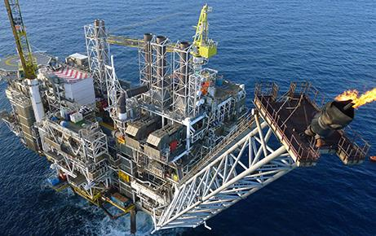
ANSWERS Software Service Overview
Paul N Smith
26 February 2015

Slide 2
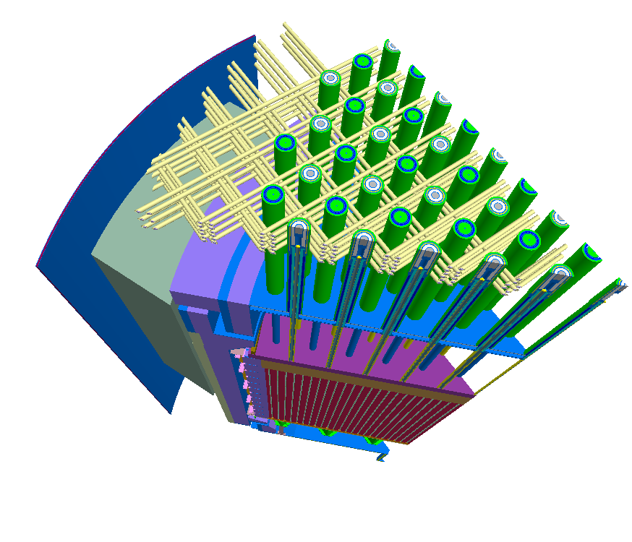
ANSWERS Software
ANSWERS offers a range of services and products in the areas of:
Reactor Physics and Nuclide Inventory
Radiation Shielding and Dosimetry
Nuclear Criticality Safety
Other stuff
In existence > 30 years
Distribute to 30 countries

Slide 3
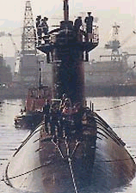
Reactor Physics Software
The WIMS modular family of software
Currently capable of modelling all thermal reactor types:
PWR, BWR, VVER, RBMK, CANDU, AGR, VHTR, Magnox and Material Test reactors
Wide range of methods up to a 3D whole core capability
Collision Probability Method (2D)
Characteristics Method (3D)
Diffusion Method (3D)
Monte Carlo Method (3D)
FISPIN is used to for nuclide inventory predictions

Slide 4
Reactor Physics Software
The PANTHER Core Performance package for PWR, BWR, AGR, MAGNOX, RBMK & VVER combines the strengths of:
WIMS - to determine few group lattice data for whole core calculations
PANTHER- which uses general transient diffusion and thermal hydraulic methodologies
to carry out a comprehensive range of calculations for the analysis of thermal reactor cores:
Steady State Performance, Fuel Management, Safety Transient Analysis, On-line core support and Operational Support

Slide 5
Shielding Software
MCBEND - A generalised 3D Monte Carlo code for radiation transport applications.
Forward & adjoint solutions
Importance map generation
Splitting & Russian Roulette
RANKERN - A 3D point kernel method for design and assessment of gamma-ray shielding

Slide 6
Shielding Software
MCBEND - A generalised 3D Monte Carlo code for radiation transport applications.
Forward & adjoint solutions
Importance map generation
Splitting & Russian Roulette
RANKERN - A 3D point kernel method for design and assessment of gamma-ray shielding

Slide 7
Shielding Software
Amongst their many applications MCBEND & RANKERN have been extensively used for:
The design substantiation of the radiological shields for Sizewell B PWR
The design of THORP at Sellafield.
Plant Life Extension calculations for Magnox, AGR, PWR and BWR reactors (RPV Damage)
Neutron Flux calculations for Decommissioning Inventories of Magnox Plant
The assessment and design of shipping casks and source transport containers
Nuclear instrumentation calibration
Analysis of bore-hole logging tools
The design and operational assessment of a Gamma Irradiation Facility
Shield design for medical linac at NPL

Slide 8
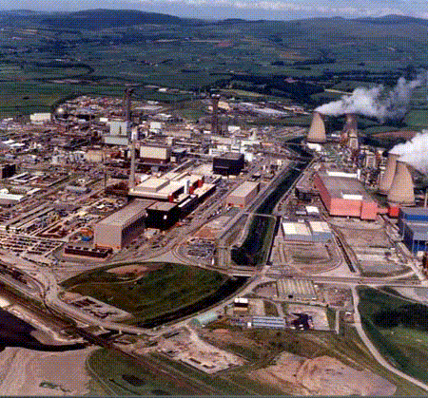
Criticality Software
WIMS - a fast assessment tool for a wide range of systems
MONK - a 3D Monte Carlo neutronics code for criticality assessment
Super-History powering
Conventional & Woodcock tracking

Slide 9
Criticality Software
Amongst many applications MONK has been extensively used for:
supporting studies for Sellafield Ltd plant:
THORP, MOX fuel plant, Oxide Fuels Complex, Vitrification Plant, Encapsulation Plant
shipping cask assessments
fuel pond storage analyses
dry fuel store design studies
waste storage analyses
burn up credit studies

Slide 10
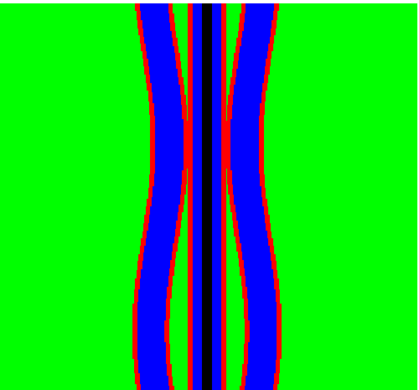
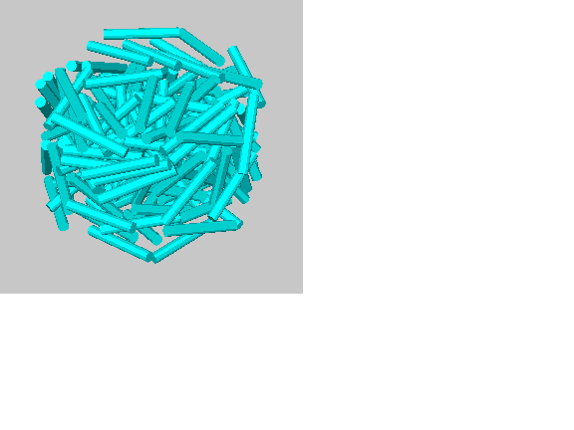
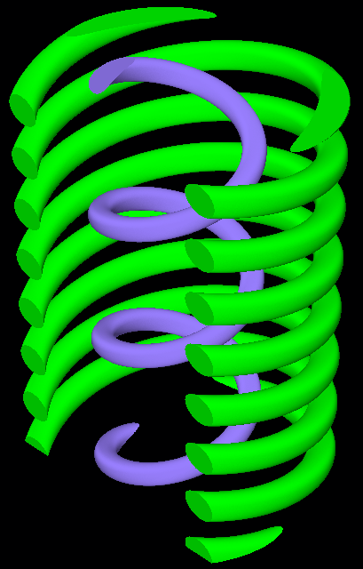
Shielding & Criticality Software
Improved nuclear data capabilities
The new BINGO continuous energy nuclear data library
Run-time doppler broadening
Burnup and thermal-hydraulic coupling
On-going geometry improvements
Bent pins, random RODs, coiled wire, PBMR, TET Mesh, CAD

Slide 11
Nuclear Data
Nuclear data is at the heart of all ANSWERS Software. The ANSWERS nuclear data team have been responsible for providing nuclear data for all codes from UKNDL, JEFF3.1, ENDF/B7, CENDL3.1 and JENDL3 data libraries:
Multigroup transmission and diffusion data (172 & 1986 groups)
Point-wise in energy transmission data
Fission Product, Activation and Actinide data
Particle production data (including gamma-ray production)
Variance-Covariance data

Slide 12
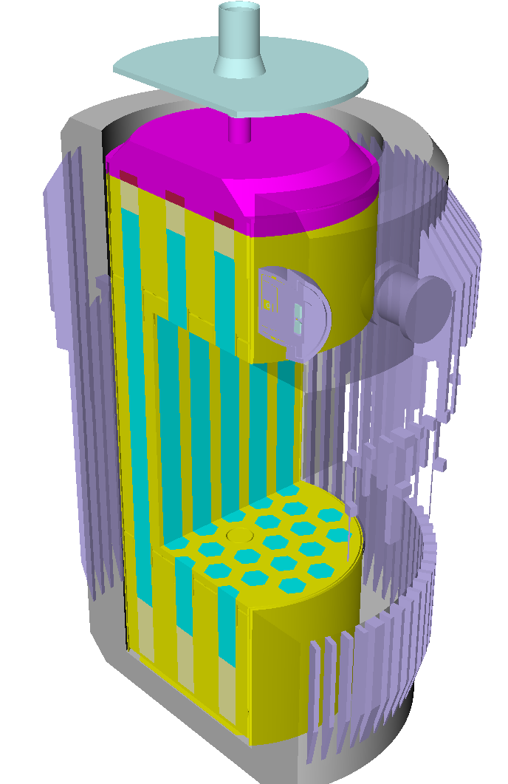
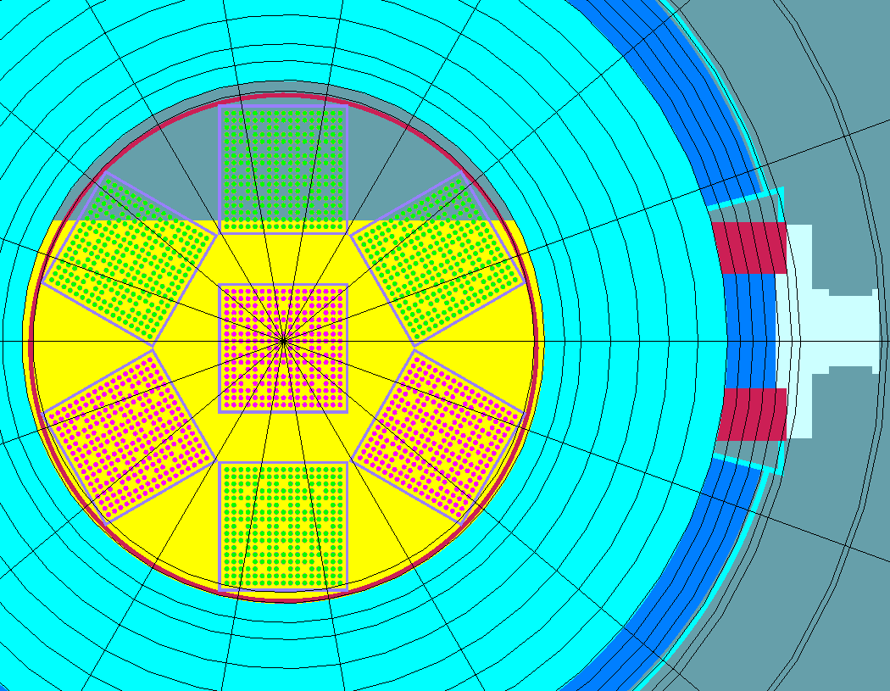
Graphics Software

Slide 13
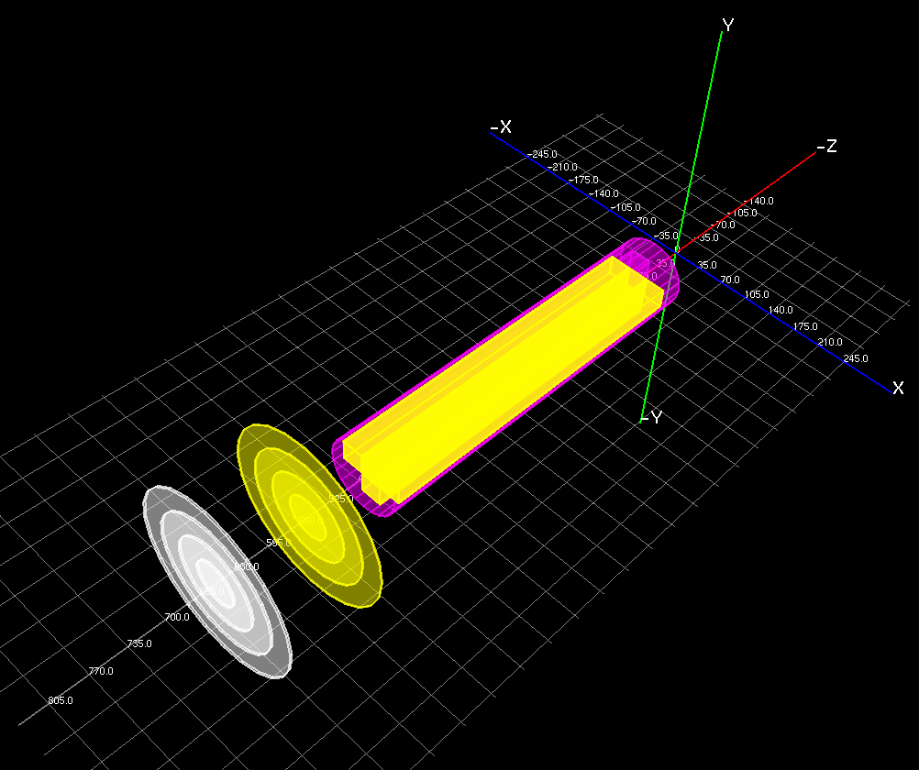
Graphics Software

Slide 14
Customer Support Services
Helpline providing access to expert technical support
Easy-to-use documentation and interfaces
Computer-based workshops
Ready-to-run software
Central validation database
Supporting applications documentation
Quality Management System certified to ISO 9001

Slide 15
Thank you!

