Slide 1
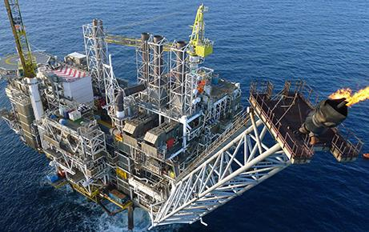
Problem Overview
Paul N Smith, Max Shepherd
1 June 2015

Slide 2
Contents
Commercial background
Amec Foster Wheeler
The ANSWERS suite of software
Technical background
The Boltzmann Transport Equation
Deterministic versus Monte Carlo methods
Challenges in Monte Carlo
Why is MC reactor physics hard?
Calculation of distributed parameters

Slide 3
Contents
Commercial background
Amec Foster Wheeler
The ANSWERS suite of software
Technical background
The Boltzmann Transport Equation
Deterministic versus Monte Carlo methods
Challenges in Monte Carlo
Why is MC reactor physics hard?
Calculation of distributed parameters

Slide 4
Amec Foster Wheeler
Key Points
43,000 employees
Working in a variety of sectors: Oil & Gas, Clean Energy, Environment and Infrastructure, Mining
Provider of: Consultancy, Engineering, Project Management
Clients include:
BP
Shell
GDF Suez
EDF
Many more
Nuclear business
Sits within Clean Energy
3,000+ Nuclear specialists
Main locations in: UK, Canada, US
Offices in many other countries throughout the world
Key nuclear clients include:
EDF
Nuclear Decommissioning Authority
Bruce Power
BAE Systems
Rolls Royce

Slide 5
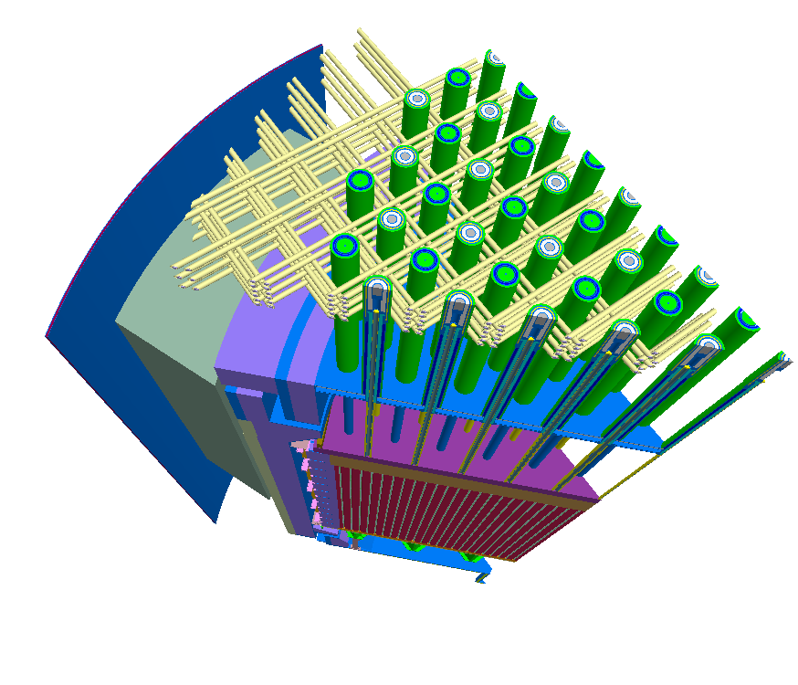
ANSWERS
Sits within Clean Energy
Provider of internationally recognised codes for:
Shielding (MCBEND, RANKERN)
Criticality (MONK)
Reactor Physics (WIMS, MONK)
Codes, going under their current names, have been used and developed for 30+ years.
MONK, if you include its predecessor GEM, has been in use for nearly 50 years.
We supply software and support to customers in ~30 countries.

Slide 6
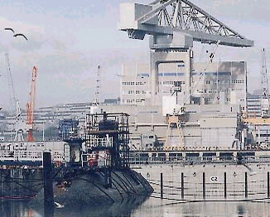
Shielding software
MCBEND – A generalised 3D Monte Carlo for radiation transport applications
Forward & adjoint solutions
Importance map generation
Splitting & Russian Roulette
RANKERN – A 3D point kernel method for design and assessment of gamma-ray shielding

Slide 7
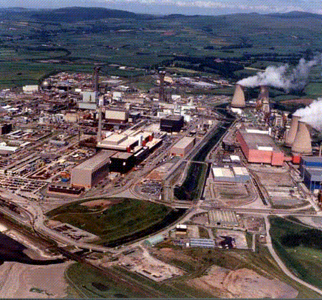
Criticality Software
WIMS – a fast assessment tool for a wide range of systems
MONK – a 3D neutronics code for criticality assessment
Super-History powering
Conventional and Woodcock tracking

Slide 8
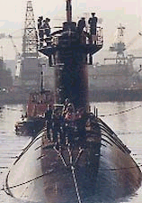
Reactor Physics Software
The WIMS modular family of software
Currently capable of modelling all thermal reactor types:
PWR, BWR, VVER, RBMK, CANDU, AGR, VHTR, Magnox and Material Test reactors
Wide range of methods up to a 3D whole core capability
Collision Probability Method (2D)
Method of Characteristics (2/3D)
Diffusion Method (3D)
Monte-Carlo Method (3D)
FISPIN is used for nuclide inventory predictions

Slide 9
Example applications
Applications of MCBEND include:
Design substantiation of radiological shields for Sizewell B
Design of THORP at Sellafield
Plant life extension calculations for Magnox, AGR, PWR and BWR reactors (RPV damage)
Neutron Flux calculations for decommissioning inventories of Magnox Plant
Assessment of transport flasks and storage containers
Analysis of bore-hole logging tools
Shield design for medical linacs
Applications of MONK include:
Supporting studies for Sellafield: THORP, MOX fuel plant, Oxide Fuels Complex, Vitrification Plant, Encapsulation Plant
shipping cask assessments
fuel pond storage analyses
dry fuel store design studies
waste storage analyses
burn up credit studies

Slide 10
Contents
Commercial background
Amec Foster Wheeler
The ANSWERS suite of software
Technical background
The Boltzmann Transport Equation
Deterministic versus Monte Carlo methods
Challenges in Monte Carlo
Why is MC reactor physics hard?
Calculation of distributed parameters

Slide 11
The Boltzmann Transport Equation
Effectively, all the codes mentioned solve the Boltzmann Transport Equation.
The BTE is a statement of balance – it keeps track of the neutrons gained and lost in a system.
It has a 6+1 dimensional phase space (3 in space, 2 in direction, 1 in energy + time). We only solve the time independent problem.
The equation is not amenable to analytic solution without a very large number of assumptions – which render the solutions of minimal practical utility.

Slide 12
Radiation Transport
We can split neutron transport problems in to two problem types and two solution methods.
Problem types:
Shielding – We know the source distribution of neutrons (BVP).
Criticality / Reactor physics – We need to solve for the source distribution (Eigenvalue problem).
Solution methods:
Deterministic – Make approximations so that we can solve for the behaviour of average particles
Monte Carlo – Simulate the path of neutrons moving through the geometry and extract physically meaningful parameters by tracking where they go.
Monte Carlo methods make essentially no approximations, so they are considered something of a gold standard in the industry. Unfortunately, at the moment, they are computationally intractable for routine calculations of whole core problems.

Slide 13
Operator form of the BTE
Conceptually, it’s easiest to understand what’s going on in the BTE from the operator form of the equation
For shielding problems:
For criticality / reactor physics problems:
Where T is the transport operator, S is the scatter operator, F is the fission operator and Q is the source term, ψ(x, E, Ω) is the flux of particles at position x with energy E travelling in direction Ω and λ is the principal eigenvalue.
We generally talk about k-effective, the reciprocal of λ.

Slide 14
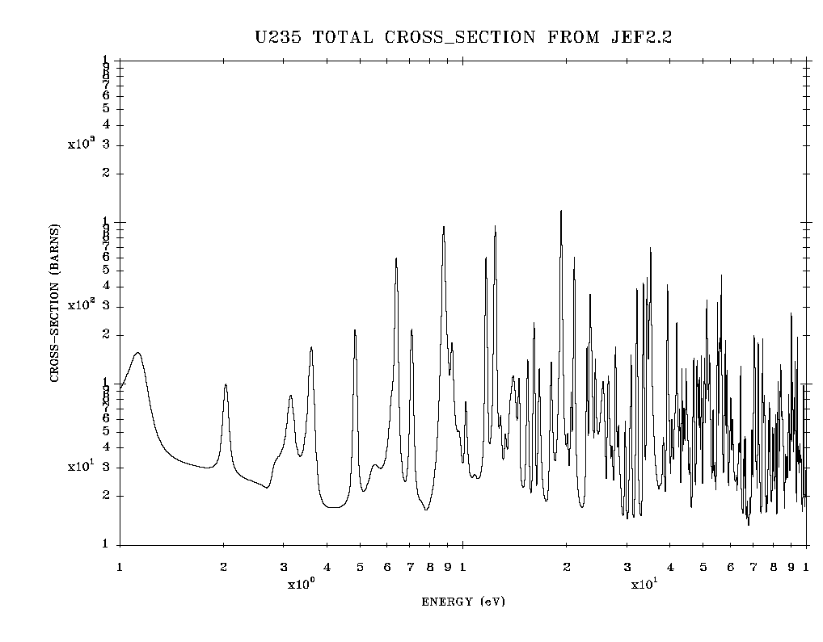
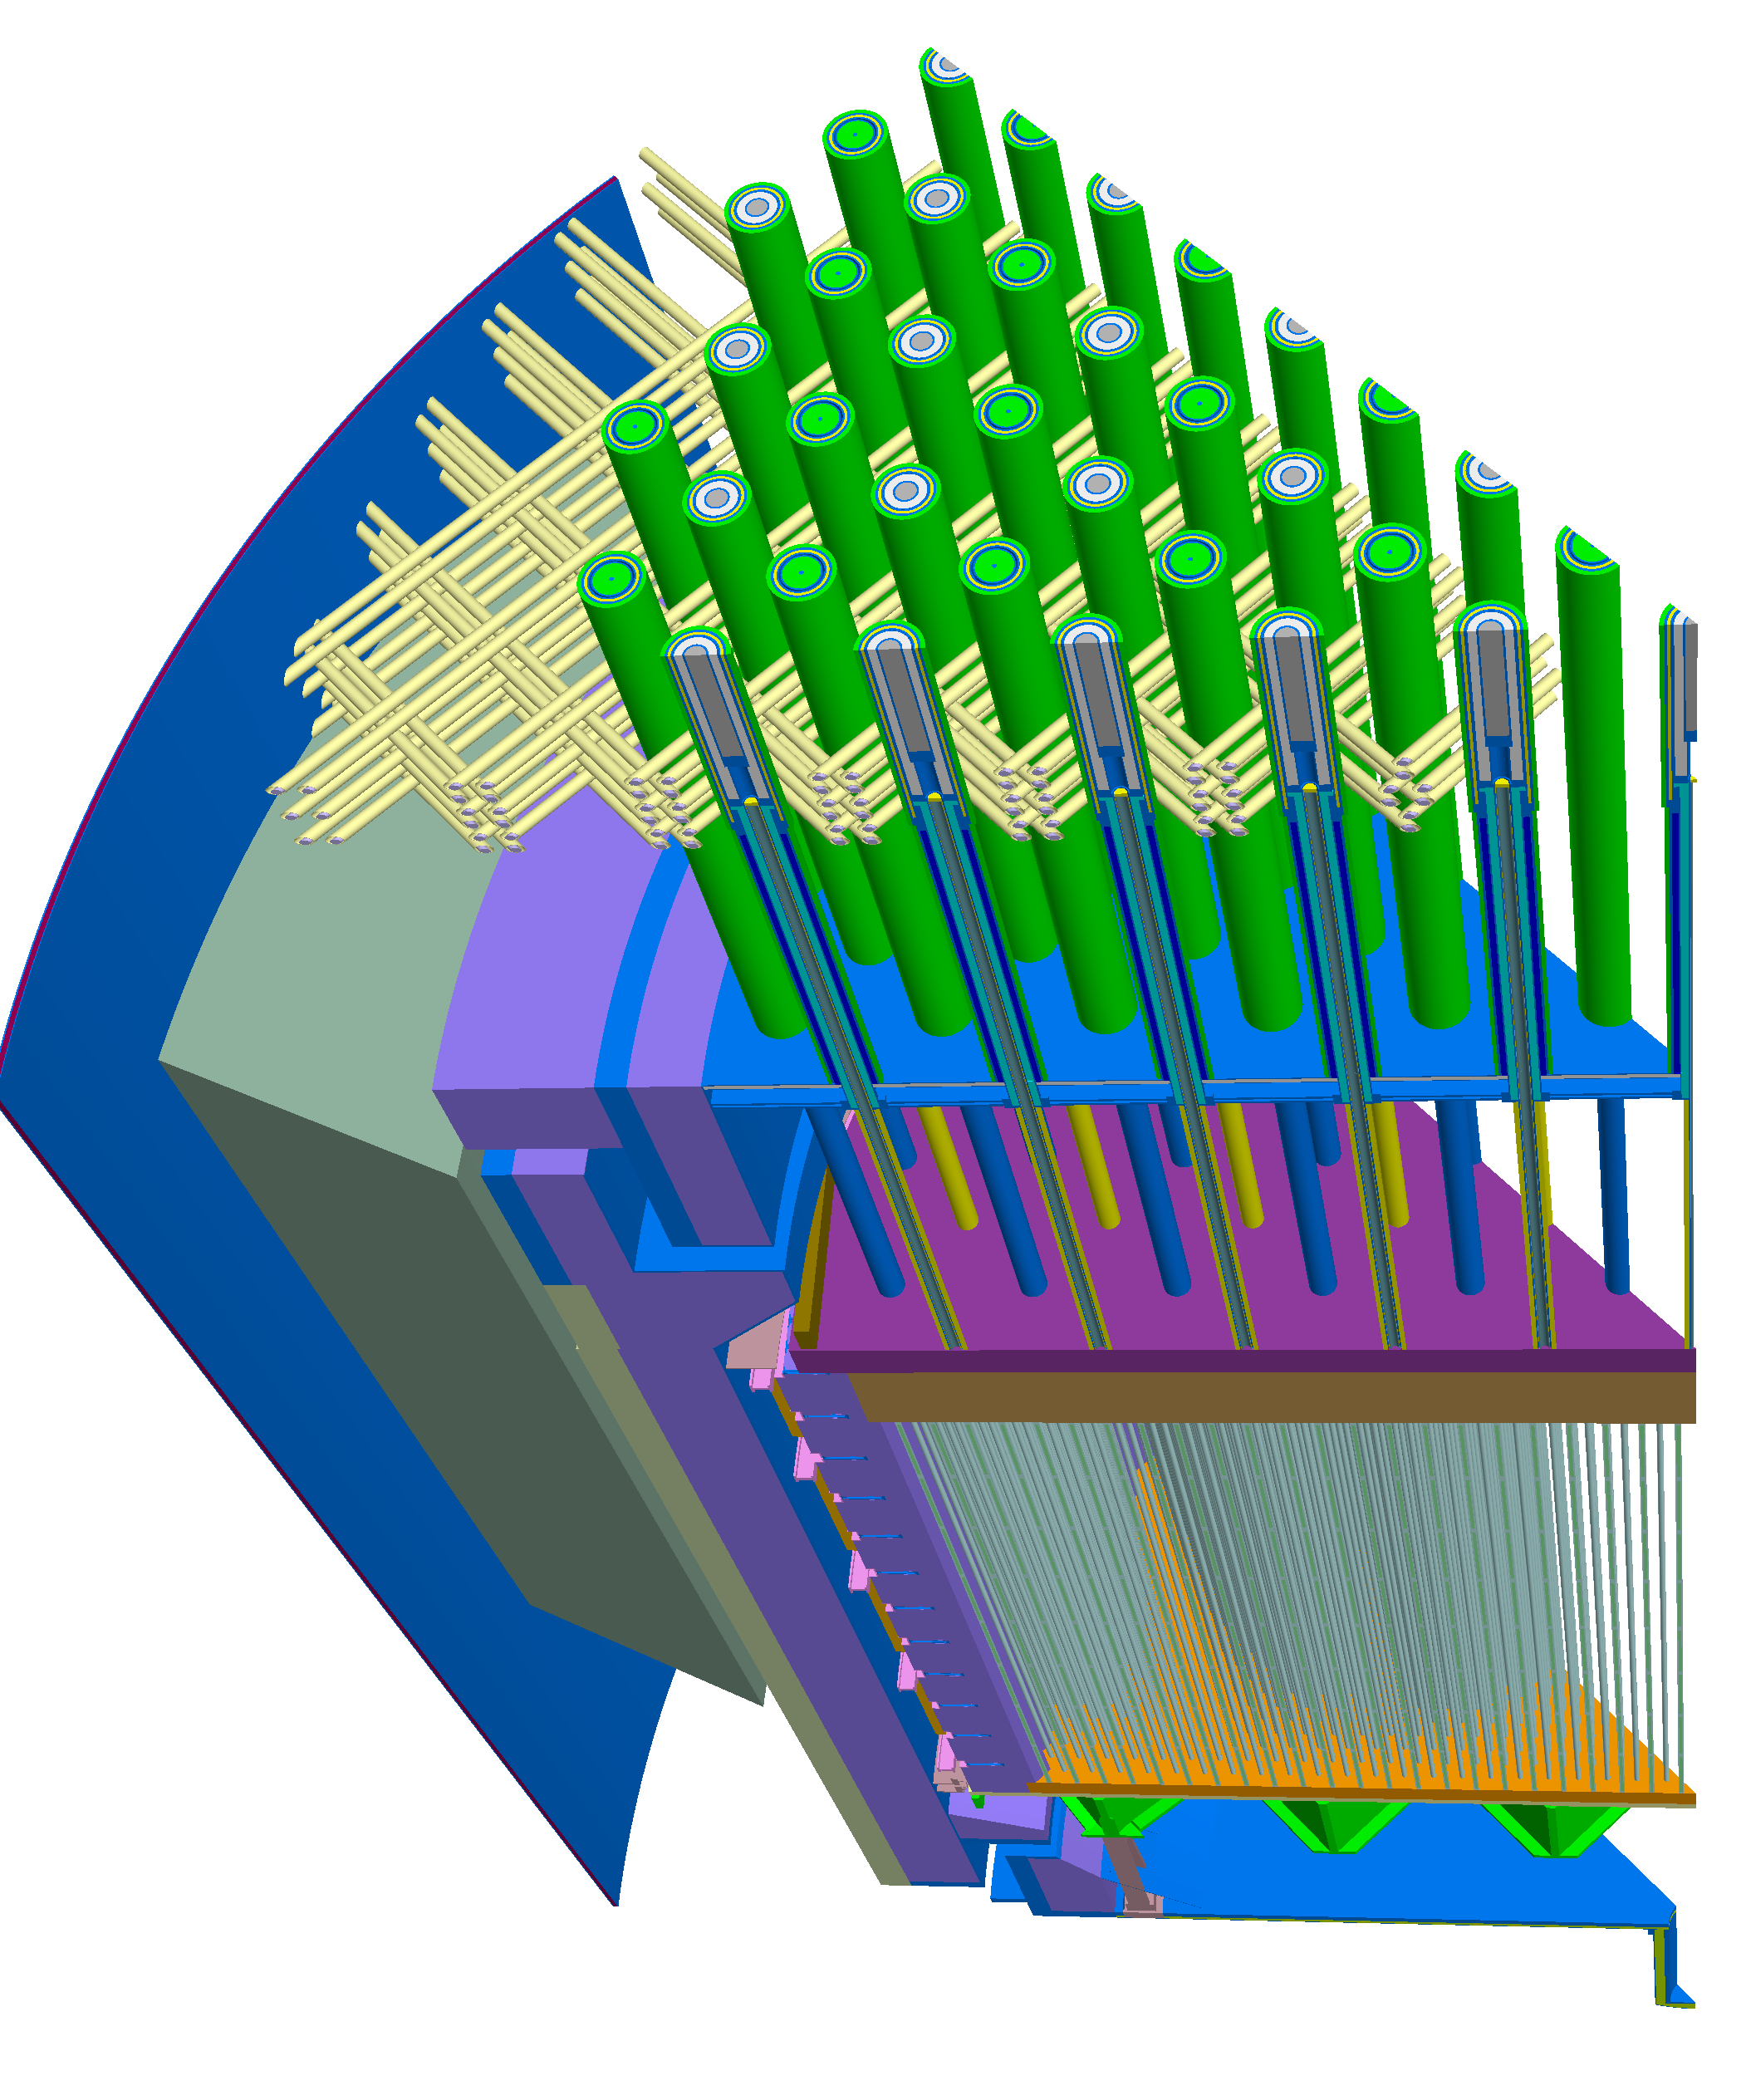
Why is solving the BTE hard?
6+1 dimensional phase space:
For a deterministic code need to discretise in:
position,
angle,
energy,
(and time)
Dependence of cross section on velocity / energy highly nontrivial
Complicated geometries:
Structure on multiple scales
Gap between pin and clad < 1mm
Height of core ~ 4m
Industrial problems completely lacking in symmetry

Slide 15
Deterministic methods
Deterministic methods generally run quickly but require high levels of approximation – the trick is knowing which approximations are valid in which circumstance.
The energy dependence is approximated by working in different energy `groups’ – can be as many as 172, often condense down to 6 or even 2 for a full core calculation.
Angular variation can captured using eg discrete ordinates: S_{N} (based on Gauss-Legendre quadrature) , P_{N} (based on spherical harmonics).
Finite difference based spatial discretisation (usually)
For full core problems, people generally use nodal two-group diffusion methods.
Carry out a calculation on an assembly level (with an infinite lattice i.e. 2D problem) to get homogenised cross-sections for assemblies and discontinuity factors.
This approach only works for reactors with a reasonable degree of symmetry and can introduce large errors if done incorrectly.

Slide 16
Monte Carlo Methods
In Monte Carlo methods, we follow neutrons through the geometry, keeping track of collisions and boundary crossings.
Capture
Source
Fission
Scatter
Source’
Escape
We use a continuous energy representation of the cross-section (as opposed to the energy groups used in deterministic calculations).
We do not need to discretise in angle or space.
`All’ we need to do is keep track of neutrons.

Slide 17
Assumptions for Monte Carlo Simulations
In a Monte Carlo simulation, we track each neutron individually (ie we assume superposition). In more detail, we make the following assumptions:
No time variation (of material properties/geometry etc)
Collisions instantaneous
No dependence on past neutron history (ie only care about current position, momentum, energy)
Material properties isotropic
No neutron-neutron interactions
Neutrons are point particles
Particle motion is classical (ie non-relativistic)
Quantum effects are unimportant (except in a few cases eg hydrogen)
Particles fly in straight lines between collisions
No back-reaction of the particle on the material/geometry

Slide 18
Nomenclature / Method
A history is a sequence of states p_{i}
When we follow a particle through the geometry, we describe this as tracking
We track the particle from one collision to the next.
A tally is a sum related to particle motion which is scored within a region for each history. Some example tallies include:
Collision density
Path length
So, the Monte Carlo method is:
Generate a history p_{i} by randomly sampling for the source and transitions
Estimate result by averaging over states of lots of histories

Slide 19
Overall process
For a fixed source problem we effectively:
Loop over all particles
Loop over all transition / collision in a history
For each transition / collision update the particle state using a combination of physics and random numbers
Tally results for k-effective etc
Amalgamate results from different histories into an estimate of the desired quantity
For an eigenvalue problem, we then loop over multiple sets of particles which we call stages.
The particles produced by fission in each stage are stored in a Fission Bank and used to create the source distribution for the next stage.
The source distribution for the first stage needs to be guessed / set by the user

Slide 20
Contents
Commercial background
Amec Foster Wheeler
The ANSWERS suite of software
Technical background
The Boltzmann Transport Equation
Deterministic versus Monte Carlo methods
Challenges in Monte Carlo
Why is MC reactor physics hard?
Calculation of distributed parameters

Slide 21
Contents
Commercial background
Amec Foster Wheeler
The ANSWERS suite of software
Technical background
The Boltzmann Transport Equation
Deterministic versus Monte Carlo methods
Challenges in Monte Carlo
Why is MC reactor physics hard?
Calculation of distributed parameters

Slide 22
Why is Monte Carlo reactor physics hard?
We’ve already seen why solving the BTE in general is hard. Particular challenges in Monte Carlo reactor physics are:
Representation of complicated energy dependence
Have different schemes for different nuclides
Need to search through non-uniform energy grids with ~10⁵ nodes
Calculation of distributed parameters
Number of tallies and computational time required for calculation of distributed parameters is very large
What is the best way to calculate / store distributed parameters?
Convergence of the fission source distribution
As we are solving an eigenvalue problem, we need an idea of what the source is, prior to being able to start calculating the eigenvalue

Slide 23
Challenges in Monte Carlo reactor physics
Monte Carlo is an inherently random process – we find the result of interest by averaging lots and lots of samples.
Thus, the rate of convergence for Monte Carlo is N^{-1/2} where N is the number of trials. That is, to double the accuracy, you need to run for four times as long.
For criticality calculations, where all you need to calculate is the principal eigenvalue λ, this isn’t actually a problem – every single neutron you track contributes to the statistics of the answer you want.
In reactor physics calculations, you need to know more than just the eigenvalue, you also want to know the eigenfunction, and other things derived from the eigenfunction – we call these distributed parameters.
Distributed parameters are calculated by overlaying a mesh on the model and tallying (ie counting) relevant things in the mesh cells.
There are other approaches to calculating distributed parameters.

Slide 24
Examples of tallies
We can tally things for selected events / subsets of the phase space eg:
Energy ranges
Particles in given cells
Particle crossing a specified service
Conditional events
Number of fission children
Energy of neutrons causing fission
Scattering from one range to another
Collision density
Path length

Slide 25
Some relevant physical quantities
The BTE equation is phrased in terms of the angular flux:
Integrating over angle and energy gives us the scalar flux:
This is the total distance travelled by the particles in a given volume per unit time
The reaction rate for a given reaction n is:
Reactions per unit volume per unit time
Where is the macroscopic cross-section for the reaction
The collision density is:
Where is the total macroscopic cross-section

Slide 26
Tallies for calculating flux
Some ways to estimate the flux include:
Collision density
Path length
Surface crossings
Flux at a point
There are various variance reduction techniques that involve weighting different particles. Assume particle i has weight w_{i}. Total weight is W. Work in a region of volume V.
Collision density tally:
Path length tally:
d_{i} length of particle path in region

Slide 27
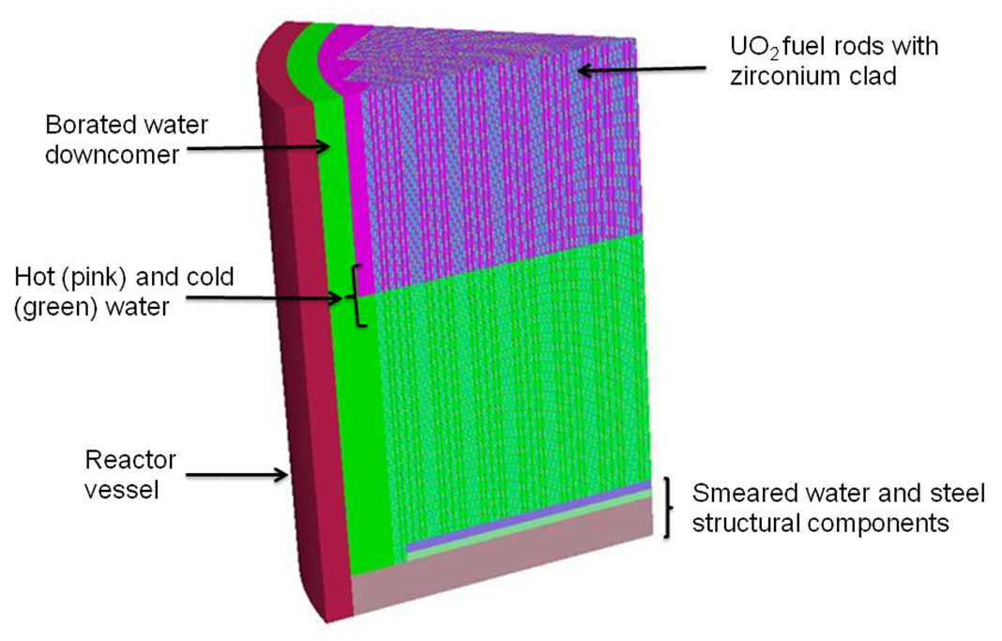
Monte Carlo calculation of flux
Idealised 1/8th core PWR model
Consider calculating the flux distribution in a PWR core:
~300 pins per assembly
~200 assemblies per core
~100 axial slice
~10 nodes per axial slice
=> 60 million cells
Flux calculation requires 60 million tallies versus 1 tally for k-effective.
Assume we need flux accurate to 1%.
In a conventional criticality calculation, we get results accurate to 0.01%.
With N^{-1/2} dependence on number of trials => 6000 times more samples for flux
That is, a 1 hr criticality calculation becomes a year long flux calculation

Slide 28
The Kord Smith Challenge
In 2003 Kord Smith proposed a gold standard challenge for Monte Carlo reactor physics. This is a variant on the problem already discussed that also includes burn-up of 100 different materials => 6 billion tallies.
Require 1% error on peak powers.
Huge demand on computational power and memory.
Approx 48 GB to hold tallies.
Bill Martin (M&C+SNA, 2007) estimates ~1500 hr to complete a full-core calculation on a Cray XD1 single processor.
Hoogenboom & Martin proposed an idealised benchmark for this problem (see image on previous slide).
At PHYSOR 2010, the developers of MC21 reported a simulation running for 18 hours on 400 processors requiring 6.5GB of memory per CPU. For regions of high relative power density (ie lots of neutrons) they are close to the 1% error on peak powers.
In total tracked 40 billion neutron histories.

Slide 29
Source convergence / settling
When solving an eigenvalue problem, we need to supply an initial guess for the fission source; however, we don’t know what that guess is.
We adopt an iterative procedure to calculate a source distribution – we use the first guess to get an improved second guess and so on.
At some point, we decide that the source distribution has converged and start tallying physically meaningful data. If we start tallying too early, we risk biasing the eventual value.
At present, it is till not known how to determine whether or not the source distribution has converged sufficiently or not.
We call the initial stages in which we do not tally results settling stage. The big open question is: how many is enough?

Slide 30
Contents
Commercial background
Amec Foster Wheeler
The ANSWERS suite of software
Technical background
The Boltzmann Transport Equation
Deterministic versus Monte Carlo methods
Challenges in Monte Carlo
Why is MC reactor physics hard?
Calculation of distributed parameters

Slide 31
Calculation of distributed parameters
The main challenge we think it would be useful to focus on this week is the calculation of distributed parameters.
We work in terms of discrete events.
How best to construct continuous distributions?
In the approach we’ve talked about, we mesh the domain and calculate average values for each cell .
Cell average values are subject to stochastic noise
How to interpolate between cell averages?
How to optimise the mesh? (Errors often highest in only a couple of cells)
Can results from neighbouring cells be combined to give trends / reduce noise? (And reduce storage requirements?)
Other approaches are possible: Functional Expansion Tallies (FET)
Expand distributed parameters in terms of basis functions.
What is the optimal choice of basis functions?

Slide 32
Computational challenges
There are significant computational challenges associated with speeding up Monte Carlo calculations
Huge amount of data needed to be stored (~48GB for tallys)
Effective parallelisation (current implementations have serial components that aren’t parallelisable). Possible methods include:
Domain decomposition
Phase space decomposition
Most successful parallel Monte Carlo algorithms are based on history decomposition. Some success has been achieved with domain decomposition.
Generally a big problem with load balancing due to non-deterministic nature of calculation.
Need to pass information between different processes on different cores
Domain decomposition into N domains can be anything between O(N) and O(1)

Slide 33
Summary
We have looked at:
The ANSWERS suite of software
A brief technical overview:
Deterministic and Monte-Carlo methods for the BTE
Uncertainty quantification for criticality calculations
Challenges in MC reactor physics:
Source convergence
Estimation of distribute parameters

