Slide 1
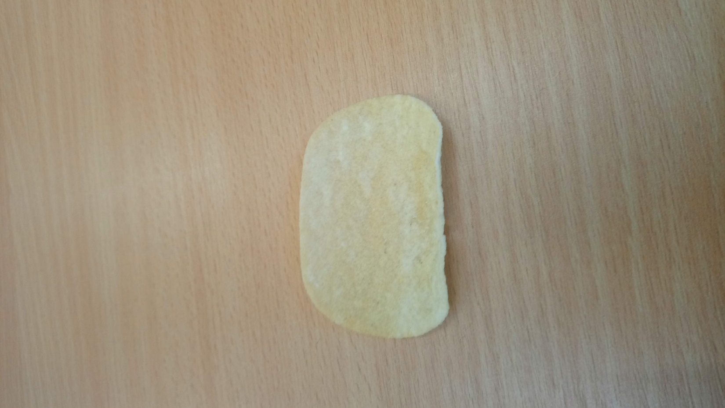
Mixing of Crisp Ingredients
Thomas Bartos, Alex Cox, Mathew Penrose, Zsofia Talyigas

Slide 2
The Problem
Crisps are formed from a mixture of water and potato flakes.
The ingredients are mixed, flattened and then fried.
Sources of randomness in the process:
Mixing of the dough - random initial condition for the heating process
Heating process

Slide 3
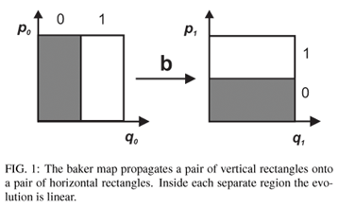
Model for mixing
Baker’s map
First on the unit square with dense grid
Next we generalise for 3D
Randomise the map
Apply the map repeatedly
See the long time behaviour of this process
The limit gives an initial condition for the heating process

Slide 4
Model for heating
Understand how the heating process depends on the initial condition we got from the mixing process
Conjecture:
Well mixed – uniform small sized bubbles
Not well mixed – there are larger coagulated bubbles and large regions of no bubbles
Consider the structure of the end product in terms of crunchiness
Create a numerical simulation of the effect of the heating process on the bubble distribution

