Slide 1
3D – 2D: Slapping down potato slices
Alex Cox, Benjamin Dadoun, Yvonne Krumbeck, Babasola Oluwatosin, Jason Wood

Slide 2
Moving from 3D to 2D
Processes used to make slices of potato are 3 dimensional
Conveyer belts are flat
Issues with moving from 3D to 2D

Slide 3
Plan for the next few days
Sample shapes from the distribution of potato slices
Place these slices at random centres within a plane
Compute overlap of these ellipses
Vary the size of the plane and the number of shape
From these simulations get “efficiency distribution” and “overlap distribution”

Slide 4
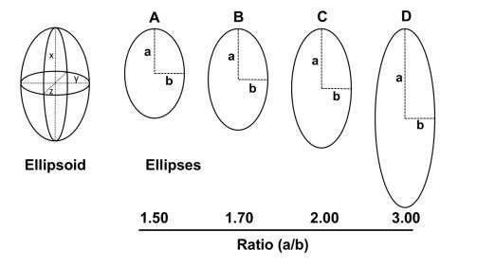
Example of data

