Slide 1
Realignment of Stax Crisp
Eileen Russell, Piotr Morawiecki, Jeremy Worsfold & Carlos Galeano Rios.

Slide 2
Problem Summary:
θ = 108°
Radius = 29 mm
Center of mass
Center of mass
$$d≈25mm$$
$$d≈25mm$$
1. Minimise the number crisps falling through to waste.
2. Realign misaligned crisps to prevent future issues and waste.

Slide 3
Approaches Considered:
Varying the separation distance of the two chains.
Changing crisps parameters: The angle (θ), the radius (R).
Applying an external force.
Vibration of the chains.

Slide 4
1. Varying the separation distance

Slide 5
d = 24.33mm will catch crisps up to a misalignment angle α = 29֯
Safe zone
Current separation on PEPSICO production line

Slide 6
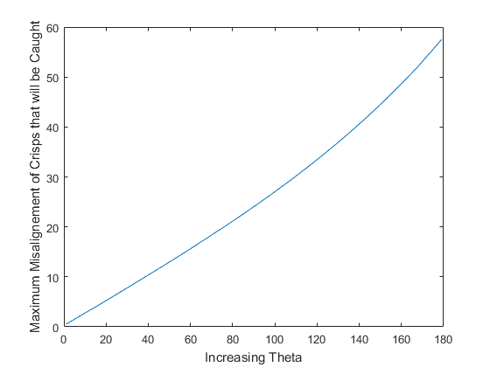
2. Altering Shape Parameters.
Changing the radius will not affect the number of misaligned crisps wasted.
Increasing θ will increase misalignment angle at which crisps can be caught.

Slide 7
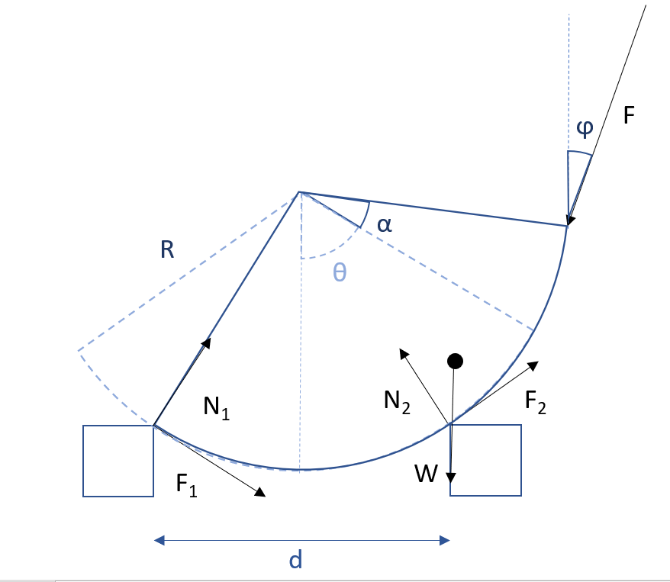
3. Applying an External Force
Apply a force tangential to the worst case of misaligned crisp ??
$\left[\begin{matrix}\sin{β−μ\cos{β}} & \sin{β+μ\cos{β}} & −\cos{φ} \\ \cos{β+μ\cos{β}} & −\cos{β+μ\sin{β}} & −\sin{φ} \\ μ & μ & −1\end{matrix}\right]\left[\begin{matrix}N_{1} \\ N_{2} \\ F\end{matrix}\right]=\left[\begin{matrix}W \\ 0 \\ \frac{d}{2R}W\end{matrix}\right]$

Slide 8
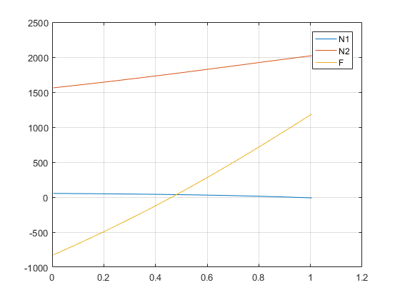
3. Applying an External Force
Applying a Force Tangential to the Crisp (φ = 7.5)
Applying a Force at the Calculated optimal Angle (φ = 52.2)
Applied Force [10⁵ N]
Applied Force [10⁵ N]
Narrow μ range
Wide μ range
Coefficient of friction
Coefficient of friction

Slide 9
3. Possible Further Developments
Analyse the effect of the optimal angle of the force on crisps for all misalignment angles.
For a given range of static friction values, find the angle of the force such that the magnitude of the force is minimalised but still enough to initiate movement. The idea is to minimise crisp damage.

Slide 10
4. Vibrations: Dynamical model for vibrations
Key idea: Consider noninertial frame of reference associated with the supports. Inertial forces $W_{x}$ and $W_{y}$ need to be added.
Dynamical model for vibration is based on second Newton’s law of motion:
$$\left[\begin{matrix}\cos{α}+μ\sin{α} & \cos{α}−μ\sin{α} \\ \sin{α}−μ\cos{α} & −\sin{α}−μ\cos{α}\end{matrix}\right]\left[\begin{matrix}N_{1} \\ N_{2}\end{matrix}\right]=\left[\begin{matrix}m\ddot{y}+W_{y} \\ m\ddot{x}−W_{x}\end{matrix}\right]$$
where $\ddot{x}$ and $\ddot{y}$ are components of acceleration of the center of mass.
Finding $N_{1}$ and $N_{2}$ allows to find the angular acceleration $\ddot{θ}$:
$$μ\left(N_{1}+N_{2}\right)R+\left(−W_{y}\sin{θ}+W_{x}\cos{θ}\right)r=mr^{2}\ddot{θ}$$
a
$$g+a$$

Slide 11
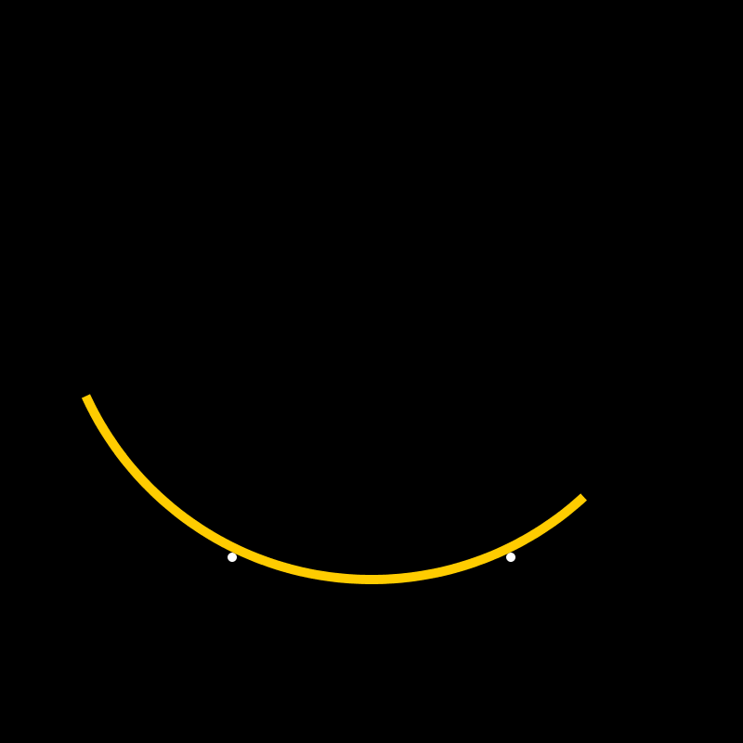
Vibration modes of the support
Horizontal vibrations
Hard to model…
Mixed
In phase
Out of phase
Yet to be explored…
Vertical vibrations

Slide 12
Vertical vibrations (in phase)
Conclusion: Vertical vibrations are useless.

Slide 13
Horizontal vibrations (in phase)
Conclusion: For an appropriate amplitude and frequency the crisp drifts to the centre.

Slide 14
Optimizing horizontal vibrations
Frequency: 8.0 Hz
Amplitude: 0.5 mm

Slide 15
Further development of the dynamic model
Determine the optimal amplitude and frequency for the vertical oscillations.
Apply stochastic methods to check the effect of fracture of crisp on its dynamics.
Analyse vibrations in antiphase and mixed modes of vibrations.
Optimize the numerical methods used for simulations.
Include the difference between the value of static and dynamic friction.
Consider the crisp misalignment in 3D.

